Slide 1
Experiences with Machine Translation at NRC Germany (BfArM)
Translation User Group, SNOMED Business Meeting, Atlanta
25.10.2023

Slide 2
Questions
Why did you do machine translation?
How did you proceed? Which technology?
What were the advantages and disadvantages? Both in process and result
Where there any surprises?

Slide 3
Use cases
Translation English to German
  ICD-11
  SNOMED CT
  LOINC
  Translation German to English
        National procedural classification (OPS)
        ICD-10-GM
        Websites

Slide 4
Why did you do machine translation?
Resources
  Time
  Money
  Personal
  Known Accuracy
  First translation takes time, review of pretranslated content is easier
  Fits into workflow (pretranslation, review, editorial review)

Slide 5
How did you proceed? Which technology?
  First contact: Refset and Translation Tool (Google Translate), Weblate (Google Translate, Amazon Translate, DeepL)
  -> we mainly worked with DeepL
  Different types of accounts
        DeepL Free: 1.500 characters (on PCs) or 3.000 characters (on mobile devices)
        DeepL Pro: no character limit, CAT integration, no translation memory

Slide 6
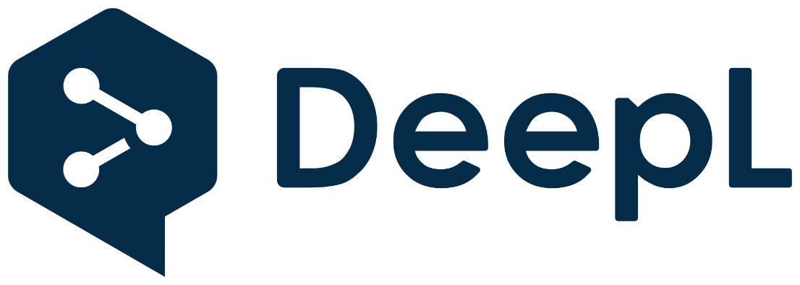
DeepL
  DeepL Translator is a neural machine translation service
  launched in August 2017
  owned by Cologne-based DeepL SE
  the translating system was first developed within Linguee and launched as entity DeepL
  Available in 31 languages
  Its algorithm uses convolutional neural networks and an English pivot
  proprietary algorithm with convolutional neural networks (CNNs) that have been trained with the Linguee database

Slide 7
Internal rules at BfArM with DeepL
  The translations from DeepL Pro are a helpful translation suggestion, but must not be adopted uncontrolled. Each translation must still be checked under the responsibility of the user and, if necessary, revised in terms of technical language. As a rule, DeepL as well as DeepL Pro offers further synonyms as support.
  For confidential texts/data, DeepL Pro should always be used.
  For texts intended for publication, e.g. on the BfArM website, the open version of DeepL should be used, including the correction function, so that the system can learn from the technical language corrections. This is not possible in the Pro version, as the translated text is not saved.
  (translated by DeepL)

Slide 8
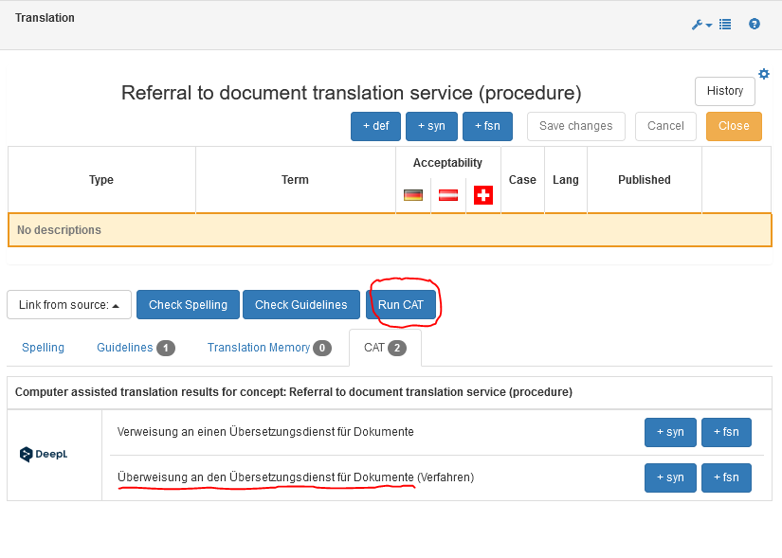
DeepL in termSpace – single CAT

Slide 9
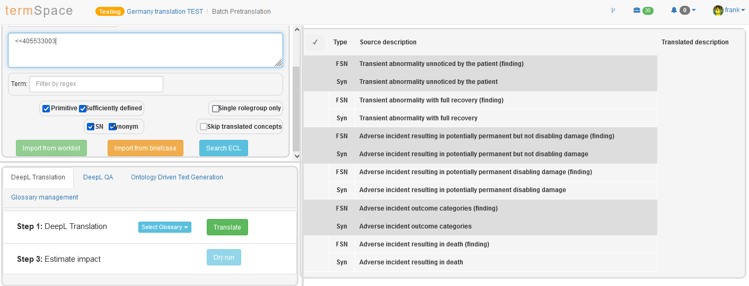
DeepL in termSpace – bulk CAT

Slide 10
Advantages and disadvantages
  +
  Time-efficient
  Can give a context for difficult translations
  Can be used for free
  A lot of experience in German/English -> less errors
  -
  Cannot learn (DeepL Pro account)
  Oversee clear mistakes, especially in bigger worklists
  In texts it can lose words
  Complex SNOMED CT concepts are translated incorrectly, especially from non-medical fields

Slide 11
Future considerations
Contact with DeepL
  -> referencing specific bilingual databases and websites (EMA/EU)
  -> translation memory for Pro accounts

Slide 12
Thank you very much for your attention!
Contact
Federal Institute for Drugs and Medical Devices
Division K – Code systems and registers
Kurt-Georg-Kiesinger-Allee 3
D-53175 Bonn
Frank Geier
Frank.Geier@bfarm.de
www.bfarm.de
Phone +49 (0)228 99 307-4820

