Slide 1
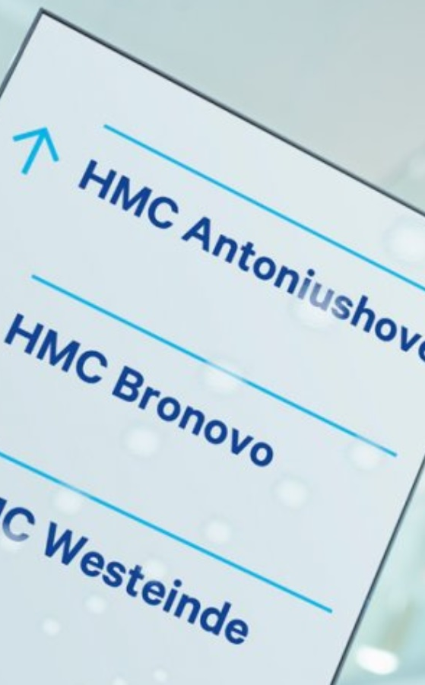
Haaglanden Medical Center, the Hague (Netherlands) nanda-I nic noc
Document what you did, why you did it and what you achieved.

Slide 2



Who AM I
Friso Raemaekers
B Health, RN, CEN, FNI
Nursing Policy Officer
Haaglanden MC, Den Haag
Coordinator Dutch NANDA-I Network Group
Emergency Nurse

Slide 3
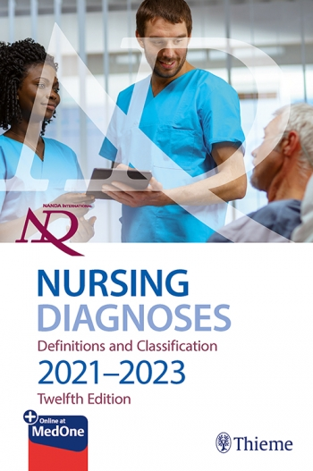
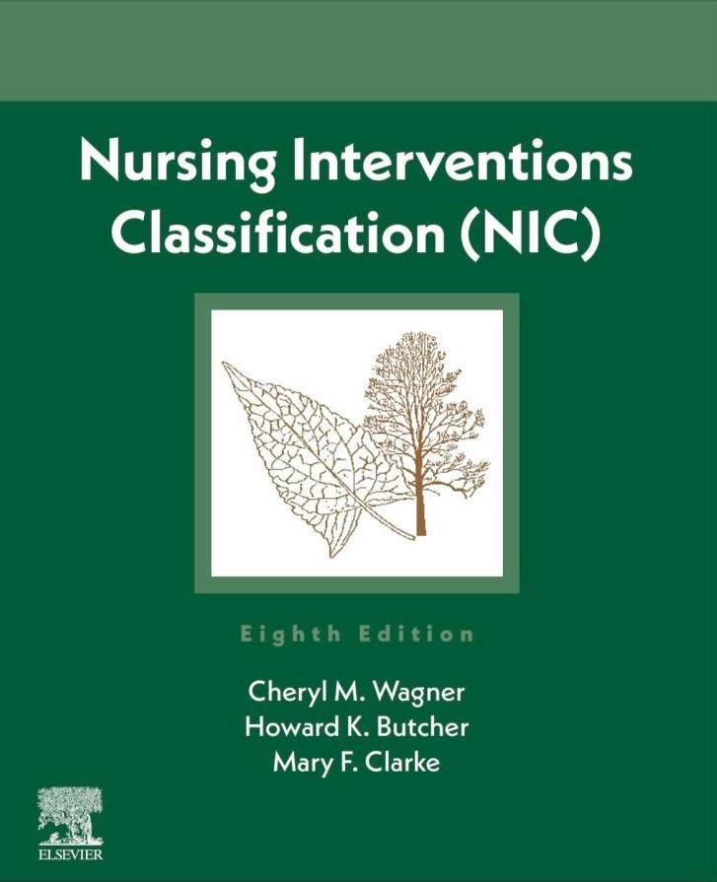
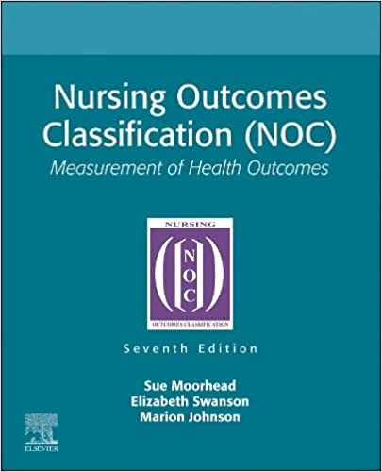
NANDA-I NIC NOC
Haaglanden MC aims to enhance nursing care by utilizing standardized classifications providing a structured framework for nursing documentation and care planning. classification

Slide 4
New editions of classification NIC and NOC in 2023

Slide 5
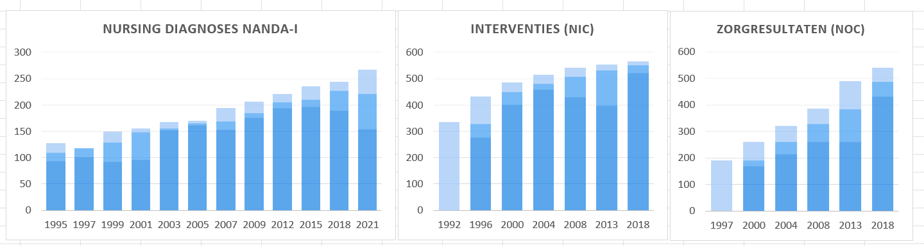
STANDARDIZED Nursing language

Slide 6
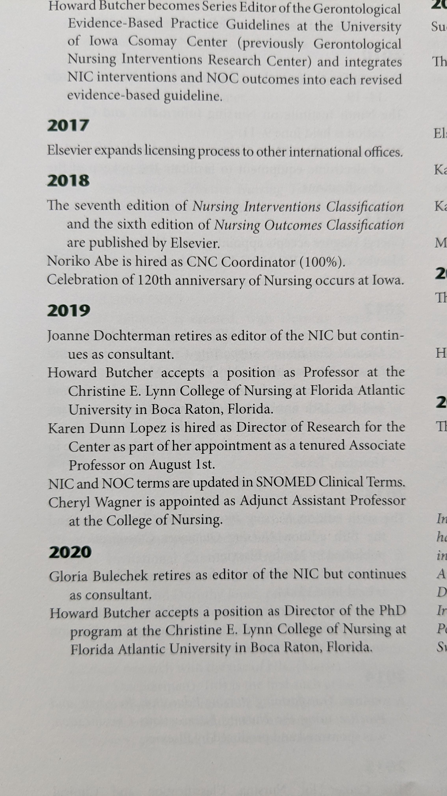

Slide 7

Why is it important to connect Nanda-I NIC NOC with Snomed CT?
Notes:
Connecting NANDA, NIC, and NOC with SNOMED CT is important because it promotes standardized terminology, interoperability, comprehensive patient care, data analytics, research, quality improvement, and smoothly exchange of handoffs from different terminologies, ultimately leading to better patient outcomes and more efficient healthcare delivery.

Slide 8
Domain 2: Physiological: Complex
Class L: Skin/Wound Management
Interventions to maintain or restore tissue integrity
Interventions
3420 Amputation Care
3440 Incision Site Care
3460 Leech Therapy
3480 Lower Extremity Monitoring
0480 Ostomy Care
3510 Phototherapy: Skin
3520 Pressure Injury Care
3540 Pressure Injury Prevention
3550 Pruritus Management
3570 Skin Care: Absorbent Products
3582 Skin Care: Donor Site
3583 Skin Care: Graft Site
3584 Skin Care: Topical Treatment
3590 Skin Surveillance
3620 Suturing
3660 Wound Care
3661 Wound Care: Burns
3662 Wound Care: Closed Drainage

Slide 9
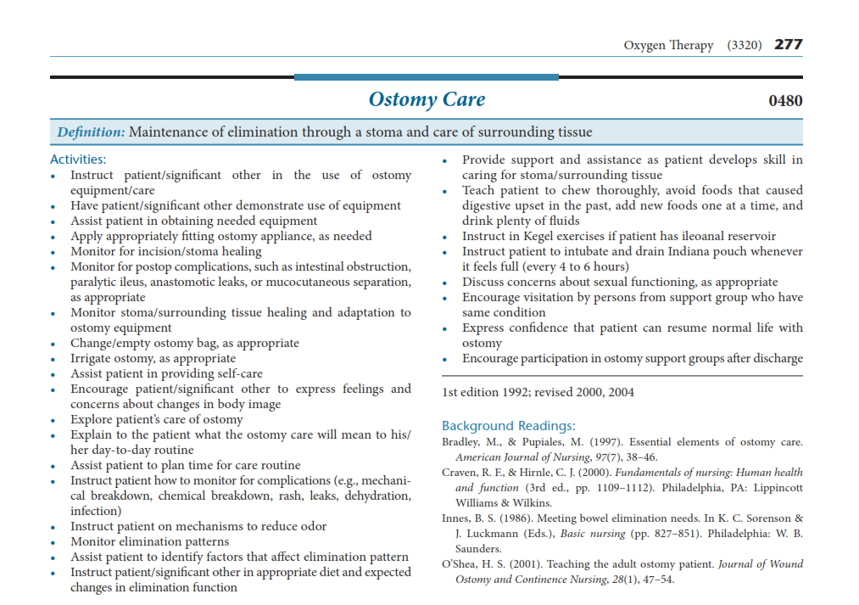

Slide 10
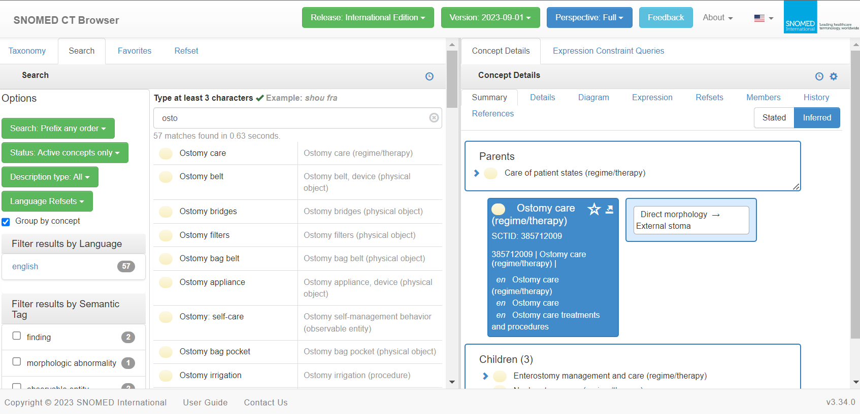

Slide 11
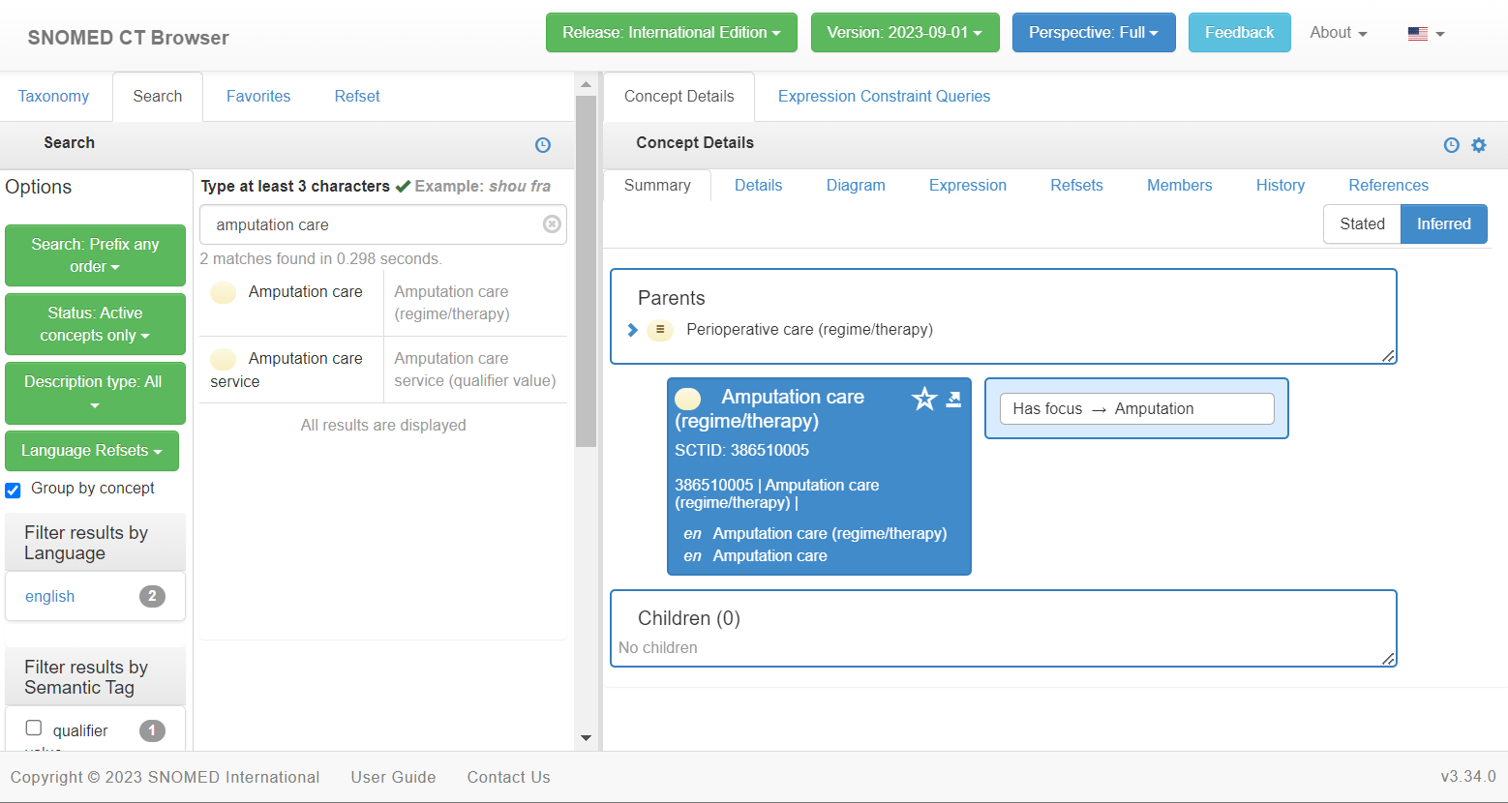

Slide 12
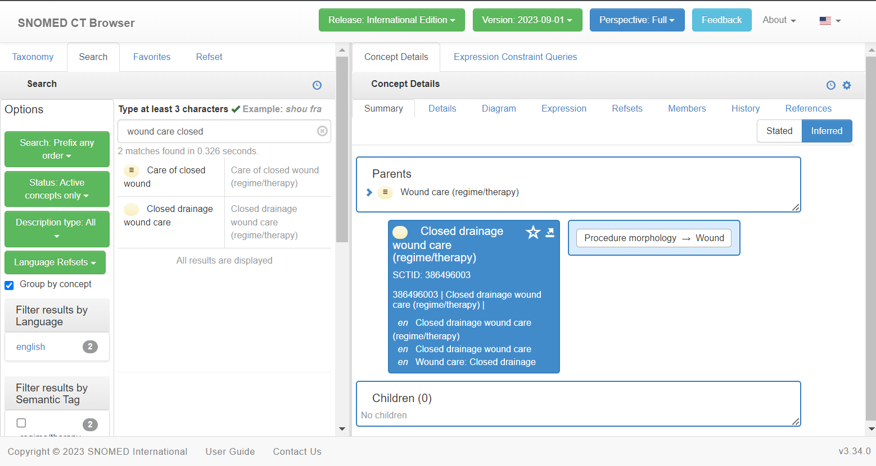

Slide 13
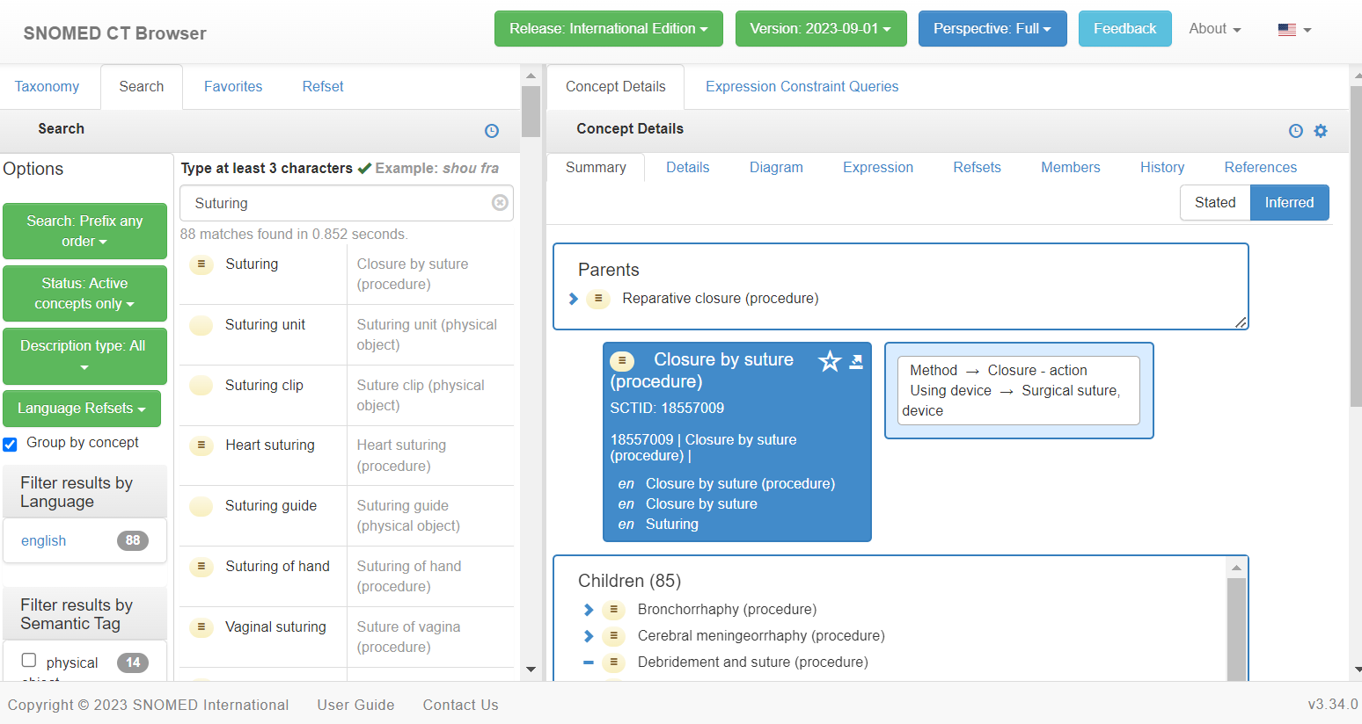

Slide 14
Domain 2: Physiological: Complex
Class L: Skin/Wound Management
Interventions to maintain or restore tissue integrity
Interventions
3420 Amputation Care
3440 Incision Site Care
3460 Leech Therapy
3480 Lower Extremity Monitoring
0480 Ostomy Care
3510 Phototherapy: Skin
3520 Pressure Injury Care
3540 Pressure Injury Prevention
3550 Pruritus Management
3570 Skin Care: Absorbent Products (2023)
3582 Skin Care: Donor Site
3583 Skin Care: Graft Site
3584 Skin Care: Topical Treatment
3590 Skin Surveillance
3620 Suturing
3660 Wound Care
3661 Wound Care: Burns (2008)
3662 Wound Care: Closed Drainage

Slide 15
Domain 2: Physiologic health
Class L: Tissue Integrity
Outcomes that describe the condition and function of an individual’s body tissues
Outcomes
1104 Bone Healing
1106 Burn Healing
1107 Burn Recovery
1108 Foot Health
1105 Hemodialysis Access
1100 Oral Health
1913 Physical Injury Severity
1101 Tissue Integrity: Skin & Mucous Membranes
1109 Tissue Injury Severity: Percutaneous Procedure
1110 Vocal Function
1102 Wound Healing: Primary Intention
1103 Wound Healing: Secondary Intention

Slide 16
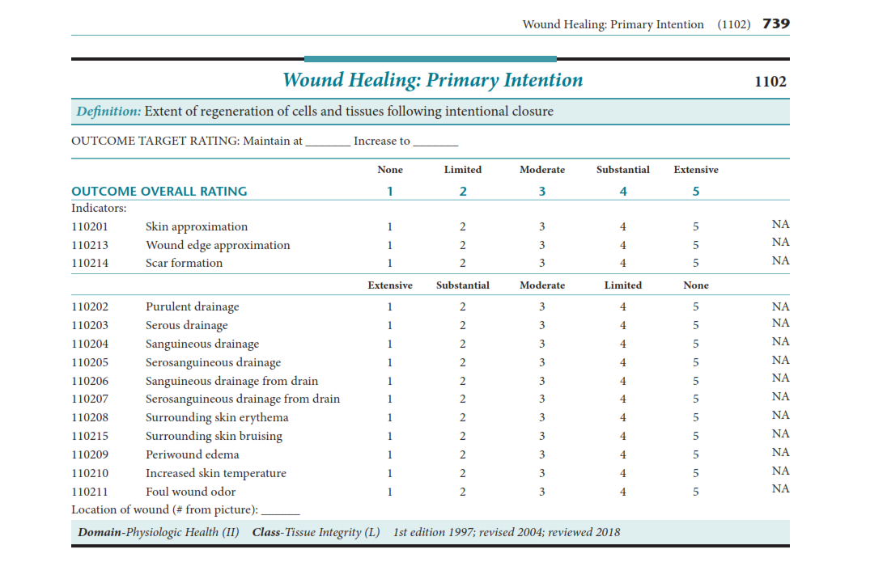

Slide 17
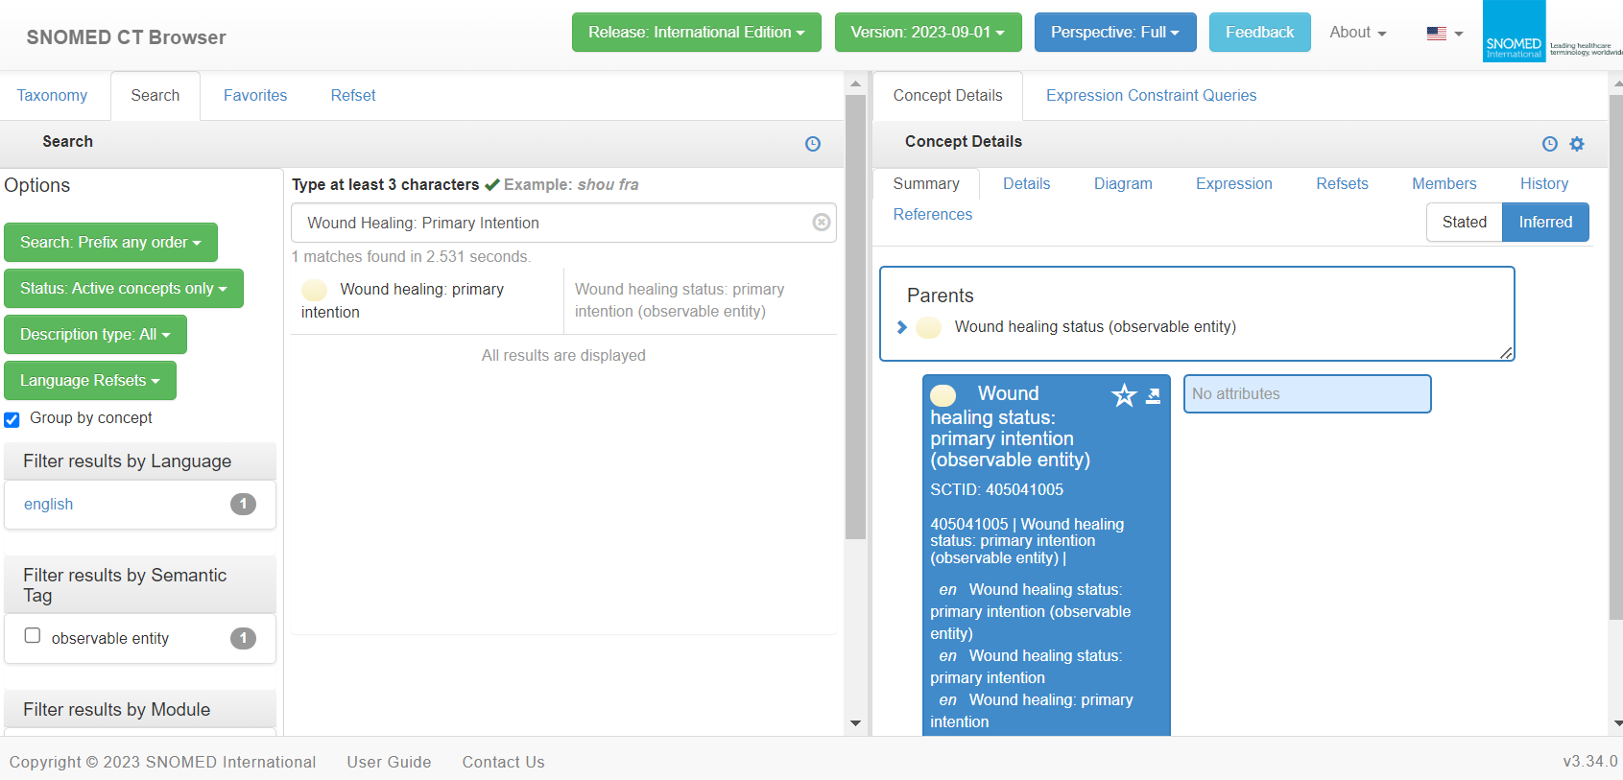

Slide 18
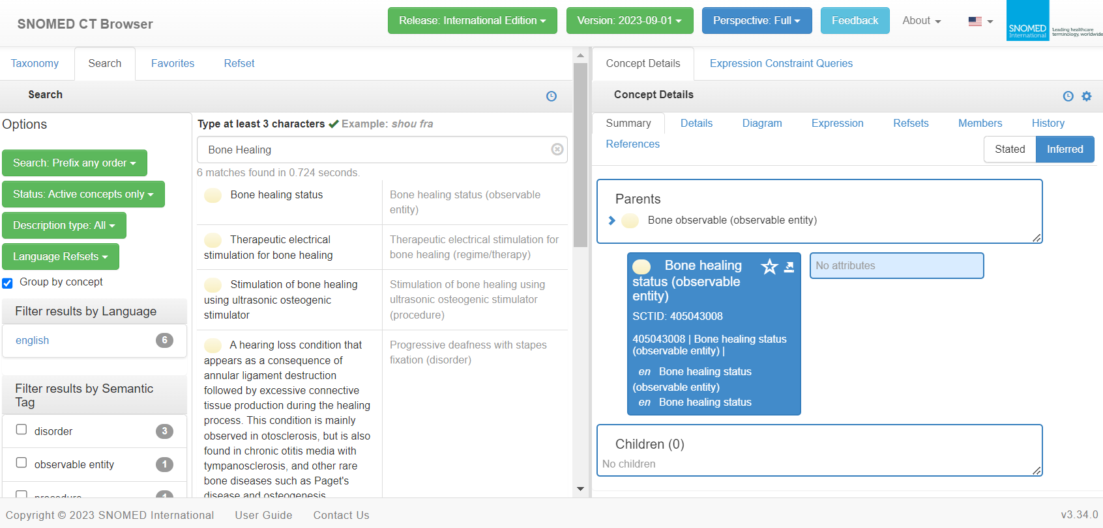

Slide 19
Domain 2: Physiologic health
Class L: Tissue Integrity
Outcomes that describe the condition and function of an individual’s body tissues
Outcomes
1104 Bone Healing
1106 Burn Healing
1107 Burn Recovery
1108 Foot Health
1105 Hemodialysis Access
1100 Oral Health
1913 Physical Injury Severity
1101 Tissue Integrity: Skin & Mucous Membranes
1109 Tissue Injury Severity: Percutaneous Procedure
1110 Vocal Function
1102 Wound Healing: Primary Intention
1103 Wound Healing: Secondary Intention

Slide 20
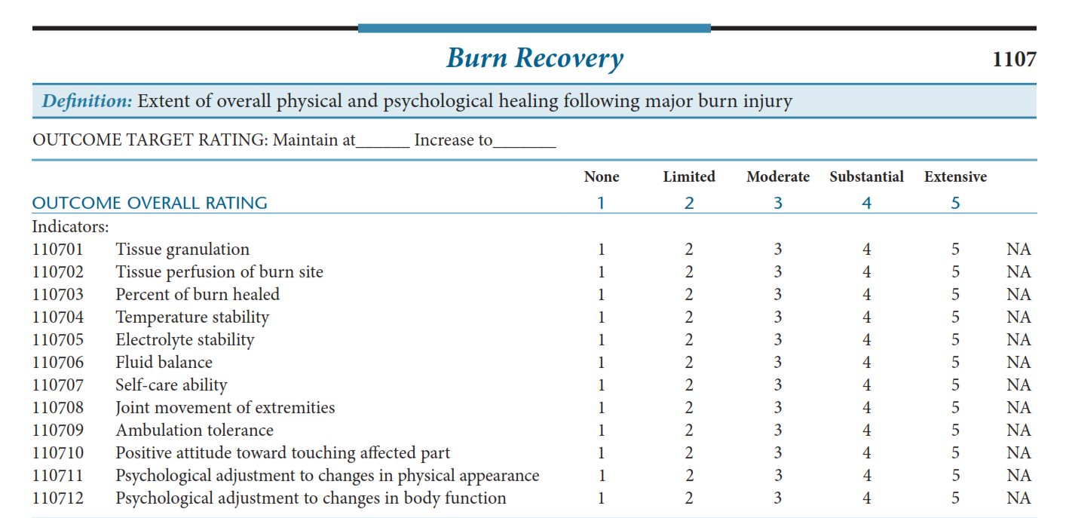

Slide 21
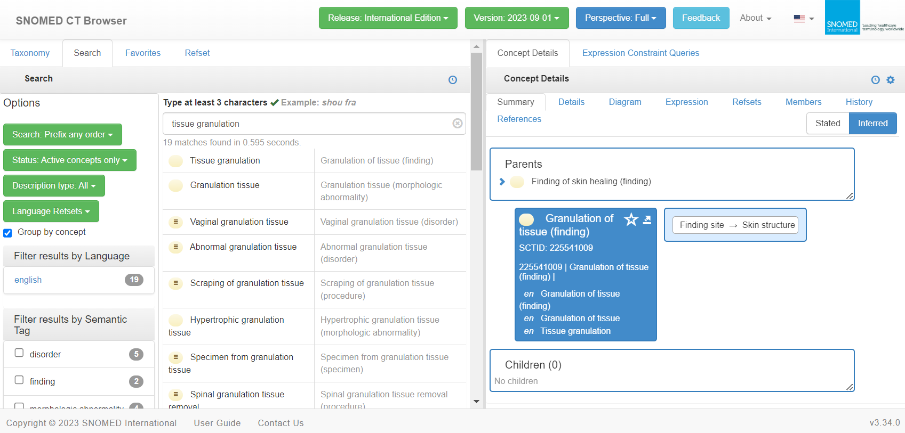

Slide 22

How to continue?
Happy to hear your thoughts

