Slide 1


SNOMED International
Glaucoma Project
Anthony Khawaja
Moorfields Eye Hospital & UCL Institute of Ophthalmology, London, UK
EGS Members’ Meeting, Reykjavik
14th July 2023

Slide 2


What is SNOMED CT?
The world’s most comprehensive multilingual clinical language
A resource with comprehensive, scientifically validated clinical content
Enables consistent representation of clinical content for processing in electronic health records
Maps to many international standards, including but not limited to
ICD-10, OPCS-4, GMDN, ICPC-2, LOINC, etc.
Used in more than eighty countries
Notes:
Authors research evidence based articles and journals to ensure that the SNOMED content is modelled correctly and is not just accurate but clinically validated as well
Even in a single hospital clinicians can refer to clinical ideas by different names or terms or abbreviations, so internationally this can increase significantly, and that can bring challenges to ensure that we are still taking about the same thing. SNOMED ensures that these idea can be represented in a number of different ways by allowing the addition of various descriptions that can be searched and retrieved.
There are a number of maps from SNOMED to a number of various international standards. These are done by specialist mappers you have domain knowledge of the source and targets of these maps.
The increasing use of SNOMED across the world is showing the fantastic possibilities and benefits of SNOMED in enhancing interoperability.

Slide 3
SNOMED CT top hierarchies
Clinical finding | Disorders, symptoms／signs
Procedure | Surgical procedures, exams, lab tests, nursing care, mgmt procedures
Body structure | Systems, tissues, organs
Observable | Height, weight, blood pressure
Pharmaceutical/biological products | Antibiotics, vitamins, hormones, anaesthetics
Specimen | Blood, urine, biopsy specimen
Organism | Bacteria, virus, animal, plant
Substance | Biological／chemical substance, plasma, protein
Environment or geographical location | Countries, languages, hospital, department, clinics, community environment

Slide 4
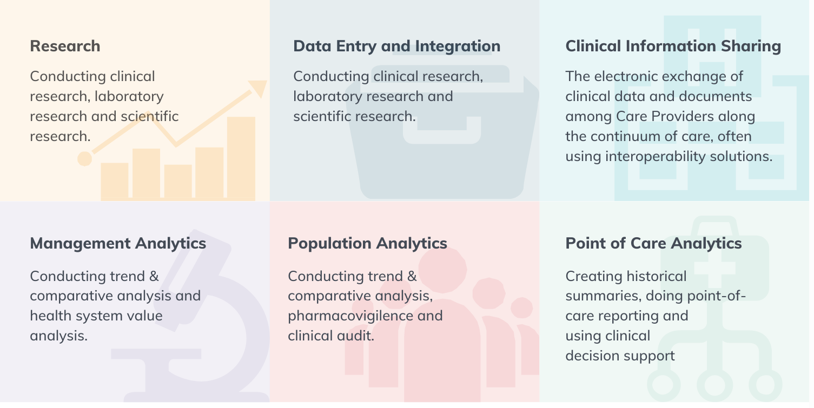

How is SNOMED CT used?

Slide 5
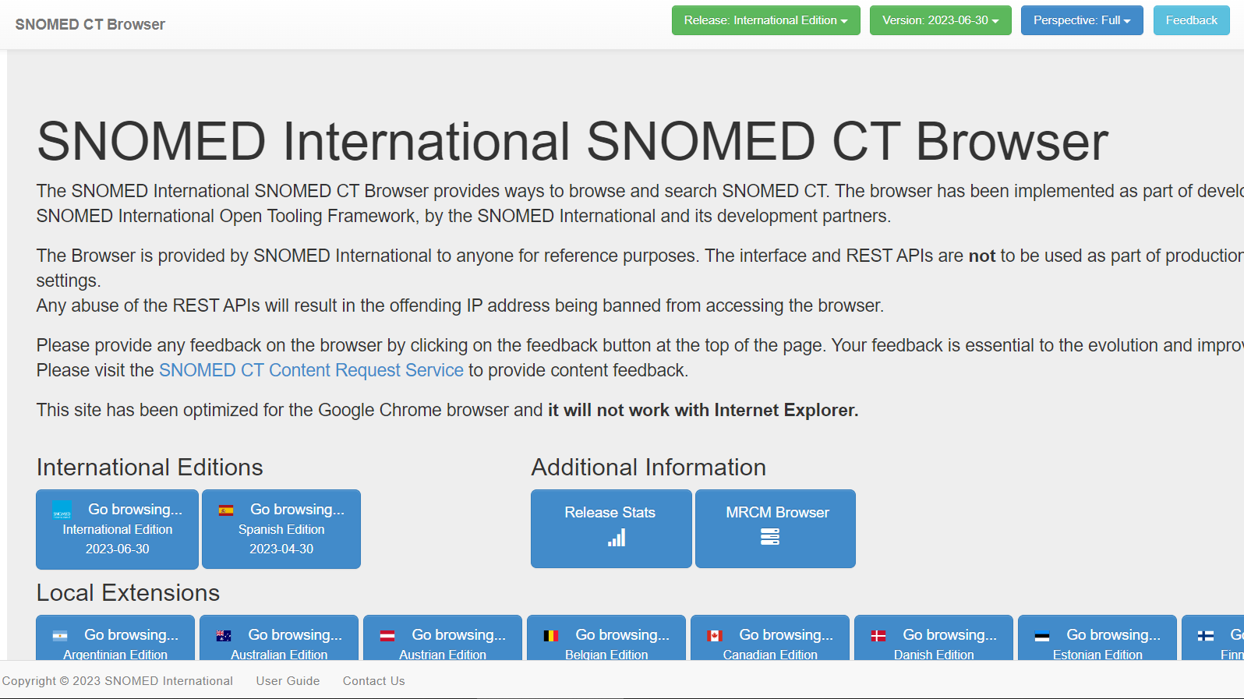

Slide 6

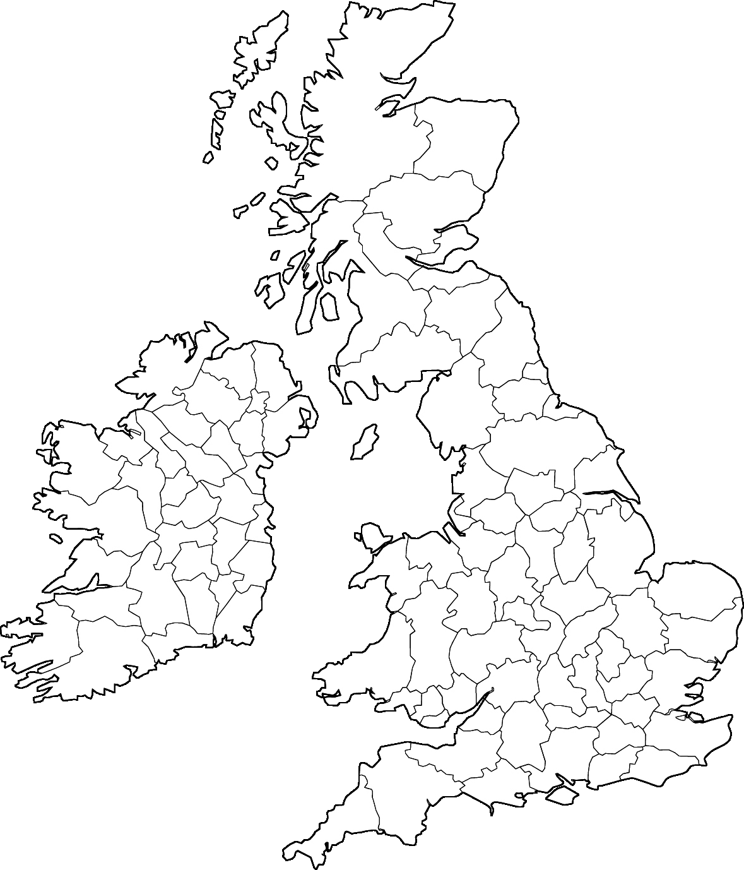


Electronic Medical Record
Install base, Nov 2021:
~200 hospitals;
70% of NHS Trusts
NHS / public hospital
Private hospital
Notes:
So, what is the coverage of Medisoft use? Well, there has been wide uptake across the UK, with it supplying around 70% of hospital trusts. How does it relate to UK Biobank recruitment centres? Well, here they are ordered by the number of self-reported glaucoma cases. And these are the centres where the major local ophthalmology unit uses Medisoft, including 14 of the top 16 in terms of numbers of participants. We estimate there will be linked data for 15,000 UK Biobank participants with glaucoma.

Slide 7
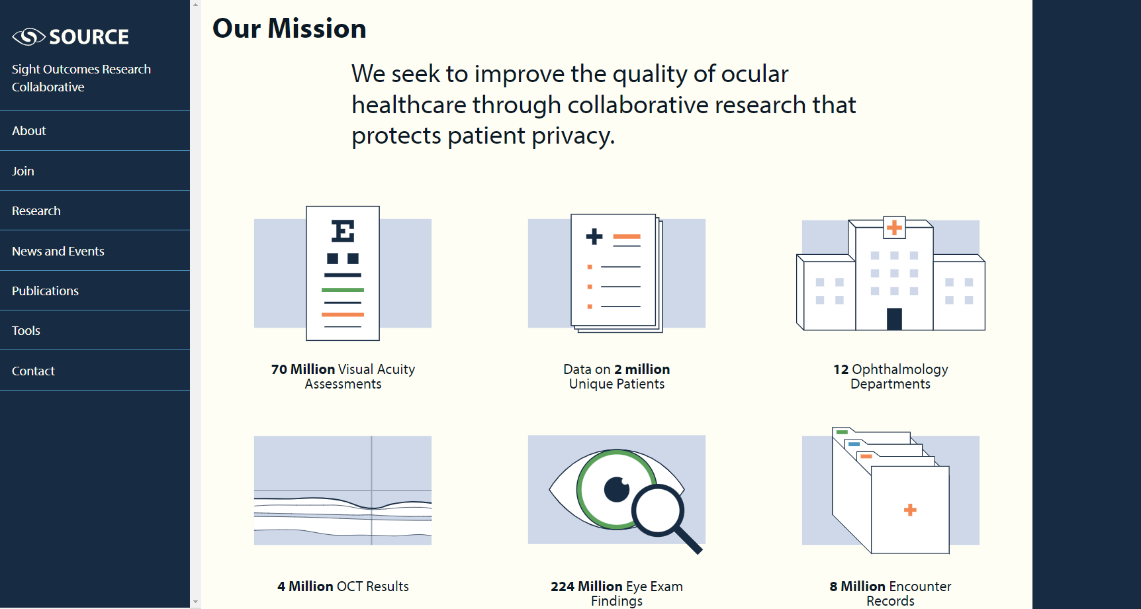
SOURCE – Overview
Sourcecollaborative.org
Consortium of EHR data from academic ophthalmology departments using Epic
Wide range of data types (ophthalmic data + systemic data)
  Also some free-text notes
Some sites contributing imaging/testing data

Slide 8

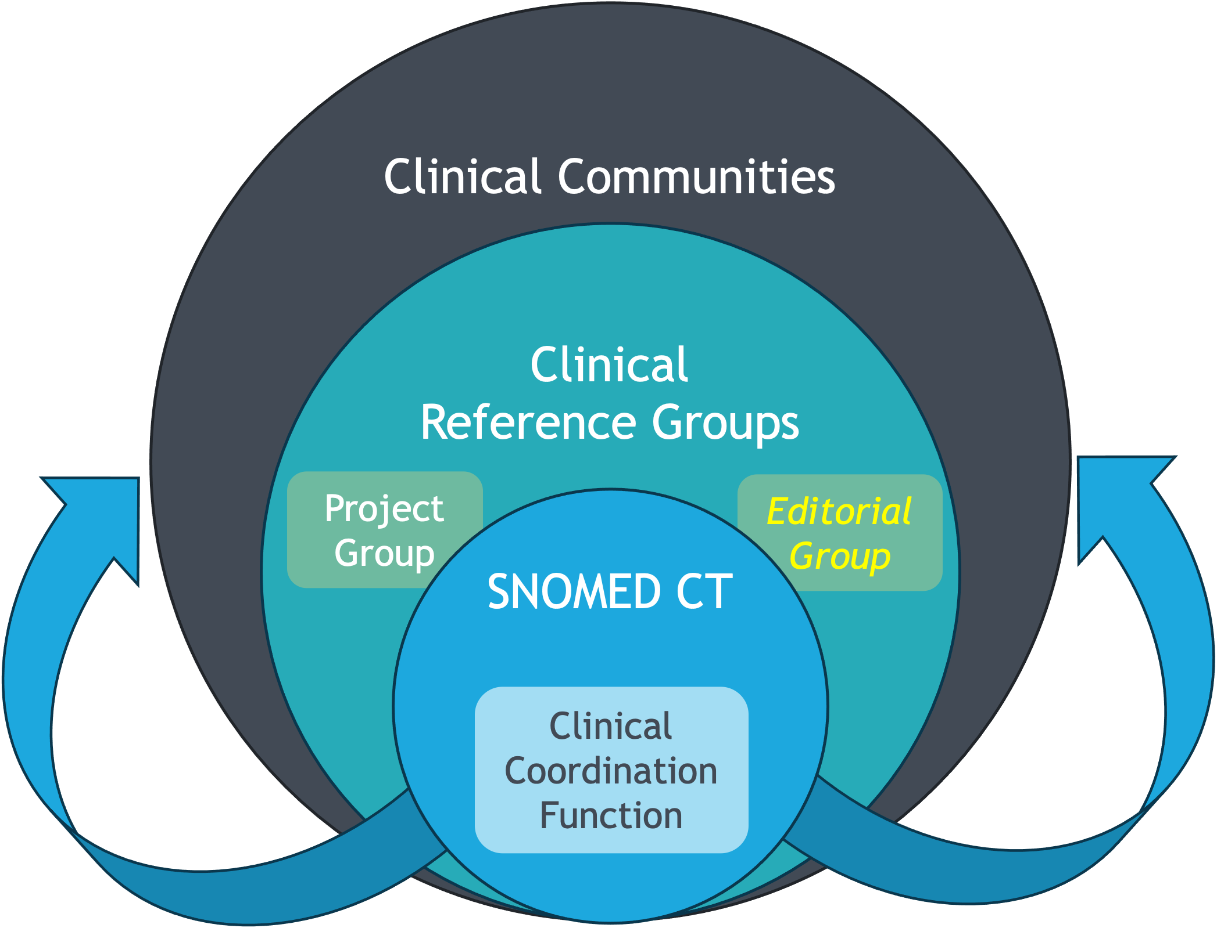
Clinical Reference Groups

Slide 9

Clinical Reference Groups (CRGs)
Enable topic focused discussions between clinicians
Provides a platform for clinicians to discuss issues and experience relating to SNOMED CT implementation
Dedicated web sites to support discussion
Open and transparent
(does not require an account to access)
Open to all, input not limited to just clinicians from the clinical specialty
Task and finish project groups (and Editorial groups) are linked to the CRGs
KEY: We all have experiences, and we can all learn from each other

Slide 10
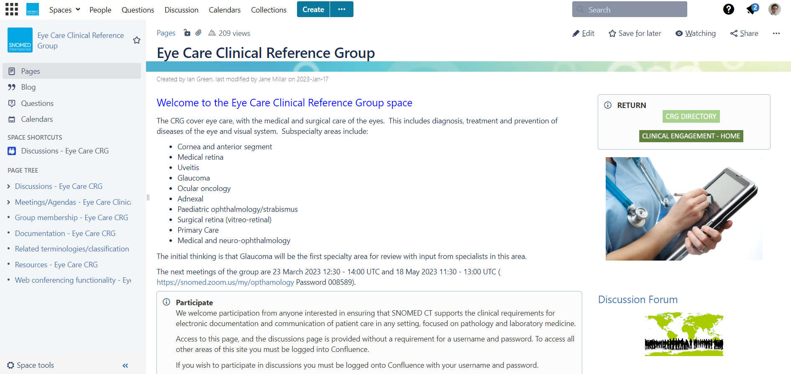
https://confluence.ihtsdotools.org/

Slide 11
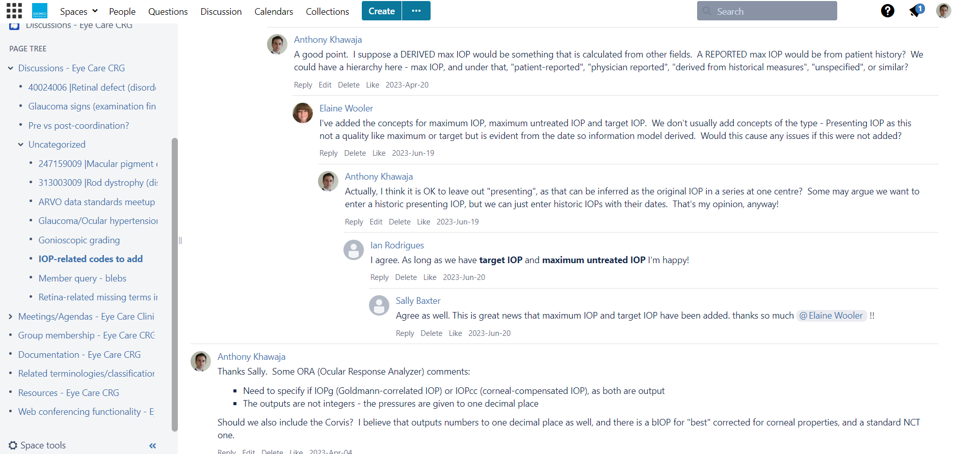

Slide 12
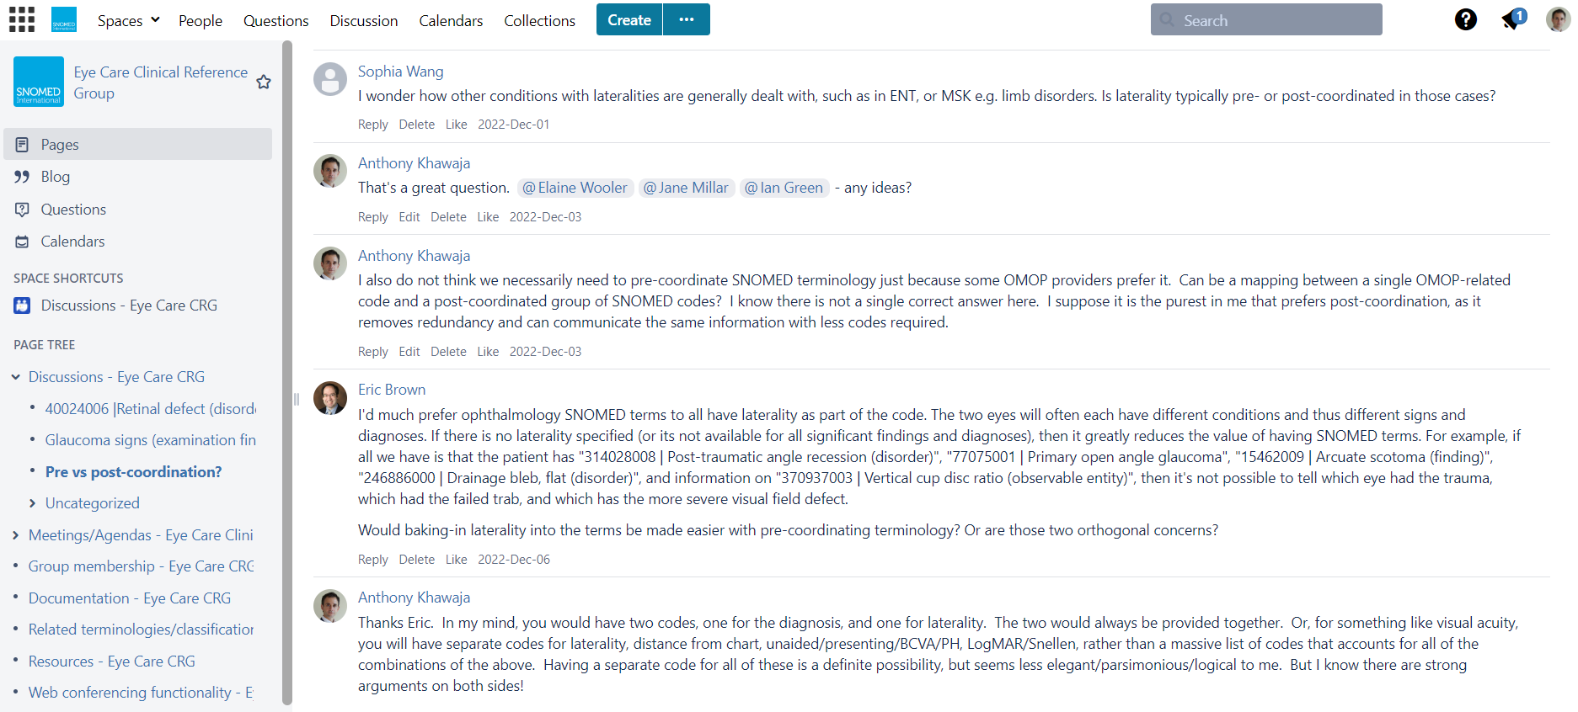

Slide 13
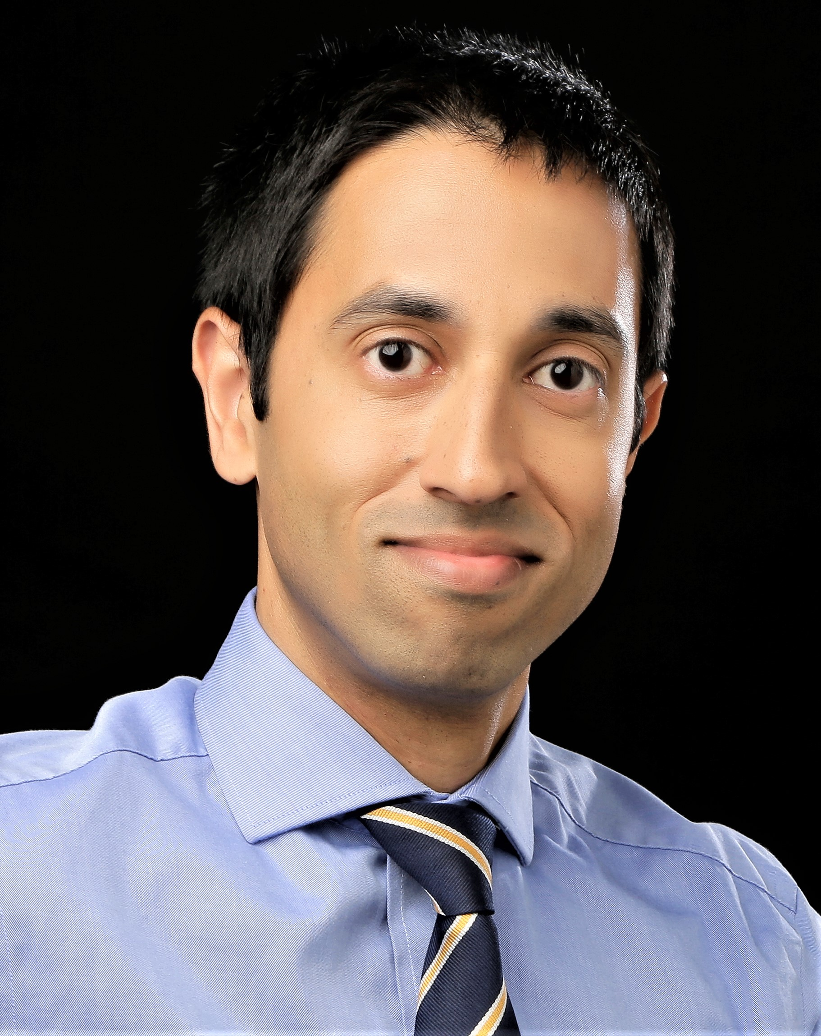
Diagnoses / medications working group

Slide 14
SNOMED Eye Care CRG
– Update on Glaucoma Diagnoses Work
Anthony Khawaja, Ian Rodrigues and Elaine Wooler
London, UK

Slide 15
Scope of Glaucoma Diagnoses SNOMED Work
Check all relevant diagnoses available
  Assume laterality is post-coordination
  Disease severity also post-coordination
Remove incorrect diagnoses
Merge redundant diagnoses
Preferred diagnoses
Childhood / paediatric glaucoma – NOT COVERED
  Similar process of adding, retiring, modifying SNOMED terms
  Preferred SNOMED diagnoses terms

Slide 16
New glaucoma diagnoses SNOMED terms added 2020
Open angle glaucoma suspect [replaced Open-angle glaucoma – borderline]
  Open angle glaucoma suspect of bilateral eyes
  Open angle glaucoma suspect of right eye
  Open angle glaucoma suspect of left eye
Glaucoma suspect caused by steroids [replaced Steroid-induced glaucoma – borderline]
  Glaucoma suspect of bilateral eyes caused by steroids [replaced Suspected glaucoma of bilateral eyes caused by steroids]
  Glaucoma suspect of right eye caused by steroids [replaced Suspected glaucoma of right eye caused by steroids]
  Glaucoma suspect of left eye caused by steroids [replaced Suspected glaucoma of left eye caused by steroids]
Angle closure glaucoma suspect [replaced Suspected angle-closure glaucoma and Angle-closure glaucoma – borderline]
  Angle closure glaucoma suspect of bilateral eyes [replaced Borderline angle-closure glaucoma of bilateral eyes]
  Angle closure glaucoma suspect of right eye [replaced Borderline angle-closure glaucoma of right eye]
  Angle closure glaucoma suspect of left eye [replaced Borderline angle-closure glaucoma of left eye]
Glaucoma suspect due to type 2 diabetes mellitus [replaced Suspected glaucoma due to type 2 diabetes mellitus]
Acute angle closure
Acute primary angle closure
Primary angle closure
Primary angle closure suspect

Slide 17
Glaucoma diagnoses SNOMED terms retired 2020
Borderline glaucoma (synonymous term Suspected glaucoma)
Open-angle glaucoma of bilateral eyes caused by steroid (synonymous term Corticosteroid-induced glaucoma of bilateral eyes)
Open-angle glaucoma of right eye caused by steroid (synonymous term Corticosteroid-induced glaucoma of right eye)
Open-angle glaucoma of left eye caused by steroid (synonymous term Corticosteroid-induced glaucoma of left eye)

Slide 18
Proposed glaucoma diagnoses SNOMED terms to RETIRE
30041005 |Acute angle-closure glaucoma (disorder)
  Acute angle-closure glaucoma of right eye
  Acute angle-closure glaucoma of left eye
  Bilateral Acute angle-closure glaucoma
193562004 | Glaucoma due to ocular vascular disorder (disorder)
  ? Synonymous to 19309007 | Glaucoma associated with vascular disorder (disorder) and
  34623005 Glaucoma with increased episcleral venous pressure (disorder)
95213001 | Primary glaucoma due to combination of mechanisms (disorder)
  Self-contradictory

Slide 19
Proposed glaucoma diagnoses SNOMED terms to MODIFY
788948008 Glaucoma due to retinal detachment (disorder)
  ? Add → Glaucoma due to retinal detachment surgery (disorder)
  ? Add → Ocular hypertension due to retinal detachment (disorder)
  ? Add → Ocular hypertension due to retinal detachment surgery (disorder)
232090003 Glaucoma following surgery (disorder)
  ? Change to Glaucoma following ocular surgery
  ? Add OHT following ocular surgery
93435005 |Drug-induced glaucoma (disorder)
  ? Change to → Drug induced open angle glaucoma (disorder)

Slide 20
Proposed glaucoma diagnoses SNOMED terms to ADD
Drug induced angle closure
Drug induced acute angle closure
Drug induced angle closure glaucoma

Slide 21
Proposed PREFERRED glaucoma diagnoses SNOMED terms
Attachment for discussion
Ultimate aim is for international CRG agreement
Adoption into EMRs globally

Slide 22
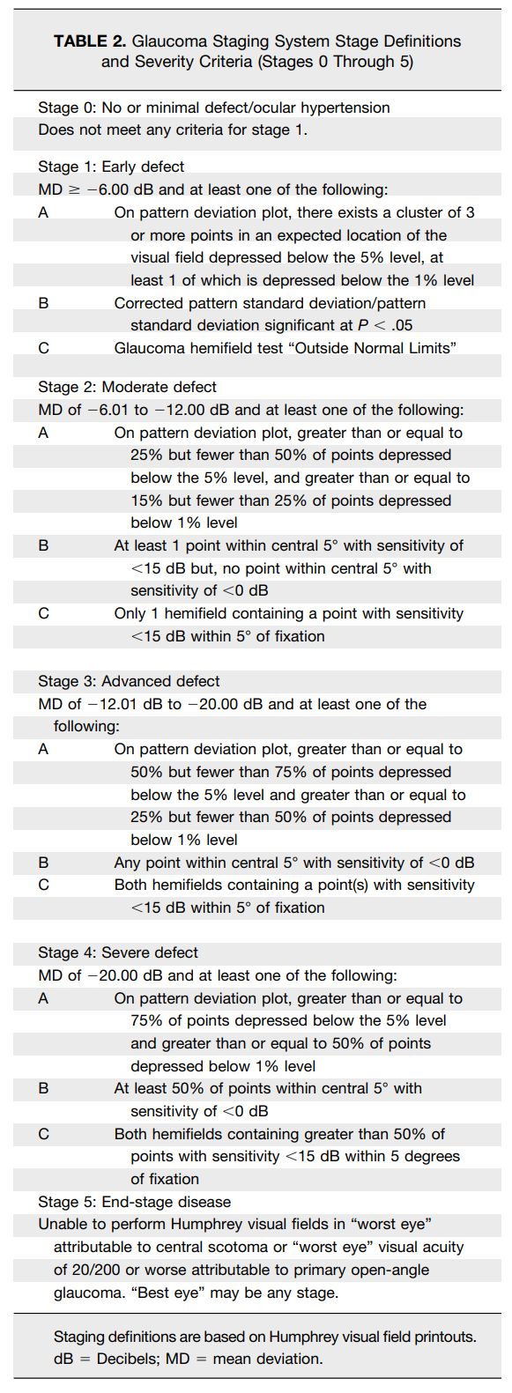
Post-coordination of Severity of Glaucoma
Hodapp-Anderson-Parrishstaging system
https://www.aoa.org/assets/documents/EBO/924-012MILLS-2006.pdf

Slide 23
Post-coordination of Severity of Glaucoma
ICD-9 staging definitions
https://www.aao.org/eyenet/article/know-new-glaucoma-staging-codes
*365.71 Mild or early-stage glaucoma (defined as optic nerve abnormalities consistent with glaucoma but no visual field abnormalities on any white-on-white visual field test, or abnormalities present only on short-wavelength automated perimetry or frequency-doubling perimetry)
*365.72 Moderate-stage glaucoma (optic nerve abnormalities consistent with glaucoma and glaucomatous visual field abnormalities in one hemifield, and not within 5 degrees of fixation)
*365.73 Severe-stage glaucoma, advanced-stage glaucoma, end-stage glaucoma (optic nerve abnormalities consistent with glaucoma and glaucomatous visual field abnormalities in both hemifields, and/or loss within 5 degrees of fixation in at least one hemifield)
*365.74 Indeterminate (visual fields not performed yet, or patient incapable of visual field testing, or unreliable/uninterpretable visual field testing)
*365.70 Unspecified, stage not recorded in chart

Slide 24

Signs / procedures working group

Slide 25
Methods
Gaps identified in US EHR (Epic) using process in last slide
Collated list of gap areas
Survey of glaucoma specialists
Gaps identified in UK EHR (Medisoft) based on data shared by Anthony Khawaja (Moorfields)
Michael Boland, MD, PhD (MEEI)
Eric Brown, MD, PhD (Vanderbilt)
Aiyin Chen, MD (OHSU)
Brian Stagg, MD (University of Utah)
Josh Stein, MD (University of Michigan)
Cathy Sun, MD (UCSF)
Swarup Swaminathan, MD (Bascom)
Sophia Wang, MD (Stanford)
Benjamin Xu, MD (USC)

Slide 26
Exam elements with no matches in SNOMED and rating of importance
 | Very or somewhat important
 | N | %
Angle visible to PTM | 9 | 100%
Max IOP | 9 | 100%
Target IOP | 9 | 100%
Angle visible to CBB | 8 | 89%
Gonio quadrant | 8 | 89%
No angle pigmentation | 8 | 89%
Angle visible to ATM | 7 | 78%
No iris neovascularisation | 7 | 78%
Tonometry method: Palpation | 7 | 78%
No anterior chamber angle rubeosis | 7 | 78%
No evidence of glaucoma or ocular hypertension | 7 | 78%
Bleb grading system | 7 | 78%
Spaeth classification | 6 | 67%
No evidence of glaucoma | 6 | 67%
No abnormality on gonioscopy | 5 | 56%
Visual field not tested | 4 | 44%
No previous fields | 3 | 33%
No iris processes | 2 | 22%

Slide 27
Exam elements with partial matches in SNOMED

Slide 28
Areas of gaps in glaucoma examination findings
IOP modifiers
  Target IOP
  Maximum IOP
  Method
Gonioscopy findings
  Grading system specification (Spaeth, Shaffer, etc.)
  Grading quantification (Grade 1-4)
  Quadrant specification
  Visible angle structures
Some aspects of bleb characterization
Negative findings

Slide 29
Summary of Comments
Method of gonioscopic grading important to specify
  Multiple (4) respondents felt multiple classification systems should be represented
    Spaeth
    Scheie
    Shaffer
    Van Herick
    Non-codified (just reporting what angle structures are visible: none, ATM, PTM, SS, CBB)
Bleb grading – perhaps not as high yield (“seldom used in clinical practice”)

Slide 30




Slide 31





Thank you

