Slide 1


About
SNOMED CT
Contributors:
August 2023
Last Updated:
August 6 2023

Slide 2





What is SNOMED CT?
The world’s most comprehensive multilingual clinical language
A resource with comprehensive, scientifically
validated clinical content
Maps to many international standards,
including but not limited to ICD-10, MedDRA, GMDN, LOINC, ICNP etc.
Enables consistent representation of clinical
content for processing in electronic health records
Used in more than eighty countries
‹#›
Notes:
Authors research evidence based articles and journals to ensure that the SNOMED content is modelled correctly and is not just accurate but clinically validated as well
Even in a single hospital clinicians can refer to clinical ideas by different names or terms or abbreviations, so internationally this can increase significantly, and that can bring challenges to ensure that we are still taking about the same thing. SNOMED ensures that these idea can be represented in a number of different ways by allowing the addition of various descriptions that can be searched and retrieved.
There are a number of maps from SNOMED to a number of various international standards. These are done by specialist mappers you have domain knowledge of the source and targets of these maps.
The increasing use of SNOMED across the world is showing the fantastic possibilities and benefits of SNOMED in enhancing interoperability.

Slide 3
How is SNOMED CT created?
Four basic principles guide the development of clinical content and technical design:
Inclusive
Quality
Quality improvement process
Minimal barriers
Involvement of diverse clinical groups and medical informatics experts.
Focused content development with adherence to strict editorial rules.
Minimal barriers to adoption and use.
Open to public scrutiny & input.
‹#›
Notes:
Medical terminologies are complex and SNOMED is no exception, the SNOMED community is internationally inclusive, and there are a number of areas of active collaboration with domain experts.
SNOMED Ed guide enforces rules to ensure terminology is developed in a standardised and controlled manner, supported by technical tools like the Machine Readable Concept Model, as well as peer reviews by fellow authors
With every release of SNOMED we are working to improve Quality and this next release is focussing on Quality of existing content…We have a number of process that not only allow transparency of where the Quality issues are, but also take on feedback to aid the entire process
We want to work to make it as easy as possible to use and adopt SNOMED and we offer Open Source software tools and provide support services and assistance where we can to remove any barriers to understanding or using SNOMED from individuals and National Release Centres like yourselves to Partners and Vendors implementing SNOMED in their systems.

Slide 4




How does
SNOMED CT work?
Concepts
Descriptions
Represent clinical thoughts. Every concept has a unique numeric identifier.
Enable meaning-based queries
Link human readable terms to concepts.
Assist searching for concepts and provides multi-lingual support
A consistent means to index, store, retrieve, and aggregate clinical data, reducing the variability in how data are captured, encoded and used.
Relationships
Link concepts to other concepts whose meaning is related in some way.
Support aggregation and queries
Concepts – numerical codes that represent clinical terms organized in hierarchies
Descriptions – text descriptions of Concepts
Relationships – relationships between Concepts
A consistent means to index, store, retrieve, and aggregate clinical data, reducing the variability in how data are captured, encoded and used.
Click here to learn more >
‹#›
Notes:
Authors research evidence based articles and journals to ensure that the SNOMED content is modelled correctly and is not just accurate but clinically validated as well
Even in a single hospital clinicians can refer to clinical ideas by different names or terms or abbreviations, so internationally this can increase significantly, and that can bring challenges to ensure that we are still taking about the same thing. SNOMED ensures that these idea can be represented in a number of different ways by allowing the addition of various descriptions that can be searched and retrieved.
There are a number of maps from SNOMED to a number of various international standards. These are done by specialist mappers you have domain knowledge of the source and targets of these maps.
The increasing use of SNOMED across the world is showing the fantastic possibilities and benefits of SNOMED in enhancing interoperability.

Slide 5

SNOMED CT top hierarchies
Clinical finding | Disorders, symptoms／signs
Procedure | Surgical procedures, exams, lab tests, nursing care, mgmt procedures
Body structure | Systems, tissues, organs
Observable | Height, weight, blood pressure
Pharmaceutical/ biological products | Antibiotics, vitamins, hormones, anaesthetics
Specimen | Blood, urine, biopsy specimen
Organism | Bacteria, virus, animal, plant
Substance | Biological／chemical substance, plasma, protein
Environment or geographical location | Countries, languages, hospital, department, clinics, community environment
‹#›

Slide 6
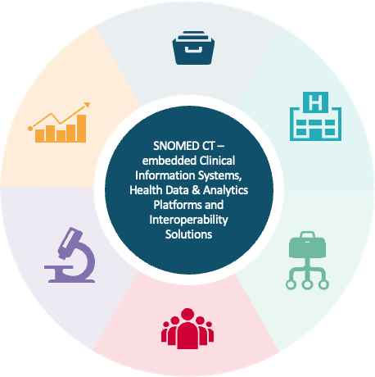
Real world examples of SNOMED CT use
North York General Hospital
SNOMED CT evidence-based order sets used to reduce preventable mortality
Kaiser Permanente
SNOMED CT enabled HealthConnect CIS yields accurate and comprehensive records, improved patient safety and enhanced population management
Population and management analytics have resulted in a significant drop in patient harm and cost of care rates
Honghu Public Health Surveillance
SNOMED CT provided vocabulary control in the surveillance data platform to strengthen support, diagnosis, treatment and reporting of COVID-19
AEHRC and CSIRO
Predictive Analytics and Data-Driven Intelligence using SNOMED CT
Knowledge Representation and Reasoning using SNOMED CT
Human Language Understanding using NLP and SNOMED CT
University of Nebraska
Medical Centre
SNOMED CT terminology extensions for genomics data sets supporting care
Detailed coding of Cancer Synoptic data
Extends analytics capabilities of SNOMED CT observables for laboratory medicine
SNOMED CT supports many emerging health trends
Visit value.snomed.org
to review SNOMED CT case studies and benefits
Notes:
Authors research evidence based articles and journals to ensure that the SNOMED content is modelled correctly and is not just accurate but clinically validated as well
Even in a single hospital clinicians can refer to clinical ideas by different names or terms or abbreviations, so internationally this can increase significantly, and that can bring challenges to ensure that we are still taking about the same thing. SNOMED ensures that these idea can be represented in a number of different ways by allowing the addition of various descriptions that can be searched and retrieved.
There are a number of maps from SNOMED to a number of various international standards. These are done by specialist mappers you have domain knowledge of the source and targets of these maps.
The increasing use of SNOMED across the world is showing the fantastic possibilities and benefits of SNOMED in enhancing interoperability.

Slide 7
How is SNOMED CT used?
Research
Data Entry and Integration
Clinical Information Sharing
Conducting clinical research, laboratory research and scientific research.
Conducting clinical research, laboratory research and
scientific research.
The electronic exchange of clinical data and documents among Care Providers along the continuum of care, often using interoperability solutions.
Management Analytics
Population Analytics
Point of Care Analytics
Conducting trend & comparative analysis and health system
value analysis.
Conducting trend & comparative analysis, pharmacovigilence
and clinical audit.
Creating historical
summaries, doing
point-of-care reporting
and using clinical
decision support
Notes:
Authors research evidence based articles and journals to ensure that the SNOMED content is modelled correctly and is not just accurate but clinically validated as well
Even in a single hospital clinicians can refer to clinical ideas by different names or terms or abbreviations, so internationally this can increase significantly, and that can bring challenges to ensure that we are still taking about the same thing. SNOMED ensures that these idea can be represented in a number of different ways by allowing the addition of various descriptions that can be searched and retrieved.
There are a number of maps from SNOMED to a number of various international standards. These are done by specialist mappers you have domain knowledge of the source and targets of these maps.
The increasing use of SNOMED across the world is showing the fantastic possibilities and benefits of SNOMED in enhancing interoperability.

Slide 8
Our collaborative partnerships
SNOMED International has an active program of collaboration with international standards development organizations and professional clinical bodies in order to facilitate the use of SNOMED CT with other international standards.
Professional Clinical Bodies
SDOs
Education
Vendor & Industry
Professional Clinical Bodies
Research
ADA
AND (NCPT)
AMA
ERA
ICN (ICNP)
INSERM (Orphanet)
WONCA
ILEA
AJCC
DICOM
GMDNA
GS1
HL7 International
JIC
IHE
ISO
WHO
CHIA
CHIMA
Digital China Health
Hospital Italiano
University of Eastern Finland
Cerner
Google
IBM Watson
Philips
Roche
Siemens
Healthineers
ICH (MedDRA)
GA4GH
CDISC
HPO
OBO
OHDSI
OMIM
Notes:
Authors research evidence based articles and journals to ensure that the SNOMED content is modelled correctly and is not just accurate but clinically validated as well
Even in a single hospital clinicians can refer to clinical ideas by different names or terms or abbreviations, so internationally this can increase significantly, and that can bring challenges to ensure that we are still taking about the same thing. SNOMED ensures that these idea can be represented in a number of different ways by allowing the addition of various descriptions that can be searched and retrieved.
There are a number of maps from SNOMED to a number of various international standards. These are done by specialist mappers you have domain knowledge of the source and targets of these maps.
The increasing use of SNOMED across the world is showing the fantastic possibilities and benefits of SNOMED in enhancing interoperability.

Slide 9
Where is SNOMED CT used?
Data Entry and Integration
The recording and
integration of SNOMED CT in clinical information systems
and health data &
analytics platforms.
Research
Conducting clinical research, laboratory research and scientific research.
Clinical Information Sharing
The electronic exchange of clinical data and documents among Care Providers along the continuum of care, often
using interoperability
solutions.
SNOMED CT–embedded Clinical Information Systems, Health Data & Analytics Platforms and/or Interoperability Solutions
Management Analytics
Conducting trend & comparative analysis and health system value analysis.
Point-of-Care Analytics
Creating historical summaries, doing point-of-care reporting and using clinical decision support.
Population Analytics Conducting trend & comparative analysis, pharmacovigilence and clinical audit.

Slide 10
SNOMED CT
Demonstrated use cases
Veterans Health Administration: the cost benefit analysis of the SNOMED CT-embedded VistA system, as well as the benefits derived from the Veterans Health Information Exchange (VHIE).
AEHRC and CSIRO (Australia): a look into the current and future possibilities for SNOMED CT use in artificial intelligence.
Honghu Public Health Surveillance (COVID-19): a description of the SNOMED-CT-embedded Honghu Hybrid System that supported policy makers and public health officials with COVID-19 surveillance and control.
OHDSI: the SNOMED CT-embedded OMOP CDM, and the benefits obtained from research projects using the OHDSI research collaborative.
University of Nebraska Medical Centre: the benefits obtained from the SNOMED CT-embedded i2B2 data warehouse and its use for clinical and translational research.
Kaiser Permanente: the benefits derived from a SNOMED CT-embedded HealthConnect clinical information system and patient portal, as well as analytics and research
North York General Hospital: the benefits obtained from a SNOMED CT-embedded eCare clinical decision support system.
Barts NHS Trust and the East London Health and Care Partnership: the benefits derived from a SNOMED CT-embedded Cerner clinical information system and a regional EHR and data & analytics platform.
University of Cambridge Hospitals NHS Foundation Trust: the benefits derived from a SNOMED CT-embedded eHospital clinical information system, patient portal and a health data & analytics platform.
Northern Queensland Primary Health Network and Mackay Hospital and Health Service: an economic evaluation of the Mackay SNOMED CT-embedded HealthPathways implementation.
Notes:
Authors research evidence based articles and journals to ensure that the SNOMED content is modelled correctly and is not just accurate but clinically validated as well
Even in a single hospital clinicians can refer to clinical ideas by different names or terms or abbreviations, so internationally this can increase significantly, and that can bring challenges to ensure that we are still taking about the same thing. SNOMED ensures that these idea can be represented in a number of different ways by allowing the addition of various descriptions that can be searched and retrieved.
There are a number of maps from SNOMED to a number of various international standards. These are done by specialist mappers you have domain knowledge of the source and targets of these maps.
The increasing use of SNOMED across the world is showing the fantastic possibilities and benefits of SNOMED in enhancing interoperability.

Slide 11
SNOMED CT
Demonstrated use cases
Documented
Patient Service & Patient Health
Outcome Benefits
Patient Service Outcome
Improvements
Patient (Panel) Management
Health Record Management
Diagnostic Tests
Patient Safety
Infection Control
Referral Management
Population Health
Data Sharing
Efficiencies and Cost Savings
Patient Service Outcome
Improvements
Patient Safety
Infection Control
Population Health
Analytics and Research
Notes:
Authors research evidence based articles and journals to ensure that the SNOMED content is modelled correctly and is not just accurate but clinically validated as well
Even in a single hospital clinicians can refer to clinical ideas by different names or terms or abbreviations, so internationally this can increase significantly, and that can bring challenges to ensure that we are still taking about the same thing. SNOMED ensures that these idea can be represented in a number of different ways by allowing the addition of various descriptions that can be searched and retrieved.
There are a number of maps from SNOMED to a number of various international standards. These are done by specialist mappers you have domain knowledge of the source and targets of these maps.
The increasing use of SNOMED across the world is showing the fantastic possibilities and benefits of SNOMED in enhancing interoperability.

Slide 12
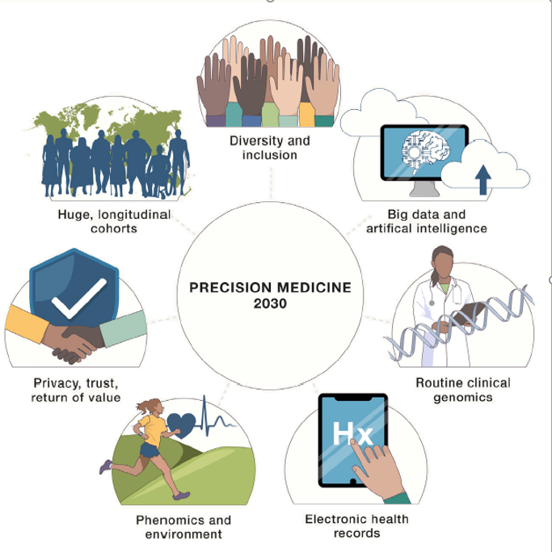
SNOMED CT
Huge Interoperable Longitudinal Cohorts - Over the last 20 years, national cohorts (e.g. UK Biobank), have amassed huge populations with genomic, laboratory, and lifestyle assessments as well as longitudinal follow-up on health outcomes. The breadth and depth of data is staggering, as is the opportunities for discovery.
Diversity and Inclusion - With a growing depth of data, we have an opportunity to replace adjustments for race and ethnicity with more specific measures.
Big Data and AI - AI approaches in medicine have been limited by the (un)availability of large, commonly structured datasets. Looking forward, biomedical datasets will become increasingly ready for analyses.
Routine Clinical Genomics – Moving forward, whole genome approaches will become a routine, early step in the understanding, prevention, detection, and treatment of common and rare diseases.
Electronic Health Records – Many site-based and national research cohorts now use EHRs and other health data to provide up to decades of disease and treatment information that can be repurposed for research. This use will continue to expand.
Phenomics and Environment – Continued growth of research and clinical uses for different ways to measure clinical phenotypes, exposures, and lifestyles.
Privacy, Trust and Return of Value - The utility of precision medicine is dependent on broad participation, and broad participation of large populations requires trust, protection of privacy, and a return of value to the participants.⁸
Future opportunities – Personalized, precision medicine 2023

Slide 13


Clinical Reference Groups
ORGANIZATION, STRUCTURE & REPORTING
CLINICAL COMMUNITIES
CLINICAL REFERENCE GROUPS
PROJECT GROUP
EDITORIAL GROUP
CLINICAL COORDINATION FUNCTION
‹#›
Notes:
Authors research evidence based articles and journals to ensure that the SNOMED content is modelled correctly and is not just accurate but clinically validated as well
Even in a single hospital clinicians can refer to clinical ideas by different names or terms or abbreviations, so internationally this can increase significantly, and that can bring challenges to ensure that we are still taking about the same thing. SNOMED ensures that these idea can be represented in a number of different ways by allowing the addition of various descriptions that can be searched and retrieved.
There are a number of maps from SNOMED to a number of various international standards. These are done by specialist mappers you have domain knowledge of the source and targets of these maps.
The increasing use of SNOMED across the world is showing the fantastic possibilities and benefits of SNOMED in enhancing interoperability.

Slide 14

Clinical Reference Groups
(CRGs)
Enable topic focused discussions between clinicians
Provides a platform for clinicians to discuss issues and experience relating to SNOMED CT implementation
Dedicated web sites to support discussion
Open to all, input not limited to just clinicians from the clinical specialty
Task and finish project groups (and Editorial groups) are linked to the CRGs
Open and transparent
(does not require an account to access)
KEY: We all have experiences, and we can all learn from each other
‹#›

Slide 15

How to Join
Existing CRGs
All CRG pages are hosted on Confluence
Pages are open, and can be viewed by anyone with no log in restrictions
However, to participate in discussions, you must be logged in to Confluence
To obtain a Confluence account please visit http://snomed.org/accounts
Please advise us if joining a group
info@snomed.org
‹#›

