Slide 1


SNOMED Implementation Support
ELAG Update
[Insert Title]
Anne Randorff Højen
[Insert Date]
Atlanta, USA
October 2023
snomedexpo.org | linkedin.com/company/ihtsdo | x.com/snomedct | youtube.com/@snomedct

Slide 2

Implementation Support Update
Agenda
Introduction
Activity Update
  Individual Support
  Implementation Guides
  Computable Languages
  R&D (Research and Development)
  Implementation Support Portal
  Implementation Support Tooling

Slide 3
SNOMED Implementation Support Update
Introduction

Slide 4



SNOMED International’s Implementation Support Team
Our goal: To collaborate with Members to achieve their SNOMED CT implementation goals, in a way that delivers the most value for them
Alejandro Lopez Osornio
Senior Implementation Support Specialist
Anne Randorff Højen
Implementation Support Specialist
Kai Kewley
Implementation Support
Technical Specialist
Notes:
My name is Anne Højen, I am a member of SNOMED internationals Implementation Support Team.
Together with my colleagues Alejandro Lopez Osornio and Kai Kewley, our goal is to collaborate with SNOMED International Members to successfully achieve their implementation goals.
Kai and I a very pleased to be here in Israel, and we want to thank the Ministry of Health for organizing this conference, and for your warm hospitality.
We look forward to the next days, where we will do the best we can to give you the insights you need to continue on the SNOMED CT implementation journey.

Slide 5
Individual Support
Implementation Guides
Computable Languages
R&D (Research and Development)
Implementation Support Portal
Implementation Support Tooling
SNOMED Implementation Support Update
Activity Update

Slide 6

Individual Support - Workshops and Meetings
Developer Days
Targeted at software developers
Learn how to setup and apply a terminology server
See more at: https://snomed.org/dev-training
Can be run virtually or f2f
Tailored Web Series
Targeted at NRCs
Promote SNOMED CT nationally and advance implementations
SI provides platform and presenters
See example at:
https://www.snomed.org/advancing-snomedct-implementation
Implementation
Consultation
Targeted at NRCs, local implementation projects and vendors
National implementation strategy and planning
Support and consultation on local projects
Vendor techniques and solution design
See more:
https://www.implementation.snomed.org/implementation-workshops

Slide 7

Individual Support - Bahmni Partnership
Background
  “SNOMED collaborates with the Bahmni Coalition to equip their open-source EMR with SNOMED CT’s clinical terminology for low-resource and digitally maturing settings”
Objective of partnership?
  Lowering the barrier for adoption
  Demonstrate implementation techniques
  Showcase SNOMED CT implementation benefits
The way we worked
  A year of weekly collaboration meetings with their development team
  Hands-on software development
See more:
https://www.snomed.org/bahmni-snomed-ct

Slide 8
Individual Support - Bahmni Partnership
Innovation and Learning
  An innovative architecture: light coupling between the FHIR terminology server and existing concept dictionary
  New FHIR CDS Service drives SNOMED-enabled business logic
  Snowstorm Lite allows for deployment in low resource settings
Features Delivered
  Best practice search and constrained data entry
  CDS for
    drug-condition contraindications
    drug-drug interactions
    drug-dose warnings
  ICD-10 automatic report generation
  Bulk Patient record FHIR export
    Integrated with Snolytical data analytics tool
Demo of features available

Slide 9

Implementation Guides
SNOMED CT Implementation Guides
  Follow a general structure
    1. Introduction
    2. Clinical Use Case
    3. SNOMED CT Content
    4. Information Models and Terminology Binding
    5. Technical Application
  Supported by demonstrator
Published or in progress
  Allergy, Hypersensitivity and Intolerance
    Guide: http://snomed.org/allergy
    Demonstrator:
    http://snomed.org/allergy-demo
  Cancer Synoptic Reporting
    Publication expected later this year

Slide 10

Computable Languages
Postcoordination
  Guide and reference implementation available in Snowstorm-X
ECL v2.2
  Top and bottom operators
  Alternate identifier
ECL Lite (WIP)
  Reduced set of ECL features
  Simplified and fast terminology servers

Slide 11

R&D (Research and Development)
Advancing data analytics with SNOMED CT
  Patient data clustering using graphs
  Preparing data for machine learning analysis
Using Large Language Models (AI)
  Coding natural language clinical phrases
  Generating descriptions from attributes
  Patient friendly descriptions
  etc.
Enhancing support for FHIR Questionnaires
  Updates to the NLM FHIR Questionnaire Editor
    SNOMED CT integration
    ECL support for question options value sets
  FHIR Questionnaire bindings validator

Slide 12

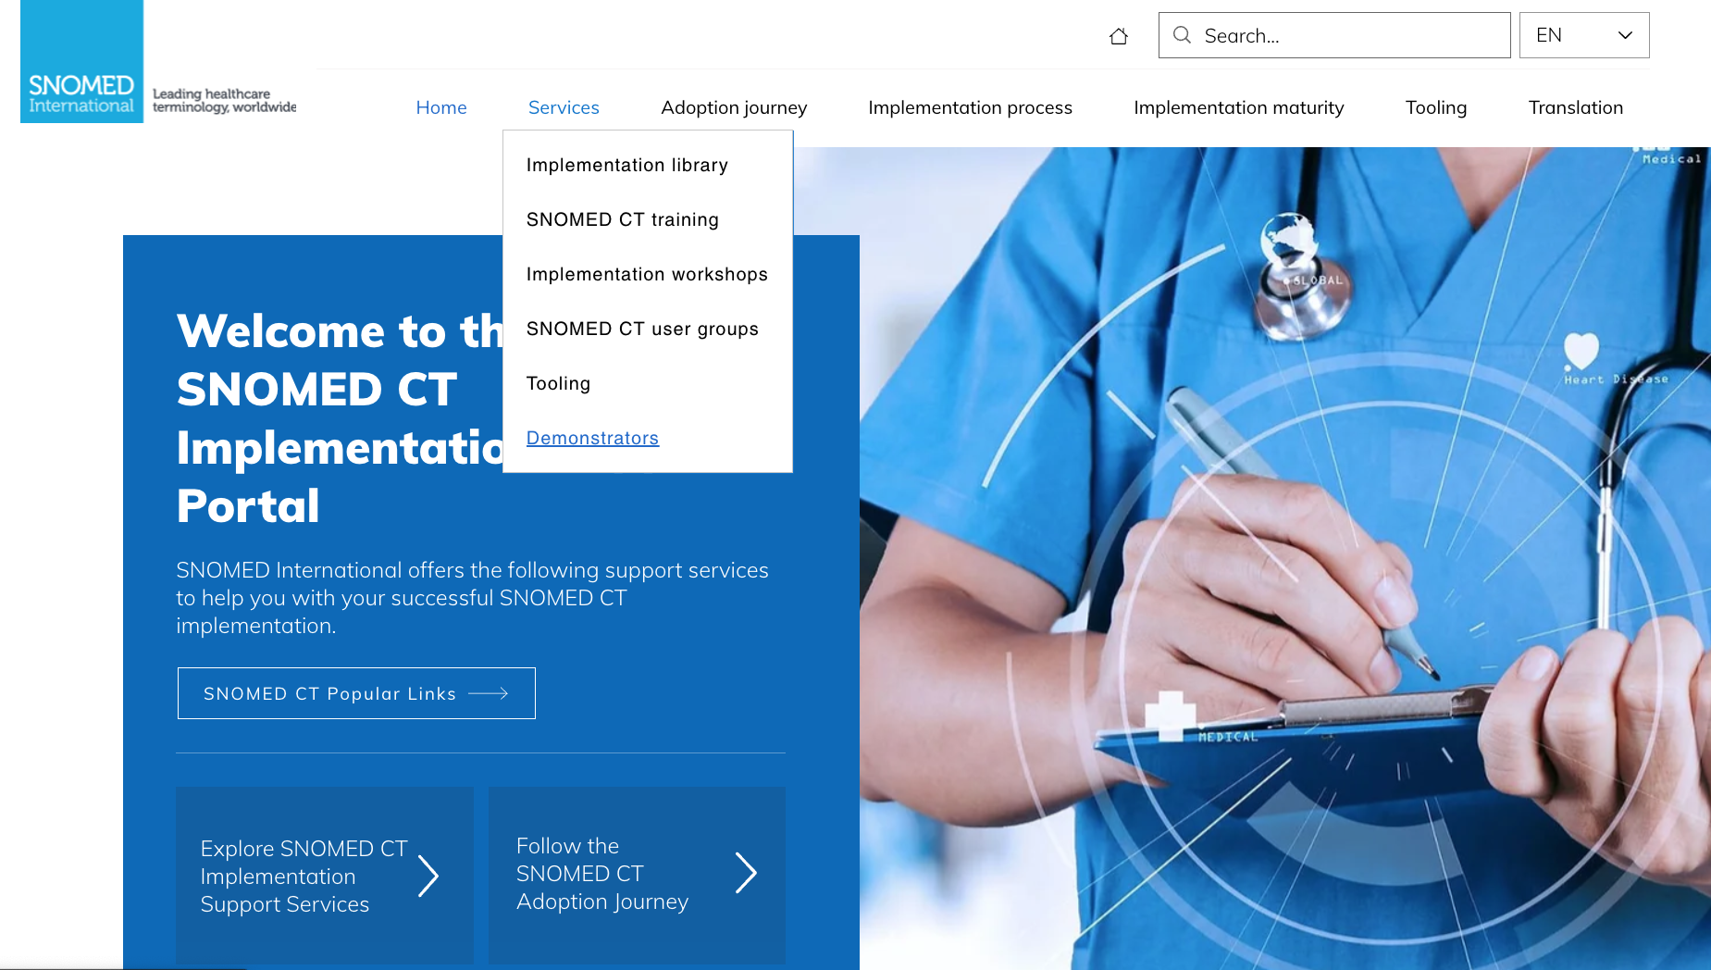
Implementation Support Portal
Translation area
Easy access to demonstrators

Slide 13
Implementation Support Tooling
Snowstorm Lite
  A fast read-only FHIR Terminology Server for SNOMED CT with a small memory footprint
Snap2Snomed
  New version with new and improved features
Terminology binding editor
  Practice terminology binding with SNOMED CT
Simplex
  Tool for creation and management of simple extensions

Slide 14
Simplex
Snap2Snomed
Terminology Binding and
FHIR Questionnaires
Postcoordination
Implementation Support Update
Implementation Support Tooling

Slide 15

The Challenge with Free SNOMED Tools
Terminology
Tooling
Vendors
Managed Services Users (NRCs)
SNOMED CT
Release Package
Free Tools and Spreadsheets
Manual
Technical Work

Slide 16

Simplex: Solution Outline
Implementation Tools
Release Tools
Production Systems
Weblate
Clinical information systems
Refset & Translation Tool
Terminology Server
Simplex
RF2 Release
Snap2Snomed
SNOMED CT Browser
Spreadsheets

Slide 17
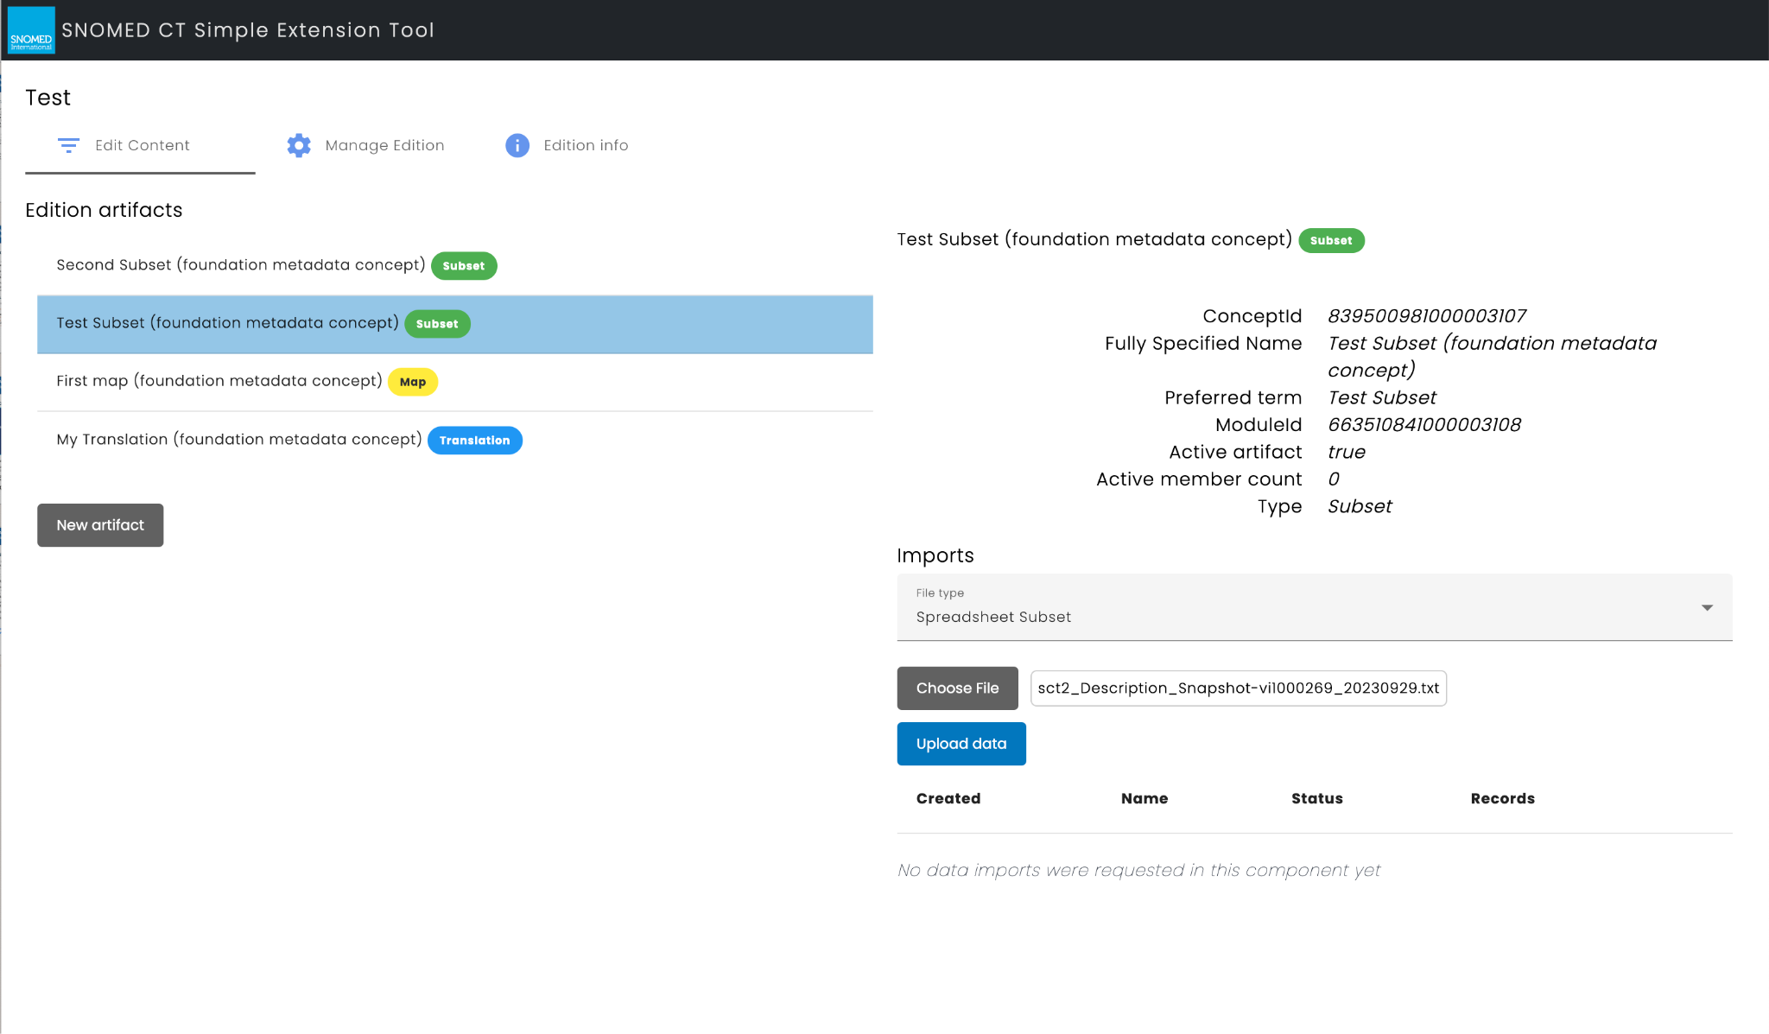
Simplex Service

Slide 18
Simplex
Snap2Snomed
Terminology Binding and
FHIR Questionnaires
Postcoordination
Implementation Support Update
Implementation Support Tooling

Slide 19
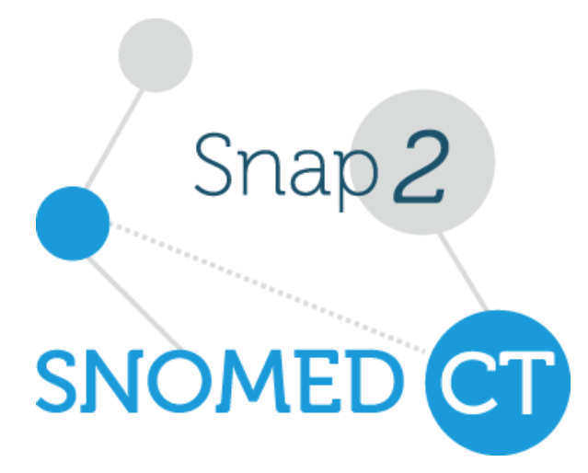
Snap2Snomed
New features
  Streamlines login process
  Dual author mode with reconciliation
  Support for replacement of inactive concepts
  Display concept definitions
  Enhanced export format (multiple columns, notes and more)
  Export to FHIR ConceptMap
Expected Deployment: November 2023

Slide 20


Snap2Snomed
Single author mode
Source code
Source code set
(to be mapped)
Mapper
Reviewer
Each source code can be assigned to a single author/mapper
Each map row can be assigned to a single reviewer

Slide 21

Snap2Snomed
Dual author mode with reconciliation
Mapper #1
No
Reconciler
Source code
?
Have the mappers selected the same map target(-s)?
Source code set
(to be mapped)
Yes
Each map row can be assigned to two authors/mappers
Mapper #2
Reviewer

Slide 22
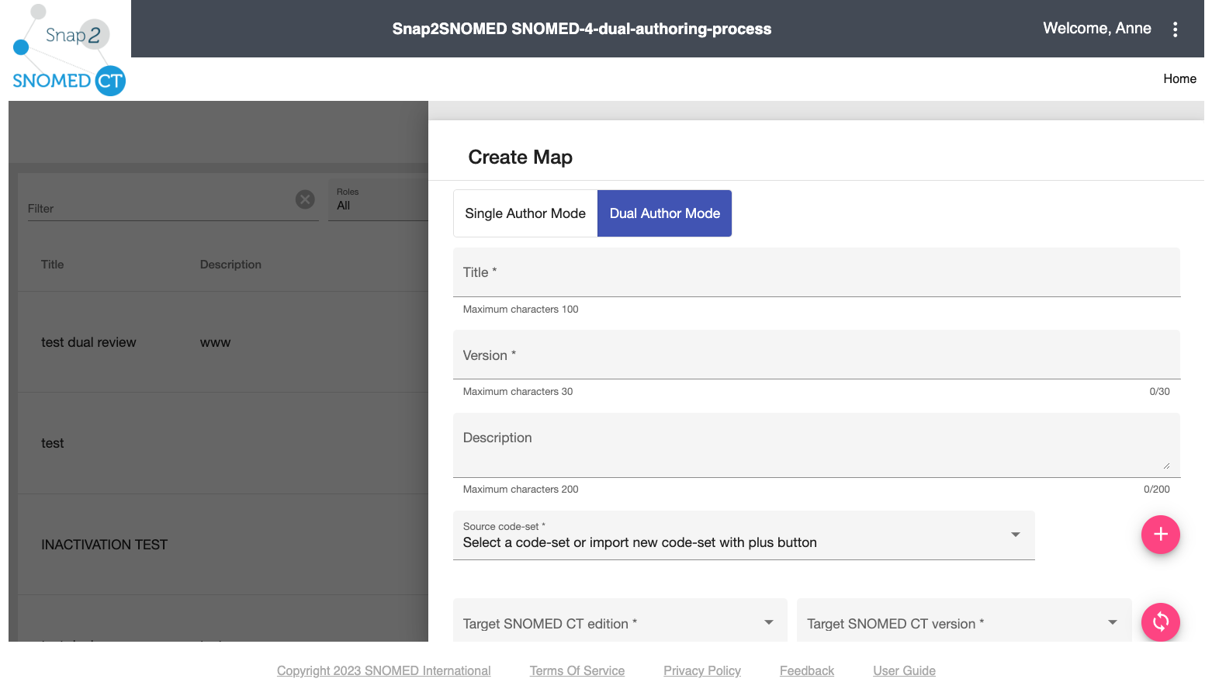
Snap2Snomed

Slide 23
Snap2Snomed
Support for replacement of inactive concepts
Int Edition
Jul 2019
Int Edition
Sep 2023
Uses historical associations to propose replacements for map targets that are inactive (out of scope) in the new version
Each version of a map is based on a specific substrate/ SNOMED CT version

Slide 24
Simplex
Snap2Snomed
Terminology Binding and
FHIR Questionnaires
Postcoordination
Implementation Support Update
Implementation Support Tooling

Slide 25
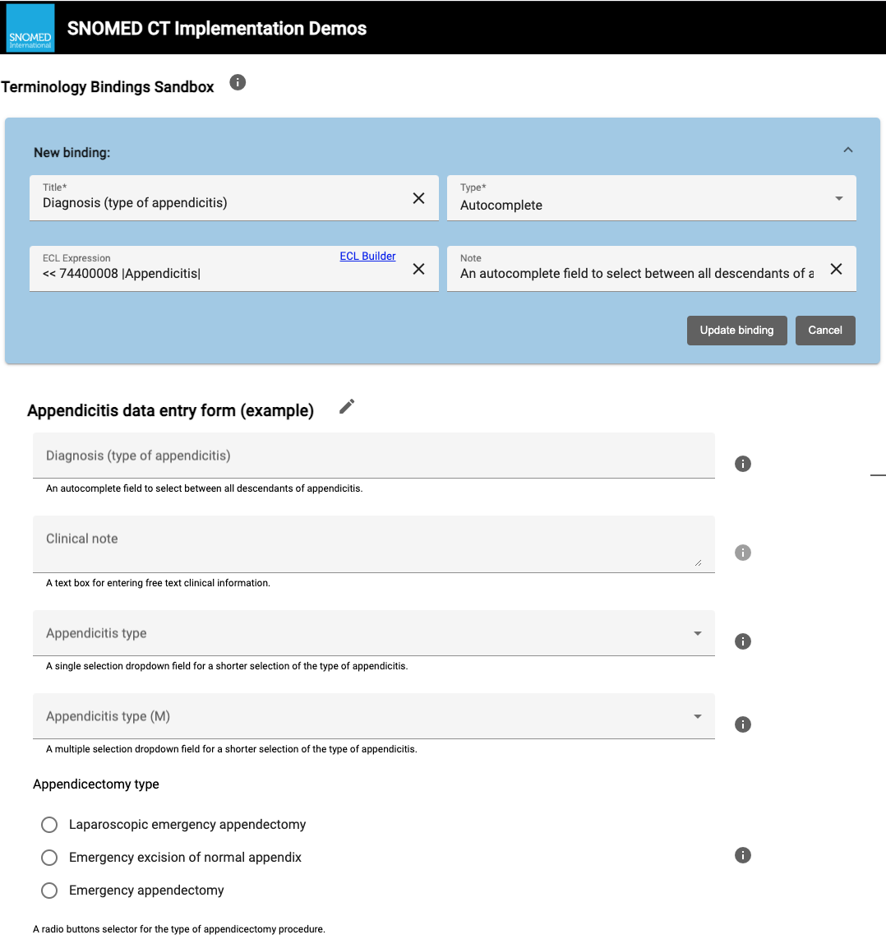
Terminology Binding + FHIR Questionnaires
Objective
  Designed to demonstrate and
  practice terminology binding
Features
  Select from a range of structured
  data entry controls
  Specify the value constraints
  Export form
    Proprietary json
    FHIR Questionnaire
Available at:
https://ihtsdo.github.io/sct-implementation-demonstrator/#/sandbox

Slide 26
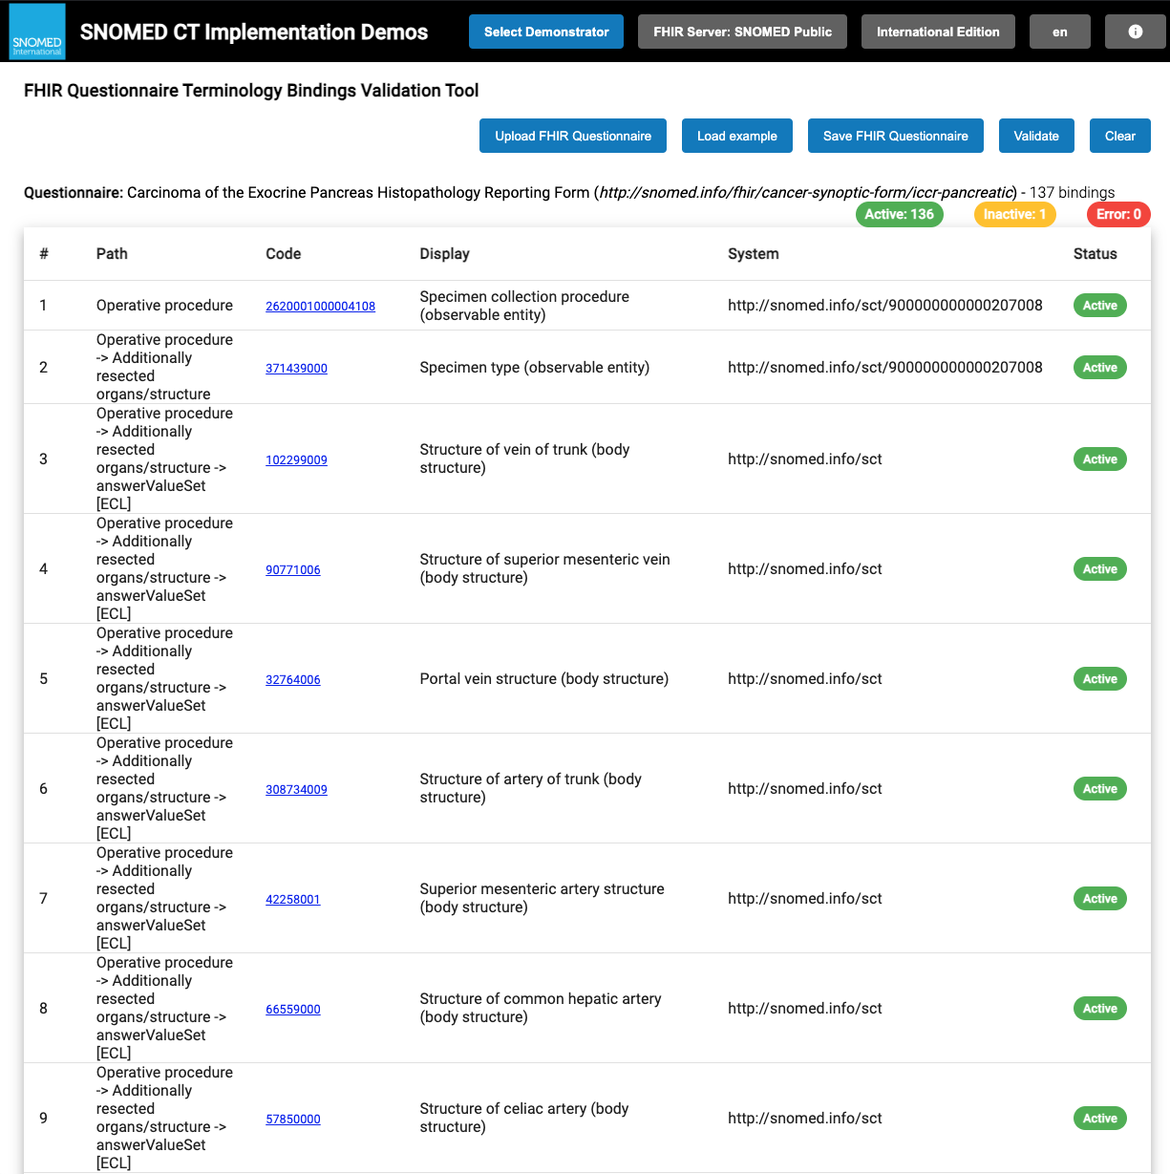
Terminology Binding + FHIR Questionnaires
NLM Form Builder
  Create FHIR Questionnaires
  Supports bindings to SNOMED CT
  https://lhcformbuilder.nlm.nih.gov/
FHIR Questionnaire validation tool
  Import FHIR Questionnaires
  Validate bindings
  Replace inactive concepts with proposed replacements
Available at:
https://ihtsdo.github.io/sct-implementation-demonstrator/#/questionnaires

Slide 27
Simplex
Snap2Snomed
Terminology Binding and
FHIR Questionnaires
Postcoordination
Implementation Support Update
Implementation Support Tooling

Slide 28
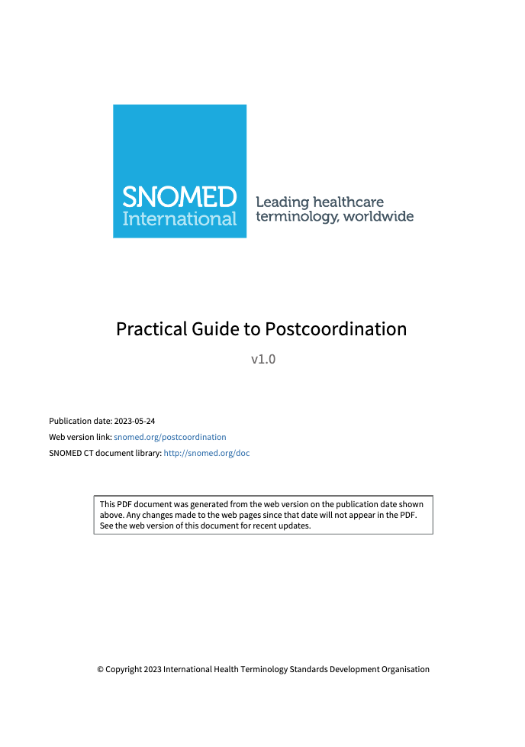
The Guide
Practical Guide to Postcoordination
SNOMED CT Expressions
  Pre- and postcoordination
  Concept Model and Editorial Guidance
  Syntax and forms
  Benefits and Challenges
  Use Cases
Expressions in the EHR
  Create, enter, store, display, query and exchange expressions
Expressions in a Terminology Server
  Requirements, Design, Implementation
  (Expression repository and terminology services)
Published for trial use
Please provide your feedback
snomed.org/postcoordination
Notes:
The idea of postcoordination has been well-known since the establishment of SNOMED CT, and even before that.
Although SNOMED CT is designed to allow new meanings to be composed there has been a lack in guidance on how to do this, and a lack of implementations demonstrating the safe and effective use of postcoordination.
Given the fact that implementers of SNOMED CT are increasingly exploring the option to apply postcoordination to meet specific requirements, we’ve felt the need to develop guidance in this area.
As a result, we have now published the new practical guide to postcoordination.
This guide has been under development for the last couple of years, where the SNOMED CT Computable Languages Project Group has been actively trying to clarify use cases, principles and implementation advice for anyone attempting to apply postcoordination with SNOMED CT.
If out haven’t already looked at this guide, we recommend that you take a look at this url, and we encourage you to follow the implementation approaches outlined in this guide on a trial basis to evaluate their effectiveness and suitability for your specific use case. Please reach out to us if you have any questions, or experiences that you would like to share.

Slide 29



The Transformations
Approaches to Ensuring
“Safe” Postcoordination
TS is generic to
ensure flexibility
Client determines its own risk profile
Terminology
Server
TS ONLY requires expression to be MRCM compliant after applying loose attributes to all definitional values in the correct domain
L3
Client can throw any expression at the TS, and
know that it will do its best to transform & classify
TS gives warnings/errors
if generic transformation
is considered logically ambiguous
Client can throw any expression at the TS,
and know that it will stop it doing anything “risky”
L2
Current guidance and implementation
TS permits some non-MRCM compliant expressions for limited, predefined set of cases
Simple templates must conform to ‘known’ patterns (eg laterality on a procedure/finding)
L1
Client
TS requires ALL expressions to be fully MRCM compliant
User must create expressions in classifiable form OR client must do its own transformations
L0
TS is restricted to
ensure safety
Client does the “heavy lifting”
Notes:
Postcoordination can be hard to get right. To produce a complete expression, with attribute groups ready for classification, you need some understanding of concept authoring - and to have checked the current state of the existing concepts.
During the creation of the guide the Snomed Computable Languages Group explored options for automation, to make postcoordination simpler for implementers. This diagram represents four levels of automation using expression transformations.
At the bottom of the diagram we start with no transformations, at Level 0. Here the healthcare system implementer must create a user interface that produces prefect classifiable expressions. This is achievable using carefully designed expression templates.
The very top of the diagram is Level 3. This is where there are very little constraints. The terminology server has to do it’s best to transform the expression into something classifiable. This highest level of flexibility also has a high level of risk, because the transformations do not throw an error, even when the expression meaning is ambiguous. It’s probably only appropriate for some research data mining use cases.
[click]
For now, in the guide we have designed processes for Level 0 and Level 1.
Level 1 allows a small set of 8 conservative transformations with simple inputs, to reduce complexity for implementers.

Slide 30
The Transformations
Level 1 Transformations
Refining Existing Attribute
372130007 |Malignant neoplasm of skin| : 363698007 |Finding site| = 113179006 |Skin structure of nose|
Adding a Self-grouped Attribute
84229001 |Fatigue| : 255234002 |After| = 840539006 |COVID-19|
Adding Severity to Clinical Findings
16331000 |Heartburn| : 246112005 |Severity| = 24484000 |Severe|
Lateralizing Clinical Findings
301354004 |Pain of ear| : 272741003 |Laterality| = 7771000 |Left|
Lateralizing Procedures
14600001000004107 |Closure of wound of ankle with flap| : 272741003 |Laterality| = 7771000 |Left|
Adding Context to Clinical Findings
363358000 |Lung cancer| : 408729009 |Finding context| = 415684004 |Suspected|
Adding Context to Procedures
74400008 |Appendicitis| : 408730004 |Procedure context| = 443390004 |Refused|
Notes:
Here is the full list of the level 1 transformations.
The first transformation allows refining a concept by making one of the existing attribute values more specific, for example giving a more specific finding site.
The rest of the transformations are for qualifying meaning, by adding new attributes. Some of them change the domain of the concept. For example adding context to a finding, like the example shown adding a “suspected” context to a disorder. This will be transformed to the “finding with explicit content” domain.
These transformations behave in different ways but they all require just one focus concept and one attribute as input in order to produce a complete classifiable expression.

Slide 31


The Reference Implementation
SnowstormX is the beta version of
the Snowstorm Terminology Server
Postcoordination support via the FHIR API
  CodeSystem Supplement
  (Expression repository)
Supports Transformation Level 0
  Syntax validation
  MRCM validation
  Incremental Classification
  ECL Querying
Also Supports Transformation Level 1
  Known set of transformations
X
(Beta Version)
github.com/IHTSDO/Snowstorm-X
Notes:
In SnowstormX we have implemented both Level 0 and Transformation Level 1.
SnowstormX is the beta version of the Snowstorm Terminology Server. SnowstormX gives us a way to publish new features for trail use, before those features become mature and are moved into the main Snowstorm product.
Postcoordination support is given via the FHIR API using CodeSystem Supplements as the expression repository.
Implementers can choose to use Level 0 or Level 1.
Level 0 includes validation and incremental classification. This implementation allows selecting published concepts and postcoordinated expressions using ECL.
Level 1 includes all the features of Level 0 plus a set of 8 known transformations.
The FHIR responses do contain some non FHIR conformant information like the inferred attributes (NNF), equivalent concepts.
Compared to Ontoserver This is a more fully featured but less mature.

Slide 32

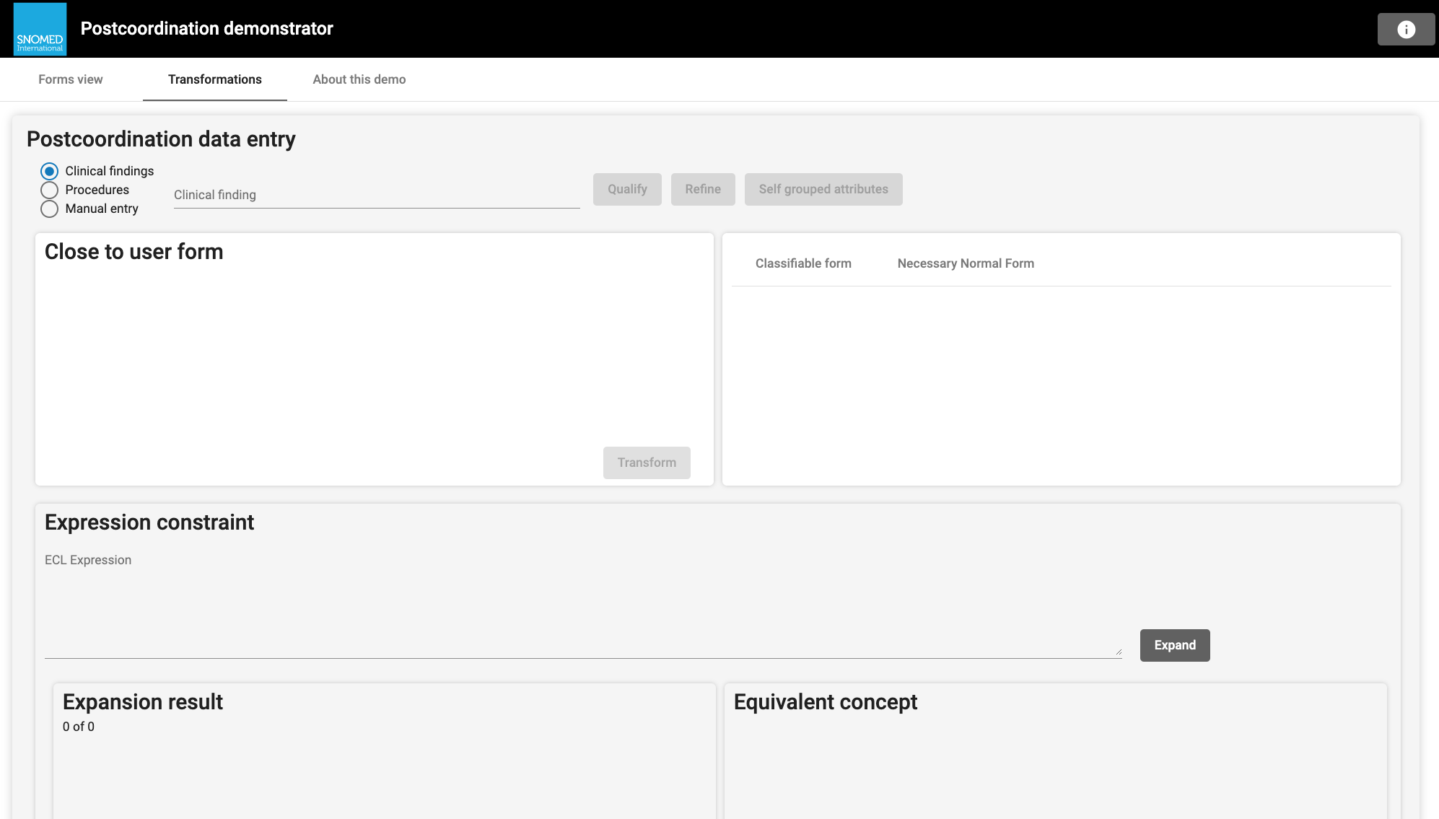

The Demonstrator
To explore visit:
snomed.org/postcoordination-demo

Slide 33


Thank You

