Slide 1


E-Learning Advisory Group (ELAG) Meeting
[Insert Title]
October 2023 Business Meeting
Chair : Ian Spiers
[Insert Date]
Atlanta, USA
October 2023
snomedexpo.org | linkedin.com/company/ihtsdo | x.com/snomedct | youtube.com/@snomedct

Slide 2

Welcome
Agenda
ELAG Administration
Education Team update
Implementation Support Team update
Any other business

Slide 3

Agenda
ELAG Administration
Education Team update
Implementation Support Team update
Any other business

Slide 4


ELAG Administration
Objectives of ELAG
Members of ELAG
Work Items for 2023

Slide 5
ELAG Administration
Objective
Provide an effective link between SI E-Learning activities and educational requirements and activities in Member countries
Ensure that the MF reps of the Member countries represented on the Group are kept informed about prioritization and other advice on E-Learning given by the group
Review and provide constructive feedback on new E-Learning materials and regularly revisiting existing materials to identify areas where changes are needed
Facilitate effective sharing and reuse of materials by SI and Members to enable translation and localization while maintaining international consistency
!
!

Slide 6
ELAG Administration
Members
ELAG Members
Ayala Pablo | Member Representative | Argentina
Aileen dela Pena | Member Representative | Australia
David Op de Beeck | Member Representative | Belgium
Janice Spence | Member Representative | Canada
Vasos Scoutellas | Member Representative | Cyprus
Louise Bie | Member Representative | Denmark
Rutt Lindström | Member Representative | Estonia
Mikko Härkönen | Member Representative | Finland
Vicky Fung | Member Representative | Hong Kong
Manisha Mantri | Member Representative | India
Yvonne Coughlan | Member Representative | Ireland
Kristina Dienine | Member Representative | Lithuania
Fareed Mohamad | Member Representative | Malaysia
Inge Soons | Member Representative | Netherlands
Aleksandar Zivaljevic | Member Representative | New Zealand
Leandro Luis | Member Representative | Portugal
Belen Delgado | Member Representative | Spain
Keng-Ling Wallin | Member Representative | Sweden
Pero Grgic Tracy Simmonite | Member Representative Member Representative | Switzerland UK
!

Slide 7
ELAG Administration
Declaration of Interest
!
Could all members of ELAG please
Go to http://snomed.org/elag
Click on ‘Group Members’
  If you are an ELAG Member representative,
  and your name does not appear on the list, please email isp@snomed.org
Click on ‘Declaration of Interests’
  Add any potential conflicts of interest
  Update the ‘Last updated’ date (even if no changes)
!
Note: If you don’t have access, please email isp@snomed.org

Slide 8

To advise on national and international priorities and activities needed to increase knowledge and skills related to SNOMED CT
To review and provide advice on SNOMED CT courses
To identify local languages required by each Member's SNOMED CT community for education
Identify potential education delivery partners for each required language
ELAG Administration
ELAG Work Items - 2023
!

Slide 9
Agenda
ELAG Administration
Education Team update
Implementation Support Team update
Any other business

Slide 10
Education Team Update
E&PS Team
E-Learning Status
SNOMED CT Starter Tutorial & Education Resource Guide
Implementation Course Update

Slide 11
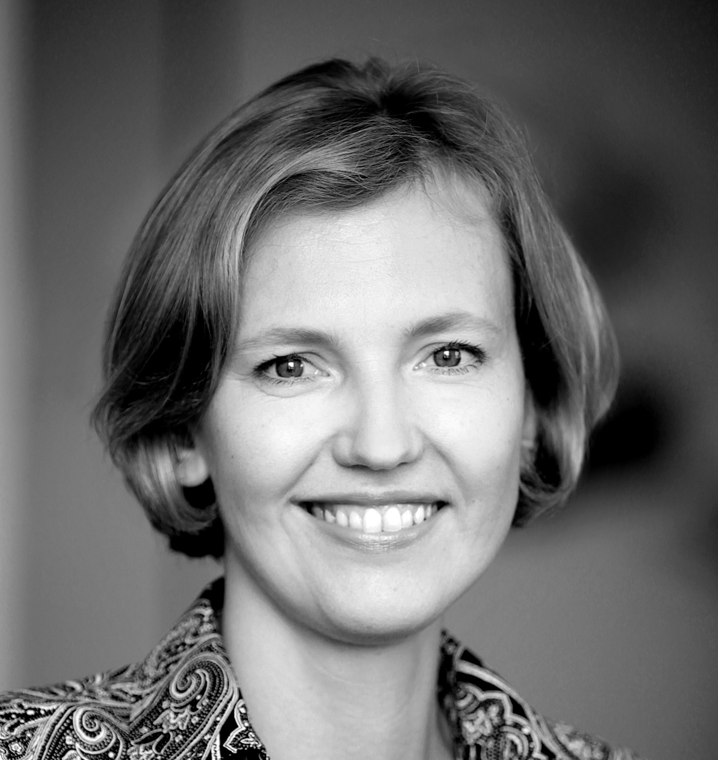
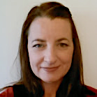
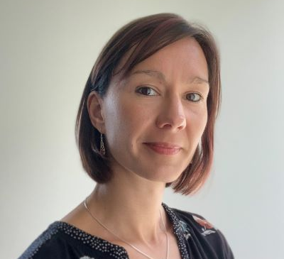
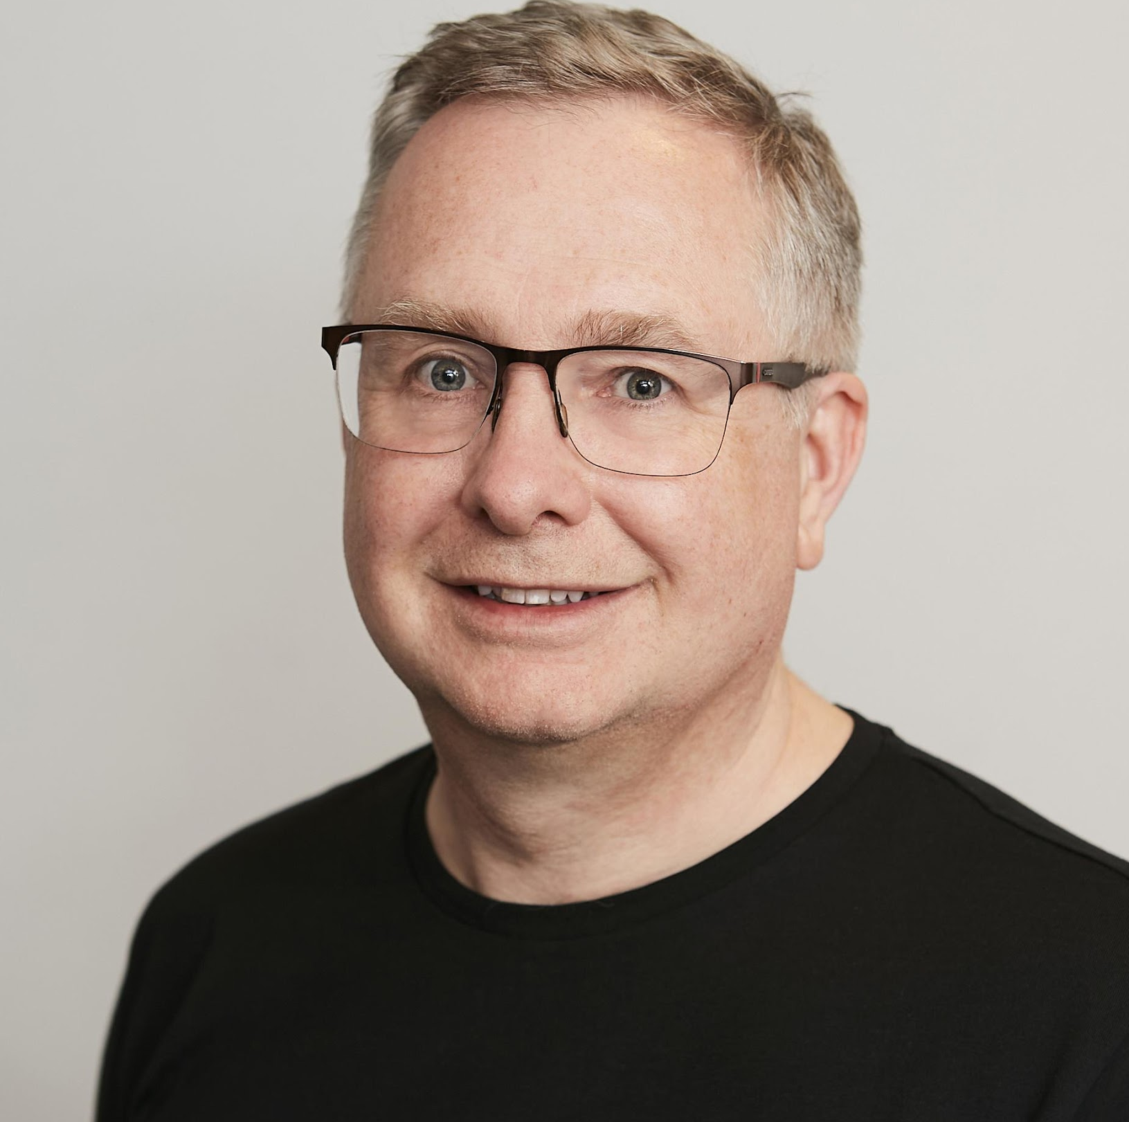


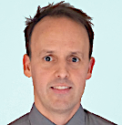
Education Team
Liara Tutina
Louise Jones
Kath Priest
Ian Spiers
Education Lead
eLearning Administrator
Education and Product
Support Specialist
Terminology Education
Specialist
Anne Højen
Penny Livesay
Jon Zammit
Implementation
Support Specialist
Authoring Specialist
Education and Product
Support Specialist

Slide 12
E-Learning Courses
SNOMED CT courses - free for SNOMED International Members
Fees for certification exams (50% discount for Members)
Members – 1 free certification exam per year for each type of certification exam
All learning pathways free to all
Increased demand for courses – book early
Authoring Courses
  Currently AL1 course seats are offered by a first come,
  first served basis so book early (Capped)
  Places retained for NRC’s

Slide 13
Education Team Update
E-Learning Status
Foundation Course
Implementation Course
Active: 462
Completions: 3678
Active: 163
Completions: 757
E-Learning Platform
Fundamentos Course
Unique user logins the last year: 2554
Active: 297
Completions: 430
Notes:
Unique user logins (https://elearning.ihtsdotools.org/report/customsql/view.php?id=262) looks at last 365 days - run on the 4th October, 2023
Active (last 6 months)
Completions - Total figure up to end of Sep

Slide 14
Education Team Update
E-Learning Status
Authoring Level 1 Course
Terminology Services Course
Active: 44
Completions: 322
Active: 68
Completions: 97
Authoring Level 2 Course
Active: 11
Completions: 48
Notes:
Active (last 6 months)
Completions - Total figure up to end of Sep

Slide 15
Education Team Update
E-Learning Status
Authoring Level 1 Certification Exam
Terminology Services Certification Exam
Passed: 101
Passed: 21
Authoring Level 2 Certification Exam
Passed: 19
Notes:
Enrolments - Overall enrolments
Active - Last 6 months (Oct - Feb)

Slide 16
Education Team Update
E-Learning Status
Clinicians learning pathway
Developers learning pathway
Enrolments: 966
Active: 193
Enrolments: 1476
Active: 271
Data Analysts learning pathway
Translators Learning Pathway
Enrolments: 1703
Active: 226
Enrolments: 169
Active: 51
Notes:
Enrolments - Overall enrolments
Active - Last 6 months (Oct - Feb)

Slide 17
Education Team Update
E-Learning Course Ratings
Overall, how would you rate the course? 1-5
Course | Average Score | Score of 3 or above (%)
Foundation | 4.3 | 100%
Foundation Spanish | 4.2 | 98%
Implementation | 4.3 | 98%
Terminology Services | 4.3 | 98%
Authoring Level 1 | 4.4 | 98%
Authoring Level 2 | 4.6 | 100%
Notes:
March 3rd 2023 Figures

Slide 18
Education Team Update
Revamp SNOMED CT Starter Tutorial and
New Education Resource Guide
            Interactive Tutorial and Guide
            SNOMED CT Starter Tutorial provides an overview of the basics of SNOMED CT
            SNOMED CT Education Resources Guide provides details of educational material that cover a range of topics related to the terminology
            Free to all to view (No E-learning account needed)
            Good for those individuals starting their SNOMED CT Journey but also for those refreshing their knowledge
            Link : Starter Tutorial and Education Resources Guide
Notes:
Show Guides 10 minutes

Slide 19
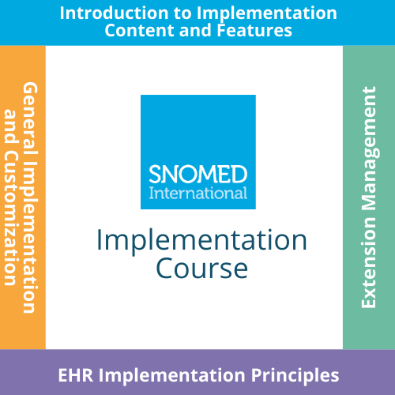
Education Team Update
Implementation Course Changes, Why?
Student feedback
  Long course
  More hands on
  Low attendance on webinars
Education team perspective (e-learning management)
  Flexible management to meet implementers requirements
  Update outdated material more easily
  Resource capacity management
Implementation team perspective
  Disseminate new implementation techniques and services/tools quickly to the community
  Signpost implementers to specific learning topics
Notes:
Kath to talk about timeline changes to Implementation Course

Slide 20
Education Team Update
Current Implementation Course - Feedback
Strengths | Weaknesses | Suggested Improvements
Flexible nature of the course being able to fit around work and family life | Presentations are extremely boring, too much unnecessary technical detail and explained too slowly | Information about Terminology Servers
Practical exercises and assignments | Some of the presentations were difficult to listen to and concentrate on | More on the benefits of SNOMED CT to the patient and selling SNOMED CT to clinical audience
Different users were picked up by the implementation course | Some presentations felt repetitive | More examples of implementation in health system
Self-paced nature and well structured content. | Topics to reduce: Compositional grammar, OWL, Refsets, RF2, Clinical Decision Support, Logical Model | How to use SNOMED CT in context of HL7 CDA FHIR
Webinars were really helpful and liked the practical exercise examples | More students on webinars, would have liked to speak to more peers across the globe, often only 1-2 people on the webinars | Prefer to split the implementation course into two or three different parts because I found it very long
Inspires by presenting many features and possible use cases of SNOMED CT | Some topics are quite challenging and may be better off in short courses | More hands-on exercises/assignments

Slide 21
Education Team Update
Implementation Course Structure and Requirements
Requirements
Completed the Foundation Course
Proposed Structure
17 Modules:
  2 mandatory modules
  15 optional self paced bite sized learning modules
  Complete the modules relevant to your work or role
Divided into theme specific groups
  General implementation and Customization
  EHR Implementation Principles
  Extension Management
Completion
  Can follow the learning pathway through the groups
  Can complete groups and modules in a different order to suit requirements
What are your thoughts about the
overall approach - self paced and grab and go/bite sized learning modules?

Slide 22
Education Team Update
Implementation Course Structure and Achievements
Implementation Course
What do you think about having mandatory modules as part of the course?
What do you think about the themes of
the course?
Implementation
Basics
(mandatory)
Introduction to Implementation
Content and Features
General Implementation
and Customization
EHR Implementation Principles
Extension Management
SNOMED CT and
Information models
Data capture
Extensions and Editions
Expression constraints
Data analytics
Logical model, release files and versioning
Subsets and Value sets
Data exchange
Translating SNOMED CT
Maps
Postcoordination
Maintenance
Terminology services
Clinical Decision Support
Logical foundation
Skills Assessment
+ Certificate
Skills Assessment
+ Certificate
Skills Assessment
+ Certificate
Full Implementation Course Certificate

Slide 23

ELearning Platform

Slide 24
Education Team Update
Implementation Course Module Structure
Module Introductory video
Lessons:
    Videos
    Reading
    Interactive content
    Practical exercises
Assessment/Assignment
Feedback
    Questionnaire to indicate satisfaction with module

Slide 25
Education Team Update
Accreditation/Assessments
What are your thoughts on badges being awarded for each module?
Module
Assessment/Assignment per module
Quiz or Practical exercise formats
Badge awarded on completion of each module
Theme/Programme
Assessment for each group on the relevant theme
Certificate issued on completion of each group assessment
Course Completion
Certificate issued for the whole course (no overall assessment)
CPD points available on completion of all modules and assessments

Slide 26
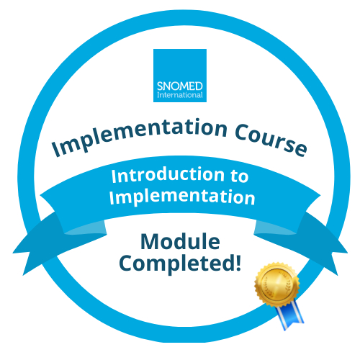

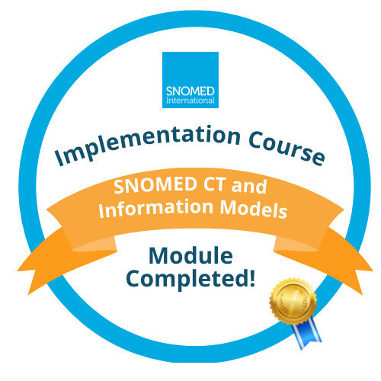
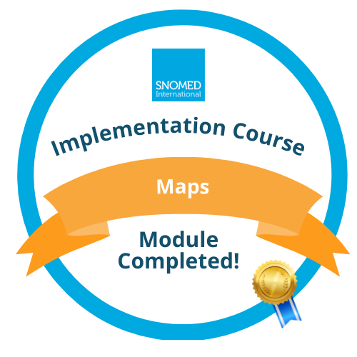
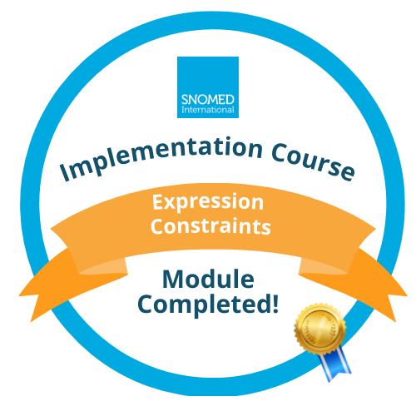
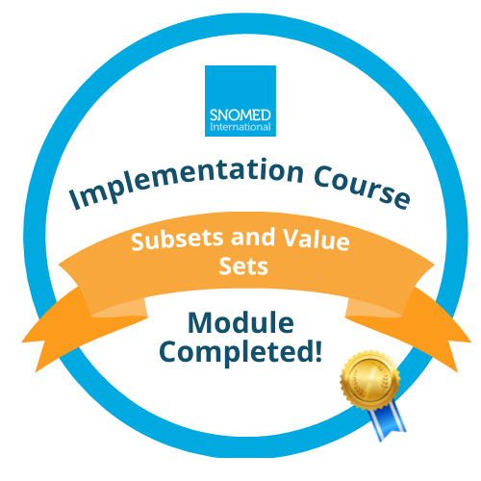
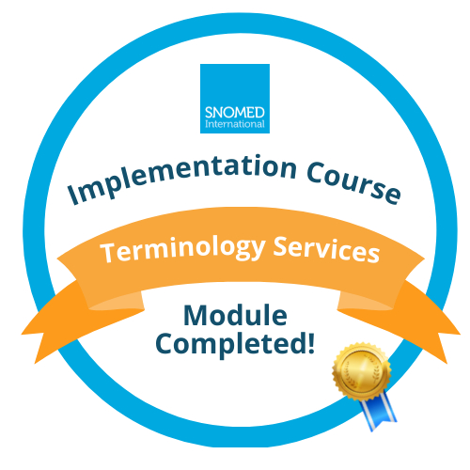

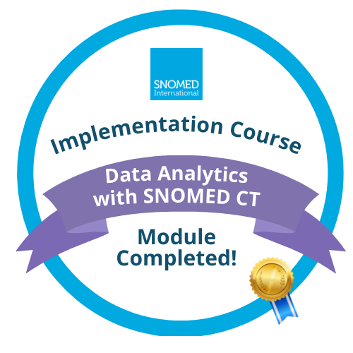

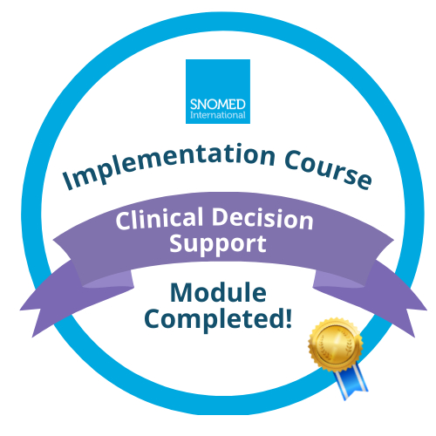
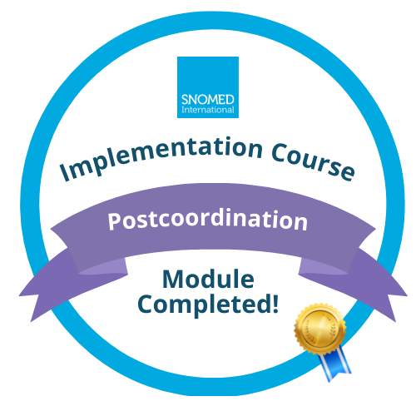

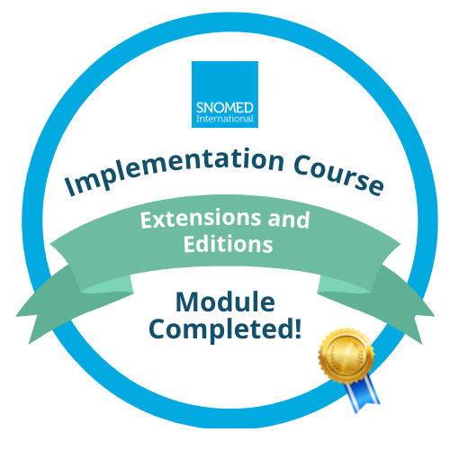
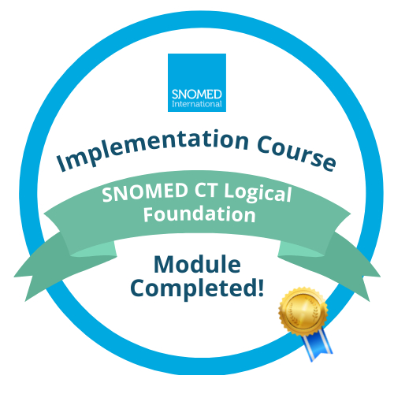


Education Team Update
Badges

Slide 27
Education Team Update
Engagement and Completions
No webinars
No strict completion schedule
No time limit
No emails from Louise (necessarily?)
Can you suggest three ways that may help us engage students and ensure completion of the levels and the whole course?
What can the NRCs do to support engagement?
Will this new course structure support your requirements for national implementation support? In what way?

Slide 28
BREAK - DISCUSSION
During the break please discuss at least one of the following questions and fill out your answer on the corresponding colored post-it note provided.
We will then discuss the responses after the break.
Colour | Questions
Green Post-it | What are your thoughts about the overall approach - self paced and grab and go/bite sized learning modules?
Orange Post-it | What do you think about the themes of the course? What do you think about having mandatory modules as part of the course?
Purple Post-it | What are your thoughts on badges being awarded for each module?
Blue Post-it | Can you suggest three ways that may help us engage students and ensure completion of the levels and the whole course? What can the NRCs do to support engagement? Will this new course structure support your requirements for national implementation support? In what way?

Slide 29


Slide 30
BREAK - DISCUSSION
Results:
VS: It should be a time limit eg a year with regular reminders
PM: Is completion needed – know there are low rates. Good to have a balance. Engagement from particular users per country could help with engagement.
S: defining stakeholders and what courses might be useful for them. Might support implementation course.
MN: Self-paced from SI but can be paced by NRC or organization. Consider the two different people – tiny detail and software developers. Other where people need to know everything about an implementation. No overlaps between the modules is key. Need to cover terminology and information models.
MH: Self-paced good but need some encouragement to complete as well. Networks/social media for new courses.
JS: Self-paced good but an ability for NRC to state a time of when this is completed. And reminders to complete the courses. Monitor clicks but not who has signed up. Current too monolithic – badges are a plus. Which modules are relevant for particular roles would be useful. Could information be shared on the roles from Canada?
DB: Links with projects that they are doing nationally. Support will be ok if part of implementation projects and as an NRC would put forward a roadmap for completion. Want to link to implementation projects that are taking place. Link streams to particular user profiles.
IS: Self paced is good, NRC can specify the completion. Some contact moments – regarding the course. Eg monthly Q&A. Real world examples.
CG: Who are implementers. Time limits, gateway checks would be useful. Clinical system teams and roles.

Slide 31
Education Team Update
Implementation Course Review
Internal review and external review of each level/theme of modules
Volunteers from ELAG to help review the entry modules – Volunteers needed
External review General Implementation and Customization - out for review by December 2023 – Volunteers needed
Review by access to the relevant modules via the e-learning platform
Completion of the review form
Course will be published one group at a time

Slide 32

Education Team Update
Education partnerships
SNOMED International is interested in Education partnerships
Please send enquiries to elearning@snomed.org
Notes:
Liara to talk about Education Partnerships

Slide 33

Education Team Update
E-Learning Sharing
SNOMED International can share course content with members to enable reuse and translation of material
Please send enquiries to elearning@snomed.org and we can provide the material
Notes:
Liara to talk about Education resourses sharing

Slide 34

Education Team Update
E-Learning Sharing
Notes:
Liara to talk about Education resourses sharing – can add links to members education area

Slide 35
Agenda
ELAG Administration
Education Team update
Implementation Support Team update
Any other business

Slide 36
Agenda
ELAG Administration
Education Team update
Implementation Support Team update
Any other business

Slide 37


Thank You

