Slide 1
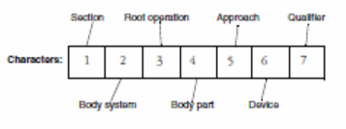

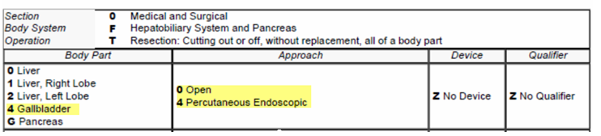
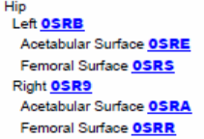
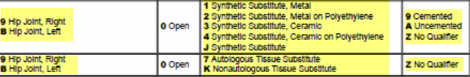
Developing a Map from SNOMED CT Procedure Concepts to ICD-10-PCS
Kin Wah Fung, Julia Xu, US National Library of Medicine; Arabella D'Havé, Filip Ameye, Belgian Federal Public Service of Health, Food Chain Safety and Environment; Arturo Romero Gutiérrez, Ministry of Health, Social Services and Equality - Spain; Anabela Santos, Portuguese Ministry of Health Shared Services
Abstract
Finding ICD-10-PCS targets
Map Benefits
Abstract: An international collaborative effort is underway to create a Map from SNOMED CT to ICD-10-PCS. Apart from following the ‘code once, use many times’ principle, the creation and use of this Map can also bring other benefits, including faster and better coding. It will promote the use of SNOMED CT and help to improve the quality of both terminology systems. The Map can facilitate the generation of ICD-10-PCS codes in a number of IHTSDO Member countries.
    All ICD-10-PCS codes are 7 characters long, each character represents an aspect of the procedure
      Improved ICD-10-PCS coding efficiency
      Better coding reproducibility
      Re-use of clinical data for epidemiologic and statistical purposes
      Promote use of SNOMED CT
      Improved quality of the two terminologies
ICD-10-PCS index and tables
Excision: Cutting out or off, without replacement, a portion of a body part
Resection: Cutting out or off, without replacement, all of a body part
Tooling development
Introduction
0FT
The current tooling used by the IHTSDO Mapping Service Team already has many functions to support other mapping projects:
Role-specific access and functionalities
Batch creation
SNOMED CT content look up
Team communication
Workflow management
New ICD-10-PCS-specific features (e.g., index, table, guideline searching, functions for building and validation of Regular Expressions) will be added by technical resources provided by Spain, with assistance from IHTSDO technical team
ICD-10-PCS is a procedure coding system created to replace volume 3 of ICD-9-CM. It provides greater specificity to support research, statistical analysis and administrative uses. [1,2] In the US, ICD-10-PCS replaced ICD-9-CM from October 2015 onwards. Belgium has already transitioned to ICD-10-PCS in January 2015, and similar transition is happening in Spain and Portugal.
The SNOMED CT to ICD-10-PCS Map Project Group was formed in January 2015. Through bi-weekly conference calls, the group established mapping methodology and principles, and discussed tooling requirements, scope of work and project planning.
0SR
One-to-many maps very common because some aspects not specified in the SNOMED CT concept e.g., approach, laterality, device
A convenient way to represent multiple options is by Regular Expressions e.g.,
38102005 Cholecystectomy (procedure) maps to 0FT4[04]ZZ
52734007 Total replacement of hip (procedure) maps to 0SR[9B]0[01234J][9AZ]||0SR[9B]0[7K]Z
Work in Progress
References
Continue to develop technical documentation of map
Work on a project plan to define scope and timeline of project
1. US Centers for Medicare & Medicaid Services ICD-10-PCS web page http://www.cms.gov/Medicare/Coding/ICD10/2014-ICD-10-PCS.html .
2. Giannangelo. K: Healthcare Code Sets, Clinical Terminologies and Classification Systems. Third edition. AHIMA

