Slide 1

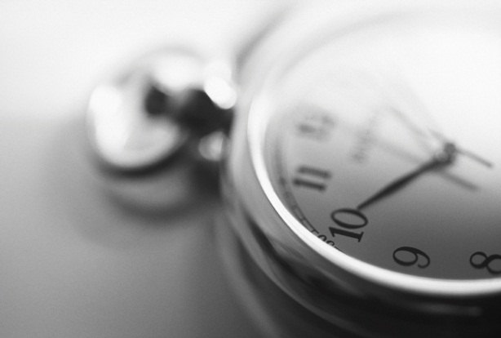

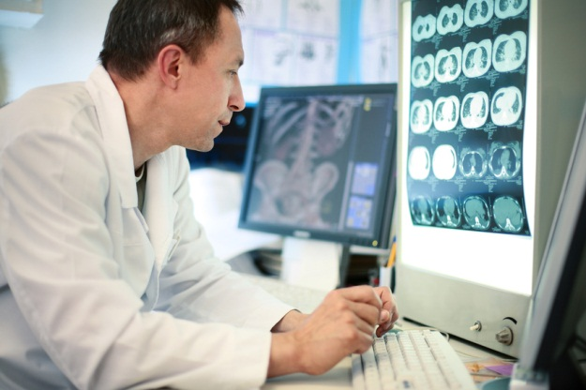
Observable and Investigation Model
2014-10-27
Amsterdam, NL

Slide 2
Agenda
Time slot | Item
9.00-10.00 | Introduction to Observables (DK)
10.00-10.30 | LOINC mapping (FA, SS)
10.30-11.00 | Break (All)
11.00-12.30 | LOINC mapping (FA, SS)
12.30-13.30 | Lunch (All)
13.30-15.00 | Clinical Observables (together with Nursing SIG and IHTSDO staff)
15.00-15.30 | Break (All)
15.30-16.15 | Genetic testing orderables (MO)
16.15-17.00 | Histopathology observables (SC)

Slide 3
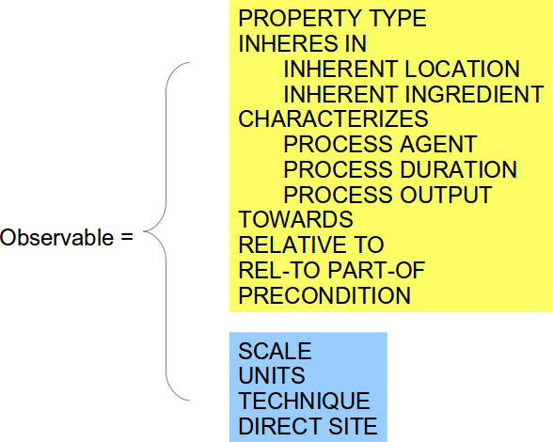
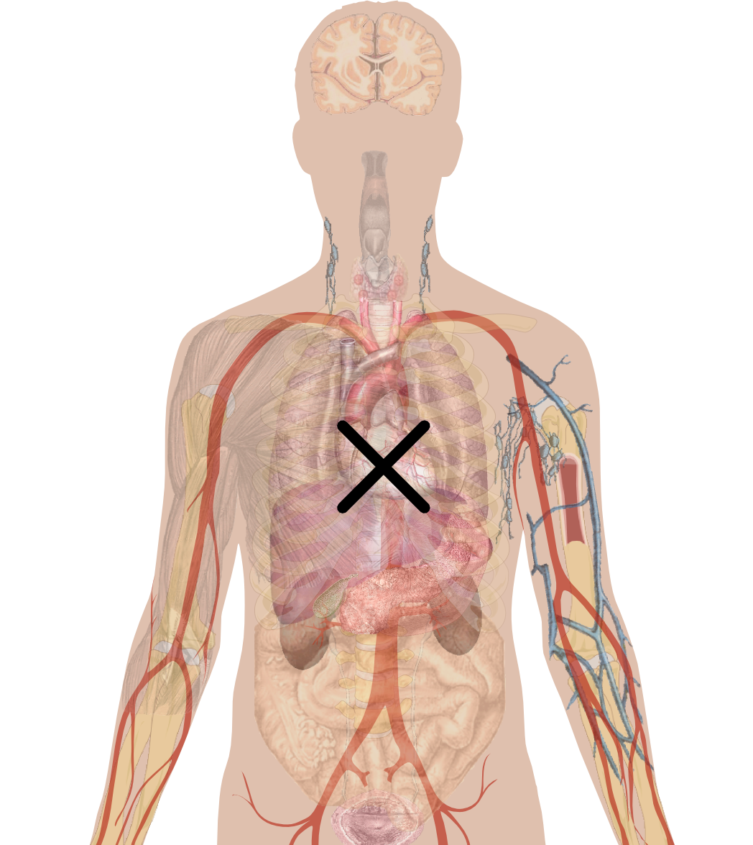
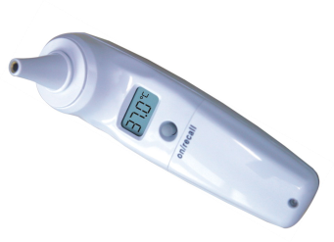
Observables model in 30 seconds
TECHNIQUE
WHAT
Observation device
SCALE
UNITS
DIRECT SITE
PROPERTY TYPE
INHERES IN
...
HOW
PRECONDITION

Slide 4
Example: Core body temperature
observable entity =
what is intended to be observed +
how that is observed
Notes:
4

Slide 5
Observables model
Quality/Property, the intended target of observation
Observable =
Observation procedure, how the quality is observed
Notes:
5

Slide 6
Observables, Observation procedures, and Observation results
observable
entity
property / quality
is about
specified by
observes
observation result
output of
observation procedure
specified by ○ observes ⊑ is-about
Notes:
An observable entity is specified by an observation procedure, which observes some property. [An observation procedure specifies an observable entity.]
An observation result is the output of an observation procedure, which observes some property
An observation procedure produces as output an observation result.

Slide 7
Observables model
TECHNIQUE
WHAT
Observation device
SCALE
UNITS
DIRECT SITE
PROPERTY TYPE
INHERES IN
...
HOW
PRECONDITION

Slide 8
Example: Core body temperature
Observation device
USING DEVICE
Observation proxy location
DIRECT SITE
Observation technique
TECHNIQUE
Notes:
8

Slide 9
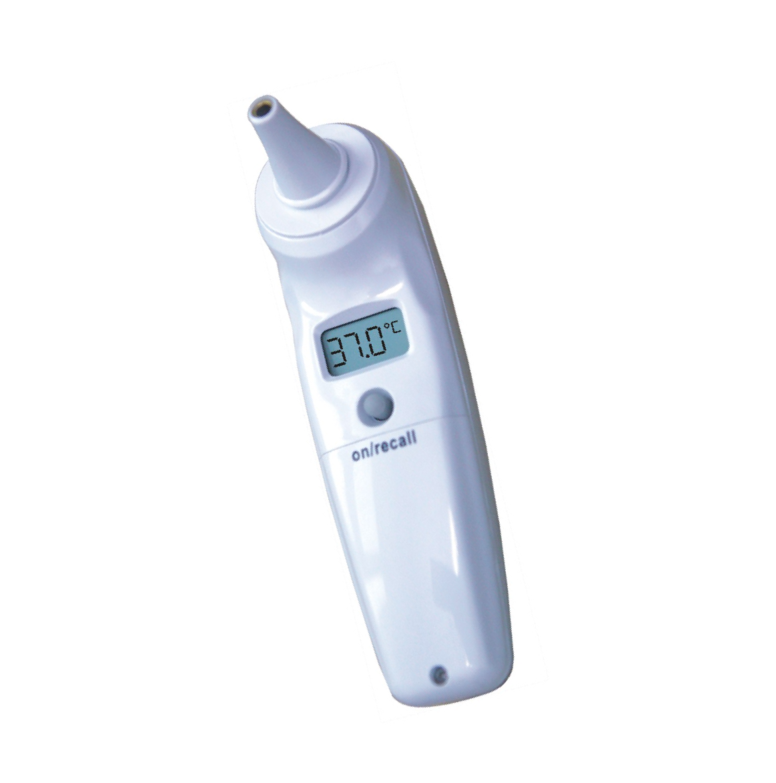
Example: Core body temperature
SCALE
UNIT
Notes:
9

Slide 10
Example: Core body temperature, tympanic thermometer
===|Observable entity|:
  |Specified by| = (
  |Observation procedure|:
  |Observes| = (
  |Property type| = |Temperature|,
  |Inheres in| = |Body internal region| ),
  |Using device|=|Tympanic thermometer|,
  |Units| = |degrees C|,
  |Direct site| = |Tympanic membrane structure| )
Notes:
10

Slide 11
Example: Core body temperature, oral thermometer
===|Observable entity|:
  |Specified by| = (
  |Observation procedure|:
  |Observes| = (
  |Property type| = |Temperature|,
  |Inheres in| = |Body internal region| ),
  |Using device|=|Oral thermometer|,
  |Units| = |degrees C|,
  |Scale| = |Interval|,
  |Direct site| = |Sublingual space| )
Notes:
11

Slide 12
Example: Joint temperature
===|Observable entity|:
  |Specified by| = (
  |Observation procedure|:
  |Observes| = (
  |Property type| = |Temperature|,
  |Inheres in| = |Knee joint structure| ) )
Notes:
12

Slide 13
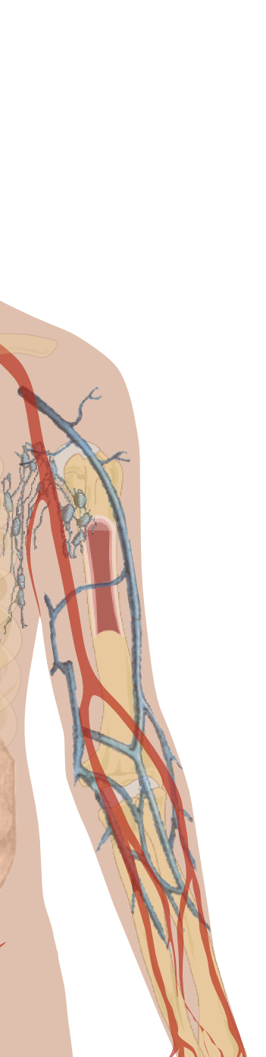

Example: Serum sodium concentration
relational quality
Clinically intended target of observation
|PROPERTY TYPE|=|Mass conc.|,
|INHERES IN|=|Plasma|,
|TOWARDS|=|Sodium electrolyte|
|DIRECT SITE|=|Serum sample|
Observation proxy location

Slide 14
Example: Serum sodium concentration
===|Observable entity|:
  |Specified by| = (
  |Observation procedure|:
  |Observes| = (
  |Property type| = |Mass conc.|,
  |Inheres in| = |Plasma|,
  |Towards| = |Sodium electrolyte| ),
  |Direct site| = |Serum sample| )
Notes:
14

Slide 15
Example: Relative mass concentration of IgG in csf to IgG in plasma
TOWARDS
INHERES IN
RELATIVE TO
RELATIVE TO PART OF
Ig G
Csf
Ig G
Plasma

Slide 16
Example: Relative mass concentration…
===|Observable entity|:
  |Specified by| = (
  |Observation procedure|:
  |Observes| = (
  |Property type| = |Mass conc.|,
  |Towards| = |IgG|,
  |Inheres in| = |Csf|,
  |Relative to| = |IgG|,
  |Relative to, part of| = |Plasma| ) )
Notes:
16

Slide 17
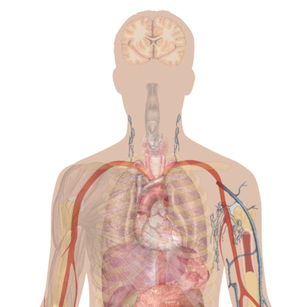
Process observables
===|Observable entity|:
  |Specified by| = (
  |Observation procedure|:
  |Observes| = (
  |Property type| = |Number rate|,
  |Characterizes| = |Respiration|
  ) )
Respiration

Slide 18
Process observables
===|Observable entity|:
  |Specified by| = (
  |Observation procedure|:
  |Observes| = (
  |Property type| = |Number rate|,
  |Characterizes| = |Respiration|
  ) )
Respiration

Slide 19


