Slide 1
LOINC – SNOMED
Cooperation on Content
Observable and Investigation Model Project
October 2014
Amsterdam, Netherlands

Slide 2
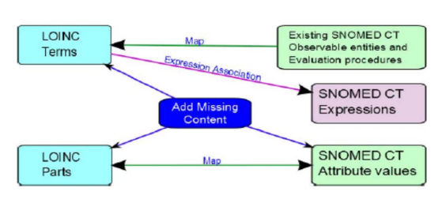
Background
Cooperative agreement between RII and IHTSDO, July 2013
  Builds on strengths of each terminology
  Minimize and manage duplication
  SNOMED and LOINC work better together
  Provide links between LOINC and SNOMED

Slide 3
Value
Greater consistency in coding of order entry and results reporting
Improvements in each terminology
Improved analytics and quality control
  Query LOINC via SNOMED hierarchy and relationships
  Better identification and maintenance of laboratory tests value sets for public health reporting
  Enhanced tracking and management of infectious disease outbreaks
Integrates disparate elements in EHRs
  Lab test in LOINC with elements in patient chart in SNOMED (e.g. allergies, chief complaint, vital signs, age)
  Enables clinical decision support, may aid in reimbursement

Slide 4
Roles of individuals and groups
Internal project team – currently 6 individuals
  Head of Terminology, Head of Content Development, Head of Implementation and Education, Head of Delivery, Terminologists
LOINC project team contact
Executive Policy Group (3 from RII and 3 from IHTSDO)
Observable and Investigation Model Project
  Subproject on CollabNet (those interested in participating contact SSA or FAS)
Project groups (Substance Redesign; Organisms; Microbiology)
External collaborators:
  US Veterans Administration
  Kaiser Permanente
IHTSDO Content Committee:
  Guidance, coordination with other IHTSDO initiatives
Contractors:
  Developing implementation guidance: BITAC
Notes:
IHTSDO individuals and roles:
Head of Terminology – Kent Spackman
Head of Content Development – Ian Green
Head of Implementation and Education – David Markwell
Head of Delivery – Robert Turnball
Terminologists – Farzaneh Ashrafi and Suzanne Santamaria

Slide 5
Project scope
Scope
  Laboratory LOINC
  Vital signs
  Physiologic measurements
  Anthropomorphic measurements and evaluations
Phases
  Initial
    Top 2000 lab LOINC tests
    Microbiology
    Chemistry
    Vital signs
  Subsequent
    Remainder of lab LOINC
    Measurements

Slide 6
Roadmap
Alpha release
Technology Preview release
Map LOINC parts
to SNOMED
Candidate baseline
release
Map LOINC codes
to SNOMED
expressions
Develop
distribution
format
Create
SNOMED
value sets
for LOINC codes
Business Meeting
Business Meeting
June 2014
April 2015
Jan 2014
November 2014
July 2015

Slide 7
Development phase objectives
Collaboration
  Invite participation by stakeholders
  Regular meetings (internal group; EPG; KP)
  Ensure approach works with other concurrent design projects (e.g. Substance Redesign)
  Publicize work and progress
Content development
  Add and update content to SNOMED to complete the LOINC Parts map (techniques, substances, etc.)
  Determine the best approach for handling complex concepts
  Create documentation of process and outcomes
  Create and deliver alpha release and Technology Preview
Test and obtain feedback
  Document and test the Observables model (including description logic)
  Document the quality test plan
  Review feedback on releases from stakeholders

Slide 8
Development phase progress
Collaboration
  IPaLM SIG, internal project groups (e.g. Substance Redesign) engaged
  Regular meetings held (internal group; EPG; KP)
  Posters at ICBO and SNOMED CT Showcase this Fall
Content development
  SNOMED concepts added for LOINC Part mapping, metadata, etc.
  Draft implementation guidance released July 2014
  alpha release released May 2014 with documentation
    117 LOINC Terms
  Development of Technology Preview Structure Process
  Technology Preview released October 2014 with documentation
    2100 LOINC Parts in LOINC Part to SNOMED RefSet
    9700 LOINC Terms in LOINC Term to Expression RefSet

Slide 9
Development phase progress continued
3. Test and obtain feedback
  Report on implementation horizon and scope released April 2014
  Documented and tested the Observables model (including description logic and creation of OWL ontology)
  Performed quality test plan for functionality and reproducibility
  Analyzed feedback on alpha prototype and modified content

Slide 10
Summary of sequence for content development
Initial focus on lab LOINC and top 2000 LOINC Terms
Collaborate with each other and with community
Map LOINC Parts to SNOMED
Use Part map as basis for creating Expressions, modify as needed
Create and classify ontology
Review results (internal and external collaborators)
Perform quality assurance checks
Use OWL API to create SNOMED post-coordinated expressions
Create SNOMED reference sets of Part map and Expressions

Slide 11
Summary of sequence for content release
Prototype: Released in May 2014
Initial Technology Preview: Released in October 2014
Repeat of Technology Preview: Scheduled for March 2015
Candidate baseline: Scheduled for July 2015
Actual baseline: TBD (July 2015 release becomes baseline if no changes needed)

Slide 12
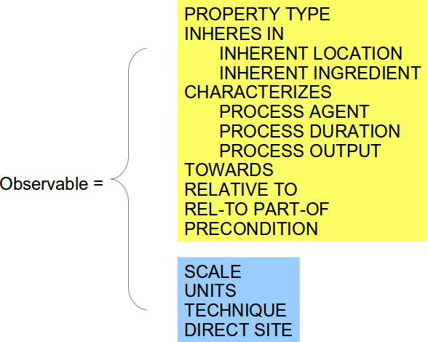
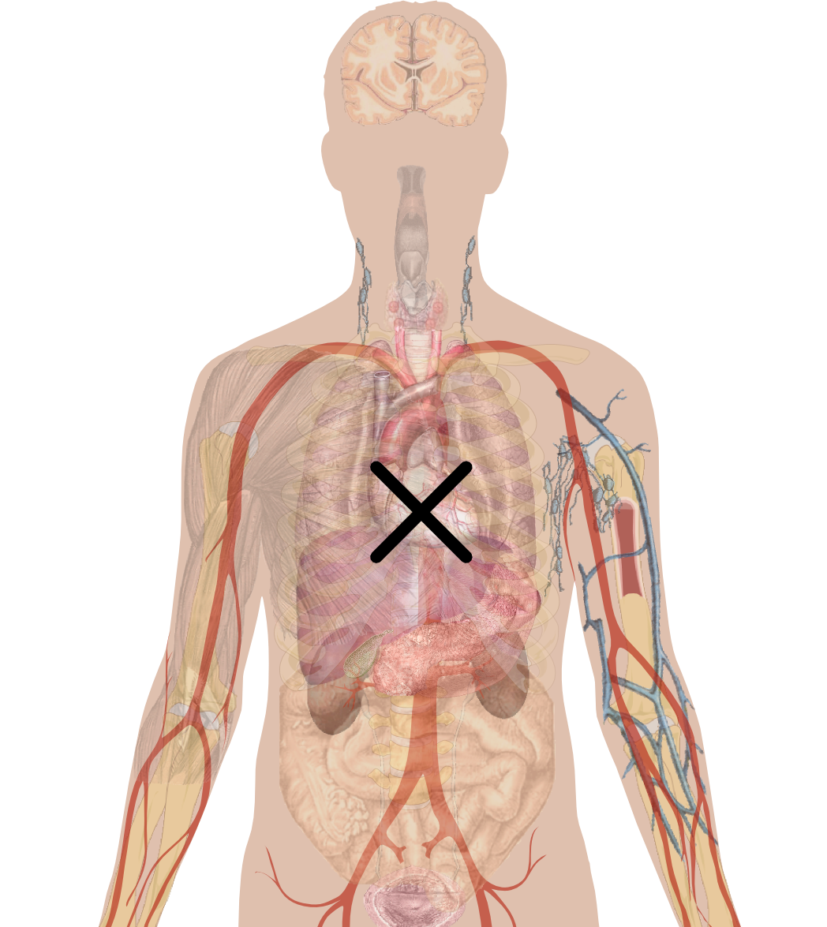
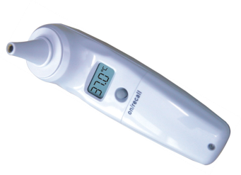
Observables model in 20 seconds
(slide used with permission of Daniel Karlsson)
TECHNIQUE
WHAT
Observation device
SCALE
UNITS
DIRECT SITE
PROPERTY TYPE
INHERES IN
...
HOW
PRECONDITION

Slide 13
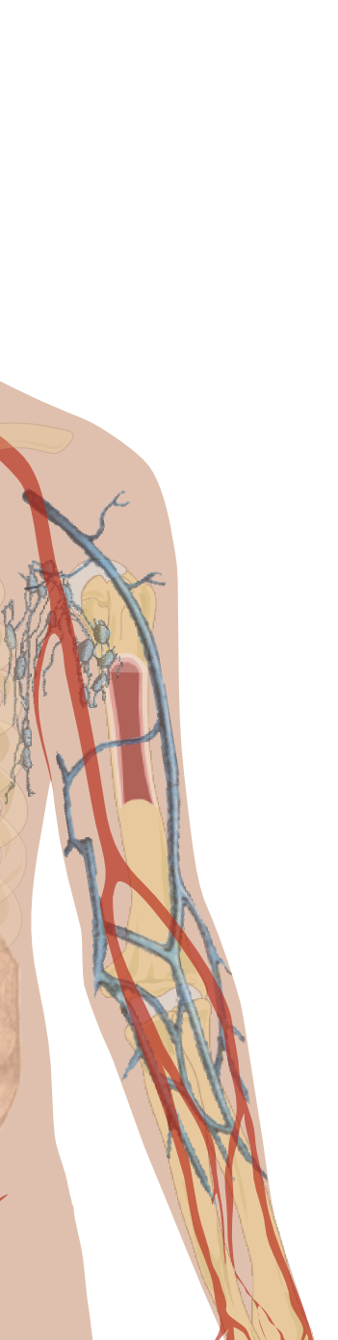

Example: Serum sodium concentration
relational quality
Clinically intended target of observation
|PROPERTY TYPE|=|Mass conc.|,
|INHERES IN|=|Plasma|,
|TOWARDS|=|Sodium electrolyte|
Observation proxy location
|DIRECT SITE|=|Serum sample|
(slide used with permission of Daniel Karlsson)
Notes:
13

Slide 14
Example: Serum sodium concentration
|Observable entity|:
|PROPERTY TYPE|=|Mass concentration|,
|INHERES IN|=|Plasma|,
|TOWARDS|=|Sodium electrolyte|,
|DIRECT SITE|=|Serum sample|
(slide used with permission of Daniel Karlsson)
Notes:
14

Slide 15
LOINC Term to SNOMED Expression Refset Example – Quality Observable
id | mapTarget | expression
823815fc-cb5a-4655-b486-19da62053943 | 27182-5 | Calcium:ACnc:Pt:Bld:Ord | 363787002|Observable entity|:70434600|Specified by|=(386053000|Observation procedure|:704347000|Observes|=(414237002|Feature of entity|:704319004|Inheres in|=87612001|Blood|,704320005|Towards|=5540006|Calcium|,704318007|Property type|=118569000|Arbitrary concentration|),704327008|Direct site|=119297000|Blood specimen|,370132008|Scale|=117363000|Ordinal value|)
LOINC Term
SNOMED attribute concept
SNOMED value concept

Slide 16
LOINC Term to SNOMED Expression Refset Example – Process Observable
id | mapTarget | expression
2bea5348-61e9-4d47-9204-bdeaf17a83b8 | 2989-2 | Testosterone:MRat:24H:Urine:Qn | 363787002|Observable entity|:70434600|Specified by|=(386053000|386053000|Observation procedure|:704327008|Direct site|=122575003|Urine|,704347000|Observes|=(Feature of entity|:704323007|Process Duration|=123027009|24 hours|,704321009|Characterizes|=63911002|Excretion|,704318007|Property Type|=118544000|Mass rate|,704324001|Process Output|=43688007|Testosterone|),370132008|Scale|=30766002|Quantitative|)
LOINC Term
SNOMED attribute concept
SNOMED value concept

Slide 17
LOINC Term to SNOMED Expression Refset Example – Quality Observable
id | mapTarget | expression
cc1e1a70-48c0-44e6-8ba8-88a40d2b1a52 | 9796-4 |Color:Type:Pt:Calculus:Nom | 363787002|Observable entity|:70434600|70434600|Specified by|=(386053000|Observation procedure|:704327008|Direct site|=119350003|Calculus specimen|,370132008|Scale|=117362005|Nominal|,704347000|Observes|=(414237002|Feature of entity|:704318007|Property Type|=703247007|Color|,704319004|Inheres In|=794887015|Calculus|))
LOINC Term
SNOMED attribute concept
SNOMED value concept

Slide 18
LOINC Term to SNOMED Expression Refset Example – Quality Observable
id | mapTarget | expression
33434620-1e97-4656-8a14-263d8fa9c7a2 | 5783-6 | Crystals.unidentified:ACnc:Pt:Urine sed:Ord:Microscopy.light | 363787002|Observable entity|:70434600|Specified by|=(386053000|Observation procedure|:246501002|Technique|=703754002|Detecting by light microscopy without classifying|,704347000|Observes|=(414237002|Feature of entity|:704320005|Towards|=413935006|Crystal|,704318007|Property type|=118569000|Arbitrary concentration|,704319004|Inheres In|=386100006|Urine sediment|),704327008|Direct site|=122567009|Urine sediment specimen|,370132008|Scale|=117363000|Ordinal|)
LOINC Term
SNOMED attribute concept
SNOMED value concept

Slide 19
Challenges in mapping thus far
Where mapping of LOINC Parts to SNOMED codes cannot be 1:1
Where LOINC Parts do not appear to have a clear, reproducible meaning
Verifying possible duplication within LOINC or within SNOMED
When SNOMED lacks the type of information needed to complete a map
Lack of clear differentiation between general categories of classes and specific types, present in both SNOMED and LOINC
Notes:
Examples:
Appearance of urine, Unidentified crystals, specimen + system
Leukocytes other
4. New population of cells hierarchy needed in SNOMED
5. Amphetamines vs amphetamine

Slide 20
Discussion points
Mapping and modeling questions
Planning
Notes:
Mapping and modeling questions
Impression
Population of cells concepts
Context of cell representation
Specimen and system
Leukocytes other
Planning
Scope
Current roadmap
Modeling current SNOMED lab Observables
Modeling clinical observables

Slide 21
Discussion – mapping and modeling questions
LOINC Part: Impression/interpretation of study (property type)
  Description from RII: (impression) is a diagnostic statement, always an interpretation or abstraction of some other observation (a series of test results, an image, or a total patient), and almost always generated by a professional.
  ~900 LOINC Terms use property type “Impression”
    666 lab, 164 clinical, 36 claims attachments, 11 surveys
    Calculus analysis [interpretation] in Stone
    Toxoplasma gondii Ab [interpretation] in Serum

Slide 22
Discussion – mapping and modeling questions
Population of cells concepts
  (examples of concepts and mapping, how used))
    what is the current guidance on collections vs. single entity in
    various hierarchies? Do cell concepts always represent single entities,
    i.e. is the "population of" part necessary?
    that the cells swim around in fluid would be specified with the
    INHERES IN attribute in an observable definition, I guess many LOINC
    codes would specify body fluids, but not e.g. cell fractions in tissue
    (LOINC search for "cell nfr tiss" gives 109 codes). Thus, could the "in
    portion of fluid" part be removed or is there some specific problem
    here?
    Population of cells in a portion of fluid is a Population of cells?
    Saying where located or is it fluid and cells all together?

Slide 23
Discussion – mapping and modeling questions
Context of cell representation
  such as with entitic number tests, e.g. http://search.loinc.org/search.zul?query=entnum+cell
  Are the cells/Is the cell same or different as compared to e.g. RBC count? Is it the receptors on a single cell or the average number of receptors in a population of cells? Does this matter enough to justify two hierarchies (like in the case of substances vs. molecular entities)?

Slide 24
Discussion – mapping and modeling questions
Leukocytes other
  From RII:
    "Other cells" refer to cells that are present in blood or body fluid that are not classified elsewhere in the report. The type of cells will vary depending on the method or instrument used.
    "Leukocyte other" does not have a fixed definition; rather, it represents types of leukocytes that are not specifically identified in a particular report, and this can be different based on different methods and reporting practices.

Slide 25
Discussion – mapping and modeling questions
Leukocytes other
  Current modeling in LOINC – SNOMED project
    LOINC Part left unmapped
    LOINC Terms with Leukocyte others left as primitive and no value in Toward attribute
  Recommendations?
    Create new SNOMED concept so can fully define relevant LOINC Terms?
    Leave as is?

Slide 26
LOINC Term to SNOMED Expression Refset Example – Quality Observable
id | mapTarget | expression
c11e74ec-5935-4757-bdae-abab8320ac4d | 15190-2 | Leukocytes other:Prid:Pt:Bld:Nom:Automated count | 363787002|Observable entity|:70434600|Specified by|=(386053000|Observation procedure|:704327008|Direct site|=119297000|Blood specimen|,370132008|Scale|=117362005|Nominal|,246501002|Technique|=702659008|Automated count|,704347000|Observes|=(414237002|Feature of entity|:704319004|Inheres In|=87612001|Blood|,704318007|Property Type|=118584009|Presence OR identity|))
LOINC Term
SNOMED attribute concept
SNOMED value concept

Slide 27
Discussion – mapping and modeling questions
Specimen and system
  Define issue
  how should we handle LP Challenge of type specimen and LP system (specimen) together?

Slide 28
Discussion – planning
Scope
Current roadmap
Modeling current SNOMED lab Observables
Modeling clinical observables

Slide 29
Roadmap
Alpha release
Technology Preview release
Map LOINC parts
to SNOMED
Candidate baseline
release
Map LOINC codes
to SNOMED
expressions
Develop
distribution
format
Create
SNOMED
value sets
for LOINC codes
Business Meeting
Business Meeting
June 2014
April 2015
Jan 2014
November 2014
July 2015

Slide 30
Discussion – planning
Current roadmap
Modeling current SNOMED lab Observables
Modeling clinical observables

Slide 31
Contact information
IHTSDO Project Team
  LOINC-SNOMEDProject@ihtsdo.org

Slide 32
References
Content
  Alpha prototype files (including OWL file)
    https://csfe.aceworkspace.net/sf/frs/do/viewRelease/projects.snomed_ct_international_releases/frs.3_other_releases.loinc_snomed_alpha_prototype
  Technology Preview files
    https://csfe.aceworkspace.net/sf/frs/do/listReleases/projects.snomed_ct_international_releases/frs.technology_preview_packages
Implementation
  Horizon and scoping report (Phase 1)
    https://csfe.aceworkspace.net/sf/go/doc10329
  Draft implementation guidance (Phase 2)
    https://csfe.aceworkspace.net/sf/go/doc10699
Observables redesign
  https://csfe.aceworkspace.net/sf/go/doc9931
RII – IHTSDO Agreement
  http://ihtsdo.org/fileadmin/user_upload/Docs_01/About_IHTSDO/Harmonization/Cooperation_Agreement_between_IHTSDO_and_RII_20130817.pdf

Slide 33
QUESTIONS & DISCUSSION

