Slide 1
Histopathology and Proposed Observable entity and evaluation procedure Model
W. Scott Campbell, MBA, PhD
James R. Campbell, MD
University of Nebraska Medical Center

Slide 2
Background
Basis of discussion: Recently published investigation of capability of SNOMED CT to represent detailed Histopathology Findings in Breast Biopsies*
24 Biopsy cases reviewed
90+ Unique clinical statements inventoried
75% could be represented using post-coordinated clinical findings and situations with explicit context
One (1) statement was fully specified by pre-coordinated concept
25% of statements could not be represented using 2013 international release due to limitations of concept model
Pathologists expressed requirement for statement of (un)certainty in pathological findings
*Campbell WS, Campbell JR, West WW, McClay JC, Hinrichs SH. Semantic analysis of SNOMED CT for a post-coordinated database of histopathology findings. J Am Med Inform Assoc. 2014.

Slide 3
Expectations of this Discussion
AXIOM: Significant use of post-coordination to represent clinical facts in histopathology is necessary
AXIOM: Situation with explicit context hierarchy/model is required for histopathology due to issues of uncertainty
Clarification of observables model and application to post-coordinated Situations would benefit from development of templates
Goal: Structured and encoded surgical pathology report built directly from structured clinical findings developed with WSA

Slide 4
Surgical Pathology Overview
Case
Clinical Findings
Final Pathology Report
(Diagnoses)
3
Clinical Findings
Specimen
1..n 1
Clinical Findings
2
Blocks
1..n 1
Observations
Pathologist Examines Slides by Microscope with various stains
Observations lead to Clinical Findings, incorporate other patient information
Diagnoses rendered
Slides
1
1..n 1

Slide 5
Typical Pathology Report
Final Diagnosis:
RIGHT BREAST, VACUUM-ASSISTED NEEDLE CORE BIOPSY:
- DUCTAL CARCINOMA IN SITU WITH EXTENSIVE PERIDUCTAL SCLEROSIS AND INFLAMMATION.
- FOCUS SUSPICIOUS BUT NOT DIAGNOSTIC FOR MICROINVASION.
- GROWTH PATTERN: SOLID.
- NUCLEAR GRADE: HIGH.
- NECROSIS: PRESENT.
- MICROCALCIFICATION IN DCIS: YES.
Microscopic Report: Performed

Slide 6
Findings to be asserted in final report
  Conclusive statements regarding the patient (person)
  Example: “Invasive carcinoma of female breast”
  Clinical Finding reached by aggregation of relevant tissue morphologies and nuclear details observed by the pathologist using microscopy, histopathology and staining techniques
  Clinical details about the patient: History of breast cancer excised 2010 (Situation)
  Gross and microscopic observations about the tissue features as evaluated by microscope => Observable entity?

Slide 7
Observable Entities of relevance
Applicable to histopathology microscopic exam
  Tumor size
  Presence/absence of particular tissue morphologies
  Histologic grade?
  Eosinophil counts
How best to represent observation data?
  |IS ABOUT| some |Clinical finding|
  |SCALE| some |Scale type|
  |HAS VALUE| some |value|
  Concrete domains required for numeric measurements

Slide 8
Situation with Explicit Hierarchy?
Surgical Pathology is interpretive
Necessary to make assertions of suspicion, probability and negation
  Example: Ductal carcinoma in situ suspicious for microinvasion
  The statement is common in clinical practice and VERY important to the patient and subsequent care

Slide 9
Examples

Slide 10
Diagnostic Level Statement:
Example: Invasive Carcinoma of female breast
404684003|clinical finding|:
{363698007|finding site| = 64633006|lactiferous duct structure|,
116676008|associated morphology| = 82711006|infiltrating duct carcinoma|},
418775008|Finding method|= (104210008|hematoxylin and eosin stain method| + 252416005|histopathology test| +104157003|light microscopy|)

Slide 11
Diagnostic Level Statement:
Example: Ductal Carcinoma in situ suspicious for microinvasion
243796009|situation with explicit context|:
{408729009|finding context| = 415684004|suspected|,
410510008|temporal context value| = 410585006|current – unspecified|,
408732007|subject relationship context| = 410604004|subject of record,
246090004|associated finding|= 404684003|clinical finding|:
{363698007|finding site| = 64633006|lactiferous duct structure|,
116676008|associated morphology| = 82711006|infiltrating duct carcinoma|}
}

Slide 12
Observation of morphology?
Epithelial hyperplasia in breast biopsy
Not a diagnosis
|IS ABOUT| (Property type?) =
404684003|Clinical finding|:
{363698007|Finding site|= 31737007|structure of small lactiferous ducts|,
116676008|Associated morphology|= 31390008|epithelial hyperplasia|}, |Scale| = 26716007|qualitative|,
|Has value| = 52101004|present|,
|Technique| = 418775008|Finding method|= (104210008|hematoxylin and eosin stain method| + 252416005|histopathology test| + 104157003|light microscopy|),
|DIRECT SITE|=373102004 | specimen from breast obtained by image guided core biopsy|
Ability to call out staining methods important

Slide 13
Observation: Measurement of tumor extent
|IS ABOUT| =
|PROPERTY TYPE| = 444740005|largest dimension of in situ neoplasm|,
|INHERES IN| = 86616005|intraductal carcinoma, noninfiltrating|,
|Scale| = 30766002|quantitative|,
|Has value| = 1.7,
|Units| = 258673006|mm|,
|Technique| = 418775008|Finding method|= (104210008|hematoxylin and eosin stain method| + 252416005|histopathology test| + 104157003|light microscopy|),
|DIRECT SITE|=373102004 | specimen from breast obtained by image guided core biopsy|

Slide 14
Histologic Grade (Option 1)
|IS ABOUT| =
404684003|Clinical finding|:
{363698007|Finding site|= 64633006| lactiferous duct structure|,
116676008|Associated morphology|= 86616005|intraductal carcinoma, noninfiltrating, no ICD-O subtype|,
47429007|Associated with|= 373399007|nuclear pleomorphism, grade 2: neither nuclear grade 1 nor nuclear grade 3|},
|Scale| = 26716007|qualitative|,
|Has value| = 52101004|present|,
|Technique| = 418775008|Finding method|= (104210008|hematoxylin and eosin stain method| + 252416005|histopathology test| + 104157003|light microscopy|) ,
|DIRECT SITE|=373102004 | specimen from breast obtained by image guided core biopsy|

Slide 15
Histologic Grade (Option 2)
|IS ABOUT| =
404684003|Clinical finding| = 373399007|nuclear pleomorphism, grade 2: neither nuclear grade 1 nor nuclear grade 3|,
|INHERES IN| = 86616005|intraductal carcinoma, noninfiltrating|,
|Scale| = 26716007|qualitative|,
|Has value| = 52101004|present|,
|Technique| = 418775008|Finding method|= (104210008|hematoxylin and eosin stain method| + 252416005|histopathology test| + 104157003|light microscopy|)
|DIRECT SITE|=373102004 | specimen from breast obtained by image guided core biopsy|

Slide 16
Suspicion as an Observation
|IS ABOUT| =
404684003|Clinical finding|:
{363698007|Finding site|= 64633006| lactiferous duct structure|,
116676008|Associated morphology|= 82711006|infiltrating duct carcinoma|},
|Scale| = 26716007|qualitative|,
|Has value| = 373068000|undetermined|,
|Technique| = 418775008|Finding method|= (104210008|hematoxylin and eosin stain method| + 252416005|histopathology test| + 104157003|light microscopy|)
|DIRECT SITE|=373102004 | specimen from breast obtained by image guided core biopsy|
42425007|equivocal| ?

Slide 17
Conclusions: Direction needed
Clarification of acceptable attribute/value domains and ranges
Continue to struggle with descriptive language for architectural features (pre-diagnostic or importance to be determined)
Suspicion and probability of the Clinical Finding (diagnostic lines)
Binding to synoptic reports

Slide 18

Thank you

Slide 19
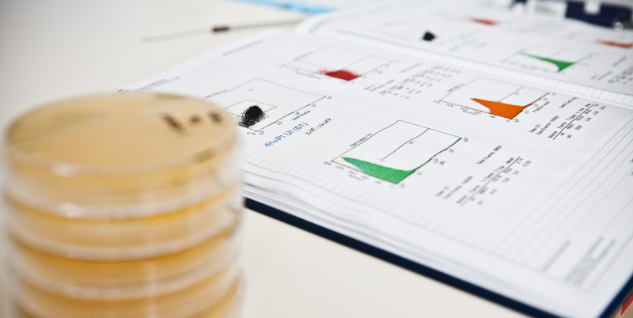


University of Nebraska Medical Center

