Slide 1
Naming and modelling of genetic tests
Michael Osborne
Content Committee

Slide 2
CollabNet Discussion
https://csfe.aceworkspace.net/sf/discussion/do/listPosts/projects.observable_and_investigation_mod/discussion.general_discussions_observables.topc6701
Notes:
This started as a collabnet discussion triggered by a request for content through the UKTC. You can follow it through the link

Slide 3
Disposition to Disease
Many genetic tests are looking to confirm a clinical suspicion of a disease or to predict a future diagnosis e.g.
  Cystic Fibrosis
  MODY
  Huntington’s disease
  Muscular dystrophy

Slide 4
Detection of a particular gene variant
Tests can be for specific gene variants
  APOB
  HFE
  CHIC2
  BCR/ABL
  EGFR
  SHOX

Slide 5
Gene Panels
Tests can look for Panels of Genes
Example: MODY Gene Analysis
Core Genes: HNF4A (NM_175914.3), GCK (NM_000162.3), HNF1A (NM_000545.5), HNF1B (NM_000458.2);
Rare Genes: PDX1
(NM_000209.3), NEUROD1 (NM_002500.4), KLF11 (NM_003597.4), CEL (NM_001807.4), PAX4 (NM_006193.2), INS (NM_000207.2), BLK (NM_001715.2), ABCC8 (NM_000352.3) and KCNJ11 (NM_000525.3).
Notes:
These fall into the category of panels of genes to evaluate the presence of a disposition towards a disorder e.g. MODY (Mature onset diabetes of the young)

Slide 6
Disposition Towards a Disease
Many Gene panels are requested because of a link to disease either from a novel mutation or inherited
The mere presence of genetic variants does not guarantee that the disease is present but may confirm a clinical finding
Complicated by variable penetrance of gene variants, epigenetic control and perhaps other undiscovered factors.
Notes:
Variable penetrance means that a gene variant may be present but not causing the disease that the variant is associated with.
Phenotypes are dependent on how genes are regulated. A variant can cause different phenotypes depending on the level of silencing or promotion caused by the epigenome.

Slide 7
Modelling Genetic Panels as “Dispositions”
Possible replacement for “property type” where the value of “is about” is neither a quality nor a process, but instead is a disposition or function
Controversial because a disposition necessarily occurs given a certain condition…Should this then be a tendency but ……
Notes:
This is from the Observables Model 2014-03-13 powerpoint slides.

Slide 8
Dispositions in BFO
Dispositions exist along a strength continuum. Weaker forms of disposition are realized in only a fraction of triggering cases. These forms occur in a significant number of entities of a similar type such that there exists a statistical, concomitant correlation present between two entities, if they are in certain circumstances. Examples of weaker forms of disposition include:
a hemophiliac’s disposition to bleed an abnormally large amount of blood,
a person who smokes two packs of cigarettes a day throughout adulthood has the disposition to die of a disease earlier than average
Genetic and other risk factors for disease.
http://ontology.buffalo.edu/smith/articles/realizables.pdf

Slide 9
Mature Onset Diabetes of Youth Gene Analysis (procedure)
Mature Onset Diabetes of Youth
disposition type
inheres in
Patient
is about
disposition
towards
Functions/substances
precondition
body states
observation procedure
TIME ASPECT
Time aspects
scale
scale types
units
units
technique
Sanger Sequencing
direct site
Blood Specimen
method
observation action

Slide 10
Evaluation Procedures – Presence or Absence of a specific gene variant
E.g HFE Gene Analysis
In patients with hereditary hemochromatosis (HFE1; 235200), Feder et al. (1996) identified 2 mutations in the HFE gene (C282Y, 613609.0001 and H63D, 613609.0002). The C282Y mutation was detected in 85% of all HFE chromosomes, indicating that in their population 83% of hemochromatosis cases are related to C282Y homozygosity. (http://www.omim.org/entry/613609)
Notes:
Patients Homozygous for this gene variant have a high probability (~80%) of having Hemochromatosis

Slide 11
HFE gene pyrosequencing (procedure)
is about
HFE gene (gene taxon)
observationprocedure
scale
scale types
units
units
has value
Numeric, ordinal, nominal
technique
Pyrosequencing
direct site
Blood specimen
method
observation action
Notes:
The Gene Taxon hierarchy doesn’t currently exist but is preferred over the substances hierarchy.
This is similar to Slide 86 of the Observable Model 2014-03-13 ppt – MRSA POC test

Slide 12
Human Gene Taxon
http://www.genenames.org/ HUGO responsible for approving (human) gene names
HGNC body could be a target for collaboration with IHTSDO
Required for LOINC collaboration
Notes:
Note that it has been suggested that the appropriate hierarchy for Genes is not “Substances”, rather “Gene Taxon”

Slide 13
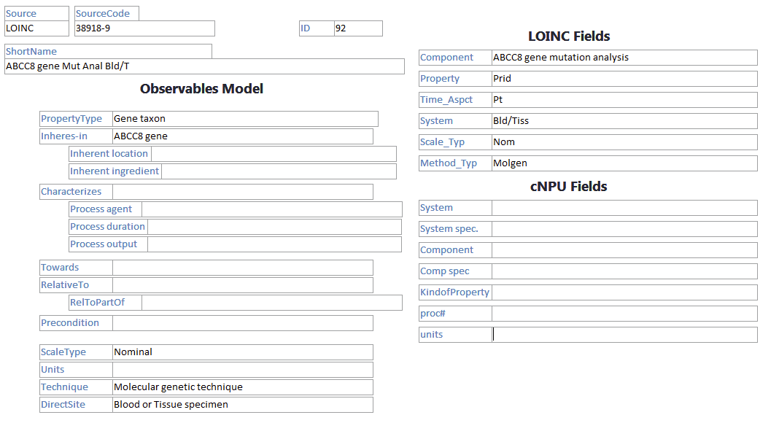
Example LOINC/SNOMED modelled Observable
Notes:
This is from the 2008 LOINC collaboration work

