Slide 1
ICD 11 FC and SNOMED CT – finding as
Ontologies of Clinical Situations
Stefan Schulz

Slide 2
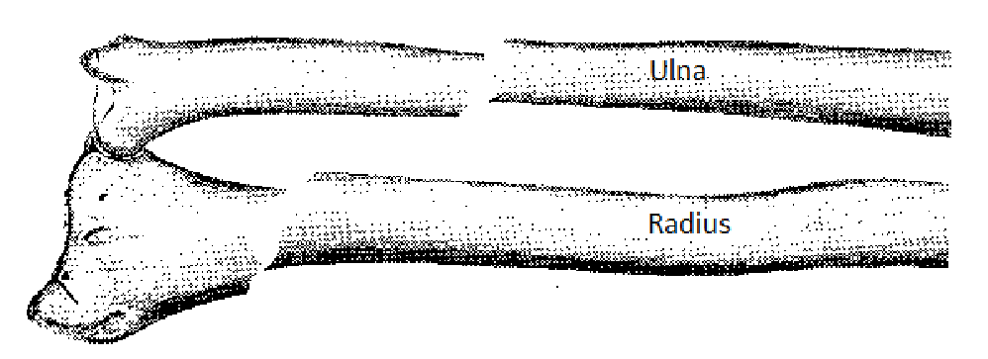
Example 1
Fracture of
Ulna
Fracture of
Radius
subClassOf
subClassOf
Fracture of
Radius and Ulna

Slide 3
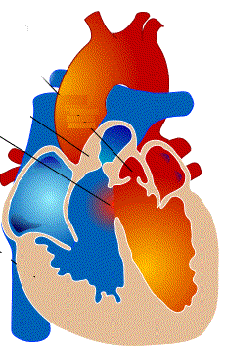
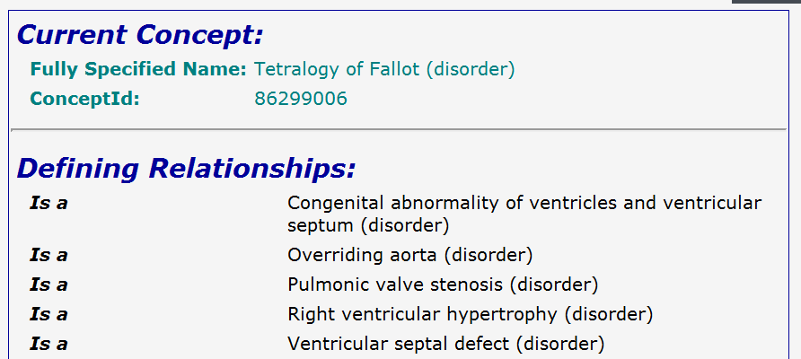

Example 2

Slide 4
Example 2
Extension of “Pulmonic Valve Stenosis” includes extension of “Tetralogy of Fallot”: FALSE

Slide 5

Example 2
Extension of “Situation with Pulmonic Valve Stenosis” includes extension of “Situation with Tetralogy of Fallot”: TRUE
P
F
P
P
F
P
F
F
P
P
P

Slide 6

Definition of Clinical Situation
A clinical situation with C is a phase of a patient's life in which a condition of the type C is wholly present
A clinical situation without X is a phase of a patient's life that does not include any condition
of the type X at any time
situation without C
situation without C
C situation
C situation

Slide 7
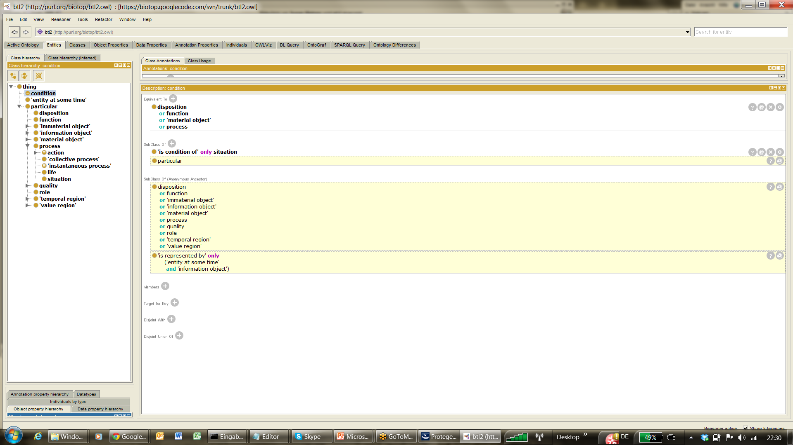
Model according to SemanticHealthNet / BioTopLite 2
includes
condition
Clinical Diagnosis
isAbout
Situation
Clinical Situation
Clinical Condition
not
includes
condition
isA
isA
isA
Clinical Disposition
Clinical
Structure
Clinical
Process
EHR
Patient

Slide 8
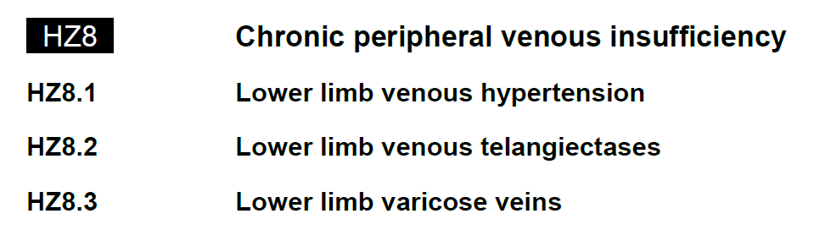
Situation interpretation in other terminologies (here ICD11 draft)
clinical disposition ?
clinical process?
clinical structure?
clinical structure?
Situation
isA
Situation
isA
Situation
Situation
isA

Slide 9
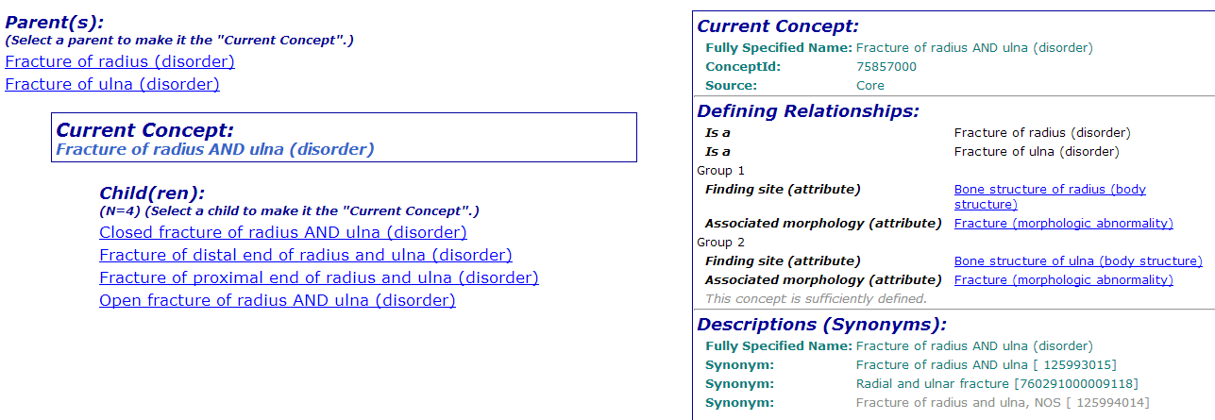
Reinterpretation of role groups
Clinical Situation
Clinical Condition
Has condition

Slide 10
Summary
Numerous Is-a links in the SNOMED finding hierarchy only plausible for situations
Very difficult to draw a line between conditions and situations, empirical study (AMIA 2012 paper)
Findings and disorders best considered as clinical situations
Here, “has condition” is the best interpretation of the role group relation
Caveat: Bipartition in existing SNOMED situation hierarchy (context model):
  Situations proper (e.g. Has a red eye)
  Information entities (e.g. Suspected sarcoma)
Caveat: Situation interpretation may be ambiguous
  HER2-positive carcinoma of breast (disorder) AND
  Progesterone receptor positive tumor (disorder)
  One or two tumors

Slide 11


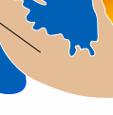




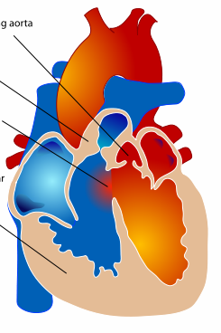

Proper parts or taxonomic parents ?
Example from Harold Solbrig
VSD PVS RVH OA
Red Light Yellow Light Green Light
is-a
is-a
is-a
is-a
is-a
is-a
is-a
Tetralogy of Fallot Traffic Light

