Slide 1
Histopathology and Proposed Observable entity and evaluation procedure Model
W. Scott Campbell, MBA, PhD
University of Nebraska Medical Center

Slide 2
Surgical Pathology Overview
Case
Clinical Findings
(Diagnoses)
Clinical Findings
Specimen
1..n 1
Clinical Findings
Blocks
1..n 1
Clinical Findings
Observations
Pathologist Examines Slides by Microscope with various stains
Observations lead to Clinical Findings Other patient information
Diagnoses rendered
Slides
1..n 1

Slide 3
Typical Pathology Report
Final Diagnosis:
RIGHT BREAST, VACUUM-ASSISTED NEEDLE CORE BIOPSY:
- DUCTAL CARCINOMA IN SITU WITH EXTENSIVE PERIDUCTAL SCLEROSIS AND
INFLAMMATION.
- FOCUS SUSPICIOUS BUT NOT DIAGNOSTIC FOR MICROINVASION.
- GROWTH PATTERN: SOLID.
- NUCLEAR GRADE: HIGH.
- NECROSIS: PRESENT.
- MICROCALCIFICATION IN DCIS: YES.
Microscopic Report: Performed
Finding and observation
Observations

Slide 4
Review of Common Histopathology Observations and Findings
Observation of morphology (Model helpful)
Size of tumor (Model very helpful)
Histologic grades?
Possibility/Suspicion?
Finding vs. Observation
  Situations…again!?!

Slide 5
Observation of morphology: Epithelial hyperplasia in breast biopsy
|IS ABOUT| (Property type?) =
404684003|Clinical finding|:
{363698007|Finding site|= 31737007|structure of small lactiferous ducts|,
116676008|Associated morphology|= 31390008|epithelial hyperplasia|}, |Scale| = 26716007|qualitative|,
|Has value| = 52101004|present|,
|Technique| = 418775008|Finding method|= (104210008|hematoxylin and eosin stain method| + 252416005|histopathology test| + 104157003|light microscopy|),
|DIRECT SITE|=373102004 | specimen from breast obtained by image guided core biopsy|
Ability to call out staining methods important

Slide 6
Observation of morphology: Epithelial hyperplasia in breast biopsy
First, see slide 11 of this presentation:
https://csfe.aceworkspace.net/sf/go/doc9931?nav=1
Use multiple techniques instead of the intersection of multiple methods
This would be the *tentative* solution:
Observable:
IS ABOUT = Finding…,
SPECIFIED BY = (Obs. procedure:
SCALE = …,
TECHNIQUE = 104210008|hematoxylin …,
TECHNIQUE = 104157003|light microscopy|,
…)
See slide 23- for Observation results
|IS ABOUT| (Property type?) =
404684003|Clinical finding|:
{363698007|Finding site|= 31737007|structure of small lactiferous ducts|,
116676008|Associated morphology|= 31390008|epithelial hyperplasia|}, |Scale| = 26716007|qualitative|,
|Has value| = 52101004|present|,
|Technique| = 418775008|Finding method|= (104210008|hematoxylin and eosin stain method| + 252416005|histopathology test| + 104157003|light microscopy|),
|DIRECT SITE|=373102004 | specimen from breast obtained by image guided core biopsy|
Ability to call out staining methods important

Slide 7
Observation: Measurement of tumor extent
|IS ABOUT| =
|PROPERTY TYPE| = 444740005|largest dimension of in situ neoplasm|,
|INHERES IN| = 86616005|intraductal carcinoma, noninfiltrating|,
|Scale| = 30766002|quantitative|,
|Has value| = 1.7,
|Units| = 258673006|mm|,
|Technique| = 418775008|Finding method|= (104210008|hematoxylin and eosin stain method| + 252416005|histopathology test| + 104157003|light microscopy|),
|DIRECT SITE|=373102004 | specimen from breast obtained by image guided core biopsy|

Slide 8
Observation: Measurement of tumor extent
|IS ABOUT| =
|PROPERTY TYPE| = 444740005|largest dimension of in situ neoplasm|,
|INHERES IN| = 86616005|intraductal carcinoma, noninfiltrating|,
|Scale| = 30766002|quantitative|,
|Has value| = 1.7,
|Units| = 258673006|mm|,
|Technique| = 418775008|Finding method|= (104210008|hematoxylin and eosin stain method| + 252416005|histopathology test| + 104157003|light microscopy|),
|DIRECT SITE|=373102004 | specimen from breast obtained by image guided core biopsy|
This is more of a typical Observables use case
Observable:
IS ABOUT = (Quality:
PROPERTY TYPE = size (or length or possible largest diameter…),
INHERESI IN = 86616005|intraductal …. )
SPECIFIED BY = (Obs. procedure:
SCALE = …,
TECHNIQUE = 104210008|hematoxylin …,
TECHNIQUE = 104157003|light microscopy|,
…)
And…
Observation result:
<the same as above>,
HAS VALUE = 1.7

Slide 9
Histologic Grade (Option 1)
|IS ABOUT| =
404684003|Clinical finding|:
{363698007|Finding site|= 64633006| lactiferous duct structure|,
116676008|Associated morphology|= 86616005|intraductal carcinoma, noninfiltrating, no ICD-O subtype|,
47429007|Associated with|= 373399007|nuclear pleomorphism, grade 2: neither nuclear grade 1 nor nuclear grade 3|},
|Scale| = 26716007|qualitative|,
|Has value| = 52101004|present|,
|Technique| = 418775008|Finding method|= (104210008|hematoxylin and eosin stain method| + 252416005|histopathology test| + 104157003|light microscopy|) ,
|DIRECT SITE|=373102004 | specimen from breast obtained by image guided core biopsy|
See slide 6 above

Slide 10
Histologic Grade (Option 2)
|IS ABOUT| =
404684003|Clinical finding| = 373399007|nuclear pleomorphism, grade 2: neither nuclear grade 1 nor nuclear grade 3|,
|INHERES IN| = 86616005|intraductal carcinoma, noninfiltrating|,
|Scale| = 26716007|qualitative|,
|Has value| = 52101004|present|,
|Technique| = 418775008|Finding method|= (104210008|hematoxylin and eosin stain method| + 252416005|histopathology test| + 104157003|light microscopy|)
|DIRECT SITE|=373102004 | specimen from breast obtained by image guided core biopsy|
Using both IS ABOUT = Finding and INHERES IN would not be allowed (I guess). IS ABOUT specifies a Quality OR a Condition/finding but not both.

Slide 11
Suspicion as an Observation
|IS ABOUT| =
404684003|Clinical finding|:
{363698007|Finding site|= 64633006| lactiferous duct structure|,
116676008|Associated morphology|= 82711006|infiltrating duct carcinoma|},
|Scale| = 26716007|qualitative|,
|Has value| = 373068000|undetermined|,
|Technique| = 418775008|Finding method|= (104210008|hematoxylin and eosin stain method| + 252416005|histopathology test| + 104157003|light microscopy|)
|DIRECT SITE|=373102004 | specimen from breast obtained by image guided core biopsy|
42425007|equivocal| ?

Slide 12
Diagnostic Level Statement:
Example: Ductal Carcinoma in situ suspicious for microinvasion
243796009|situation with explicit context|:
{408729009|finding context| = 415684004|suspected|,
410510008|temporal context value| = 410585006|current – unspecified|,
408732007|subject relationship context| = 410604004|subject of record,
246090004|associated finding|= 404684003|clinical finding|:
{363698007|finding site| = 64633006|lactiferous duct structure|,
116676008|associated morphology| = 82711006|infiltrating duct carcinoma|}
}

Slide 13
Conclusions
Clarification of acceptable attribute/value domains and ranges
Continue to struggle with descriptive language for architectural features (pre-diagnostic or importance to be determined)
Suspicion and probability of the Clinical Finding (diagnostic lines)
Binding to synoptic reports

Slide 14

Thank you

Slide 15
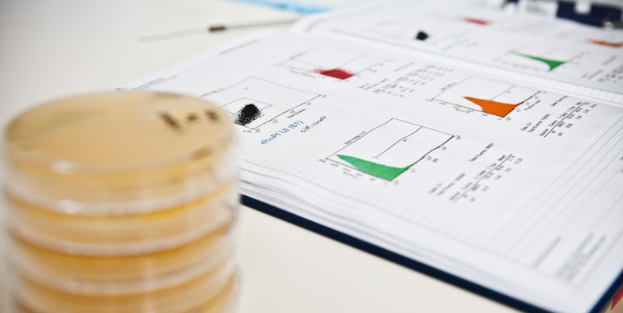


University of Nebraska Medical Center

