Slide 1
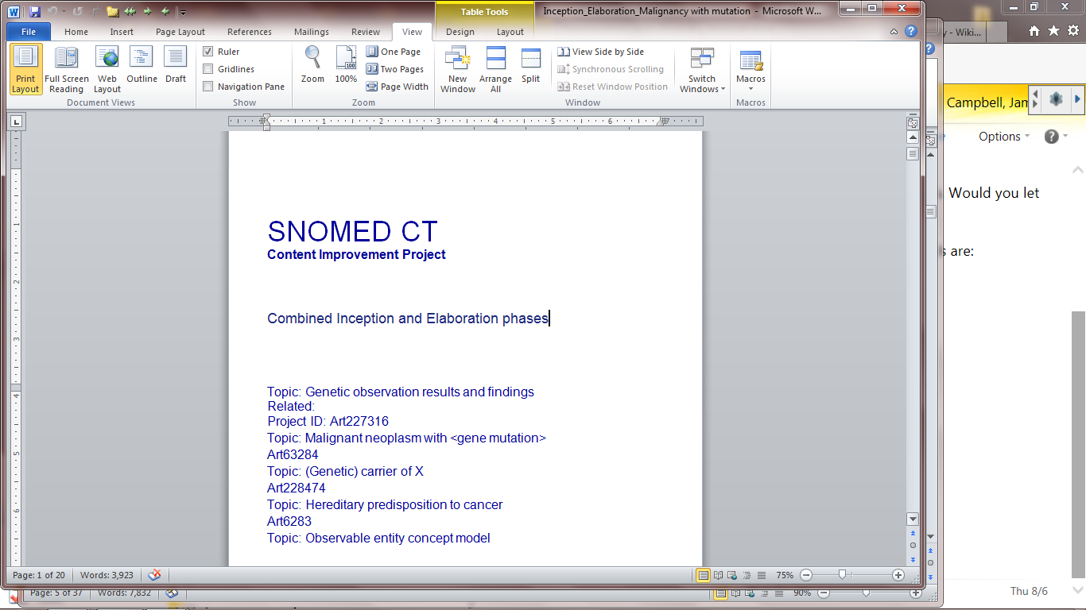
Topic: Genetic observation results and findings
Related:
Project ID: Art227316
Topic: Malignant neoplasm with <gene mutation>
Art63284
Topic: (Genetic) carrier of X
Art228474
Topic: Hereditary predisposition to cancer
Art6283
Topic: Observable entity concept model
unmc001
SNOMED CT representation of CAP cancer checklist data

Slide 2
Topic: Genetic observation results and findings
Related:
Project ID: Art227316
Topic: Malignant neoplasm with <gene mutation>
Art63284
Topic: (Genetic) carrier of X
Art228474
Topic: Hereditary predisposition to cancer
Art6283
Topic: Observable entity concept model
unmc001
SNOMED CT representation of CAP cancer checklist data

Slide 3
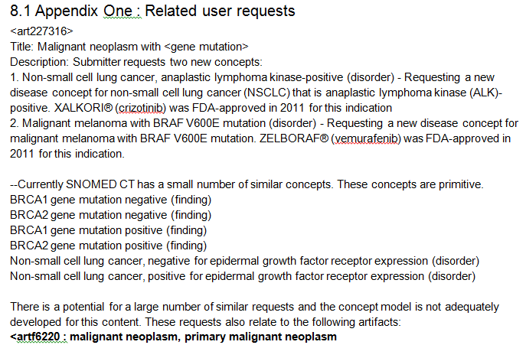
Statement of the problem

Slide 4
272394005|Technique(qualifier)|
Expanded SNOMED CT draft Lab/Pathology semantics
Clinical pathology techniques
Gross techniques
  Inspection
  Dissection
Light microscopy
  Histochemical techniques
    Hematoxylin/Eosin…etc
  Frozen section technique
Molecular and proteomic techniques
  Immunohistochemical techniques
    Immunoperoxidase techniques
    Immunoflourescence techniques
  PCR-ELISA technique
  Flourescent in-situ hybridization technique
Genomic techniques
  Pyrosequencing technique
  Next generation sequencing technique
  Array karyotype technique
  Bisulfite sequencing technique
  Karyotype analysis – banding techniques
  *New SNOMED CT content
  Question: Why are we not expanding procedures?

Slide 5
118598001 |Measurement property(qualifier)
Expanded SNOMED CT draft Lab/Pathology semantics
Measurement property
  Mass
  Volume
  …
  Histologic feature
    Histologic invasiveness

Slide 6
Reference Nomenclatures
HUGO: Human Gene Ontology (NCBI)
Human Gene Nomenclature Committee: standardized nomenclature for human genes and variants
Uniprot: Protein nomenclature
ISCN 2013 International System for Human Cytogenetic Nomenclature

Slide 7
SIRS:
“Malignant melanoma with BRAF V600E mutation”

Slide 8
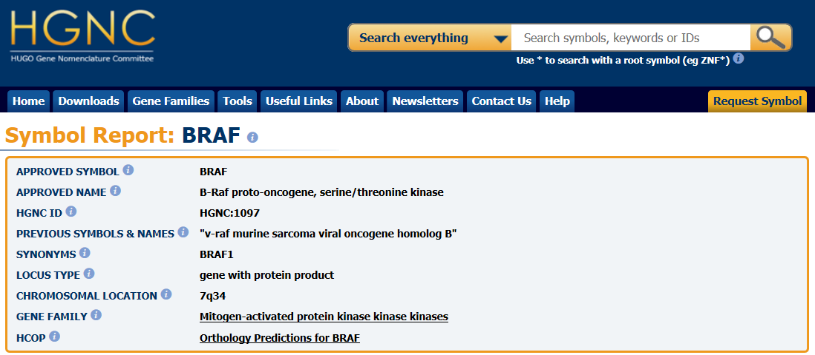
B-RAF genetics
Gene: “B-Raf proto-oncogene, serine/threonine kinase”
  Official symbol: BRAF (not in SNOMED CT 2015)
  Cytogenetics: 7q34; base pairs 140,715,950 to 140,924,763
  Locus type: gene with protein product
  Mutation phenotypes (30+ characterized): Cardiofaciocutaneous syndome; Erdheim Chester disease; Giant congenital melanocytic nevus; Noonan syndrome; cancers – melanoma, colon, ovary, thyroid; Langerhans cell histiocytosis; hairy cell leukemia
  Two antibody based treatments have been developed for malignancies that arise from BRAF mutations
Encodes…..
Protein: Serine/threonine-protein kinase B-raf
  UniProtKB - P15056 (BRAF_HUMAN)
  Protein kinase involved in the transduction of mitogenic signals from the cell membrane to the nucleus.

Slide 9
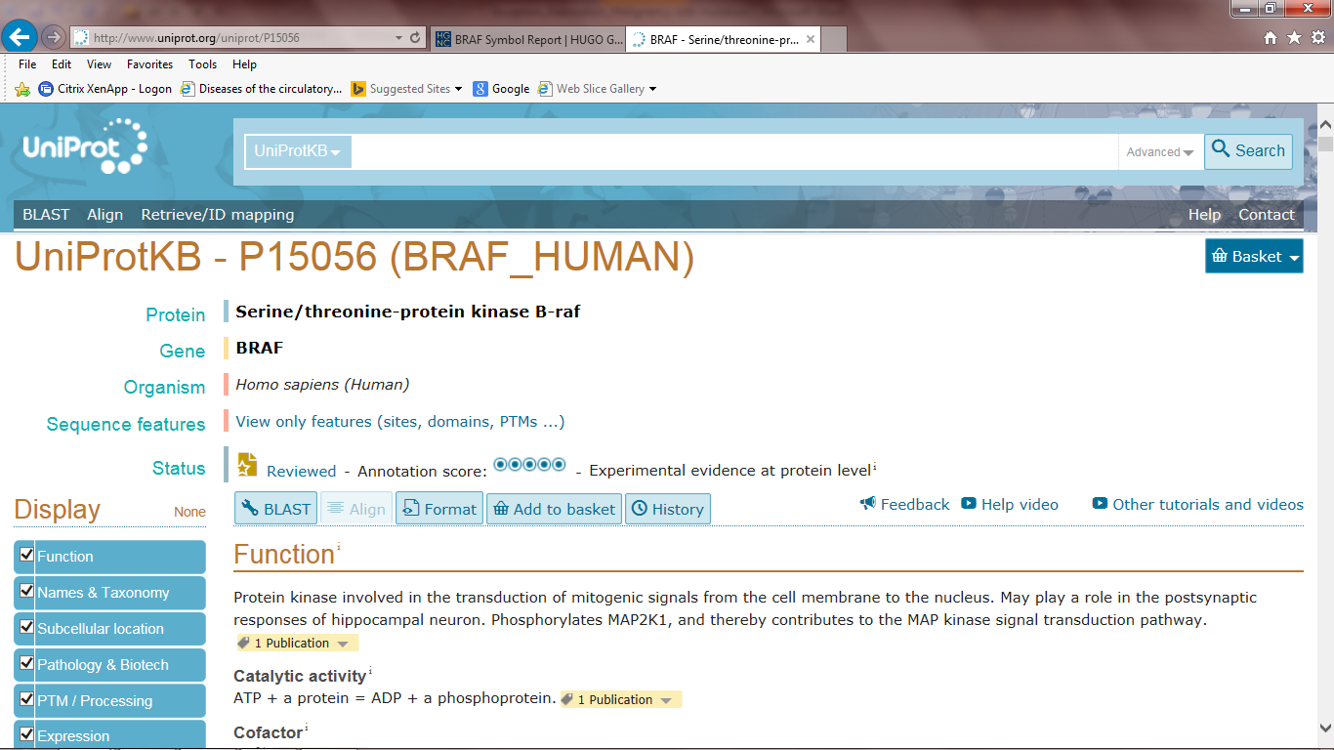
B-RAF genetics
Gene: “B-Raf proto-oncogene, serine/threonine kinase”
  Official symbol: BRAF (not in SNOMED CT 2015)
  Cytogenetics: 7q34; base pairs 140,715,950 to 140,924,763
  Mutation phenotypes: Cardiofaciocutaneous syndome; Erdheim Chester disease; Giant congenital melanocytic nevus; Noonan syndrome; cancers – melanoma, colon, ovary, thyroid; Langerhans cell histiocytosis
  Two antibody based treatments have been developed for malignancies that arise from BRAF mutations
Encodes…..
Protein: Serine/threonine-protein kinase B-raf
  UniProtKB - P15056 (BRAF_HUMAN)
  Not in SNOMED CT Jan 2015
  Protein kinase involved in the transduction of mitogenic signals from the cell membrane to the nucleus.

Slide 10
Use Cases for Data Management
Find all patients that had a tumor with positive test results for a BRAF (V600E) mutation

Slide 11
Cytogenetic tehniques employed at UNMC for BRAF V600E testing
Immunoperoxidase staining for mutant protein
Pyrosequencing looking for mutant DNA
It is very common in pathology for techniques to be developed and commercialized for the DNA sequence finding or the protein (or both)
How to support SNOMED CT observables definitions that will support query across testing methods?

Slide 12
B-raf draft SNOMED CT semantics supporting retrieval use cases
Chromosome(cell structure) -is a-
  Chromosome 7 -part of -
    7q long arm -part of -
      B-Raf proto-oncogene serine threonine kinase(cell structure)
      HGNC:1097 -Synonym:BRAF-1
        (Encodes) Ser-Thre protein kinase B-raf(substance)(defining?)
        (Has mutation) BRAF V600E mutation(cell structure)(not defining)
Enzyme(substance) - is a -
    Protein kinase - is a -
      Serine threonine protein kinase B-raf(substance)
    Synonym: BRAF_HUMAN UniProt: P15056
        (Is coded by) B-Raf proto-oncogene(cell structure)(defining?)
      B-raf mutant protein kinase(substance)
        (Is coded by) BRAF V600E mutation(cell structure)
*New SNOMED CT content
Alternatively, could the concept model for abnormal
Body structures be expanded to include a body
location [BRAF V600E mutation(cell structure)]
since it is present in the B-Raf proto-oncogene?
Instead of loading all HGNC and UNIPROT content into
SNOMED CT, should we think about employing concrete
domains and referencing their ontology by code value?
Not all mutant proteins are named or characterized but
may be simply identified by immunohistochecmical
techniques. Do we lose anything by not specifying
the protein in our definition of those concepts?

Slide 13
BRAF V600E mutation detection by
pyrosequencing DNA of melanoma skin biopsy specimen
(observable)
Concrete domain with ISCN
nomenclature or comparable
PROPERTY TYPE
705057003|Presence(property)|
INHERES IN
2092003|Malignant melanoma(morphology)|
IS ABOUT
quality
TOWARDS
BRAF V600E mutation(cell structure)(NEW)
INHERENT LOCATION
B-Raf proto-oncogene serine threonine kinase (cell structure)(NEW)
observable
Needlessly redundant?
TIME ASPECT
123029007|Single point in time(qualifier)|
SCALE
117362005|Nominal value(qualifier)|
UNITS
units
TECHNIQUE
|Pyrosequencing technique|(NEW)
DIRECT SITE
309066003|Skin biopsy sample (specimen)|

Slide 14
58415-1|BRAF gene.p.V600E|Arb|Pt|Tiss|Ord|
BRAF V600E mutant protein detection by immunoperoxidase staining of melanoma skin biopsy specimen (observable)
PROPERTY TYPE
118536000|Entitic number(property)|
INHERES IN
2092003|Malignant melanoma(morphology)|
IS ABOUT
quality
TOWARDS
BRAF V600E mutant protein kinase(substance)(NEW)
62035001|Cytoplasmic matrix| OR
?B-Raf proto-oncogene serine threonine kinase (cell structure)(NEW)?
INHERENT LOCATION
observable
Overly elaborate if protein
Is properly designated…?
TIME ASPECT
123029007|Single point in time(qualifier)|
SCALE
117362005|Nominal value(qualifier)|
UNITS
units
TECHNIQUE
|Immunoperoxidase technique|(NEW)
DIRECT SITE
309066003|Skin biopsy sample (specimen)|

Slide 15
Template Proposal
Pyrosequencing of specimen for detection of mutation
PROPERTY TYPE
705057003|Presence(property)|
INHERES IN
<<123037004|Body structure|
IS ABOUT
quality
TOWARDS
Named Mutation or ISCN?
<<91272006|Chromosome(body structure)|
INHERENT LOCATION
observable
TIME ASPECT
123029007|Single point in time(qualifier)|
SCALE
117362005|Nominal value(qualifier)|
UNITS
units
TECHNIQUE
|Pyrosequencing technique|
DIRECT SITE
<<123038009|Specimen)|

Slide 16
Template Proposal
Cancer Genetic/Molecular lab test observables
PROPERTY TYPE
INHERES IN
<<108369006|Neoplasm(morphology)|
IS ABOUT
quality
TOWARDS
Named Mutation or ISCN?
<<91272006|Chromosome(body structure)|
INHERENT LOCATION
observable
TIME ASPECT
SCALE
UNITS
units
TECHNIQUE
<<Molecular technique (NEW)
<<Genomic techniques (NEW)
DIRECT SITE
<<123038009|Specimen)|

Slide 17
SIRS:
“BRCA1 mutation carrier”

Slide 18
BRCA1 mutation
Over 1800 mutations identified, most with oncogenetic risk but prevalence rates often specific to ethnicity
Hereditary risk for breast, ovarian, fallopian tube and prostate cancers as well as leukemias and lymphomas
Testing available for BRCA1 mutated proteins(antigen) as well as sequence analysis

Slide 19
BRCA1 gene
Gene: “Breast cancer 1, early onset”
  Synonyms: BRCA1/BRCA2-containing complex, subunit 1; Fanconi anemia, complementation group S; FANCS; PPP1R53; Protein phosphatase 1 regulatory subunit 53, RNF53
  Tumor suppressor gene; not a true oncogene
  Symbol: BRCA1 HGNC:1100
  Locus type: gene with protein product
  Chromosome: 17q21.31; base pairs 41,196,312 to 41,277,500
  Lung and ovarian cancer expression of BRCA1 predictive of response to chemotherapy
Encodes:
Protein: Breast cancer type 1 susceptibility protein
  Uniprot: P38398 (BRCA1_HUMAN)
  Function: cellular DNA repair

Slide 20
BRCA1 draft SNOMED CT semantics supporting retrieval use cases
Chromosome(cell structure) -is a-
  Chromosome 17 -part of -
    17q long arm -part of -
      Breast cancer 1, early onset gene(cell structure)(NEW)
      HGNC: 1100 -Synonym:BRCA1 gene
        (Encodes)Breast cancer type 1 susceptibility protein (substance)
        (Has mutations) BRCA1 mutation(cell structure)(not defining)(NEW)
Enzyme(substance) - is a -
  Nuclear phosphoprotein - is a -
      Breast cancer type 1 susceptibility protein(substance)
        (Is coded by) Breast cancer type 1, early onset gene(Cell structure)(defining?)
      Breast cancer type 1 susceptibility mutant protein (substance) (NEW)
        (Is coded by) BRCA1 mutation(cell structure)(NEW)
*New SNOMED CT content

Slide 21
BRCA1 mutant protein detection by
immunoperoxidase staining of blood specimen
PROPERTY TYPE
118536000|Entitic number(property)|
INHERES IN
4421005|Cell structure(body structure)|
IS ABOUT
quality
TOWARDS
BRCA1 mutant protein(substance)(NEW)
INHERENT LOCATION
Breast cancer 1, early onset gene(cell structure)(NEW)
observable
TIME ASPECT
123029007|Single point in time(qualifier)|
SCALE
117362005|Nominal value(qualifier)|
UNITS
units
TECHNIQUE
|Immunoperoxidase technique|(NEW)
DIRECT SITE
119297000|Blood specimen (specimen)|

Slide 22
BRCA1 mutation detection by
pyrosequencing DNA of blood specimen
PROPERTY TYPE
705057003|Presence(property)|
INHERES IN
2092003|Malignant melanoma(morphology)|
IS ABOUT
quality
TOWARDS
BRCA1 mutation(cell structure)(NEW)
INHERENT LOCATION
Breast cancer 1, early onset gene(cell structure)(NEW)
observable
TIME ASPECT
123029007|Single point in time(qualifier)|
SCALE
117362005|Nominal value(qualifier)|
UNITS
units
TECHNIQUE
|Pyrosequencing technique|(NEW)
DIRECT SITE
119297000|Blood specimen (specimen)|

Slide 23
UNMC Genetic Pathology testing
Solid Tumors:
  B-RAF (codon 600 by pyrosequencing)
  KRAS (codons 12, 13 and 61 by pyrosequencing)
  EGFR Epidermal growth factor receptor Mutations (29 mutations by real time PCR)
MicroSattelite Instability by PCR and capillary electrophoresis
Hemepath
Chronic Myeloproliferative Neoplasms
    JAK2 janus kinase 2 Mutation by real-time PCR
    Calreticulin by fluorescent PCR and capillary electrophoresis
    BCR-ABL - qualitative and quantittive (PCR and gel)
Lymphoma
  IgHeavy Gene rearrangements by fluorescent PCR and capillary electrophoresis
  Tcell Receptor gamma gene rearrangement by fluorescent PCR and capillary electrophoresis
AML
  FMS-related Tyrosine kinase 3 by fluorescent PCR and capillary electrophoresis
  NPM1 nucleophosmin by fluorescent PCR and capillary electrophoresis
ProMyelocytic Leukemia-RARA translocation - by real time PCR
50 Gene Cancer Panel - 50 cancer gene hotspots in metastatic cancer
5 gene colorectal cancer panel (KRAS, and NRAS codons 12,13,61,146 and others, BRAF codon 600, PIK3CA hotspots, HRAS)

Slide 24
Proposal
Add content for techniques (?procedures) <20 concepts
Add content for properties (<5 concepts)
Assemble pragmatic list of gene mutations of clinical importance for UNMC along with protein products and add content to cell structure and substance hierarchies 100 concepts (Alternative: to support concrete domains in observables and include by reference?)
Develop Observable template consensus for 10-15 most common genetic/molecular pathology (and anatomic pathology) tests
Modeling and testing of content and retrieval use cases in Nebraska Lexicon extension for pathology database with view to promotion to US extension or International release 20-50 mutations
Exploration of collaboration with HUGO Gene Nomenclature committee and UNIPROT to scale content development and automate SNOMED CT content development in conjunction with evolution of clinical genotypic laboratory procedures

Slide 25
