Slide 1
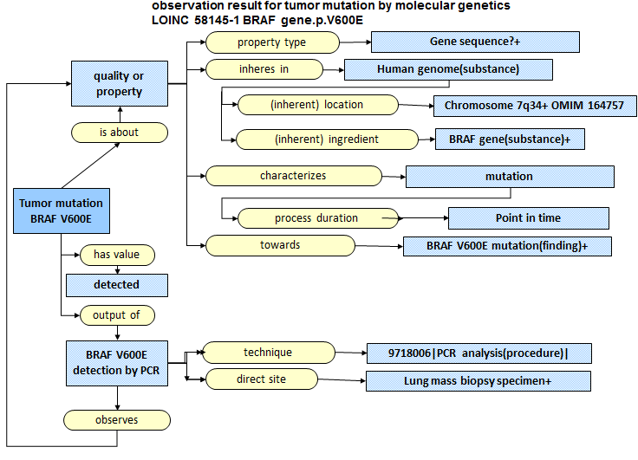
Application of Observables model

Slide 2
Is it an Observation result or a Clinical finding?
|clinical finding|:
{
|finding site|=|7q34 (cell structure)| OR |lung mass biopsy specimen|,
|associated morphology|=|BRAF V600E mutation (morphologic abnormality)|,
|finding method|=|PCR analysis|
}
Is a gene mutation like a fracture?

Slide 3
Observable model
Property type
  “Gene sequence” does not match value “detected”
  Sequence variation?
|observable entity|:
|property type|=|sequence variation|,
|inheres in|=|BRAF gene|,
|(inherent) location|=|7q34|,
|technique|=|PCR|,
|direct site|=|lung mass biopsy specimen|

Slide 4
Presence/absence observable
|observation result|:
|is about|=|BRAF V600E mutation (morphologic abnormality)|,
|technique|=|PCR|,
|direct site|=|lung mass biopsy specimen|,
|has value|=|present|

