Slide 1
SNOMED CT and Surgical Pathology
Opportunity to develop and deploy SNOMED CT encoded surgical pathology data
Endeavor at University of Nebraska Medical Center (UNMC) using cancer synoptic reports
Invitation to collaborate and extend beyond local U.S. use case.

Slide 2
Encoded Cancer Synoptic Reports
Cancer Synoptic Reports provide a consistent, structured avenue to record and communicate pathology assessments of malignant conditions
Used by oncologists and surgeons in patient care decisions in many nations.
Provide a generally accepted mechanism to capture important clinical information simultaneously in humanly readable and machine computable formats
Various accepted formats available based on country
E.g., College of American Pathologists

Slide 3
Current Synoptic Encoding Status
Format of check sheets consists of serial question/answer data elements
Use of computable terminology is limited
When used, it is atomic in nature.
Example: Histologic type of tumor = 82711006|infiltrating duct carcinoma (morphologic abnormality)
Interpretation of data requires knowledge of the context of the question.
Not optimal for reporting and/or information reuse
We can do better

Slide 4
Objective
Create fully defined expressions (pre or post-coordinated) for each question/answer element in the cancer synoptic work sheet library
Employ the proposed Observable Results model
Identify modeling issues and definitional requirements to deploy into production
Institutional Mandate
The University of Nebraska Medical Center (UNMC) requires richer, more complete encoding of cancer synoptic reports for use in clinical and research applications. Leadership has authorized effort for deployment in UNMC environment.

Slide 5
Methodology
Model individual cancer synoptic worksheets codes using the proposed Observable results model
Create required definitional content and hierarchy within the context of the Nebraska Extension (“The Laboratory”)
Deploy authored content into the UNMC pathology information system

Slide 6
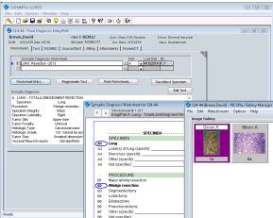
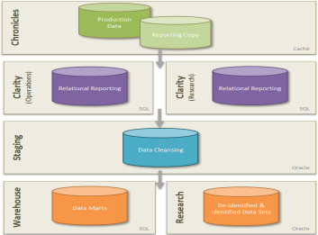
Process Flow Overview
Copath
Structured capture
Structured data entry for reporting of cancerous diagnostic information using checklists for surgical specimens
Production
Data
Caché
Cloverleaf
Interface Engine
Paraffin Biobank
Core Hospital Infrastructure
Diseased and Non-diseased
SNOMED CT
(In process)
Graph
Semantic storage of the core in the y and x axis of the data set for improved querying
Cancerous diagnostic information from surgical specimens within OneChart
Data available for reporting and research

Slide 7
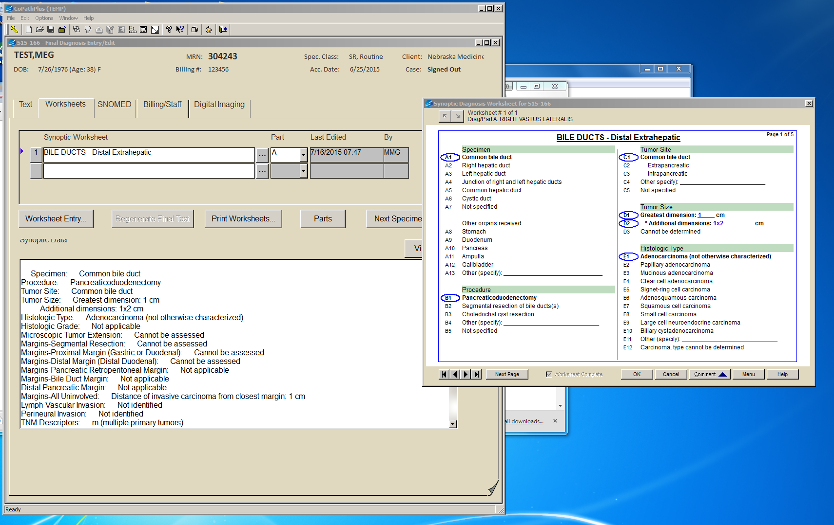
Pathologist Information System
User Interface – Selections within synoptic worksheet are associated with natural language and SNOMED CT expression (pre-coordinated)

Slide 8
Excision site of breast tumor (observable entity)
PROPERTY TYPE
Location (NEW)
INHERES IN
Neoplasm(body structure)
IS ABOUT
quality
Breast structure(body structure)
INHERENT LOCATION
PRECONDITION
Body states (challenges, fasting etc.)
observable
TIME ASPECT
Single point in time(qualifier)
SCALE
Nominal value(qualifier)
UNITS
units
TECHNIQUE
Gross inspection (NEW)
DIRECT SITE
Surgical specimen (specimen)

Slide 9
Excision site of breast tumor is right upper outer breast quadrant (finding)
PROPERTY TYPE
Location (NEW)
INHERES IN
Breast structure(body structure)
IS ABOUT
quality
TOWARDS
Neoplasm(body structure)
PRECONDITION
Body states (challenges, fasting etc.)
Observation
result
TIME ASPECT
Single point in time(qualifier)
SCALE
Nominal value(qualifier)
UNITS
units
TECHNIQUE
Gross inspection (NEW)
DIRECT SITE
Surgical specimen (specimen)
Structure right upper outer quadrant of breast(body structure)
VALUE

Slide 10
(16112-5)(445028008)
Estrogen receptor status (observable entity)
PROPERTY TYPE
Fraction (NEW)
INHERES IN
Cells
IS ABOUT
quality
Stained cells
TOWARDS
INHERENT LOCATION
Neoplasm of Breast structure(body structure)
observable
TIME ASPECT
Single point in time(qualifier)
SCALE
Nominal value(qualifier)
UNITS
units
TECHNIQUE
Immunohistochemistry technique
DIRECT SITE
Surgical specimen (specimen)

Slide 11
Data Output Example:
HL7 version 2.3.x
OBX|1|CWE|371441004^Histologic type (observable entity)^SCT^R-
00257^^SCT2||35917007^Adenocarcinoma, no subtype (morphologic abnormality)^SCT^M-
81403^^SCT2||||||F
OBX|2|CWE|371441004^Histologic type (observable entity)^SCT^R-00257^^SCT2||82711006^Infiltrating
duct carcinoma (morphologic abnormality^SCT^M-85003^^SCT2||||||F
OBX|3|CWE|384994009^Primary Gleason pattern (observable entity)^SCT^R-
00496^^SCT2||369773008^Gleason Pattern 4 (finding)^SCT^G-F604^^SCT2||||||F

Slide 12
Cancer Checklist Modeling Samples
Observation Result | Property type (Is About) | Inheres in (Is About) | Inherent Location (Is about) | Towards (Is About) | Pre-condition (Is About) | Direct Site Output of) | Technique (Output of) | Scale (Output of) | Units (Output of) | Has value
Tumor site
Pancreatic head | Site of tumor (attribute) 263601005 | pancreas (15776009) |  | Neoplasm (108369006) |  | Surgical specimen - 445405002 | Gross Inspection (32750006) | Nominal value (117362005) |  | Head of pancreas (64163001)
Histologic type
Ductal adenocarcinoma (82711006) | Histologic feature of tumor (396984004) | Neoplasm (108369006) | pancreas (15776009) | Cancer Morphology (morphologic abnormality) 86049000 |  | Formalin-fixed paraffin-embedded tissue (441652008) | histopathology test (252416005)/ light microscopy (104157003) | nominal (117362005) |  | Ductal adenocarcinoma (82711006)

Slide 13
Next Steps
UNMC process to proceed institutionally
Collaborative efforts with other interested parties
Quality Reviews
Modeling Issues

