Slide 1
Representation of Genomic observations and results
Michael Osborne

Slide 2
New Challenges : Molecular Pathology
Pyrosequencing
Array Karyotype
Next Gen Sequencing / Massively Parallel Sequencing
Methylation testing
Pharmecogenomics
Notes:
For a few years now, techniques like these were in the domain of research and specialist labs have been creeping in to the average hospital/private laboratory.
I will explain some of the challenges and areas where SNOMED CT could be useful.

Slide 3

Genetic Testing - Pyrosequencing
PYROSEQUENCING technology is a unique method for short-read DNA sequencing, Allele Quantification and mutation/SNP analysis. Its ease of use, sequence validation and flexibility make it ideally suited for applied genomics research including molecular applications for disease diagnosis, clinical prognosis and pharmacogenomics testing. Typical run times are 10 minutes for 96 samples and approximately 30 to 45 minutes for sequence analysis applications that routinely provide 30 to 50 bases of sequence information.
Source: http://genoseq.ucla.edu/action/view/Pyrosequencing
Notes:
Advantages:
Useful for short sequences – report on well-known mutations e.g. HFE Hemochromatosis Gene Analysis
Relatively cheap to run
Fast turnaround

Slide 4
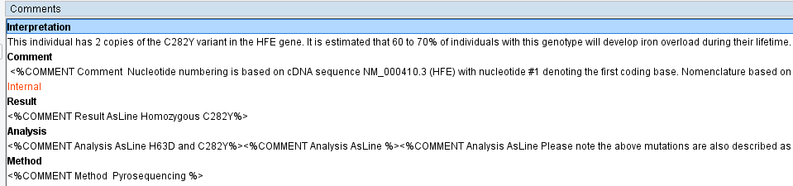
Genetics Results : HFE
In patients with hereditary hemochromatosis (HFE1; 235200), Feder et al. (1996) identified 2 mutations in the HFE gene (C282Y, 613609.0001 and H63D, 613609.0002). The C282Y mutation was detected in 85% of all HFE chromosomes, indicating that in their population 83% of hemochromatosis cases are related to C282Y homozygosity. (http://www.omim.org/entry/613609)
NCBI has more information on variants: http://www.ncbi.nlm.nih.gov/clinvar/?term=HFE[gene]
Example results from HFE test by Pyrosequencing methodology

Slide 5
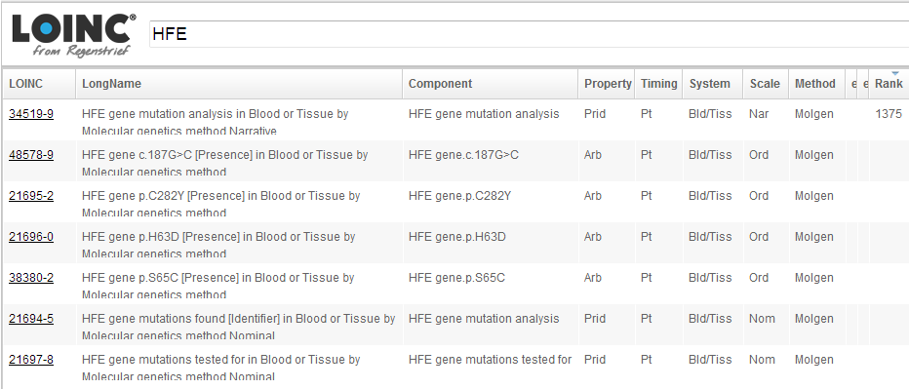
Genetic Results : HFE
How do LOINC deal with the test and how can it be modelled?
Option 1: As Narrative, most popular, but not machine processable

Slide 6
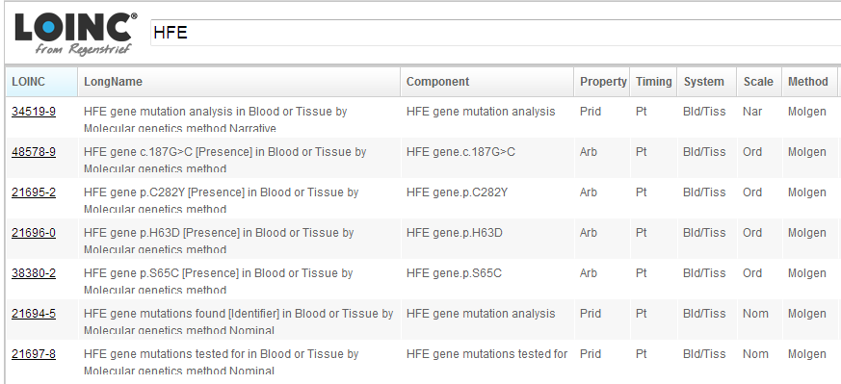
Genetic Results : HFE
Option 2: As Ordinal results, mutation present or absent but zygosity?

Slide 7
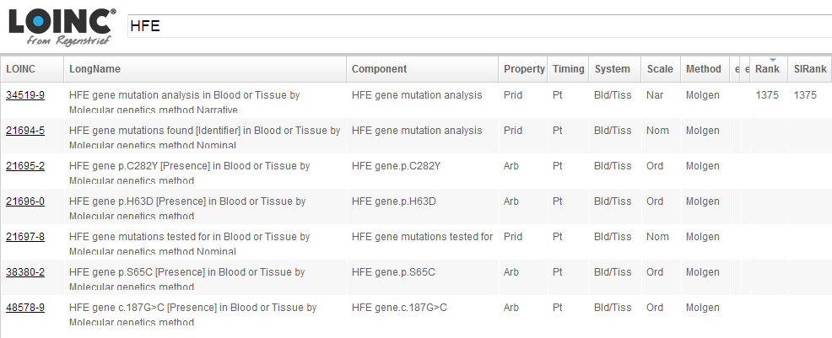
Genetic Results : HFE
Gene Mutations Found opens up the ability to express as post-coordinated SNOMED CT….

Slide 8
Genetics Results : HFE
Mutation could be post-coordinated in an expression with
(Genetic Locus) Zygosity = “Homozygous”, “Heterozygous”, “Hemizygous“, “Nullizygous“
Variant Type = “Single Nucleotide Variant”, “Copy Loss” or “Deletion”
Example for HFE:
HFE Gene p.Cys282Tyr : Zygosity = Homozygous,
Variant type = Single nucleotide variant

Slide 9
Genetics Results – α Thalassemia
Method of Testing : Multiplex GAP PCR
Detects deletions –a3.7, -a4.2, -a20.5, -SEA, -FIL, -MED, -THAI
Example results:
HBA2 gene alpha 4.2
Zygosity = heterozygous,
Variant type = deletion
(alpha Thalassemia Trait)

Slide 10
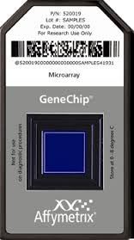
Cytogenomics
The array karyotype
  Analysis of short sequences of DNA from specific loci (SNP arrays) across the whole genome
  Infers presence of genes based on haplotype (commonly grouped genes in a population)
  Detection of genomic copy number variations (Deletions, Gains & Amplifications)
  Loss of Heterozygosity (LOH) : Duplication of a segment in the germline or Uniparental Disomy detected by some newer SNP array methods
  Paraffin embedded tissue (solid tumours) requiring only 75 ng of DNA
  Results are reported using the same ISCN nomenclature as traditional karyotyping e.g. 7q11.23 Deletion (Williams syndrome)
  Non Invasive Pre-natal Testing using fetal cells in mothers blood.

Slide 11
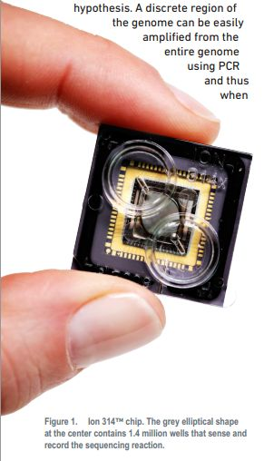
Molecular Diagnostics - NGS
Sequencing of spatially separated, clonally amplified DNA templates or single DNA molecules is performed in a massively parallel manner.
Methods include genome, transcriptome, and methylome sequencing, metagenomics, characterization of protein-nucleic acid interactions, and targeted resequencing of multiple genes and genome-wide association studies (GWAS).
A major application of NGS in testing for inherited disorders is in conditions such as congenital disorders of glycosylation, hypertrophic cardiomyopathy, developmental delay, neuromuscular disorders, retinitis pigmentosa, and seizure disorders in which the overlapping symptoms of multiple possible syndromes and many potentially affected genes can make an NGS approach cost-effective.
http://jmd.amjpathol.org/article/S1525-1578(12)00175-4/fulltext
Notes:
NGS = Next Generation Sequencing

Slide 12
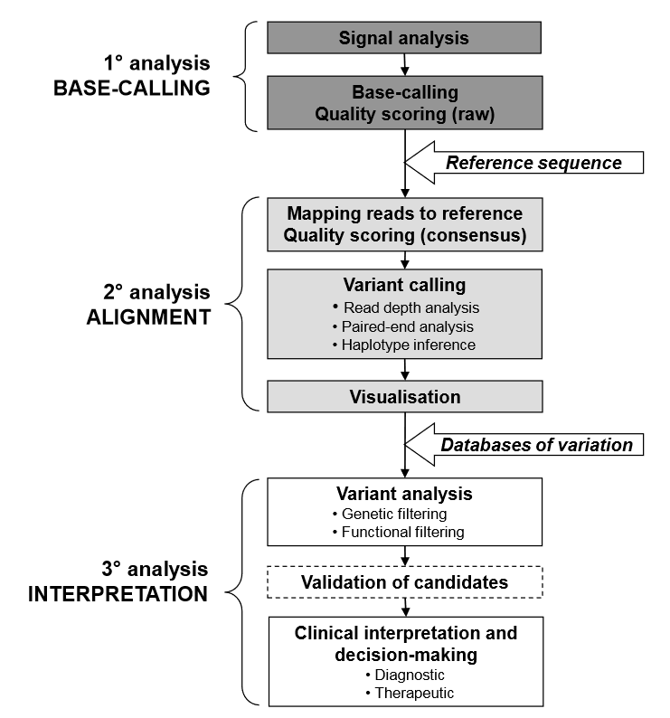
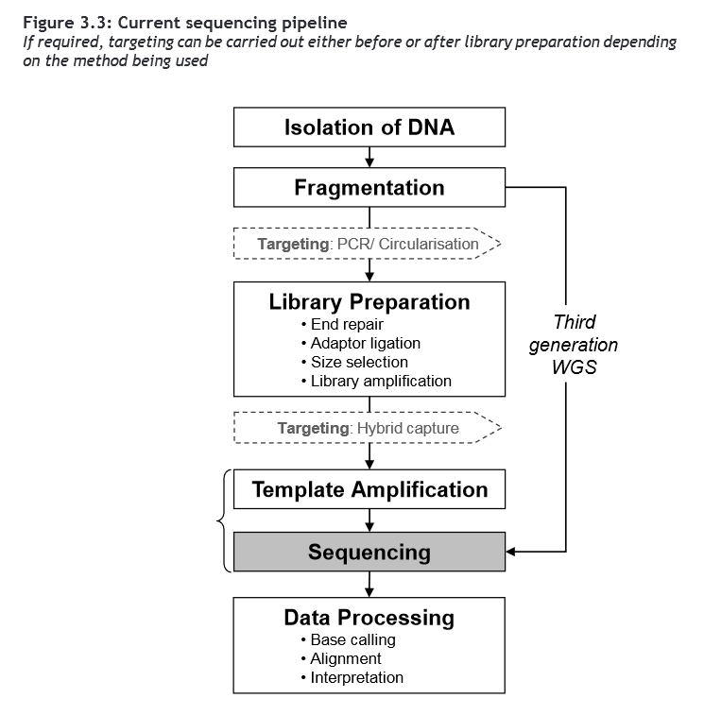
WGS Sequencing Pipeline
http://www.phgfoundation.org/file/10363
Notes:
WGS is currently still relatively expensive
Takes 2 days preparation and 2 days to perform a batch run.

Slide 13
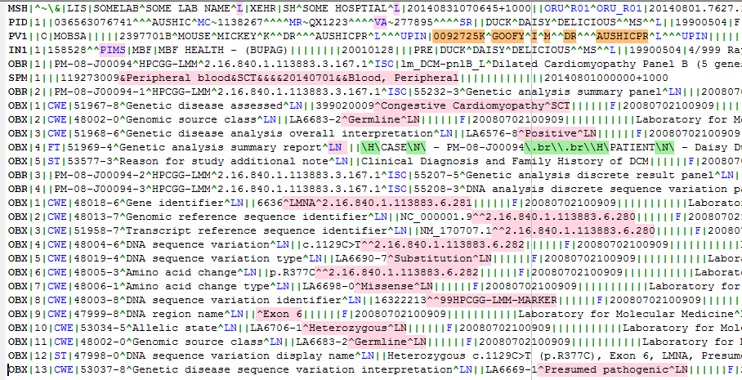
Chapter 8: Example Genetic Test Laboratory Messages
Page 42 HL7 V2 IG: Clinical Genomics; Fully LOINC-Qualified Genetic Variation Model, R2
© 2013 Health Level Seven International. All rights reserved. March 2013
Current Use of SCT
Future use of SCT (LOINC Collaboration)

Slide 14
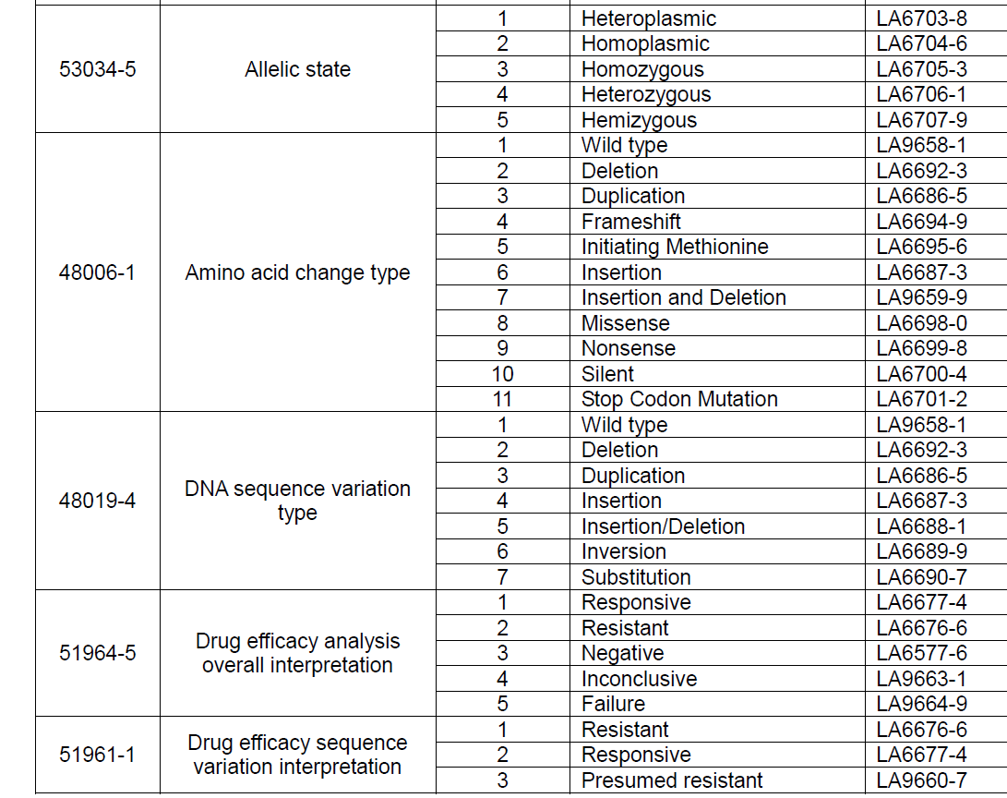
Value sets to be converted to SNOMED CT concepts?

Slide 15
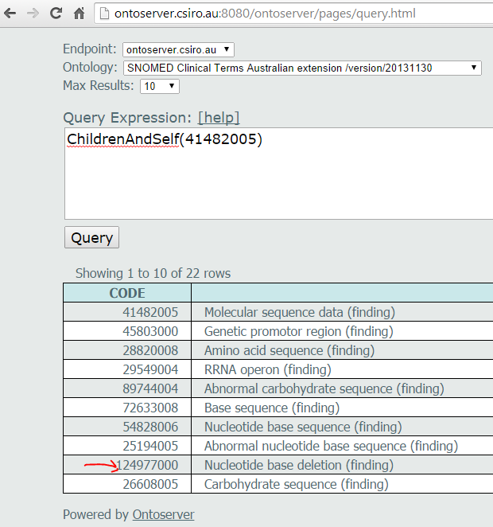
Molecular Findings in Current SNOMED CT – realignment required
Notes:
The molecular sequence data sub-hierarchy needs to realign with the questions (LOINC codes)

Slide 16
Whole Genome Sequencing Vs SNP Arrays
a low-frequency variant in HNF1A — present in 2 percent of type 2 diabetes cases and 0.4 percent of healthy controls — quintupled risk of type 2 diabetes, the largest effect ever observed for a type 2 diabetes variant found in more than 0.1 percent of the population. The variant was found only in people who live in Mexico or the southern U.S. and identify as Latino. It was not found in publicly available genetic databases, including 1000 Genomes, Exome Sequencing Project, and dbSNP. Therefore, we would have missed this variant even if we had used the latest genotyping array technology and imputed (i.e., inferred the presence of) variants that were not directly genotyped.
http://genomesunzipped.org/2014/06/a-rare-variant-in-mexico-with-far-reaching-implications.php#more-5725
Notes:
The current RefSeq or Reference Sequence to which we compare all data for variant detection is based anonymous individuals
of mainly European ancestry

Slide 17
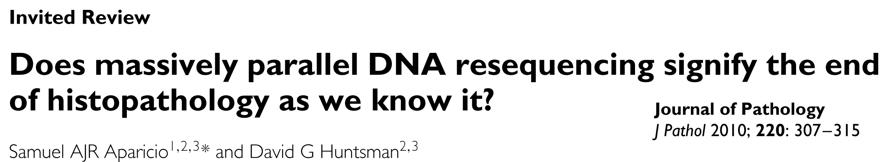
Tumour classification
VS
Used with kind permission of Prof Stephen B Fox
Director of Pathology
Peter MacCallum Cancer Centre, Melbourne, Australia.

Slide 18
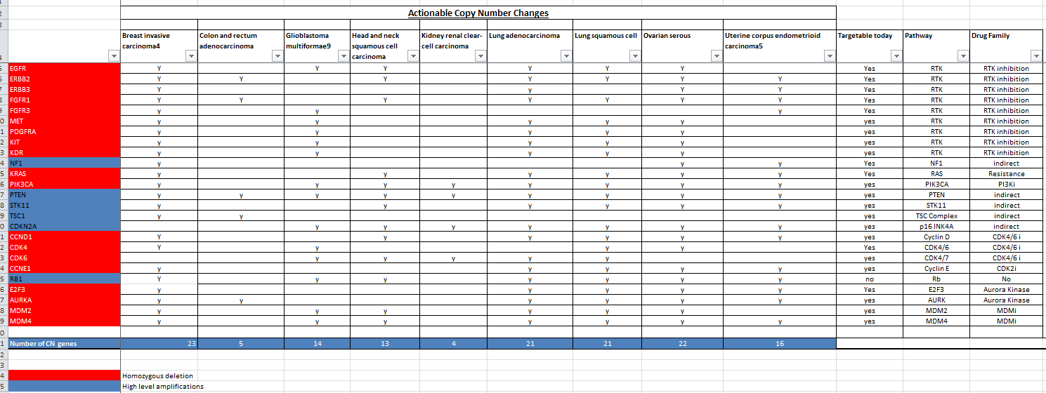
Treatable Tumour Copy Number Changes

Slide 19
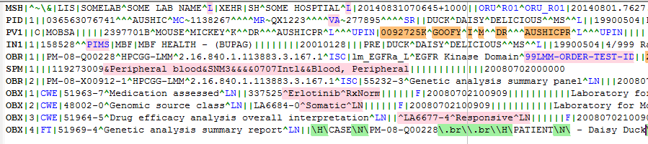
Chapter 8: Example Genetic Test Laboratory Messages
Page 42 HL7 V2 IG: Clinical Genomics; Fully LOINC-Qualified Genetic Variation Model, R2
© 2013 Health Level Seven International. All rights reserved. March 2013
Potential for SCT
Notes:
There is potential to report tumors and suggest medications based on these pathways , like in this example from HL7 Clinical genomics V2 model.

Slide 20
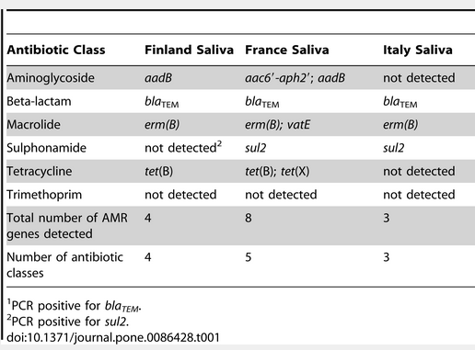
Microbial Genomics
Rapid testing for antimicrobial resistance with MicroArrays (mecA, acrRAB, folP) => Implication on modelling in reports
Identification of 'high risk' resistant clones
Analysis of potential targets for new antimicrobial agents e.g. enzymes involved in biosynthetic pathways
Identification of gene clusters in organisms for synthesis of novel antimicrobials e.g turbomycins A and B
Notes:
Sidestepping into the world of pathogenic organisms, there is great potential for fast turnaround antimicrobial testing using panels of genes in Micro Arrays.
And this has potential impact on the reporting in the future, although there is some gene reporting already happening in the general microbiology laboratory (e.g. mecA for MRSA).

