Slide 1
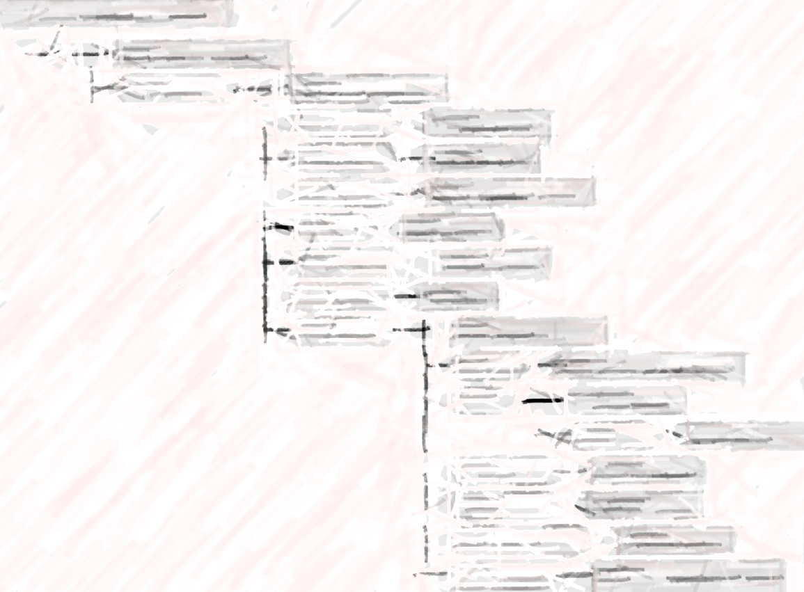
Observables and Investigation Procedure Model
Review and revision of inception/elaboration document

Slide 2
Observables Project Background
First project meeting in at IHTSDO business meeting in Birmingham 2008
Collaboration with RII and IFCC-IUPAC (S)C-NPU in 2009
Negotiations with RII resulted in agreement in 2013
Chair: DK since ~2011, SSA and FAS involved since 2014
Initially laboratory focus, but moved on to other areas e.g. clinical observables
No set deadlines initially. Things changed with:
  RII agreement and LOINC work
  Kent leaving
  More projects interested in implementing the model (e.g. functioning and IPaLM SIG projects)
Expected for implementation (beyond LOINC mapping) in 2016
Thanks SSA, FAS!

Slide 3
Observables Project Background
The 363787002 | Observable entity (observable entity) | hierarchy is currently all-primitive, zero defining attributes
The current Observable entity hierarchy contains concepts which are ambiguous in that they can be understood as the things which are observed rather than observables
  For example: functions, activities, …
Thus, a concept model for Observable entities is needed

Slide 4
Project Risk Profile
Criteria | Analysis | Score
Number of concepts affected | Potentially several tens of thousands | 3
Number of users affected | Virtually all implementers of result reporting | 3
Changes to vendor software required | Typically today implemented clinical systems using other terminologies (LOINC, NPU), local terminologies, or is uncoded; some change may be needed | 3
Change to concept model | The proposed changes involve many new object properties and potentially a significantly revised model for observation results | 3
Change to content development software or processes | Tooling for making these changes is not currently available except as prototype software | 3
Average score |  | 3

Slide 5
Elephant eating
A number of smaller domain specific projects
  Patterns
  Extensions
  Documents
For example
  Functioning
  Cancer Synoptic Report
  Vital signs
  …

Slide 6
So what is an Observable?
Plan specification for an observation procedure with the intent of observing a certain type of quality, disposition, function, or process (a feature)
  Inspired by Ontology of Biomedical Investigation (OBI)
An information entity
  Potentially problematic as SNOMED CT DL cannot faithfully represent “type of”
observable
entity
feature
is about
specified by
observes
observation result
output of
observation procedure
specified by ○ observes ⊑ is-about

Slide 7
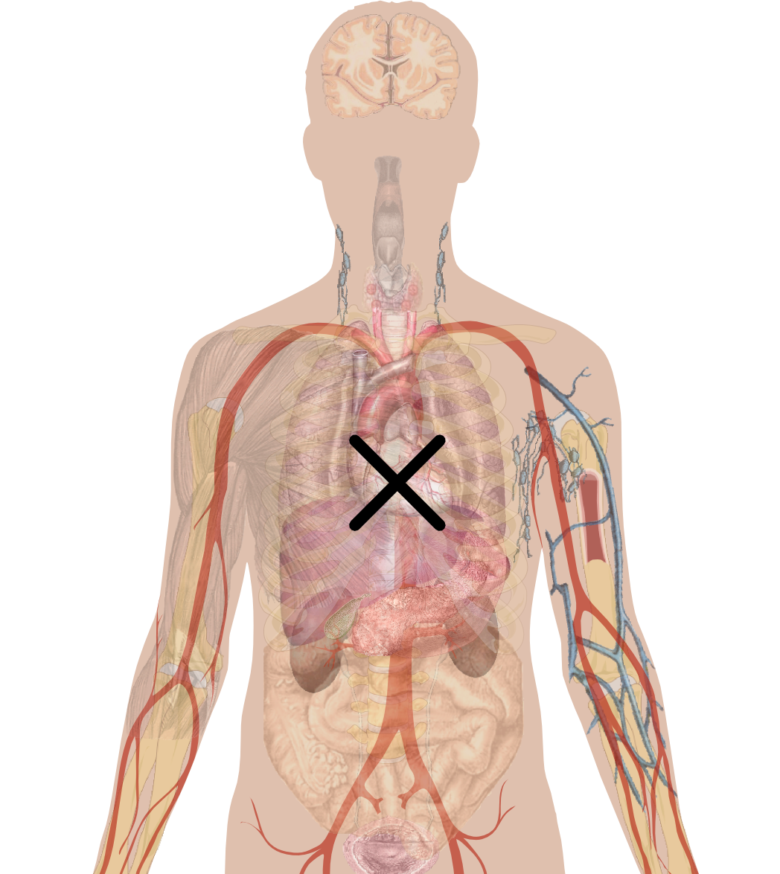
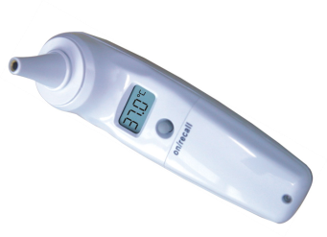
Observable Entities in 30 Seconds
WHAT
TECHNIQUE
PROPERTY TYPE
INHERES IN
INHERENT LOCATION
COMPONENT
TOWARDS
PRECONDITION
...
SCALE
UNITS
DIRECT SITE
Observable
entity
DIRECT SITE
USING DEVICE
TECHNIQUE
SCALE
UNITS
PROPERTY TYPE
INHERES IN
...
HOW
PRECONDITION

Slide 8
Four Kinds of Observable (at least?)
Quality observables
Disposition observables
Function observables
Process observables
(Presence/absence observables)

Slide 9
Why Four Kinds?
Attribute overloading
For example, three uses of Towards
  One participant in a relational quality, e.g. a constituent with a concentration in a solution
  For a disposition, what the disposition is towards, e.g. a substance triggering a reaction process
  For a function, the process that is realized, e.g. for an ability to hear it is the hearing that is realized

Slide 10
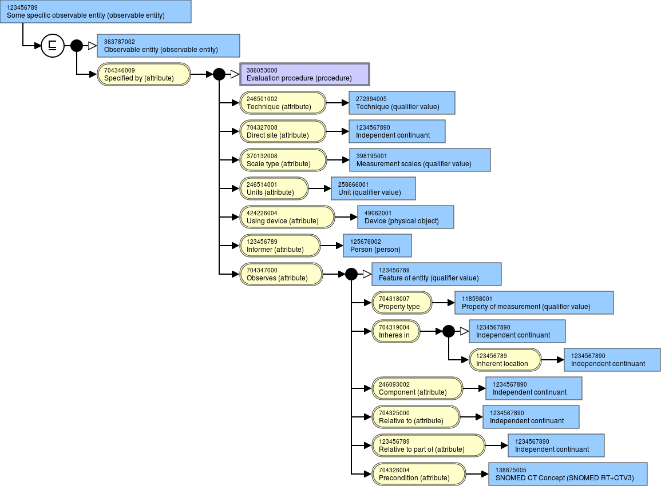
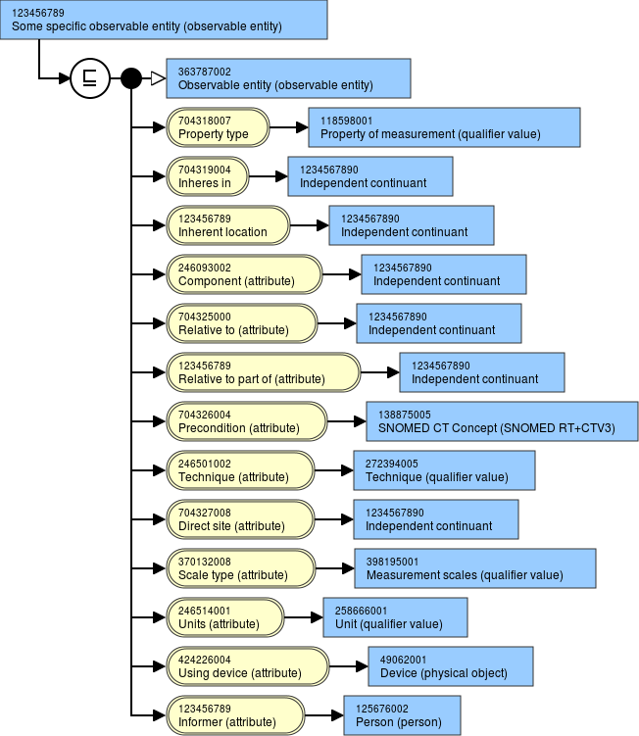
Nested vs. Flat

Slide 11
Observation results
Coordination with other content development projects
Finding/Condition/Situation in relation to Observation results
Observation results put on hold temporarily

Slide 12
Quality observables

Slide 13
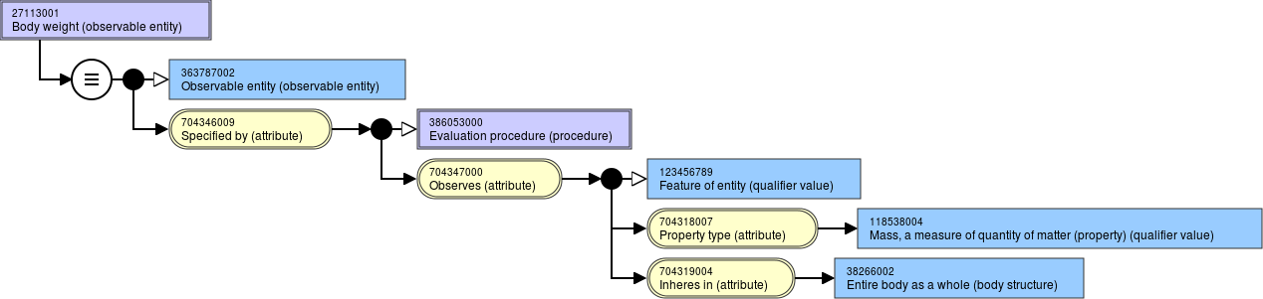
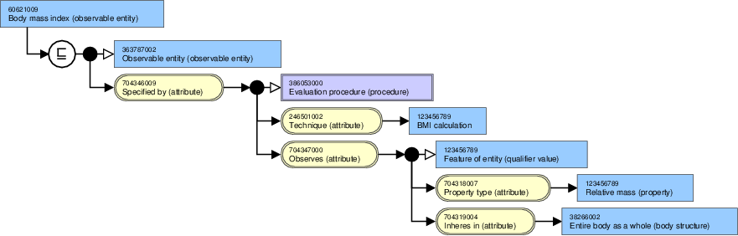
Quality observables

Slide 14
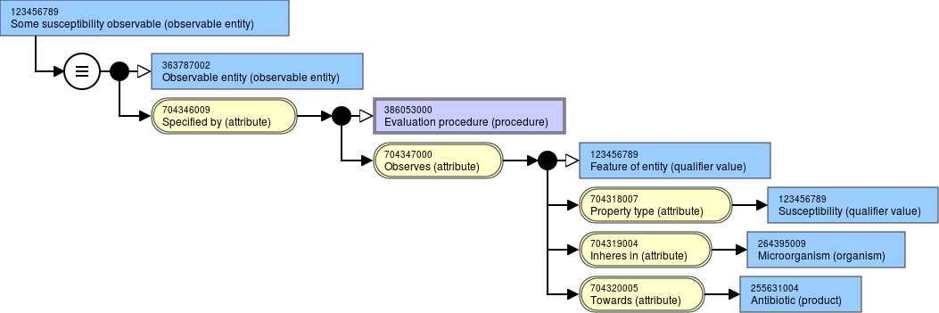
Disposition observables

Slide 15
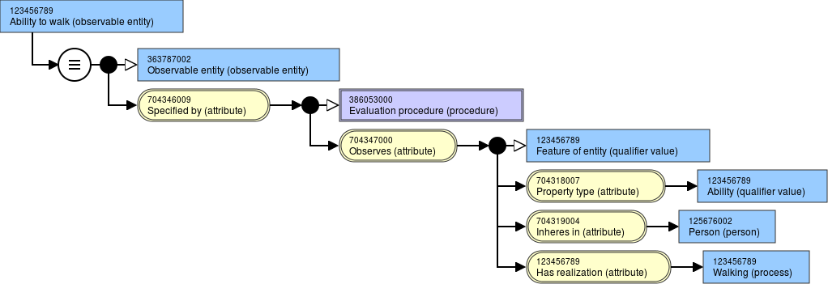
Function observable

Slide 16
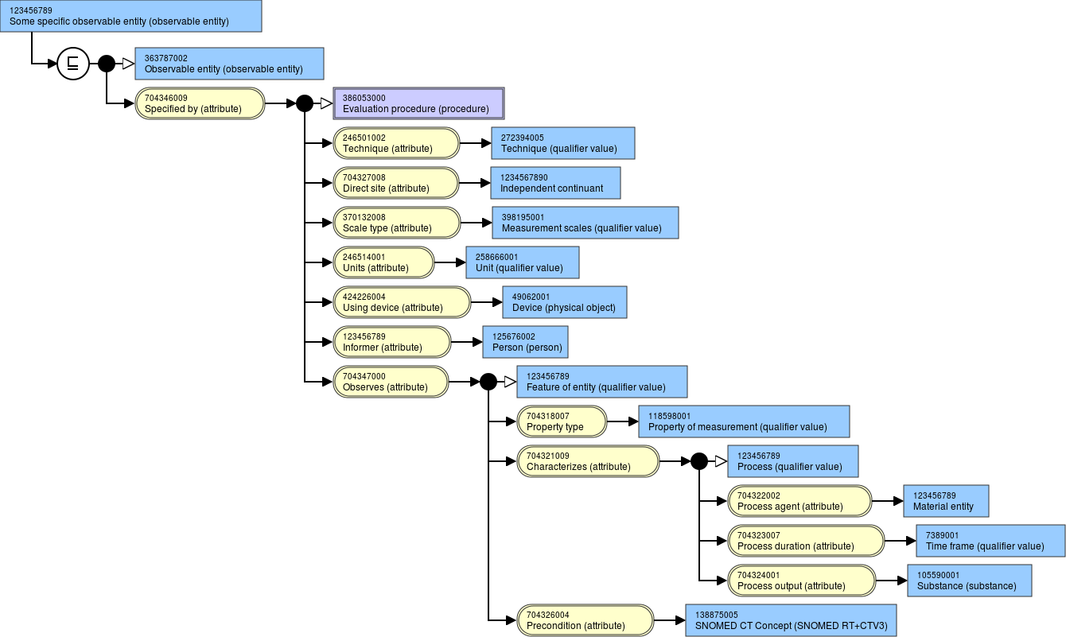
Process observables

Slide 17
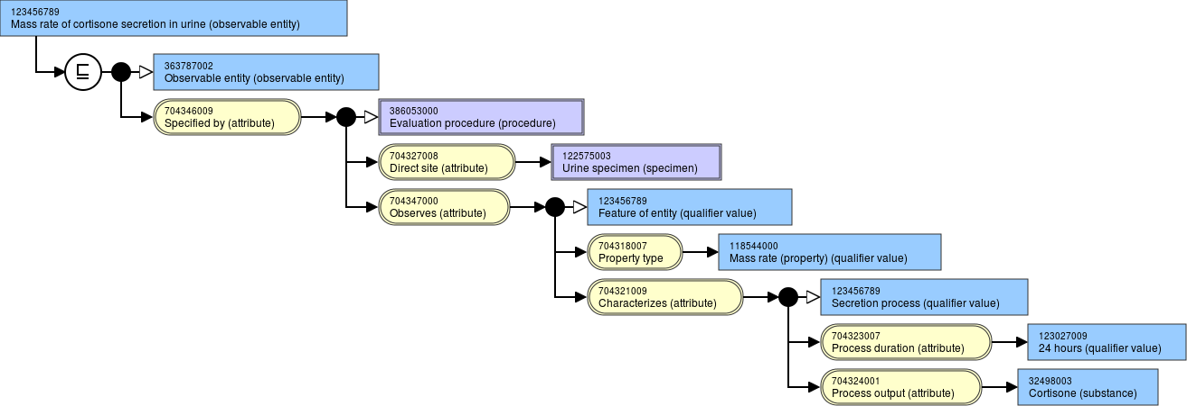
Process observables

Slide 18
Remaining issues (selection)
Aggregation
  Maximum, Average, …
Presence
  Findings
  Material entities (other than covered by Findings)
Assessment scales
Nesting
  Inherent location
Qualities and processes

