Slide 1
Observables Concept Model for Deployment of Anatomical Pathology
Montevideo, UY Discussion
10/28/2015

Slide 2
Notes from IPaLM teleconference of 10/8/2015 as follow up to London f2f meeting
Attendees:
  Farzaneh Ashrafi
  Scott Campbell
  Jim Campbell
  Alexis Carter
  Deborah Drake
  Ian Green
  Suzanne Santamaria
Consensus agreement attained for fully specified naming and concept model for all data elements listed that pertain to colon cancer, pancreatic cancer and breast cancer as contained in subsequent slides.
  JC and SC will begin terminology authoring at UNMC in the Nebraska Lexicon namespace.
  Content will be deployed in UNMC cancer reporting information flow
  Pilot terminology will be analyzed for fitness of use in UNMC environment
JC and SC to draft proposed fully specified names and concept models for immunohistochemistry content for breast cancer and colon cancer for IPaLM consideration.
Molecular pathology discussions to take place at future time. TBD.

Slide 3
Goals for today
Revisit tissue based data elements
  D Karlsson comments
  Model or Naming
Final Consensus agreement for tissue based data elements
Discussion of IHC elements
Molecular Pathology?
ID areas of development prior to concept authoring at UNMC

Slide 4
Common Data Elements Between Synoptics
Question | Colon | Breast Ca | Pancreas
Site of excised neoplasm of X | X | X | X
Greatest dimension of neoplasm of X | X | X | X
Histologic type of neoplasm of X | X | X | X
Histologic grade of neoplasm of X | X | X | X
Invasion of neoplasm of X | X | X | X
Minimum distance of invasive carcinoma to surgical margin of neoplasm of X (observable entity) | X | X | X
Presence of neoplasia at {named} surgical margin of X | X | X | X
Response of neoplasm of X to neoadjuvant therapy | X | X | x

Slide 5
More common data elements
Question | Colon | Breast Ca | Pancreas
Number of X lymph nodes examined | X | X | X
Number of X lymph nodes having neoplastic involvement from neoplasm of X | X | X | X
Site of Distant Metastesis of neoplasm of X | X | X | X
Presence of MLH1 protein expression in neoplasm of the colon detected by immunohistochemistry | X
Presence of mutant BRAF protein by Immunohistochemistry (observable entity) | X
Presence of PTEN protein by Immunohistochemistry (observable entity) | X
Percent cells of neoplasm of breast positive for estrogen receptor (observable entity) |  | X
Stain intensity of estrogen receptor positive cells of neoplasm of breast |  | X
HER2 Stain intensity of membrane of cell in neoplasm of breast (observable entity) |  | X

Slide 6
Template: Site of resection of neoplasm of XX by inspection
Site of resection of neoplasm of XXX(observable entity)
363787002|Observable entity|
≡
Property
Location NEW
Inheres in
103369006 |Neoplasm (morphology)|
Inherent location
<<123037004|Body structure(body structure)| *0-1
Scale
117362005|Nominal(qualifier)|
Technique
inspection(technique) NEW
Direct site
|Surgical excision sample(specimen)|
Note: Is direct site necessary? Is the observable about the patient or the specimen?

Slide 7
Histologic type of neoplasm of XX by LM
Histologic type of neoplasm of breast by LM (observable entity)
Note: Remove all reference
to ‘excised neoplasm’ so
not to infer completeness
363787002|Observable entity|
≡
Property
Morphology(property) NEW
Inheres in
103369006 |Neoplasm (morphology)|
Inherent location
76752008|Breast structure(body structure)|
Scale
117362005|Nominal(qualifier)|
Technique
Light microscopy with … NEW
Direct site
441652008|Formalin fixed paraffin embedded tissue|
Note: Consensus reached on this model

Slide 8
Agreed use case:{Nottingham}Histologic grade of neoplasm of XX by LM
Nottingham Grade of neoplasm of breast by LM (observable entity)
363787002|Observable entity|
≡
Property
Grade(property) NEW
DK- Is grading too generic? Is it aggressiveness?
Inheres in
103369006 |Neoplasm (morphology)|
Inherent location
76752008|Breast structure(body structure)|
Scale
117363000|Ordinal value(qualifier)|
Technique
Nottingham grading scale(scale) NEW
Technique
Light microscopy with … NEW
Direct site
441652008|Formalin fixed paraffin embedded tissue|

Slide 9
Agreed use case:
Presence of Invasion of YY of neoplasm of XX
Presence of Invasion of {Y organ/tissue} of neoplasm of XX by LM (observable entity)
Only for direct local
extension of tumor
363787002|Observable entity|
≡
Property
Local invasiveness(property) NEW
Inheres in
103369006 |Neoplasm (morphology)|
DK- If XX is pancreas, then Y cannot be represented easily => primitive.
SC-Can this be modeled as Inheres in = Neoplasm of pancreas with inherent location = YY?
Inherent location
15776008|Pancreatic structure(body structure)|
Scale
Ordinal value(qualifier)|
Technique
Light microscopy with histochemical staining NEW
Direct site
441652008|Formalin fixed paraffin embedded tissue|

Slide 10
Agreed use case: Neoplastic Involvement of YY lymph nodes of neoplasm of XX by LM
Presence metastases in XX lymph nodes of neoplasm of YY (observable)
Note: elimination
of micrometastasis
363787002|Observable entity|
≡
Property
Presence(property) NEW
Inheres in
Metastatic neoplasm (morphology)|
DK- same issues as direct extension.
Inherent location
245286003|Celiac lymph node group(body structure)|
Scale
117362005|Nominal value(qualifier)|
Technique
Light microscopy with … NEW
Direct site
441652008|Formalin fixed paraffin embedded tissue|

Slide 11
Agreed use case:
Number of X lymph nodes having neoplastic involvement from neoplasm of X
Number of X lymph nodes with having neoplastic involvement from neoplasm of XX (observable))
363787002|Observable entity|
Delete ‘micrometastases’
≡
Property
118536000|Entitic number(property)|
Inheres in
Metastatic neoplasm (morphology)|
DK-The number is really the cardinality of the set of lymph nodes with involvment. Again, this should probably be a primitive one (possibly use of precondition of neoplasm of XX)
Inherent location
245286003 |Celiac lymph node group(body structure)|
Scale
30766002|Quantitative value(qualifier)|
Technique
Light microscopy with … NEW
Direct site
441652008|Formalin fixed paraffin embedded tissue|

Slide 12
Presence of neoplasia at {named} surgical margin of neoplasm of X
Presence of neoplasia in {names} surgical margin of neoplasm of XX (observable)
Note: removal of primary
site as defining
363787002|Observable entity|
≡
Property
Invasiveness(property) NEW
Inheres in
367651003|Malignant neoplasm (morphology)|
Consensus reached on this model concept
Inherent location
Distal surgical margin (body structure) NEW
Precondition
382003004|Primary malignant neoplasm of pancreas|
Scale
117362005|Nominal value(qualifier)|
Technique
Light microscopy with … NEW
Direct site
441652008|Formalin fixed paraffin embedded tissue|

Slide 13
Proposal for Genotypic Observables Templates

Slide 14
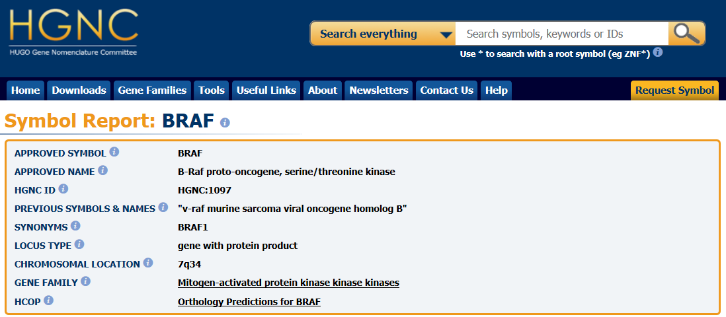
B-RAF genetics
Gene: “B-Raf proto-oncogene, serine/threonine kinase”
  Official symbol: BRAF (not in SNOMED CT 2015)
  Cytogenetics: 7q34; base pairs 140,715,950 to 140,924,763
  Locus type: gene with protein product
  Mutation phenotypes (30+ characterized): Cardiofaciocutaneous syndome; Erdheim Chester disease; Giant congenital melanocytic nevus; Noonan syndrome; cancers – melanoma, colon, ovary, thyroid; Langerhans cell histiocytosis; hairy cell leukemia
  Two antibody based treatments have been developed for malignancies that arise from BRAF mutations
Encodes…..
Protein: Serine/threonine-protein kinase B-raf
  UniProtKB - P15056 (BRAF_HUMAN)
  Protein kinase involved in the transduction of mitogenic signals from the cell membrane to the nucleus.

Slide 15
B-RAF genetics
Gene: “B-Raf proto-oncogene, serine/threonine kinase”
  Official symbol: BRAF (not in SNOMED CT 2015)
  Cytogenetics: 7q34; base pairs 140,715,950 to 140,924,763
  Locus type: gene with protein product
  Mutation phenotypes (30+ characterized): Cardiofaciocutaneous syndome; Erdheim Chester disease; Giant congenital melanocytic nevus; Noonan syndrome; cancers – melanoma, colon, ovary, thyroid; Langerhans cell histiocytosis; hairy cell leukemia
  Two antibody based treatments have been developed for malignancies that arise from BRAF mutations
Encodes…..
Protein: Serine/threonine-protein kinase B-raf
  UniProtKB - P15056 (BRAF_HUMAN)
  Protein kinase involved in the transduction of mitogenic signals from the cell membrane to the nucleus.

Slide 16
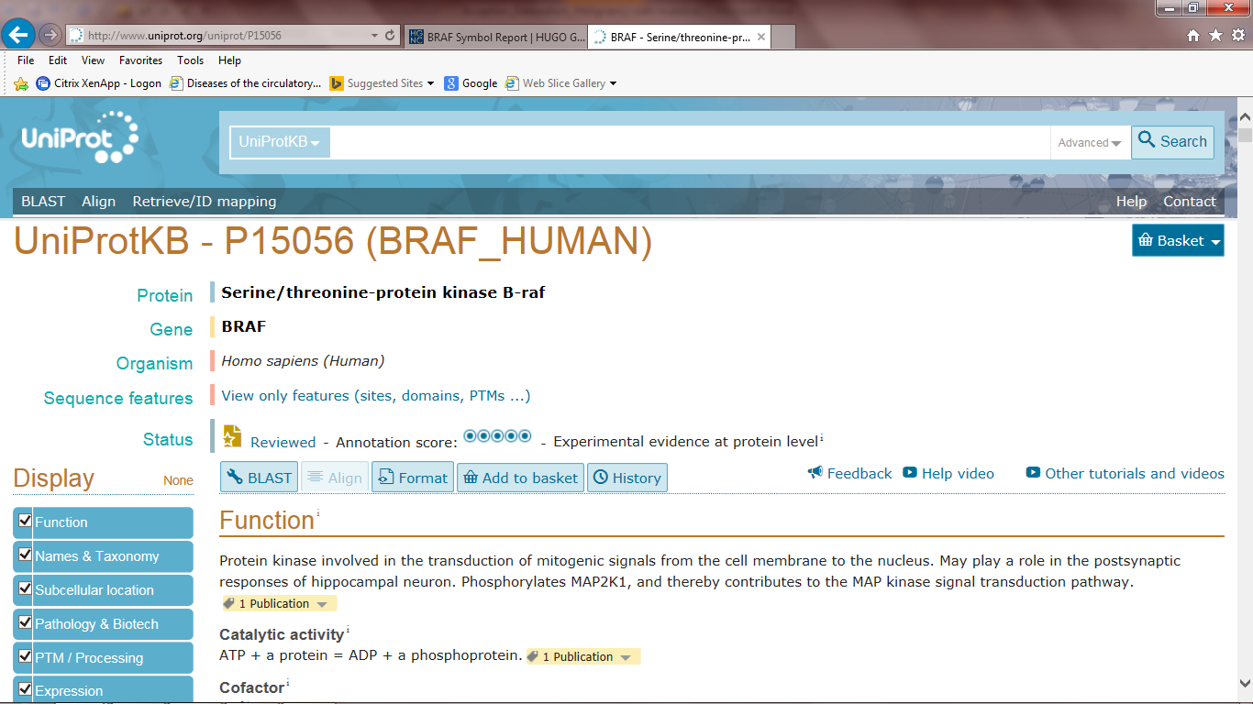
B-RAF genetics
Gene: “B-Raf proto-oncogene, serine/threonine kinase”
  Official symbol: BRAF (not in SNOMED CT 2015)
  Cytogenetics: 7q34; base pairs 140,715,950 to 140,924,763
  Mutation phenotypes: Cardiofaciocutaneous syndome; Erdheim Chester disease; Giant congenital melanocytic nevus; Noonan syndrome; cancers – melanoma, colon, ovary, thyroid; Langerhans cell histiocytosis
  Two antibody based treatments have been developed for malignancies that arise from BRAF mutations
Encodes…..
Protein: Serine/threonine-protein kinase B-raf
  UniProtKB - P15056 (BRAF_HUMAN)
  Not in SNOMED CT Jan 2015
  Protein kinase involved in the transduction of mitogenic signals from the cell membrane to the nucleus.

Slide 17
Agreed flattened observable model template for trial use
Fully specified name (observable entity)
363787002|Observable entity|
704318007|Property type|
<<118598001|Measurement property| *1
≡
704319004|Inheres in|
<<Body structure, <<Substance, <<Organism, <<Specimen *1
Inherent location NEW
<<Body structure, <<Substance, <<Organism, <<Specimen *0-1
704320005 |Towards|
<<Body structure, <<Substance, <<Clinical finding <<Organism *0-1
704326004 |Precondition|
Clinical findings, Procedures *0-many
370134009 |Time aspect|
<<272103003|Time patterns (qualifier)| *1
370132008 |Scale type|
<<278444000|Scales types(qualifier)| *0-1
246514001 |Units|
<<258666001|Units(qualifier)| *0-1
246501002 |Technique|
<<272394005 |Technique (technique)| *0-many
Specimen prep technique NEW
<<|Preparation Technique (technique)| NEW *0-many
704327008 |Direct site|
<<Body structure,<<445405002|Specimen| *0-1
Notes:
Cream attributes are defining; brown are non-defining qualifiers

Slide 18
Nucleotide sequence variant(morphologic abnormality) NEW
41669009|Alteration of chromosome structure (morphologic abnormality)
Nucleotide sequence NEW
≡
Part of
91272006|Chromosome (cell structure)|

Slide 19
BRAF gene locus (cell structure)
B-RAF proto-oncogene
HGNC 1097
312237004|Chromosome structure(cell structure)|
Part of
70488008|Chromosome pair 7|
≡
Anatomic sequence start NEW
140,715,950 NEW concrete domain
Anatomic sequence end NEW
140,924,763 NEW concrete domain
Define named gene locus
BRAF PROTO-ONCOGENE
IS_A (NAMED) NUCLEOTIDE SEQUENCE
IS_A (HUMAN) CHROMOSOME STRUCTURE

Slide 20
Sequence observation for named gene locus
XXXX sequence observed in neoplasm (observable entity)
363787002|Observable entity|
704318007|Property type|
Nucleotide sequence NEW
≡
704319004|Inheres in|
312237004|Chromosome structure|
Inherent location NEW
XXX gene locus (cell structure)| NEW
370134009 |Time aspect|
Single point in time
370132008 |Scale type|
Nominal
246501002 |Technique|
NextGen sequencing NEW
704327008 |Direct site|
<<119376003|Tissue specimen|
Notes:
Cream attributes are defining; brown are non-defining qualifiers

Slide 21
BRAF V600E detected in biopsy of neoplasm (finding)
441742003|Evaluation finding|
Interprets
BRAF sequence observed in specimen NEW
≡
Has interpretation
MCG:BRAF c1799T>A (V600E) NEW concrete domain
Finding site
BRAF gene locus(cell structure) NEW
Associated morphology
Nucleotide sequence variant NEW

Slide 22
BRAF V600E detected in malignant melanoma of skin(finding)
441742003|Evaluation finding|
≡
Interprets
BRAF sequence observed in specimen NEW
Has interpretation
MCG:BRAF c1799T>A (V600E) NEW concrete domain
Finding site
BRAF gene locus(cell structure) NEW
Associated morphology
Nucleotide sequence variant NEW
Method
NextGen sequencing NEW
Associated morphology
2092003|malignant melanoma(morphology)|
Finding site
39937001|Skin structure(body structure)|

Slide 23
BRAF V600E identified by immunoperoxidase in neoplasm(observable entity)
363787002|Observable entity|
704318007|Property type|
705057003|Presence|
≡
704319004|Inheres in|
<<108369006|Neoplasm|
704320005 |Towards|
BRAF V600E mutation (finding) NEW
370134009 |Time aspect|
Single point in time
246501002 |Technique|
Genetic protein probe NEW
Specimen prep technique NEW
Immunoperoxidase tagged stain NEW
Notes:
Cream attributes are defining; brown are non-defining qualifiers

Slide 24
SIRS:
“BRCA1 mutation carrier”

Slide 25
BRCA1 mutation
Over 1800 mutations identified, most with oncogenetic risk but prevalence rates often specific to ethnicity
Hereditary risk for breast, ovarian, fallopian tube and prostate cancers as well as leukemias and lymphomas
Testing available for BRCA1 mutated proteins(antigen) as well as sequence analysis

Slide 26
BRCA1 gene
Gene: “Breast cancer 1, early onset”
  Synonyms: BRCA1/BRCA2-containing complex, subunit 1; Fanconi anemia, complementation group S; FANCS; PPP1R53; Protein phosphatase 1 regulatory subunit 53, RNF53
  Tumor suppressor gene; not a true oncogene
  Symbol: BRCA1 HGNC:1100
  Locus type: gene with protein product
  Chromosome: 17q21.31; base pairs 41,196,312 to 41,277,500
  Lung and ovarian cancer expression of BRCA1 predictive of response to chemotherapy
Encodes:
Protein: Breast cancer type 1 susceptibility protein
  Uniprot: P38398 (BRCA1_HUMAN)
  Function: cellular DNA repair

Slide 27
BRCA1 gene locus (cell structure)
312237004|Chromosome structure(cell structure)|
Part of
Long arm chromosome 17 NEW
≡
Anatomic location NEW
17q21.31 NEW concrete domain
Notes:
Cream attributes are defining; brown are non-defining qualifiers

Slide 28
BRCA1 gene locus (cell structure)
BRCA1/BRCA2 complex
Fanconi anemia complement S
HGNC 1100
312237004|Chromosome structure(cell structure)|
Part of
|Chromosome pair 17|
≡
Anatomic sequence start NEW
43094112 NEW concrete domain
Anatomic sequence end NEW
43124540 NEW concrete domain

Slide 29
BRCA1 sequence observed in tissue (observable entity)
363787002|Observable entity|
704318007|Property type|
Nucleotide sequence NEW
≡
704319004|Inheres in|
Cell structure (cell structure)|
Inherent location NEW
BRCA1 gene locus (cell structure)| NEW
370134009 |Time aspect|
Single point in time
370132008 |Scale type|
Nominal
246501002 |Technique|
NextGen sequencing NEW
704327008 |Direct site|
119376003|Tissue specimen|
Notes:
Cream attributes are defining; brown are non-defining qualifiers

Slide 30
412734009 |BRCA1 gene mutation positive (finding)|
441742003|Evaluation finding|
Interprets
BRCA1 sequence observed in tissue NEW
≡
Has interpretation
Variant data for BRCA1 mutation
Finding site
BRCA1 gene locus(cell structure) NEW
Associated morphology
Nucleotide sequence variant NEW

Slide 31
BRCA1 variant positive by immunoperoxidase staining of blood specimen (observable entity)
363787002|Observable entity|
704318007|Property type|
<<118598001|Measurement property| *1
≡
704319004|Inheres in|
<<Body structure, <<Substance, <<Organism, <<Specimen *1
Inherent location NEW
<<Body structure, <<Substance, <<Organism, <<Specimen *0-1
704320005 |Towards|
<<Body structure, <<Substance, <<Clinical finding <<Organism *0-1
704326004 |Precondition|
Clinical findings, Procedures *0-many
370134009 |Time aspect|
<<272103003|Time patterns (qualifier)| *1
370132008 |Scale type|
<<278444000|Scales types(qualifier)| *0-1
246514001 |Units|
<<258666001|Units(qualifier)| *0-1
246501002 |Technique|
<<272394005 |Technique (technique)| *0-many
Specimen prep technique NEW
<<|Preparation Technique (technique)| NEW *0-many
704327008 |Direct site|
<<Body structure,<<445405002|Specimen| *0-1
Notes:
Cream attributes are defining; brown are non-defining qualifiers

Slide 32
MSH2 sequence observed in neoplasm(observable entity)
363787002|Observable entity|
704318007|Property type|
Nucleotide sequence NEW
≡
704319004|Inheres in|
108369006|Neoplasm(morphology)|
Inherent location NEW
MSH2 gene locus (cell structure)| NEW
370134009 |Time aspect|
Single point in time
370132008 |Scale type|
Nominal
246501002 |Technique|
NextGen sequencing NEW
704327008 |Direct site|
445405002|Surgical specimen|
Notes:
Cream attributes are defining; brown are non-defining qualifiers

Slide 33
HNPCC1 variant detected in biopsy of neoplasm (finding)
441742003|Evaluation finding|
Interprets
MSH2 sequence observed in neoplasm NEW
≡
OMIM:MSH2 c6T>C NEW concrete domain
Has interpretation
Finding site
MSH2 gene locus(cell structure) NEW
Associated morphology
Nucleotide sequence variant NEW

Slide 34
|HNPCC1 positive colorectal adenocarcinoma (finding)| NEW
|Disorder(disorder)||
Finding site
71854001|Colon structure(body structure)|
≡
Associated morphology
35917007|Adenocarcinoma(morphology)|
Associated with
HNPCC1 variant detected in neoplasm NEW

