Slide 1
LOINC – SNOMED CT
Cooperation Project Update
Observables and Investigation Model Project
October 2015
Montevideo, Uruguay

Slide 2
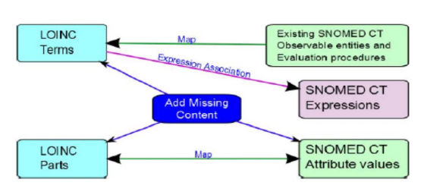
Background
Cooperative agreement between RII and IHTSDO, July 2013
  Builds on strengths of each terminology
  Minimize and manage duplication
  SNOMED CT and LOINC work better together
  Provide links between LOINC and SNOMED CT

Slide 3
Value
Greater consistency in coding of order entry and results reporting
Improvements in each terminology
Improved analytics and quality control
  Query LOINC via SNOMED CT hierarchy and relationships
  Better identification and maintenance of laboratory tests value sets for public health reporting
  Enhanced tracking and management of infectious disease outbreaks
Integrates disparate elements in EHRs
  Lab test in LOINC with elements in patient chart in SNOMED CT (e.g. allergies, chief complaint, vital signs, age)
  Enables clinical decision support, may aid in reimbursement

Slide 4
Roles of individuals and groups
Internal project team – currently 7 individuals
  Business Services Executive, Head of Education, Release Manager, Digital Product Architect, Head of Terminology, Terminologists
LOINC project team contacts
Executive Policy Group (3 from RII and 3 from IHTSDO)
Observable and Investigation Model Project
  Subproject on CollabNet (those interested in participating contact SSA or FAS)
Project groups and Special Interest Groups (e.g. Substance Redesign, Organism and Infectious Redesign, IPaLM SIG )
External collaborators:
  Kaiser Permanente
  US Veterans Administration
Notes:
IHTSDO individuals and roles:
Business Services Executive – Ian Green
Head of Education – David Markwell
Release Manager – Andrew Atkinson
Digital Product Architect – Robert Turnball
Head of Terminology – James Case
Terminologists – Farzaneh Ashrafi and Suzanne Santamaria

Slide 5
Project scope
Scope
  Laboratory LOINC
  Vital signs
  Physiologic measurements
  Anthropomorphic measurements and evaluations
Phases
  Initial
    Top 2000 lab LOINC tests
    Microbiology
    Chemistry
    Vital signs
  Subsequent
    Remainder of lab LOINC
    Measurements

Slide 6
Roadmap
Alpha release
Technology Preview release
Map LOINC parts
to SNOMED
Candidate baseline
release
Map LOINC codes
to SNOMED
expressions
Develop
distribution
format
LOINC Answer sets mapped to SNOMED codes
Business Meeting
Business Meeting
Business Meeting
Business Meeting
April 2014
September 2015
July 2016
Jan 2014
October 2014
January 2016

Slide 7
Development phase objectives
Collaboration
  Invite participation by stakeholders
  Regular meetings (internal group; EPG; KP)
  Ensure approach works with concurrent projects (e.g. Substance Redesign, Vital signs)
  Publicize work and progress
Content development
  Add and update content to SNOMED CT to complete the LOINC Parts map (techniques, substances, etc.)
  Determine the best approach for handling complex concepts
  Create documentation of process and outcomes
  Create and deliver alpha release and Technology Previews
Test and obtain feedback
  Document and test the Observables model (including description logic)
  Document the quality test plan
  Review feedback on releases from stakeholders

Slide 8
1. Collaboration
Regenstrief Institute
Project groups (Observable Redesign projects, Substance, Organism), IPaLM SIG
Regular meetings held (internal group; EPG; KP)
Posters at 2014 ICBO and SNOMED CT Showcase
Presentation at 2015 SNOMED CT EXPO

Slide 9
2. Content Development
SNOMED CT concepts added for LOINC Part mapping + metadata
  Added 1500 new concepts to SNOMED CT
Draft implementation guidance released July 2014
alpha release released May 2014 with documentation
  117 LOINC Terms
Development of Technology Preview Structure Process
Technology Preview released October 2014 with documentation
  2100 LOINC Parts in LOINC Part to SNOMED RefSet
  9700 LOINC Terms in LOINC Term to Expression RefSet
Evaluation of the feedback received on the first version of the technology preview regarding release format and content
Second Technology Preview released in September 2015 with documentation
  4061 LOINC Parts in LOINC Part to SNOMED CT RefSet
  14736 LOINC Terms in LOINC Term to Expression RefSet
  75% of top 2000 LOINC terms are mapped

Slide 10
3. Test and obtain feedback
Report on implementation horizon and scope released April 2014
Performed quality test plan for functionality and reproducibility
Analyzed feedback on alpha prototype and first release of Technology Preview and modified content accordingly
Documented and tested the Observables model (including description logic and creation of OWL ontology)

Slide 11
Next steps
  Scheduled:
    Evaluation of feedback on 2nd Technology Preview – Fall 2015
    Prepare and release 3rd Technology Preview with flattened instead of nested model – January 2015
    Evaluation of feedback on 3rd Technology Preview - Spring 2016
    Prepare candidate baseline release – July 2016
    Finalize map of LOINC Parts to SNOMED CT concepts – Pending receipt of full set from RII
    Implement SNOMED CT Observables model to define existing pre-coordinated SNOMED CT concepts – Pending Observable model implementation
  Ongoing:
    Evaluation of changes resulting from updates to the Observable model inception/elaboration document
    Resolution of known/upcoming content/modelling issues

Slide 12
Combined models for | observable entity | and | observation procedure |
https://csfe.aceworkspace.net/sf/go/doc12009
property type
property types
inheres in
independent continuants
quality or property
(inherent) location
material entities
(inherent) ingredient
substances
is about
characterizes
processes
process agent
material entities
observable
entity
process duration
time frames
process output
substances
towards
independent continuants
relative to
substances
specified by
(rel-to) part of
independent continuants
precondition
precondition values
observation procedure
scale
scale types
units
units
technique
techniques
observes
direct site
material entities
informer
subjects

Slide 13
Model for ‘quality’ observables
LOINC elements
IFCC-IUPAC NPU elements
property type
property types
Kind-of-property
property
inheres in
independent continuants
is about
quality
System/specimen
system
towards
functions, substances
component
component
precondition
body states
component
observable
scale
scale types
scale
units
units
units
technique
techniques
method
method
direct site
body structures, specimens
System/specimen

Slide 14
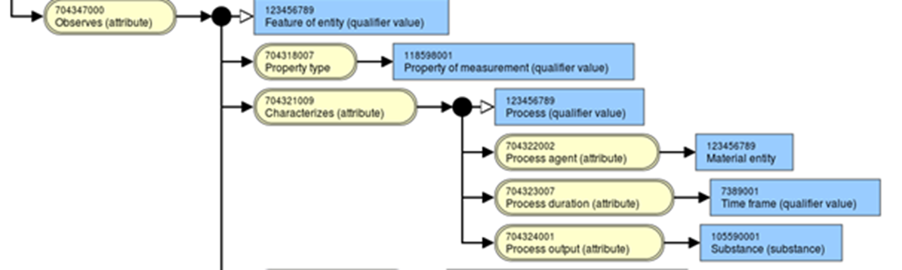
Notes:
We haven’t used process agent yet.

Slide 15
LOINC Term to SNOMED Expression Refset Example – Quality Observable
id | mapTarget | expression
823815fc-cb5a-4655-b486-19da62053943 | 27182-5 | Calcium:ACnc:Pt:Bld:Ord | 363787002|Observable entity|:70434600|Specified by|=(386053000|Observation procedure|: 704347000|Observes|=(414237002| Feature of entity|:704319004|Inheres in|=87612001|Blood|,704320005|Towards|=259295006|Calcium electrolyte|,704318007|Property type|=118569000|Arbitrary concentration|),704327008|Direct site|=119297000|Blood specimen|,370132008|Scale|=117363000|Ordinal value|)
LOINC Term
SNOMED attribute concept
SNOMED value concept
Expression is Fully Defined

Slide 16
LOINC Term to SNOMED Expression Refset Example – Quality Observable
id | mapTarget | expression
cc1e1a70-48c0-44e6-8ba8-88a40d2b1a52 | 9796-4 |Color:Type:Pt:Calculus:Nom | 363787002|Observable entity|:70434600|70434600|Specified by|=(386053000|Observation procedure|:704327008|Direct site|=119350003|Calculus specimen|,370132008|Scale|=117362005|Nominal|,704347000|Observes|=(414237002|Feature of entity|:704318007|Property Type|=703247007|Color|,704319004|Inheres In|=794887015|Calculus|))
LOINC Term
SNOMED attribute concept
SNOMED value concept
Expression is Fully Defined

Slide 17
Challenges in mapping thus far
Where mapping of LOINC Parts to SNOMED codes cannot be 1:1
Where LOINC Parts do not appear to have a clear, reproducible meaning
Verifying possible duplication within LOINC or within SNOMED
When SNOMED lacks the type of information needed to complete a map
Lack of clear differentiation between general categories of classes and specific types, present in both SNOMED and LOINC
Notes:
Examples:
Appearance of urine, Unidentified crystals, specimen + system
Leukocytes other
4. New population of cells hierarchy needed in SNOMED
5. Amphetamines vs amphetamine

Slide 18
LOINC Term to SNOMED Expression Refset Example – Quality Observable
id | mapTarget | expression
c11e74ec-5935-4757-bdae-abab8320ac4d | 15190-2 | Leukocytes other:Prid:Pt:Bld:Nom:Automated count | 363787002|Observable entity|:70434600|Specified by|=(386053000|Observation procedure|:704327008|Direct site|=119297000|Blood specimen|,370132008|Scale|=117362005|Nominal|,246501002|Technique|=702659008|Automated count|,704347000|Observes|=(414237002|Feature of entity|:704319004|Inheres In|=87612001|Blood|, 704320005|Towards|=702962009 |Population of all leukocytes in portion of fluid|,704318007|Property Type|=118584009|Presence OR identity|))
LOINC Term
SNOMED attribute concept
SNOMED value concept
Expression is Primitive

Slide 19
LOINC Term to SNOMED Expression Refset Example – Quality Observable
id | mapTarget | expression
33434620-1e97-4656-8a14-263d8fa9c7a2 | 5783-6 | Crystals.unidentified:ACnc:Pt:Urine sed:Ord:Microscopy.light | 363787002|Observable entity|:70434600|Specified by|=(386053000|Observation procedure|:246501002|Technique|=703754002|Detecting by light microscopy without classifying|,704347000|Observes|=(414237002|Feature of entity|:704320005|Towards|=413935006|Crystal|,704318007|Property type|=118569000|Arbitrary concentration|,704319004|Inheres In|=386100006|Urine sediment|),704327008|Direct site|=122567009|Urine sediment specimen|,370132008|Scale|=117363000|Ordinal|)
LOINC Term
SNOMED attribute concept
SNOMED value concept
Expression is Fully Defined

Slide 20
LOINC Term to SNOMED Expression Refset Example – Process Observable
id | mapTarget | expression
2bea5348-61e9-4d47-9204-bdeaf17a83b8 | 2989-2 | Testosterone:MRat:24H:Urine:Qn | 363787002|Observable entity|:70434600|Specified by|=(386053000|386053000|Observation procedure|:704327008|Direct site|=122575003|Urine|,704347000|Observes|=(Feature of entity|:704323007|Process Duration|=123027009|24 hours|,704321009|Characterizes|=63911002|Excretion|,704318007|Property Type|=118544000|Mass rate|,704324001|Process Output|=43688007|Testosterone|),370132008|Scale|=30766002|Quantitative|)
LOINC Term
SNOMED attribute concept
SNOMED value concept
Expression is Fully Defined

Slide 21

Release formats
Technology Preview of the LOINC - SNOMED CT Cooperative Project is made available in Release Format 2 (RF2).
There are 2 additional formats available for this Technology Preview:
  OWL
  Human Readable

Slide 22
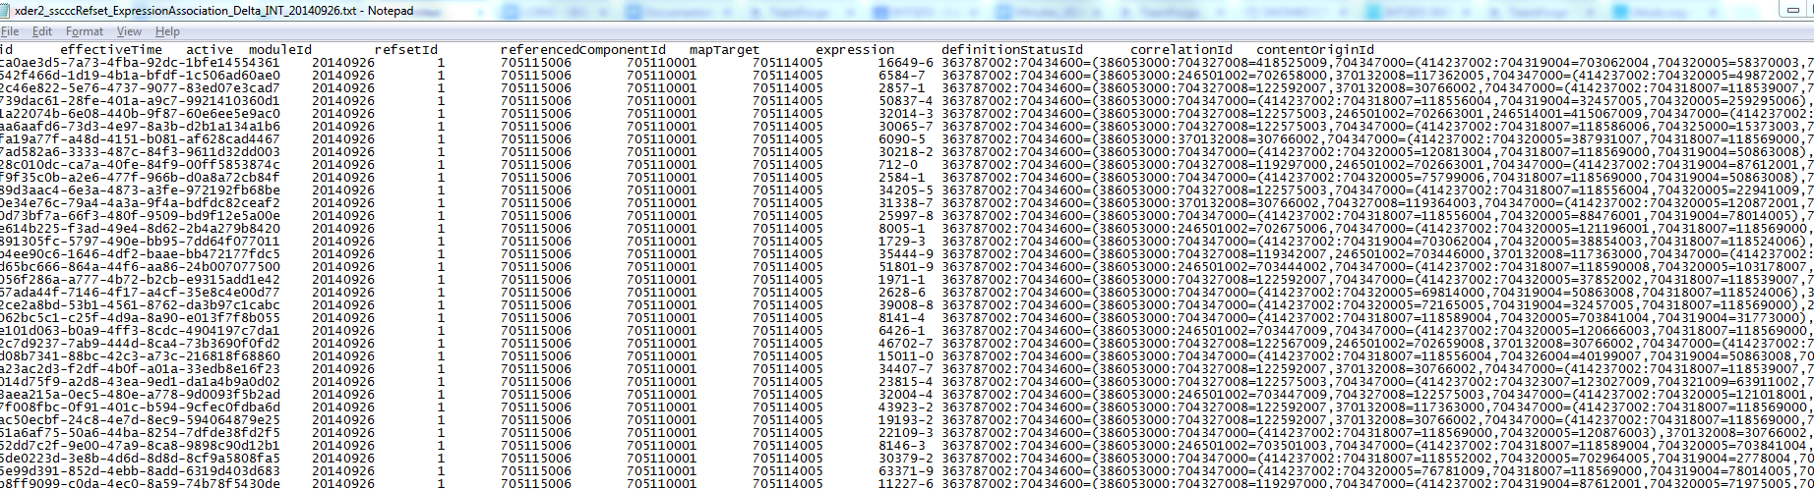
Sample of LOINC Term – SNOMED Expression Refset file
Notes:
Creates inferences between LOINC Terms.

Slide 23
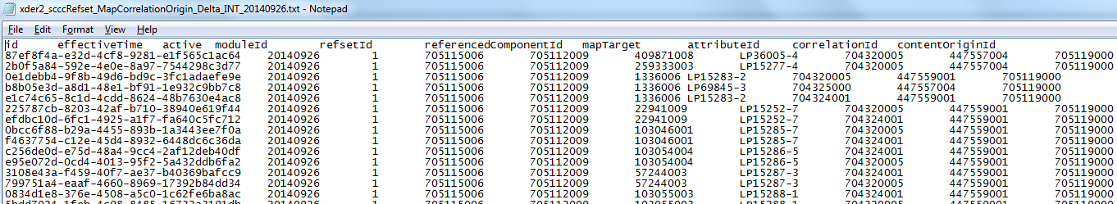
Sample of LOINC Part – SNOMED Refset file
Notes:
Creates inferences between LOINC Terms.

Slide 24
Presentation of LOINC SNOMED CT harmonization in Protégé
Notes:
Module extraction

Slide 25
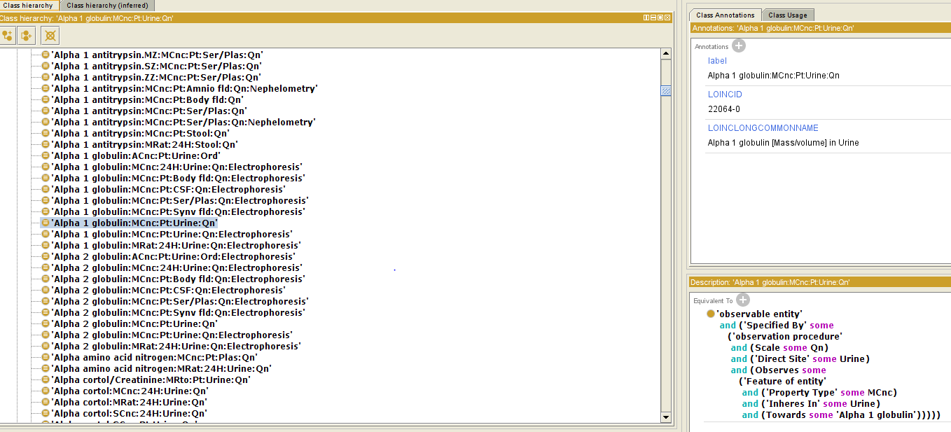
Example of review of OWL file content before classification with reasoner
Flat hierarchy
Notes:
Using Protégé software

Slide 26
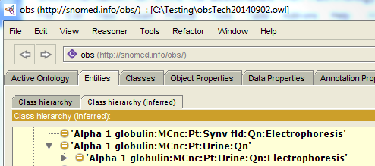
Example of review of OWL file content after classification with reasoner (ELK,..)
Inferred hierarchy
Notes:
Creates inferences between LOINC terms and equivalences.
The classification with SNOMED CT (or Extracted module)

Slide 27
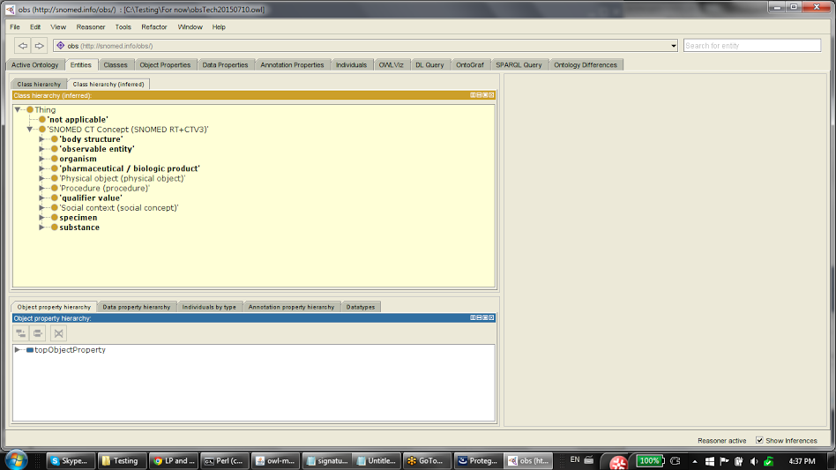
OWL file after importing SCT Module and classification with reasoner (ELK,..)

Slide 28
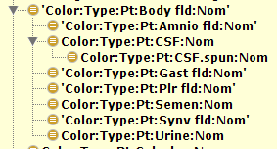
OWL file after importing SCT Module and classification with reasoner (ELK,..)

Slide 29
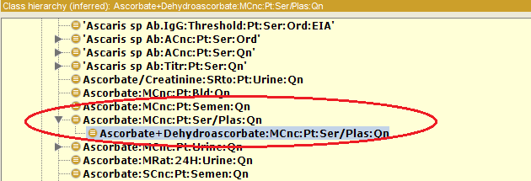
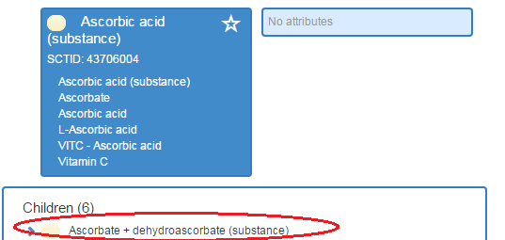
OWL file after importing SCT Module and classification with reasoner (ELK,..)

Slide 30
Project dependencies
Content and modelling questions

Slide 31
Dependency on Observable Model
  The Observables and Investigation Model is used to properly represent and provide linkage to laboratory observable content expressions that represent the meaning of LOINC terms
  New model is considered more complex than existing models in SNOMED CT
  New model is not yet finalized and is dealing with specific issues that require discussion/decisions
  Any updates/decisions to the Observable model may affect LOINC project
The mapping to date:
  Used an earlier version of the new model in a nested format
  Quality and process observables

Slide 32
Pending questions and dependencies
General
  Flat vs. Nested Model
Laboratory
  Multiple Techniques
  Direct site vs. Inheres In
  Toward vs. Component
  Numbered Specimen
  Impression/interpretation
  Inherent location
  Substance vs. product
  Genetic testing
  Susceptibility
  Allergenicity
Vital sign
  Draft Inception/elaboration document

Slide 33
Multiple Techniques
Multiple techniques vs. combination of techniques:
  One technique refers to measurement technique and the other refers to revising the value/number
  Options:
    Have two technique attributes: technique 1 for the measurement and technique 2 for adjustment of the value.
      Requires consideration about nesting, order, etc.
    Combine the techniques (the preferred option)
      Automated count output corrected for nucleated erythrocytes (qualifier value)
  IPaLM SIG discussion regarding specimen preparation technique
Notes:
Multiple techniques:

Slide 34
Direct site vs. Inheres In
Feedback on TP 2 provided by RII: “Definitions of “Inheres in” and “Direct site” from the preview spreadsheet:
  704319004 | Inheres in (attribute)
    This attribute specifies the independent continuant in which the quality inheres, and on which the dependent quality (of this observable) depends.
  704327008 | Direct site (attribute)
    This attribute represents the specific entity on which the observation is directly made, and is used when the observation is indirect, such as when a direct observation is not possible to be done on the entity in which the observable inheres.”

Slide 35
Direct site vs. Inheres In
Feedback on TP 2 provided by RII: “We are not clear why the Systems “Ser” and “Ser/Plas” are mapped to the specific Inheres in and Direct site concepts as shown below. Is plasma considered to be the “true” source for all analytes found in serum or plasma? Some analytes, such as electrolytes, are best measured in serum, so why would the Inheres in attribute be plasma?”
  Ser:
    Inheres in – Plasma (substance) | 50863008
    Direct site – Serum specimen (specimen) | 119364003
  Ser/Plas:
    Inheres in – Plasma (substance) | 50863008
    Direct site - Acellular blood (serum or plasma) specimen (specimen) | 122592007

Slide 36
Contact information
IHTSDO Project Team
  info@ihtsdo.org
  Subject: LOINC – SNOMED CT Cooperation Project

Slide 37
References
Content
  Alpha prototype files (including OWL file)
    https://csfe.aceworkspace.net/sf/frs/do/viewRelease/projects.snomed_ct_international_releases/frs.3_other_releases.loinc_snomed_alpha_prototype
  Technology Preview files (including OWL and Excel fileS)
    https://csfe.aceworkspace.net/sf/frs/do/listReleases/projects.snomed_ct_international_releases/frs.technology_preview_packages
Implementation
  Horizon and scoping report (Phase 1)
    https://csfe.aceworkspace.net/sf/go/doc10329
  Draft implementation guidance (Phase 2)
    https://csfe.aceworkspace.net/sf/go/doc10699
Observables redesign
    https://csfe.aceworkspace.net/sf/go/doc12009
RII – IHTSDO Agreement
    http://ihtsdo.org/fileadmin/user_upload/Docs_01/About_IHTSDO/Harmonization/Cooperation_Agreement_between_IHTSDO_and_RII_20130817.pdf

Slide 38
QUESTIONS & DISCUSSION

