Slide 1

IHTSDO CONFERENCE
COPENHAGEN 2010
Slovak republic – Information update

Slide 2

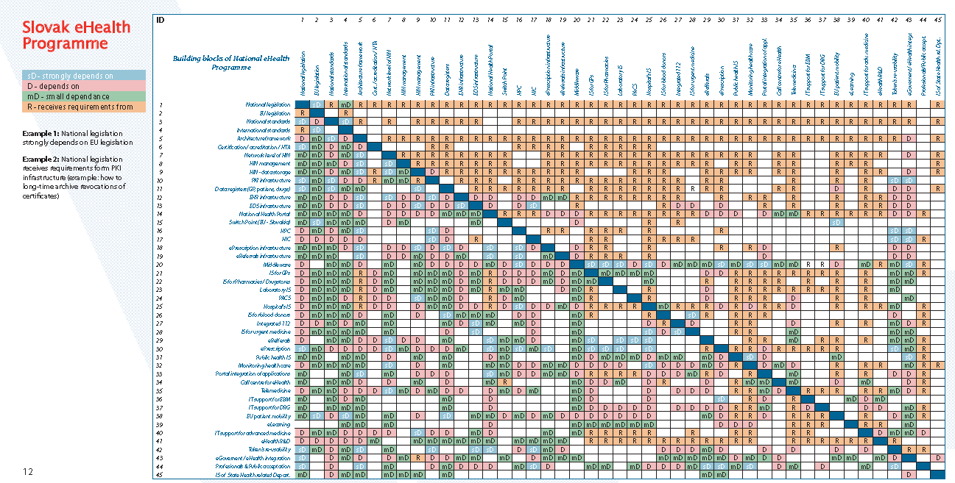
Slovak eHealth Programme

Slide 3
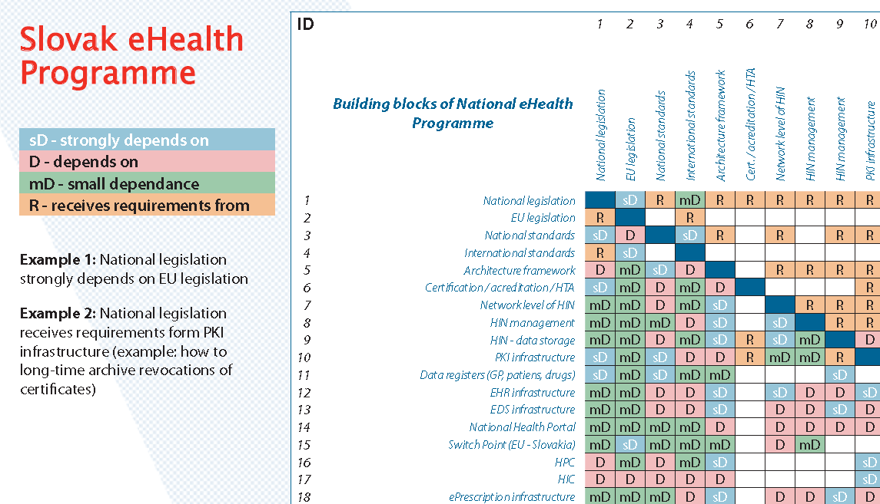
... zoom

Slide 4

National Health Portal Domain
goals
Citizens’ empowerment
Reducing inequities in health
Health policy based on the best scientific evidence

Slide 5

The services of National Health Portal
Application
domains
The electronic ordering services
The EHR/PHR services
The services of electronic prescription and
medication
The telemedicine services

Slide 6

Citizen Health eBook Domain
Candidate pages for Citizen Health eBook
1. Demographic data
2. Personal account from insurance
3. Emergency data set
4. Patient summary (epSOS compliant)
5. Vaccinations
6. Allergies
7. History
8. Diagnostic summary
9. Physiological measurements
10. Medication summary
11. Implants, prostheses and medical devices
12. Dental records
13. Laboratory tests results
14. Genealogy
15. Pregnancy page
16. Blood donor page
17. Genetic factors
18. Image documentation
19. Master patient index

Slide 7
Key services of Citizen Health eBook
Patient health record – a set of services, which
enables the safe collection, processing, storage and disclosure of structured patient medical records in electronic form.
Emergency data set – a set of services, which
enables the collection, processing, storage and rapid delivery of life-saving patient data in emergency situations.
Personal account of the insured – a service,
which provides relevant data concerning health insurance, such as assigned healthcare, prescribed drugs and medical devices.
eGenomics – a set of services, which supports
healthcare delivery by providing information about genetic screening, genetically determined predispositions and genetic risk assessment, providing access to the reference genome databases and studying the entire life cycle of genetic information.
PACS – a set of services, which enables management
of the whole life cycle of images, like collection, storage, archiving, transmission and delivery to authorized beneficiaries

Slide 8
Services of Allocation domain
eBooking – a service, which allows citizens to choose the date of visit to a physician for the first contact through the National Health Portal.
eReferral – a service, which allows physicians of the first contact to redirect patients to the specialist (including sending relevant documents in electronic form).
eWaiting list – a service, which enables management of electronic waiting lists to provide relevant information about their current status through the National Health Portal.
eReminder – a service, which provides electronic alert (via email or SMS) on the ground of impending visits to the healthcare provider.
eVaccination – a set of services, which enables the management of individual immunizations as well as data collection
eLaboratory – set of services, which enables automation of ordering laboratory tests, management of laboratory samples and reporting of results.
eCalendar – a service, which allows management of electronic calendars by healthcare providers and provides central statistical evidence.

Slide 9
Prescription Domain
Services of Prescription domain
ePrescription – a set of services, which enables
prescribing of medicine and medical devices electronically by a healthcare professional and provides centralized prescription data for the further processing.
eDispensation – a set of services, which allows
retrieving prescriptions electronically and enables centralized information reporting the dispensed medicine and medical devices.
eMedication – a set of services, which provides
a collection, processing and disclosure of relevant medication information.
ePharmacy – a set of services, which allows all
services of the pharmacy without physical visit.
eStatistics – a set of services, which allows to Ministry
of Health and health insurance companies data mining from prescription data and improve drug policy.

Slide 10
Telemedicine Domain
Services of Telemedicine domain
Tele-consilium – a service, which enables to organize
consilium of doctors, although some members of the group are physically distant, using the
video conference system with high resolution for this purpose.
Tele-monitoring – a service, which provides the
monitoring of vital signs and parameters of th patient remote from a healthcare professional, the collection of data and their transmissions to healthcare professional, or even an automatic response to the current state of the measured parameters and vital signs.
Tele-care – a service, which enables remote delivery
of professional health care or support services for individual health care.
Tele-consulting – a service, which allows remote
evaluation of pictorial information concerning the health.

Slide 11
What was done in 2009
Establishment of programme management
Conducted feasibility studies
Feasibility study of eHealth projects
Feasibility study of eHealth Architecture and
Programme management Feasibility study for the first stage
Feasibility study for the second stage
Active participation of Slovak team in semantic part of the project epSOS

Slide 12
Ongoing projects of the first stage
Legislative project
Single reference data base project – the project
aims to integrate different data sources within the health sector. At the end of 2009 the project was in its first third stage.
National Health Portal project
Citizen Health eBook project Allocation project
Prescription project

Slide 13
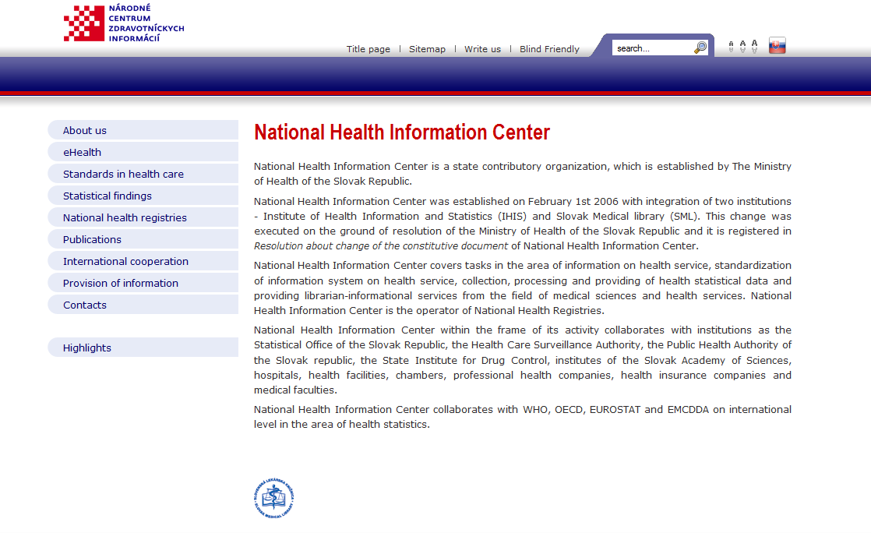

SNOMED CT National Release Centre
www.nczisk.sk

Slide 14
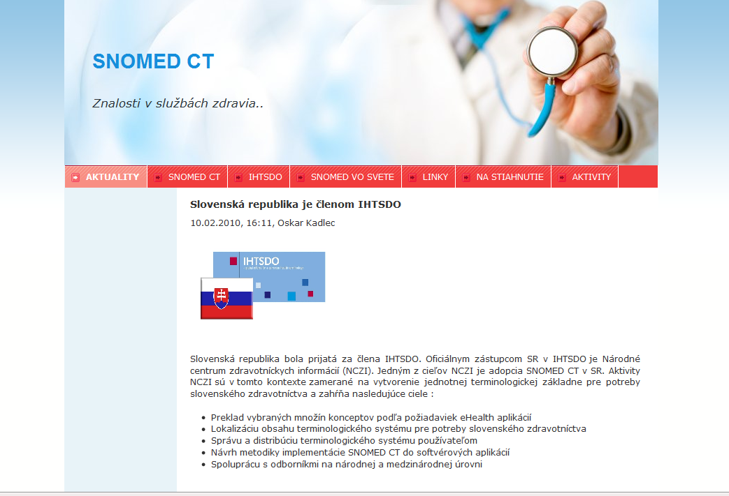
Supporting activities
www.snomed.sk

Slide 15
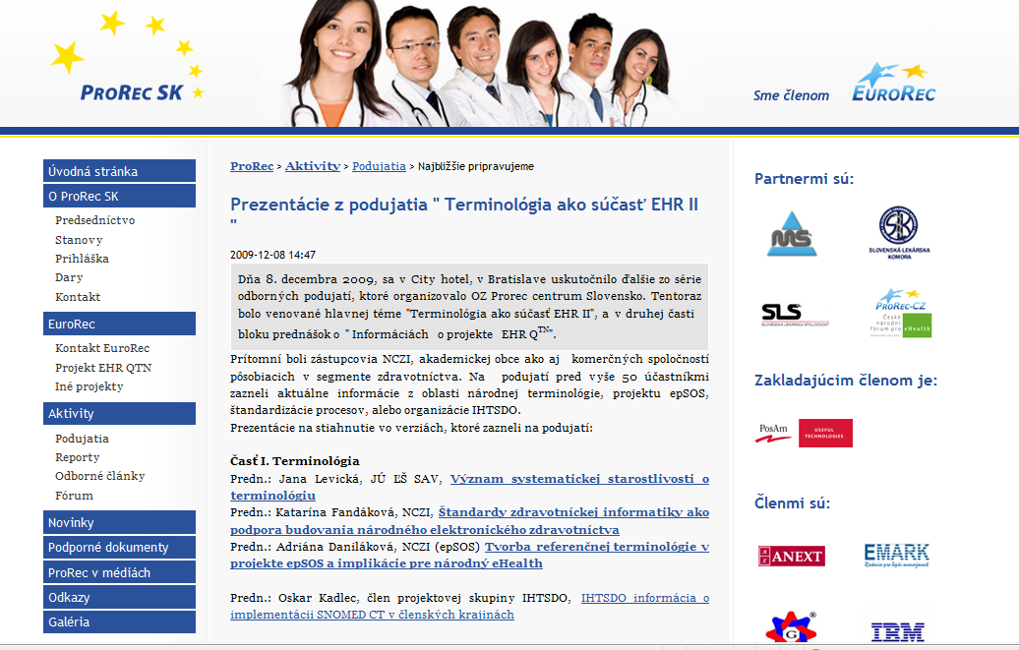
Supporting activities
www.prorecsk.sk

Slide 16

SNOMED CT and epSOS project
www.epsos.eu
SNOMED part of Master Value Set Catalogue
12 small pilot translation projects
National competence centres involved
Marketing for SNOMED CT

Slide 17
Thank you for your attention
☺

