Slide 1







London, UK
Cancer Synoptic Reporting Working Group
03/04-April 2023
snomedexpo.org | linkedin.com/company/ihtsdo | twitter.com/snomedct | youtube.com/@snomedct

Slide 2
Agenda
Agenda for Monday/Tuesday
Overview and scope of project
Progress to date
Modeling discussions (Monday)
Processes of binding to protocols for distribution (Tuesday)
Implementation guide
Future planning

Slide 3
Overview
Cancer Synoptic Reporting Working group
Project Overview and Scope
Develop the specific SNOMED CT content necessary to support pathology examination and reporting of cancer using a synoptic format (controlled questions and paired observations) such that the paired data elements maintain their meaning apart from the method or instrument of collection (i.e., paper form or GUI).

Slide 4
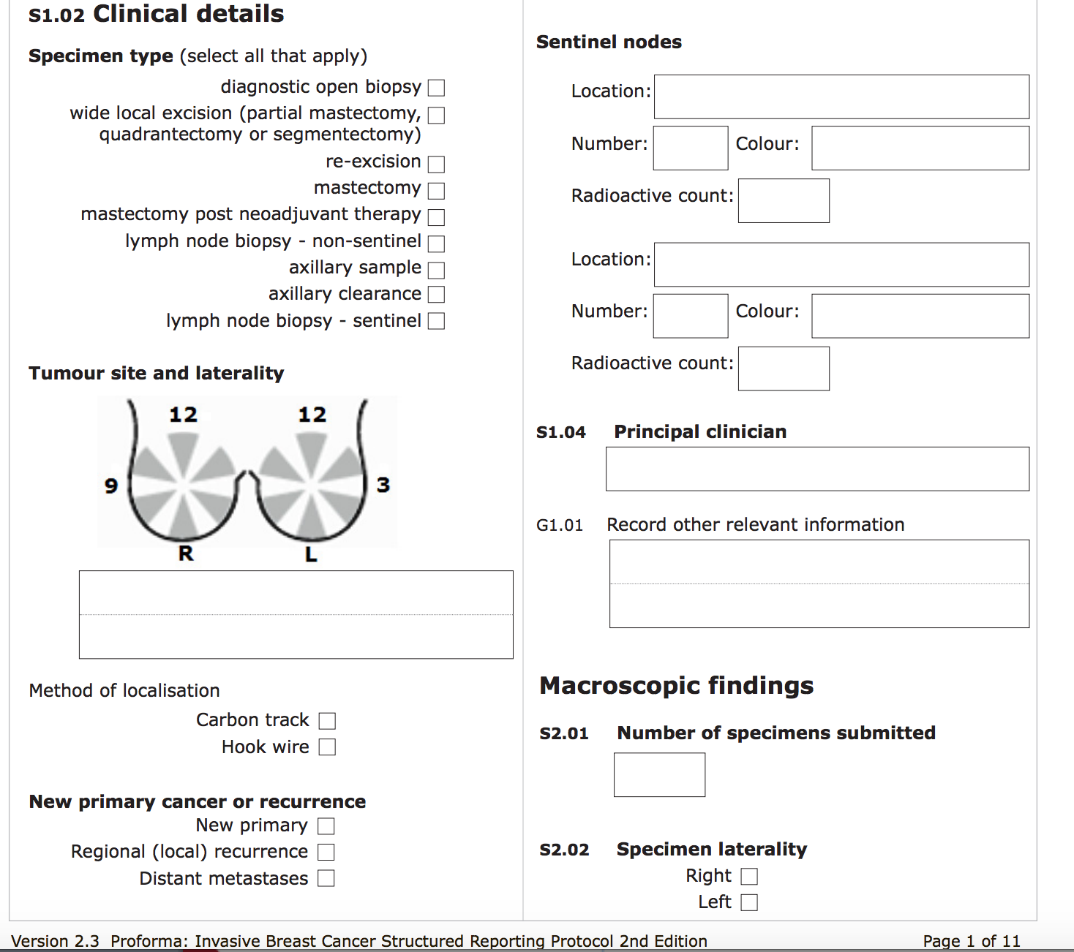
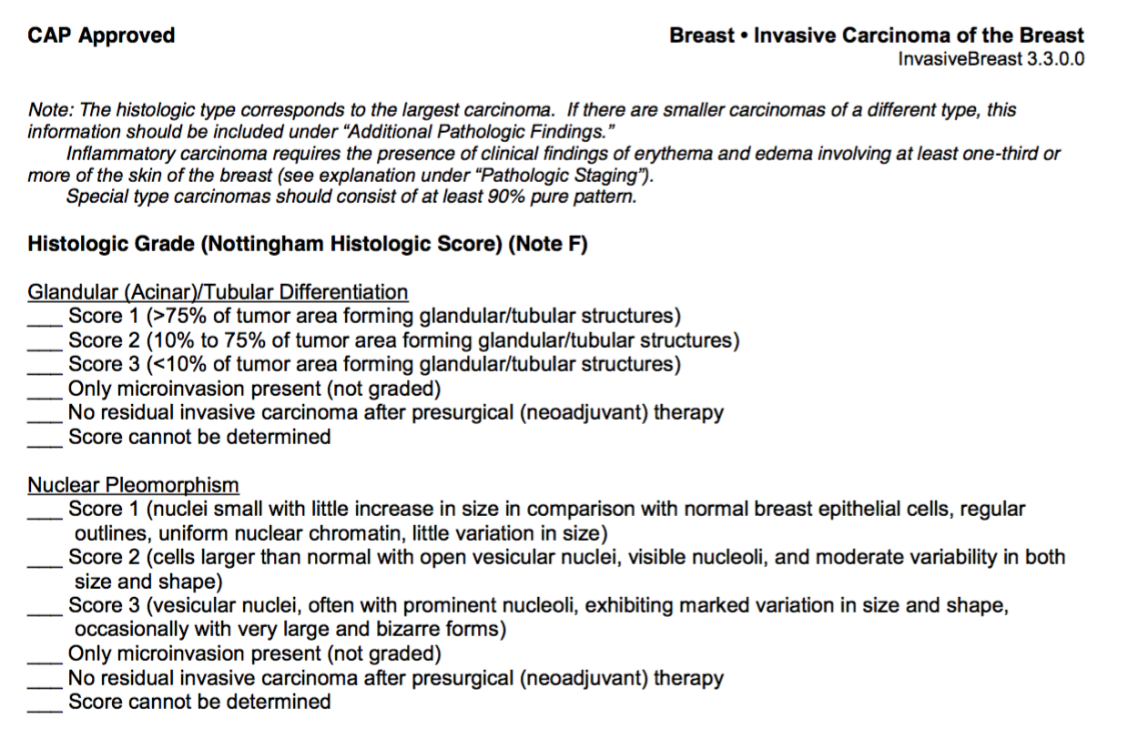
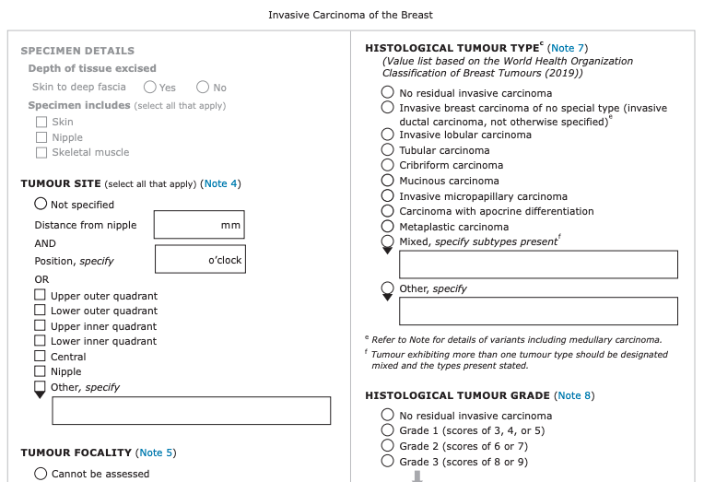
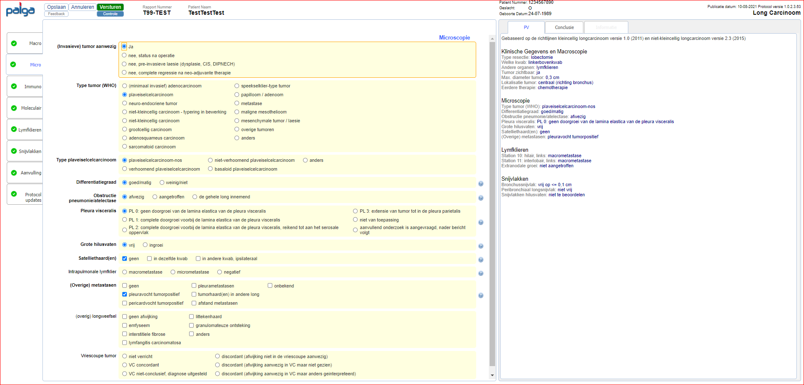
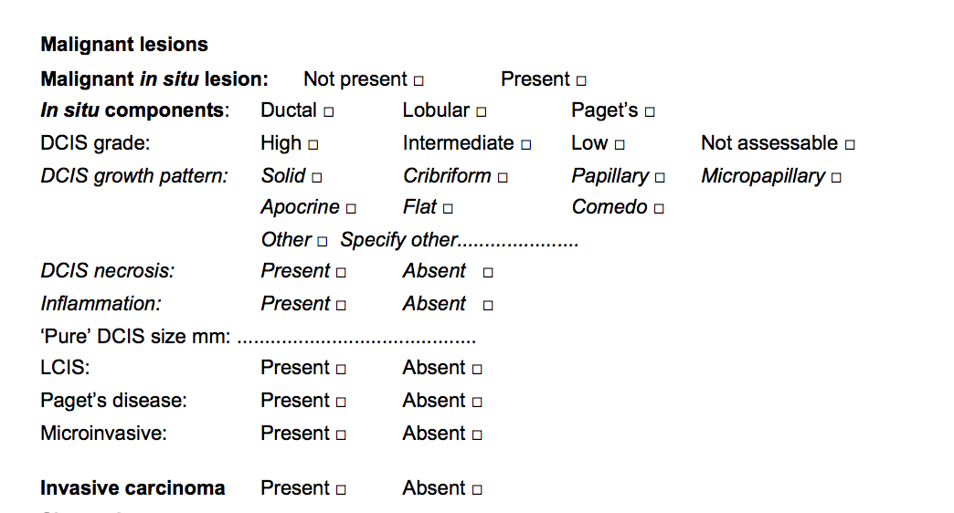
Synoptic Report Examples
Australasia- RCPA
US – College of American Pathologists
ICCR
Highly concordant
UK – RCPath
PALGA

Slide 5
Example of Work Product – RCPath Colon Dataset
Tumour type†:
Adenocarcinoma  Other, or variant of adenocarcinoma 
If Other, or variant (e.g. mucinous), specify …………………
798721000004104 |Histologic type of primary malignant neoplasm of colon (observable entity)|
798721000004104 |Histologic type of primary malignant neoplasm of colon (observable entity)| | 1187332001 |Adenocarcinoma (morphologic abnormality)|
798721000004104 |Histologic type of primary malignant neoplasm of colon (observable entity)| | 72495009 |Mucinous adenocarcinoma (morphologic abnormality)|
798721000004104 |Histologic type of primary malignant neoplasm of colon (observable entity)| | 87737001 |Signet ring cell carcinoma (morphologic abnormality)|
798721000004104 |Histologic type of primary malignant neoplasm of colon (observable entity)| | 32913002 |Medullary carcinoma (morphologic abnormality)|
798721000004104 |Histologic type of primary malignant neoplasm of colon (observable entity)| | 450948005 |Serrated adenocarcinoma (morphologic abnormality)|
798721000004104 |Histologic type of primary malignant neoplasm of colon (observable entity)| | 450895005 |Micropapillary carcinoma (morphologic abnormality)|
798721000004104 |Histologic type of primary malignant neoplasm of colon (observable entity)| | 59367005 |Adenosquamous carcinoma (morphologic abnormality)|
798721000004104 |Histologic type of primary malignant neoplasm of colon (observable entity)| | 68453008 |Carcinoma, no subtype (morphologic abnormality)|

Slide 6
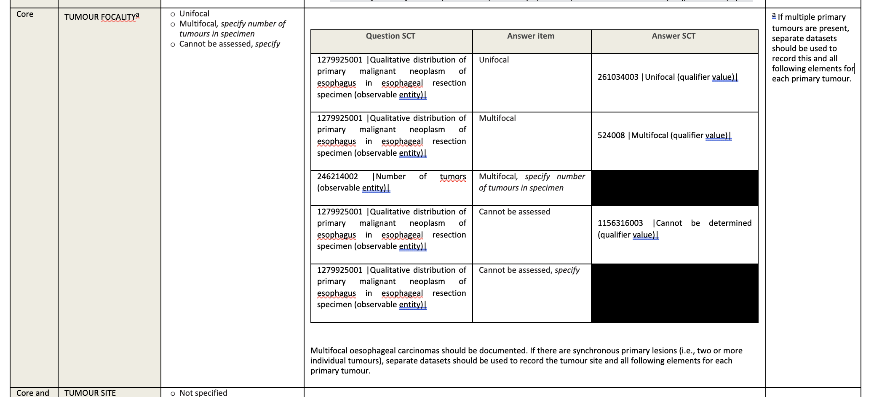
Example – ICCR Esophagus Dataset

Slide 7
Scope and Progress
Number of Protocols
  College of American Pathologists (CAP) have 60+ protocols
    The CAP are "splitters" vs. RCPath who are "lumpers"
    CAP has a form for each iteration. RCPath and ICCR group datasets.
Progress to date
  45/60 complete
  ICCR and RCPath transformations/mappings in progress
  Minimal number of ICCR-unique concepts needed
Distribution and validation of content by publishing body
  CAP, ICCR, RCPath

Slide 8
Modeling Discussions
Anaplasia
  Only in malignant tissue?
Testis
  Histologic type of metastatic lesion in lymph node
  Histologic type of non-primary malignant neoplasms (e.g., 5014008 |Leydig cell tumor, benign (morphologic abnormality)|)
Colon, colorectum, small bowel???
Neoadjuvant response scoring
Tumor staging
  To model or not to model observables?
  UICC discussion
Anatomy
  Lymph node groups and laterality
  Anatomic location landmarks germane to tumor invasion

Slide 9
Processes for content validation by publishing body
Document the process or proposed process by body
RCPath – Brian Rous, Laszlo Iglali, Michael Eden
ICCR – Meagan Judge coordinating
CAP – Scott Campbell, CAP PERT (electronic reporting team)
Palga – Paul Seegers
Sweden – Stefan Dubois

Slide 10
Project Planning and Maintenance
Finalize content coverage
  Fill remaining gaps
Implementation Guide Development
  Authoring in Confluence
  Training? Workshop in Atlanta? Elsewhere?
Manuscript discussion
Ongoing content maintenance and improvement
  How to proceed?
  Legacy content in Findings hierarchy?
Histology Quality Improvement project

Slide 11

Quality Data, Informed Healthcare
Call for Abstracts
Submit your abstract online at snomedexpo.org before April 17, 2023
linkedin.com/company/xqihtsdo | twitter.com/snomedct | youtube.com/@snomedct

Slide 12


Thank You

