Slide 1
Deposition, degeneration and osteoarthritis

Slide 2

Deposition and degenerative abnormality
Medical Definition of deposit: Matter laid down or accumulated especially in a living organism by a normal or abnormal process
  removal of calcium deposits in his knees by arthroscopic surgery

Slide 3
Degenerative disease - definition
NCI
  A disorder characterized by the progressive loss of function and/or structure of the affected tissues
  NCI-GLOSS
    A disease in which the function or structure of the affected tissues or organs changes for the worse over time. Osteoarthritis, osteoporosis, and Alzheimer's disease are examples.
Often related to aging
Most commonly affects the nervous system, cardiovascular system and musculoskeletal system
Seems that most chronic diseases can be considered to be degenerative
362975008 |Degenerative disorder (disorder)|= 3,315 descendants

Slide 4
46595003 |Deposition (morphologic abnormality)|
The deposition of endogenous or foreign material is arguably one cause of tissue degeneration but is not always the case
  Examples
    51083003 |Structure showing abnormal deposition of pigment (morphologic abnormality)|
    75594004 |Xanthomatous deposition (morphologic abnormality)|
Removing 46595003 |Deposition (morphologic abnormality)| from under 107669003 |Degenerative abnormality (morphologic abnormality)| results in the removal of 66 inferred relationships

Slide 5
Impact of Removing 46595003 |Deposition (morphologic abnormality)| from under 107669003 |Degenerative abnormality (morphologic abnormality)| lost inferences
sourceId | sourceFsn | typeId | typeFsn | destinationId | destinationFsn
71473008 | Amnion nodosum (disorder) | 116680003 | Is a (attribute) | 362975008 | Degenerative disorder (disorder)
417939004 | Amyloid corneal degeneration (disorder) | 116680003 | Is a (attribute) | 419982005 | Corneal stromal degeneration (disorder)
193247000 | Amyloid myopathy (disorder) | 116680003 | Is a (attribute) | 363059001 | Degenerative disorder of musculoskeletal system (disorder)
193247000 | Amyloid myopathy (disorder) | 116680003 | Is a (attribute) | 363058009 | Degenerative disorder of muscle (disorder)
232076001 | Amyloid of vitreous (disorder) | 116680003 | Is a (attribute) | 60189009 | Vitreous degeneration (disorder)
17602002 | Amyloidosis (disorder) | 116680003 | Is a (attribute) | 362975008 | Degenerative disorder (disorder)
3.47151E+14 | Arcus senilis of bilateral eyes (disorder) | 116680003 | Is a (attribute) | 3.44621E+14 | Degeneration of peripheral cornea of bilateral eyes (disorder)
875001 | Chalcosis of eye (disorder) | 116680003 | Is a (attribute) | 62585004 | Degenerative disorder of eye (disorder)
61565001 | Cholesterolosis of gallbladder (disorder) | 116680003 | Is a (attribute) | 362975008 | Degenerative disorder (disorder)
21461006 | Cholesterolosis of middle ear (disorder) | 116680003 | Is a (attribute) | 736432009 | Degenerative disorder of ear (disorder)
201625003 | Chondrocalcinosis due to dicalcium phosphate crystals (disorder) | 116680003 | Is a (attribute) | 363055007 | Degenerative disorder of cartilage (disorder)
201627006 | Chondrocalcinosis due to dicalcium phosphate crystals, of the shoulder region (disorder) | 116680003 | Is a (attribute) | 373623009 | Osteoarthritis of glenohumeral joint (disorder)
62660000 | Conjunctival deposit (disorder) | 116680003 | Is a (attribute) | 40787005 | Conjunctival degeneration (disorder)
420805002 | Cornea verticillata (disorder) | 116680003 | Is a (attribute) | 231929005 | Corneal epithelial degeneration (disorder)
74460005 | Corneal deposit (disorder) | 116680003 | Is a (attribute) | 111521006 | Corneal degeneration (disorder)
18834007 | Crystal arthropathy (disorder) | 116680003 | Is a (attribute) | 396275006 | Osteoarthritis (disorder)
75468006 | Crystal arthropathy of ankle AND/OR foot (disorder) | 116680003 | Is a (attribute) | 82300000 | Degenerative joint disease of ankle AND/OR foot (disorder)
428768008 | Crystal arthropathy of elbow (disorder) | 116680003 | Is a (attribute) | 239866002 | Osteoarthritis of elbow (disorder)
26241001 | Crystal arthropathy of hand (disorder) | 116680003 | Is a (attribute) | 22193007 | Degenerative joint disease of hand (disorder)
428027008 | Crystal arthropathy of hip (disorder) | 116680003 | Is a (attribute) | 239872002 | Osteoarthritis of hip (disorder)
429420005 | Crystal arthropathy of knee (disorder) | 116680003 | Is a (attribute) | 239873007 | Osteoarthritis of knee (disorder)
445477009 | Crystal arthropathy of pelvis (disorder) | 116680003 | Is a (attribute) | 445478004 | Degenerative joint disease of pelvis (disorder)
34427002 | Crystal arthropathy of shoulder region (disorder) | 116680003 | Is a (attribute) | 67315001 | Degenerative joint disease of shoulder region (disorder)
429419004 | Crystal arthropathy of wrist (disorder) | 116680003 | Is a (attribute) | 239867006 | Osteoarthritis of wrist (disorder)
29297002 | Crystalline deposits in vitreous (disorder) | 116680003 | Is a (attribute) | 60189009 | Vitreous degeneration (disorder)
46595003 | Deposition (morphologic abnormality) | 116680003 | Is a (attribute) | 107669003 | Degenerative abnormality (morphologic abnormality)
788529004 | Deposition of excess fat on visceral pericardium (disorder) | 116680003 | Is a (attribute) | 362975008 | Degenerative disorder (disorder)
445331004 | Diffuse cholesteatosis of middle ear and mastoid (disorder) | 116680003 | Is a (attribute) | 363054006 | Degenerative disorder of bone (disorder)
231907006 | Disciform keratitis (disorder) | 116680003 | Is a (attribute) | 419982005 | Corneal stromal degeneration (disorder)
418541005 | Drug-induced corneal epithlelial deposit (disorder) | 116680003 | Is a (attribute) | 231929005 | Corneal epithelial degeneration (disorder)
783161005 | Familial dementia British type (disorder) | 116680003 | Is a (attribute) | 106018006 | Hereditary degenerative disease of central nervous system (disorder)
783161005 | Familial dementia British type (disorder) | 116680003 | Is a (attribute) | 52522001 | Degenerative brain disorder (disorder)
783161005 | Familial dementia British type (disorder) | 116680003 | Is a (attribute) | 280871000 | Vascular degeneration (disorder)
783258000 | Familial dementia Danish type (disorder) | 116680003 | Is a (attribute) | 106018006 | Hereditary degenerative disease of central nervous system (disorder)
43532007 | Hereditary oculoleptomeningeal amyloid angiopathy (disorder) | 116680003 | Is a (attribute) | 106018006 | Hereditary degenerative disease of central nervous system (disorder)
236407003 | Immunoglobulin A nephropathy (disorder) | 116680003 | Is a (attribute) | 362975008 | Degenerative disorder (disorder)
191306005 | Immunoglobulin A vasculitis (disorder) | 116680003 | Is a (attribute) | 280871000 | Vascular degeneration (disorder)
871646007 | Infiltrative cardiomyopathy (disorder) | 116680003 | Is a (attribute) | 64077000 | Myocardial degeneration (disorder)
403435005 | Ligneous conjunctivitis (disorder) | 116680003 | Is a (attribute) | 1112003 | Degenerative disorder of eyelid (disorder)
423084001 | Macular exudate (disorder) | 116680003 | Is a (attribute) | 422338006 | Degenerative disorder of macula (disorder)
247155003 | Macular vitelliform deposits (disorder) | 116680003 | Is a (attribute) | 422338006 | Degenerative disorder of macula (disorder)
73751008 | Mee's line (disorder) | 116680003 | Is a (attribute) | 362975008 | Degenerative disorder (disorder)
63600008 | Mercurialentis (disorder) | 116680003 | Is a (attribute) | 62585004 | Degenerative disorder of eye (disorder)
52276000 | Metallosis (disorder) | 116680003 | Is a (attribute) | 362975008 | Degenerative disorder (disorder)
1153376004 | Monoarticular chronic gout caused by lead (disorder) | 116680003 | Is a (attribute) | 43829003 | Chronic osteoarthritis (disorder)
427055009 | Nonferrous ocular metallosis (disorder) | 116680003 | Is a (attribute) | 62585004 | Degenerative disorder of eye (disorder)
8231007 | Ocular amyloid deposit (disorder) | 116680003 | Is a (attribute) | 62585004 | Degenerative disorder of eye (disorder)
69718008 | Oxalate nephropathy (disorder) | 116680003 | Is a (attribute) | 362975008 | Degenerative disorder (disorder)
403419003 | Panniculitis due to hyperuricemia (disorder) | 116680003 | Is a (attribute) | 362975008 | Degenerative disorder (disorder)
423441007 | Particulate matter inhalation injury (disorder) | 116680003 | Is a (attribute) | 362975008 | Degenerative disorder (disorder)
40122008 | Pneumoconiosis (disorder) | 116680003 | Is a (attribute) | 362975008 | Degenerative disorder (disorder)
1153334007 | Polyarticular acute gout caused by lead (disorder) | 116680003 | Is a (attribute) | 225655006 | Degenerative polyarthritis (disorder)
1153331004 | Polyarticular acute primary gout (disorder) | 116680003 | Is a (attribute) | 225655006 | Degenerative polyarthritis (disorder)
1153332006 | Polyarticular chronic gout caused by lead (disorder) | 116680003 | Is a (attribute) | 225655006 | Degenerative polyarthritis (disorder)
1153332006 | Polyarticular chronic gout caused by lead (disorder) | 116680003 | Is a (attribute) | 43829003 | Chronic osteoarthritis (disorder)
239946005 | Postinfective immunoglobulin A vasculitis (disorder) | 116680003 | Is a (attribute) | 363061005 | Degenerative sequelae of disorders (disorder)
59714007 | Proteinosis (disorder) | 116680003 | Is a (attribute) | 362975008 | Degenerative disorder (disorder)
44219007 | Pseudoexfoliation of lens capsule (disorder) | 116680003 | Is a (attribute) | 62585004 | Degenerative disorder of eye (disorder)
95689000 | Retinal deposits (disorder) | 116680003 | Is a (attribute) | 95695004 | Degeneration of retina (disorder)
4645000 | Senile brain amyloidosis (disorder) | 116680003 | Is a (attribute) | 52522001 | Degenerative brain disorder (disorder)
25277000 | Siderosis of eye (disorder) | 116680003 | Is a (attribute) | 62585004 | Degenerative disorder of eye (disorder)
40449001 | Skin deposits (disorder) | 116680003 | Is a (attribute) | 396325007 | Degenerative skin disorder (disorder)
737272007 | Subconjunctival deposit (disorder) | 116680003 | Is a (attribute) | 737271000 | Subconjunctival degeneration (disorder)
733200004 | Superficial siderosis of central nervous system (disorder) | 116680003 | Is a (attribute) | 80690008 | Degenerative disease of the central nervous system (disorder)

Slide 6
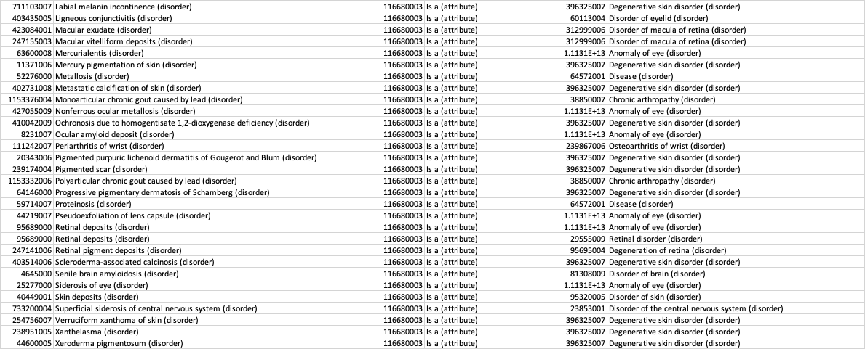
Impact of Removing 46595003 |Deposition (morphologic abnormality)| from under 107669003 |Degenerative abnormality (morphologic abnormality)|new inferences
sourceId | sourceFsn | typeId | typeFsn | destinationId | destinationFsn
417939004 | Amyloid corneal degeneration (disorder) | 116680003 | Is a (attribute) | 246954009 | Corneal stroma finding (finding)
417939004 | Amyloid corneal degeneration (disorder) | 116680003 | Is a (attribute) | 105969002 | Disorder of connective tissue (disorder)
417939004 | Amyloid corneal degeneration (disorder) | 116680003 | Is a (attribute) | 19660004 | Disorder of soft tissue (disorder)
232076001 | Amyloid of vitreous (disorder) | 116680003 | Is a (attribute) | 76682005 | Disorder of vitreous body (disorder)
17602002 | Amyloidosis (disorder) | 116680003 | Is a (attribute) | 64572001 | Disease (disorder)
231925004 | Arcus juvenilis (disorder) | 116676008 | Associated morphology (attribute) | 107669003 | Degenerative abnormality (morphologic abnormality)
231925004 | Arcus juvenilis (disorder) | 363698007 | Finding site (attribute) | 244495002 | Structure of peripheral cornea (body structure)
111522004 | Arcus senilis (disorder) | 116676008 | Associated morphology (attribute) | 107669003 | Degenerative abnormality (morphologic abnormality)
111522004 | Arcus senilis (disorder) | 363698007 | Finding site (attribute) | 244495002 | Structure of peripheral cornea (body structure)
3.47151E+14 | Arcus senilis of bilateral eyes (disorder) | 116676008 | Associated morphology (attribute) | 107669003 | Degenerative abnormality (morphologic abnormality)
3.47151E+14 | Arcus senilis of bilateral eyes (disorder) | 363698007 | Finding site (attribute) | 244495002 | Structure of peripheral cornea (body structure)
95800001 | Asteroid hyalosis (disorder) | 116680003 | Is a (attribute) | 60189009 | Vitreous degeneration (disorder)
88538005 | Calcareous degeneration of cornea (disorder) | 116680003 | Is a (attribute) | 111521006 | Corneal degeneration (disorder)
21323007 | Calcinosis cutis (disorder) | 116680003 | Is a (attribute) | 396325007 | Degenerative skin disorder (disorder)
403570005 | Calcinosis within skin cyst or tumor (disorder) | 116680003 | Is a (attribute) | 396325007 | Degenerative skin disorder (disorder)
717043006 | Calciphylaxis cutis (disorder) | 116680003 | Is a (attribute) | 396325007 | Degenerative skin disorder (disorder)
875001 | Chalcosis of eye (disorder) | 116680003 | Is a (attribute) | 1.1131E+13 | Anomaly of eye (disorder)
54739001 | Chrysoderma (disorder) | 116680003 | Is a (attribute) | 396325007 | Degenerative skin disorder (disorder)
402684002 | Colloid milium (disorder) | 116680003 | Is a (attribute) | 396325007 | Degenerative skin disorder (disorder)
8.041E+12 | Congenital arcus juvenilis (disorder) | 116676008 | Associated morphology (attribute) | 107669003 | Degenerative abnormality (morphologic abnormality)
8.041E+12 | Congenital arcus juvenilis (disorder) | 363698007 | Finding site (attribute) | 244495002 | Structure of peripheral cornea (body structure)
539009 | Conjunctival argyrosis (disorder) | 116680003 | Is a (attribute) | 40787005 | Conjunctival degeneration (disorder)
13706005 | Conjunctival concretion (disorder) | 116680003 | Is a (attribute) | 40787005 | Conjunctival degeneration (disorder)
62660000 | Conjunctival deposit (disorder) | 116680003 | Is a (attribute) | 1.1131E+13 | Anomaly of eye (disorder)
62660000 | Conjunctival deposit (disorder) | 116680003 | Is a (attribute) | 59698003 | Disorder of conjunctiva (disorder)
91268007 | Conjunctival melanosis (disorder) | 116680003 | Is a (attribute) | 40787005 | Conjunctival degeneration (disorder)
420805002 | Cornea verticillata (disorder) | 116680003 | Is a (attribute) | 246932007 | Corneal epithelium finding (finding)
74460005 | Corneal deposit (disorder) | 116680003 | Is a (attribute) | 1.1131E+13 | Anomaly of eye (disorder)
74460005 | Corneal deposit (disorder) | 116680003 | Is a (attribute) | 15250008 | Disorder of cornea (disorder)
246927006 | Corneal pigmentation (disorder) | 116680003 | Is a (attribute) | 111521006 | Corneal degeneration (disorder)
18834007 | Crystal arthropathy (disorder) | 116680003 | Is a (attribute) | 399269003 | Arthropathy (disorder)
75468006 | Crystal arthropathy of ankle AND/OR foot (disorder) | 116680003 | Is a (attribute) | 442246002 | Disorder of joint of ankle and/or foot (disorder)
428768008 | Crystal arthropathy of elbow (disorder) | 116680003 | Is a (attribute) | 429554009 | Arthropathy of elbow (disorder)
26241001 | Crystal arthropathy of hand (disorder) | 116680003 | Is a (attribute) | 428360003 | Arthropathy of joint of hand (disorder)
428027008 | Crystal arthropathy of hip (disorder) | 116680003 | Is a (attribute) | 428097001 | Disorder of hip joint (disorder)
429420005 | Crystal arthropathy of knee (disorder) | 116680003 | Is a (attribute) | 428724006 | Arthropathy of knee joint (disorder)
445477009 | Crystal arthropathy of pelvis (disorder) | 116680003 | Is a (attribute) | 128268005 | Arthropathy of pelvis (disorder)
34427002 | Crystal arthropathy of shoulder region (disorder) | 116680003 | Is a (attribute) | 444003007 | Disorder of joint of shoulder region (disorder)
429419004 | Crystal arthropathy of wrist (disorder) | 116680003 | Is a (attribute) | 428107009 | Disorder of wrist joint (disorder)
29297002 | Crystalline deposits in vitreous (disorder) | 116680003 | Is a (attribute) | 1.1131E+13 | Anomaly of eye (disorder)
29297002 | Crystalline deposits in vitreous (disorder) | 116680003 | Is a (attribute) | 76682005 | Disorder of vitreous body (disorder)
46595003 | Deposition (morphologic abnormality) | 116680003 | Is a (attribute) | 49755003 | Morphologically abnormal structure (morphologic abnormality)
110990003 | Drug induced abnormal pigmentation of skin (disorder) | 116680003 | Is a (attribute) | 396325007 | Degenerative skin disorder (disorder)
418541005 | Drug-induced corneal epithlelial deposit (disorder) | 116680003 | Is a (attribute) | 246932007 | Corneal epithelium finding (finding)
724835007 | Dystrophic calcification of skin due to inflammatory disease (disorder) | 116680003 | Is a (attribute) | 396325007 | Degenerative skin disorder (disorder)
733202007 | Dystrophic calcification of skin due to localized skin injury (disorder) | 116680003 | Is a (attribute) | 396325007 | Degenerative skin disorder (disorder)
410041002 | Exogenous ochronosis (disorder) | 116680003 | Is a (attribute) | 396325007 | Degenerative skin disorder (disorder)
783161005 | Familial dementia British type (disorder) | 116680003 | Is a (attribute) | 363235000 | Hereditary disorder of nervous system (disorder)
783161005 | Familial dementia British type (disorder) | 116680003 | Is a (attribute) | 27550009 | Disorder of blood vessel (disorder)
783258000 | Familial dementia Danish type (disorder) | 116680003 | Is a (attribute) | 363235000 | Hereditary disorder of nervous system (disorder)
238783008 | Familial pigmented purpuric eruption (disorder) | 116680003 | Is a (attribute) | 396325007 | Degenerative skin disorder (disorder)
735597009 | Fibro-osseous pseudotumor of skin of digit (disorder) | 116680003 | Is a (attribute) | 396325007 | Degenerative skin disorder (disorder)
762535004 | Hemosiderin pigmentation of lower limb due to varicose veins of lower limb (disorder) | 116680003 | Is a (attribute) | 396325007 | Degenerative skin disorder (disorder)
403262004 | Hemosiderin pigmentation of skin due to venous insufficiency (disorder) | 116680003 | Is a (attribute) | 396325007 | Degenerative skin disorder (disorder)
43532007 | Hereditary oculoleptomeningeal amyloid angiopathy (disorder) | 116680003 | Is a (attribute) | 363235000 | Hereditary disorder of nervous system (disorder)
1148444001 | Hydroxyapatite deposition disease of elbow joint (disorder) | 116680003 | Is a (attribute) | 239866002 | Osteoarthritis of elbow (disorder)
1162525009 | Hydroxyapatite deposition disease of knee joint (disorder) | 116680003 | Is a (attribute) | 239873007 | Osteoarthritis of knee (disorder)
49765009 | Hyperpigmentation of skin (disorder) | 116680003 | Is a (attribute) | 396325007 | Degenerative skin disorder (disorder)
238956000 | Idiopathic calcification of skin (disorder) | 116680003 | Is a (attribute) | 396325007 | Degenerative skin disorder (disorder)
871646007 | Infiltrative cardiomyopathy (disorder) | 116680003 | Is a (attribute) | 85898001 | Cardiomyopathy (disorder)
871646007 | Infiltrative cardiomyopathy (disorder) | 116680003 | Is a (attribute) | 128599005 | Structural disorder of heart (disorder)

Slide 7
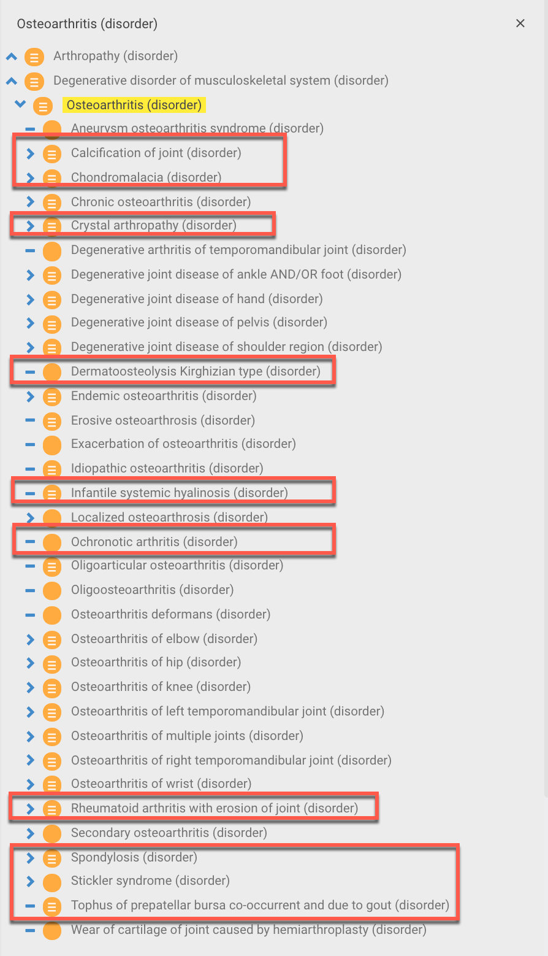
396275006 |Osteoarthritis (disorder)|
Osteoarthritis is SD as simply a degenerative abnormality of a joint structure. This results in (252/390) unrelated arthropathies being subsumed under osteoarthritis. Many of these are modeled with role groups containing a finding site of joint structure + an associated morphology of Deposition (54 concepts), Lesion of degenerative abnormality (29 concepts) or both Deposition and Lesion of degenerative abnormality (105 concepts)

Slide 8
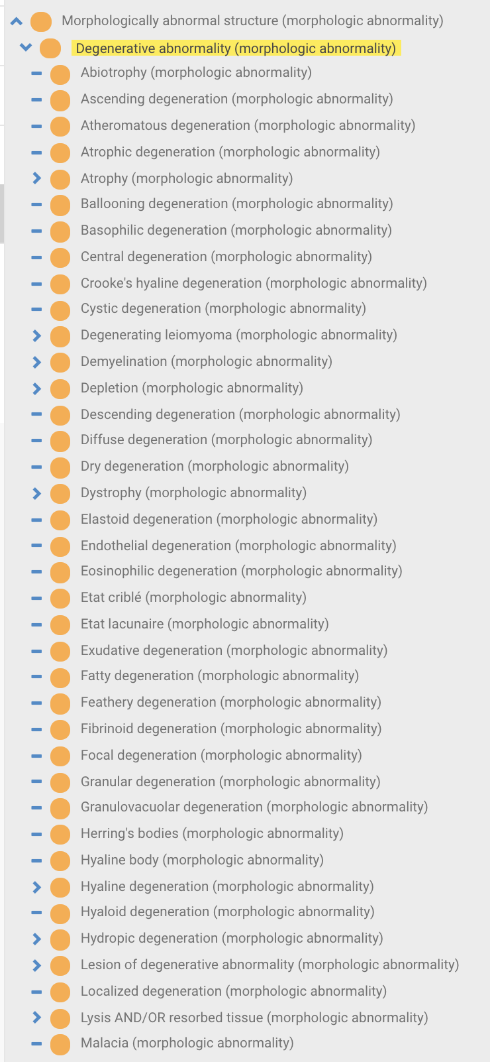
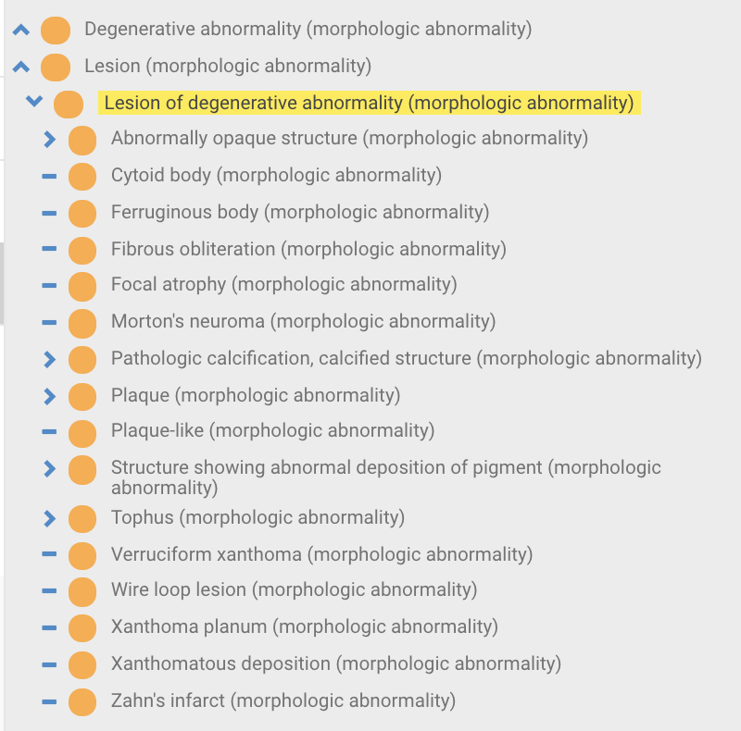
107669003 |Degenerative abnormality (morphologic abnormality)|vs. 708529002 |Lesion of degenerative abnormality (morphologic abnormality)|
What is the purpose of 708529002 |Lesion of degenerative abnormality (morphologic abnormality)|?
As 18115005 |Pathologic calcification, calcified structure (morphologic abnormality)| and 3875003 |Tophus (morphologic abnormality)|are subtypes of 708529002 |Lesion of degenerative abnormality (morphologic abnormality)|, Joint calcification and tophaceous gout will remain as subtypes of Osteoarthritis after Removing 46595003 |Deposition (morphologic abnormality)| from under 107669003 |Degenerative abnormality (morphologic abnormality)|

Slide 9
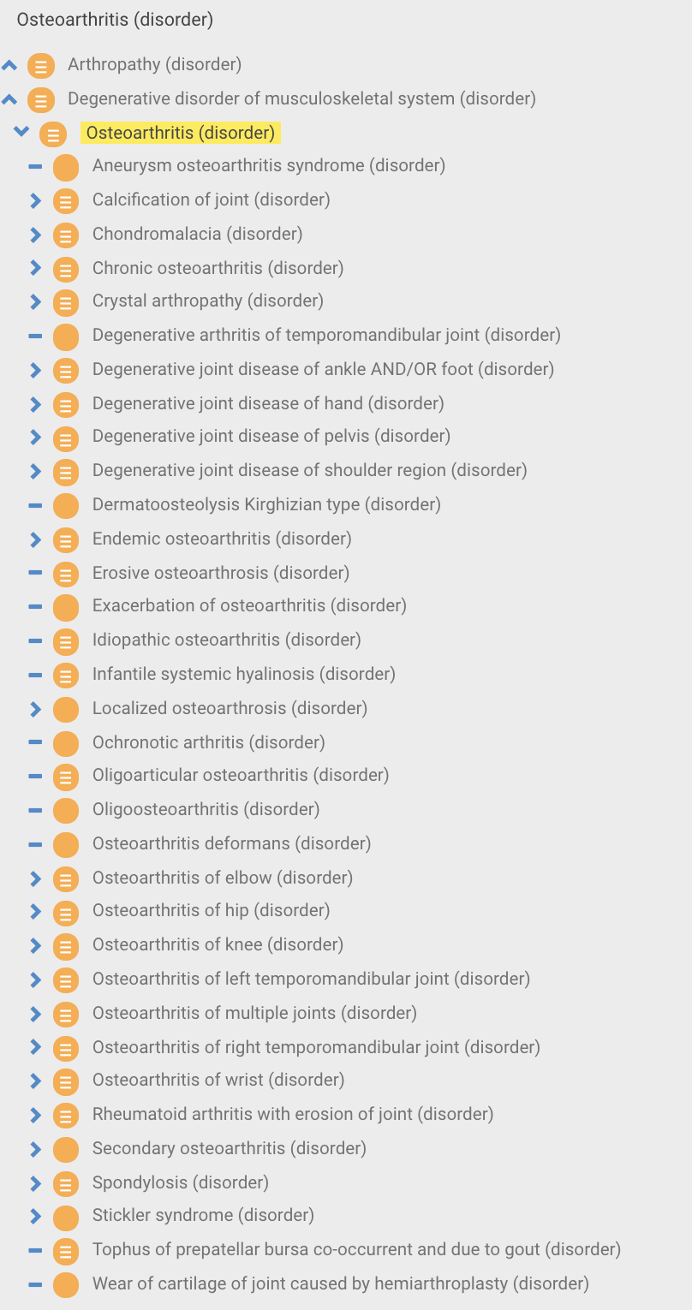
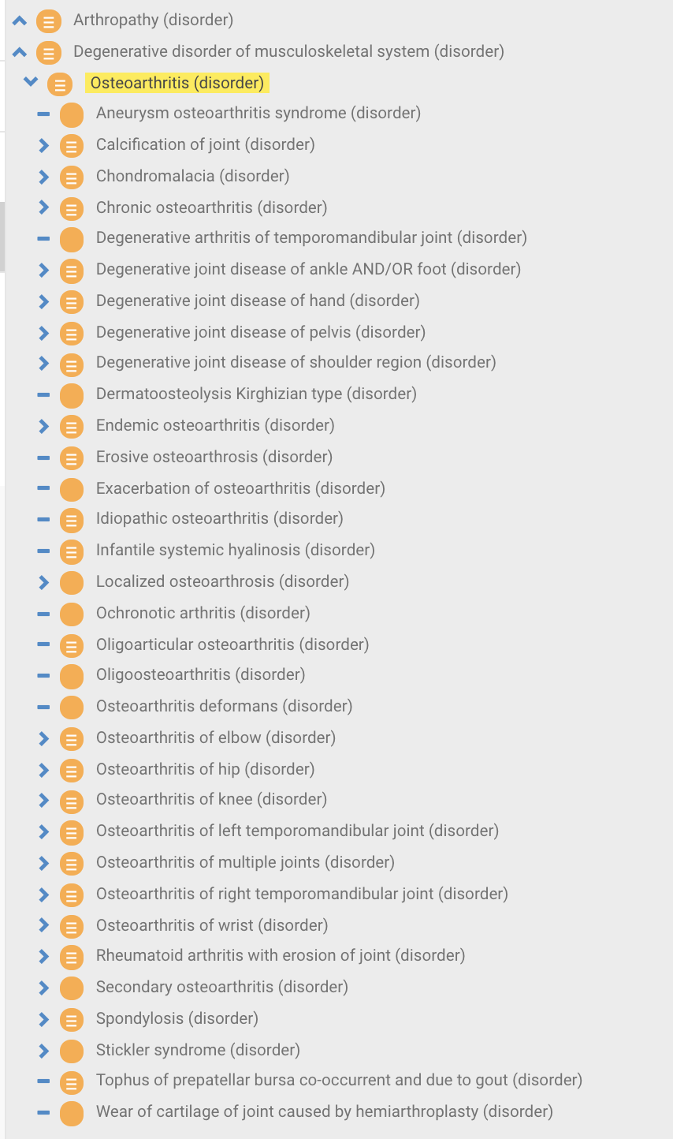
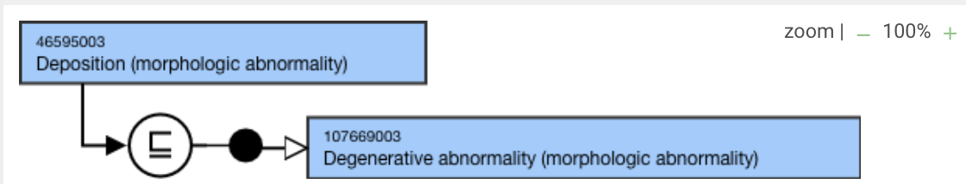
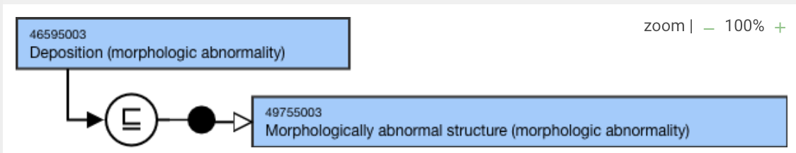
Effect of Removing 46595003 |Deposition (morphologic abnormality)| from under 107669003 |Degenerative abnormality (morphologic abnormality)|on 396275006 |Osteoarthritis (disorder)|

Slide 10
396275006 |Osteoarthritis (disorder)|
Pathogenesis of osteoarthritis
In the past, osteoarthritis (OA) was considered to be simply a degenerative "wear and tear" process and therefore often misnamed as degenerative joint disease. However, the pathogenesis of OA is much more complex than just wear and tear and the term "osteoarthritis," where "-itis" is indicative of an inflammatory process, is indeed correct. There are a variety of factors that play an important role in the pathogenesis of OA, including biomechanical factors, proinflammatory mediators, and proteases.

Slide 11
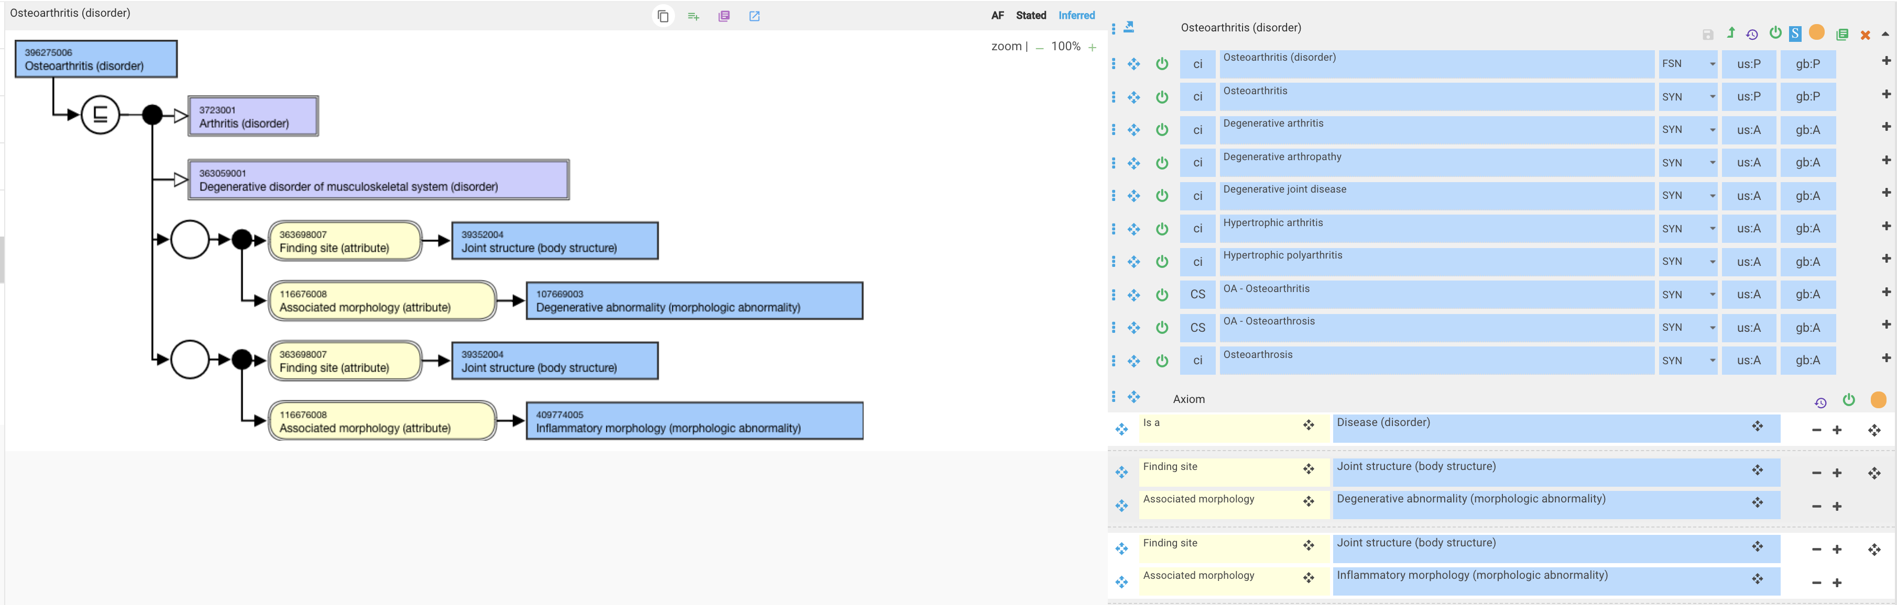
396275006 |Osteoarthritis (disorder)|- proposed revision of model
The model above is a sufficient definition for degenerative arthritis which although still frequently referred to as Osteoarthritis, the latter is properly a subtype of the former. Osteoarthritis due to its complexity cannot be SD imo

Slide 12
Proposals - 1
Removing 46595003 |Deposition (morphologic abnormality)| from under 107669003 |Degenerative abnormality (morphologic abnormality)|does not significantly improve the issues with 396275006 |Osteoarthritis (disorder)|subsuming inappropriate content
The impact of Removing 46595003 |Deposition (morphologic abnormality)| from under 107669003 |Degenerative abnormality (morphologic abnormality)|on other content needs more investigation
  E.g. adding an additional parent of 107669003 |Degenerative abnormality (morphologic abnormality)| to 68790008 |Amyloid deposition (morphologic abnormality)|

Slide 13
Proposals - 2
Add an additional role group to 396275006 |Osteoarthritis (disorder)|
  Or create a new morphology of degenerative inflammation
  The above will enable Osteoarthritis to properly classify under 3723001 |Arthritis (disorder)|
396275006 |Osteoarthritis (disorder)|to be made primitive and assigned as a parent only to those concepts containing osteoarthritis in the FSN (137/389 records) and possibly to those concepts containing degenerative joint disease in (5/389 records) and degenerative arthritis (1/389 records) in the FSN.

Slide 14
Concepts removed from under396275006 |Osteoarthritis (disorder)|by previous recommendation
id | fsn | id | fsn | id | fsn | id | fsn
1.60761E+16 | Tophus of right elbow co-occurrent and due to gout (disorder) | 3.03961E+14 | Chronic tophaceous gout of knee due to renal impairment (disorder) | 442942009 | Chondrocalcinosis of knee joint (disorder) | 201927008 | Kashin-Beck disease of the ankle and/or foot (disorder)
1.60761E+16 | Tophus of left elbow co-occurrent and due to gout (disorder) | 3.03941E+14 | Chronic tophaceous gout of hip due to renal impairment (disorder) | 442941002 | Chondrocalcinosis of joint of ankle AND/OR foot (disorder) | 201925000 | Kashin-Beck disease of the pelvic region and thigh (disorder)
1.6047E+16 | Hydroxyapatite deposition disease of right shoulder (disorder) | 3.03921E+14 | Chronic tophaceous gout of hand due to renal impairment (disorder) | 442928001 | Chondrocalcinosis of joint of shoulder region (disorder) | 201924001 | Kashin-Beck disease of the hand (disorder)
1.60466E+16 | Hydroxyapatite deposition disease of left shoulder (disorder) | 3.03901E+14 | Chronic tophaceous gout of elbow due to renal impairment (disorder) | 442925003 | Chondrocalcinosis of wrist joint (disorder) | 201921009 | Kashin-Beck disease of the shoulder region (disorder)
1.60401E+16 | Chronic tophaceous gout of bilateral hands (disorder) | 3.03881E+14 | Chronic tophaceous gout of ankle due to renal impairment (disorder) | 442884002 | Chondrocalcinosis of joint of hand (disorder) | 201858005 | Post-traumatic gonarthrosis, bilateral (disorder)
1.604E+16 | Chronic tophaceous gout of bilateral elbows (disorder) | 3.03861E+14 | Chondromalacia of left patella (disorder) | 429420005 | Crystal arthropathy of knee (disorder) | 201857000 | Post-traumatic coxarthrosis, bilateral (disorder)
1.60398E+16 | Chondromalacia of bilateral ankles (disorder) | 1.37791E+14 | Chondrocalcinosis of elbow due to disorder of calcium metabolism (disorder) | 429419004 | Crystal arthropathy of wrist (disorder) | 201826000 | Erosive osteoarthrosis (disorder)
1.60396E+16 | Chondromalacia of right hip (disorder) | 1.22691E+14 | Chondrocalcinosis of hip joint due to disorder of calcium metabolism (disorder) | 428857003 | Kashin-Beck disease of spine (disorder) | 201646007 | Chondrocalcinosis due to pyrophosphate crystals, of multiple sites (disorder)
1.60394E+16 | Chondromalacia of left hip (disorder) | 1.20401E+14 | Chondrocalcinosis of hand due to disorder of calcium metabolism (disorder) | 428768008 | Crystal arthropathy of elbow (disorder) | 201645006 | Chondrocalcinosis due to pyrophosphate crystals, of the ankle and foot (disorder)
1.60394E+16 | Chondromalacia of right shoulder (disorder) | 1162808000 | Familial calcium pyrophosphate dihydrate crystal deposition disease (disorder) | 428027008 | Crystal arthropathy of hip (disorder) | 201643004 | Chondrocalcinosis due to pyrophosphate crystals, of the pelvic region and thigh (disorder)
1.60392E+16 | Chondromalacia of left shoulder (disorder) | 1162525009 | Hydroxyapatite deposition disease of knee joint (disorder) | 387802007 | Thoracic spondylosis (disorder) | 201642009 | Chondrocalcinosis-pyrophosphate crystals, of the hand (disorder)
1.60166E+16 | Degenerative rupture of lateral meniscus of left knee (disorder) | 1162523002 | Hydroxyapatite deposition disease of hip joint (disorder) | 387800004 | Cervical spondylosis (disorder) | 201639003 | Chondrocalcinosis due to pyrophosphate crystals, of the shoulder region (disorder)
1.60166E+16 | Degenerative rupture of lateral meniscus of right knee (disorder) | 1162362005 | Felty syndrome with seronegative erosive rheumatoid arthritis (disorder) | 313294001 | Degeneration of lateral meniscus (disorder) | 201637001 | Chondrocalcinosis due to pyrophosphate crystals (disorder)
1.60165E+16 | Degenerative rupture of lateral meniscus of bilateral knees (disorder) | 1162342002 | Ossification of posterior longitudinal ligament and ligamentum flavum (disorder) | 310640003 | Degenerative lesion of articular cartilage of knee (disorder) | 201634008 | Chondrocalcinosis due to dicalcium phosphate crystals, of multiple sites (disorder)
1.60162E+16 | Chondrocalcinosis of bilateral ankles (disorder) | 1162336001 | Anti-citrullinated protein antibody positive erosive rheumatoid arthritis (disorder) | 308143008 | Seropositive erosive rheumatoid arthritis (disorder) | 201633002 | Chondrocalcinosis due to dicalcium phosphate crystals, of the ankle and foot (disorder)
1.60162E+16 | Chondrocalcinosis of bilateral feet (disorder) | 1162319009 | Rheumatoid factor and anti-citrullinated protein antibody positive erosive rheumatoid arthritis (disorder) | 281365008 | Tophus of prepatellar bursa co-occurrent and due to gout (disorder) | 201631000 | Chondrocalcinosis due to dicalcium phosphate crystals, of the pelvic region and thigh (disorder)
1.60083E+16 | Chondrocalcinosis of bilateral wrists (disorder) | 1162303002 | Seronegative rheumatoid arthritis with erosion of joint (disorder) | 270505009 | Kashin-Beck disease (disorder) | 201630004 | Chondrocalcinosis due to dicalcium phosphate crystals, of the hand (disorder)
1.6006E+16 | Tophus of bilateral elbows co-occurrent and due to gout (disorder) | 1162302007 | Ossification of ligamentum flavum (disorder) | 267970006 | Cervical spondylosis without myelopathy (disorder) | 201627006 | Chondrocalcinosis due to dicalcium phosphate crystals, of the shoulder region (disorder)
1.57492E+16 | Chondromalacia of right patella (disorder) | 1153378003 | Monoarticular acute gout caused by lead (disorder) | 240211000 | Intervertebral disk calcification (disorder) | 201625003 | Chondrocalcinosis due to dicalcium phosphate crystals (disorder)
1.57052E+16 | Chondrocalcinosis of bilateral shoulders (disorder) | 1153376004 | Monoarticular chronic gout caused by lead (disorder) | 239884000 | Malemud disease (disorder) | 193120004 | Nerve root and plexus compressions in spondylosis (disorder)
1.57052E+16 | Chondrocalcinosis of bilateral hands (disorder) | 1153334007 | Polyarticular acute gout caused by lead (disorder) | 239881008 | Otto's pelvis (disorder) | 190842000 | Tophus of hand co-occurrent and due to gout (disorder)
1.56376E+16 | Degenerative rupture of medial meniscus of bilateral knees (disorder) | 1153332006 | Polyarticular chronic gout caused by lead (disorder) | 239880009 | Lumbar spondylosis (disorder) | 190828008 | Gouty arthropathy (disorder)
1.56375E+16 | Degenerative rupture of medial meniscus of right knee (disorder) | 1153331004 | Polyarticular acute primary gout (disorder) | 239849004 | Intra-articular steroid-induced arthritis and periarthritis (disorder) | 123798002 | Lumbosacral spondylosis (disorder)
1.56375E+16 | Degenerative rupture of medial meniscus of left knee (disorder) | 1149280009 | Hydroxyapatite deposition disease of joint of ankle (disorder) | 239842008 | Monosodium urate arthritis and periarthritis (disorder) | 111242007 | Periarthritis of wrist (disorder)
1.06246E+16 | Ossification of anterior longitudinal ligament of spine (disorder) | 1149278003 | Hydroxyapatite deposition disease of joint of foot (disorder) | 239837000 | Pyrophosphate tophus (disorder) | 109668000 | Degenerative arthritis of temporomandibular joint (disorder)
1.07502E+15 | Chronic tophaceous gout of left foot (disorder) | 1148918005 | Gouty arthropathy due to sickle-cell trait (disorder) | 239833001 | Chondrocalcinosis due to pyrophosphate crystals of the knee (disorder) | 91240008 | Degeneration of thoracolumbar intervertebral disc (disorder)
1.075E+15 | Chronic tophaceous gout of right foot (disorder) | 1148911004 | Gouty arthropathy due to double heterozygous sickling disorder (disorder) | 239832006 | Calcium pyrophosphate deposition disease (disorder) | 90860001 | Localized osteoarthrosis uncertain if primary OR secondary (disorder)
1.07421E+15 | Chondrocalcinosis of left foot (disorder) | 1148444001 | Hydroxyapatite deposition disease of elbow joint (disorder) | 239828000 | Apatite-associated destructive arthritis (disorder) | 90448008 | Ossification of posterior longitudinal ligament (disorder)
1.0742E+15 | Chondrocalcinosis of left ankle (disorder) | 1055298007 | Gonarthrosis of right knee due to and following trauma (disorder) | 238867003 | Infantile systemic hyalinosis (disorder) | 86787000 | Chondrocalcinosis due to calcium hydroxyapatite crystals (disorder)
1.07419E+15 | Chondrocalcinosis of right foot (disorder) | 1055297002 | Gonarthrosis of left knee due to and following trauma (disorder) | 238850005 | Mouth and genital ulcers with inflamed cartilage syndrome (disorder) | 78675000 | Stickler syndrome (disorder)
1.07418E+15 | Chondrocalcinosis of right ankle (disorder) | 1010668008 | Stickler syndrome type 1 (disorder) | 237898004 | Periarticular calcification (disorder) | 77994009 | Primary localized osteoarthrosis of pelvic region (disorder)
1.07417E+15 | Chondrocalcinosis of joint of left knee (disorder) | 1010666007 | Stickler syndrome type 4 (disorder) | 232439007 | Relapsing polychondritis of larynx (disorder) | 77547008 | Degeneration of intervertebral disc (disorder)
1.07416E+15 | Chondrocalcinosis of joint of right knee (disorder) | 1010664005 | Stickler syndrome type 2 (disorder) | 225655006 | Degenerative polyarthritis (disorder) | 75468006 | Crystal arthropathy of ankle AND/OR foot (disorder)
1.07415E+15 | Chondrocalcinosis of left hip (disorder) | 735914007 | Wear of cartilage of joint caused by hemiarthroplasty (disorder) | 202771000 | Cervical posterior longitudinal ligament ossification (disorder) | 73877009 | Chronic tophaceous gout (disorder)
1.07414E+15 | Chondrocalcinosis of right hip (disorder) | 735611002 | Degeneration of lumbar intervertebral disc co-occurrent with osteophyte of lumbar vertebra (disorder) | 202755000 | Calcification of lumbar disc (disorder) | 72275000 | Relapsing polychondritis (disorder)
1.07413E+15 | Chondrocalcinosis of left hand (disorder) | 735610001 | Prolapse of lumbar intervertebral disc co-occurrent and due to degeneration (disorder) | 202751009 | Calcification of thoracic disc (disorder) | 69195002 | Degeneration of cervical intervertebral disc (disorder)
1.07412E+15 | Chondrocalcinosis of right hand (disorder) | 735609006 | Degeneration of lumbar intervertebral disc without prolapse (disorder) | 202747007 | Calcification of cervical disc (disorder) | 68859000 | Spondylosis without myelopathy (disorder)
1.07411E+15 | Chondrocalcinosis of joint of left wrist (disorder) | 735608003 | Degeneration of thoracic intervertebral disc co-occurrent with osteophyte (disorder) | 202696006 | Multiple-level lumbosacral spondylosis with radiculopathy (disorder) | 68675004 | Degeneration of thoracic intervertebral disc (disorder)
1.0741E+15 | Chondrocalcinosis of joint of right wrist (disorder) | 735607008 | Prolapse of thoracic intervertebral disc co-occurrent and due to degeneration (disorder) | 202695005 | Two-level lumbosacral spondylosis with radiculopathy (disorder) | 67437007 | Lumbar spondylosis with myelopathy (disorder)
1.07409E+15 | Chondrocalcinosis of left elbow (disorder) | 735606004 | Degeneration of thoracic intervertebral disc without prolapse (disorder) | 202694009 | Single-level lumbosacral spondylosis with radiculopathy (disorder) | 63198006 | Chondromalacia (disorder)
1.07408E+15 | Chondrocalcinosis of right elbow (disorder) | 735605000 | Degeneration of cervical intervertebral disc co-occurrent with osteophyte of cervical vertebra (disorder) | 202693003 | Lumbosacral spondylosis with radiculopathy (disorder) | 60937000 | Degeneration of lumbosacral intervertebral disc (disorder)
1.07407E+15 | Chondrocalcinosis of left shoulder (disorder) | 735604001 | Prolapse of cervical intervertebral disc co-occurrent and due to degeneration (disorder) | 202692008 | Multiple-level thoracic spondylosis with radiculopathy (disorder) | 60644007 | Pellegrini-Stieda syndrome (disorder)
1.07406E+15 | Chondrocalcinosis of right shoulder (disorder) | 735603007 | Wear of articular bearing surface of joint prosthesis of knee (disorder) | 202690000 | Two-level thoracic spondylosis with radiculopathy (disorder) | 53332000 | Spinal arthritis deformans (disorder)
3.21341E+14 | Spondylosis of thoracolumbar spine (disorder) | 735602002 | Wear of articular bearing surface of joint prosthesis of hip (disorder) | 202689009 | Single-level thoracic spondylosis with radiculopathy (disorder) | 52334005 | Miner's knee (disorder)
3.21311E+14 | Spondylosis of cervicothoracic spine (disorder) | 735599007 | Rheumatoid arthritis with erosion of joint (disorder) | 202688001 | Thoracic spondylosis with radiculopathy (disorder) | 50921008 | Periarthritis (disorder)
3.06591E+14 | Chronic tophaceous gout of wrist caused by drug (disorder) | 726628003 | Familial chondromalacia patellae (disorder) | 202687006 | Cervical spondylosis with vascular compression (disorder) | 48210000 | Lumbosacral spondylosis without myelopathy (disorder)
3.06571E+14 | Chronic tophaceous gout caused by drug (disorder) | 724605002 | Ossification of spinal ligament (disorder) | 202680008 | Multiple-level lumbosacral spondylosis with myelopathy (disorder) | 43132002 | Degeneration of cervicothoracic intervertebral disc (disorder)
3.06551E+14 | Chronic tophaceous gout of vertebra caused by drug (disorder) | 724604003 | Intervertebral disc degeneration of cervical spine without prolapsed disc (disorder) | 202679005 | Two-level lumbosacral spondylosis with myelopathy (disorder) | 42944009 | Degeneration of internal semilunar cartilage (disorder)
3.06371E+14 | Chronic tophaceous gout of multiple sites caused by drug (disorder) | 721090002 | Dermatoosteolysis Kirghizian type (disorder) | 202678002 | Single-level lumbosacral spondylosis with myelopathy (disorder) | 39838007 | Ochronotic arthritis (disorder)
3.06211E+14 | Chronic tophaceous gout of knee caused by drug (disorder) | 718602007 | Hereditary arterial and articular multiple calcification syndrome (disorder) | 202677007 | Lumbosacral spondylosis with myelopathy (disorder) | 37895003 | Osteoarthrosis of the carpometacarpal joint of the thumb (disorder)
3.06191E+14 | Chronic tophaceous gout of hip caused by drug (disorder) | 713911007 | Lumbosacral spondylosis co-occurrent with root compression (disorder) | 202676003 | Multiple-level lumbosacral spondylosis without myelopathy (disorder) | 36540006 | Calcification of joint (disorder)
3.06171E+14 | Chronic tophaceous gout of hand caused by drug (disorder) | 713869000 | Congenital calcium pyrophosphate dihydrate crystal deposition disease (disorder) | 202675004 | Two-level lumbosacral spondylosis without myelopathy (disorder) | 36071006 | Chondromalacia of patella (disorder)
3.06151E+14 | Chronic tophaceous gout of elbow caused by drug (disorder) | 703627005 | Asymptomatic calcium pyrophosphate deposition disease (disorder) | 202674000 | Single-level lumbosacral spondylosis without myelopathy (disorder) | 34427002 | Crystal arthropathy of shoulder region (disorder)
3.06131E+14 | Chronic tophaceous gout of ankle and/or foot caused by drug (disorder) | 699942000 | Apatite-associated destructive arthritis of shoulder (disorder) | 202672001 | Multiple-level thoracic spondylosis with myelopathy (disorder) | 33952002 | Localized osteoarthrosis (disorder)
3.04341E+14 | Chronic tophaceous gout of wrist due to renal impairment (disorder) | 699655001 | Calcification of stylohyoid ligament (disorder) | 202671008 | Two-level thoracic spondylosis with myelopathy (disorder) | 33420007 | Diffuse cervicobrachial syndrome (disorder)
3.04321E+14 | Chronic tophaceous gout due to renal impairment (disorder) | 446496001 | Heterotopic ossification of joint (disorder) | 202670009 | Single-level thoracic spondylosis with myelopathy (disorder) | 33262002 | Osteoarthrosis involving multiple sites but not designated as generalized (disorder)
3.04301E+14 | Chronic tophaceous gout of vertebra due to renal impairment (disorder) | 445496008 | Chondrocalcinosis of joint of pelvis (disorder) | 202659002 | Multiple-level cervical spondylosis without myelopathy (disorder) | 28736004 | Primary localized osteoarthrosis of multiple sites (disorder)
3.04281E+14 | Chronic tophaceous gout of shoulder due to renal impairment (disorder) | 445477009 | Crystal arthropathy of pelvis (disorder) | 202658005 | Two-level cervical spondylosis without myelopathy (disorder) | 26538006 | Degeneration of lumbar intervertebral disc (disorder)
3.04121E+14 | Chronic tophaceous gout of multiple sites due to renal impairment (disorder) | 443002008 | Chondrocalcinosis of hip joint (disorder) | 202657000 | Single-level cervical spondylosis without myelopathy (disorder) | 26241001 | Crystal arthropathy of hand (disorder)
3.03961E+14 | Chronic tophaceous gout of knee due to renal impairment (disorder) | 443001001 | Chondrocalcinosis of elbow joint (disorder) | 201929006 | Kashin-Beck disease of multiple sites (disorder) | 25343008 | Secondary localized osteoarthrosis of pelvic region (disorder)
3.03941E+14 | Chronic tophaceous gout of hip due to renal impairment (disorder) |  |  |  |  | 20075001 | Crystal arthropathy of multiple sites (disorder)
3.03921E+14 | Chronic tophaceous gout of hand due to renal impairment (disorder) |  |  |  |  | 18834007 | Crystal arthropathy (disorder)
3.03901E+14 | Chronic tophaceous gout of elbow due to renal impairment (disorder) |  |  |  |  | 11023001 | Acute calcific periarthritis (disorder)
3.03881E+14 | Chronic tophaceous gout of ankle due to renal impairment (disorder) |  |  |  |  | 10948005 | Thoracic spondylosis with myelopathy (disorder)
3.03861E+14 | Chondromalacia of left patella (disorder) |  |  |  |  | 10196009 | Juvenile osteochondrosis of acetabulum (disorder)
1.37791E+14 | Chondrocalcinosis of elbow due to disorder of calcium metabolism (disorder) |  |  |  |  | 8847002 | Spondylosis (disorder)
1.22691E+14 | Chondrocalcinosis of hip joint due to disorder of calcium metabolism (disorder) |  |  |  |  | 7126001 | Secondary localized osteoarthrosis of multiple sites (disorder)
1.20401E+14 | Chondrocalcinosis of hand due to disorder of calcium metabolism (disorder) |  |  |  |  | 4168008 | Tibial plateau chondromalacia (disorder)

