Slide 1
Plaster Allergy

Slide 2
Request from Netherlands to add specific types of plaster as allergens
The allergologists want us to create concepts for types of adhesive plasters, like E.K.G. plasters, brown plasters, white plasters etc. to register allergies or sensitivities in patients. I asked if they mean the adhesive in the plaster, which would be no problem as that would sit in the substance hierarchy. But they actually don’t want to specify the adhesive of the plaster as the allergen, but the whole plaster. Now that would become a problem I suppose, since plasters are physical objects in SNOMED.
The plasters they want to document are:
  White plasters
  Brown plasters
  Foil plasters
  EKG plasters
  And then they also have some brand names like Leukopor, Fixamull, Micropor etc which I already said we don’t add specific brand to SNOMED…

Slide 3
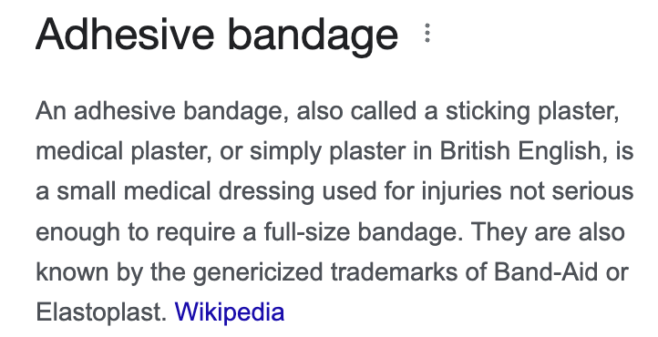

Adhesive plasters in SNOMED

Slide 4
Adhesive plaster allergy
Adhesive plasters are composed of several different substances
  Adhesives (acrylates, including methacrylates and epoxy diacrylates (which are also known as vinyl resins).
  The absorbent pad is often made of cotton, and there is sometimes a thin, porous-polymer coating over the pad
  The pad may also be medicated with an antiseptic solution or with antibiotics
  Adhesive plasters may also contain latex
Allergy to adhesive plasters is usually allergic contact dermatitis to the adhesive but this is rare
Most reactions are irritant contact dermatitis
Immediate hypersensitivity to latex or antibiotics is also possible

Slide 5
Possible solutions
Create substances derived from physical objects (similar to animal X protein (substance))
  This will result in creating many concepts of type "Substance in X physical object" in the Substance hierarchy; this seems to be essentially duplicating concepts from the Physical object hierarchy in the Substance hierarchy. Moreover, we should consider the potential need for clear definition and assignment of subtypes (specified and unspecified ingredients).
Represent adhesive plasters as products
  We do have concepts such as 863903001 |Allergy to component of vaccine product (finding)|, with causative agent being the vaccine product.
  If we consider a bandage a product, it's a product because somebody packages it a certain way but the problem with products is that the end stuff can change over time.
Extend the range in the implementation guide to include physical objects (even a restricted set of physical objects if it would meet the needs).
Consider these concepts as NRC specific (and out of scope for the international edition) is that there seems to be a need (at least in some cases) to add branded products (please see the following excerpt). However, as specified in the associated SNOMED editorial guidelines, "Concepts that refer to brand names are out of scope".

Slide 6
Parallels with Allergy to animals
We created Animal X protein (substance) concepts to use as the causative agent of Allergy to animal X (finding) concepts.
  FSN Scientific name of animal X protein (finding). This is not user friendly but we have synonyms of Allergy to animal X which should perhaps be the PT
When documenting an allergy using a list rather than clinical findings should we allow organisms and physical objects to be used in addition to substances and sometimes products while allowing only substances and products as the causative agents for clinical findings?

Slide 7
Representation of Adhesive bandages in allergy module of an EHR (using FDB content)

