Slide 1
Final editorial guidelines for modeling hypersensitivity conditions

Slide 2
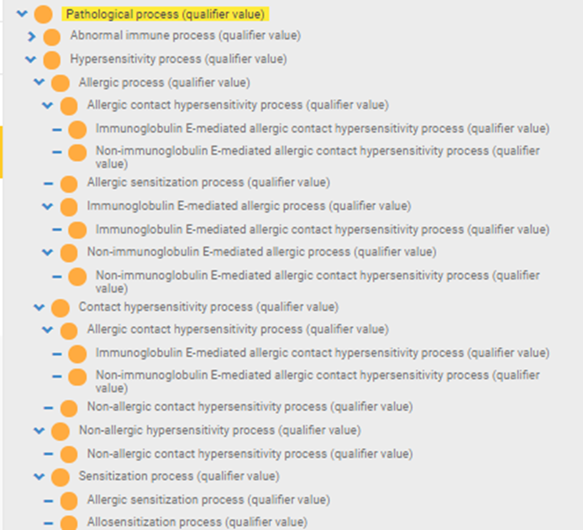
New pathological process (qualifier value) hierarchy

Slide 3
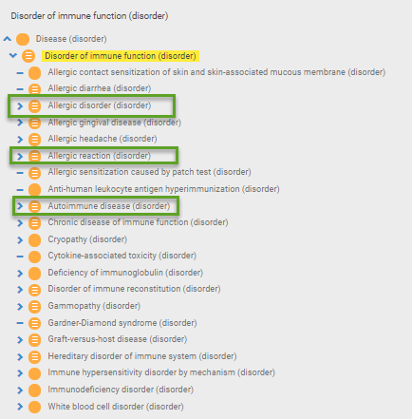
Disorder of immune function
Defining 414029004 |Disorder of immune function (disorder)|using a pathological process of |Abnormal immune response (qualifier value)| as shown in the hierarchy above, will allow allergic and autoimmune disorders to correctly classify as disorders of immune function.

Slide 4
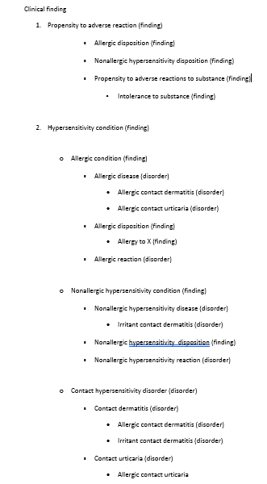
Top level hierarchies

Slide 5
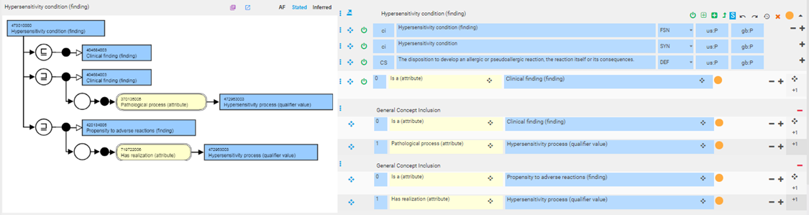
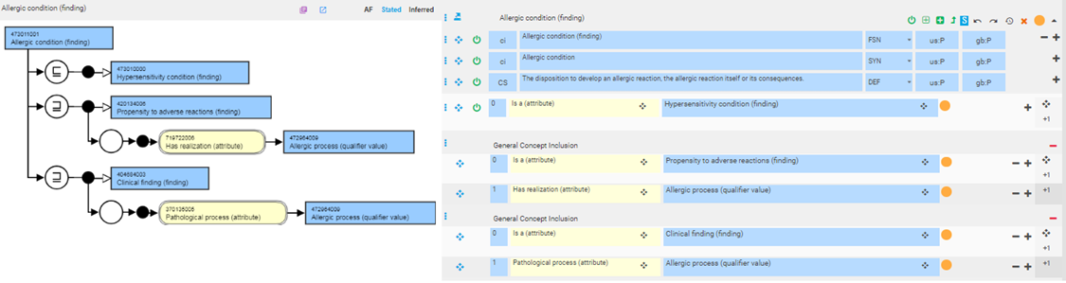
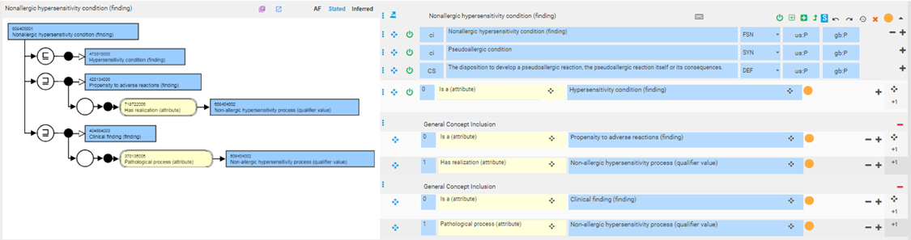
Condition classes are represented using GCIs

Slide 6
Allergic and nonallergic hypersensitivity (pseudoallergic) diseases
These classes represent manifestations of pathologic processes that may result in abnormal structures (e.g. allergic rhinitis). They are defined as diseases containing a role group consisting of an associated morphology and a finding site that represents the abnormal structure, a pathological process of hypersensitivity process or one its descendants and if specified, a causative agent relationship to a substance)

Slide 7
Allergic and nonallergic hypersensitivity (pseudoallergic) diseases 2
FSN: Allergic disease X [caused by Y] (disorder)
PT: Allergic disease X (caused by Y)
Examples
  61582004 |Allergic rhinitis (disorder)|
  473460002 |Allergic conjunctivitis (disorder)|
  91926002 |Allergic rhinitis caused by grass pollen (disorder)|
  449729000 |Allergic rhinitis caused by house dust mite (disorder)|
  Examples
  Allergic rhinitis
  Allergic conjunctivitis
  Allergic rhinitis caused by grass pollen
  Allergic rhinitis caused by house dust mite

Slide 8
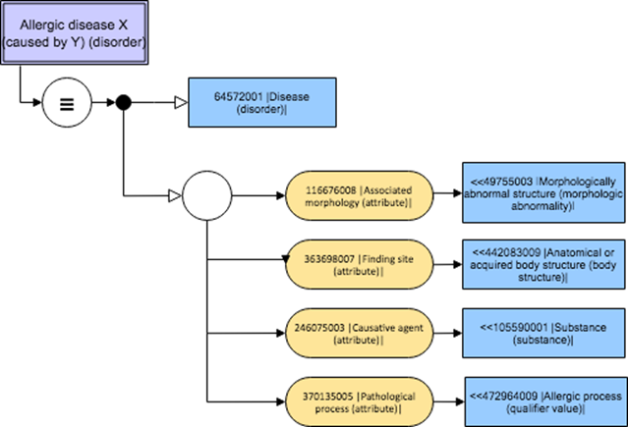
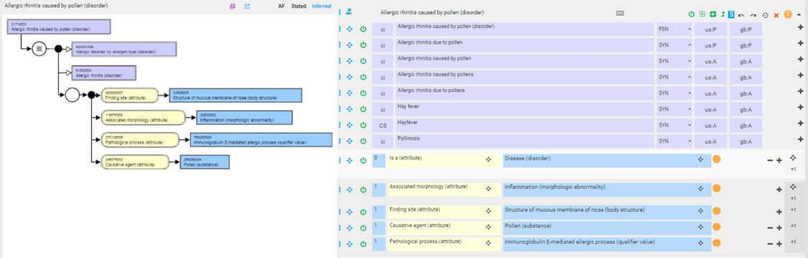
Allergic and nonallergic hypersensitivity (pseudoallergic) diseases 3
Model
Example

Slide 9
Allergic and nonallergic hypersensitivity (pseudoallergic) dispositions
These classes represent propensities to develop allergic or nonallergic hypersensitivity (pseudoallergic) reactions under appropriate conditions (i.e. allergen exposure).
As propensities, do not have a pathophysiologic manifestation prior to being realized as processes.
Allergic and nonallergic hypersensitivity (pseudoallergic) dispositions are considered to be clinical findings rather than disorders to further distinguish them from their realizations as allergic and nonallergic hypersensitivity (pseudoallergic) reactions.
Allergic and nonallergic hypersensitivity (pseudoallergic) dispositions are defined thus as propensities to adverse reactions and allergic conditions realized as allergic or nonallergic hypersensitivity (pseudoallergic) processes.

Slide 10
Allergic and nonallergic hypersensitivity (pseudoallergic) dispositions 2
FSN: Allergy/Non-allergic hypersensitivity to X (and Y) (finding)
PT: Allergy/Non-allergic hypersensitivity* to X (and Y)
Examples
  Allergy to paracetamol (finding)
  Allergy to sulfamethoxazole and trimethoprim (finding)
  Non-allergic hypersensitivity to sulfite (finding)
  Examples
    Allergy to abacavir
    Allergy to paracetamol
    Allergy to mugwort
*additional description Pseudoallergy to X
e.g. Pseudoallergy to aspartame

Slide 11
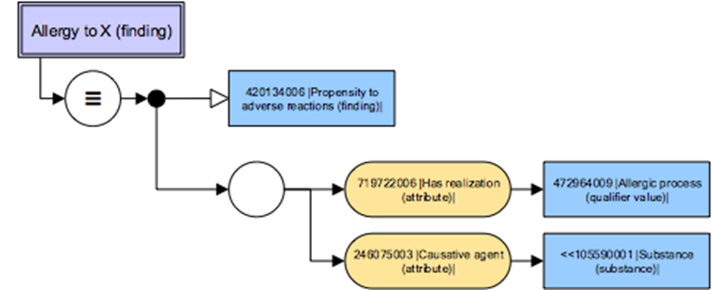
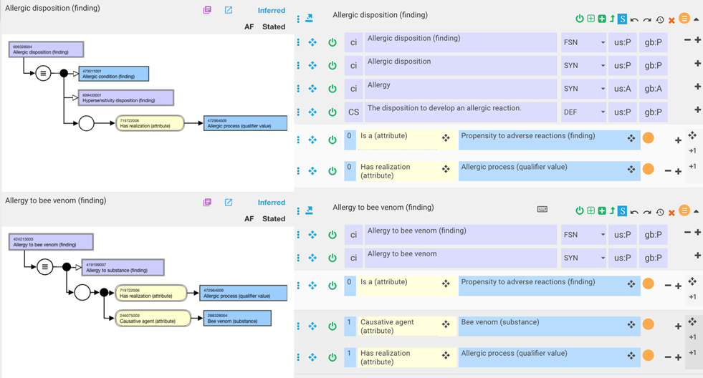
Allergic and nonallergic hypersensitivity (pseudoallergic) dispositions 3
Model
Example

Slide 12
Allergic and nonallergic hypersensitivity (pseudoallergic) reactions
These classes represent pathological processes and are defined as adverse reactions and allergic conditions with a pathological process of allergic or nonallergic hypersensitivity (pseudoallergic) process.

Slide 13
Allergic and nonallergic hypersensitivity (pseudoallergic) reactions 2
FSN
PT
Allergic reaction caused by X (disorder),
Non-allergic hypersensitivity reaction caused by X (disorder),
Anaphylactic reaction caused by X (disorder)
Anaphylactoid reaction caused by X (disorder)
Allergic reaction caused by X
Non-allergic hypersensitivity reaction caused by X

Slide 14
Allergic and nonallergic hypersensitivity (pseudoallergic) reactions 3
Examples
Additional description for Non-allergic hypersensitivity reaction to X
FSN:
  418809008 |Allergic reaction caused by dye (disorder)|
  418364006 |Allergic reaction caused by pollen (disorder)|
PT:
  Allergic reaction caused by dye
  Non-allergic hypersensitivity reaction caused by sulfite
  Pseudoallergic reaction caused by X

Slide 15
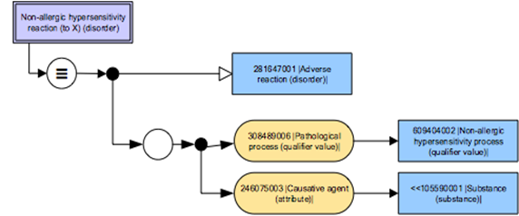
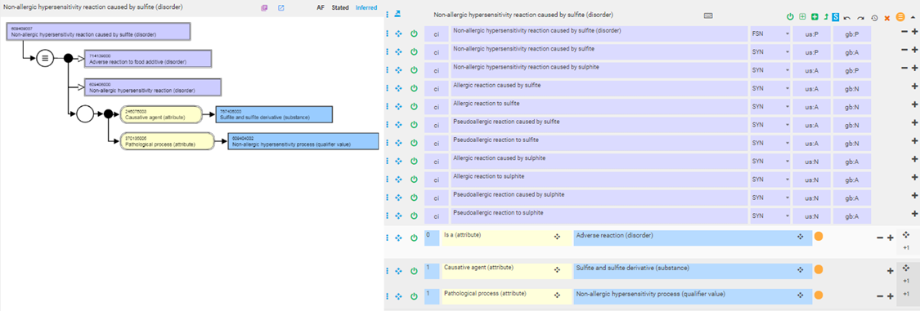
Allergic and nonallergic hypersensitivity (pseudoallergic) reactions 4
Model
Example

Slide 16
Contact hypersensitivity
Contact hypersensitivity represents a hypersensitivity response elicited by contact of the skin or mucous membranes with a substance. The response may be immune mediated (allergic) or nonimmune (irritant). Allergic responses may be immunoglobulin E mediated as in allergic contact urticaria or nonimmunoglobulin E mediated as in allergic contact dermatitis.

Slide 17
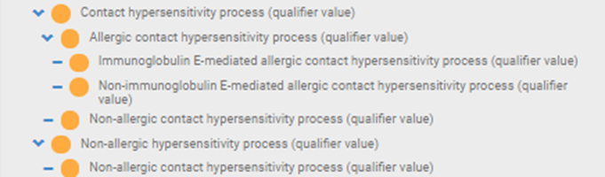
Contact hypersensitivity
Contact hypersensitivity concepts are model as hypersensitivity disorders using the pathological processes illustrated below:

Slide 18
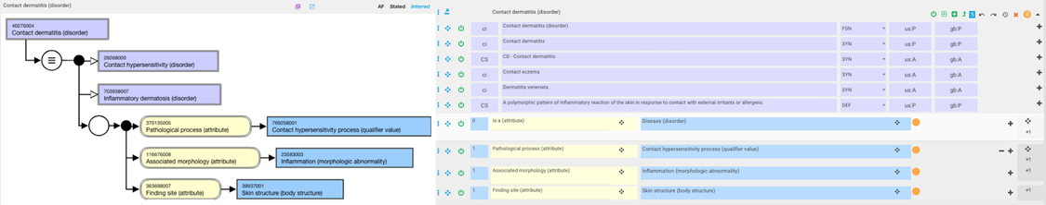
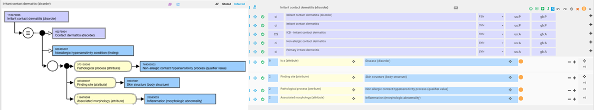
Contact hypersensitivity examples

Slide 19
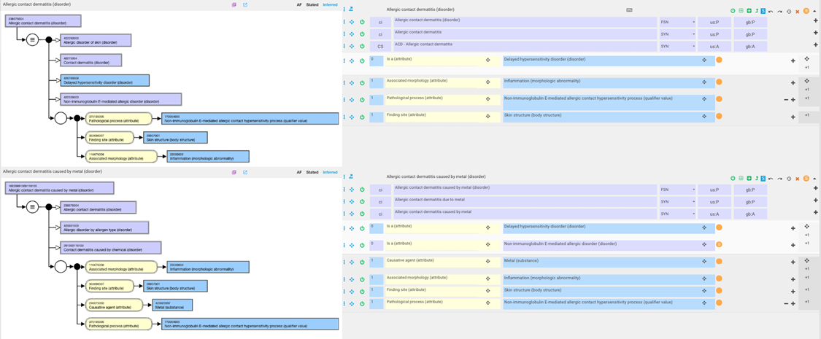
Contact hypersensitivity examples 2

Slide 20
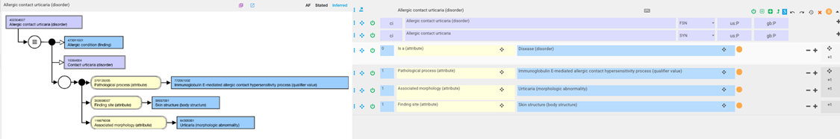
Contact hypersensitivity examples 3

Slide 21
Intolerance to substance

Slide 22
Intolerance to substance
Intolerances can represent a variety of pathological processes and due to the difficulty in precisely defining an intolerance pathological process, it becomes problematic to apply the model for hypersensitivity dispositions to defining intolerance to a substance. For this reason, as well as the difficulty in associating a material agent with a disposition, it is proposed that substances are related to the intolerance disposition by use of the associated with attribute. The parent concept, Intolerance to substance (finding) is primitive but can be used as a parent to fully define Intolerance to specific substances.

Slide 23
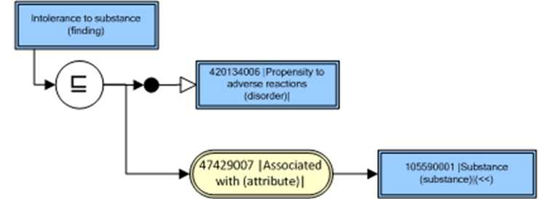
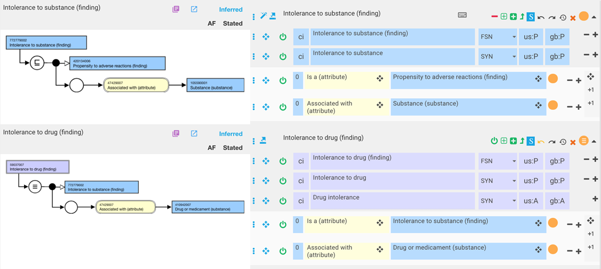
Intolerance to substance 2
FSN: Intolerance to X (finding)
Preferred Term: Intolerance to X
Model
Example

Slide 24
Allergy vs. Intolerance*
Adverse reactions may be:
  An allergy (typically type I hypersensitivity, plus other "allergy-like" reactions, including pseudoallergy)
  An intolerance (typically non-immune adverse reactions that are not determined or perceived to be allergic or "allergy-like", and are to some degree idiosyncratic and/or individually specific [i.e. are not a reaction that is expected to occur with most or all patients given similar circumstances])
In clinical practice distinguishing between allergy and intolerance is difficult and may not be practical. Often the term "allergy" is used rather generically and may overlap with "intolerance", and the boundaries between these concepts may not be well-defined or understood. As noted above, the term "intolerance" should generally be applied to a propensity for adverse reactions which is either determined (to the extent that is possible) or perceived to not be allergic or "allergy-like". If it is not possible to determine whether a particular propensity condition is an allergy or an intolerance, then the type element should be omitted from the resource
*FHIR Release 3 (STU

Slide 25
Questions
Should intolerance to substance mean the same as propensity to adverse reactions to substance and subsume allergy to substance?
The WAO/EAAACI nomenclature does not specifically mention intolerance.

