Slide 1
Allergy to living organisms

Slide 2
Request received from Netherlands for general allergy to x organism concepts
Rationale:
  “if a patient says he is allergic to dogs or cats we just want to register this without having to find out if it he is allergic to the proteins found in dog or cat hair, dander or epithelium. For this reason we would be very happy to be able to have a more general concept in Snomed like Cat protein (substance) or dog protein (substance) For allergists who do want to register very specific we can choose to make a hierarchy in this allergen list which gives those allergists the opportunity to choose cat protein (substance) and then have a choice to go more specific to cat dander protein (substance)”

Slide 3
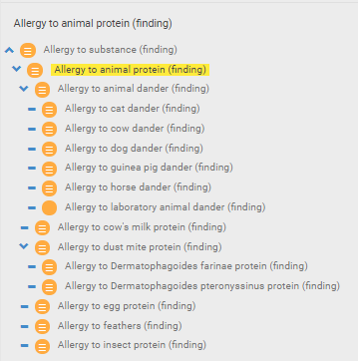
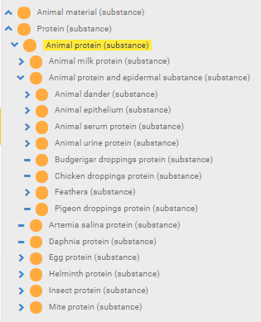
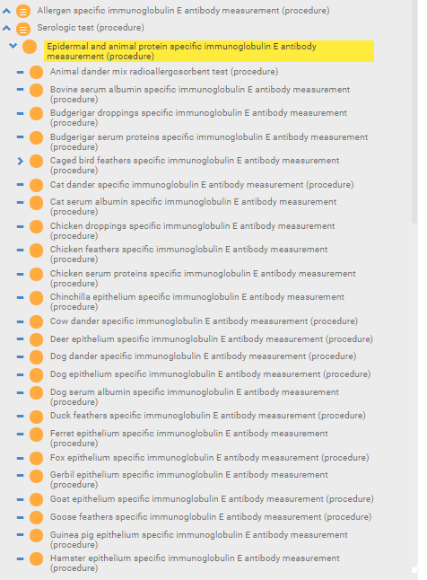
Animal allergy/substances represented in SNOMED CT by source (urine, serum, dander, epithelium, droppings)

Slide 4
Animal allergens
An animal (living organism) is not an allergen.
Animal allergens are substances derived from animals – usually proteins but can be carbohydrates
Technically, things like dander and epithelium although often referred to as allergens are not the actual allergens but rather the sources where allergens are found.
The actual allergens are specific proteins.
  For cat, 8 allergenic proteins have been identified thus far and are named Fel d 1, Fel d 2,...Fel d 8.
  For mouse, a variety of allergenic proteins have been identified in serum, urine and dander.

Slide 5
Proposal
Create Allergy to organism X concepts as headers for more specific concepts that mention allergen source
Substance could be Organism X protein (substance) or more general (to accommodate carbohydrate allergens ) such as Substance derived from organism X (substance) or both
Example:
  Allergy to cat proteins (or Allergy to substance derived from cat)
    Allergy to cat serum proteins
    Allergy to cat urine proteins
    Allergy to cat dander

