Slide 1
Allergy to combination products, stereoisomers, bases and modifications

Slide 2
Allergy use cases for stereoisomers
Modelling of stereoisomers in the substance hierarchy – recommendations by substance project group
  Model stereoisomers and their racemic mixtures as siblings in the substance hierarchy in order to resolve the faulty classifications in the product hierarchy (making both hierarchies flat)
To implement the expected classification in other hierarchies including allergies, adverse reactions, and poisoning the following proposed solutions were considered:
  Provide an association between each stereoisomer and the racemic mixture using a new attribute value association
  The general impact of adding a new attribute cannot be fully assessed based on existing use-cases--specifically considering the fact that this new attribute needs to be role-chained to other attributes such as “causative agent” and “component” which are widely used in other hierarchies.
  Assigning GCIs for such concepts requires decisions to be made at the point of creation/update of those concepts and outside of the substance hierarchy, which is considered to be the source of truth.

Slide 3
Allergy and adverse reaction findings – specific examples
Allergy to cetirizine (finding)
  Allergy to levocetirizine -- Not an existing concept, but an allergy use case
Allergy to ofloxacin (finding)
  Allergy to levofloxacin (finding)
Allergy to thyroxine (finding)
  Allergy to dextrothyroxine (finding)
Thyroxine adverse reaction (disorder)
  Dextrothyroxine sodium adverse reaction (disorder)

Slide 4
Allergy to stereoisomers - 1
Very little has been written about allergy to specific stereoisomers and racemic mixes
One would expect given the exquisite specificity of the immune system that one stereoisomer would predominate over the other in terms of causing allergic reactions however the diversity of the immune response would predict that immune responses can be directed to either or both isomers

Slide 5
Allergy to stereoisomers - 2
The issue here is similar to that observed for allergy to combined substances (previously discussed)
An allergy to a specific stereoisomer is necessarily an allergy to the racemate (assuming one excludes differences based on the amount of the pure enantiomer vs. that in the racemic mixture) as the racemate is an equal mix of both stereoisomers.
An allergy to the racemate may be an allergy to either stereoisomer or to both

Slide 6
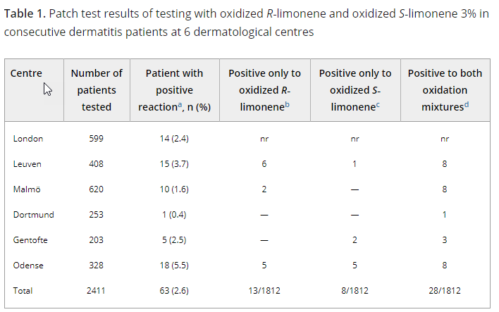
Not only oxidized R-(+)- but also S-(-)-limonene is a common cause of contact allergy in dermatitis patients in Europe
Matura, M. , Sköld, M. , Börje, A. , Andersen, K. E., Bruze, M. , Frosch, P. , Goossens, A. , Johansen, J. D., Svedman, C. , White, I. R. and Karlberg, A. (2006. Contact Dermatitis, 55: 274-279. doi:10.1111/j.1600-0536.2006.00939.x

Slide 7
Allergy to stereoisomers - 3
EHRs using decision support for allergy checking do bidirectional checking for safety concerns
Not possible to relate racemic mixtures and their stereoisomer components to each other in SNOMED to achieve this functionality
Best compromise at this time is to make Allergy to racemate X a parent of Allergy to R-X and Allergy to S-X pending further evaluation of adding an additional attribute or using GCIs.

Slide 8
Allergy to bases and modifications
Current definition for is_modification attribute
  This attribute indicates that the concept is a structural modification of another concept.

Slide 9
Examples of substances that are considered is_modification:
Liposomal preparations, Salts, hydrates, salts+hydrates, anhydrous salts
Isotopes are not considered in the list of examples for is_modification. However, "Radioisotope with salt" and "combined radioisotope substances" are considered modifications
Substances specifying "bound”
Combined Substances

Slide 10
Example of substances that are not considered as modifications:
Grouper concepts should not be targets of an IS Modification relationship.
There is no IS MODIFICATION relationship between stereoisomers.
Concepts specifying a particular physical form (Micronised, macrocrystal, microsphere, fumes, vapour, crystal) of a substance are not is_modification of the said substance.
Substances specifying "free”
Substances specifying fragment or subunit Substances specifying a source or origin

Slide 11
Should allergy to modifications of a base be inactivated ?
It should not be assumed that a modification of a base will exhibit the same allergenic properties as the base.
In some cases, a modification may result in an allergic reaction that is absent in the base or in a reaction that is different than that for the base
Examples:
  Contact dermatitis from metallic platinum vs. immediate hypersensitivity from platinum salts and complexes
  Allergic reactions to liposomal complexes

Slide 12
Platinosis
  Definition - The effects of soluble platinum salts on people exposed to these occupationally.
  Platinosis is characterized by pronounced irritation of the nose and upper respiratory passages, with sneezing, running of the eyes, and coughing, tightness of the chest, wheezing and shortness of breath.
  Reports of allergy appeared from the United States, the United Kingdom, Switzerland, the Federal Republic of Germany and South Africa

Slide 13
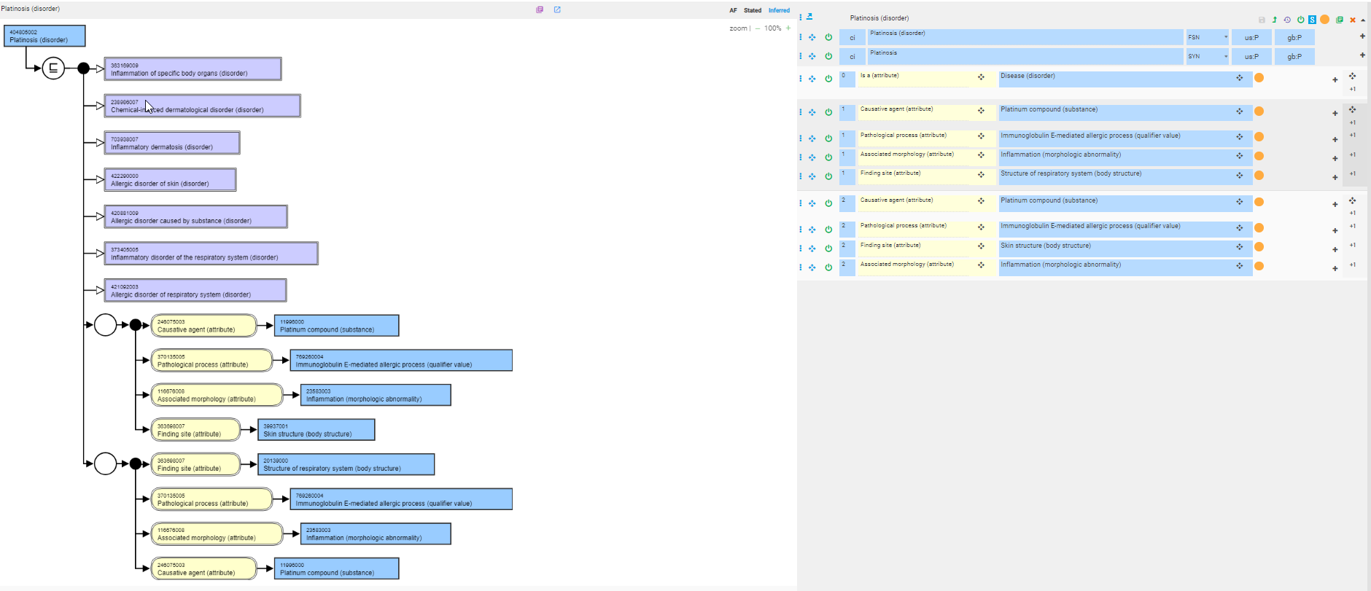
Platinosis

Slide 14
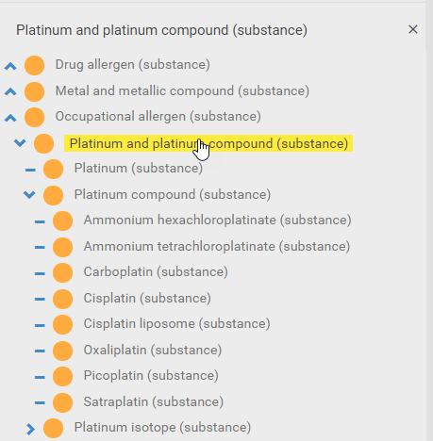
Platinum and platinum compound

Slide 15
Allergic reaction to the liposomal component of liposomal amphotericin B.
Cesaro S¹, Calore E, Messina C, Zanesco L.
Abstract
A case of severe allergic reaction arising during treatment with Ambisome and unresponsive to antihistamine and steroid medication is reported. A 2.9-year-old female child with Hurler's syndrome received an allogeneic cord blood transplant from an unrelated donor. During the aplastic phase, liposomal amphotericin B (Ambisome) was administered as part of an empirical treatment for persistent fever. The patient developed an extensive maculopapular rash and severe itching that resolved only on discontinuation of the drug. The patient subsequently had interstitial pneumonia with ingravescent respiratory failure in spite of adequate antibiotic and antiviral treatment. Treatment with conventional amphotericin B was considered essential in this critically ill patient, and the conventional formulation was administered for 20 days without causing any reaction. Severe allergic reaction to Ambisome is a rare event but, taking into account that premedication or dose testing is not recommended for this formulation, careful monitoring of the patient being treated for the first time is warranted.

Slide 16
Allergy to combined substances
For the purposes of recording allergies, adverse events and antibiotic sensitivities there is a perceived requirement to represent concepts that are a combination of two or more separate substances.
It is proposed that these are only added to SNOMED CT substance hierarchy where the combination exhibits synergy. i.e. the properties of the combination substance differ from the sum of their constituent substance properties.
Changes to SNOMED CT concept model in the future to permit the use of concepts within the products hierarchy to model disorder and findings concepts means that these combined substances concepts may no longer be required and so may be inactivated at that time.
Where non- synergistic combinations are required to be available as concepts for the recording of allergies or adverse reactions they should be recorded using the (product) concepts (when a model for using products is created).

