Slide 1
Allergy to animals
Alternate model

Slide 2
Background
Request to add Allergy to animal X (finding)
  Example Allergy to cat (finding)
  Currently SNOMED only has 232346004 |Allergy to cat dander (finding)|
  Allergens may be located in saliva, urine, and dander. Non-specialist physicians will not make a distinction
  There is no association between cat dander and cat organism in SNOMED
  Model proposed using role chaining

Slide 3
Alternate model
420134006 |Propensity to adverse reaction (finding)|
  42752001 |Due to (attribute)|=Exposure to animal X organism (event)
  {246075003 |Causative agent (attribute)|=animal X allergenic substance + 719722006 |Has realization (attribute)|=<<472964009 |Allergic process (qualifier value)|}

Slide 4
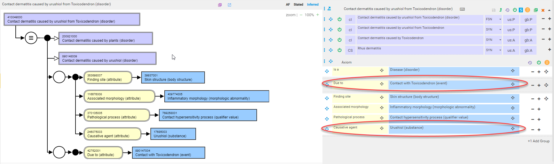
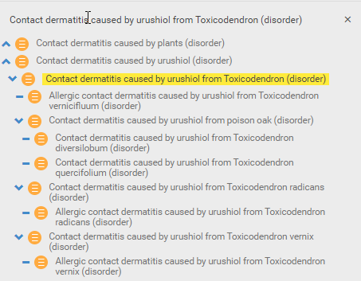
Existing precedence for alternate model – allergic contact dermatitis

Slide 5
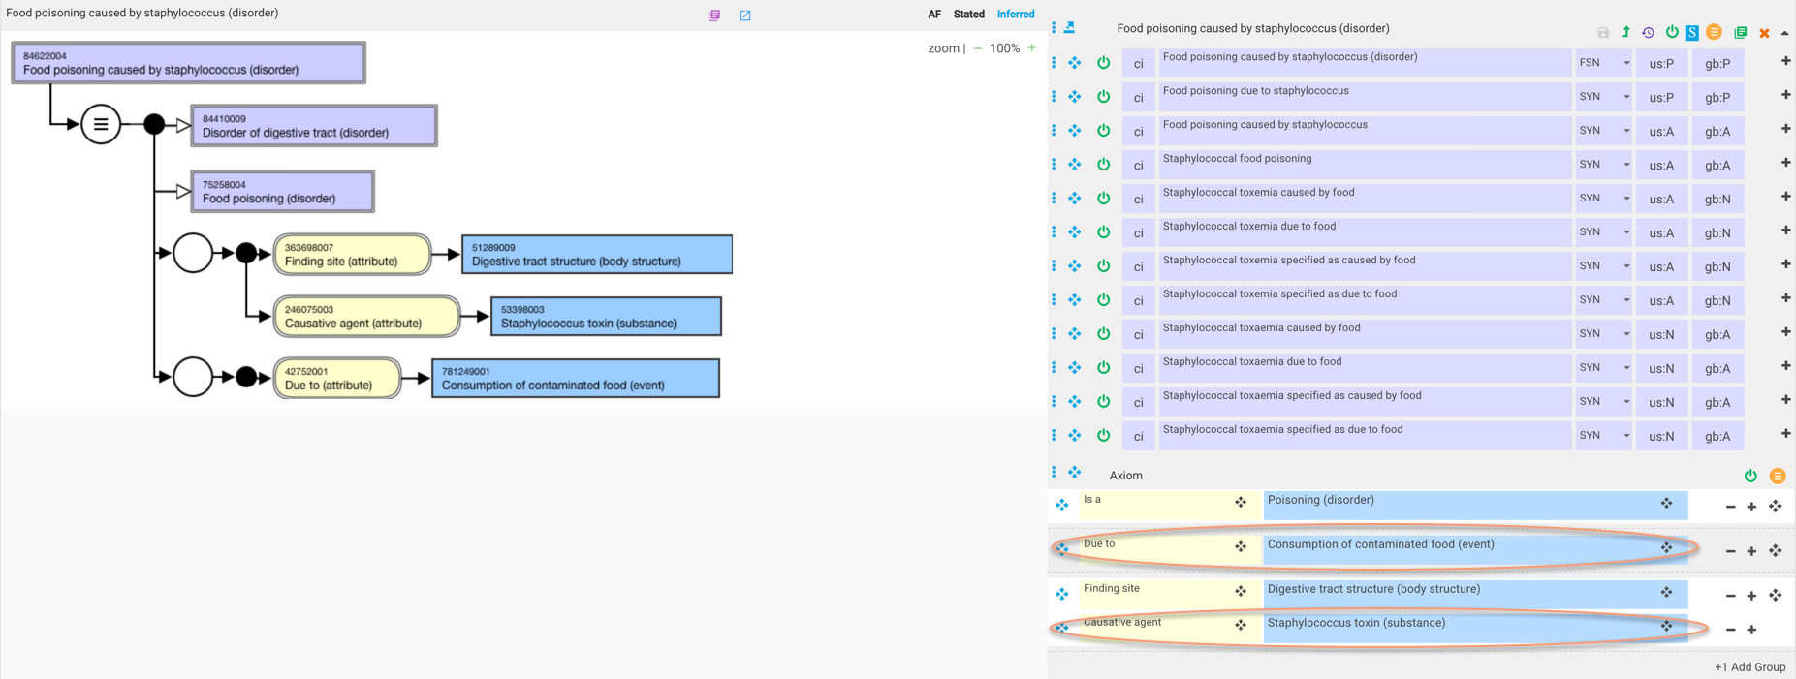
Existing precedence for alternate model – food poisoning

Slide 6
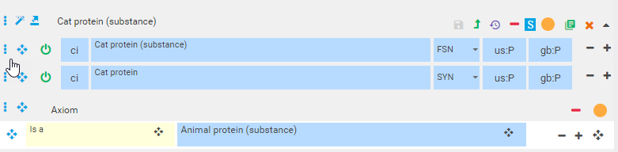
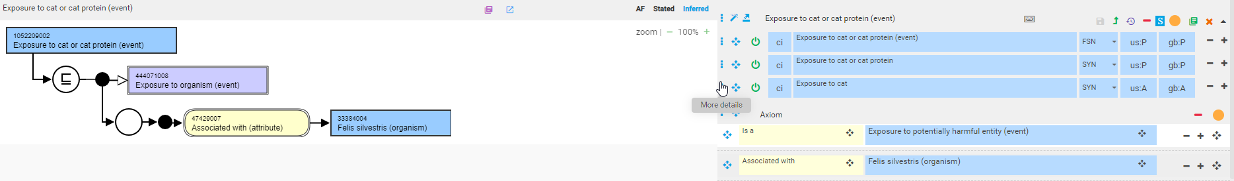
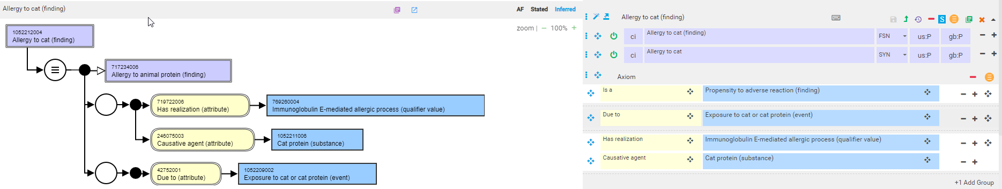
Allergy to cat (finding)

Slide 7
What is the correct causative agent?
Animal protein?
  Cat protein (substance)
Animal substance? (some allergens are carbohydrates)
  Cat substance (substance)
Animal allergen? (would represent a limited well-defined list)
  Cat allergen

Slide 8
Allergen sources
Allergen sources include hair, epithelium/dander, feathers, droppings, urine, serum, saliva
Allergen sources are not allergens but rather the site where allergenic proteins are located either due to production at that site or transfer from another site by licking, grooming, urinating, etc.
The specific protein allergens and their quantity may differ based on the source

Slide 9
Allergy to animal dander
2021 ICD-10-CM Diagnosis Code J30.81 Allergic rhinitis due to animal (cat) (dog) hair and dander
  ICD-11 CA08.03 Other allergic rhinitis
    Description-This refers to other allergic inflammation of the nasal airways. It occurs when an allergen, such as pollen, dust or animal dander (particles of shed skin and hair) is inhaled by an individual with a sensitized immune system.
Dander refers to minute particles of skin shed from animals.
Cat allergen(s) are one or more proteins produced by cat sebaceous glands or introduced onto the cat hair and skin from other parts of the cat such as saliva, urine and serum.
In terms of diagnostic testing, IgE against individual allergenic proteins can be detected by blood tests while skin test extracts are derived from allergen sources such as dander
Do we need to represent allergy to animal sources in SNOMED CT as they may be referred to in the clinical realm but are actually erroneous?

Slide 10
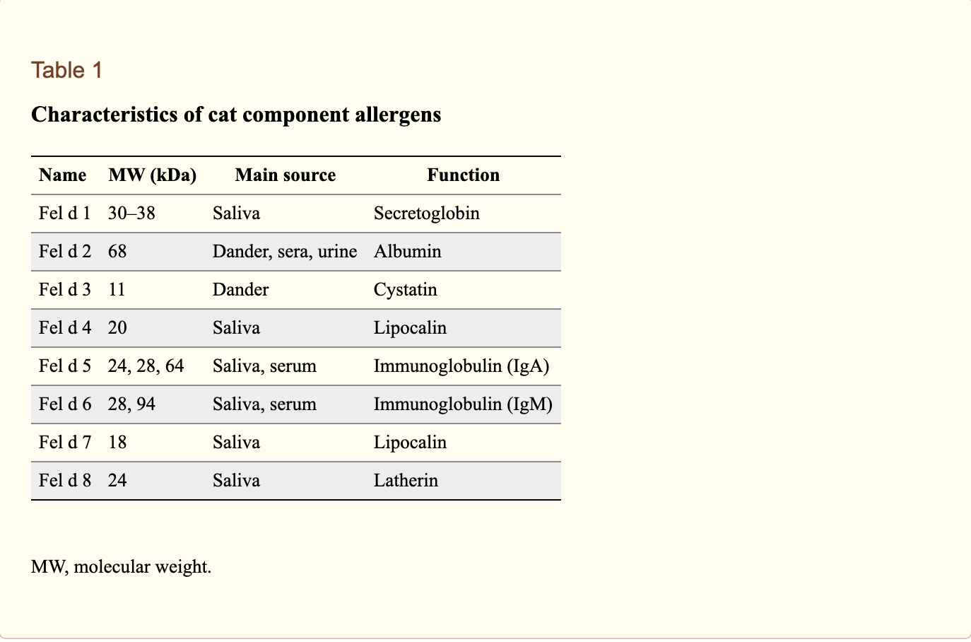
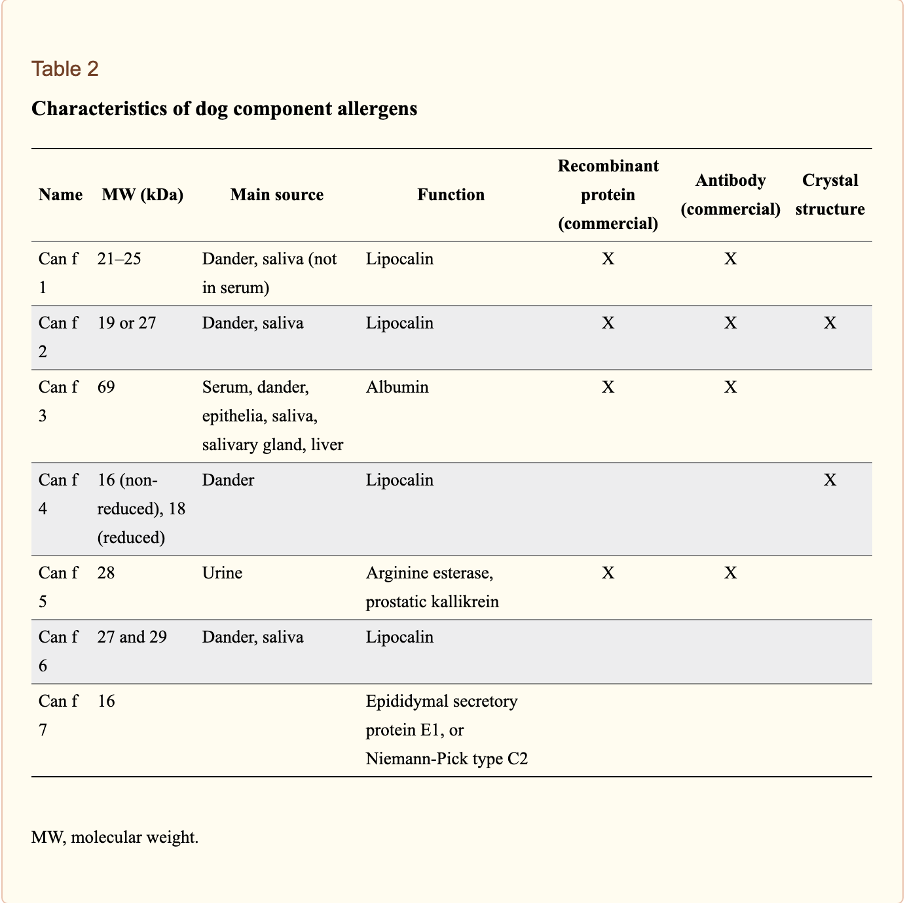
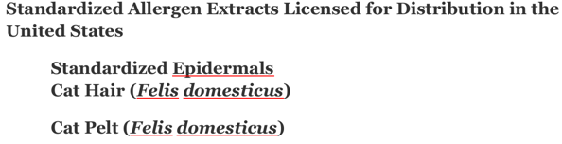
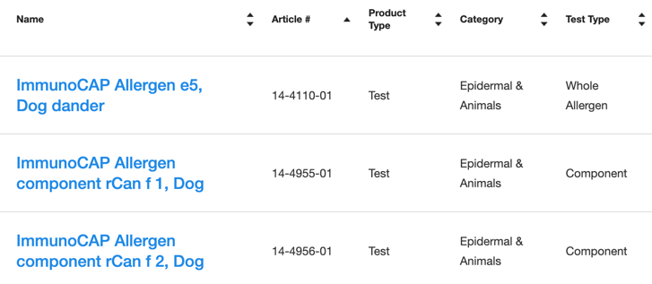
Sources of animal allergen components

Slide 11
Existing concepts
717234006 |Allergy to animal protein (finding)|
232347008 |Allergy to animal dander (finding)|
272169002 |Animal protein (substance)|
264287008 |Animal dander (substance)|
260152009 |Cat dander (substance)|

Slide 12
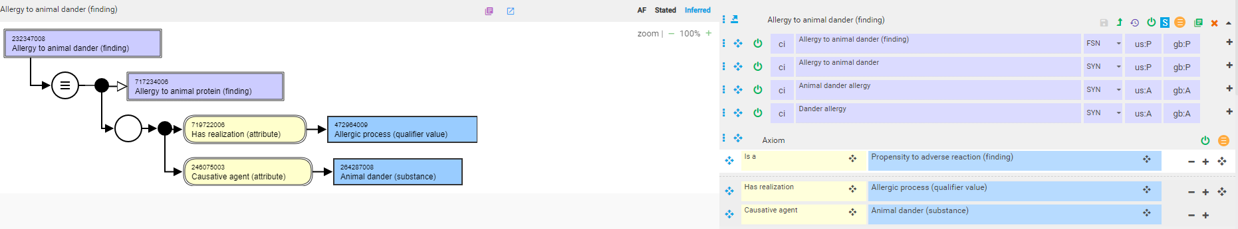
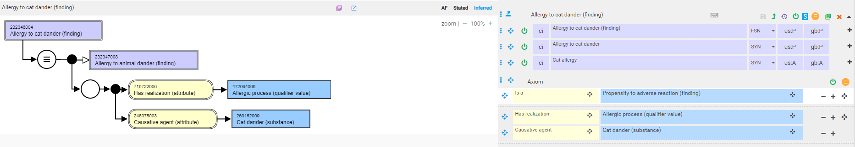
232347008 |Allergy to animal dander (finding)|and 232346004 |Allergy to cat dander (finding)|
Current models

Slide 13
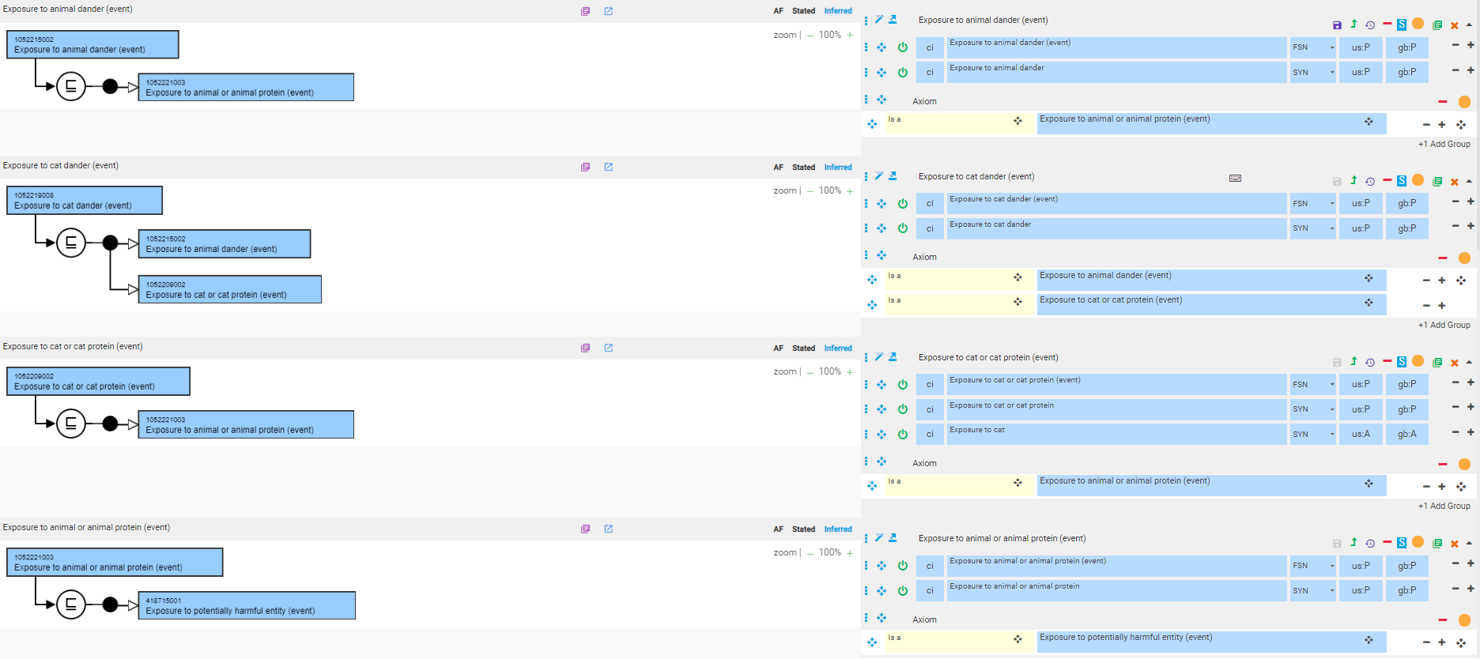
Required exposures
Required to link cat dander to cat as an exposure to cat dander is not necessarily an exposure to a cat

Slide 14
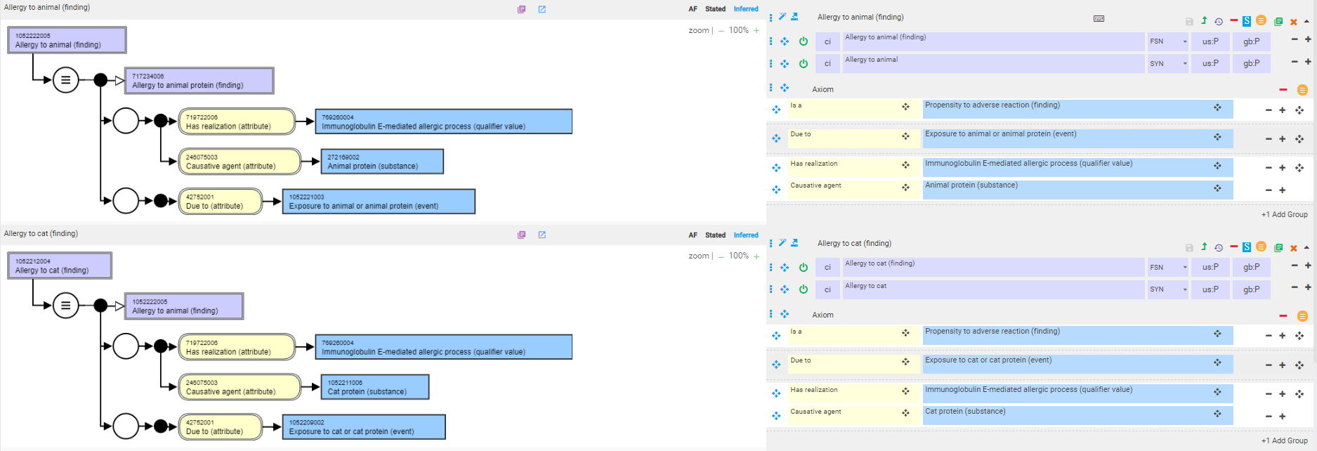
1052222005 |Allergy to animal (finding)|and 1052212004 |Allergy to cat (finding)|

Slide 15
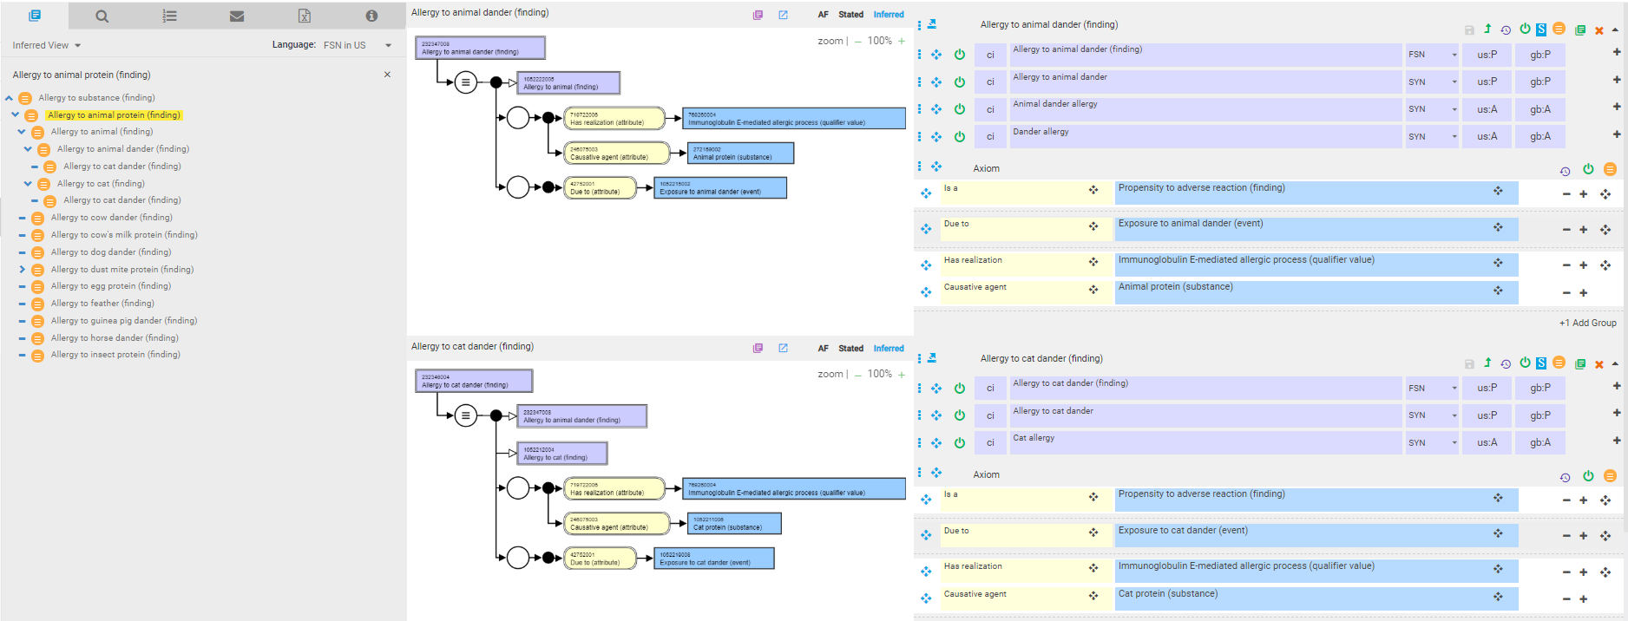
232347008 |Allergy to animal dander (finding)|and 232346004 |Allergy to cat dander (finding)|
Revised models

