Slide 1



An introduction to SNOMED
Content, descriptive logic and data analytics
Ian Green – Customer Relations Lead (Europe) & Global Clinical Engagement Lead
Charles Gutteridge – Clinical Engagement Lead (EMEA) & CCIO Barts Health NHS Trust
Kai Kewley – Implementation Support Technical Specialist

Slide 2

Aggregating and sharing clinical information
Disparate health IT systems and clinical vocabularies create barriers to using patient data efficiently and effectively
Need for standardized data and standards
“A health IT challenge for all”
Notes:
Introductory slide discussing blocks to using real world for analytics and opening discussion for importance of standardized data developed to global standards and maintained at national and international level.

Slide 3
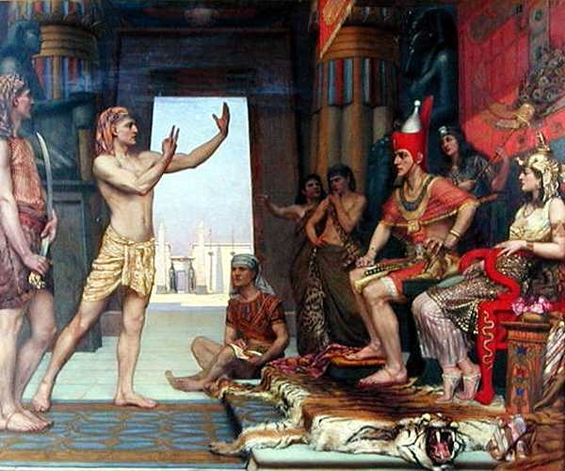
Short introduction to clinical thinking
How a SNOMED concept is developed
The machine-readable concept model
Use of SNOMED browsers
How to produce value sets using expression constraint queries
Applying SNOMED CT to real world problems
Tooling support and demonstration
Agenda
OWL2- are you being serious?

Slide 4
Why do we need standardized vocabularies and data?
“Developing actionable insights”
Clinical characteristics
Counting
Population health estimation Can we find a signal/cause?
Patient level prediction What will happen to me?
Problem oriented view

Slide 5

Back to basics
A clinical idea with a unique identifier
SNOMED CT
Concepts
22298006
Enable meaning-based queries

Slide 6
Back to basics
Human-readable term
linked to a concept
751689013
Myocardial infarction (disorder)
FSN
SNOMED CT
Descriptions
37436014
Myocardial infarction
SYN
22298006
Cardiac infarction
37442013
SYN
37333015
Heart attack
SYN
1784872019
MI - Myocardial infarction
SYN
1784873012
Myocardial infarct
SYN

Slide 7

Back to basics
126877002
SNOMED CT
Relationships
Disorder of glucose metabolism
Diabetes Mellitus
73211009
Is a
362969004
Disorder of the endocrine system
Finding site
362969004
Structure of endocrine system

Slide 8
Recording clinical thinking -
History and examination
Cough
Sputum
Blood stained
Shortness of breath
Fever
Exhaustion
Clinical idea = Concept
Descriptions
Relationships
Relationship attributes
Machine readable concept model

Slide 9
49872002
39607008
363698007
246075003
75570004
116676008
308489006
257552002
116680003
441862004
64572001

Slide 10
49872002
39607008
Has causative agent
Has finding site
75570004
Has associated morphology
Has pathological process
Is A
441862004
257552002
64572001

Slide 11
Virus (organism)
Lung structure
Has causative agent
Has finding site
Viral pneumonia
Has associated morphology
Has pathological process
Is A
Infectious process
Inflammation
Disease

Slide 12
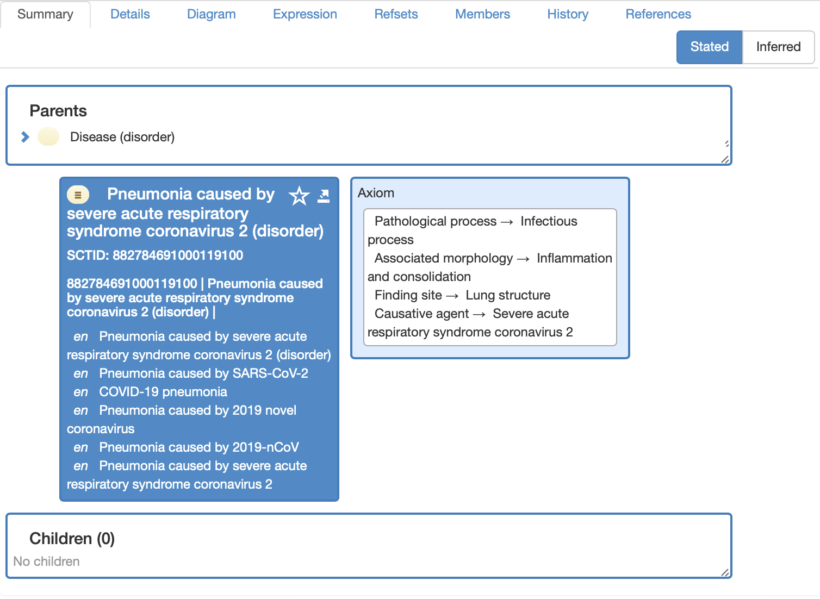

Slide 13
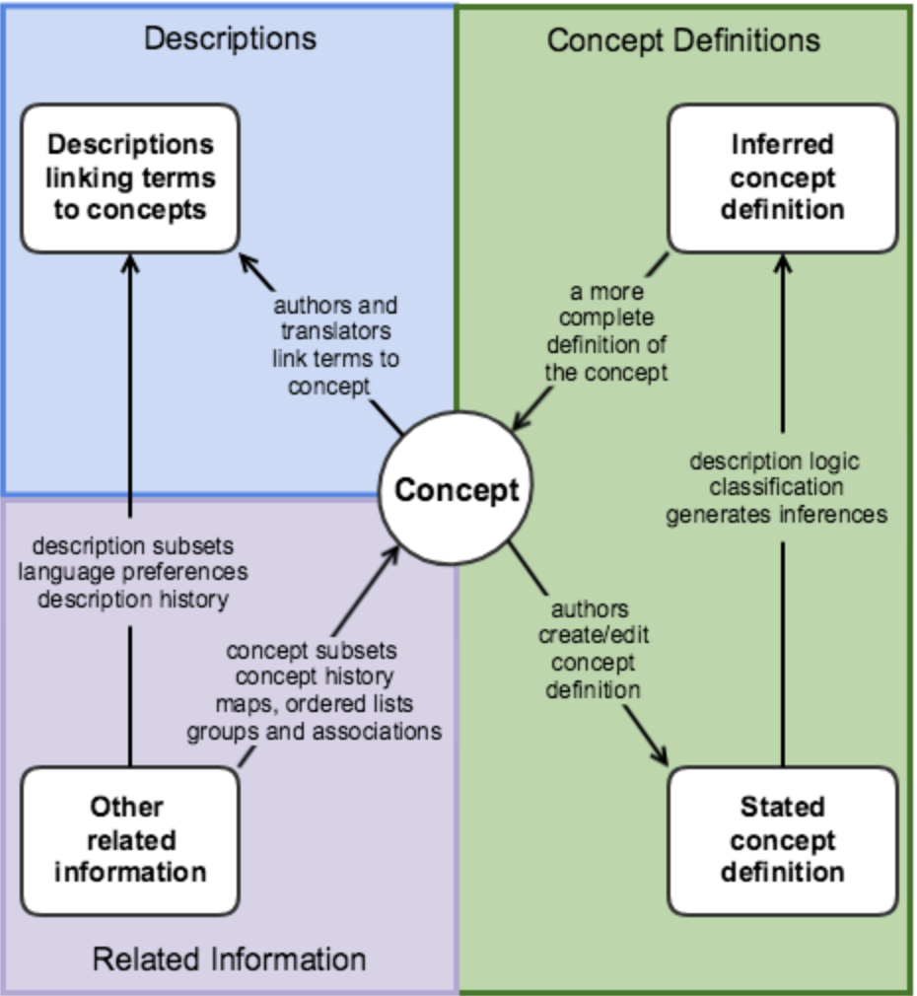

Slide 14
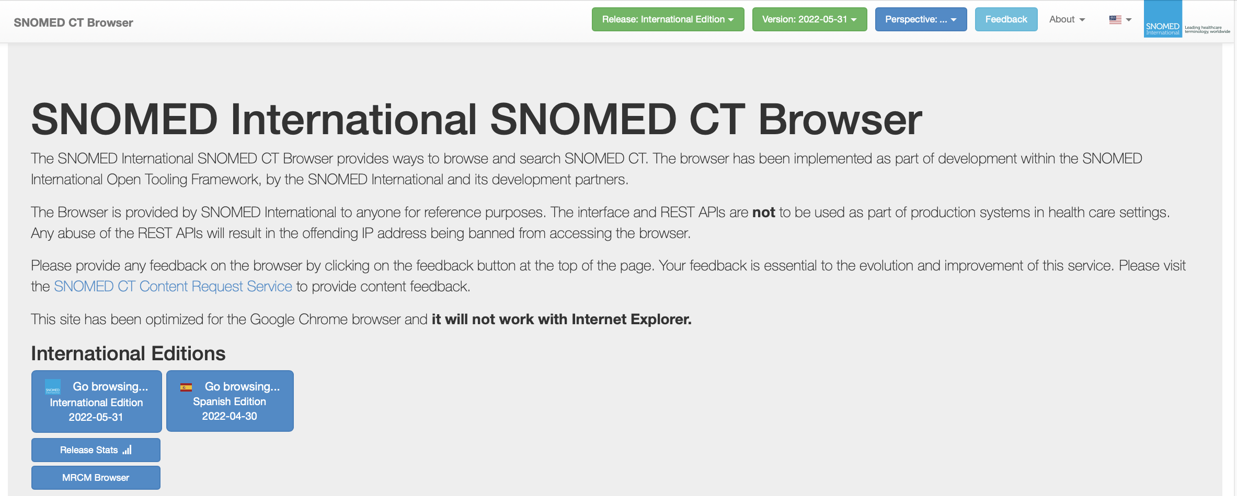
Understanding the MRCM
Demonstrating search functions
https://browser.ihtsdotools.org

Slide 15
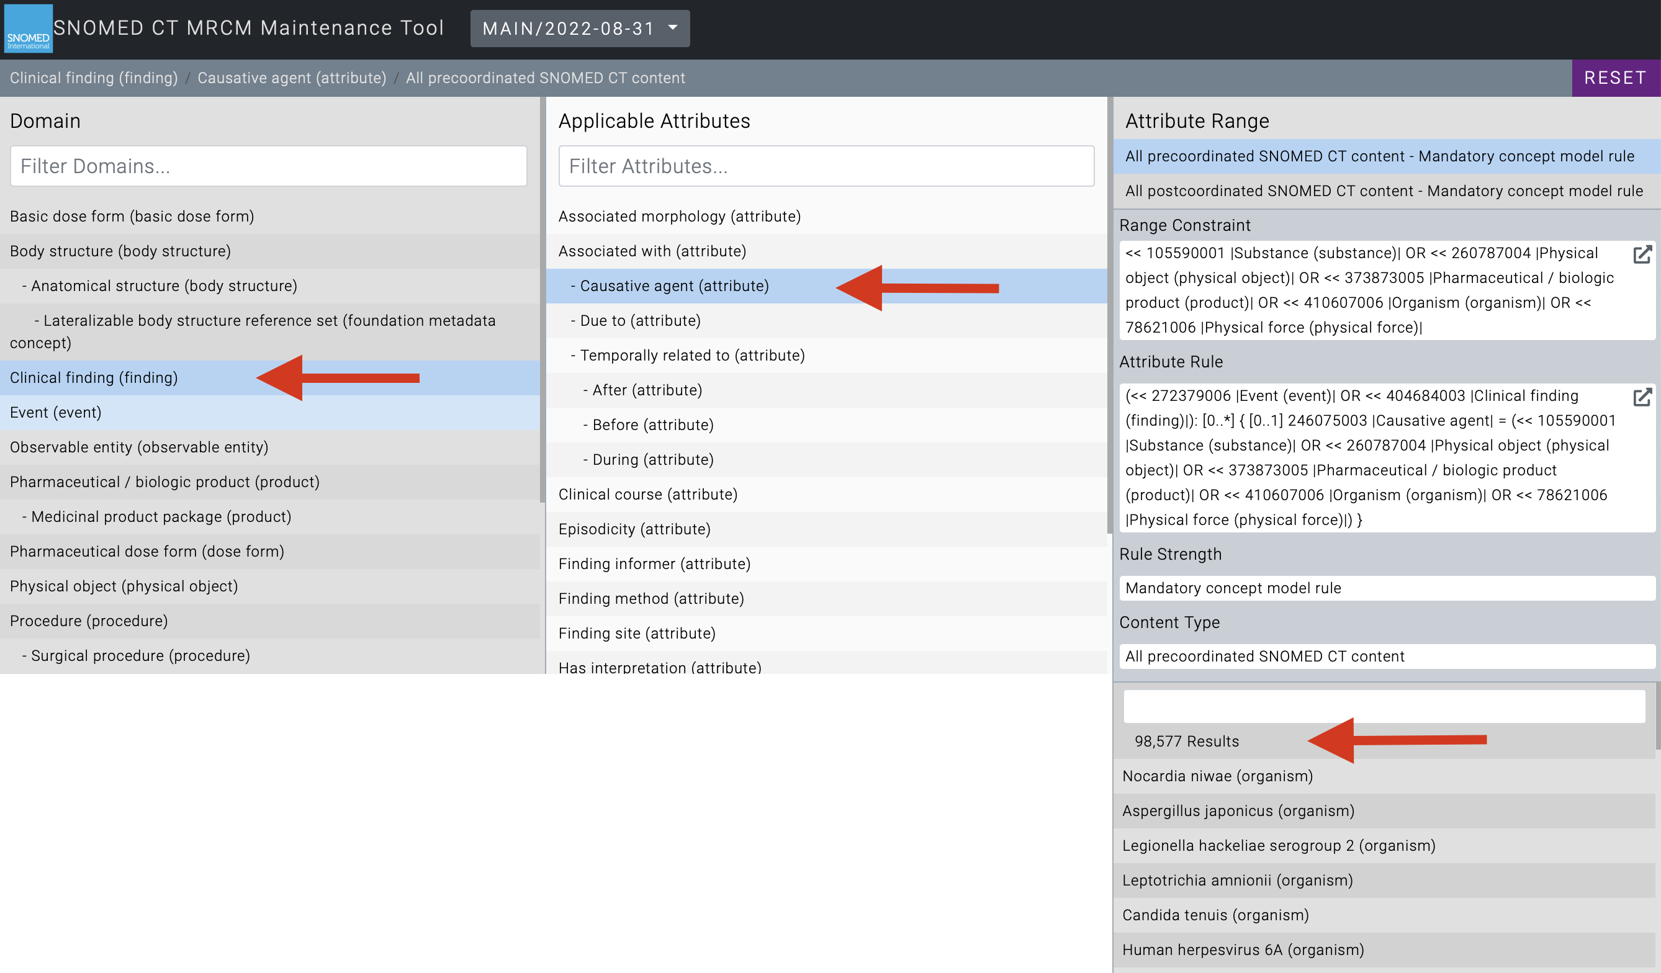

Slide 16
Use cases for the
“Machine Readable Concept Model”
Development of precoordinated terminology content
Authoring and validation of SNOMED CT expressions, constraints and queries
Natural Language Processing
Terminology binding to information models for data capture and semantic interoperability

Slide 17
Creating patient cohorts for further study
Identifying signals in big data sets
Linking data sets
Real world data analytics
Notes:
3 key aims in using real world EHR data and data from other sources for research and population health purposes
The barriers are now less technical than regulatory in relation to ethics, consent and protection of privacy

Slide 18

Cohort creation at different levels of hierarchy
Using axioms and OWL2 semantics
Testing for membership of predefined subsets
Translation and use of dialects
Clinical queries over heterogeneous datasets
Free text analysis
Clinical decision support
Mapping to classifications
Features of SNOMED CT for analytics
18

Slide 19
Use of Expression Constraint
Queries for cohort creation and signal finding
https://browser.ihtsdotools.org

Slide 20


Practical example

Slide 21
Data flow
Recording at the point of care with patient
Storage
Data exchange
Analytics
Communication and sharing

Slide 22
Information models
Problem list
  This visit
  Chronic problems
  Past history
Procedures
  Surgical
  Care interventions
Allergies and reactions
Care requirements
Medications
Environmental determinants
Social determinants
Family history

Slide 23
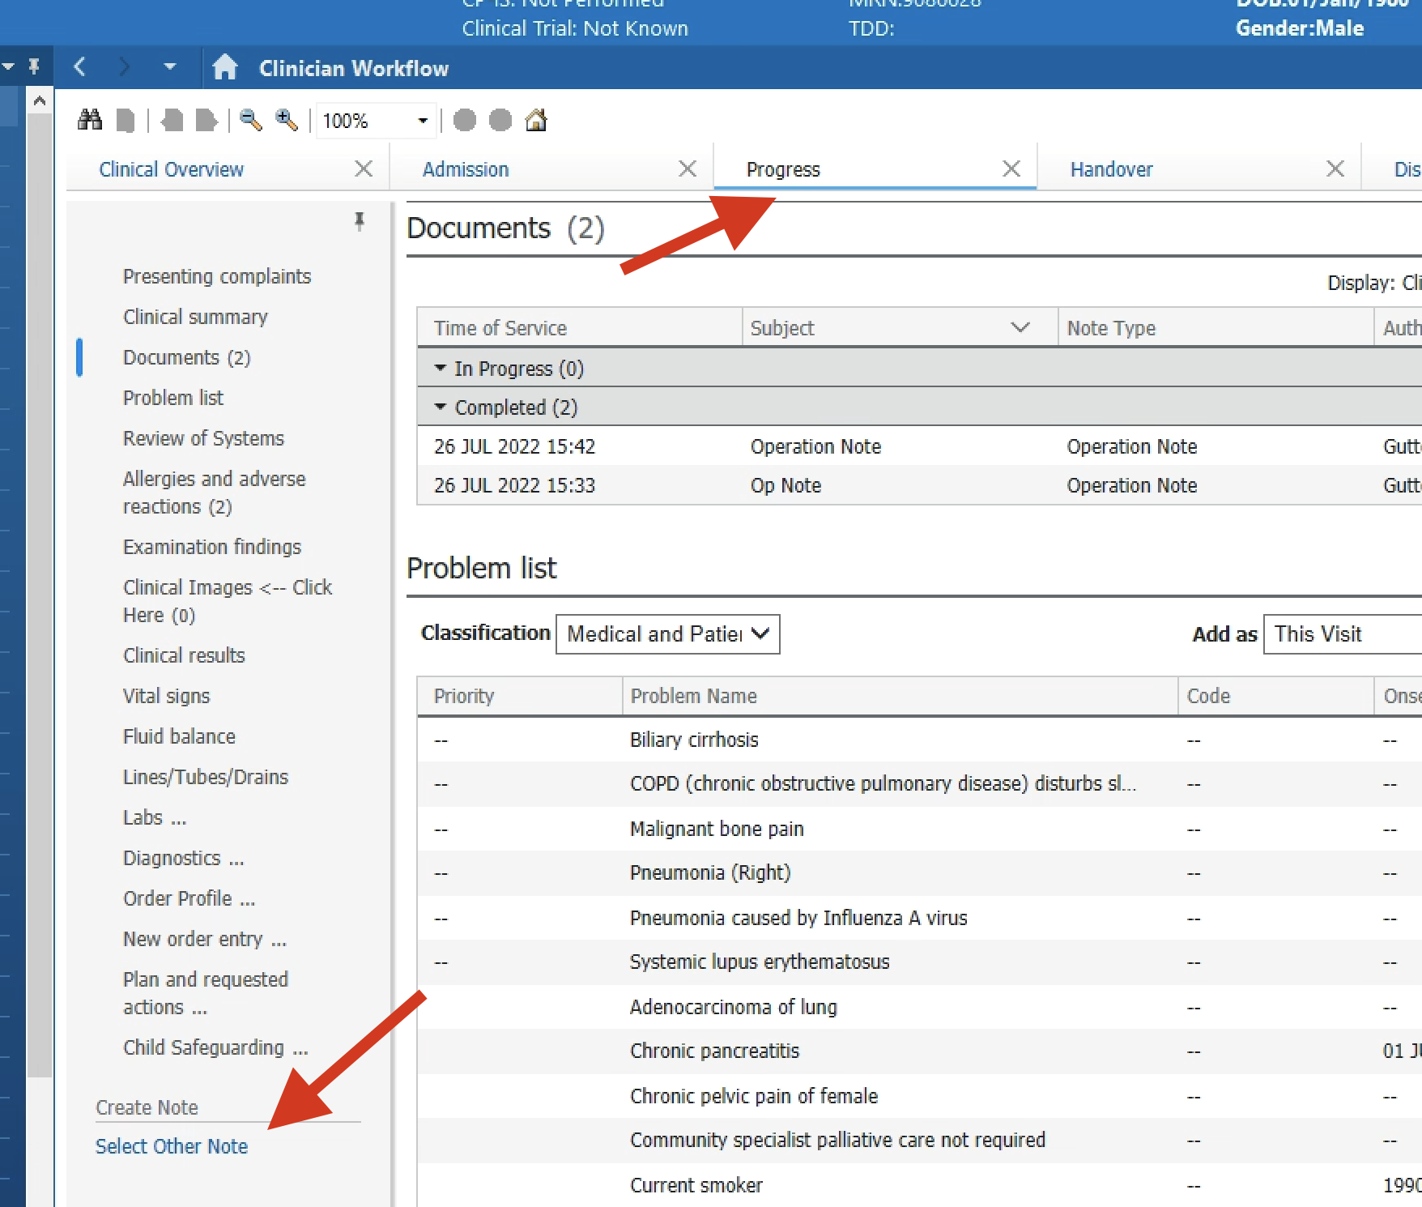

Slide 24
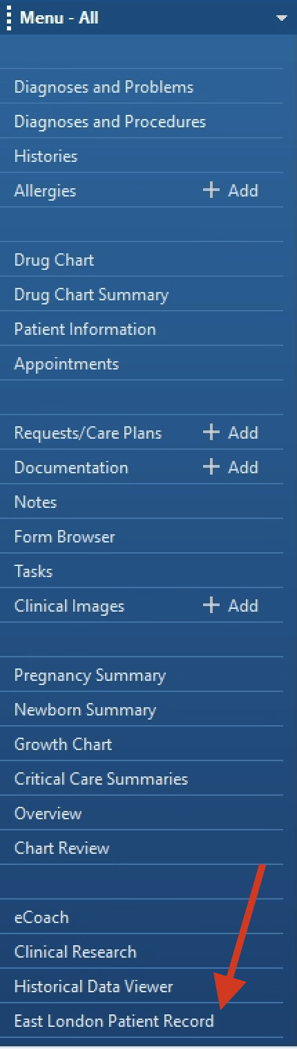
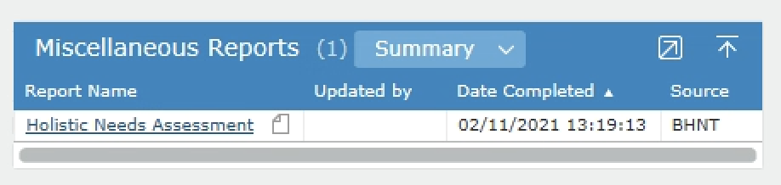
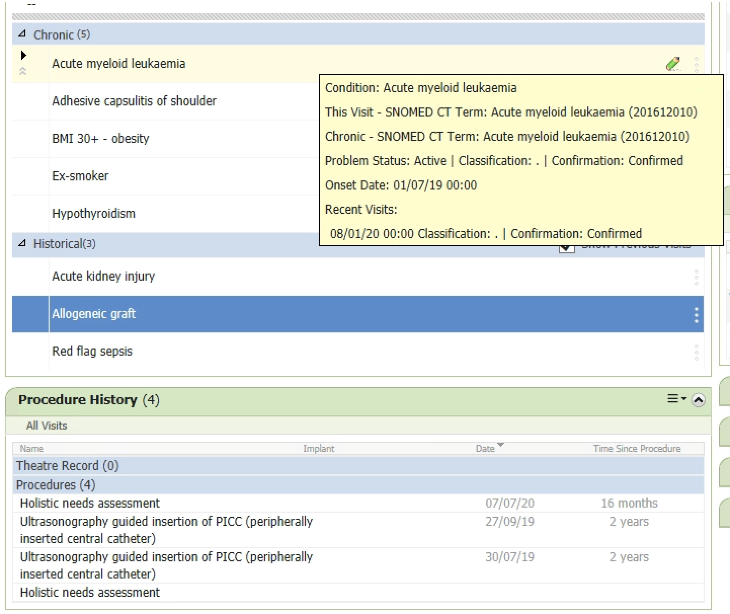
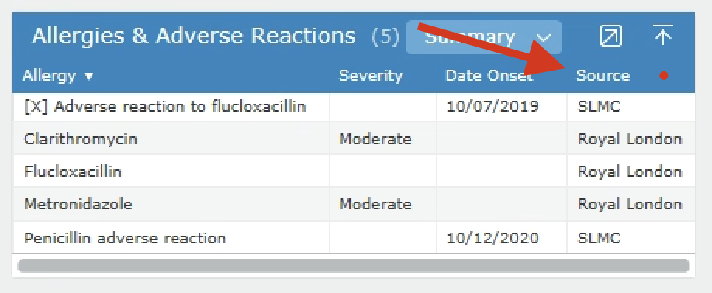
Data linking at the point of care and in the database

Slide 25
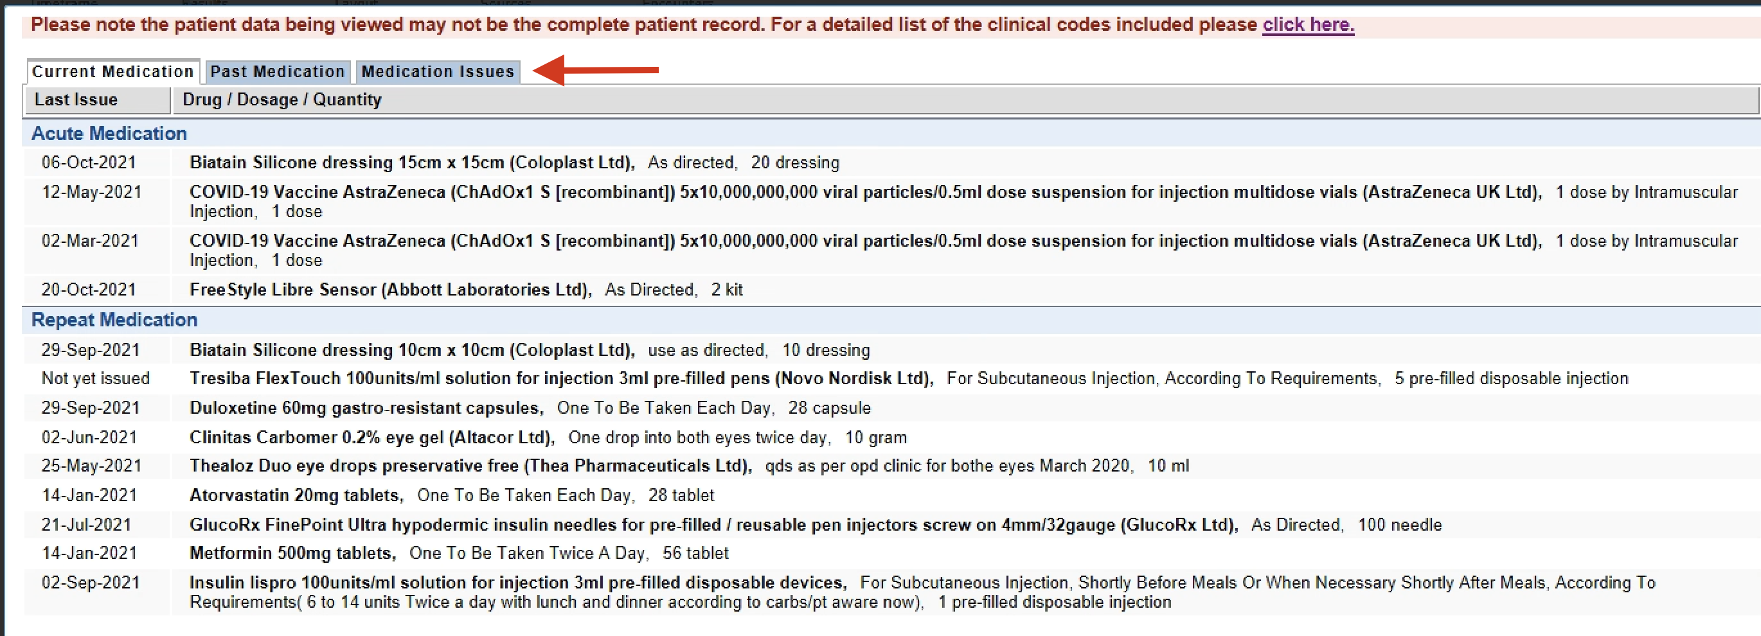
Matching the exchange
Primary care medicines data in the hospital record

Slide 26
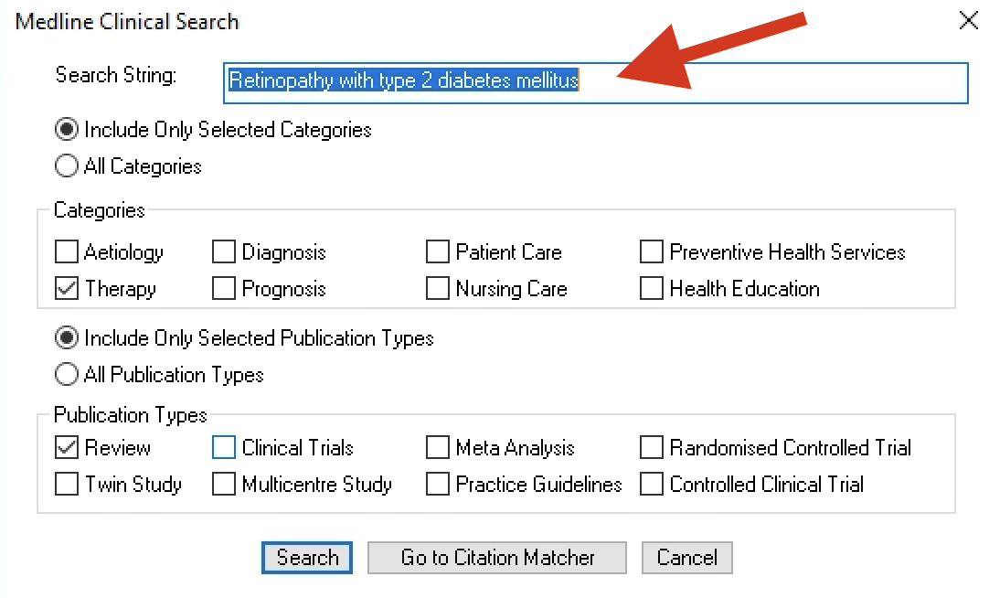
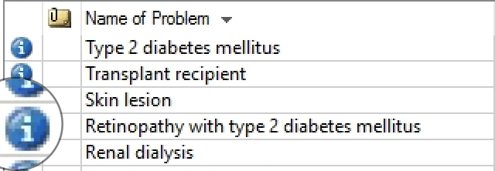
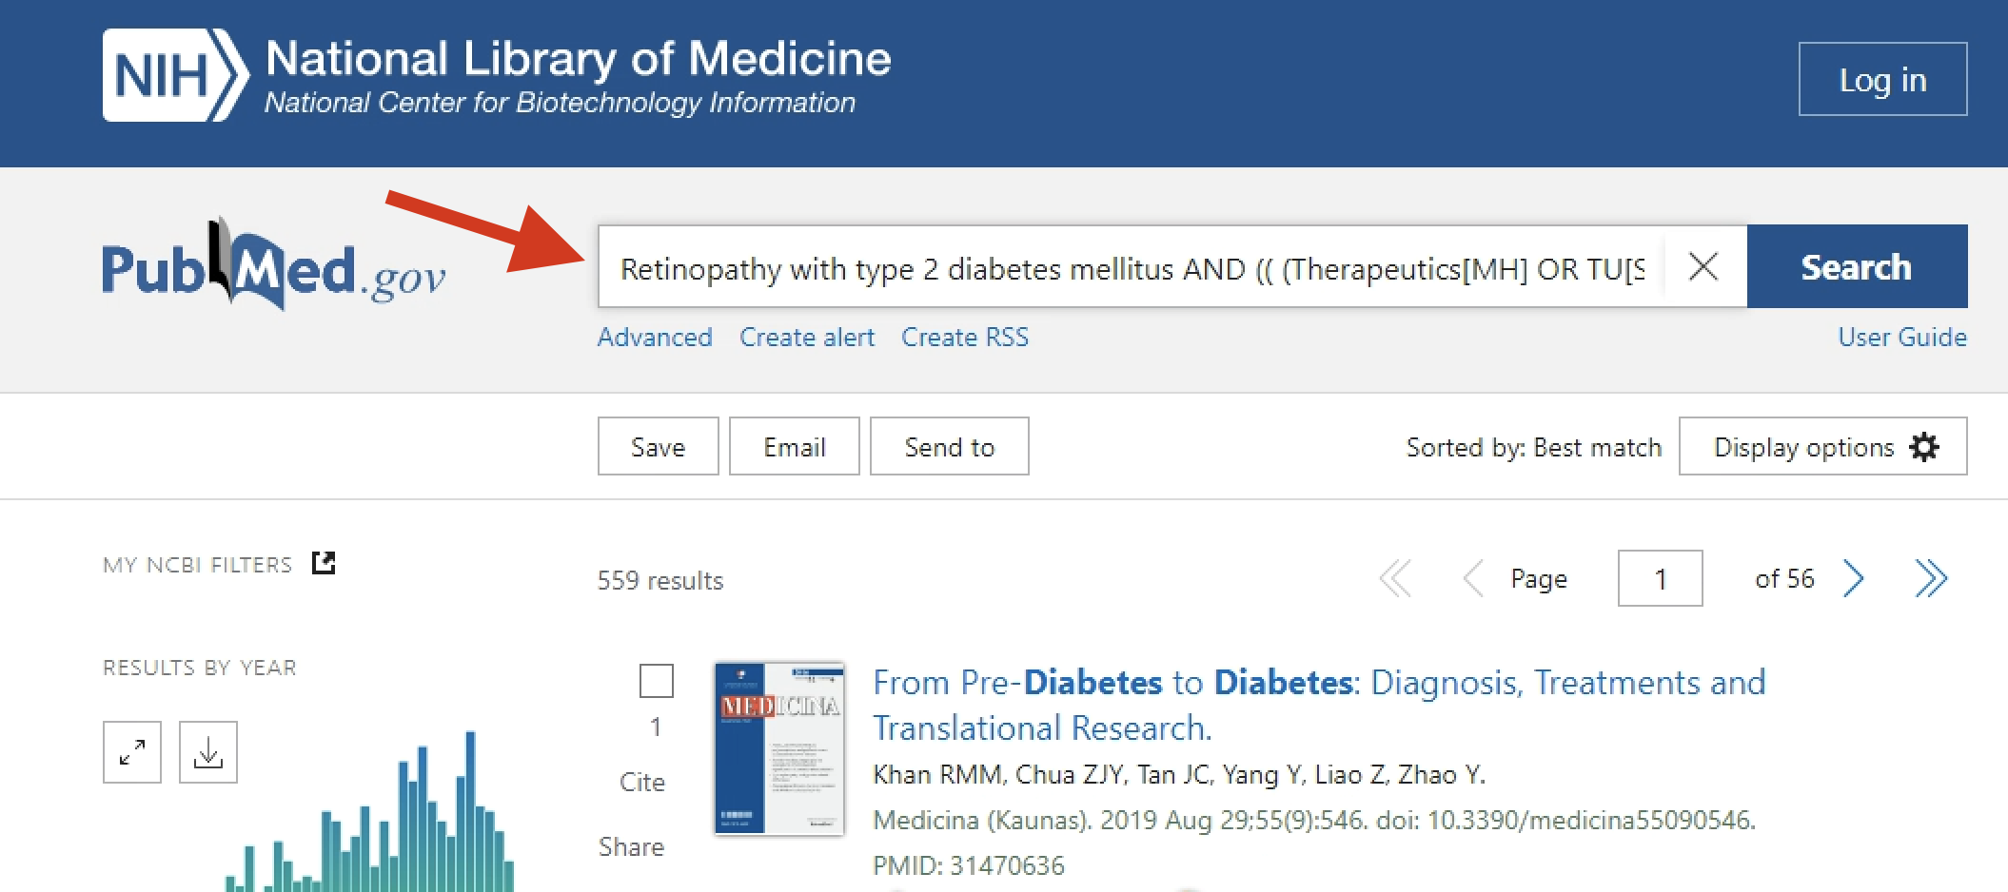

Slide 27
Features of SNOMED CT for analytics
Cohort creation at different levels of hierarchy *
Using axioms and OWL2 semantics
Testing for membership of predefined subsets *
Translation and use of dialects
Clinical queries over heterogeneous datasets *
Free text analysis *
Clinical decision support
Mapping to classifications *
Cohort creation and aggregation
Intersection of data
Semantic queries
Mapping

Slide 28
SNOMED CT based analytics in east London
Point of care analytics
  Decision support – VTE assessments, allergy alerts, BMI encoding
  Automation – referral document for smoking, patient finding with infection
  Info Button in EHR system
Population based analytics
  Use of Emergency Care Data Set to track emergency attendances
  Haemophilia registry
Clinical research
  COVID-19 master dataset
  Diabetes related foot disease study

Slide 29


Slide 30
Data required
Vaccination date
Vaccine type
Attendance date in Emergency Department
SNOMED concept recorded in ED using Emergency Care Data Set
Inpatient SNOMED concepts recorded in diagnosis/problem lists
Laboratory test results: platelet count, D-dimer, Platelet Factor 4 antibodies

Slide 31
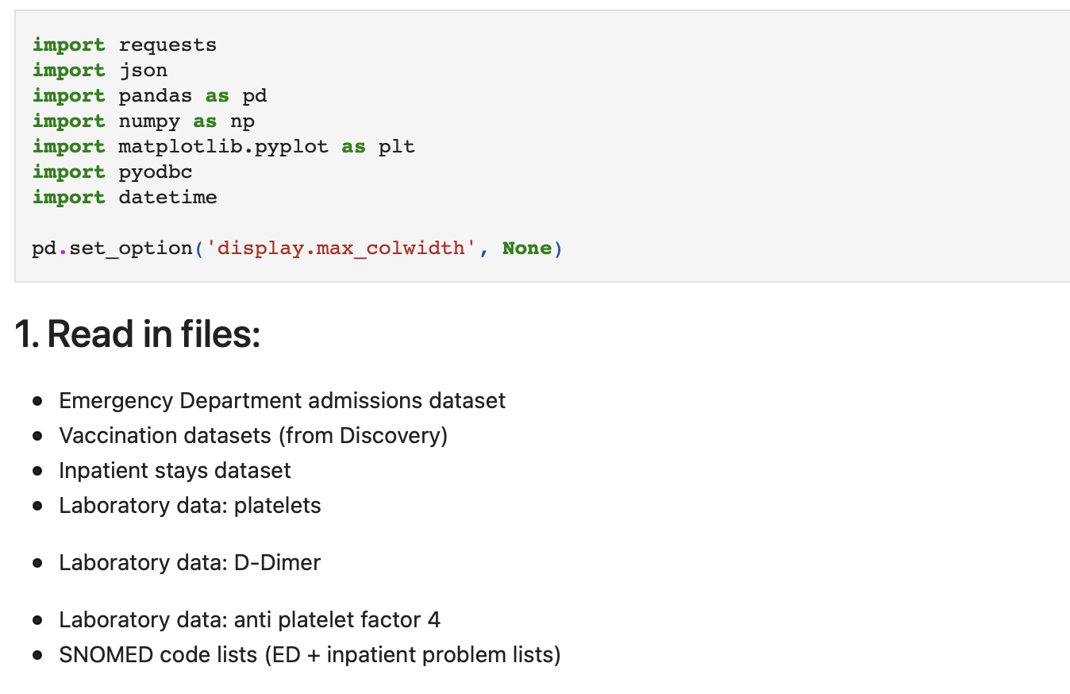
Data acquisition

Slide 32
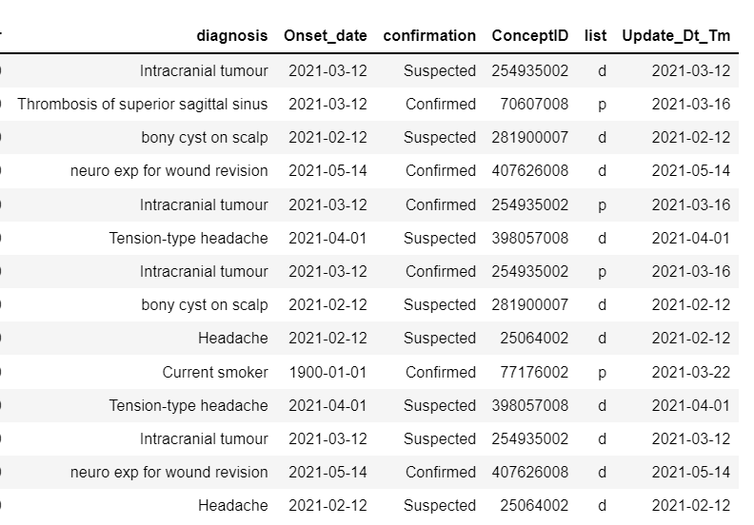
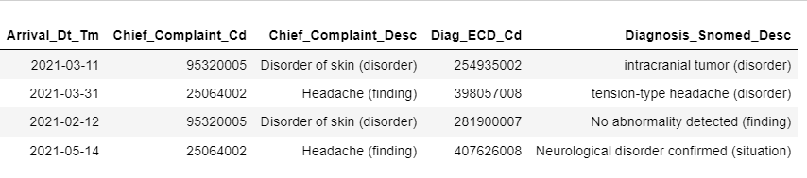
Using value sets to match SNOMED concepts with patient’s problems list or ED diagnosis
VITT algorithm
Filter to include those admitted after vaccination, who have a low platelet count, high d-dimer and positive a-PF4 antibodies

Slide 33
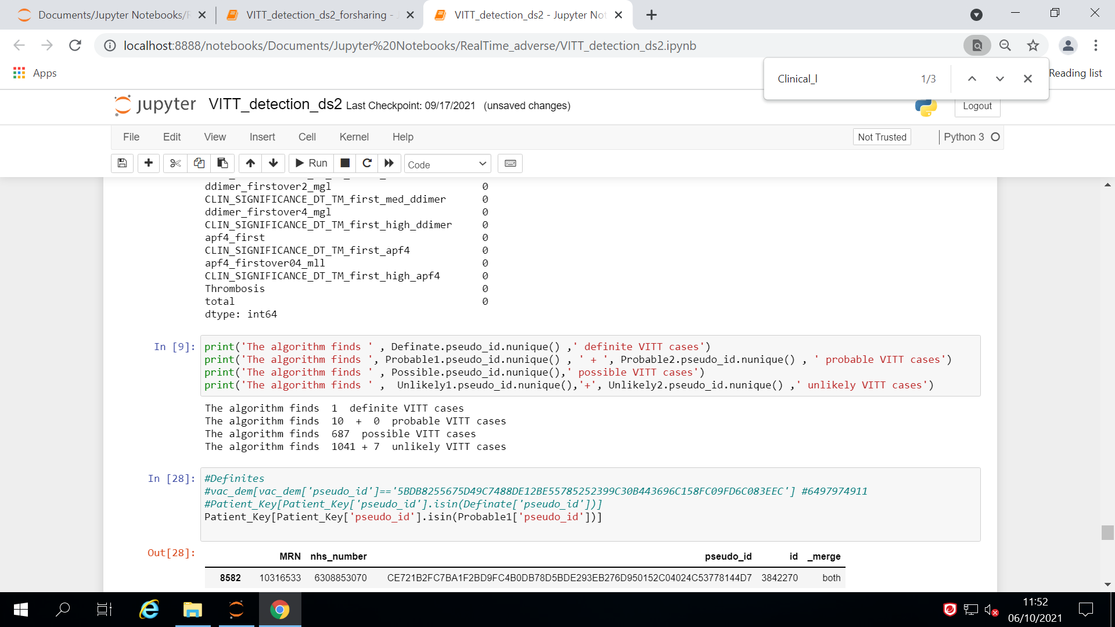
Patients identified and results from clinical validation
VITT algorithm
Precision / Positive Predictive Value (PPV)
1/1 confirmed as a VITT case by clinical team
0/10 confirmed as a VITT case by clinical team, 2/10 missing information to confirm
Many probable cases and possible cases are missing 1+ lab tests
Agreement with clinically identified cases
Of the 4 remaining confirmed-VITT cases:
4/4 identified in hospital dataset
but 4/4 from outside are so are not found in the Discovery (Primary care) vaccination data set

Slide 34
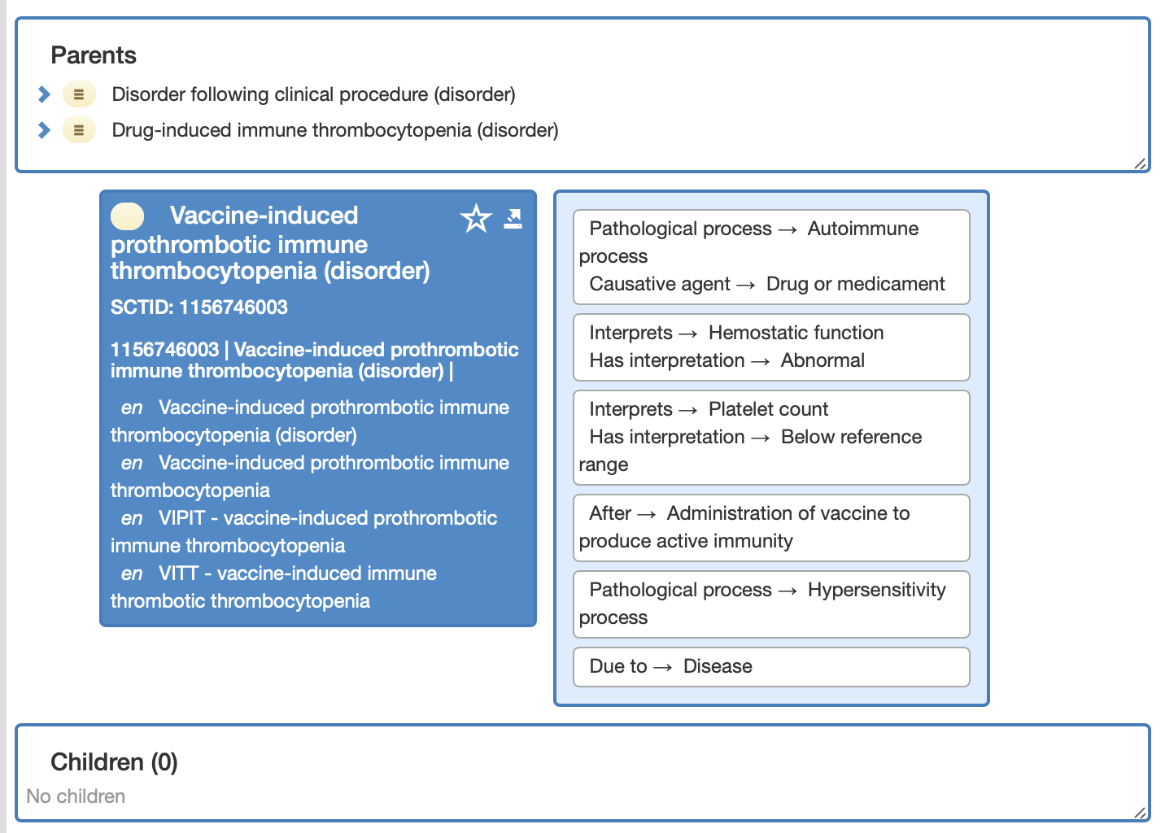
VITT modelled in SNOMED

Slide 35
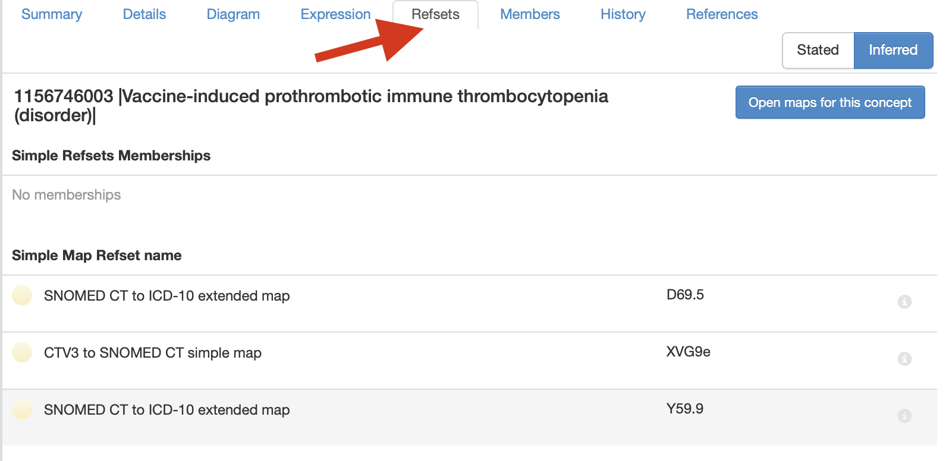
VITT SNOMED code mapped to ICD10

Slide 36
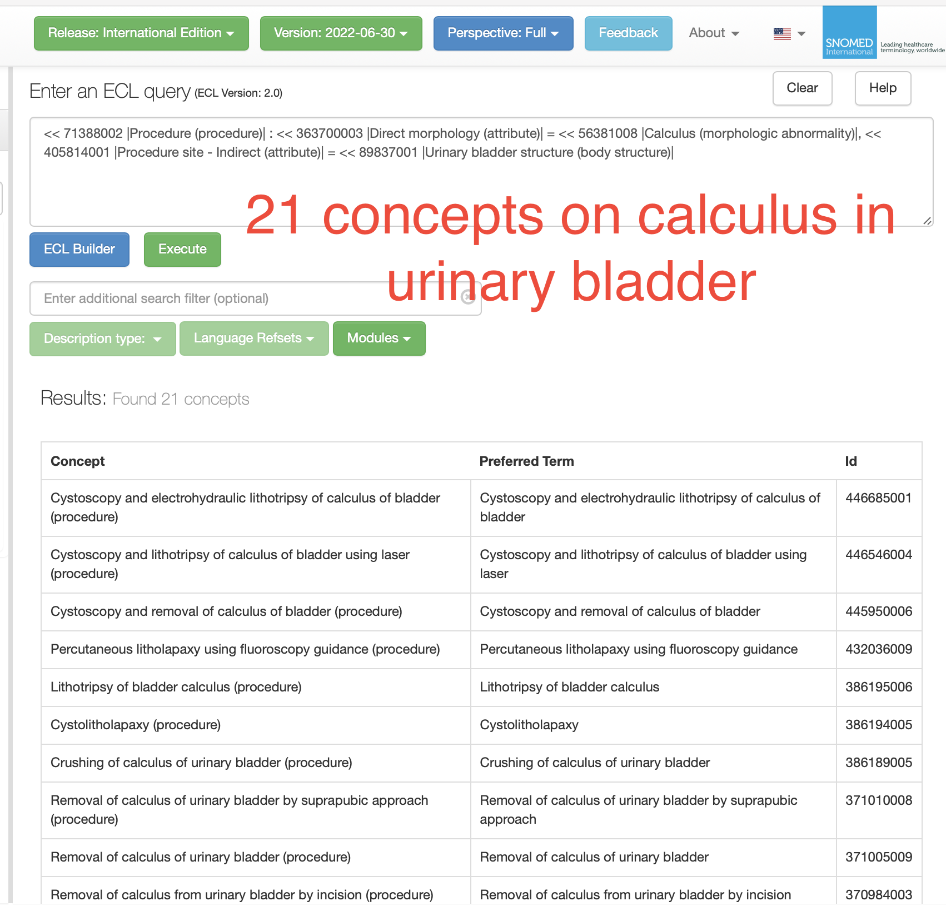
Opportunities for development and improvement
Clinical quality
  Data quality - automation
  Safety initiatives
  Effective care
  Precision health
Population health
  Data aggregation
  Descriptive statistics
  Computational health

Slide 37
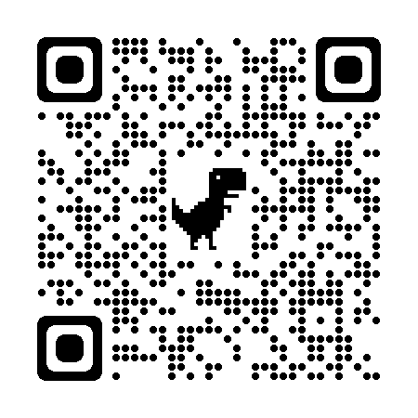
Clinical engagement for health professionals
SNOMED CT Confluence pages
Clinical reference groups
E-learning pages
  Introduction to SNOMED CT
  Authoring codes
  Data analytics

Slide 38
Developing next steps – collaborative working
Intelligent decision support
Data exchange and returning data into the EHR
Technology developments
Active patient use of the record
Real world data research platforms
Curriculum development for health students

Slide 39


Questions?
SNOMED International: Delivering SNOMED CT
igr@snomed.org
cgu@snomed.org
Or
info@snomed.org
www.snomed.org

Slide 40

THANK YOU
SNOMED International: Delivering SNOMED CT

