Slide 1
Gaps in Glaucoma Exam Findings
SNOMED Clinical Reference Group
Sally Baxter, MD, MSc
3/23/2023

Slide 2
Background
Not all glaucoma-related examination elements are represented in standardized terminologies, including SNOMED
Our group was tasked with examining current representation of glaucoma-related exam findings/signs, identifying any gaps, and proposing possible approaches to filling those gaps

Slide 3
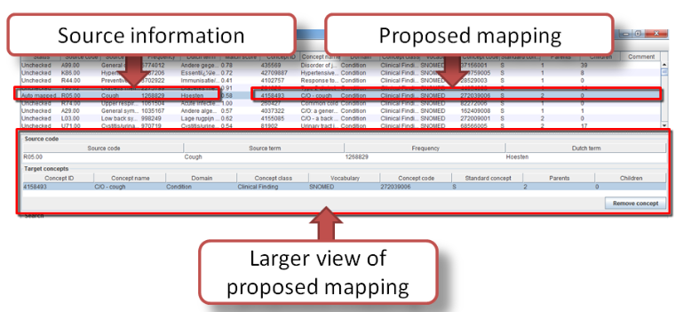
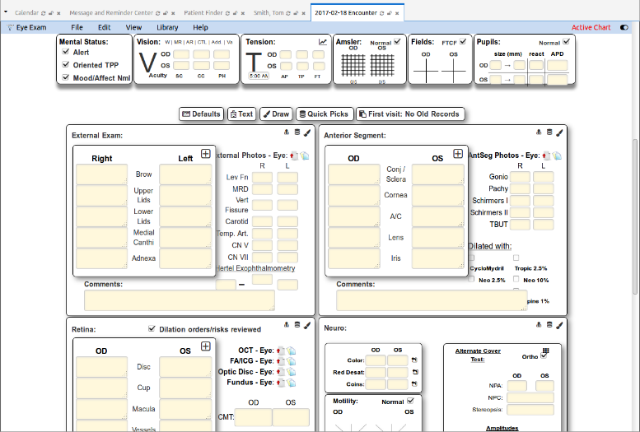
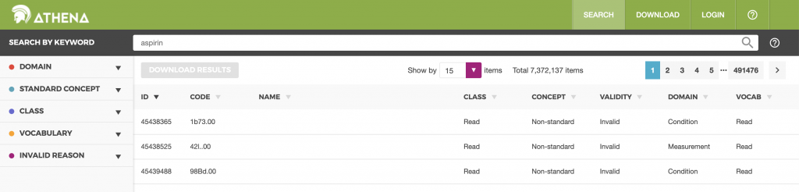

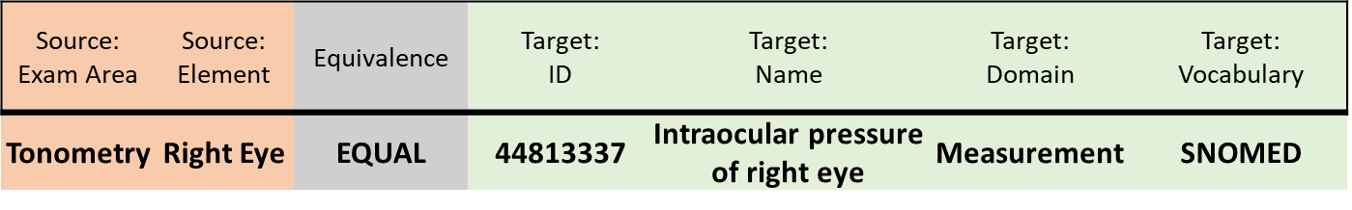
Methods
1
Source Concept Selection
2
Mapping to OMOP
3
Tiered Review & Gap Analysis
Exam Area | Data Element
Tonometry | Method
Tonometry | Right Eye
Tonometry | Left Eye
… | …
Reviewer 1
Gap Analysis
Idenftiied data elements with no matches or only partial matches in SNOMED
Primary Mapping
Agreement Calculation
Overall agreement
Equivalence mappings
Consensus Mapping
Reviewer 2

Slide 4
Methods
Gaps identified in US EHR (Epic) using process in last slide
Collated list of gap areas
Survey of glaucoma specialists
Gaps identified in UK EHR (Medisoft) based on data shared by Anthony Khawaja (Moorfields)
Michael Boland, MD, PhD (MEEI)
Eric Brown, MD, PhD (Vanderbilt)
Aiyin Chen, MD (OHSU)
Brian Stagg, MD (University of Utah)
Josh Stein, MD (University of Michigan)
Cathy Sun, MD (UCSF)
Swarup Swaminathan, MD (Bascom)
Sophia Wang, MD (Stanford)
Benjamin Xu, MD (USC)

Slide 5
Areas of gaps in glaucoma examination findings
IOP modifiers
  Target IOP
  Maximum IOP
  Method
Gonioscopy findings
  Grading system specification (Spaeth, Shaffer, etc.)
  Grading quantification (Grade 1-4)
  Quadrant specification
  Visible angle structures
Some aspects of bleb characterization
Negative findings

Slide 6
Exam elements with no matches in SNOMED and rating of importance
 | Very or somewhat important
 | N | %
Angle visible to PTM | 9 | 100%
Max IOP | 9 | 100%
Target IOP | 9 | 100%
Angle visible to CBB | 8 | 89%
Gonio quadrant | 8 | 89%
No angle pigmentation | 8 | 89%
Angle visible to ATM | 7 | 78%
No iris neovascularisation | 7 | 78%
Tonometry method: Palpation | 7 | 78%
No anterior chamber angle rubeosis | 7 | 78%
No evidence of glaucoma or ocular hypertension | 7 | 78%
Bleb grading system | 7 | 78%
Spaeth classification | 6 | 67%
No evidence of glaucoma | 6 | 67%
No abnormality on gonioscopy | 5 | 56%
Visual field not tested | 4 | 44%
No previous fields | 3 | 33%
No iris processes | 2 | 22%

Slide 7
Exam elements with partial matches in SNOMED

Slide 8
Summary of Comments
Method of tonometry important to delineate
  3 separate respondents specifically indicated importance of delineating Tonopen measurement
  1 also suggested iCare
  1 suggested the below as a list of methods for tonometry:
    Goldman applanation
    Rebound (iCare)
    Non-contact
    Pneumatonometer
    Mackay-Marg (Tonopen)
    Dynamic contour
    Indentation
    Tactile
    ORA (not sure how to deal with – to discuss with group)
IOP: Max IOP, Max untreated IOP, presenting IOP, target IOP

Slide 9
Summary of Comments
Method of gonioscopic grading important to specify
  Multiple (4) respondents felt multiple classification systems should be represented
    Spaeth
    Scheie
    Shaffer
    Van Herick
    Non-codified (just reporting what angle structures are visible: none, ATM, PTM, SS, CBB)
Bleb grading – perhaps not as high yield (“seldom used in clinical practice”)

