Slide 1


SNOMED CT Drug Content Analysis Project
Hanne Fjeldstad Johansen, Norwegian Directorate of eHealth
Julie James, Blue Wave Informatics
Monica Harry, SNOMED International
Thursday 24th November 2022, 13.00 UTC

Slide 2

Welcome and Objectives
Introduction and Discussion of Suggested Work Process
  To include “what we’ve done so far”
  Specific topics for discussion
The Anti-Infectives
Drug Content Analysis Group
Next meeting - ?
AGENDA
https://confluence.ihtsdotools.org/display/USRG/Drug+Content+Analysis+Project

Slide 3

Welcome and Objectives
Notes:
Launched in Sept. 2022. DEUSG discussions suggest a large number of international clinical drug content is required in the International release. Rather than ask for an infinite no. of CRS requests, SI decided to set up this project to review existing content that we know about and when that is approved and agreed to be international then promote to the international release.

Slide 4
Welcome and Objectives
In response to discussions about gaps in content
Improve the content in the Medicinal product hierarchy
Create an efficient process to identify and author content
Notes:
Identify concepts from the 763158003 |Medicinal product (product)| that exist in the extension modules of participating NRCs that are eligible for promotion to the international release and define a process for having that content promoted on an ongoing basis.
Requires appropriate reference to authoritative source material, to the international edition.

Slide 5
Introduction and Discussion of Suggested Work Process

Slide 6
What we’ve done so far
Weekly meetings
Selecting a therapeutic area (anti-infectives)
Getting an initial set of concepts for consideration
  Hanne’s process
Initial assessment of the concepts….for example….
  Use of administrable dose form
  Incorrect use of unit of presentation (for parenteral liquid dose forms)

Slide 7
Process - selecting concepts for consideration
Norway has chosen not to use the national drug extension model
Striving to provide a complete mapping of manufactured and distributed actual products to generic representations (CD) – this is an automated mapping process based on work done to map SCT concepts to the “building blocks” in NoMA (Norwegian Medicines Agency)
Process for this project
Producing a query-based list per category using Swagger connected to a Snowstorm server
Discarding CDs that don’t comply with international rules (f.ex. hydrates, pharmaceutical dose forms that are more granular than international, etc.)
Adding references to product name, supplier and, where possible, the Norwegian (or other) SmPC

Slide 8
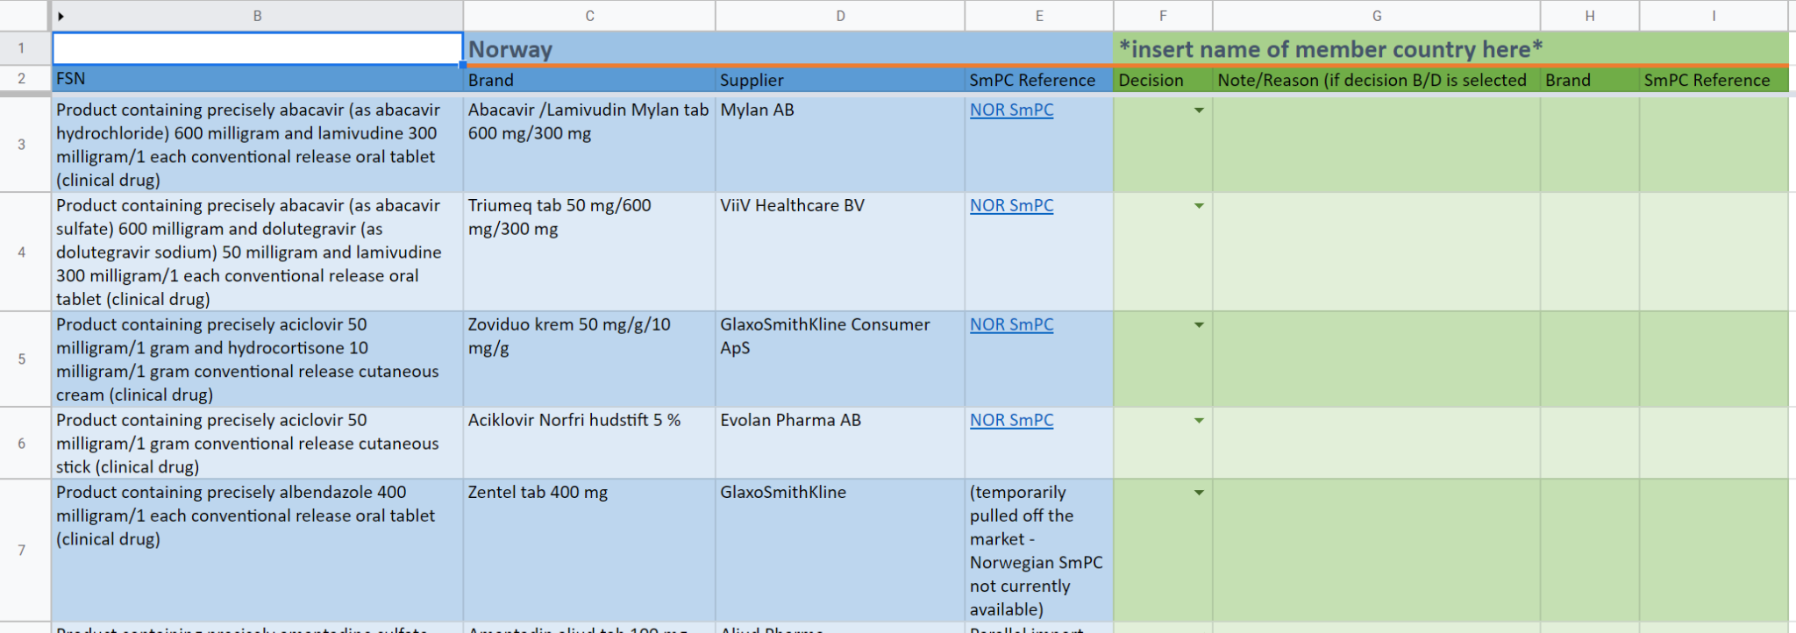
Working document
(tentative design - we’re open to suggestions!)

Slide 9
Possible process for discussion
Have the CD in national MPD and can provide SmPC
A member will offer potential Clinical Drugs for consideration for inclusion in the International Edition based on a therapeutic area
Content submitted for consideration for addition to the International Edition
Do not have the CD in national MPD but would support its inclusion if properly referenced
Other members of the group review and annotate the spreadsheet content
Have very similar CD in national MPD and can provide SmPC
Spreadsheet with potential new content including SmPC reference
Note the difference for discussion
Do not have the CD in national MPD and would NOT support its inclusion
With reason(s) if possible
Offer other CDs in this therapeutic area for consideration
Select another therapeutic area for consideration

Slide 10
Specific topics
Drops (and sprays) dose form granularity
If you have the same product but described differently
  The “calcium/calcium carbonate challenge” - nystatin and bleomycin in the Anti-infectives
Concentrates - especially for parenteral products
Injection, infusion and injection/infusion
PAI challenges

Slide 11
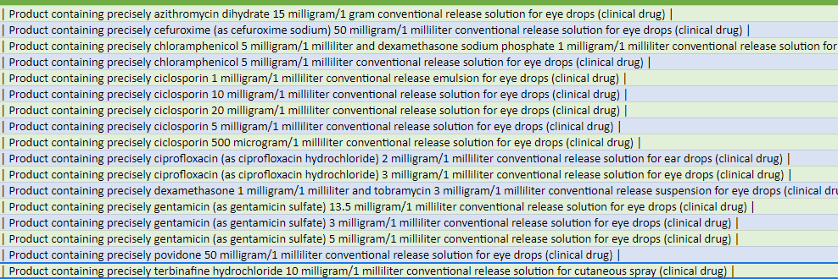
Drops (and sprays) dose form granularity

Slide 12
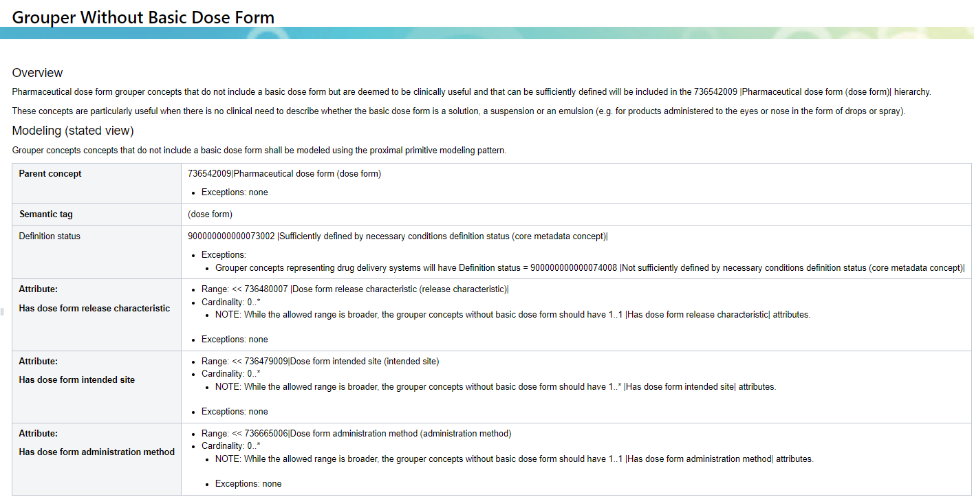
From the Dose Form Editorial Guidance
https://confluence.ihtsdotools.org/display/DOCEG/Grouper+Without+Basic+Dose+Form

Slide 13
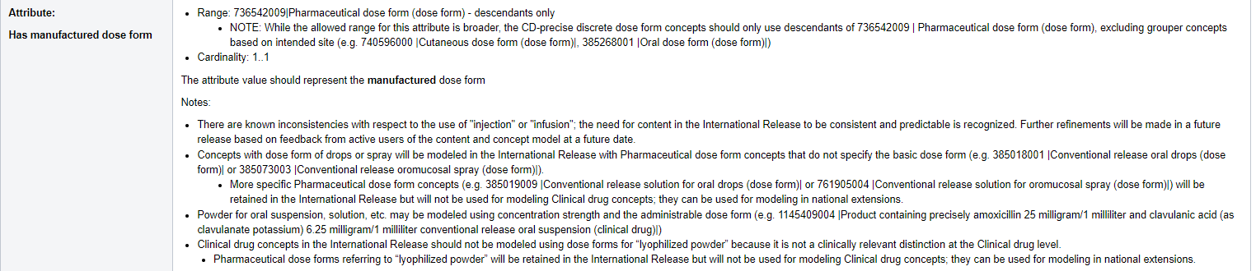
From the Clinical Drug Editorial Guidance
https://confluence.ihtsdotools.org/display/DOCEG/Clinical+Drug+containing+precisely+Concept+-+Discrete+Dose+Form

Slide 14
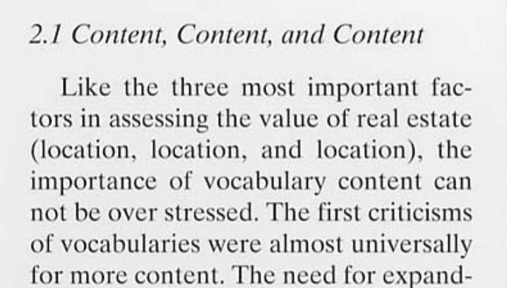
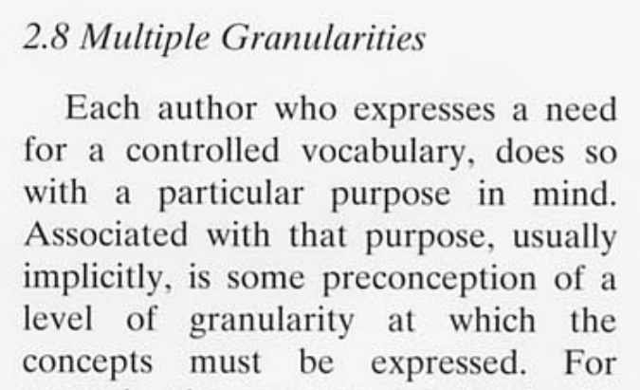
A couple of “Cimino desiderata”

Slide 15
Editorial policy can (should) evolve….
Do we need to change, based on our use cases, or not?
To provide a consistent and usable set of international medications concepts for member nations to use as a foundation for national medicinal product terminology
  For those member nations with an existing terminology, the improved model underpinning the concepts will facilitate both direct use or mapping
  For those member nations without an existing terminology, the concepts provide a consistent starting set of concepts and a model to develop from, reducing resource (especially set up costs) and risk in development
To provide compatibility with the IDMP model, where possible, for identification of medicinal products. Having compatibility between the patterns used to describe medicinal products in the regulatory environment and those used in clinical care will facilitate the information flow between the two domains of use. For all licensed medicinal products, the prime source of information for their description is their regulatory data; compatibility therefore streamlines the flow of information for maintenance of the clinical terminology. Similarly, for example in pharmacovigilance, the flow of information from clinical records into regulatory reporting, both for suspect and concomitant medications involved in safety events is streamlined. Describing the relationship between the SNOMED CT medicinal product hierarchy and the IDMP model also shows how some SNOMED CT medicinal product concepts complement and add value to IDMP-based concepts, particularly for patient care
To facilitate international interoperability of medication concepts for (for example) patient summaries and cross-border care; this is supported most efficiently when the medication concepts themselves are from national extensions built upon or mapped to the international core
To facilitate development of international medication decision support, such as allergy checking and duplicate therapy checking, thereby reducing costs of maintenance and implementation
To support the use of a classifier on both international and national medicinal product concepts, to facilitate maintenance of the hierarchy
To support analysis of medication information in healthcare data for various research purposes
To provide medication concepts to support sufficiently defining concepts in other hierarchies within SNOMED CT

Slide 16
The anti-infectives

Slide 17
The anti-infectives
https://docs.google.com/spreadsheets/d/1tTdjlWNWtX4qZhbvE45r5U2ylAdirOjn/edit#gid=1320004122

Slide 18

Next meeting - Thursday 26th January
  The content request process for this project
Alternating times:
UTC: Thu Jan 26, 20:00 / 8:00 pm
UTC: Thu Feb 23, 11:00 / 11:00 am
NEXT STEPS
18

Slide 19


THANK YOU
SNOMED International: Delivering SNOMED CT

