Slide 1


Editor’s report
Request submission: 3rd October deadline for inclusion for January 2023 release
Odontogram and General Dentistry Diagnostic refsets have been reviewed and are ready for publication.
Periodontal classification: total 58 new concepts/synonyms and 3 in discussion.
Ireland: creating Irish National Dentistry Refset
      Requests received covering findings, disorders and procedures

Slide 2
Editor’s report
Promotion of 6 concepts from US. This content has been suggested for inclusion in the International Classification of Nursing Practice (ICNP) Nursing Practice Refset
  Assistance required to clean own dentures (finding)
  Independent cleaning of own dentures (finding)
  Denture cleaning refused (situation)
  Assistance required to brush own teeth (finding)
  Independent brushing of own teeth (finding)
  Brushing of teeth refused (situation)

Slide 3
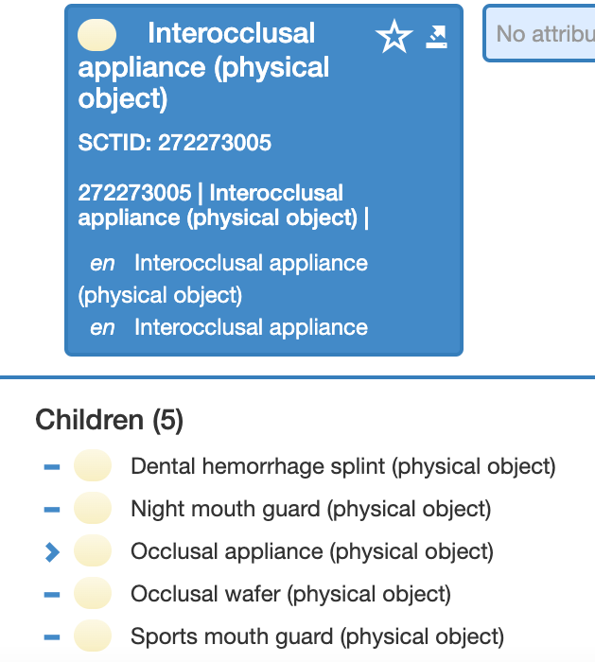
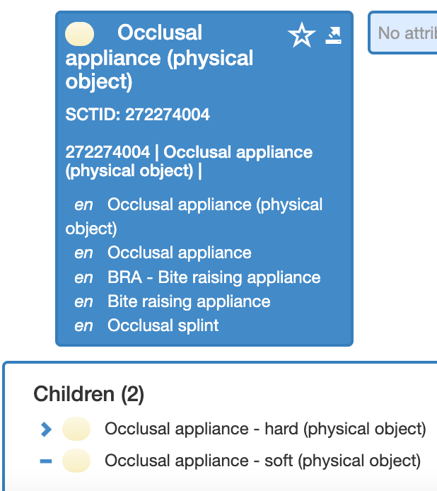
Question for group
Does occlusal appliance and interocclusal appliance mean the same thing?

