Slide 1
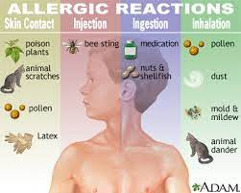
Allergy CRG
Bruce Goldberg MD, PhD (chair)
Marie Alexandra Lambot MD (co-chair)

Slide 2
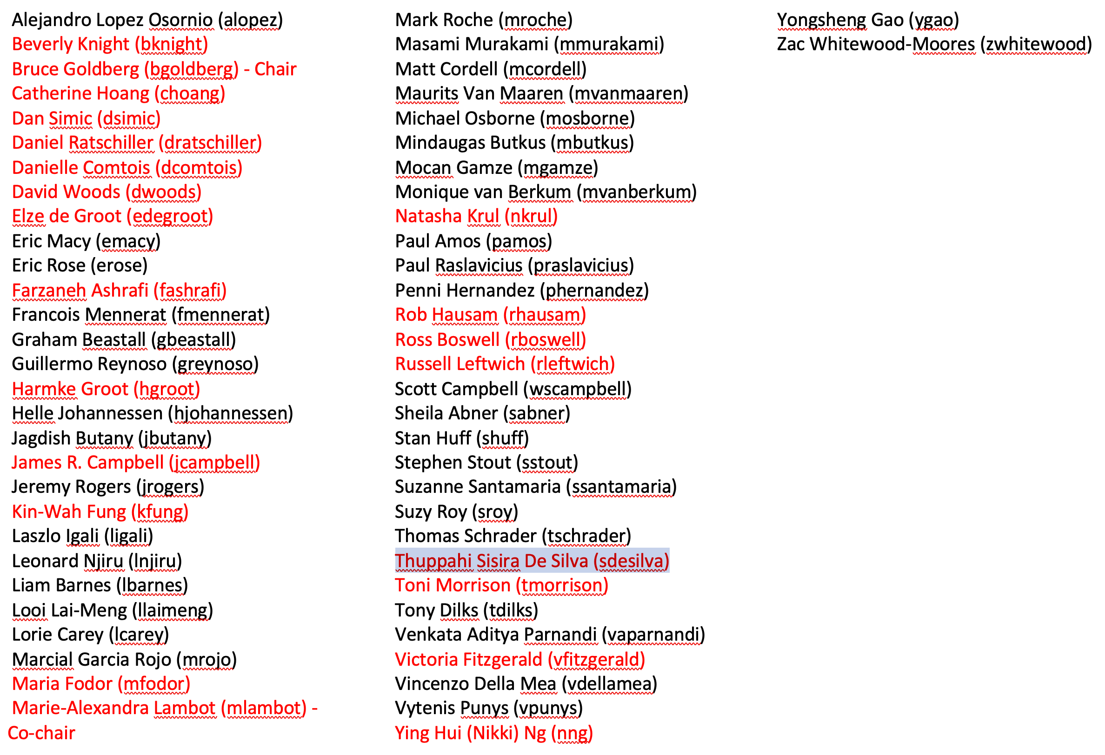
Membership
Names highlighted in red have participated in at least one call

Slide 3
Charter
The SNOMED International Clinical Reference Group is a community of practice for the clinicians focused on allergies/hypersensitivity and intolerance
The allergies/hypersensitivity and intolerance Clinical Reference Group has been established to ensure that the requirements of clinicians are incorporated into the content of SNOMED CT international Release and also to support the development of derivative products that will support implementations focused on the allergies/hypersensitivity and intolerance specialty.

Slide 4
Collaborations
Substances project (Farzaneh Ashrafi)
Drug project (Toni Morrison)
Events, Conditions, Episodes project group (Bruce Goldberg, Yongsheng Gao, Farzaneh Ashrafi, Jim Case)
SNOMED on FHIR (Marie-Alexandra Lambot, Rob Hausam, Daniel Karlsson)

Slide 5
Projects/Accomplishments
Retirement of Allergen hierarchy
Changes to the modelling of hypersensitivity, allergy and non-allergic hypersensitivity content
Allergy to substance concepts remediation project
Model for allergy to animals
Hyposensitization/desensitization therapy
Value sets for Belgium (Allergy to substance for DPI flat sheets => Substance + Type to be used in FHIR AllergyIntolerance resource)
Allergy implementation guide

Slide 6
Allergy Implementation Guide - 1
https://confluence.ihtsdotools.org/display/AL/May+13%2C+2022+Allergy+CRG+meeting+agenda
History
  Suggested by Jim Campbell
  Work began in Implementation SIG 2014
  Development suspended 2015 after dissolution of implementation SIG
  Resumed development 2021 in Allergy CRG

Slide 7
Allergy Implementation Guide - Background
Interoperable deployment of SNOMED CT in support of Electronic Health Record (EHR) adverse sensitivity data (which encompasses allergy, non-allergic hypersensitivity and intolerance) is inconsistent and fails to support interoperability across SNOMED International member realms.
This arises due to confusion regarding the scope and definition of adverse sensitivity data, uncertainty regarding the reference models for defining relevant data records and inconsistency in guidance for the appropriate value sets from SNOMED CT that should populate those records.
Several Standards Development Organizations (SDOs) such as HL7 have also provided some general guidance to assist implementers, however specific guidance in using SNOMED CT is still lacking.

Slide 8
Allergy Implementation Guide - Purpose
This implementation guide is intended to accelerate consistent implementation of vocabulary with an emphasis on the use of SNOMED CT within the domain of adverse sensitivity and adverse reactions by:
  Extending previous SNOMED International work on definitions of adverse sensitivity
  Surveying and summarizing the relevant interoperability standards,
Advising the SNOMED International community regarding best practice deployment of allergy data within the EHR and identify the SNOMED CT refsets (value sets) that would constitute best practice for use in electronic health records.
Addressing issues using SNOMED in day-to-day clinical practice
  Provide guidance in reconciling substances as allergens with clinical findings representing diseases and propensities as used in problem lists
  Leverage products and substances hierarchy for allergy decision support

Slide 9
Allergy Implementation Guide - Organization
Review of Adverse sensitivity information models
  SNOMED CT Concept model
  Reference information models and value sets (HL7 CCDA), HL7 Patient Care Domain Analysis Model, FHIR)
Inclusive Information Model
  After considering reference information models from various standards development organizations and other national or regional sources, an inclusive information model is proposed. This simplified model aligns the essential elements of different information models into a coherent and comprehensive model. Classes and data elements in the inclusive information model can be mapped to individual models for compatibility.
  The inclusive information model is made up of three classes – propensity, adverse sensitivity and adverse reaction
SNOMED CT reference sets + a FHIR extension to use them done by the SNOMED on FHIR group
Practical guidance in using SNOMED CT for adverse sensitivity documentation
  Documentation of adverse sensitivity – allergy list and problem list
  Documentation of Allergy Desensitization
Clinical decision support (Appendices)
  Allergy alerts
    Comments regarding drug class, excipients/adjuvants cross reactivity and bi-directional allergy checking
Glossary, SNOMED CT allergy content historical perspective and detailed analyses of several information models

Slide 10
SNOMED on FHIR (Dr. Marie-Alexandra Lambot)
Contacted for two reasons:
To see how we could use SNOMED CT concepts in the FHIR elements that were not codable concepts and that had a too restricted value list compared to the clinical expressivity SNOMED CT could offer (Type, Severity)
  Issues escalated to the HL7 Patient Care WG => an extension has been developed by SNOMED on FHIR group to allow the use of SNOMED CT concepts to represent the Type of hypersensitivity mechanism (modification of the HL7 FHIR resource itself can be discussed if the extension gets used)
To check the correctness of the FHIR rendering of the examples in the Allergy Implementation guide
  FHIR rendering of the examples in table form in Allergy Implementation guide checked by Rob Hausam and Daniel Karlsson from SNOMED on FHIR
  FHIR message rendering of the examples in the Allergy Implementation guide done by Daniel Karlsson and posted in the SNOMED FHIR implementation guide

Slide 11
Future Directions
Complete and publish Allergy Implementation Guide
ICD-11 now has a separate section for Allergy and Hypersensitivity which has been aggressively populated with content.
  We need to perform a gap analysis to determine areas where SNOMED CT may be deficient compared to ICD-11 and rectify that situation
Review the WAO/EAAACI definitions of allergy, hypersensitivity and intolerance upon which the SNOMED CT concept models are based to determine if still relevant
  Determine the necessity of representing non-allergic hypersensitivity (pseudoallergy) as distinct from Allergy (immune mediated hypersensitivity) in SNOMED CT and the EHR
Determine the need to represent major allergenic protein classes and components in the SNOMED CT substance hierarchy
Discuss methods of representing cross reactivity in the substance and hypersensitivity condition hierarchies

Slide 12
Challenges
Our group has been composed mainly of implementers.
We have had little representation from clinicians especially those in the specialty of Allergy which will be necessary for discussions related to relevant content from ICD-11, allergy/hypersensitivity definitions, non-allergic hypersensitivity and allergenic protein classes and components
  Other clinical specialties representation needed
    Pulmonary medicine
    Dermatology
    Head and neck
    Primary care

