Slide 1


SNOMED CT DEUSG Subgroup
EDQM Dose Form Mapping
Linda Bird, SNOMED International
Julie James, Blue Wave Informatics
Thursday 30th June 2022

Slide 2

Welcome
Progress update
Snap-to-SNOMED
Issues discussion
Next meeting
AGENDA
http://snomed.org/deusg

Slide 3

Progress update

Slide 4
Our documentation
Mapping Guidance:
https://confluence.ihtsdotools.org/display/USRG/Mapping+Guidance+for+EDQM+to+SNOMED+CT+Pharmaceutical+Dose+Form+Mapping
“EDQM discussion items” List
https://confluence.ihtsdotools.org/display/USRG/Issues+for+discussion+with+EDQM
“SNOMED CT discussion items” List
https://confluence.ihtsdotools.org/display/USRG/Issues+for+discussion+with+SNOMED+CT
IMPLEMENTATION guidance https://confluence.ihtsdotools.org/display/USRG/Guidance+for+Implementation+of+the+EDQM+PDF+to+SNOMED+CT+PDF+mapping
Recommendations
https://confluence.ihtsdotools.org/display/USRG/Recommendations

Slide 5




Date | WIP | RC1 | No Match | In “holding” | New requests | Change requests
15:12:2021 | 255 | 115 |  | 6 | 5
10:01:2022 | 255 | 130 |  | 21 | 5 | 1
27:01:2022 | 242 | 123 | 3 | 22 | 10 | 3
10:02:2022 | 214 | 138 | 3 | 37 | 14 | 4
24:02:2022 | 190 | 138 | 10 | 54 | 16 | 7
10:03:2022 | 163 | 138 | 10 | 65 | 20 | 17
24:03.2022 | 157 | 142 | 14 | 68 | 28 | 22
07:04:2022 | 147 | 146 | 27 | 61 | 39 | 32
21:04:2022 | 124 | 162 | 30 | 80 | 58 | 35
05:05:2022 | 91 | 163 | 45 | 97 | 68 | 52
19:05:2022 | 49 | 167 | 49 | 84 | 94 | 56
15:06:2022 | 16 | 219 | 57 | 60 | 110 | 61
29:06:2022 | 0 | 266 | 75 | 35+30+12

Slide 6
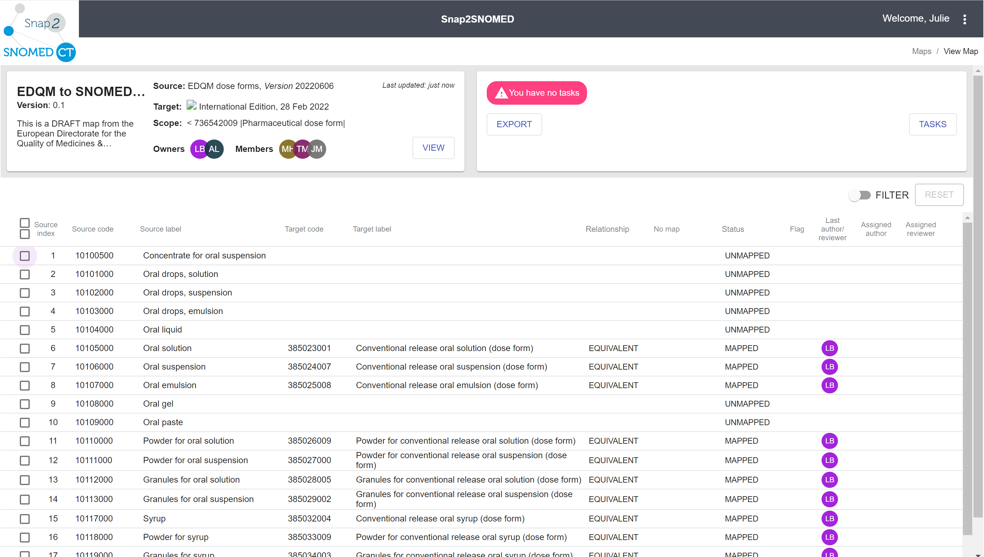
Snap-to-SNOMED
Our content (RC1 and NoMap) has been put into Snap-to-SNOMED as a step towards the review process
S2S has its target as SNOMED CT – which is our mapping use case

Slide 7
Issues for discussion

Slide 8
Multi-site dose form concepts
Our scope has been to map EDQM Standard Terms PDFs to SNOMED CT PDFs
We have made requests for new concepts with multiple intended sites when these are present in EDQM and we have products that would use those dose forms in their definition
Is there any guidance we can offer regarding other concept requests?

Slide 9
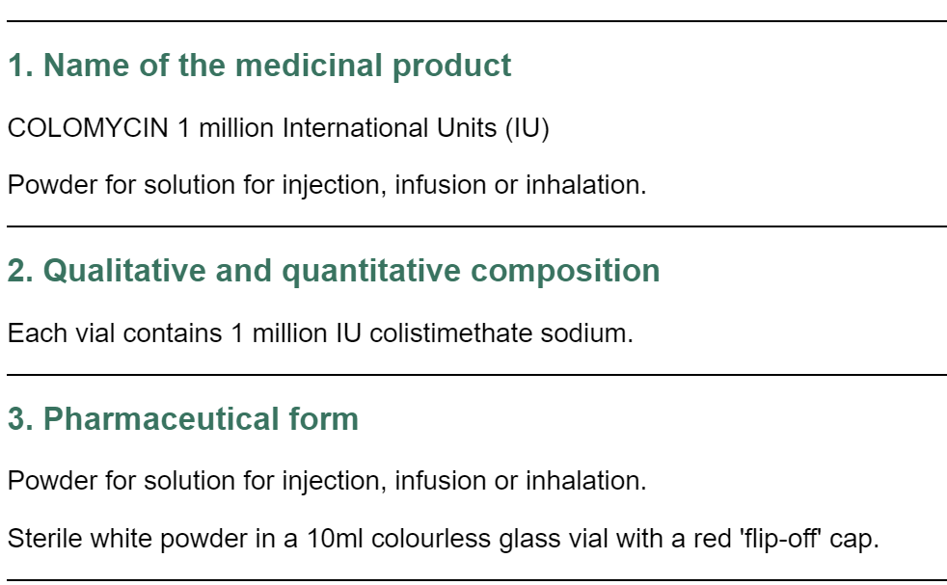

Slide 10
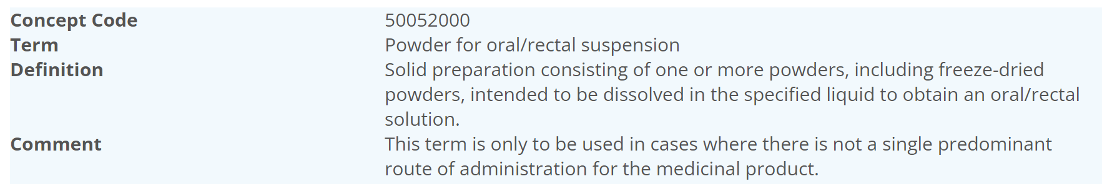
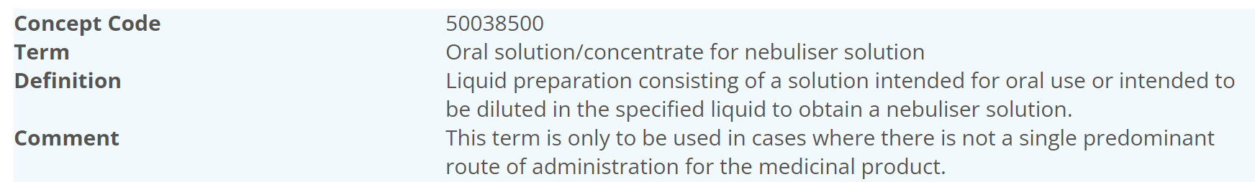
EDQM “Multi-site” Guidance is
Comments and Possible Guidance
EDQM covers regions beyond the EU; EDQM also accepts request from other Competent Authorities (esp. those in ICH)
Safety – different microbiologic requirements…should be different Marketing Authorisations (so different RCDs)
Can look at RMS and see why a term has been rejected as a “standard term” (see next slide)
NB: the Colomycin DF is actively rejected (see next slide)
NZ – no known explicit rules – no products that have this combination (colistimethate products have separate SmPCs for parenteral and nebuliser)

Slide 11
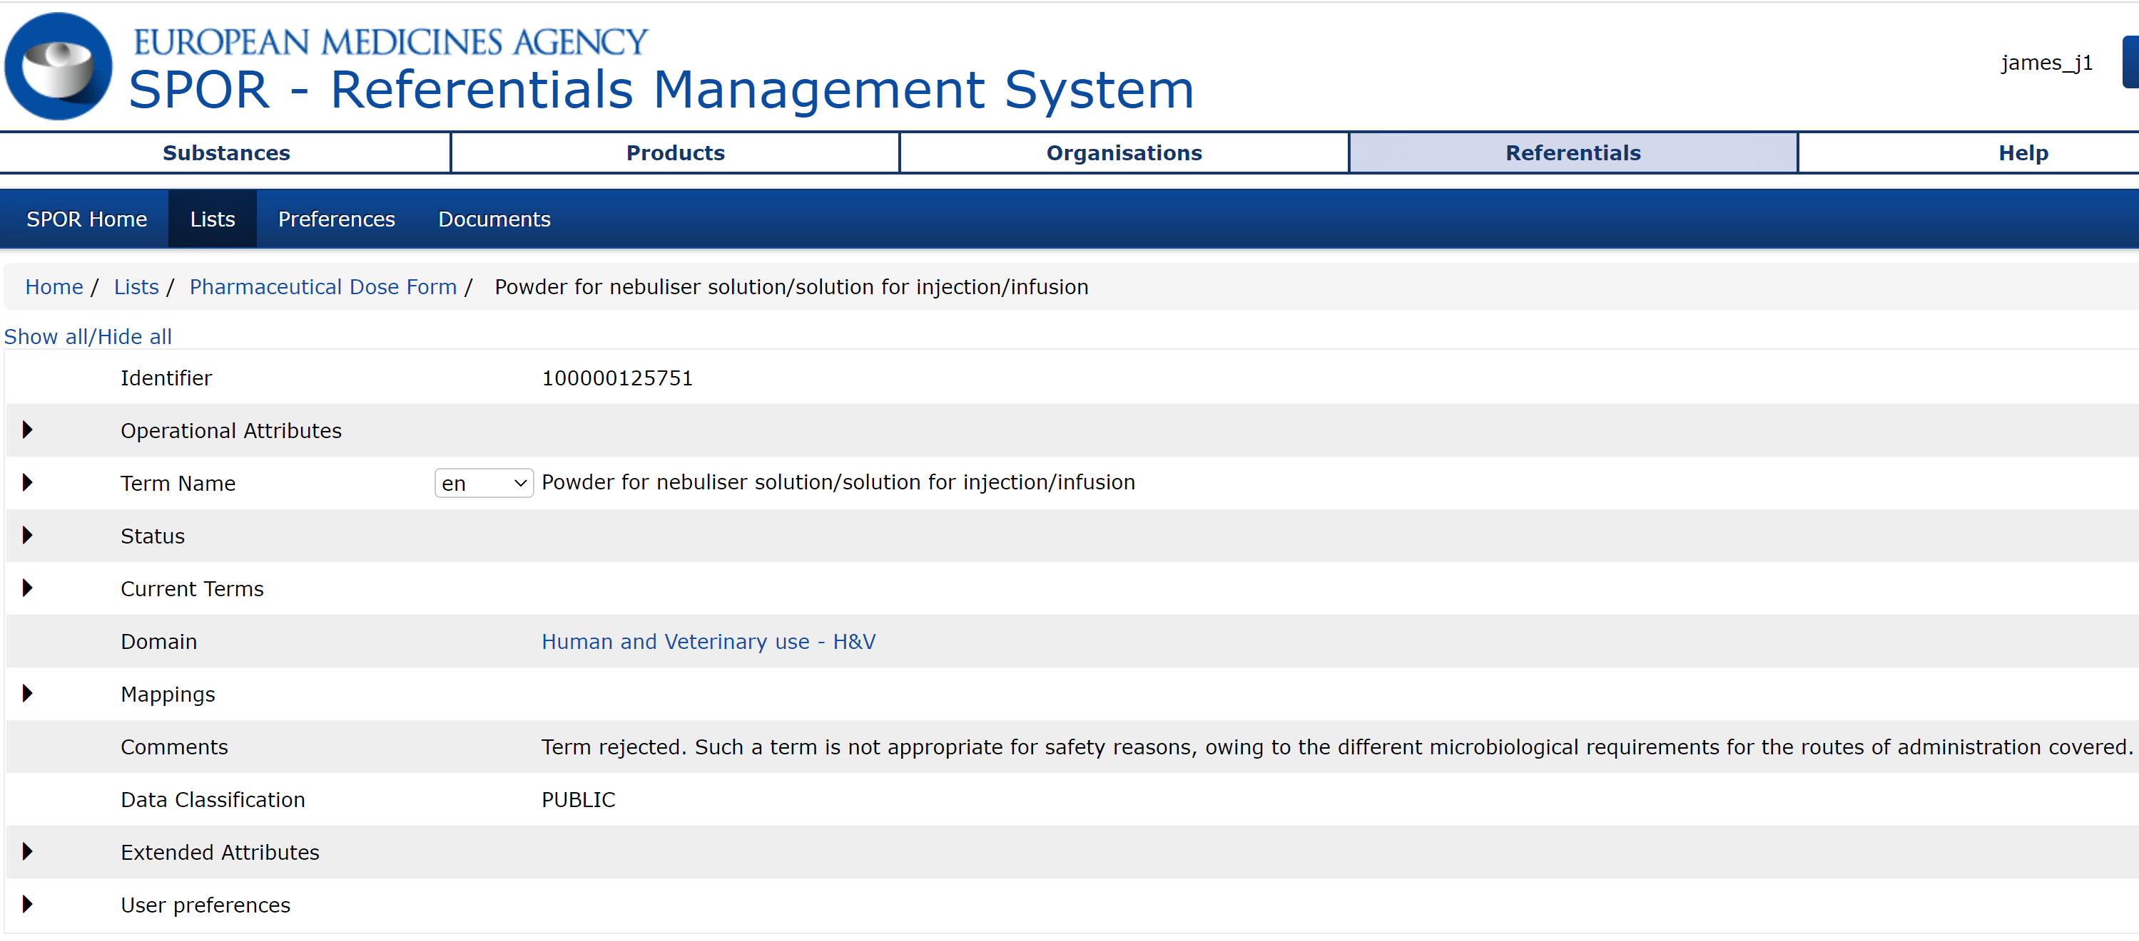
EMA’s SPOR - RMS

Slide 12
Sealant Terming challenge – Tissue adhesive
12115100 | Sealant matrix | Solid sterile preparation consisting of a pliable piece of material impregnated or coated with a sealant or with a powder that forms a sealant after contact with an appropriate fluid (e.g. blood). It may act as a haemostatic agent and/or tissue glue. The matrix may itself form part of the seal, and is usually absorbed by the body over time | Conventional release impregnated sealant material (dose form)
12115200 | Sealant powder | Solid sterile preparation consisting of one or more powders, including freeze-dried powders, intended to be applied directly onto the intended site (e.g. a lesion) to form a haemostatic agent and/or tissue glue after contact with an appropriate fluid (e.g. blood) | Conventional release powder for sealant Conventional release powder for tissue adhesive
12115000 | Sealant | Liquid, more or less viscous, sterile preparation intended for use as tissue glue But BDF characteristic is solution | Conventional release solution for tissue adhesive Conventional release solution for tissue adhesive
13031000 | Powder for sealant | Solid sterile preparation consisting of one or more powders, including freeze-dried powders, intended to be dissolved in the specified liquid to obtain a sealant | Powder for conventional release sealant solution Powder for conventional release tissue adhesive
50061500 | Solution for sealant | Liquid sterile preparation consisting of a solution intended for the preparation of a sealant | Solution for conventional release sealant solution Solution for conventional release tissue adhesive solution
“Fibrin sealant kit” is an old monograph, so sealant is the term that has appeared. The Norwegian term is a direct translation of tissue adhesive; some other languages also. FR = colle (sealant)

Slide 13
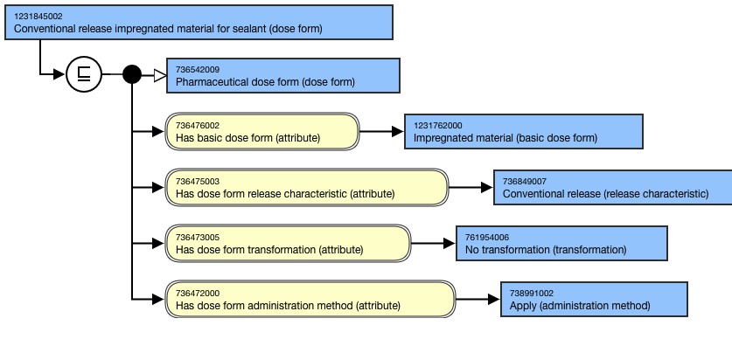
Sealant matrix

Slide 14
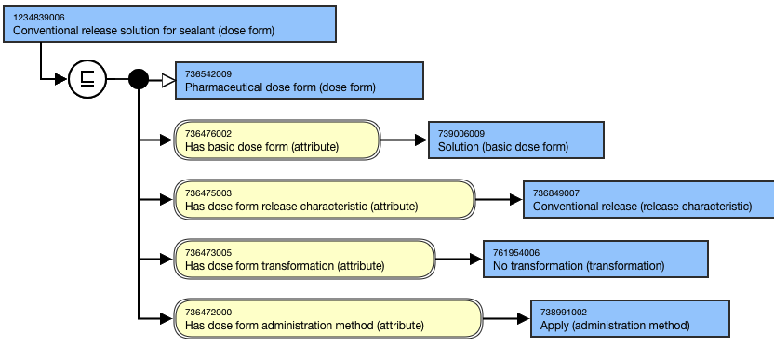
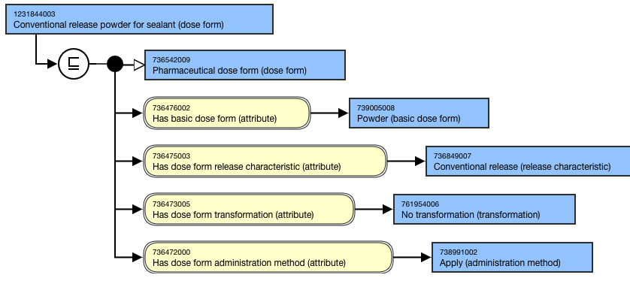
Sealant
Sealant powder

Slide 15
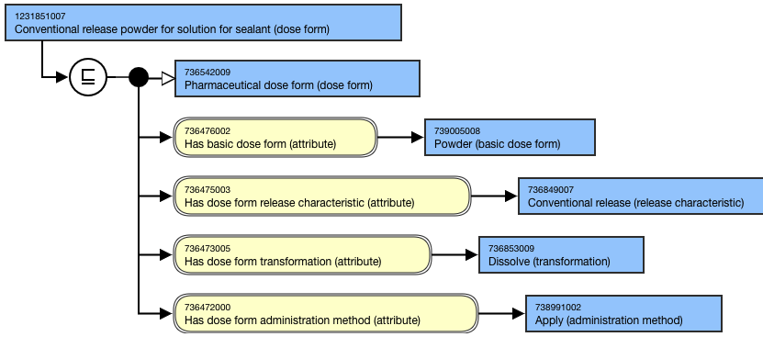
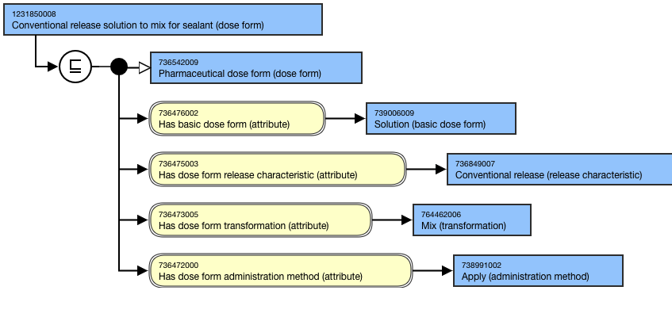
Powder for sealant
Solution for sealant

Slide 16
Model change: Current model

Slide 17
Proposed change:

Slide 18
Example:
Logical sense that a pre-transformed DF doesn’t have the method and intended site
However, the pharmacopoeial requirements for the pre-transformed dose form still exist
That information can still be “found” through query
This would be a major change to the whole PDFs as we have them
For those PDFs that have both a transform and no transform, would be separate role groups, one with method and site, one without…but with a administrable dose form

Slide 19
Benefits of model change
Supports full definition of more complex dose forms with multiple applicability
  Different transforms, different methods, different sites can be correctly associated
Supports correct associations between transformed concepts…important for Closed Loop Medication systems as RCDs with these dose forms can be correctly associated with the more abstract CDs
The administrable dose form change – removes risk of redundant information

Slide 20
Further comments
Administration dose form example: vancomycin – powder for solution for injection but often given orally
  Not everything is covered in the PDF – for vancomycin, the oral solution is not covered in the DF
  Therefore – it is only the recognised transformations of that dose form
UNICOM has recommended this link to the admin dose form, but the way that the link is made would be different
  The link would be to the “intravesical solution/solution for injection” as this is the exact transformation, still with “choice” for the actual administration

Slide 21
Conjunction
And And/Or Or
Not discussed

Slide 22

A break for the summer
A well deserved rest
THANK YOU ALL for your work with this
NEXT STEPS
22

Slide 23


THANK YOU
SNOMED International: Delivering SNOMED CT

