Slide 1


SNOMED CT DEUSG Subgroup
EDQM Dose Form Mapping
Linda Bird, SNOMED International
Julie James, Blue Wave Informatics
Thursday 16th June 2022

Slide 2

Welcome
Progress update
Snap-to-SNOMED
Issues discussion
Next meeting
AGENDA
http://snomed.org/deusg

Slide 3

Progress update

Slide 4
Our documentation
Mapping Guidance:
https://confluence.ihtsdotools.org/display/USRG/Mapping+Guidance+for+EDQM+to+SNOMED+CT+Pharmaceutical+Dose+Form+Mapping
“EDQM discussion items” List
https://confluence.ihtsdotools.org/display/USRG/Issues+for+discussion+with+EDQM
“SNOMED CT discussion items” List
https://confluence.ihtsdotools.org/display/USRG/Issues+for+discussion+with+SNOMED+CT
IMPLEMENTATION guidance https://confluence.ihtsdotools.org/display/USRG/Guidance+for+Implementation+of+the+EDQM+PDF+to+SNOMED+CT+PDF+mapping
Recommendations
https://confluence.ihtsdotools.org/display/USRG/Recommendations

Slide 5
Lots of CRS requests submitted and being processed
Lots of new concepts being processed into DailyBuild by the Content Team
Some issues needing discussion….
  Usually due to other issues elsewhere
    For example, in adding the dialysis concepts, a variety of old, non-conformant dialysis dose forms have been retired (including those that mentioned “free” – like “acetate free” which are very non-conformant ☺)
  Two methods – a process challenge
    Instill and swallow
    Chew and swallow

Slide 6
Date | WIP | RC1 | No Match | In “holding” | New requests | Change requests
15:12:2021 | 255 | 115 |  | 6 | 5
10:01:2022 | 255 | 130 |  | 21 | 5 | 1
27:01:2022 | 242 | 123 | 3 | 22 | 10 | 3
10:02:2022 | 214 | 138 | 3 | 37 | 14 | 4
24:02:2022 | 190 | 138 | 10 | 54 | 16 | 7
10:03:2022 | 163 | 138 | 10 | 65 | 20 | 17
24:03.2022 | 157 | 142 | 14 | 68 | 28 | 22
07:04:2022 | 147 | 146 | 27 | 61 | 39 | 32
21:04:2022 | 124 | 162 | 30 | 80 | 58 | 35
05:05:2022 | 91 | 163 | 45 | 97 | 68 | 52
19:05:2022 | 49 | 167 | 49 | 84 | 94 | 56
15:06:2022 | 16 | 219 | 57 | 60 | 110 | 61

Slide 7
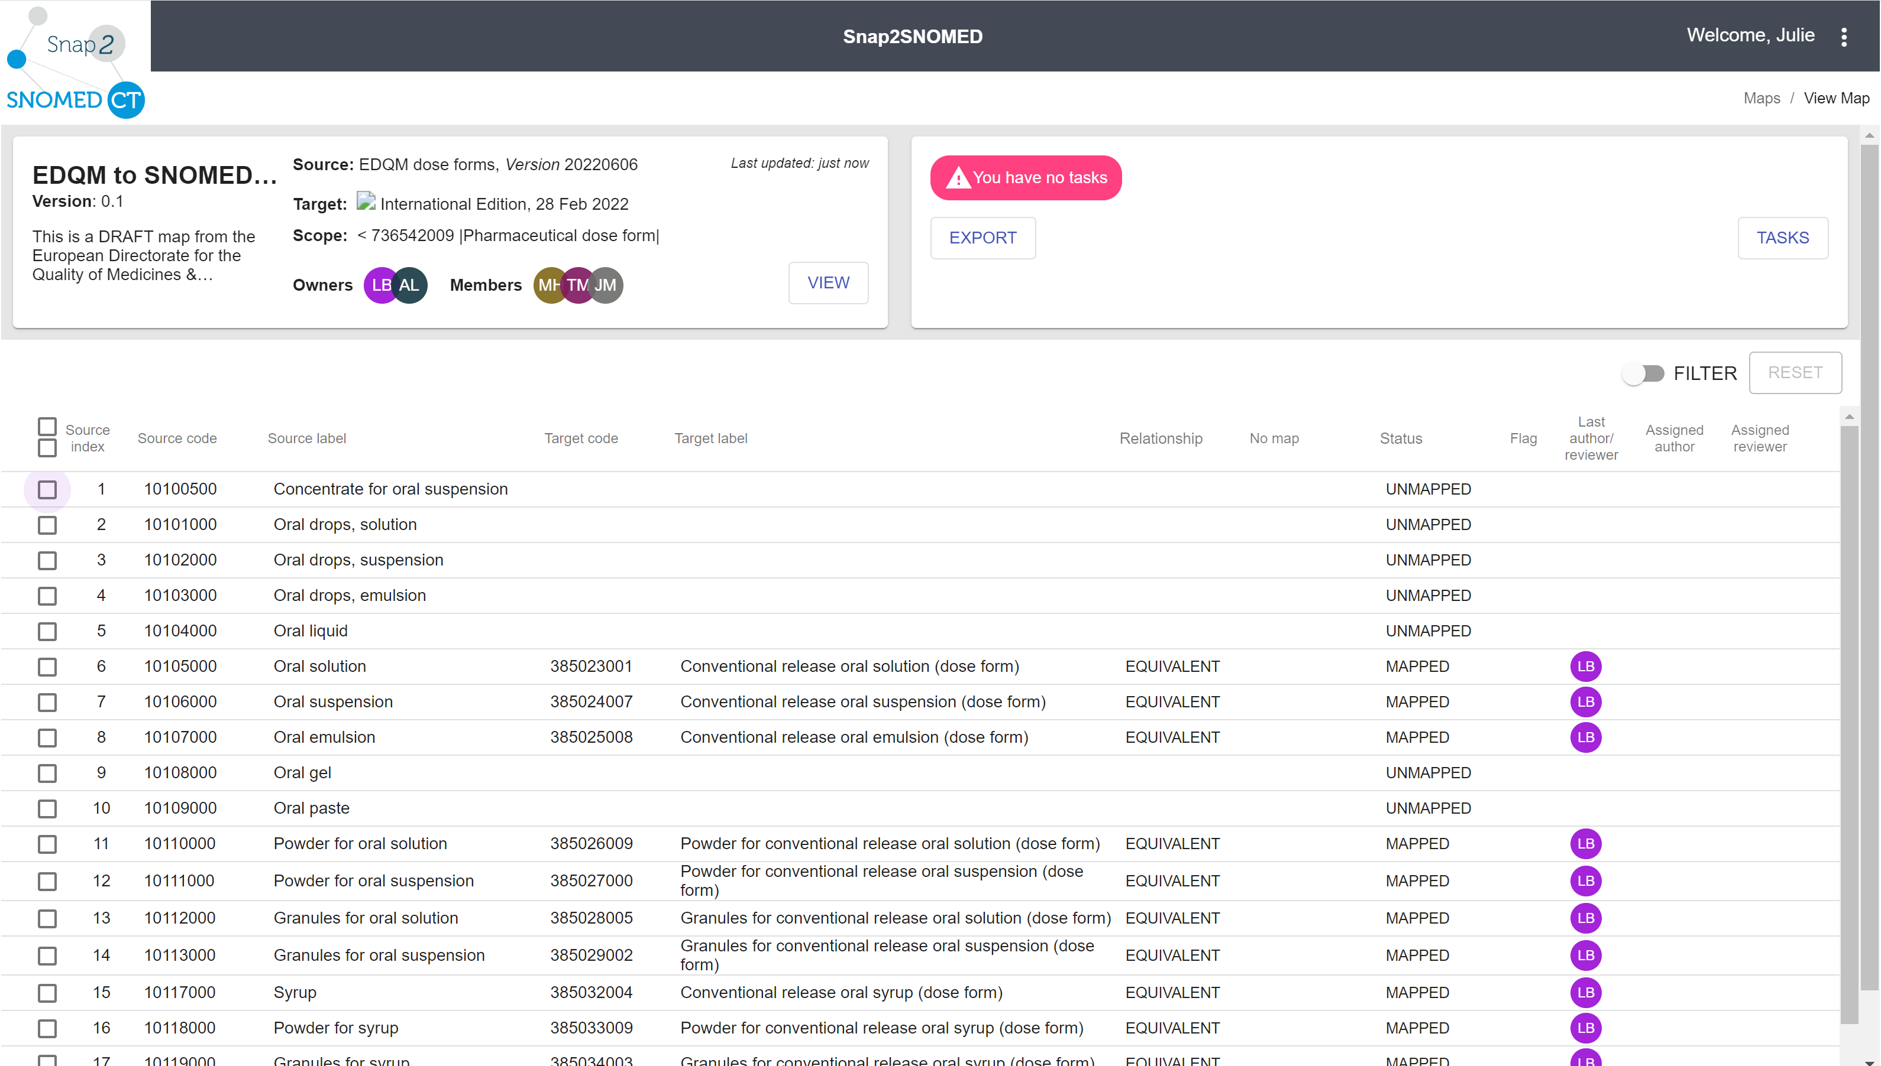
Snap-to-SNOMED
Our content (RC1 and NoMap) has been put into Snap-to-SNOMED as a step towards the review process

Slide 8
Issues for discussion

Slide 9
Some more PDFs have been sorted
The dialysis fluids
  They are primitive – the granularity needed to fully define them would not add value at this stage
  Including retiring some previous “product” concepts that were either ambiguous or non-conformant to current editorial policy
  Some grouper concepts remain to be used as target concepts for procedures etc.
Lyophilisate, film and orodispersible PDFs have been worked through. There was a consistent pattern that could be followed
  Existing concepts have been mapped
  New concepts have been requested (and created and mapped)
  The slides following are for your reference….☺

Slide 10
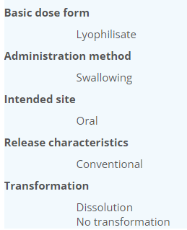
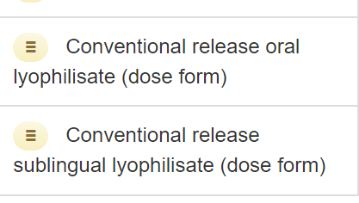
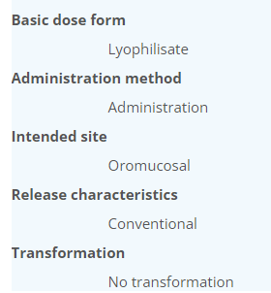
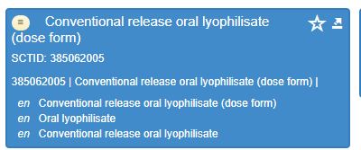
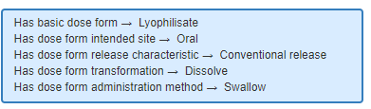
Lyophilisate
Lyophilisate (BDF) – disc made by freeze-drying of a liquid or semi-solid preparation.
Likely to be fast-releasing preparation.
Oral: Will be placed in the mouth where its contents are released in saliva and swallowed OR alternatively, to be dissolved in water before oral administration
Sublingual: Solid single-dose preparation made by freeze-drying of a liquid or semi-solid preparation, intended for sublingual use
Need new
Note: PLACED is the method word used
Change to add "no transform" with oral and swallow as well

Slide 11
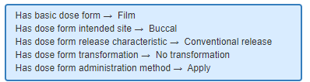

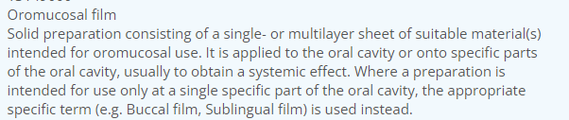
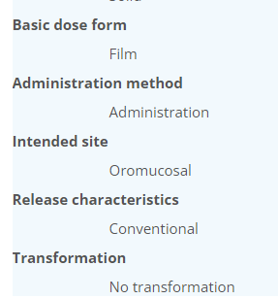
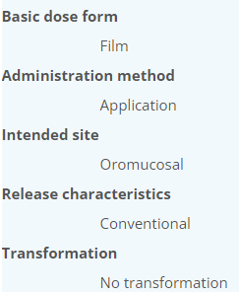
Film
Film (BDF) – thin, single- or multilayer sheet of material, which usually dissolves or otherwise dissipates in an aqueous environment.
10314011: Buccal film - 443424002 | Conventional release buccal film (dose form) |
10317500: Sublingual film – add new
13149000: Oromucosal film – add new grouper

Slide 12

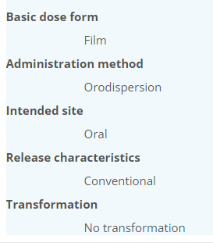
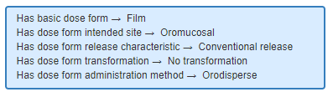
10236100: Orodispersible film and 447050008 Conventional release orodispersible film (dose form)
Change Has intended site from oromucosal to oral as product should be swallowed after the orodispersion; could add "swallow" as additional method*

Slide 13

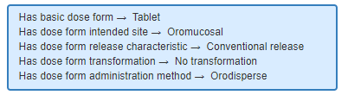
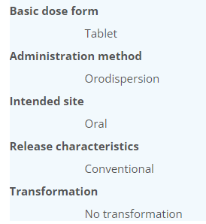
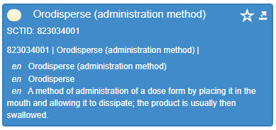
10223000: Orodispersible tablet : 447079001 Conventional release orodispersible tablet (dose form)

Slide 14
Combinations: do we need these?
EDQM ID | EDQM Term
50024500 | Gargle/nasal wash |  | Spanish product
50036500 | Nasal/oromucosal solution
50036700 | Nasal/oromucosal spray, solution |  | ACTISOUFRE sol p pulv bucc/nasal en flacon pressurisé
50037400 | Nasal spray, solution/oromucosal solution
13140000 | Cutaneous/oromucosal solution | Not usually allowed but is specifically stated as non-sterile | Povidone iodine
50033400 | Intravesical solution/solution for injection
50050500 | Powder for intravesical solution/solution for injection
EDQM: General rule is to focus on primary intended site when possible – also linked to “strictest” pharmacopoeial requirements
These “awkward” combinations are often for a small number of products with “equal use”
Move towards separate marketing authorisations for very different uses/indications
Put on “No match” for now

Slide 15
Irrigation concepts:
EDQM ID | EDQM Term
12113000 | Irrigation solution
12114000 | Stomach irrigation
11502000 | Bladder irrigation
11503000 | Powder for bladder irrigation
50073000 | Powder for solution for intraocular irrigation | Were discussed with the ocular – are in “No Map” with a “Should add if needed” – can revisit if needed
50073500 | Solution for intraocular irrigation

Slide 16
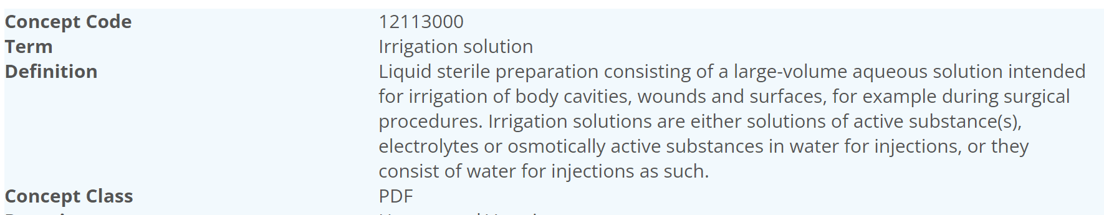
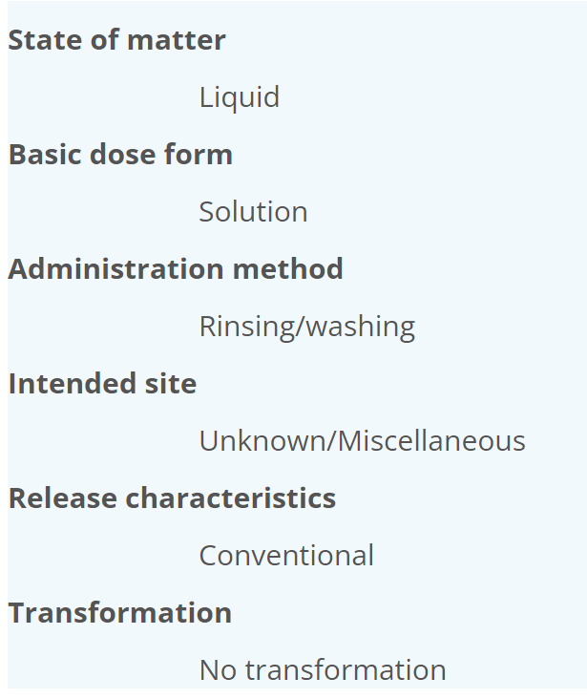
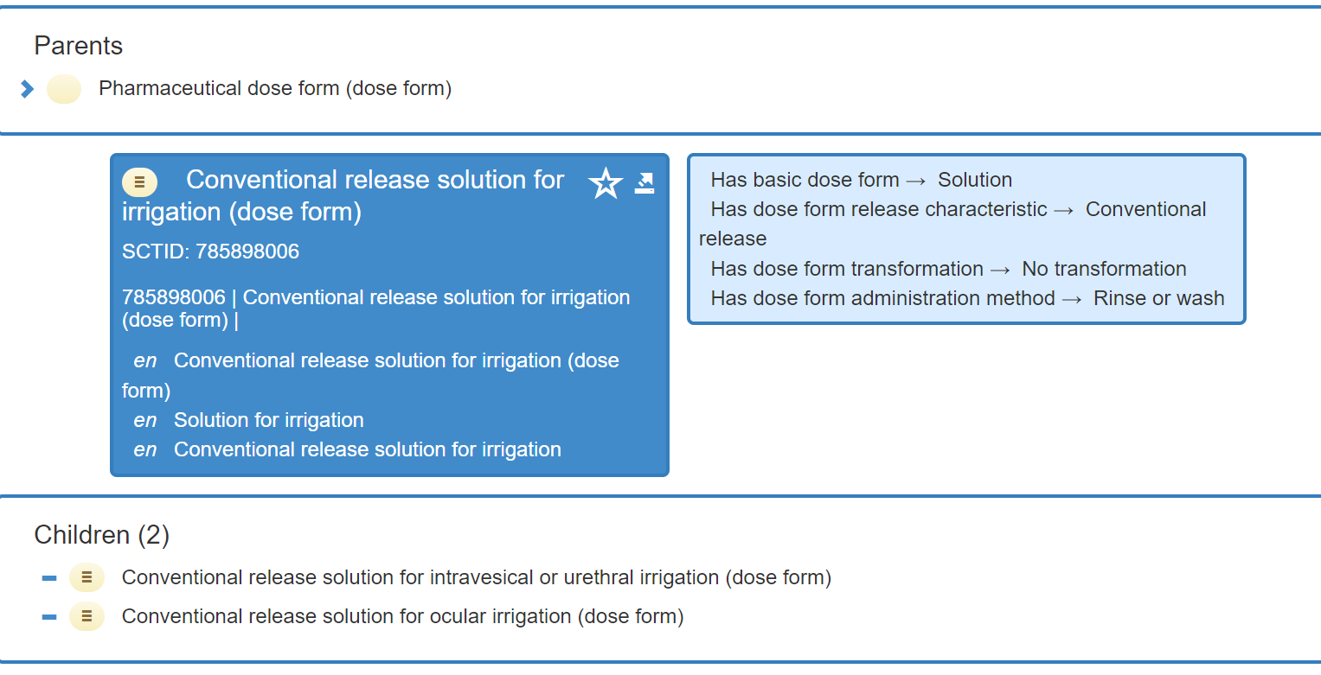
(General) Irrigation:
Map to this one?....Yes, as the “unknown” intended site matches to the “unspecified intended site” in SNOMED CT
But it does act as a grouper concept in S-CT
EDQM: this concept is considered as very general (“and surfaces”)

Slide 17
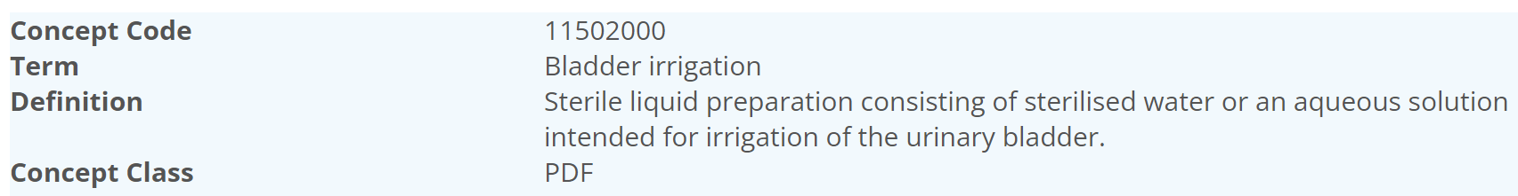
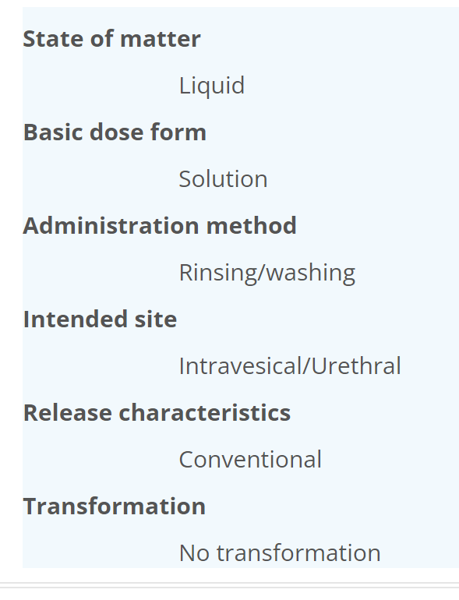
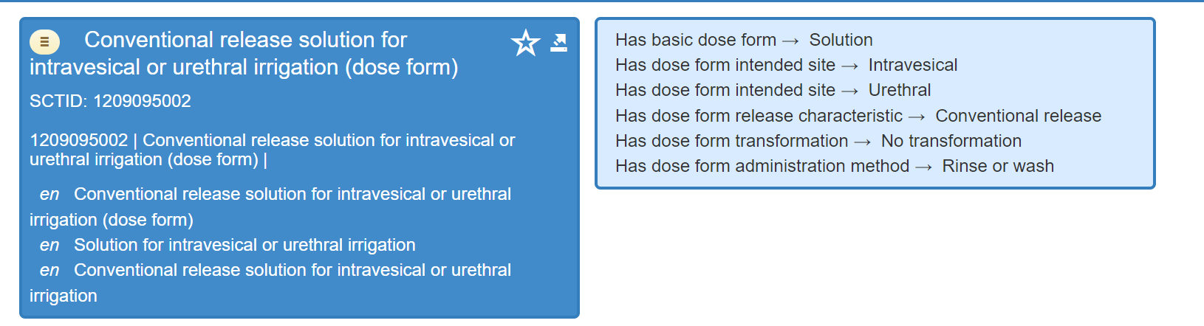
(Powder for) bladder irrigation:
Any products? Chlorhexidine BWO – most products longer available
Action? Map the solution irrigation to this; add “powder for” onto the “No Map” – may be some globally so mark as “Should”

Slide 18
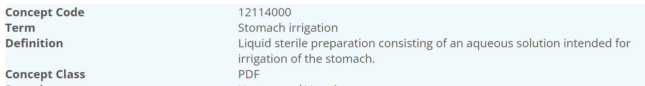
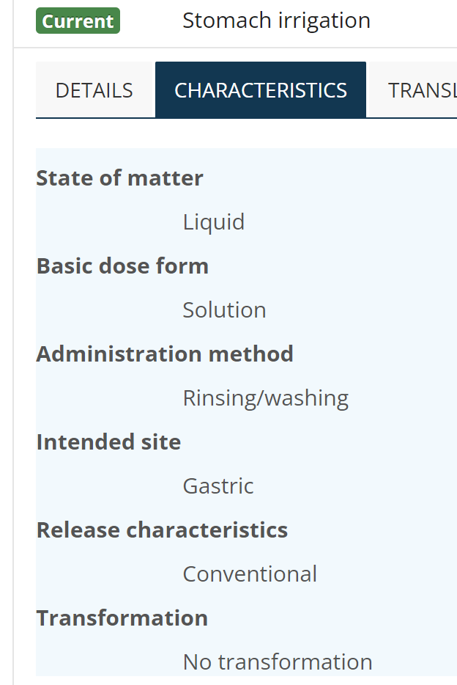
Stomach Irrigation: (Gastric irrigation procedure)
Any products?
Action? No map
Only PDF with Int Site of Gastric
Relating to the stomach as the intended site of administration, where direct administration is achieved using an appropriate device

Slide 19
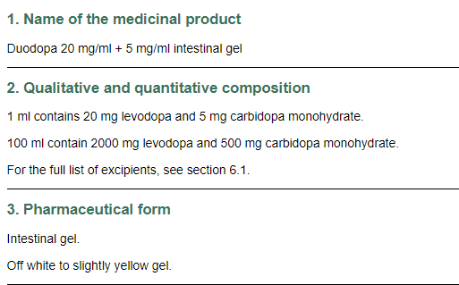
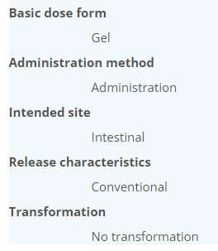

12120000: Intestinal gel
The CD is not in SNOMED CT – we stop at the MPF. I cannot find any other products that use this dose form….should there be a PDF for just one product?
Can we offer an alternative? No…which leaves us no choice but to have the dose form

Slide 20

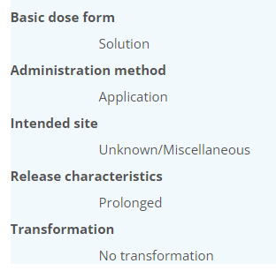
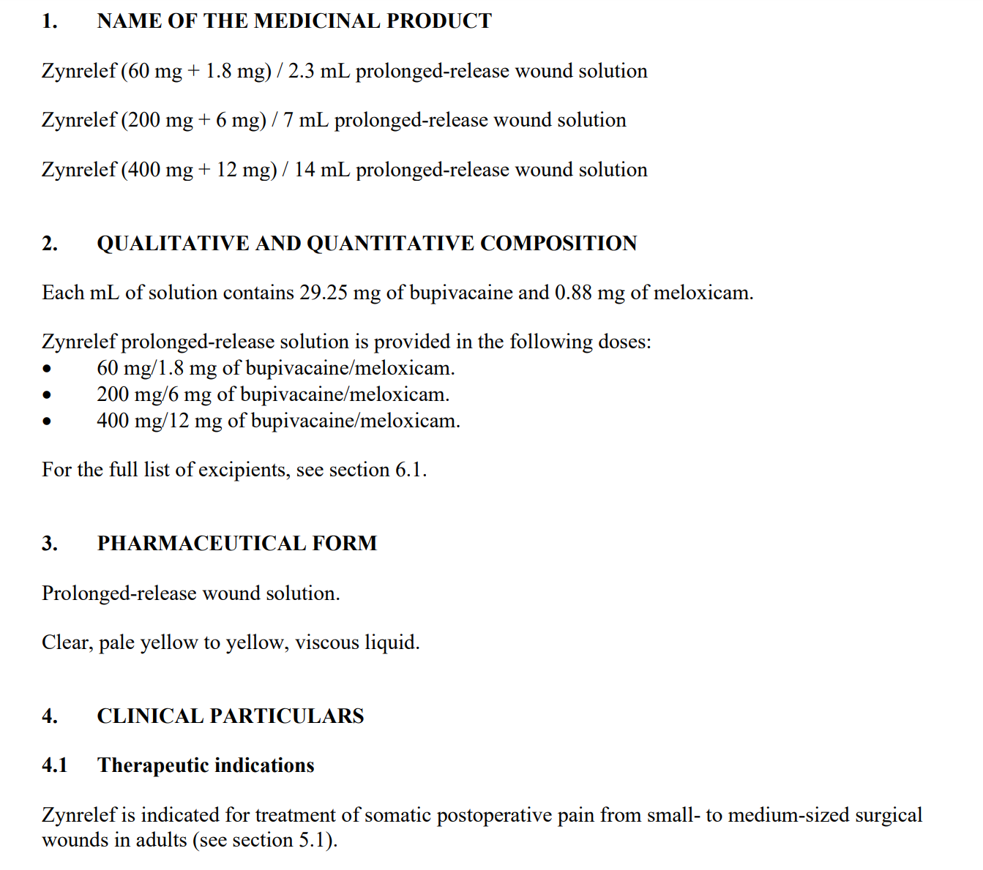
13128000: Prolonged-release wound solution
From Chris J – a relatively new concept used for Zynrelef – which has no CD in SNOMED CT at the moment
Same question as before: should there be a PDF for just one product?
Can we offer an alternative?
EDQM found this hard….It is definitely prolonged-release (has matrix); intended site is a challenge….to look at further for SNOMED CT
No map for now (“Should” be added)

Slide 21
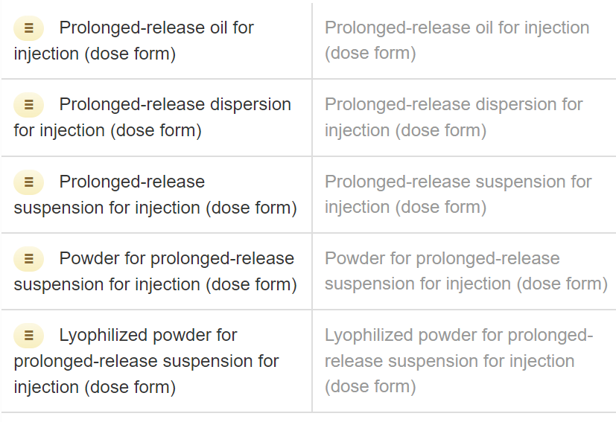
Prolonged-release parenteral concepts
EDQM ID | EDQM Term | S-CT ID | S-CT FSN
13126000 | Prolonged-release dispersion for injection | 1230186001 | Prolonged-release dispersion for injection (dose form)
11208500 | Prolonged-release suspension for injection | 420873008 | Prolonged-release suspension for injection (dose form)
13076000 | Prolonged-release solution for injection | ? | Need new concept

Slide 22
13076000: Prolonged-release solution for injection
Mapper comments:
S-CT has a prolonged release oil for injection and a prolonged release suspension for injection but not a prolonged release solution for injection.
I found a centralised product Buvidal, which is a prolonged release solution for injection, formulated as weekly or monthly depots. When injected into the subcutaneous (SC) or intramuscular (IM) tissue, the Fluid Crystal formulation absorbs interstitial aqueous body fluid and transforms from liquid to highly viscous (>>106 mPas) liquid crystal (LC) (or gel-like) phases in situ, which effectively encapsulate the active substance. This results in a slow and consistent release of buprenorphine, which can be controlled for a week or a month depending on the composition. I am not sure about this...the product is not prolonged release until after it is injected - for discussion?

Slide 23

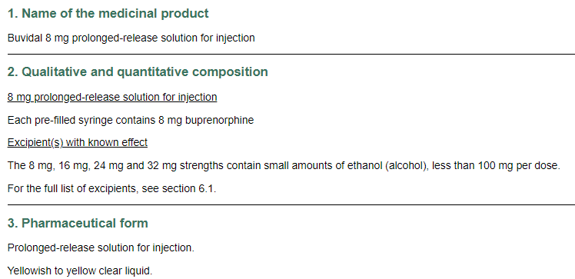
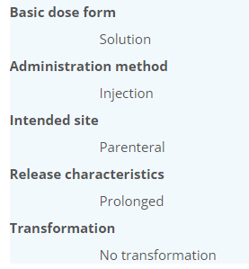
13076000: Prolonged-release solution for injection
Request to add?
What about the oil dose form? Retire and re-direct to solution

Slide 24
Note from Chris about ST PDFs
In ST, sometimes a PDF term that has been authored for a vet product is also put as “applicable for human use” as there is nothing explicitly excluding its use in humans at some point – so there may be terms marked as “human” that don’t have any human products that use them
Example of vet only dose forms: Intraruminal dose forms

Slide 25

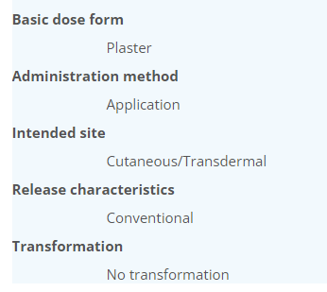
10550000: Plaster for provocation test
Is this too specific for a mapping?
  It could be put as “no map”

Slide 26
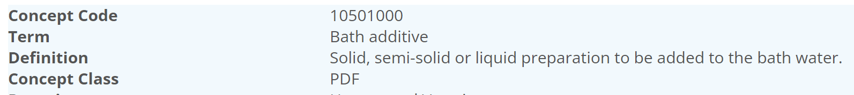
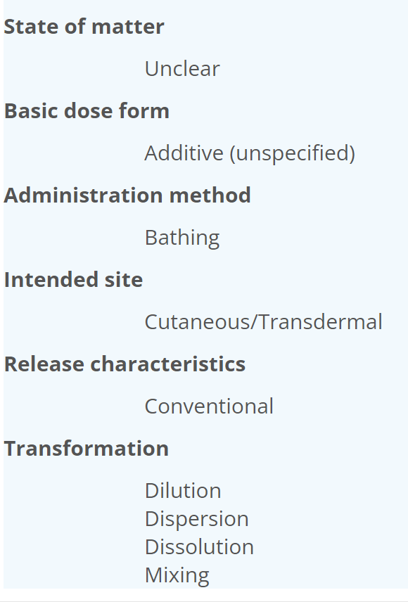
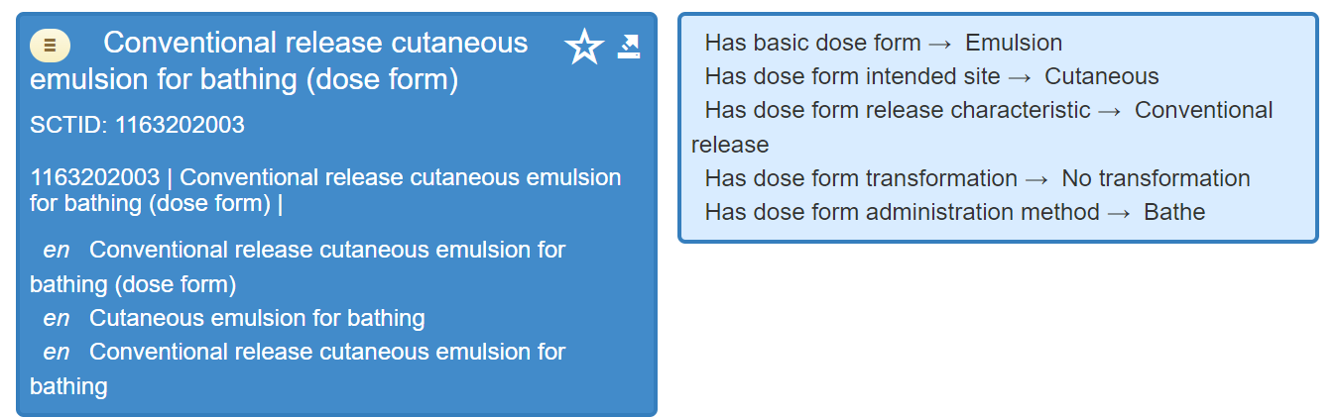
Bath additive
EDQM ID | EDQM Term | S-CT ID | S-CT FSN
10501000 | Bath additive
☺
Should we map exactly or should we map S-CT is “narrower than”

Slide 27
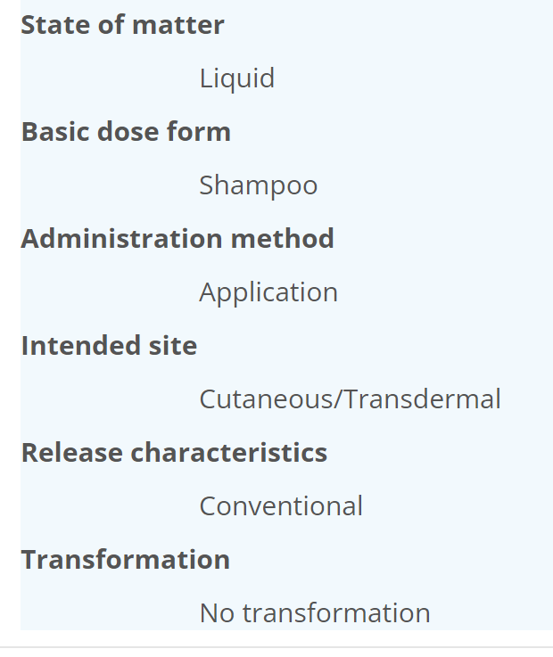
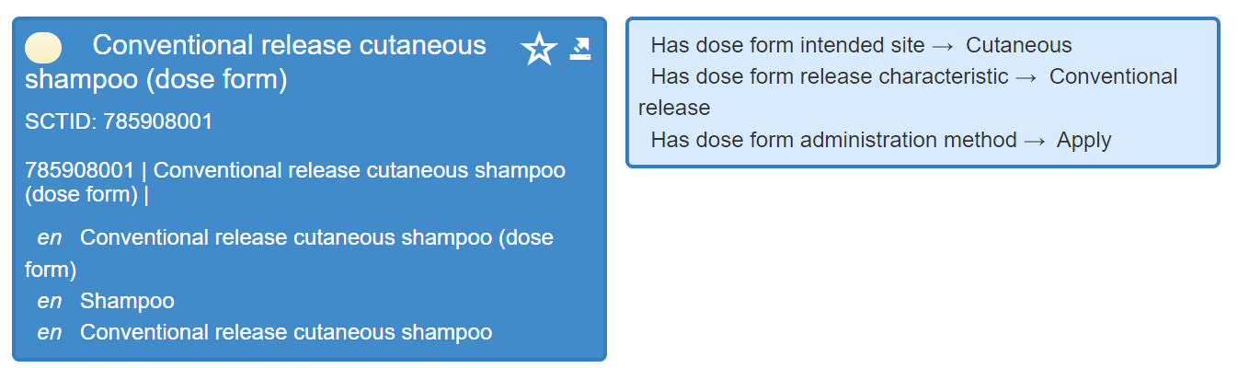
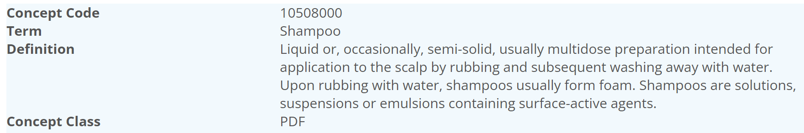
Shampoo
EDQM ID | EDQM Term | S-CT ID | S-CT FSN
10508000 | Shampoo | 785908001 | Conventional release cutaneous shampoo (dose form)
☹
☹
Why not “rinse/wash”?
Is the map OK?

Slide 28
Infuse definition (method)
Current definition:
  “A method of administration of a liquid dose form by introducing it into the circulatory system or into a body cavity”
Suggested update to definition
  A method of administration of a liquid dose form usually slowly and over a prolonged period of time and typically in larger volumes by introducing it into the circulatory system or into a body cavity
  EDQM: Administration of a pharmaceutical product, usually slowly and in larger volumes than for an injection, by introducing it into the body, usually after puncturing the skin; it is usually administered intravenously, but occasionally by other routes, e.g. subcutaneously.
  Inject (administration method) : A method of administration of a dose form by a parenteral route

Slide 29
Model change: Current model

Slide 30
Proposed change:

Slide 31
Example:

Slide 32
Benefits of model change
Supports full definition of more complex dose forms with multiple applicability
  Different transforms, different methods, different sites can be correctly associated
Supports correct associations between transformed concepts…important for Closed Loop Medication systems as RCDs with these dose forms can be correctly associated with the more abstract CDs

Slide 33
Conjunction
And And/Or Or

Slide 34

Another meeting ???
30th June ☺
NEXT STEPS
34

Slide 35


THANK YOU
SNOMED International: Delivering SNOMED CT

