Slide 1


Dental CRG - Editor’s Report
Sarah Warren - Terminologist 01 June 2022

Slide 2


Editor’s Report
Periodontal classification - addition 5 new concepts and 1 new synonym.
3 periodontal classification requests relate to Cairo classification and will require permission to be added.
Plan to inactivate 272661000 |Alveolar ridge structure (body structure)| as a DUPLICATE of 129143008 |Structure of alveolar process (body structure)|.
Fully defined content:
<<118818008 |Procedure on tooth (procedure)| - primitive 295 vs. fully defined 57
<<234947003 |Tooth disorder (disorder)| - primitive 506 vs. fully defined 347
SNOMED International – Leading healthcare terminology, worldwide | www.snomed.org |
@Snomedct | © 2018 IHTSDO

Slide 3
Education
Searching SNOMED CT: using the browser demo
Education resources: https://www.snomed.org/snomed-ct/education
Videos/presentations - handouts/scripts. Webinars (live discussion) form part of courses. Additional requirements can be raised with course tutors and will be accommodated as necessary.

Slide 4
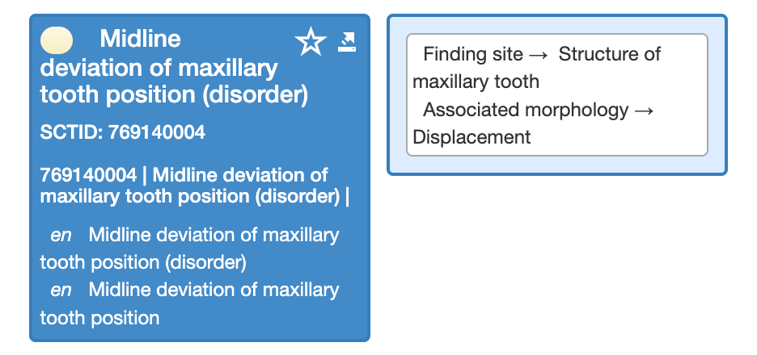
Question for group
Currently there are 15 concepts with the term ‘midline deviation’ in their FSNs.
Q - Do you consider midline deviations to be a displacement or malposition?
(no proposed changes to descriptions, modelling changes only)

