Slide 1

Adult Social Care terminology – stakeholder engagement
TechUK Social Care Working Group
5 July 2022
Ben Bennetts, Consultant

Slide 2






What could a terminology product do?
Focus on the individual
Focus on service management and reporting
Care provision
Make record keeping easier for front line staff
Relevant info available to all professionals at the point of care
Support the quality and effectiveness of the care provided to an individual
  Improved transfer of care
Service management
  Consistent, clear communication within and between organisations and professions
  Population health management
  Support clarity and consistency in procurement documentation
  Support for CQC assurance of adult social care
Managing personal information
  Enable individuals’ information to be shared and understood by the people who care for them – and by the individuals themselves
  Support Shared Care Records, Care Accounts, and other tools for managing personal information
Reporting
  Help to translate operational data into management intelligence and insight
  Ensure clarity and consistency in the data reported on nationally

Slide 3
Stakeholders
People receiving care and carers
Adult social care professionals
Health professionals
Care providers and care workers
Social prescribers
Public Health; Children’s; Housing
Statisticians and researchers
Other professional stakeholders
System suppliers
Who’s missing?

Slide 4
What does a win look like for you? (1)
Common terminology across health and social care
“Whatever setting you're in, people would understand what you're talking about as you wouldn't need to check what it means”
“Vocabulary that accurately describes the work of social care and hence the ability for systems to be able to capture it”
“To achieve some cohesion/understanding between the two in terms of how we speak to people and refer to/describe aspects of their care would be a huge step forward”
Standardisation across local authorities to improve procurement
Appropriate synonyms and terms for different audiences
Jargon- and acronym-buster
“Consistent approach that enables system interoperability across health and care, ensuring that people receive safe, appropriate and timely care and support”
When care workers make day-to-day notes about an individual, they use language which is intuitive to them but may not be to a clinician. When these notes end up in a Shared Care Record, the care worker and the individual need to be confident that a clinician will understand exactly what is meant. But we can’t demand that care workers learn clinical language; we have to recognise the language they already use.

Slide 5
What does a win look like for you? (2)
Other wins
Information captured to the same standard as health data
Allows data to be mapped across between the two sectors
Interoperability between local authority systems, Digital Social Care Record and Shared Care Record
Supports reporting of the whole patient pathway for vulnerable people, which will be invaluable for research and the design of support packages and services which work best for the patient/client
More reliable reporting as people would be asked for data in a way they understood
Better outcomes for care recipients
“For care providers, a product which leads to better experiences for the people that they are supporting and their workforce, but which doesn't impact on them, doesn't take them away from being able to deliver their work.”
Increased awareness of social care factors as part of someone’s care journey, and
Reduced stigma for adults who access adult social care services
… and one or two out-of-scope comments

Slide 6
Use cases – focused on the individual
Use case | Priority
Better definitions and descriptions of technology enabled care products, to help practitioners and individuals to choose and use the right equipment | 4.00
Multiple clinicians/professionals/carers involved in an individual's day-to-day life (GP, District Nurse, Adult Social Care, care provider, care worker, social prescriber, local authority call handler, others), not operating as part of a multi-disciplinary team, but needing to access clear and accurate records - in a language that bridges the gap between clinical and everyday terminology - and capture/share information to inform ongoing care delivery and to help the person live the life they want to. | 3.93
Communicating an individual's care needs between local authority and care provider at the point of commissioning | 3.87
Improving the way services are described in local online directories, thus making it easier for people to find and access the support they need | 3.80
Hospital admissions/discharge teams understand the care plan already in place and are able to provide the necessary care information to care providers on discharge | 3.67
Consistency of care to a service user when a temporary worker needs to step in (domiciliary or residential) | 3.60
Transfer of young people's information during transition from children's to adults' social care | 3.47
Recipients of care can access and understand the records of their past and planned health and social care activity | 3.40
"...many of today’s care homes with nursing, commissioned by local authorities, have by default become the modern equivalent of cottage hospitals. And care workers are skilfully and safely performing tasks that used to be the preserve of health staff. That may well be the right way to go, but it has not been discussed and planned..." (Sarah McClinton, inaugural speech as ADASS President, 28 April 2022). Need to identify how these tasks are documented and recorded. | 3.27
Care Home sending information to GP system | 3.13

Slide 7
Use cases – service management/reporting
Use case | Priority
Local authority strategy documents using agreed terminology consistently for stakeholder clarity | 4.00
Supporting the assurance process for local authorities and Integrated Care Systems | 4.00
Local authority contracts and service specs using agreed terminology consistently, supporting providers to have a clear understanding of what they are bidding for | 3.80
Department of Health and Social Care able to receive management information from all local authorities and care providers which uses agreed, understood and shared terminology | 3.80
Sharing elements of care planning information across many systems – componentisation of care plan | 3.80
As care providers move to digital systems (by 2024?), enable easier transfer of routine info to local authorities | 3.73
Emerging Care Account/Care Cap requirements, including transfer of information between local authorities when a person moves | 3.67
Population Health Management – greater ability to share health and care datasets to gain insights across a place | 3.53
Local authorities receiving information from care providers that enables activity (review of needs etc) to be stratified through artificial intelligence | 3.40
Care providers can interrogate the data they are capturing, rather than just recording it | 3.27
Capacity Tracker to use agreed terminology to allow inclusion of care package details and enable providers to update consistently across the adult social care market | 3.27

Slide 8
Blockers
Stakeholder category | Blocker
NHSEI, NHSD, DHSC | Along with changes to information recording we need changes to culture and working practice. Too many examples of information being available but ignored by professionals in a different setting, eg a routine medication regime for a long-term condition goes haywire when the person is admitted to hospital for an acute need.
Care providers | NHS has teams of clinical coders inputting data - care providers can't afford this. Some capture may be able to take place in the background, eg clicking a button to say I've given this person a drink; but free text entries are very hard to code automatically, "and I am absolutely passionate about making sure that we do not make this another task that care workers have to do".
System suppliers | The majority of data stored in the system is text based data with no codification. Local authorities are unlikely to want codification on this as there is a lot of free text. The outcomes are also not codified.
System suppliers | Roadmap priorities: 1. Care Account 2. Department of Work and Pensions integration 3. Liberty Protection Safeguarding | LAs are likely to have the same priorities and unlikely to see terminology as one to push. (But ADASS said their highest priority is assurance)
System suppliers | Within the system the structure of the data needs to be as open as possible so it can be shared with other systems. I get the sense that people are getting more siloed with data rather than opening it up. They are risk adverse, especially at senior management level. There is a registered data controller but people have over interpreted this to believe they can't share information.
NHSEI, NHSD, DHSC | This project can't/mustn't be about teaching care providers/frontline staff to use clinical language.
ADASS | If it is driven by national policy needs rather than by local care and support operational needs

Slide 9
Next steps
Develop personas
Continue to prioritise use cases and develop them into user stories
Develop design principles
Investigate the language used in needs assessments and Care Package Line Items
Continue to engage with stakeholders and special interest groups
  Occupational Therapy; Mental Health; Social Prescribers
  Care recipients and carers

Slide 10
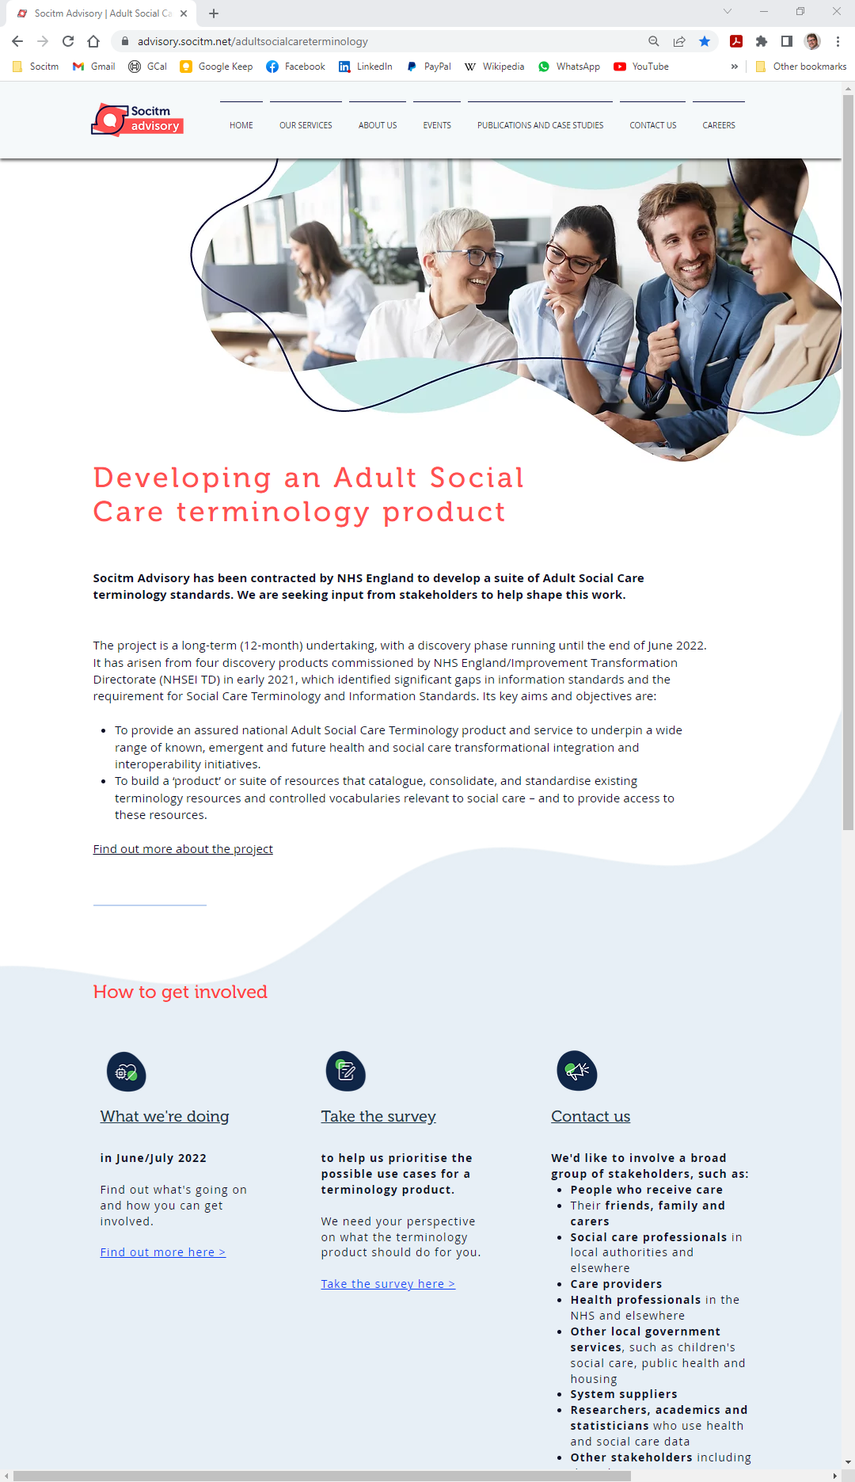
https://www.advisory.socitm.net/adultsocialcareterminology
ben.bennetts@socitm.net

