Slide 1


Social Care Future Directions
September 2022
Jane Millar

Slide 2

Table of Contents
2021 project outcome
The Current Pilot Project
Current state and Use Case example
Next steps

Slide 3
2021 Project Scope
Complete a gap analysis of Social Care to support the evolution of SNOMED CT content by:
Understanding the context and meaning of Social Care within Member countries.
Understanding the current use and future priorities for SNOMED CT use in Social Care among Member countries.
Understanding the current activities in Member countries to expand or enhance the use of SNOMED CT within Social Care, including any commonalities and differences.
Provide a set of recommendations regarding the future use of SNOMED CT in Social Care for SNOMED International’s consideration.

Slide 4
Social Care - definition
Social care is defined as:
the provision of social work, personal care, protection or social support services to children or adults in need or at risk, or adults with needs arising from illness, disability, old age or poverty
And
The term “Social Care” is commonly used by 75% of the survey respondents.
The exceptions were North America (U.S. and Canada), Norway and Switzerland.
Given its common utilization, it is appropriate for SNOMED International to use the term ‘Social Care’.

Slide 5
Social Care
Types of Services
2022
Older People
Disabilities
Homelessness
Services for older people that includes home care/support, long term care and palliative care.
Services for people with learning and physical disabilities.
Services to support needs related to homelessness.
Mental Health
Adult Abuse and Neglect
Children
Services for people with mental health problems.
Services to prevent adult abuse or neglect.
Child protection, placement, fostering and adoption services.
Alcohol/Substance Misuse
Domestic Abuse
Young Offenders
Services for people with alcohol and substance misuse problems.
Services to provide support in situations of domestic abuse.
Services for young offenders.

Slide 6
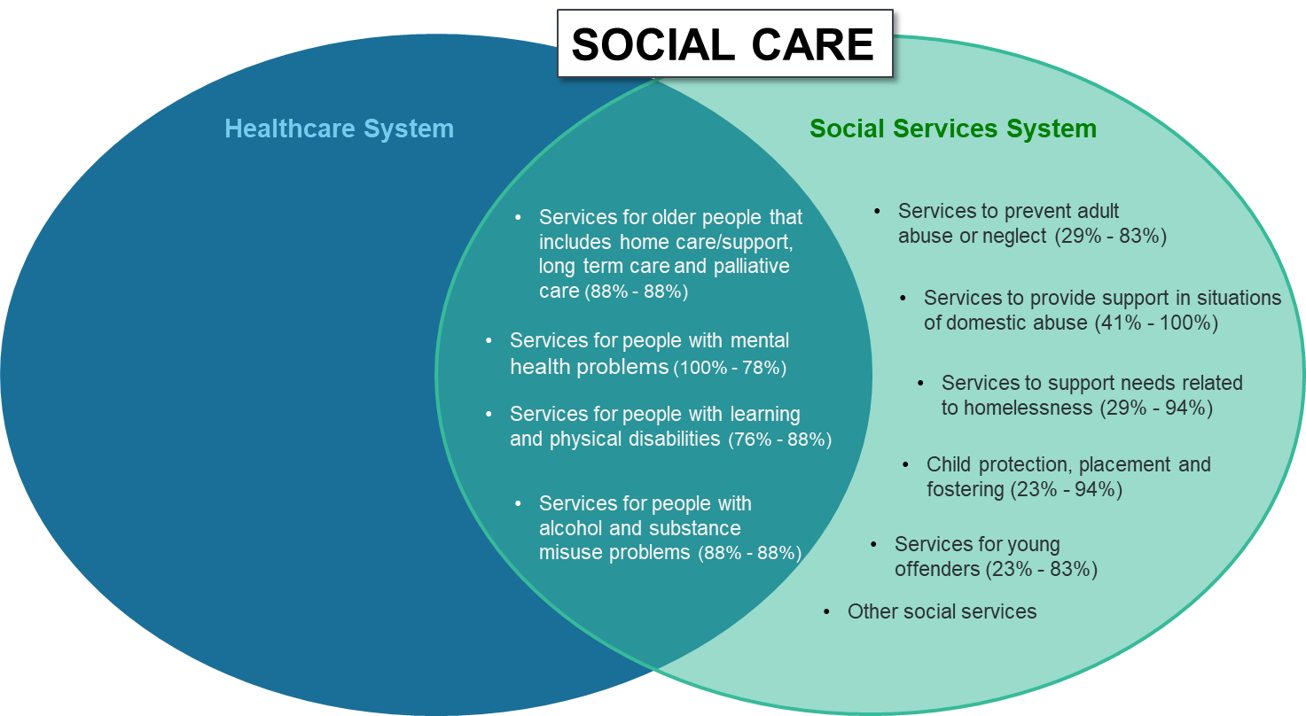
Social Care 2021 Survey key result offering contexts
Social Care services are predominately provided within the Social Services system in Member countries.
However, four Social Care services (i.e., home care/support & long term care, mental health, alcohol and drug misuse and services to people with learning and physical disabilities) are provided in both the health care and social service systems.
Health issues impact Social Care
Social care impacts health
Note 1: The percentage values indicate the percent of respondent countries where the specified Social Care service is provided within the Healthcare system (left value) and the Social Services system (right value).
Note 2: This diagram is a generalization of the results from the 18 survey respondents and does not necessarily reflect the exact organization of Social Care within each country.

Slide 7
Social Care Pilot Project 2022
Internal team - Project coordinator Jane Millar, Author Cathy Richardson, Suzy Roy and Ian Green
Project contractor – William Goossen
Member Countries (so far) – UK, Denmark, Netherlands, Spain, Norway, Finland, Australia
Other input resources (so far) – Gravity project US, InterRAI project Australia (Implementation team), UK Social Prescribing, HL7 FHIR work
SME group

Slide 8
Social Care Project 2022
Priority areas as agreed in survey:
  - Services for older people including home care/support, long term care and palliative care focusing across healthcare and social care
  - Services for people with mental health problems
  Services for people with alcohol and substance misuse problems
  Collate and document requirements
  Identify relevant content in SNOMED CT and identify gaps – using Subject Matter Experts
  Hand over to content team for content work (outside scope of project but sharing of SMEs)
  Start with ‘Older People’ to develop methodology, then apply to ‘Mental Health’ and ‘Alcohol and substance misuse problems
  Goal to complete by end of 2022

Slide 9
Social Care Project 2022 use case example
Assessment of needs to enable an older person to stay at home
use case description Mrs. Jones had a fall at home and was found by her neighbors. Whilst she did not require medical treatment, her family are concerned about her ability to manage safely in the home. The Healthcare staff assessing her medical needs, have referred her for a home care assessment undertaken in the community. She has therefore been referred to a social worker to arrange for the assessment to be undertaken.
actors and roles:
Client – focus of assessment
Healthcare Staff assessing her medical needs
Assessor(s) – review individuals’ ability to take care of themselves at home & assess ability to communicate, social interactions and financials
Family/friends (support network) – assessment of external support mechanism available to client
purpose: To establish degree of support required for the client to live at home safely and at an acceptable level of quality to the client.
assumptions: The client wishes to remain in their own home, and that the relevant support mechanisms will be available. Assessor should preferably be somebody that works community based.
Process:
Agree with client to undertake needs assessment
Meet with client and document assessment details
Meet with family/support network to gather and discuss
Discuss with wider Multi Disciplinary Team (MDT)
Identify required resources, including financial aspects
Discuss and agree support package with client
Implement support package

Slide 10
Social Care Project 2022 use case impact for SCT
The good news
SNOMED CT has many concepts available that are useful in the social care use cases identified so far.
e.g. Gravity: 710824005 Assessment of health and social care needs (procedure) or 711069006 Coordination of care plan (procedure)
e.g. Denmark: 365550006 Finding of financial circumstances (finding) or 365242003 Finding related to ability to perform domestic activities (finding)
e.g. InterRAI: 301566006 Does not mobilize outside (finding) or 105529008 Lives alone (finding)
The even better news
As can be anticipated for any new area being reviewed, Social Care work does imply that gaps exists.
Filling gaps and reviewing existing hierarchies in SCT
Example gaps: 464081000124100 Referral to home-delivered meals program (procedure) US Extension or social prescribing referral/offer (Not in SCT, UK Oxford)
Adding content for social care can be done gradually, e.g. starting with required broad categories, and gradually adding more granular concepts
Existing work e.g. Gravity data sets, Social Prescribing ontology, the ICF, InterRAI assessments, and provide clear pointers to where additional content might fit and propose additional concepts.

Slide 11
Social Care Project challenges
Expanding the scope of SNOMED CT and fundamental shift as an organisation
Recognizing the health bias - approach and language utilised
Fit of current SNOMED CT model and terming used (person/client based). OBSERVABLES!
Consideration of requirements for social care systems, in addition to clinical systems
Vendor requirements, who are they, maturity of humans, current practice and systems, information model availability (include information model aspects – system maturity)
Levels of detail/granularity
Individual care v central reporting (funding and statistics)
Community aspects and environment/culture

Slide 12
Next steps
Complete SNOMED CT requirements for ‘Older people’ based on use cases
Final Review by SME group and handover to content team
Collate requirements and identify use cases
      Mental Health
      Alcohol/substance misuse
      We want to hear from you and add to our SME group

Slide 13
THANK YOU
SNOMED International: Delivering SNOMED CT

