Slide 1


SNOMED CT DEUSG Subgroup
EDQM Dose Form Mapping
Linda Bird, SNOMED International
Julie James, Blue Wave Informatics
Thursday 19th May 2022

Slide 2

Welcome
Progress update
Issues discussion
Next meeting
AGENDA
http://snomed.org/deusg

Slide 3

Progress update

Slide 4
Our documentation
Mapping Guidance:
https://confluence.ihtsdotools.org/display/USRG/Mapping+Guidance+for+EDQM+to+SNOMED+CT+Pharmaceutical+Dose+Form+Mapping
“EDQM discussion items” List
https://confluence.ihtsdotools.org/display/USRG/Issues+for+discussion+with+EDQM
“SNOMED CT discussion items” List
https://confluence.ihtsdotools.org/display/USRG/Issues+for+discussion+with+SNOMED+CT
IMPLEMENTATION guidance https://confluence.ihtsdotools.org/display/USRG/Guidance+for+Implementation+of+the+EDQM+PDF+to+SNOMED+CT+PDF+mapping
Recommendations
https://confluence.ihtsdotools.org/display/USRG/Recommendations

Slide 5
Lots of CRS requests submitted and being processed
Toni from Content Team worked on CRS while François was on holiday (thank you Toni)
Status as of Monday: 20/134 requests resolved (15% complete)
New concepts are appearing in the Daily Build
Not yet added these to the RC1, but will start doing that ASAP

Slide 6
Our numbers
Date | WIP | RC1 | No Match | In “holding” | New requests | Change requests
15:12:2021 | 255 | 115 |  | 6 | 5
10:01:2022 | 255 | 130 |  | 21 | 5 | 1
27:01:2022 | 242 | 123 | 3 | 22 | 10 | 3
10:02:2022 | 214 | 138 | 3 | 37 | 14 | 4
24:02:2022 | 190 | 138 | 10 | 54 | 16 | 7
10:03:2022 | 163 | 138 | 10 | 65 | 20 | 17
24:03.2022 | 157 | 142 | 14 | 68 | 28 | 22
07:04:2022 | 147 | 146 | 27 | 61 | 39 | 32
21:04:2022 | 124 | 162 | 30 | 80 | 58 | 35
05:05:2022 | 91 | 163 | 45 | 97 | 68 | 52
19:05:2022 | 49 | 167 | 49 | 84 | 94 | 56

Slide 7
Issues for discussion

Slide 8
More “exec decisions”…for example
EDQM ID | EDQM Term | Action | Justification | In “holding”
10101000 | Oral drops, solution | Request new | Many products (e.g. citalopram, tramadol) | BDF: Solution Int Site: Oral Rel Char: Conv release Admin Method: Instill, Swallow Transform: No transform
10102000 | Oral drops, suspension | Request new | Many products (e.g. paracetamol, amoxicillin, nystatin) | BDF: Suspension Int Site: Oral Rel Char: Conv release Admin Method: Instill, Swallow Transform: No transform
10103000 | Oral drops, emulsion | Request new | Some products (e.g. simeticone) | BDF: Emulsion Int Site: Oral Rel Char: Conv release Admin Method: Instill, Swallow Transform: No transform

Slide 9
Drops and Sprays
Like other “drops” dose forms, these will not be used to define CDs in the International Edition; drops CDs will use the oral drops grouper concept.
We need to have guidance to fully explain this

Slide 10
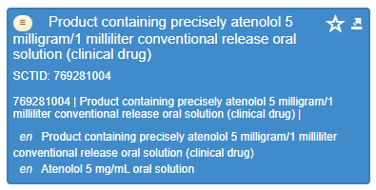
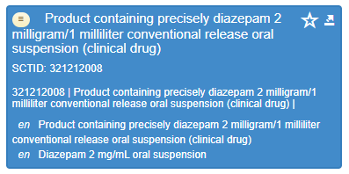
Oral drops
Question: clinically, just using “drops” as a PDF for CDs seems fine (to me) for “topical” products (eye drops, nose drops, cutaneous sprays) where mixing is unlikely.
Is it OK for oral preparations? Is it inconsistent with other oral preparations?
David: It doesn’t matter
Martha: agrees it’s challenging. Norway has the detailed PDF but may have a grouper
  If national extensions create RCDs or CDs with the more granular PDFs, they will subsume correctly to the international concept

Slide 11
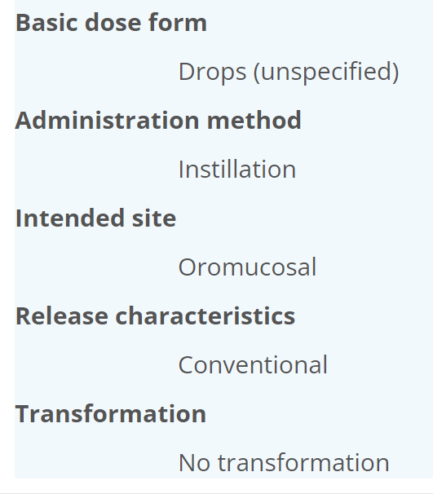
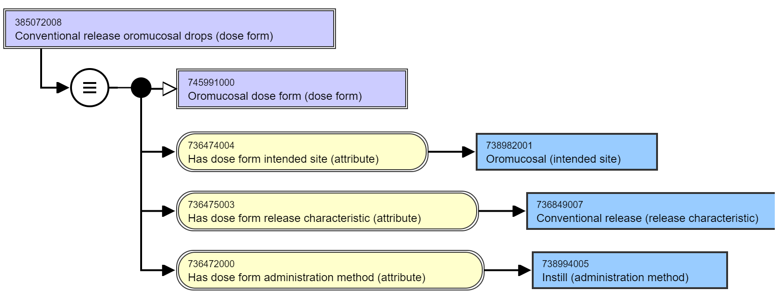
Other drops concepts
OK to map? YES
Exact match or SCT ‘broader than’?
Most non-specific (e.g. not defined as solution/suspension etc.) “drops” (and sprays) concepts in EDQM are PFTs so are out of scope for us
But there is 10307000 Oromucosal drops
  Is an old concept in EDQM (2006) – maybe retired in future; it doesn’t follow current EDQM policy
This was mapped to 385072008: Conventional release oromucosal drops (dose form)
  This is a grouper concept with only 3 attributes in SNOMED CT
No CDs use this PDF in International Edition
Liquid, usually multidose preparation consisting of a solution, suspension or emulsion intended for oromucosal use. Oromucosal drops are administered by instillation into the oral cavity or onto a specific part of the oral cavity.

Slide 12
Cachet and Pillules
Do we need them?
  Suspect they may be used in countries I am less familiar with…..
Cachet: Solid discoid preparation consisting of a wafer enclosing a unit dose intended for oral use
  Has ‘cachet’ basic dose form
Pillules: Solid preparation for homoeopathic use, obtained from sucrose, lactose or other suitable excipients. Pillules may be prepared by impregnation of preformed pillules with a dilution or dilutions of homoeopathic stocks or by progressive addition of these excipients and the addition of a dilution or dilutions of homoeopathic stocks. Pillules are intended for oral or sublingual use
  Should we rule this PDF ‘out of scope’? NO map unless formally requested

Slide 13
1040900 : Toothpaste
Not the same as dental paste in EDQM (which can go in or on a tooth)
Same attributes as dental paste
? How should we map ?
  There are medicinal toothpastes – especially fluoride ones
Should have it as a PDF so need to add
  Method? We can get a unique full definition if we add “Wash” or similar in addition to “apply” to keep the congruence with EDQM

Slide 14
Challenges with pattern consistency

Slide 15
Challenges with basic dose form : film coating
For “film coated tablets” we now have an exact match (not just a BDF) as a new PDF concept has been authored using the BDF of “film coated tablet” – which is different from (more granular than) EDQM
  10221000: Film-coated tablet on RC1 mapped as exact match to 1163573008: Conventional release film-coated oral tablet (dose form)
Does this set a precedent to “extend” basic dose forms for just a small number of concepts?

Slide 16
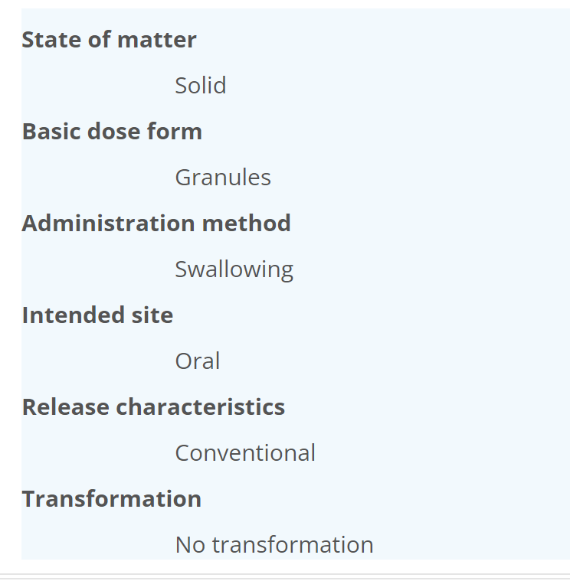
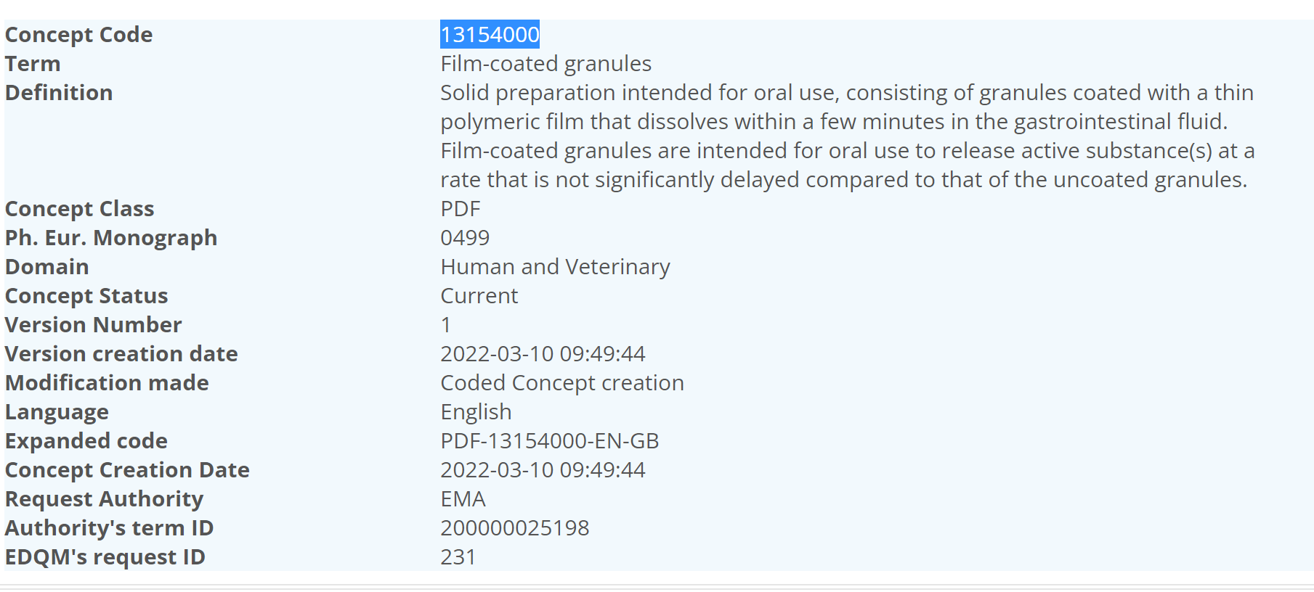
NEW – and not on our list: Film coated granules

Slide 17
10201000: Oral powder mapped to 385041009: Conventional release oral powder (dose form)
Single-dose or multidose preparation consisting of one or more particulate solids of varying degrees of fineness. Oral powders are intended for oral administration. They are generally administered in or with water or another suitable liquid, but may also be swallowed directly.
 | EDQM | SNOMED CT
BDF: | Powder | Powder
Admin method: | Swallow | Swallow
Intended site: | Oral | Oral
Release char: | Conventional | Conventional
Transform: | Dispersion/dissolution/no transformation | No transformation
If the powder is dissolved or dispersed, doesn’t it become an oral solution or oral suspension?

Slide 18
10204000: Granules mapped to 420509004: Conventional release oral granules (dose form)
Solid single-dose or multidose preparation consisting of solid, dry aggregates of powder particles that are sufficiently resistant to withstand handling. Granules are intended for oral use to release active substance(s) in the gastrointestinal fluids by a rate depending essentially on the intrinsic properties of the active substance(s) (conventional release). They may be swallowed as such and/or chewed before swallowing, and some may also be dissolved or dispersed in water or another suitable liquid before oral administration. Granules for oral solution and Granules for oral suspension are excluded.
 | EDQM | SNOMED CT
BDF: | Granules | Granules
Admin method: | Chew/Swallow | Swallow
Intended site: | Oral | Oral
Release char: | Conventional | Conventional
Transform: | No transformation | No transformation
IF we include “chew” in the logical definition in SNOMED CT, they should really be “chewable granules”
This dose form has no transformation but can be dissolved or dispersed – feels inconsistent from previous

Slide 19
From Chris
Some granules are intended to be dissolved and so should use the more specific dose forms
For powders, there is probably not quite the requirement for intention
  Oral powders can be mixed with Food (Fosrenol or Tiorfan)
Chewable tablets often have to be chewed as they are large
Oral granules could be chewed but it’s not as likely
Oral tablets can be chewed
For the Oral Granules: Ignore the “chew” in EDQM and have exact match
Powder: Ignore the transformation mismatch and allow exact match. Possibly EDQM might add the “exclusion” wording to oral powder in the future

Slide 20
10222000: Effervescent tablet – mapped to 764780001: Conventional release effervescent oral tablet (dose form) – but not in RC1 yet
Solid single-dose preparation consisting of an uncoated tablet generally containing acid substances and carbonates or hydrogen carbonates, which react rapidly in the presence of water to release carbon dioxide. Effervescent tablets are intended to be dissolved or dispersed in water before oral use
 | EDQM | SNOMED CT
BDF: | Tablet | Effervescent tablet
Admin method: | Swallow | Swallow
Intended site: | Oral | Oral
Release char: | Conventional | Conventional
Transform: | Disperse Dissolution | Disperse or dissolve

Slide 21
10203000: Effervescent powder (no map)
Solid single-dose or multidose preparation consisting of one or more powders generally containing acid substances and carbonates or hydrogen carbonates that react rapidly in the presence of water to release carbon dioxide. Effervescent powders are intended to be dissolved or dispersed in water before administration."
 | EDQM | 769115006 | Effervescent powder for conventional release oral solution (dose form) | 769120006 | Effervescent powder for conventional release oral suspension (dose form)
BDF: | Powder | Effervescent powder | Effervescent powder
Admin method: | Swallow | Swallow | Swallow
Intended site: | Oral | Oral | Oral
Release char: | Conventional | Conventional | Conventional
Transform: | Disperse Dissolution | Dissolve | Disperse

Slide 22
Discussion
Also effervescent granules for oral suspension
For Effervescent powder request a new (parent) concept
Example : Husk with effervescent powder form => oral suspension (PSYLIA pdre efferv p susp buv en sachet)

Slide 23
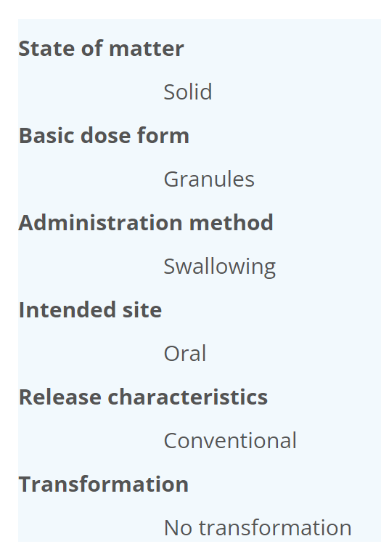
13046000: Coated granules – no map
Solid preparation intended for oral use, consisting of granules coated with one or more layers of mixtures of various substances that are usually applied as a solution or suspension in conditions in which evaporation of the vehicle occurs. The thickness of the coating is greater than that of film-coated granules. When the coating dissolves or disintegrates any active substance is released into the gastrointestinal fluid at a rate depending essentially on its intrinsic properties (conventional release).
No “coated” PDF concepts in SNOMED CT

Slide 24
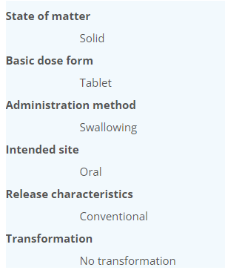
10220000: Coated tablet – no map
Solid single-dose preparation consisting of a tablet coated with one or more layers of mixtures of various substances such as sugars and waxes. To the coating colouring matter, flavouring substances and active substance(s) may be added. The thickness of the coating is greater than that of a film-coated tablet. Coated tablets have a smooth surface. They are intended for oral use. When the coating dissolves or disintegrates the active substance(s) is (are) released into the gastrointestinal fluid at a rate depending essentially on its intrinsic properties (conventional release).
No “coated” PDF concepts in SNOMED CT
RCDs do exist using this term, but it is not felt to be well defined….there is a coating but we don’t know what
Will disintegrate more slowly than an uncoated tablet BUT it is still conventional release
Film coated has faster dissolution test
Coating not mentioned in USA
Ask Content about why film coat but not coated basic dose form

Slide 25
Dose form concept model changes
Role groups
Administrable dose form association
  Powder for solution for injection solution for injection

Slide 26


Next meeting ???
Thursday 2nd June is a UK Celebration…
Meet 16th June 09.00 UTC
NEXT STEPS
26

Slide 27


THANK YOU
SNOMED International: Delivering SNOMED CT

