Slide 1


SNOMED CT DEUSG Subgroup
EDQM Dose Form Mapping
Linda Bird, SNOMED International
Julie James, Blue Wave Informatics
Thursday 5th May 2022

Slide 2

Welcome
Progress update
Issues discussion
Next meeting
AGENDA
http://snomed.org/deusg

Slide 3

Progress update

Slide 4
Our documentation
Mapping Guidance:
https://confluence.ihtsdotools.org/display/USRG/Mapping+Guidance+for+EDQM+to+SNOMED+CT+Pharmaceutical+Dose+Form+Mapping
“EDQM discussion items” List
https://confluence.ihtsdotools.org/display/USRG/Issues+for+discussion+with+EDQM
“SNOMED CT discussion items” List
https://confluence.ihtsdotools.org/display/USRG/Issues+for+discussion+with+SNOMED+CT
IMPLEMENTATION guidance https://confluence.ihtsdotools.org/display/USRG/Guidance+for+Implementation+of+the+EDQM+PDF+to+SNOMED+CT+PDF+mapping
Recommendations
https://confluence.ihtsdotools.org/display/USRG/Recommendations

Slide 5
Our numbers
Date | WIP | RC1 | No Match | In “holding” | New requests | Change requests
15:12:2021 | 255 | 115 |  | 6 | 5
10:01:2022 | 255 | 130 |  | 21 | 5 | 1
27:01:2022 | 242 | 123 | 3 | 22 | 10 | 3
10:02:2022 | 214 | 138 | 3 | 37 | 14 | 4
24:02:2022 | 190 | 138 | 10 | 54 | 16 | 7
10:03:2022 | 163 | 138 | 10 | 65 | 20 | 17
24:03.2022 | 157 | 142 | 14 | 68 | 28 | 22
07:04:2022 | 147 | 146 | 27 | 61 | 39 | 32
21:04:2022 | 124 | 162 | 30 | 80 | 58 | 35
05:05:2022 | 91 | 163 | 45 | 97 | 68 | 52

Slide 6
Issues for discussion

Slide 7
Some “exec decisions”
EDQM ID | EDQM Term | Action | Justification | In “holding”
10546400 | Transdermal solution | Request new | Some products (e.g. in US) | BDF: Solution Int Site: Transdermal Rel Char: Conv release Admin Method: Apply Transform: No transform
10546500 | Transdermal solution (spray) | Request new | Several products (e.g. buprenorphine) | BDF: Solution Int Site: Transdermal Rel Char: Conv release Admin Method: Spray Transform: No transform
10308100 | Oromucosal spray, emulsion | Request new | Some products (e.g. melatonin) | BDF: Emulsion Int Site: Oromucosal Rel Char: Conv release Admin Method: Spray Transform: No transform
10512000 | Cutaneous liquid | Request new | Pure liquid products such as arachis oil, almond oil, coconut oil | BDF: (Pure) liquid Int Site: Cutaneous Rel Char: Conv release Admin Method: Apply Transform: No transform

Slide 8
Inhaling aerosol powders…(2)
EDQM ID | EDQM Term | S-CT ID | FSN | Comments etc. from mapper
11109000 | Inhalation powder | 385207009 | Conventional release powder for inhalation (dose form) | To be used for metered dose dry powder inhalers | Bricanyl ® Turbohaler etc
11110000 | Inhalation powder, hard capsule | 385207009 | Conventional release powder for inhalation (dose form) | Hard capsule can be viewed as a container | Rotacaps® etc
11111000 | Inhalation powder, pre-dispensed | 385207009 | Conventional release powder for inhalation (dose form) | S-CT concept has no sense of the "pre-dispensed" | Ventodisks ® ® Ellipta ® Twisthaler ®etc. – powder in a blister in a disk or a unit dose container
50030000 | Inhalation powder, tablet |  |  | EDQM definition is Solid multidose preparation intended for inhalation use. The dose of inhalation powder is generated from the tablet by a metering mechanism within the inhaler, for example by scraping off a small amount of powder from the tablet.

Slide 9
Other pulmonary powders are “powder for…” e.g. Powder for conv rel nebulizer solution
Is already correctly mapped to “Inhalation powder” – the metered dose dry powder inhalers
Will move to not be an (uncomfortable) child of this concept with the new “vaporize” transform and will be fully defined
Pulmonary PDF
385207009| Conv rel powder for inhalation
385211003 | Conv vapor powder for inhalation
How to map “Inhalation powder, hard capsule” and “Inhalation powder, pre-dispensed”?
And…. Inhalation powder, tablet

Slide 10
What does an “Inhalation powder, tablet” look like?
Explained by a German expert (?) – the inhaler has a blade that scrapes powder off the tablet and this is what is inhaled – it is metered (somehow)
None of us have ever come across this (and nor had the ST experts!)
We will say “no map”

Slide 11
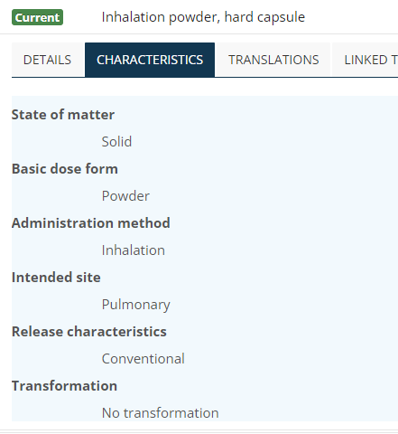
How to manage “a container” for inhalation powder?
EDQM has “no transformation” for any of these concepts, but it is not the hard capsule that is inhaled….just the powder inside it
And pre-dispensed is even harder…..
For now, map this is a “many to one”…..Also possibly a direct discussion with SNOMED CT Content as there is no good solution
Chris: Note the BDF – it is powder not capsule
There are also the “sprinkle capsules” – the capsule is the container and is not swallowed (although it is not such an issue if it is). Products have “capsule for opening” on the licence but this is not a standard PDF – in ST it is “oral powder in single dose container” (which is a Combined Term)
These PDFs in EDQM are more like CT, but for now they are PDFs

Slide 12
Administration methods
To discuss
  A body cavity (rectum, vagina, endocervix, urethra) should not be a body surface?
    If so, should not use “apply” as a method – but what should it use?
    Can solutions and foams be “inserted”?
    Could “placing” be “introducing”?
  Anything oromucosal is a body surface?
    If so, can use “apply” as a method
    What about oropharyngeal???
  Anything nasal is a body surface?
    If so, can use “apply” as a method
  Buccal and sublingual tablets – “administer”….can we do any better?

Slide 13

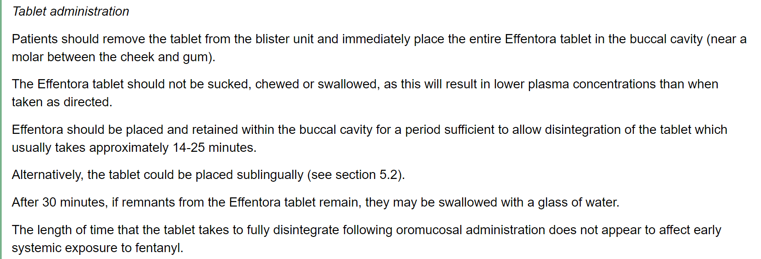

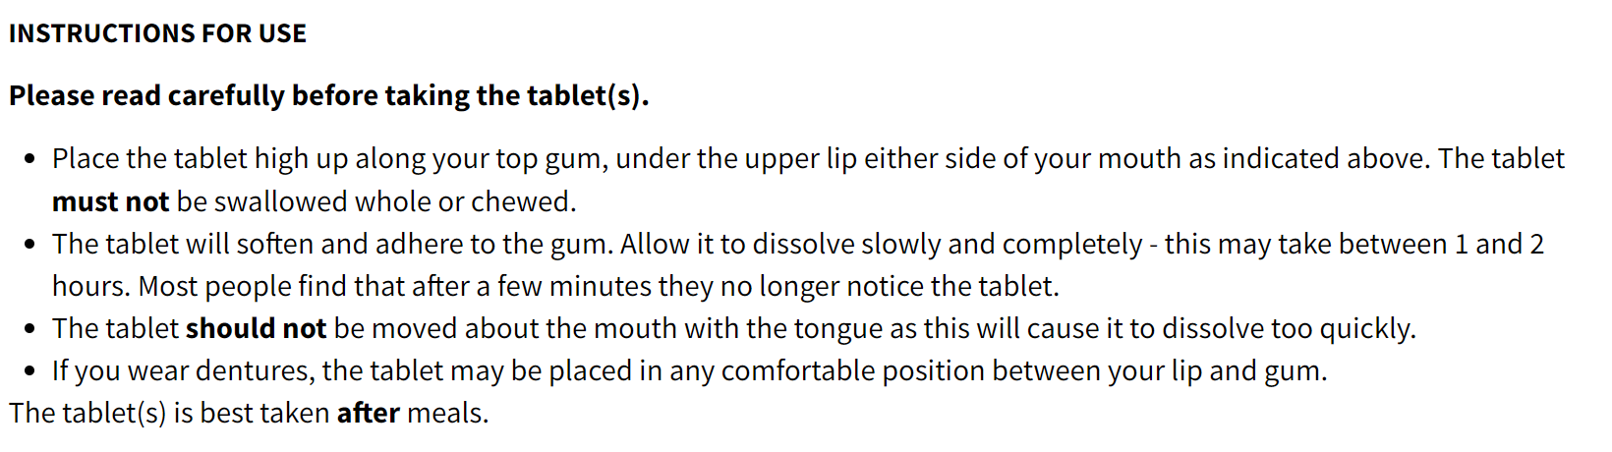

Slide 14
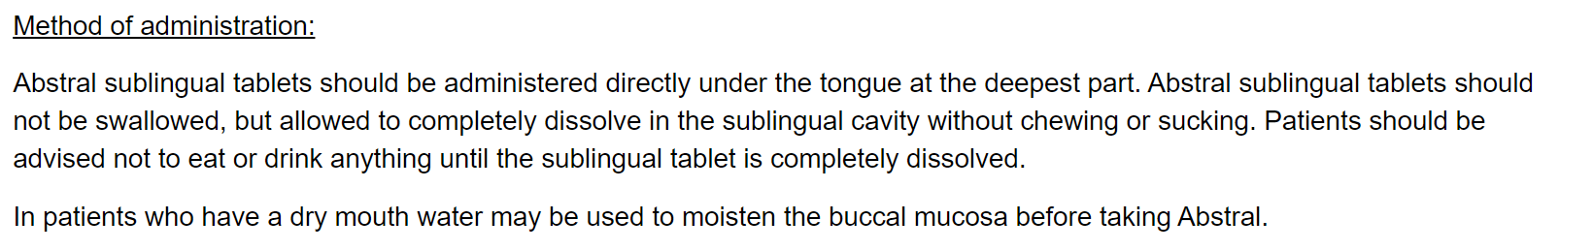
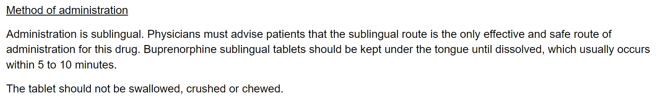

Slide 15
What might be appropriate?
“Place” (as a verb/gerund)? Might work for S/L but NOT vaginal/rectal
Insert? Only works for solid dose forms into a cavity
  “administering” a liquid or semi-solid usually uses a device…which is solid…but the applicator is removed….but the liquid stays behind
Do we really need to change “administer”? We have the CRS to change the definition to “A generic method of administering a dose form” ….
We will come back to this topic

Slide 16
Specialist dose forms discussion
We need these specialist dose forms for national extensions – there are lots of products
  Some extensions have already had to create some of their own terms for these which unfortunately is not great for interoperability…
Some of them are “old terms” in EDQM ST but….
They have explicit monographs and explicit pharmaceutical requirements/standards, particularly for the extracorporeal solutions
Haemodiafiltration is different from haemodialysis and uses different types of solutions because some are not purely extracorporeal….
The allergen (skin prick) dose forms are also used and are not “parenteral” so cannot really just be “solution for injection”
We all have the sealant products – they are challenging to make into CDs/RCDs but we all have them; not sure how to model them – need to come back to this

Slide 17
In addition to requesting the concepts themselves…. We will need
A “dialysis” method of administration
  A method of administration of a dose form through a dialysis (separation membrane) system
An “extracorporeal” intended site
  An intended site for administration of a dose form that is initially outside of the body but is subsequently returned into the body
  NB: EDQM has “parenteral” and “extracorporeal” but are two sites useful? Does the “parenteral” adds anything to the concepts? (except for the cardioplegia/organ preservation where both do apply)
Unfortunately, some of these concepts will be primitive, as there is no easy way to give them unique logical definitions without (for example) adding granularity to the dialysis method – which seems more effort than value (at least for now)

Slide 18
Specialist dose forms (solutions mostly)(1)
EDQM ID | EDQM Term | Notes from mappers
11209500 | Solution for cardioplegia | S-CT has Cardioplegia solution (product) SCTID 353410005 with a parent Medicinal product categorized by therapeutic role (product) SCTID: 763087004. EDQM have this as a dose form with a definition Liquid sterile preparation consisting of an aqueous solution intended for use in inducing cardiac arrest during heart surgery. A few products exist – e.g. BRETSCHNEIDER, “Martindale solution for Cardioplegia”
11401000 | Solution for peritoneal dialysis | 8 “products” (not MPs – no attributes – no active ingredient substance) Many RCD products in national extensions – 50+ (!) e.g. EXTRANEAL
11402000 | Solution for haemofiltration | no notion of the use "haemofiltration" BDF in SNCT 5 “products” (not MPs – no attributes – no active ingredient substance) Various RCD products in national extensions – e.g. REGIOCIT
10518500 | Powder for solution for iontophoresis | Is a “solution for iontophoresis” dose form already exists; this “makes” that Glycopyrrolate products (Robinul); otherwise uses sterile water or sterile saline Can also be done with lidocaine, silver or antifungal agents, sometimes even anti-inflammatory medications (possibly no authorised products available)

Slide 19
Specialist dose forms (solutions mostly)(2)
EDQM ID | EDQM Term | Notes from mappers
11403000 | Solution for haemodiafiltration | no notion of the use "haemodiafiltration" BDF in SNCT No “products” for haemodiafiltration Some products exist – e.g. MultiFiltrate
11404000 | Solution for haemodialysis | no notion of the use "haemodialysis" BDF in SNCT 8 “products” (not MPs – no attributes – no active ingredient substance) Note: some concepts are “xxx free” (e.g.lactate free) Many products exist – e.g. BICART, CLEANCART
13107000 | Solution for cardioplegia/organ preservation | no BDF in SNCT Organ preservation solution is a physical object in SNOMED CT A few products exist – e.g. PERISOC
50057000 | Solution for haemodialysis/haemofiltration | no notion of the use "haemodialysis/haemofiltration" BDF in SNCT Many products exist – e.g. Hemasol B0, Prismasol, multiBic, Phoxilium
13042000 | Epilesional solution | Administered onto a lesion
50049300 | Powder for epilesional solution | Administered onto a lesion
Not discussed
Epilesional DF have unknown/misc intended site in EDQM

Slide 20
Specialist dose forms (3)
EDQM ID | EDQM Term | Notes from mappers
10548000 | Solution for skin prick test | Purpose included?
10549000 | Solution for skin scratch test | Purpose included?
13051000 | Solution for injection/skin prick test
12101000 | Denture lacquer | Applied to dentures to form lacquer. Might be possible to add if the new basic dose form of lacquer is available, but intended site would be challenging – dentures are physical objects in SNOMED CT No map for now
12115000 | Sealant | Liquid, more or less viscous, sterile preparation intended for use as a tissue glue
12115100 | Sealant matrix | Solid, sterile prep – pliable piece of material impregnated or coated with sealant or powder that forms a sealant after contact with appropriate fluid Usually absorbed by the body
12115200 | Sealant powder | Intended to be applied to form a haemostatic agent or tissue glue
13031000 | Powder for sealant | Intended to be dissolved in a specified liquid to obtain a sealant
50061500 | Solution for sealant | Intended for the preparation of a sealant
Sealants have unknown/misc intended site in EDQM

Slide 21

Next meeting on
Thursday 19th May
at 09:00 UTC
NEXT STEPS
21

Slide 22


THANK YOU
SNOMED International: Delivering SNOMED CT

