Slide 1


SNOMED CT DEUSG Subgroup
EDQM Dose Form Mapping
Linda Bird, SNOMED International
Julie James, Blue Wave Informatics
Thursday 5th May 2022

Slide 2

Welcome
Progress update
Issues discussion
Next meeting
AGENDA
http://snomed.org/deusg

Slide 3

Progress update

Slide 4
Our documentation
Mapping Guidance:
https://confluence.ihtsdotools.org/display/USRG/Mapping+Guidance+for+EDQM+to+SNOMED+CT+Pharmaceutical+Dose+Form+Mapping
“EDQM discussion items” List
https://confluence.ihtsdotools.org/display/USRG/Issues+for+discussion+with+EDQM
“SNOMED CT discussion items” List
https://confluence.ihtsdotools.org/display/USRG/Issues+for+discussion+with+SNOMED+CT
IMPLEMENTATION guidance https://confluence.ihtsdotools.org/display/USRG/Guidance+for+Implementation+of+the+EDQM+PDF+to+SNOMED+CT+PDF+mapping
Recommendations
https://confluence.ihtsdotools.org/display/USRG/Recommendations

Slide 5
Our numbers
Date | WIP | RC1 | No Match | In “holding” | New requests | Change requests
15:12:2021 | 255 | 115 |  | 6 | 5
10:01:2022 | 255 | 130 |  | 21 | 5 | 1
27:01:2022 | 242 | 123 | 3 | 22 | 10 | 3
10:02:2022 | 214 | 138 | 3 | 37 | 14 | 4
24:02:2022 | 190 | 138 | 10 | 54 | 16 | 7
10:03:2022 | 163 | 138 | 10 | 65 | 20 | 17
24:03.2022 | 157 | 142 | 14 | 68 | 28 | 22
07:04:2022 | 147 | 146 | 27 | 61 | 39 | 32
21:04:2022 | 124 | 162 | 30 | 80 | 58 | 35

Slide 6
Issues for discussion

Slide 7
Ears and Nose…
EDQM ID | EDQM Term | S-CT ID | FSN | Comments etc. from mapper | Comments in meeting
50020200 | Ear/nasal drops, suspension | 420891003 | Conventional release suspension for ear drops (dose form) | Narrower than | Are products using this dose form (Italian, Spanish, Belgian e.g. Doricum) – request new concept
13006000 | Ear drops, powder for suspension | 385136004 | Conventional release ear drops (dose form) | Narrower than | Is standard pattern, but a one off; add if needed
10713000 | Ear wash, emulsion |  |  | S-CT has very few concepts that have "wash" or similar | See other slides
10712000 | Ear wash, solution | 421713001 | Conventional release ear solution (dose form) | washing is an EDQM AM, whereas SNCT has apply AM | See other slides
10811000 | Nasal wash |  |  | stc: no nasal wash | See other slides
13041000 | Endosinusial solution |  |  | stc: no nasal refinement | See other slides
13025000 | Powder for endosinusial solution |  |  |  | See other slides
50022000 | Endosinusial wash, suspension |  | Conventional release nasal suspension (dose form) | may fit but we lose notion of wash | See other slides
13020000 | Nasal drops, powder for solution |  |  | No powder for nasal preparation in SCT | Is standard pattern; add if needed
50037100 | Nasal spray, powder for solution |  |  | No powder for nasal preparation in SCT | Is standard pattern; add if needed

Slide 8
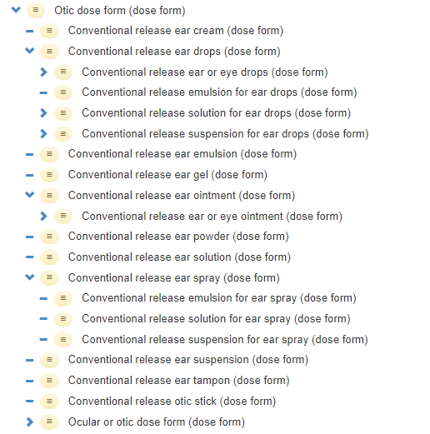
Ears…
50020200 | Ear/nasal drops, suspension
13006000 | Ear drops, powder for suspension
10713000 | Ear wash, emulsion
10712000 | Ear wash, solution
Ear wash solution: Liquid single-dose or multidose preparation consisting usually of an aqueous solution with a pH within physiological limits. Ear washes are intended to clean the external auditory meatus
Although considered an “old term”, “Wash” is about “in and out” rather than (for example, a simple solution) being left in situ to have a (local) therapeutic effect. So it has value as a concept in PDFs Add this to guidance
Add new concepts if requested (no map for now)

Slide 9
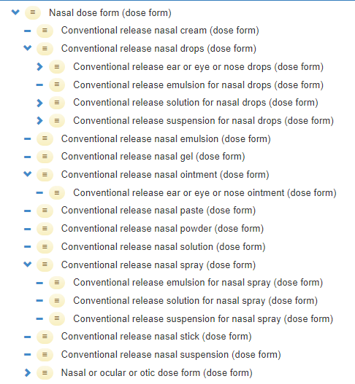
Nose…
10811000 | Nasal wash
13020000 | Nasal drops, powder for solution
50037100 | Nasal spray, powder for solution
Nasal wash: Liquid single-dose or multidose preparation consisting of usually an aqueous isotonic solution intended for cleansing the nasal cavities
NB: is a solution in characteristics
See previous slide regarding “wash” as a PDF

Slide 10
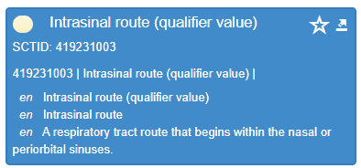
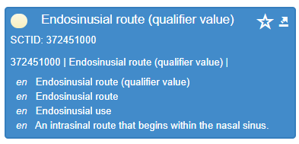
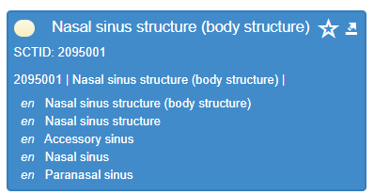
(Nasal) sinuses…
No “endosinusial” site of administration for a PDF in SNOMED CT but there are two Routes of administration….
13041000 | Endosinusial solution
13025000 | Powder for endosinusial solution
50022000 | Endosinusial wash, suspension
Endosinusial solution: Liquid preparation consisting of a solution intended to be administered to the sinuses to obtain a local effect
Endosinusial wash, suspension: Liquid preparation consisting of a suspension intended for cleaning the sinuses
Nothing in the EuPh for “endosinusial” dose forms (!)
Products??? None that we found; also nothing in Daily Med (US)
Recommendation? Put all in “no match” for now

Slide 11
Eyes…
EDQM ID | EDQM Term | S-CT ID | FSN | Comments etc. from mapper | Comments in meeting
10609000 | Eye drops, prolonged-release | 385128008 | Prolonged-release eye drops (dose form) | SNOMED CT has no basic dose form; EDQM has the problematic "drops". SNOMED CT has no transformation stated - why not? | Old term in EDQM; doesn’t follow current rules - Update
10610000 | Eye lotion | 385130005 | Conventional release eye lotion (dose form) | EDQM = Bathing; Rinsing/Washing and BDF = Solution S-CT = Apply and BDF = Lotion | S-CT to update
13010000 | Eye drops, powder for solution |  |  | sct: only 385125006 |Conventional release solution for eye drops (dose form)| | Is standard pattern; add if needed
13011000 | Eye drops, powder for suspension |  |  | sct: only 761900009 |Conventional release emulsion for eye drops (dose form)| | Is standard pattern; add if needed

Slide 12
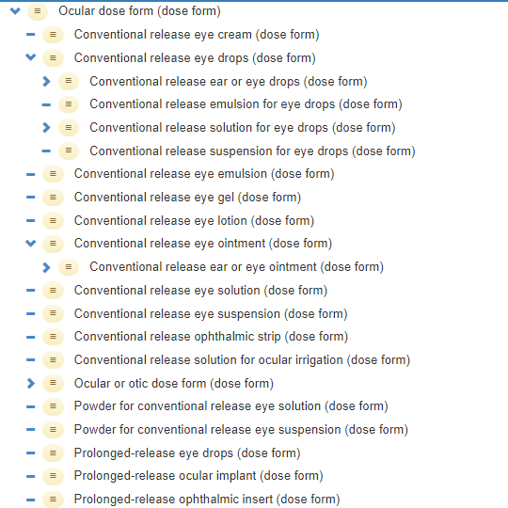
Eyes…(2)
13010000 | Eye drops, powder for solution
13011000 | Eye drops, powder for suspension
EDQM has no “powder for….eye solution/suspension” concepts, only for the drops as above
No CDs use the powder for….eye solution/suspension” PDFs
Should we add the two EDQM terms? Add when needed; no match for now

Slide 13

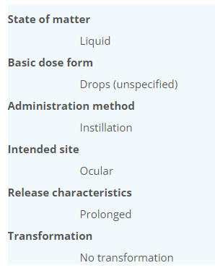
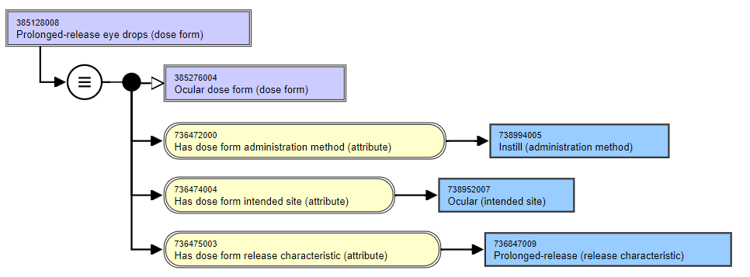
Eyes…(3)
10609000 | Eye drops, prolonged-release
766432002 | Product containing precisely fusidic acid 10 milligram/1 gram prolonged-release eye drops (clinical drug) | - and none of the products that relate to this seem to use this dose form now!
Why “no transformation”? Request change to add transformation attribute
BUT – old term; best not to use going forward. Use prolonged release solution/suspension/emulsion

Slide 14

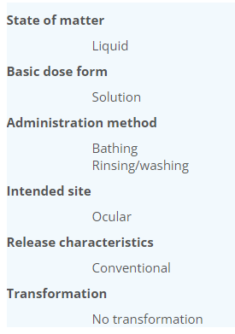
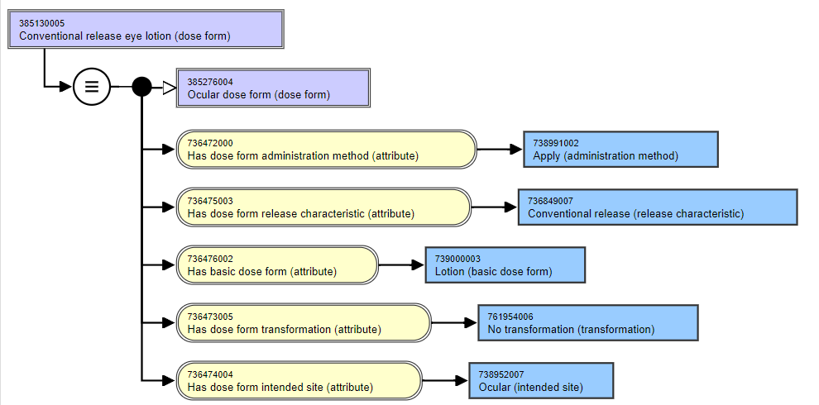
Eyes…(4)
10610000 | Eye lotion | 385130005 | Conventional release eye lotion (dose form) | EDQM = Bathing; Rinsing/Washing and BDF = Solution S-CT = Apply and BDF = Lotion
Not used in any CDs
Should be made more “matching” at the attribute level? YES

Slide 15
Inside eyes…
EDQM ID | EDQM Term | S-CT ID | FSN | Comments etc. from mapper | Comments in meeting
13029000 | Powder for intraocular instillation solution
50073000 | Powder for solution for intraocular irrigation |  |  | sct: 785899003 |Conventional release ocular solution for irrigation (dose form)|
13044000 | Intraocular instillation solution
50073500 | Solution for intraocular irrigation
Site in EDQM is “ocular” but definition states for use “into an internal part of the eye” or “one or more internal structures of the eye”
Intraocular instillation solution: Liquid sterile preparation consisting of a solution intended to be instilled as drops into an internal part of the eye.
Solution for intraocular irrigation: Liquid sterile preparation consisting of a solution intended for irrigation of one or more internal structures of the eye, for example during surgical procedures.
Site in SNOMED CT is a child of parenteral….
1 CD = 781931005 | Product containing precisely sodium hyaluronate 10 milligram/1 milliliter conventional release solution for intraocular injection (clinical drug) |

Slide 16
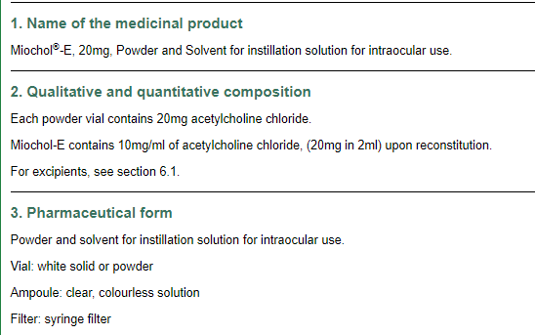
I wonder….if EDQM sees an “intraocular injection” just as any other injection…the standards (for sterility etc.) can’t be any higher…
But solutions for irrigation/instillation are of parenteral standards, but not “injected” so have separate dose forms
Intraocular irrigation…We used to use a large volume Balanced Salts Solution….and bags of saline infusion!
There is nothing explicit in the EuPh for “intraocular”
Actions: S-CT to retire the “intraocular injection” PDF and re-author the one CD (using just “solution for injection”)
For the EDQM concepts – put in “no map” with an “add if/when needed” note; add the concepts to support Miochol E

Slide 17
Some vaginal and rectal PDFs…
EDQM ID | EDQM Term | S-CT ID | FSN | Comments etc. from mapper
11009000 | Powder for rectal solution | 761899004 | Powder for conventional release rectal solution (dose form) | EDQM AD is administration whereas SNCT is apply,
11010000 | Powder for rectal suspension | 385191006 | Powder for conventional release rectal suspension (dose form) | here SNCT use Administer AM whereas for rectal solution it was apply
13015000 | Granules for rectal suspension
13111000 | Powder for vaginal solution |  |  | Conventional release vaginal powder exists but AM is different and there is no transformation , maybe too broad | Spanish products and IRE as ULM; Rosalgin
50029500 | Granules for vaginal solution |  |  | in SNCT granules are only for oral or oromucosal intended site | Old term – no map
Administration method inconsistencies….any products for the vaginal dose forms?
Yes – add the one, put no map (and no future use) for the granules term

Slide 18
Inhaling aerosol liquids…(1)
EDQM ID | EDQM Term | S-CT ID | FSN | Comments etc. from mapper
11106000 | Pressurised inhalation, solution | 420407000 | Conventional release aerosol solution for inhalation (dose form) |
 |  | 385204002 | Pressurized conventional release solution for inhalation (dose form)
11108000 | Pressurised inhalation, emulsion | 385206000 | Conventional release pressurized emulsion for inhalation (dose form) | S-CT uses pressurized emulsion, EDQM uses emulsion as basic dose form. S-CT has inconstant ordering of pressurized vs conventional release in FSN for the pressurized dose forms
11107000 | Pressurised inhalation, suspension | 385205001 | Pressurized conventional release suspension for inhalation (dose form) | edqm: BDF = suspension sct: BDF = pressurised suspension
Pressurised inhalation, solution
Liquid, usually multidose preparation consisting of a solution intended for inhalation use. The preparation is presented in a pressurised container usually fitted with a metering dose valve

Slide 19
Inhaling aerosol powders…(2)
EDQM ID | EDQM Term | S-CT ID | FSN | Comments etc. from mapper
11110000 | Inhalation powder, hard capsule | 385207009 | Conventional release powder for inhalation (dose form) | Hard capsule can be viewed as a container | Rotacaps® etc
11111000 | Inhalation powder, pre-dispensed | 385207009 | Conventional release powder for inhalation (dose form) | S-CT concept has no sense of the "pre-dispensed" | Ventodisks ® etc. – powder in a blister in a disk or a unit dose container
50030000 | Inhalation powder, tablet |  |  | EDQM definition is Solid multidose preparation intended for inhalation use. The dose of inhalation powder is generated from the tablet by a metering mechanism within the inhaler, for example by scraping off a small amount of powder from the tablet.

Slide 20
Inhalations…already mapped:
EDQM ID | EDQM Term | S-CT ID | FSN | Comments
11109000 | Inhalation powder | 385207009 | Conventional release powder for inhalation (dose form) | To be used for metered dose dry powder inhalers
50081000 | Inhalation solution | 420641004 | Conventional release solution for inhalation (dose form) | To be used with non-pressurised metered dose inhalers (Respimat® and the like)

Slide 21
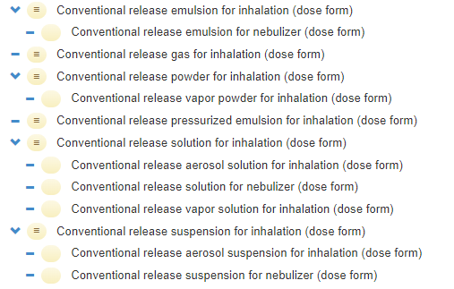
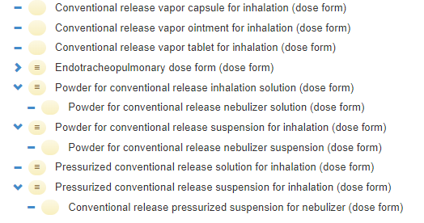
Inhalations…in SNOMED CT:
All the nebuliser PDFs have mapped (although the S-CT concepts are primitive)

Slide 22
Not in EDQM. Would be like a Respimat® if used (a non-pressurised “softhaler”)
Pulmonary PDF
421056002| Conv rel emulsion for inhalation
385202003 | Conv rel emulsion for nebulizer
385206000 | Conv rel pressurized emulsion for inhalation
Note FSN word order
Standard pressurised aerosol inhaler – liquid inside is an emulsion

Slide 23
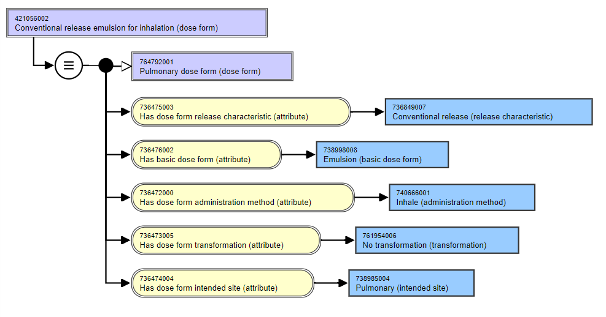
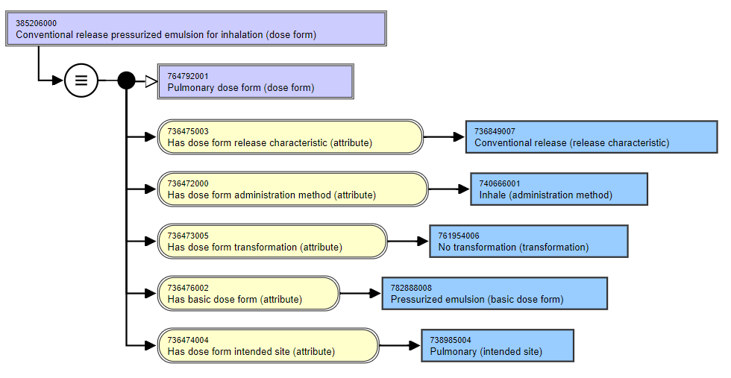
Basic dose form difference:
“Pressurized emulsion” versus “Emulsion” – sibling concepts

Slide 24
Which of 385199008
and 385205001 is the “Standard pressurised aerosol inhaler – liquid inside is a suspension”?
Not in EDQM. Would be like a Respimat® if used (a non-pressurised “softhaler”)
Pulmonary PDF
421221008 | Conv rel suspension for inhalation
385199008 | Conv rel suspension for nebulizer
385205001 | Pressurized conv rel suspension for inhalation
420705007 | Conv rel aerosol suspension for inhalation
420450005 | Conv rel pressurized suspension for nebulizer
Request retirement of 420450005 | Conv rel pressurized suspension for nebulizer as it is “incorrect” – the solution itself cannot be pressurized
AND retirement of aerosol concept as ambiguous (it is incorrectly used a a synonym for pressurized (by FDA), but not consistently and it is acknowledged that US products must be mapped separately
AND alignment of the FSN word order
Note FSN word order
Does this exist? No CDs use it

Slide 25
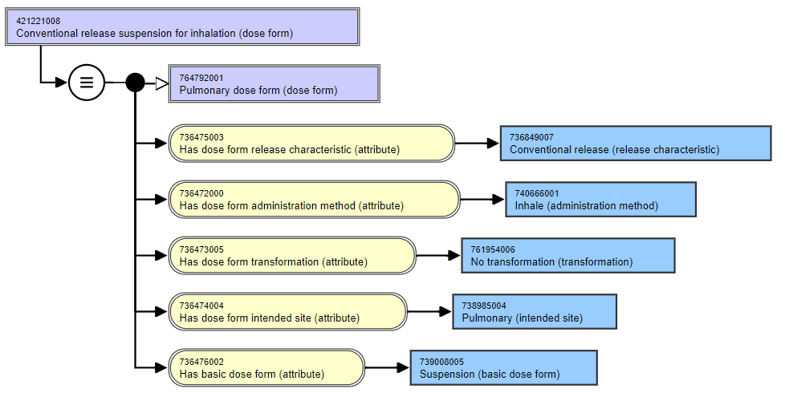
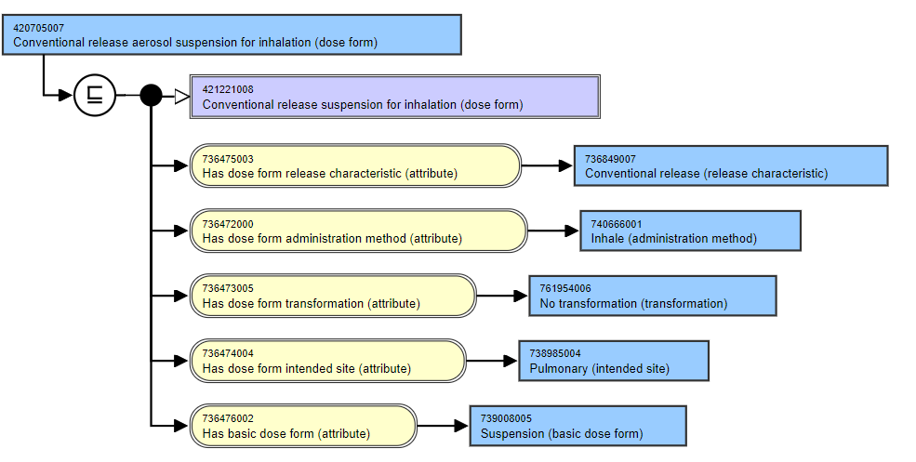
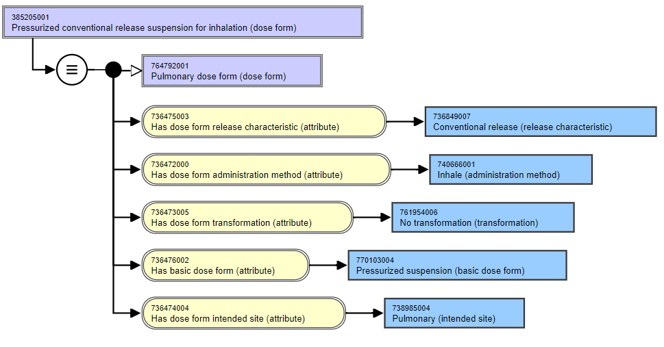
No difference in logical definition therefore child concept is primitive
Basic dose form difference:
“Pressurized suspension” versus “Suspension” – sibling concepts

Slide 26
Which of 420407000
and 385204002 is the “Standard pressurised aerosol inhaler – liquid inside is a solution”?
Is in EDQM. Is the Respimat® type products (a non-pressurised “softhaler”) Is already mapped
Pulmonary PDF
20641004| Conv rel solution for inhalation
385198000 | Conv rel solution for nebulizer
385204002 | Pressurized conv rel solution for inhalation
420407000 | Conv rel aerosol solution for inhalation
385213000 | Conv rel vapor solution for inhalation
Same characteristics pattern as for the suspension
Request retirement of aerosol concept as ambiguous (it is incorrectly used a a synonym for pressurized (by FDA), but not consistently and it is acknowledged that US products must be mapped separately
AND alignment of the FSN word order
Note FSN word order

Slide 27
Other pulmonary powders are “powder for…” e.g. Powder for conv rel nebulizer solution
Is already mapped to “Inhalation powder” – the metered dose dry powder inhalers
Pulmonary PDF
385207009| Conv rel powder for inhalation
385211003 | Conv vapor powder for inhalation
For next time
How to map “Inhalation powder, hard capsule” and “Inhalation powder, pre-dispensed”?

Slide 28
Inhaling vapours…
EDQM ID | EDQM Term | S-CT ID | FSN | Comments etc. from mapper
11113000 | Inhalation vapour, capsule | 385212005 | Conventional release vapor capsule for inhalation (dose form) | S-CT says no transformation. EDQM says Dissolution or Mixing or No transformation.Solid preparation consisting of a capsule formulation intended for generation of vapour to be inhaled to obtain a local effect. The vapour is usually generated by adding the whole capsule or the capsule contents to hot water. No transformation is an option - eg open capsule onto a tissue, but it seems that dissolution or mixing are also correct options.
11115000 | Inhalation vapour, tablet | 385214006 | Conventional release vapor tablet for inhalation (dose form) | S-CT says no transformation, EDQM says Dissolution. Solid preparation consisting of a tablet intended for generation of vapour to be inhaled to obtain a local effect. The vapour is usually generated by adding the tablet to hot water. You cannot inhale a tablet, so it must be dissolved? No transformation seems wrong.

Slide 29
Inhaling vapours…(2)
EDQM ID | EDQM Term | S-CT ID | FSN | Comments etc. from mapper
11117000 | Inhalation vapour, liquid | 385213000 | Conventional release vapor solution for inhalation (dose form) | edqm: BDF = liquide / sct: BDF = solution
50032000 | Inhalation vapour, emulsion |  |  | exist: 385213000 |Conventional release vapor solution for inhalation (dose form)| create: xxxxx |Conventional release vapor emulsion for inhalation (dose form)| with BDF = 738998008 |Emulsion (basic dose form)|
11116000 | Inhalation vapour, ointment | 385215007 | Conventional release vapor ointment for inhalation (dose form) | EDQM has mixing and no transformation. SCT has no transformation. Definition status is P
11114000 | Inhalation vapour, solution | 385213000 | Conventional release vapor solution for inhalation (dose form) | EDQM specifies local effect and has transformation mixing and no transformation. SCT has no transformation. Status P
11112000 | Inhalation vapour, powder | 385211003 | Conventional release vapor powder for inhalation (dose form) | EDQM has additionnal transformation: dissolution, mixing.

Slide 30
Specialist dose forms (solutions mostly)
EDQM ID | EDQM Term | Notes from mappers
11209500 | Solution for cardioplegia | S-CT has Cardioplegia solution (product) SCTID 353410005 with a parent Medicinal product categorized by therapeutic role (product) SCTID: 763087004. EDQM have this as a dose form with a definition Liquid sterile preparation consisting of an aqueous solution intended for use in inducing cardiac arrest during heart surgery. Don't think this needs a dose form in S-CT
11401000 | Solution for peritoneal dialysis | 8 “products” (not MPs – no attributes – no active ingredient substance)
11402000 | Solution for haemofiltration | no notion of the use "haemofiltration" BDF in SNCT 5 “products” (not MPs – no attributes – no active ingredient substance)
11403000 | Solution for haemodiafiltration | no notion of the use "haemodiafiltration" BDF in SNCT No “products” for haemodiafiltration
11404000 | Solution for haemodialysis | no notion of the use "haemodialysis" BDF in SNCT 8 “products” (not MPs – no attributes – no active ingredient substance) Note: some concepts are “xxx free” (e.g.lactate free)
13107000 | Solution for cardioplegia/organ preservation | no BDF in SNCT Organ preservation solution is a physical object in SNOMED CT
50057000 | Solution for haemodialysis/haemofiltration | no notion of the use "haemodialysis/haemofiltration" BDF in SNCT
10518500 | Powder for solution for iontophoresis | Is a solution for iontophoresis dose form

Slide 31

Next meeting on
Thursday 5th May
at 09:00 UTC
NEXT STEPS
31

Slide 32


THANK YOU
SNOMED International: Delivering SNOMED CT

