Slide 1


SNOMED CT DEUSG Subgroup
EDQM Dose Form Mapping
Linda Bird, SNOMED International
Julie James, Blue Wave Informatics
Thursday 24th March 2022

Slide 2

Welcome
Progress update
Issues discussion
Next meeting
AGENDA
http://snomed.org/deusg

Slide 3
Olivier has retired…..welcome Emilie
We have sent our best wishes to Olivier for his retirement

Slide 4

Progress update

Slide 5
Our documentation
Mapping Guidance:
https://confluence.ihtsdotools.org/display/USRG/Mapping+Guidance+for+EDQM+to+SNOMED+CT+Pharmaceutical+Dose+Form+Mapping
“EDQM discussion items” List
https://confluence.ihtsdotools.org/display/USRG/Issues+for+discussion+with+EDQM
“SNOMED CT discussion items” List
https://confluence.ihtsdotools.org/display/USRG/Issues+for+discussion+with+SNOMED+CT
IMPLEMENTATION guidance https://confluence.ihtsdotools.org/display/USRG/Guidance+for+Implementation+of+the+EDQM+PDF+to+SNOMED+CT+PDF+mapping

Slide 6
Mapping Spreadsheet update
The number of “tabs” is still expanding as we organise various subject areas
François has submitted lots of CRS requests – thank you François ☺
The Content Team have a spreadsheet managing CRS requests that Julie is putting references into, to avoid duplicate work
We are without Chris J from EDQM for the next couple of meetings; he is travelling

Slide 7
Our numbers
Date | WIP | RC1 | No Match | In “holding” | New requests | Change requests
15:12:2021 | 255 | 115 |  | 6 | 5
10:01:2022 | 255 | 130 |  | 21 | 5 | 1
27:01:2022 | 242 | 123 | 3 | 22 | 10 | 3
10:02:2022 | 214 | 138 | 3 | 37 | 14 | 4
24:02:2022 | 190 | 138 | 10 | 54 | 16 | 7
10:03:2022 | 163 | 138 | 10 | 65 | 20 | 17
24:03.2022 | 157 | 142 | 14 | 68 | 28 | 22
07:04:2022 | 147 | 146 | 27 | 61 | 39 | 32

Slide 8
In “holding”:
Capsules = 6
Multiple sites/methods = 10
Intravesical/Urethral = 7
Infusion/Injection = 3
Misc = 5
Dispersions = 12
Implants, Inserts etc. 17
Concentrates = 6

Slide 9
Issues for discussion

Slide 10
Swabs, pads, plugs and strips
EDQM ID | EDQM Term | EDQM definition | Products
13145000 | Impregnated cutaneous swab | Solid preparation consisting of a piece of absorbent material impregnated usually with a liquid preparation, intended to be applied to the skin for a limited period of time with one or more wiping motions, and which may be attached to an application device such as a stick. Impregnated pad is excluded | FR: No longer marketed: DOLAL http://agence-prd.ansm.sante.fr/php/ecodex/rcp/R0201324.htm NZ: Betadine Swab Aid 10% (100 mg/mL) wipe: medicated, 100 wipes, strip pack Betadine Swab Aid 10% wipe: medicated, 10 wipes, sachet Betadine Swab Aid 10% wipe: medicated, 9 wipes, sachet Betadine Swab Stick 10% (100 mg/mL) wipe: medicated, 3 wipes, sachet Betadine Swab Sticks 10% (100 mg/mL) wipe: medicated, 12 wipes, strip pack Betadine Swab Sticks 10% (100 mg/mL) wipe: medicated, 200 wipes, strip pack Povidone-Iodine (Dynarex) Swabstick 10% (100 mg/mL) solution, 50 applicators, carton SoluPrep swab, 30 x 5.2 mL swabs, sachet SoluPrep swab, 50 x 1.6 mL swabs, sachet
12117000 | Impregnated pad | Solid preparation consisting of a piece of absorbent material impregnated with a liquid preparation. Impregnated cutaneous swab is excluded | NZ: Betadine Gauze 10% (22.5 cm x 7.5 cm) dressing: medicated, 12 x 3 pads, pack Betadine Gauze 10% (22.5 cm x 7.5 cm) dressing: medicated, 3 pads, carton Oxy Duo Pads (salicylic acid 0.5% (5 mg/g) + triclosan 0.2% (2 mg/g)) solution, 36 item Povidone Iodine Pharmacia (povidone-iodine 10% (100 mg/g)) pad, 100 item

Slide 11
Swabs, pads, plugs and strips
EDQM ID | EDQM Term | EDQM definition | Products
50033000 | Inhalation vapour, impregnated pad | Solid preparation consisting of a piece of absorbent material impregnated usually with a liquid or semi-solid preparation, intended for generation of vapour to be inhaled to obtain a local effect. Comment: After reconsideration of this term, and for reasons of consistency with other related terms, this term replaces 'Inhalation impregnated pad'. | FR: VICKS INHALER tampon imprég p inhal p fumig FR: NICORETTE INHALEUR 10 mg, cart 1 doses (UCD: 3400892184333) http://agence-prd.ansm.sante.fr/php/ecodex/frames.php?specid=60772526&typedoc=R&ref=R0353836.htm NICORETTE INHALEUR 10 mg, cart 1 doses + étui (UCD: 3400892184562)
12117500 | Impregnated plug | Solid preparation consisting of a piece of material (e.g. polyethylene), usually porous, in which a liquid, semi-solid or solid preparation is impregnated. Implants, pads, sponges and tampons are excluded.
50033100 | Inhalation vapour, impregnated plug | Solid preparation consisting of an impregnated plug that generates a vapour to be inhaled, for example by the patient inhaling through a device containing the plug, thereby drawing air through or over it and vaporising the active ingredient(s) impregnated therein | NZ: Vicks Inhaler inhalation, 0.5 mL, tube http://agence-prd.ansm.sante.fr/php/ecodex/frames.php?specid=65846076&typedoc=R&ref=R0373993.htm
10613000 | Ophthalmic strip | Solid sterile single-dose preparation consisting of a strip made of a suitable material usually impregnated with active substance(s) intended for use on the eyeball | NZ: Fluorescein Sodium (OptiTech) 1 mg strip: diagnostic, 100 strips, wrapping Fluorets ophthalmic 1 mg strip: diagnostic, 100 strips, tube IRE and NOR: Unlicenced fluorescein strips e.g. https://avssuk.co.uk/fluorescein-sodium-opthalmic-strips-bio-fluoro.html

Slide 12
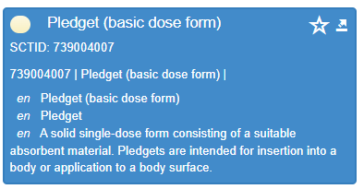
Swabs, pads, and strips are needed as dose forms – but not the plain plug
The difference between a plug and a pad seems to be that
a pad is made from absorbent material (soaks a liquid into itself) whereas
a plug is porous (liquid can pass into it and out of it – implies tiny holes)
The difference between a swab and a pad seems to be
???
There is no admin method or intended site for “Impregnated Pad” in EDQM….
SNOMED CT currently has no BDF for “impregnated material”. But it does have “pledget”
ECL queries = no CDs use a PDF with BDF pledget…because no PDF have a BDF of pledget (!)
Retire and request re-author as meaning not exactly the same

Slide 13
Suggestions for PDFs:
FSN | Basic DF | Intended Site | Admin Method | Release Characteristic | Transform
[Absorbent] Material impregnated for conventional release cutaneous application Syn: Impregnated cutaneous swab/pad | Impregnated material | Cutaneous | Application | Conventional | No transform
Impregnated pad | Impregnated material | ? | ? | Conventional | No transform
Absorbent material impregnated for conventional release vapour inhalation Syn: Inhalation vapour, impregnated pad | Impregnated material | Pulmonary | Inhalation | Conventional | No transform
Porous material impregnated for conventional release vapour inhalation Syn: Inhalation vapour, impregnated plug | Impregnated material | Pulmonary | Inhalation | Conventional | No transform
Material impregnated for conventional release ophthalmic application Syn: Ophthalmic strip | Impregnated material | Ocular | Application | Conventional | No transform
Do we try to differentiate between porous and absorbent material in the basic dose form order to get full definition? Little clinical value in having these fully defined; as leaf concepts, the “concern” of primitive concepts is reduced

Slide 14
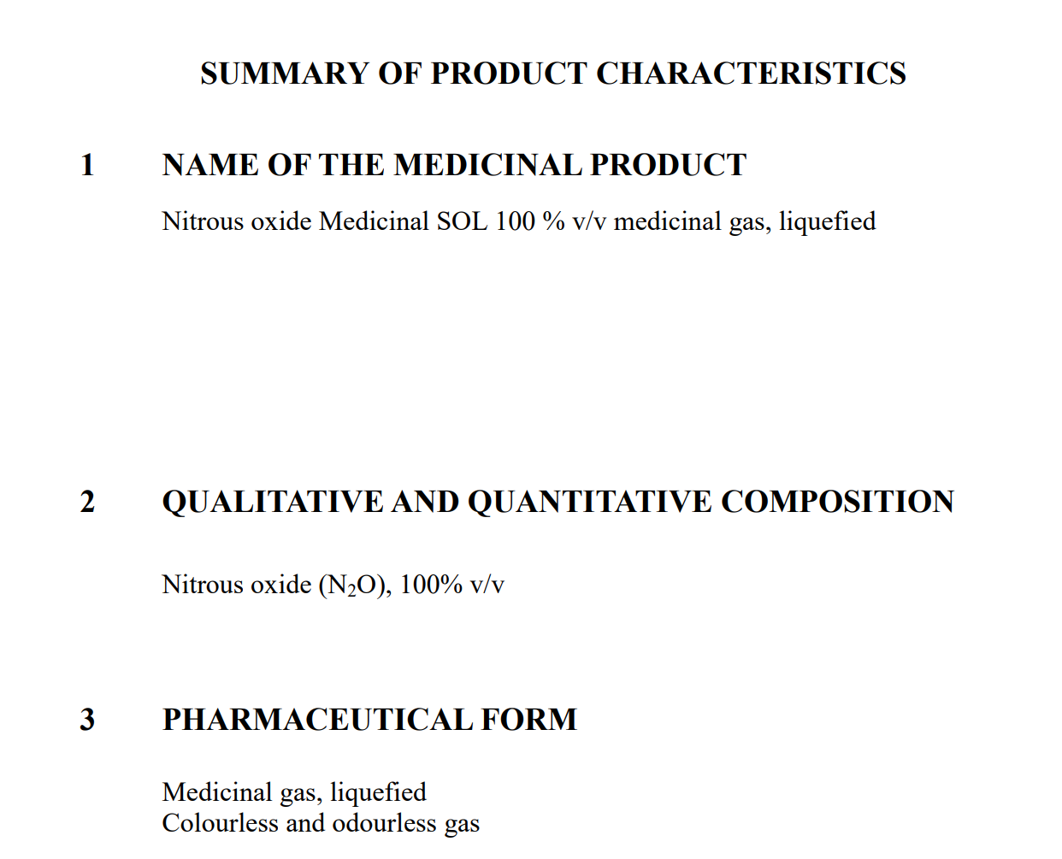
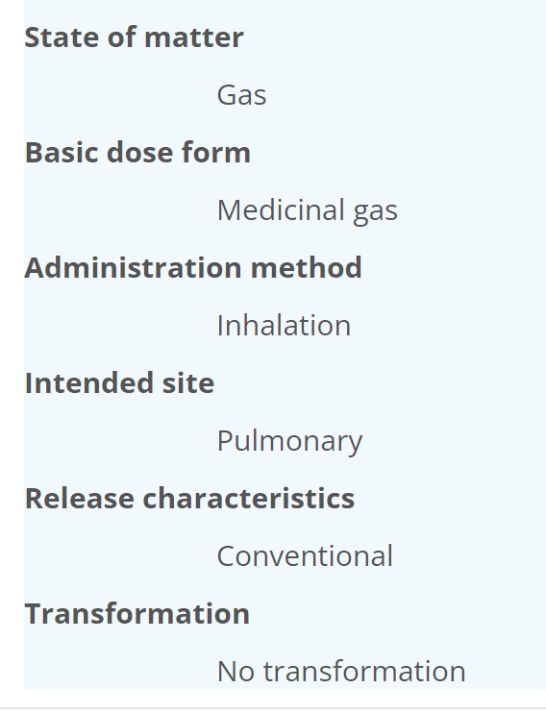
Gas dose forms (1)
EDQM ID | EDQM Term | EDQM Definition | Products
12301000 | Medicinal gas, compressed | A gas packaged under pressure which is entirely gaseous at - 50 °C | Irish products French products
12302000 | Medicinal gas, cryogenic | A gas which liquifies at 1.013 bar at a temperature below -150 °C. | Liquid nitrogen for cryotherapy
12303000 | Medicinal gas, liquefied | A gas packaged under pressure, which is partially liquid (gas over liquid) at -50 °C.
For all three concepts

Slide 15
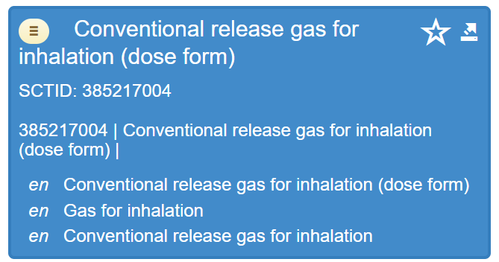
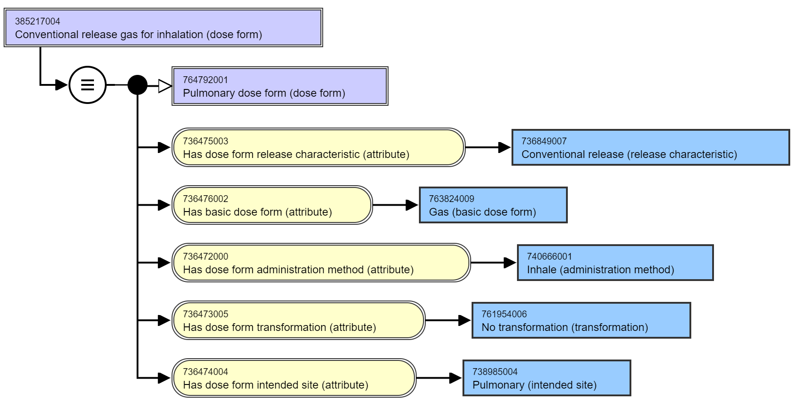
Gas dose forms (2)

Slide 16
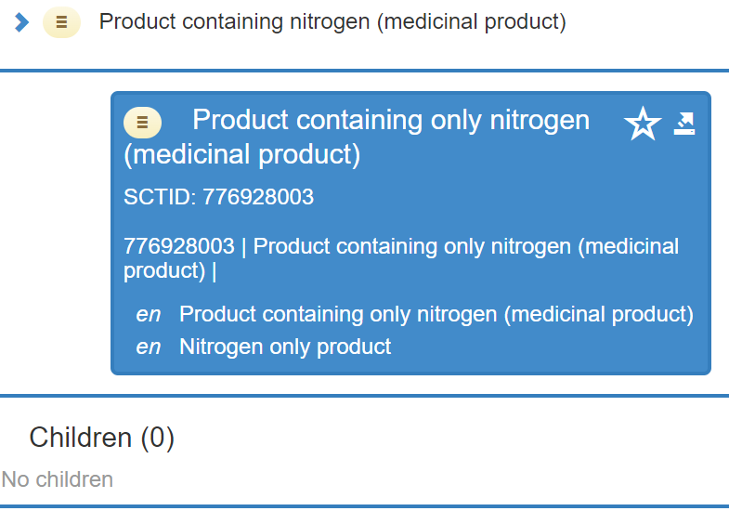
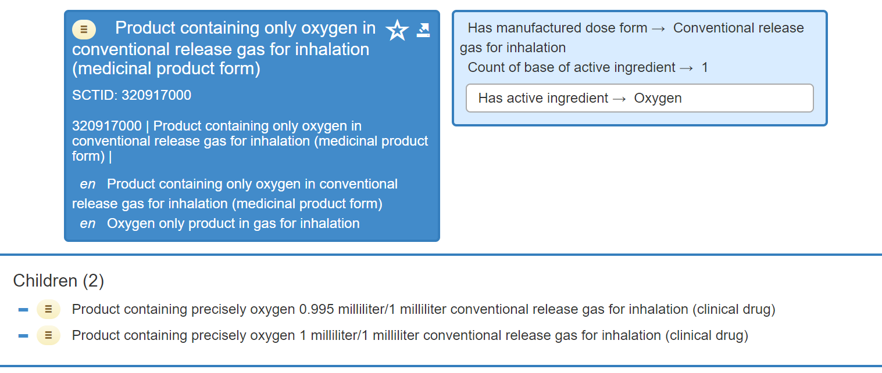
Gas dose forms (3)
? Why is the MPF not a “pulmonary dose form” ?

Slide 17
Gas dose form summary
EDQM ID | EDQM Term | SNOMED CT ID | SNOMED CT FSN
12301000 | Medicinal gas, compressed |  | Conventional release gas for inhalation (dose form)
12302000 | Medicinal gas, cryogenic | No map for dose form for now
12303000 | Medicinal gas, liquefied | 385217004 | Conventional release gas for inhalation (dose form)
Will request two child BDFs using the EDQM text definitions then compressed and liquified PDF concepts can be fully defined

Slide 18
Periodontal dose forms
We have already requested a periodontal intended site for the periodontal insert dose form
10401000 Periodontal powder
  Products: with minocycline, glycine – for treatment of periodontitis
  So: can request a Conventional release periodontal powder
10410000 Periodontal gel
  Products: with hydrogen peroxide, chlorhexidine - for treatment of periodontitis
  So: can request a Conventional release periodontal gel
✓

Slide 19
Some remaining dental dose forms
10413000 Powder for dental cement
  Products: with zinc phosphate, fluoride
  So: can request a Powder for conventional release dental cement
  We already have a Conventional release dental cement
13022000 Powder for dental gel
  Products? None found
✓

Slide 20
Modified-release granules for oral suspension
50036000 Modified-release granules for oral suspension
Currently no map
Could be new PDF (noting that S-CT would not author CDs)
Most products now use the more explicit PR or GR
Can only be used for RCDs
Is there a requirement for this as a grouping concept? Because there are the defining attributes, this could be queried using an ECL
On the “no map” list for now, with a “SHOULD be added to SNOMED CT if it is required to support authoring of RCD concepts only” note

Slide 21
Specialist dose forms (solutions mostly)
EDQM ID | EDQM Term | Notes from mappers
11209500 | Solution for cardioplegia | S-CT has Cardioplegia solution (product) SCTID 353410005 with a parent Medicinal product categorized by therapeutic role (product) SCTID: 763087004. EDQM have this as a dose form with a definition Liquid sterile preparation consisting of an aqueous solution intended for use in inducing cardiac arrest during heart surgery. Don't think this needs a dose form in S-CT
11401000 | Solution for peritoneal dialysis | 8 “products” (not MPs – no attributes – no active ingredient substance)
11402000 | Solution for haemofiltration | no notion of the use "haemofiltration" BDF in SNCT 5 “products” (not MPs – no attributes – no active ingredient substance)
11403000 | Solution for haemodiafiltration | no notion of the use "haemodiafiltration" BDF in SNCT No “products” for haemodiafiltration
11404000 | Solution for haemodialysis | no notion of the use "haemodialysis" BDF in SNCT 8 “products” (not MPs – no attributes – no active ingredient substance) Note: some concepts are “xxx free” (e.g.lactate free)
13107000 | Solution for cardioplegia/organ preservation | no BDF in SNCT Organ preservation solution is a physical object in SNOMED CT
50057000 | Solution for haemodialysis/haemofiltration | no notion of the use "haemodialysis/haemofiltration" BDF in SNCT
10518500 | Powder for solution for iontophoresis | Is a solution for iontophoresis dose form
13041000 | Endosinusial solution | stc: no nasal ISI refinement
Next time

Slide 22

Next meeting on
Thursday 21st April
at 09:00 UTC
NEXT STEPS
22

Slide 23


THANK YOU
SNOMED International: Delivering SNOMED CT

