Slide 1
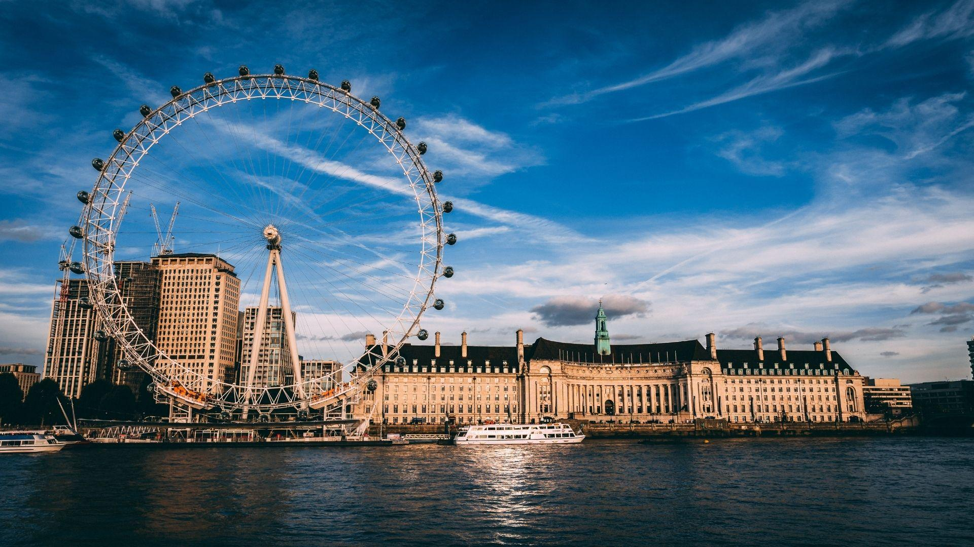



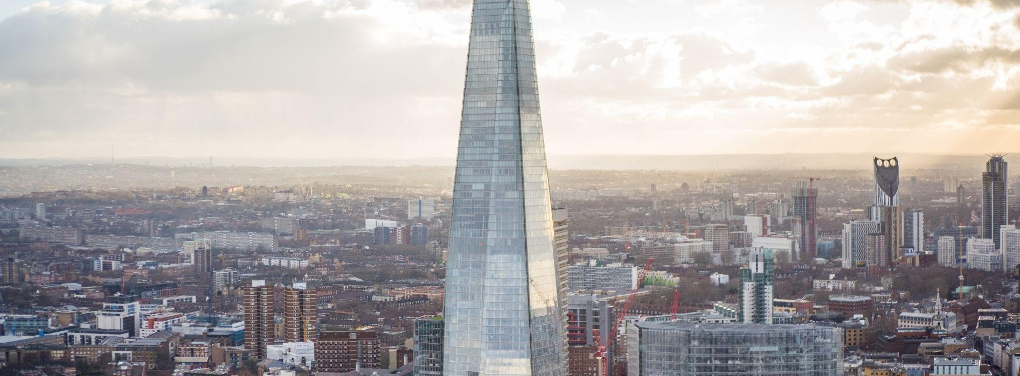


London, UK
Dentistry CRG Meeting
4th April 2022
snomedexpo.org | linkedin.com/company/ihtsdo | twitter.com/snomedct | youtube.com/c/ihtsdoorg

Slide 2
Agenda
Attendance and regrets
Updates from SNOMED International
Update on Periodontal Classification concepts
Review/Identify concepts for improvement
Update on forensic concept development
Update on Orthodontic concept development
Discuss possible changes to GD ref set
Request from Allergy CRG
Periodontal outcomes support request
Future work item discussion
Notes:
SLAs

Slide 3
Editor’s Update
New member - Thailand (42nd)
Now moved to monthly SNOMED International Edition releases (5 April 2022 will be reviewed for the July 2022 International release).
Request for support from UCL Eastman Dental Institute for a review paper (Periodontology 2000) that wanted to align research outcomes with SNOMED CT - probing pocket depth, gingival recession, clinical attachment level, gingival bleeding, BOP, dental plaque
Periodontal classification - addition 3 concepts (total: 52)
Work ongoing for ~100 forensic concept additions
Update on <<712471003 |Restorative dental procedure on tooth (procedure)| (141 concepts)
Notes:
SLAs

Slide 4
Anatomy
Editorial guide:
“Even though teeth are supported by the maxillary or mandibular bone, they are not part of the 70925003 |Bone structure of maxilla (body structure)| or 91609006 |Bone structure of mandible (body structure)|. Teeth are part of the 4335006 |Upper jaw region structure (body structure)| and 48077000 |Lower jaw region structure (body structure)|.”
Example of Lower jaw region structure:
661005 |Jaw region structure (body structure)|
48077000 |Lower jaw region structure (body structure)|
91609006 |Bone structure of mandible (body structure)|
420730005 |Structure of mandibular tooth (body structure)|
Notes:
Qs last time around where tooth structure sat in the anatomy hierarchy in relation to alveolar process.

Slide 5
Anatomy - Where does ‘tooth structure’ sit in relation to dental arch?
Definition - dental arch: the composite structure of the natural teeth and alveolar bone (The Journal of Prosthetic Dentistry)
Option:
4442007 |Dental arch structure (body structure)|
38199008 |Tooth structure (body structure)|
But this would make…
23997001 |Anomaly of dental arch (disorder)|
80967001 |Dental caries (disorder)|
32620007 |Pulpitis (disorder)|
1716305005 |Demineralization of tooth (disorder)|
etc
In other words: many tooth disorders would become a type of anomaly of the composite structure of the natural teeth and alveolar bone.
Notes:
Currently tooth structure is not a subtype of dental arch.
Moving tooth structure to be a subtype of dental arch structure would bring in quite a few errors: a tooth disorder shouldn’t be a type of disorder of teeth AND a tooth disorder is NOT a disorder of the composite structure of the natural teeth and alveolar bone.

Slide 6
Anatomy - definitions
Alveolar process - “the cancellous and compact bony structure that surrounds and supports the teeth” (The Journal of Prosthetic Dentistry, Glossary Ninth Edition)
Alveolar arch - “the arch of the upper or lower jaw formed by the alveolar processes” (Mariam-Webster Dictionary)
Alveolar ridge - “the U-shaped bony crests of the upper and lower jaw in which the teeth are situated.” (2009, American Journal of Medical Genetics)
415636008 |Structure of alveolar process of maxilla (body structure)|
52982007 |Structure of alveolar arch of maxilla (body structure)|
288541004 |Upper alveolar ridge structure (body structure)|
Q - Is the alveolar process the same as the alveolar ridge?

Slide 7
Periodontal Classification System Update
Clarified a small number of concepts with advisory group
Discussed other concepts needed to categorize implant related periodontal conditions/diseases
  Less than 10 additional concepts identified. Currently submitting.
Small number needed for specific, less common conditions or variations of conditions
  Again a small number. Working on submissions.
One additional request for a stage and grade
Currently, these are the last known requests
Refer to Appendix A
Notes:
Qs last time around where tooth structure sat in the anatomy hierarchy in relation to alveolar process.

Slide 8
Dental Concept Review
Over the past few years, we have had requests for multiple reviews, including substances, procedures, some anatomy issues etc.
Some to many of our concepts are primitive, which creates certain problems
Belgium is also considering review of procedures for their future use
Benoit, working with our editor Sarah has proposed a template to review and evaluate dental concepts that may need alteration
Sarah to address specific issue Appendix E.
Review of approach to identify concepts - Appendix B

Slide 9
Procedure - 712471003 |Restorative dental procedure on tooth (procedure)|
Recap of issues
712471003 |Restorative dental procedure on tooth (procedure)| causing inheritance issues due to METHOD - Restore - action (qualifier value) e.g. 234741008 |Veneer preparation of tooth (procedure)|
Many concepts do not state the action being performed e.g. 15903008 |Crown, resin with noble metal (procedure)|
Many concepts contain references to materials - Q: do we need to replace all of these e.g. 19662007 |Restoration, crown, full cast, predominantly base metal (procedure)|?

Slide 10
Procedure - 712471003 |Restorative dental procedure on tooth (procedure)|
Possible solutions
Inactivate 712471003 |Restorative dental procedure on tooth (procedure)| and use 173307000 |Restoration of tooth (procedure)| instead.
Where concepts are unclear e.g. 42937000 |Restoration, crown, single (procedure)| these will be replaced e.g. ‘Restoration of tooth using dental crown’.
Review of all synonyms.
Replace all types of material? E.g. 44764005 |Crown, porcelain fused to noble metal (procedure)| replaced by Restoration of tooth using porcelain fused to noble metal dental crown (procedure) OR replace by general concept Restoration of tooth using dental crown (procedure)
Notes:
Restoration concepts containing material originated in 2002 and do not appear to have come from Read codes.

Slide 11
Restoration of tooth planned
Restoration of tooth
Restoration type
Restoration of tooth indirect
Restoration of tooth direct
Restoration material
Tooth preparation
Anaesthesia
Tooth preparation
Insertion of intermediate
material
Tooth reproduction
(Impression/scanning)
Anaesthetic
agent
Insertion of restoration
Fabrication of
restoration
Impression
material
Insertion of intermediate
material
Insertion of reconstructive
material
Insertion of
restoration
Luting material
Restoration of tooth in place
Restoration
Pharmaceutical/biologic product
Physical object
Situation with explicit context
Procedure
Observable entity
Substance

Slide 12
Updates on Forensic concepts
We have completed two iterations
Ready to start submissions
Approximately 100, so it will take some time
Refer to Appendix C
Notes:
Restoration concepts containing material originated in 2002 and do not appear to have come from Read codes.

Slide 13
Orthodontic Concepts
Substantial additional content
Related to different views
Refer to Appendix G

Slide 14
Orthodontic Concepts 2
Listing of radiographic concepts
Needs initial review
Develop common model
Dental radiographic concepts - Is there a way to “match’ via NLP or similar?
Refer to Appendix D

Slide 15
General Dentistry Ref Set
Joel White has volunteered to manage
Need representatives / Modeling design
Great Britain has ideas
Malaysia also has asked
Others?

Slide 16
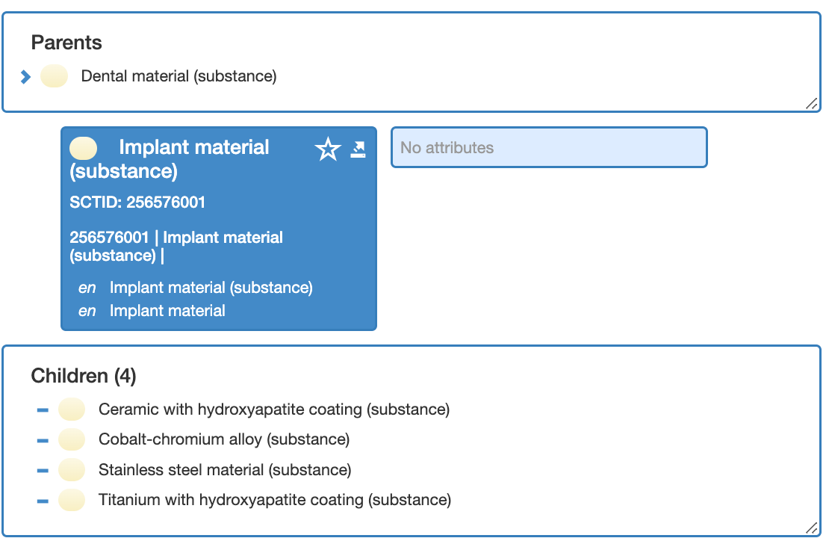
Requests to Dentistry CRG
Allergy re: #256576001 - can we alter and update appropriately
Periodontal outcomes concepts
Refer to Appendix F

Slide 17
Future work items/work plans
Breakout of procedure “steps”
Substances
Anatomical issues
Possible Periodontal ref set
Changes to odontogram ref set?
Others?

Slide 18
Next Meetings
June 1, 13:30 UTC
August 3, 1330 UTC
Lisbon, late September

Slide 19
Quality Data, Informed Healthcare
Call for Abstracts
Submit your abstract online at snomedexpo.org before April 17, 2022
linkedin.com/company/ihtsdo | twitter.com/snomedct | youtube.com/c/ihtsdoorg

Slide 20
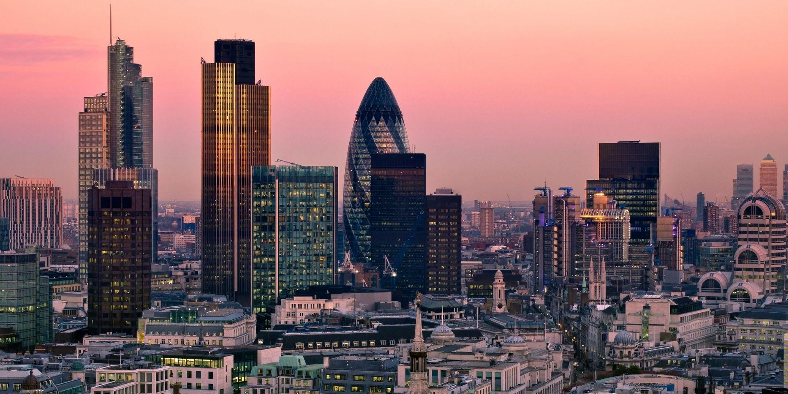

Thank You

