Slide 1
Observables: Assessment Scales
James R. Campbell
University of Nebraska Medical Center
Omaha, NE, USA

Slide 2
Epworth Sleepiness Scale
Johns MW. A new method for measuring daytime sleepiness:
The Epworth Sleepiness Scale. Sleep; 1991; Dec 14(6): 540-5.
The development and use of a new scale, the Epworth sleepiness scale (ESS),
is described. This is a simple, self-administered questionnaire which is shown
to provide a measurement of the subject's general level of daytime sleepiness.
One hundred and eighty adults answered the ESS, including 30 normal men
and women as controls and 150 patients with a range of sleep disorders.
They rated the chances that they would doze off or fall asleep when in eight
different situations commonly encountered in daily life. Total ESS scores
significantly distinguished normal subjects from patients in various diagnostic
groups including obstructive sleep apnea syndrome, narcolepsy and idiopathic
hypersomnia. ESS scores were significantly correlated with sleep latency
measured during the multiple sleep latency test and during overnight
polysomnography. In patients with obstructive sleep apnea syndrome
ESS scores were significantly correlated with the respiratory disturbance
index and the minimum SaO2 recorded overnight. ESS scores of patients
who simply snored did not differ from controls.

Slide 3
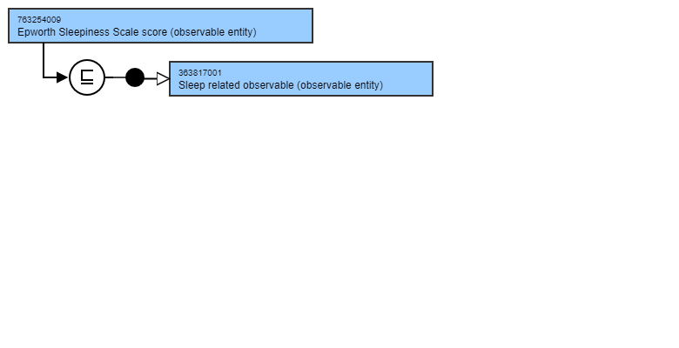
763254009|Epworth Sleepiness Scale score (observable entity)
Assesses RISK of the patient bearing the assessment of a sleep disorder
A DISPOSITION class of Observable Entity.

Slide 4
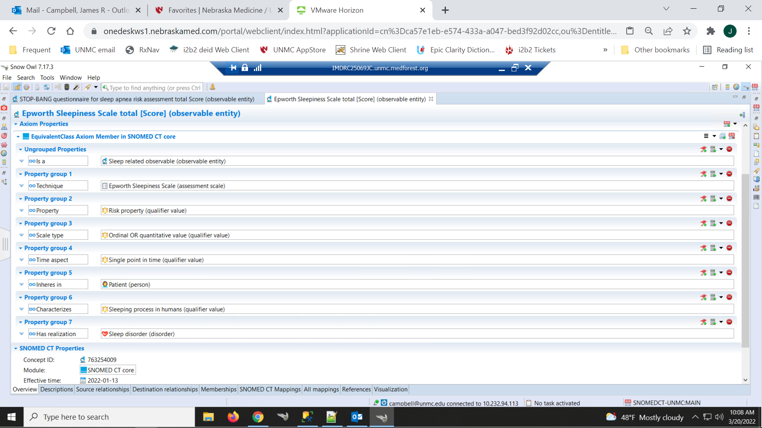
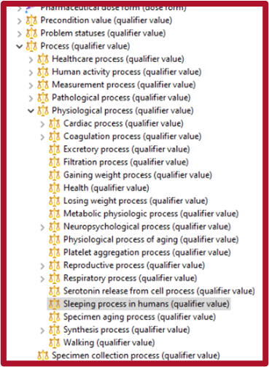
763254009|Epworth Sleepiness Scale score (observable entity)

Slide 5
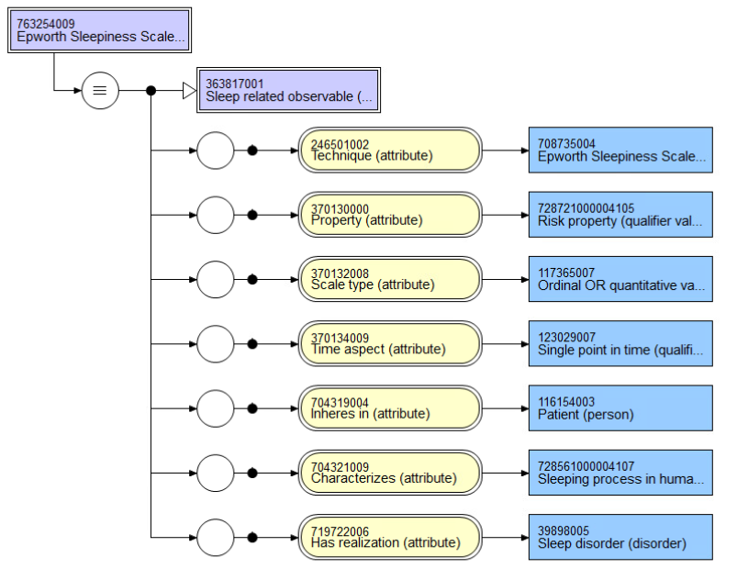
763254009|Epworth Sleepiness Scale score (observable entity)

Slide 6
STOP-BANG Questionnaire for screening of OSA
Validated in abbreviated form as STOP questionnaire by Canadian anesthesiologist
  Snoring
  Tired
  Observed apneas
  hyPertension
Extended for more detailed picture of OSA risk in preoperative setting

Slide 7
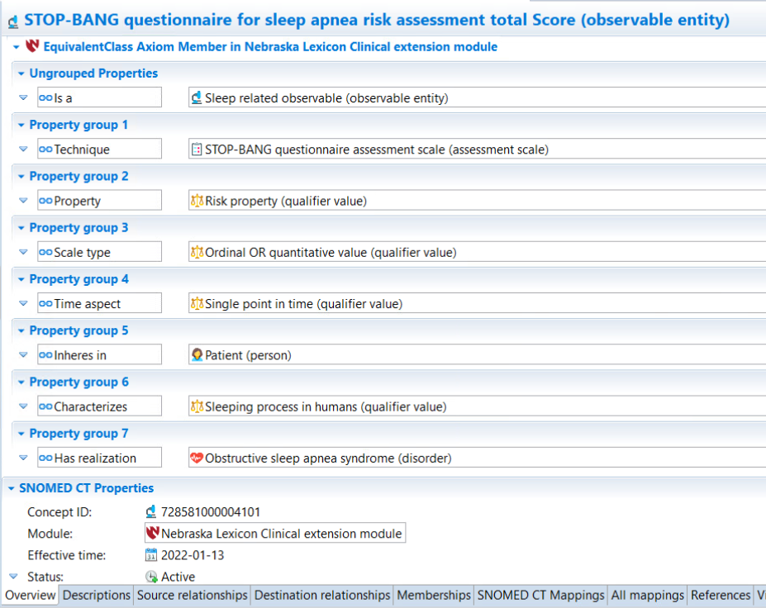
728581000004101|STOP-BANG questionnaire for sleep apnea risk assessment total SCORE (observable entity)

Slide 8

STOP-BANG scale score total

Slide 9
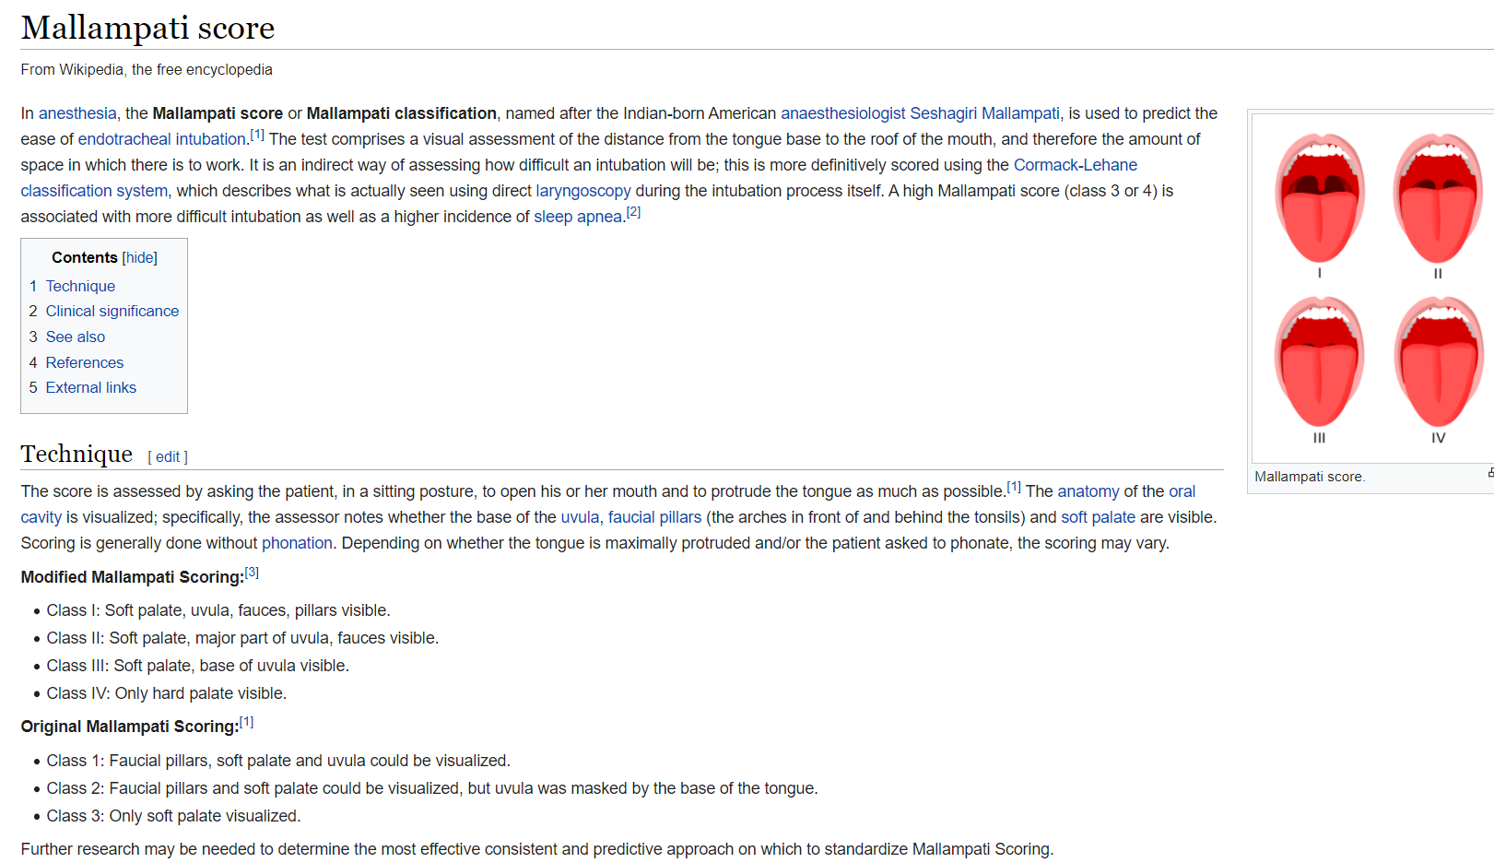

Mallampati Airway Assessment Scale

Slide 10
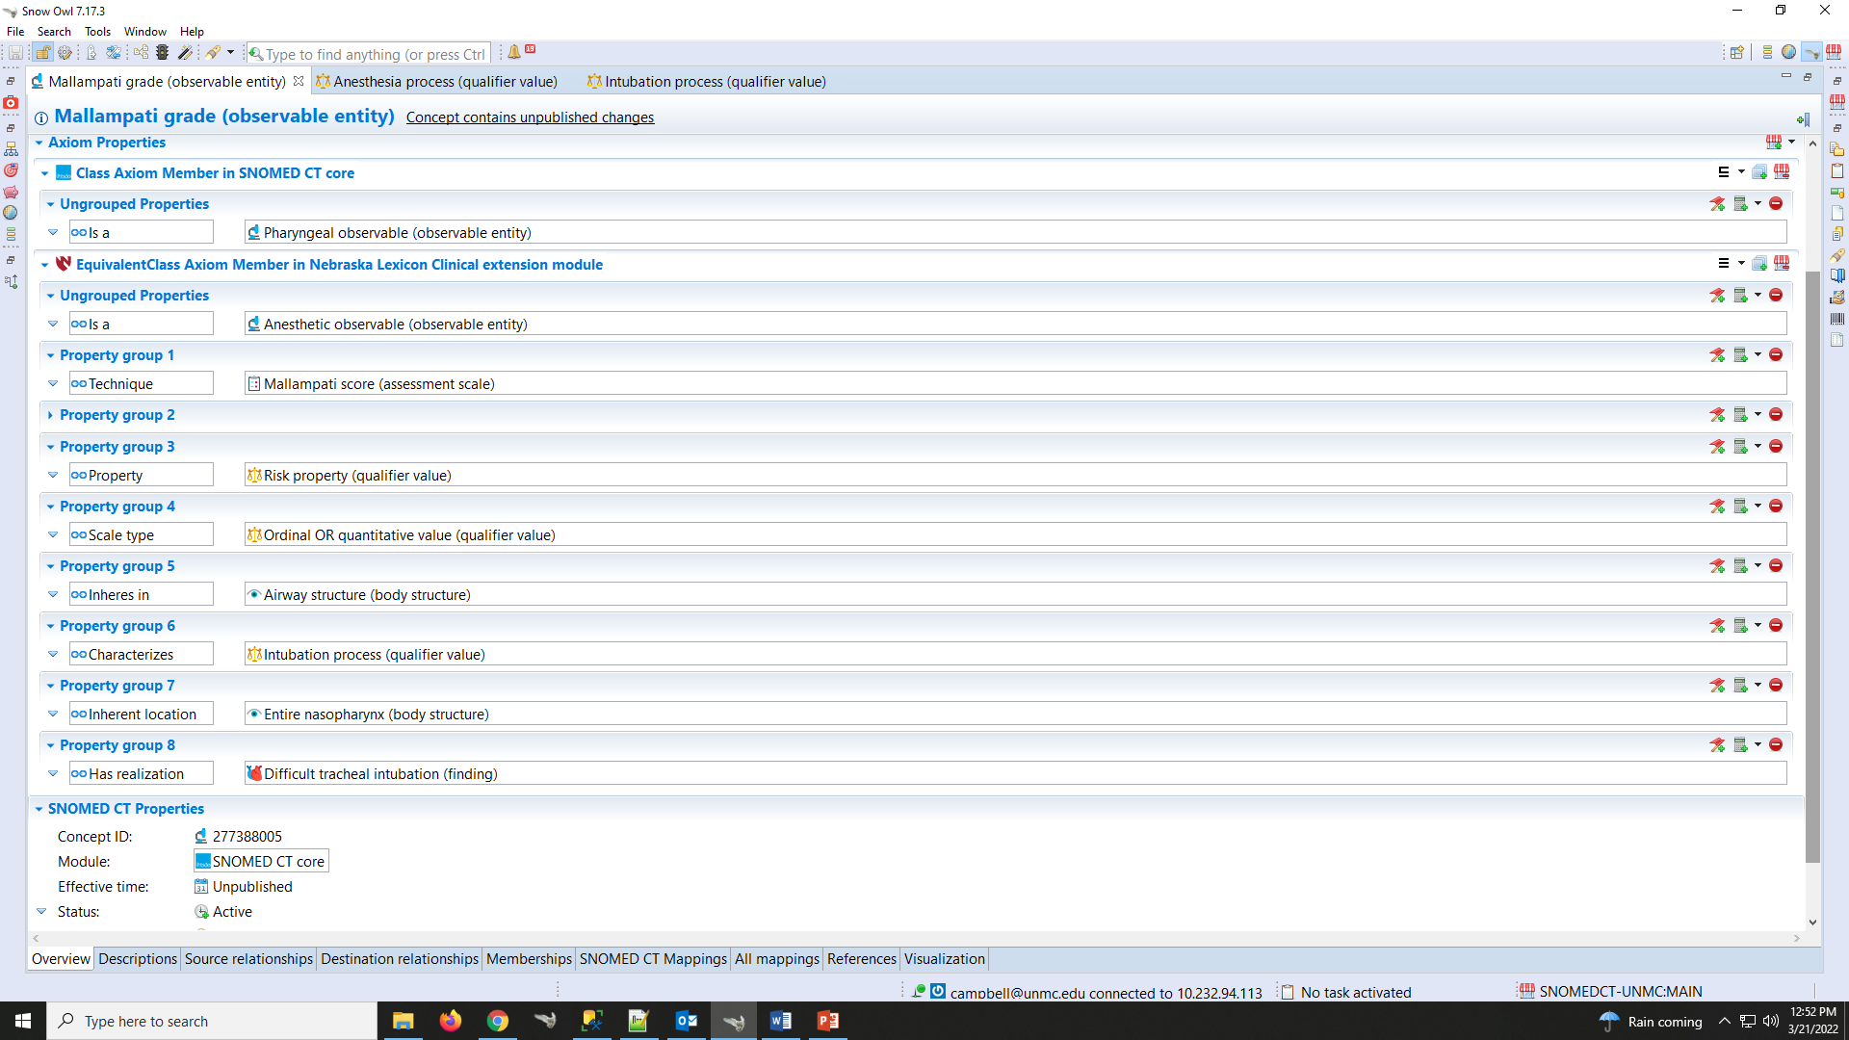
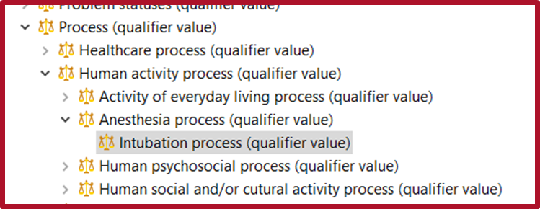
277388005|Mallampati grade (observable entity)

Slide 11
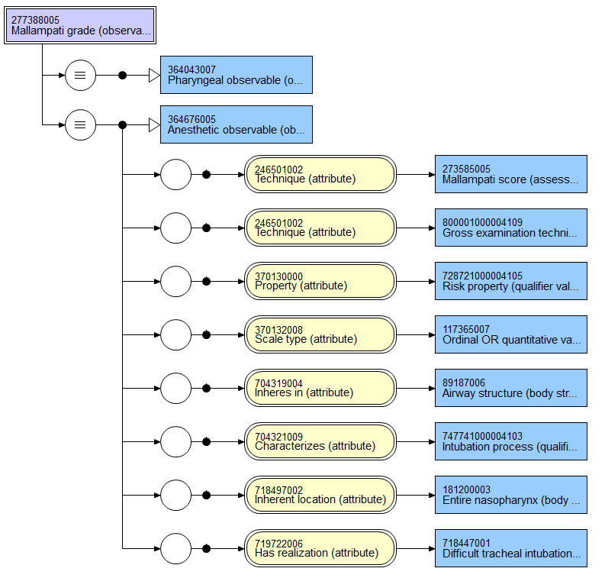
277388005|Mallampati grade (observable entity)

Slide 12
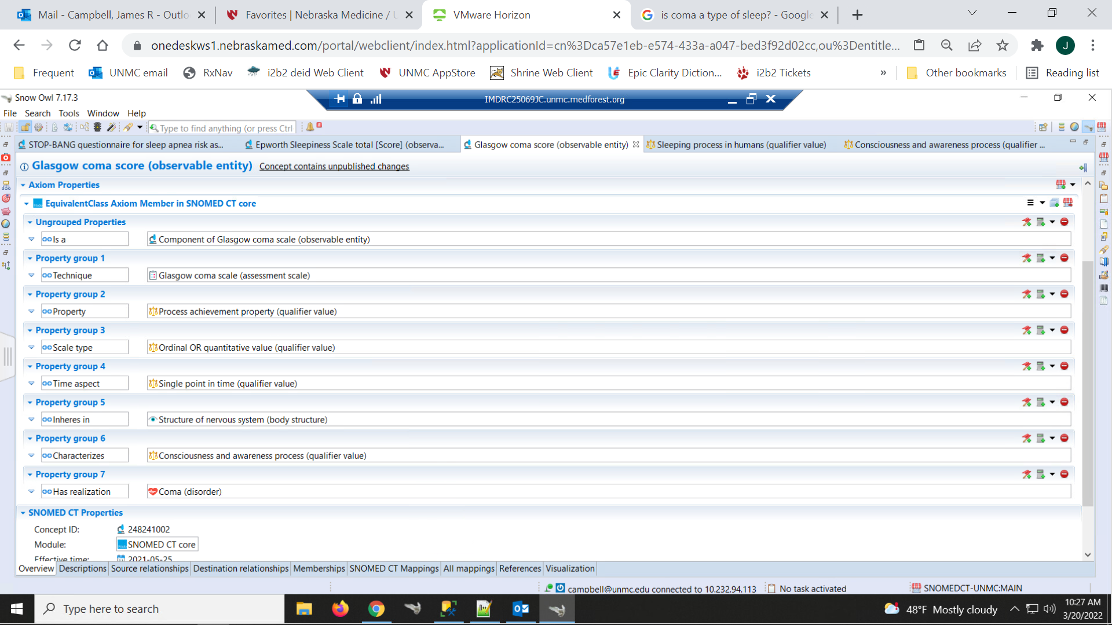
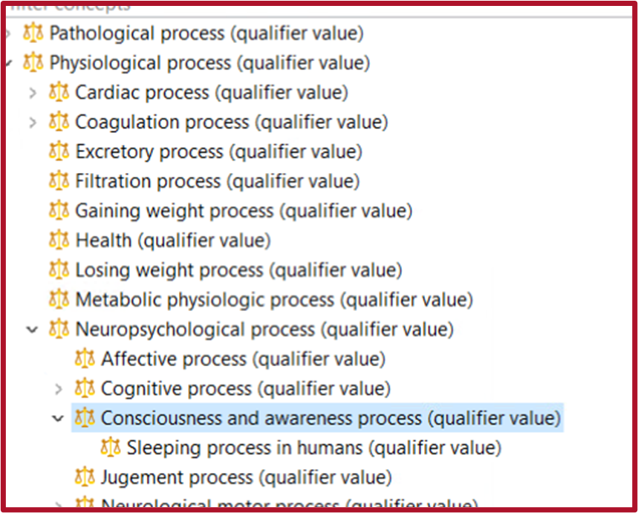
248241002|Glasgow coma score (observable entity)

Slide 13
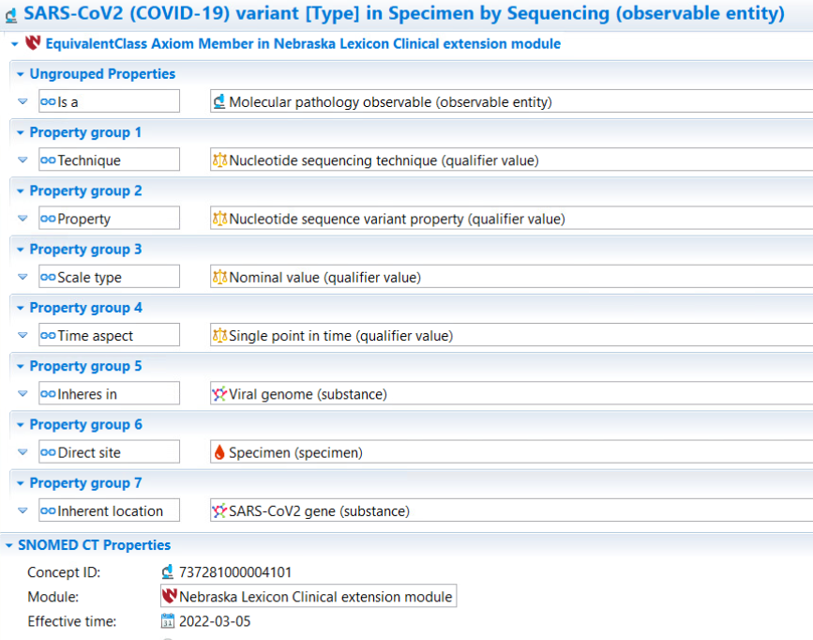
LOINC:96741-4 SARS-CoV2(COVID-19) Variant [Type] in Specimen by Sequencing

Slide 15
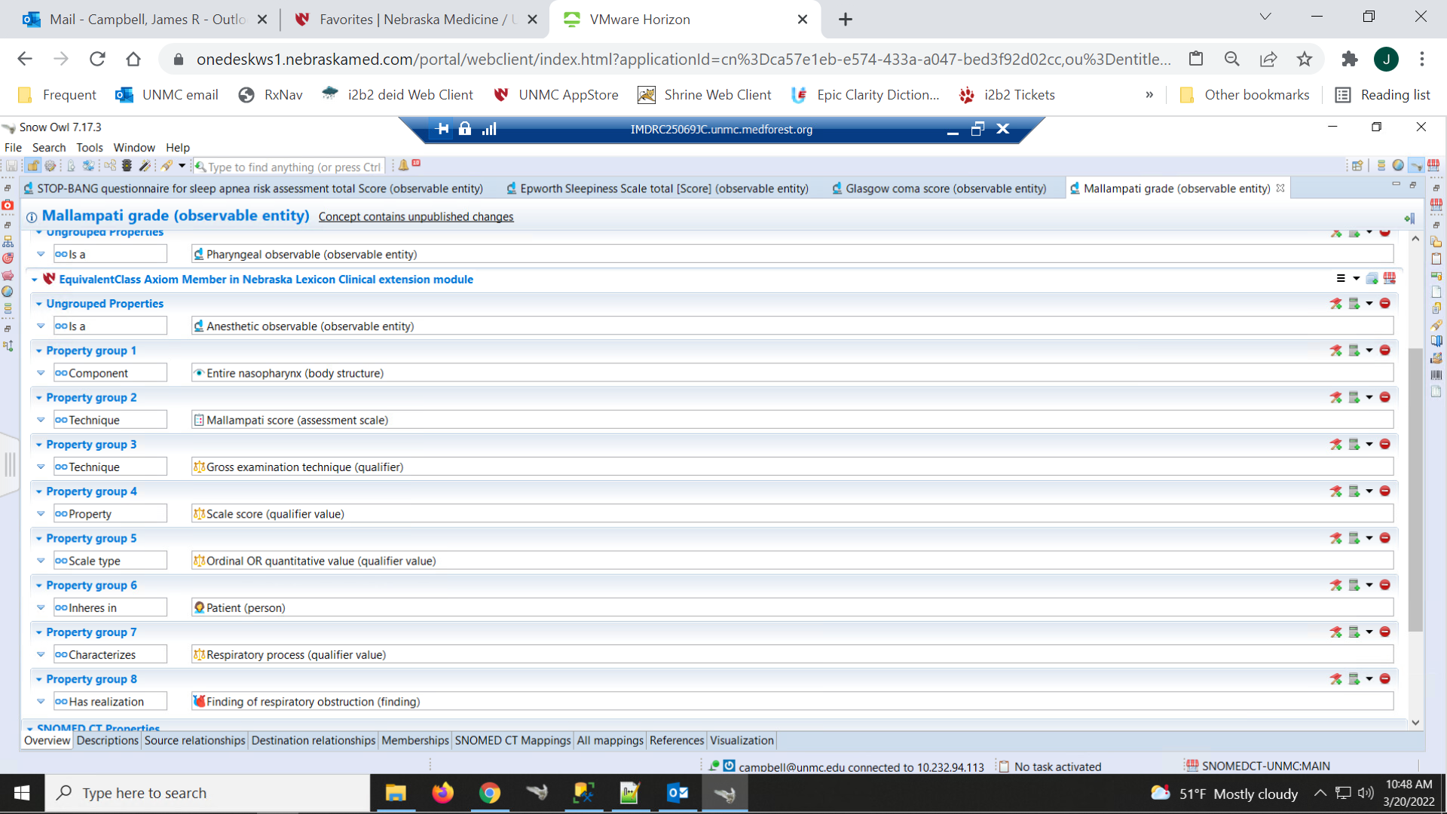
277388005|Mallampati grade (observable entity)

Slide 16
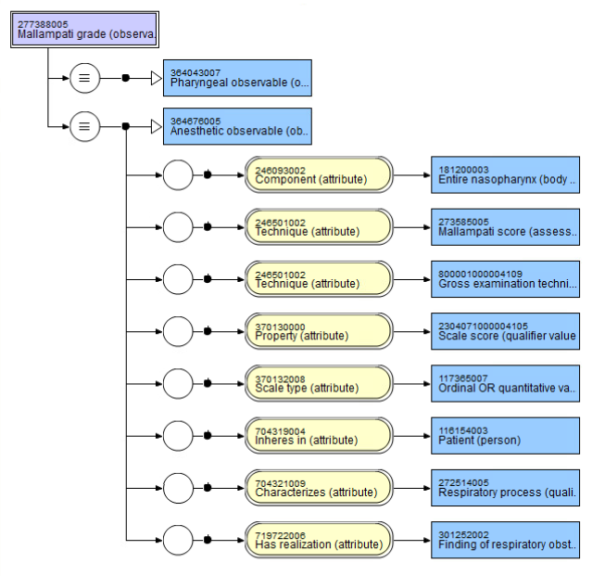
277388005|Mallampati grade (observable entity)

Slide 17
