Slide 1


SNOMED CT DEUSG Subgroup
EDQM Dose Form Mapping
Linda Bird, SNOMED International
Julie James, Blue Wave Informatics
Thursday 24th March 2022

Slide 2

Welcome
Progress update
Issues discussion
Next meeting
AGENDA
http://snomed.org/deusg

Slide 3

Progress update

Slide 4
Our documentation
Mapping Guidance:
https://confluence.ihtsdotools.org/display/USRG/Mapping+Guidance+for+EDQM+to+SNOMED+CT+Pharmaceutical+Dose+Form+Mapping
“EDQM discussion items” List
https://confluence.ihtsdotools.org/display/USRG/Issues+for+discussion+with+EDQM
“SNOMED CT discussion items” List
https://confluence.ihtsdotools.org/display/USRG/Issues+for+discussion+with+SNOMED+CT
IMPLEMENTATION guidance https://confluence.ihtsdotools.org/display/USRG/Guidance+for+Implementation+of+the+EDQM+PDF+to+SNOMED+CT+PDF+mapping

Slide 5
Mapping Spreadsheet update
The number of “tabs” is still expanding as we organise various subject areas
François has submitted lots of CRS requests – thank you François ☺
We are without Chris J from EDQM for the next couple of meetings; he is travelling

Slide 6
Our numbers
Date | WIP | RC1 | No Match | In “holding” | New requests | Change requests
15:12:2021 | 255 | 115 |  | 6 | 5
10:01:2022 | 255 | 130 |  | 21 | 5 | 1
27:01:2022 | 242 | 123 | 3 | 22 | 10 | 3
10:02:2022 | 214 | 138 | 3 | 37 | 14 | 4
24:02:2022 | 190 | 138 | 10 | 54 | 16 | 7
10:03:2022 | 163 | 138 | 10 | 65 | 20 | 17
24:03.2022 | 157 | 142 | 14 | 68 | 28 | 22
In “holding”:
Capsules = 6
Multiple sites/methods = 10
Intravesical/Urethral = 7
Infusion/Injection = 3
Misc = 5
Dispersions = 12
Implants, Inserts etc. 17
Concentrates = 6

Slide 7
Issues for discussion

Slide 8
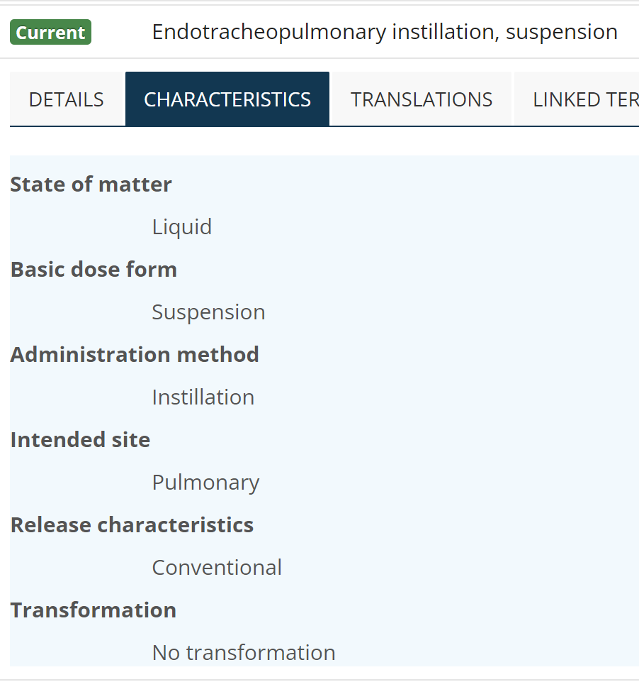
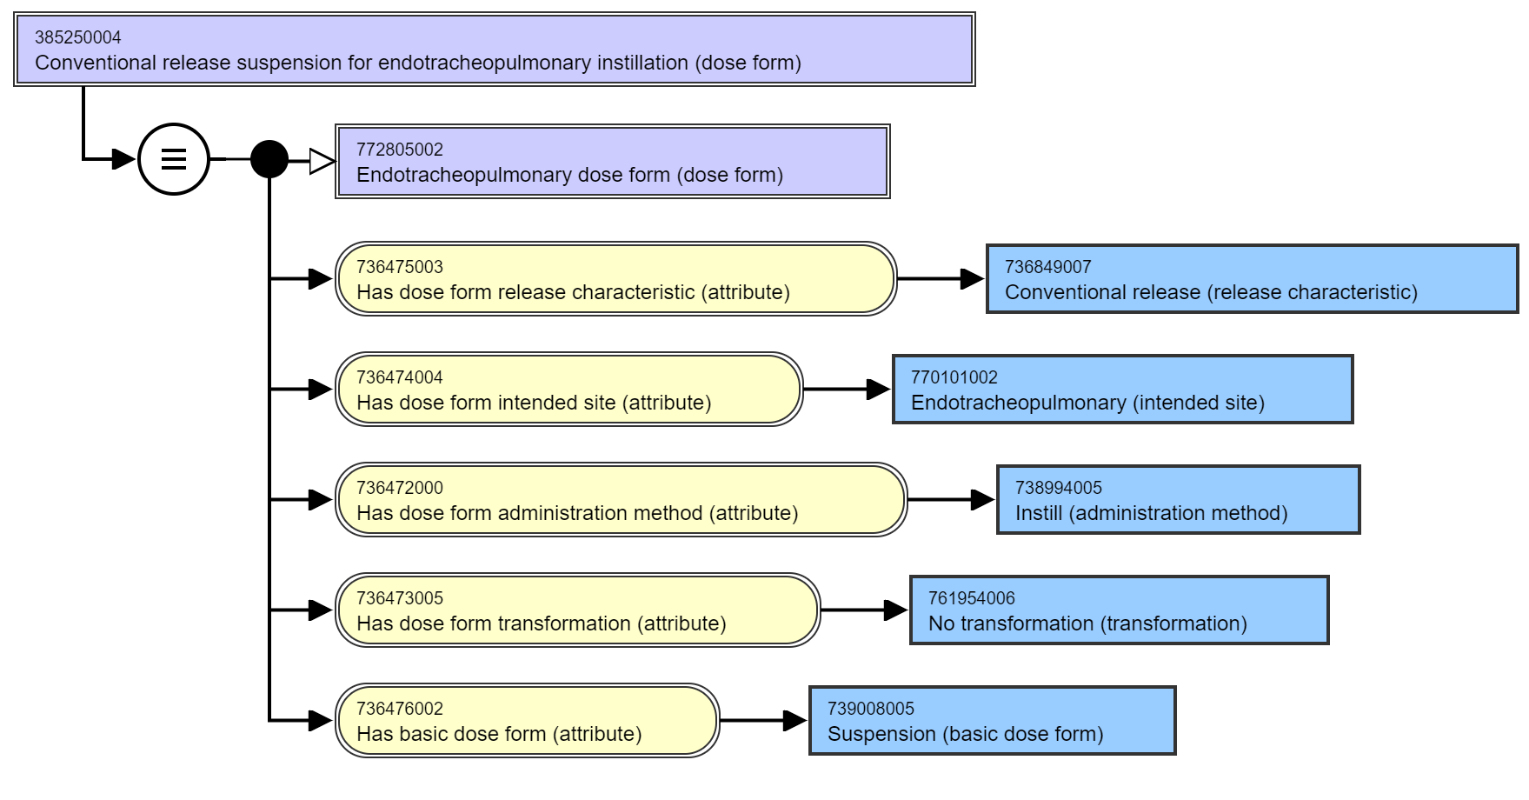
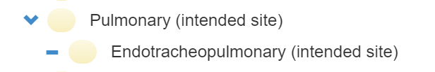
A couple of quick ones… (I hope)
EDQM ID | EDQM Term | SNOMED CT ID | SNOMED CT FSN
11603000 | Endotracheopulmonary instillation, suspension | 385250004 | Conventional release suspension for endotracheopulmonary instillation (dose form)
11601000 | Endotracheopulmonary instillation, solution | 385247002 | Conventional release solution for endotracheopulmonary instillation (dose form)
11602000 | Endotracheopulmonary instillation, powder for solution | 385248007 | Powder for conventional release solution for endotracheal instillation (dose form)
13009000 | Endotracheopulmonary instillation, powder for suspension | 770109000 | Powder for conventional release suspension for endotracheal instillation (dose form)
✓
Endotracheal – the ISI is endotracheopulmonary

Slide 9
CRS Request
We would like the two SNOMED CT concepts
  Powder for conventional release solution for endotracheal instillation (dose form)
  Powder for conventional release suspension for endotracheal instillation (dose form)
To have the FSN to say “endotracheopulmonary” rather than “endotracheal” because
Their logical definition uses “endotracheopulmonary”
They are the manufactured dose forms that would transform to the two concepts that use “endotracheopulmonary”
We understand this is most probably a “retire and re-author” but we do feel this is justified

Slide 10

Implants
There are 10 “implant” dose forms in EDQM
And 4 in SNOMED CT
No implant dose forms have currently found their way to RC1 – all are “unmapped” in WIP – this may mean there is quite a conceptual “mismatch”
Last time we “sorted”
Inserts (solid, single use, inserted into a cavity, extended release)
Tampons (update definition to include “material”, also inserted into a cavity and extended release)
Sticks (also solid, single use, inserted into a cavity, extended release)
Systems
Sponges
BUT NOT implants or plugs, strips and pads…. We continue to explore….

Slide 11
EDQM implant concepts (1):
EDQM ID | EDQM Term | EDQM definition | Comments from mappers
11303500 | Implantation suspension | Liquid sterile preparation consisting of a suspension intended for implantation in the body; the active substance(s) are released over an extended period of time to obtain a local or systemic effect | edqm: implant SOM = liquid sct: implant SOM = solid
11302000 | Implantation tablet | Solid sterile preparation prepared by compression of a solid active substance as such or of a formulation thereof into an implant of a size and shape suitable for implantation, usually subcutaneously. Each implantation tablet is presented in a sterile container. Implantation tablets are intended for release over an extended period of time in order to obtain local or systemic effect | no real product in our MPD
11301000 | Implant | Solid sterile preparation of a size and shape suitable for implantation. It may be prepared by moulding or other means other than compression. Each implant is presented in a sterile container that may be provided with an administration device. Implants are intended for release over an extended period of time in order to obtain local or systemic effect. 'Implantation tablet', 'Implantation chain' and 'Implantation matrix' are excluded | sct: 385286003 |Implant (basic dose form)| ; one real product, doscoid form for intracavitary implantation
11303000 | Implantation chain | Solid sterile preparation consisting of small spheres mounted on a non-degradable thread to form a chain that allows withdrawal of the remainder of the chain after a certain period of action. Each implantation chain is presented in a sterile container. The implantation chain is intended for release over an extended period of time in order to obtain local or systemic effec | no real product in our MPD
11303300 | Implantation matrix | Solid sterile preparation consisting of a usually pliable, absorbent piece of material (e.g. collagen), usually impregnated with a liquid preparation, intended for implantation in the body. The material may be cut into smaller pieces before implantation, and may be shaped around a tissue (e.g. a bone) or inserted into a medical device that is then implanted. Implantation matrices are intended for release over an extended period of time, usually in order to obtain a local effect. Usually the matrix disappears with time. When the product is packaged as a separate matrix, powder and solvent (or matrix and solution), which are used to prepare the implantation matrix immediately before use, the appropriate combined term should be used; see for example ‘Powder, solvent and matrix for implantation matrix’. | no real product in our MPD

Slide 12
EDQM implant concepts (2):
EDQM ID | EDQM Term | EDQM definition | Comments from mappers
13018000 | Matrix for implantation matrix | Solid sterile preparation consisting of a usually pliable, absorbent piece of material (e.g. collagen) intended to be used in the preparation of an implantation matrix.
50049500 | Powder for implantation suspension | Solid sterile preparation consisting of one or more powders, including freeze-dried powders, intended to be dispersed in the specified liquid to obtain an implantation suspension
13027000 | Powder for implantation matrix | Solid sterile preparation consisting of one or more powders, including freeze-dried powders, intended to be used in the preparation of an implantation matrix, e.g. by dissolving in the specified liquid to prepare the solution used to impregnate the matrix | SCT focuses on where the implant "goes" (intralesional, subcutan). EDQM focuses on what the implant is (implant, matrix, tablet, chain, paste etc)
13028000 | Powder for implantation paste | Solid sterile preparation consisting of one or more powders intended to be mixed with the specified liquid or paste to obtain an implantation paste
13043000 | Implantation paste | Semi-solid sterile preparation containing large proportions of solids finely dispersed in the basis, intended to be implanted in the body for release of the active substance(s) over an extended period of time, usually to obtain a systemic effect | no parenteral paste, nor implant associated AM, some BDF implant with IS subcutaneaous. No French Drug example to investigate deeper

Slide 13
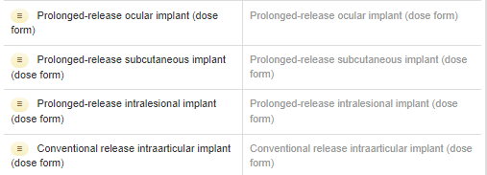
SNOMED CT implant PDF concepts
CDs using “implant” PDFs include
A ganciclovir ocular implant
A dexamethasone and a fluocinolone ocular implant
Estradiol, etonorgestrel and levonorgestrel subcutaneous implants
A carmustine intralesional implant
Testosterone and goserelin subcutaneous implants
An autologous cultured chondrocyte intraarticular implant

Slide 14
Discussion points
Clearly quite a mismatch between EDQM and SNOMED CT for implant concepts
Not sure if there is clinical value for all the different types of implant concepts in EDQM (although there may be a need to differentiate between a gentamicin matrix implant and a gentamicin chain implant – we need to explore this further)
See for example a Septopal product
Also do more with the known implant products (goserelin, carmustine etc.)

Slide 15
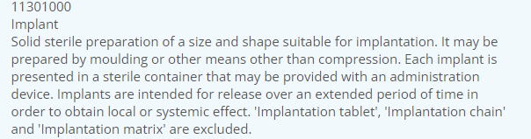
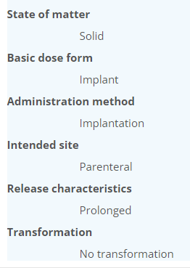
EDQM Implant

Slide 16
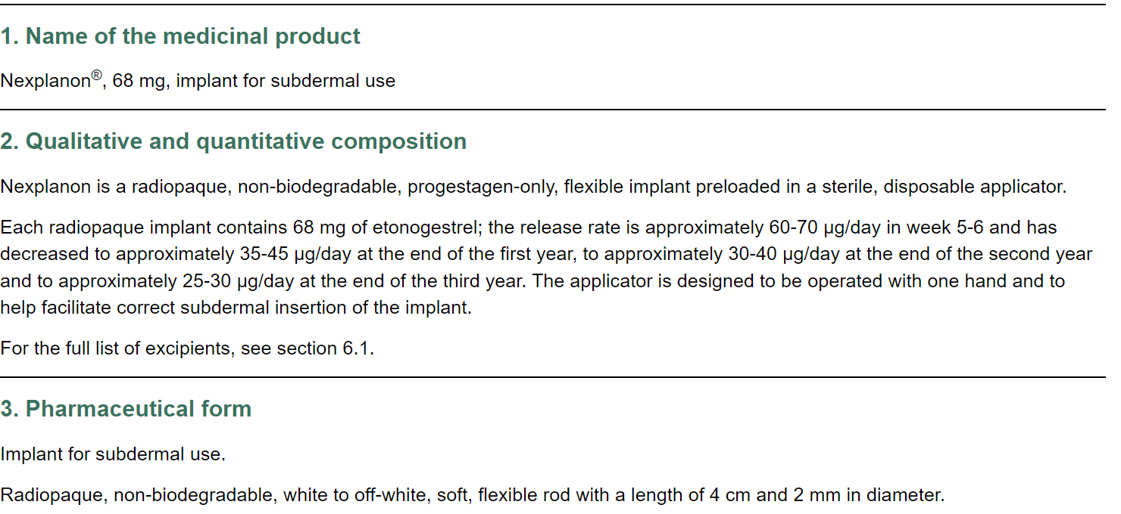
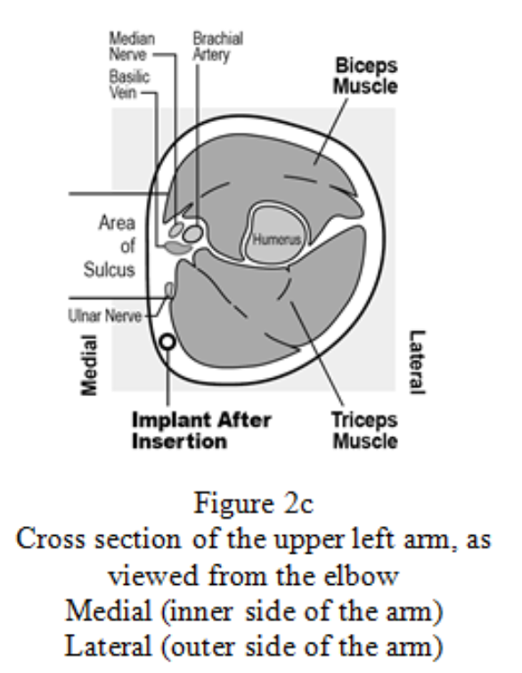
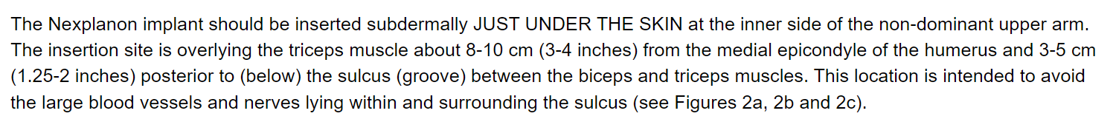
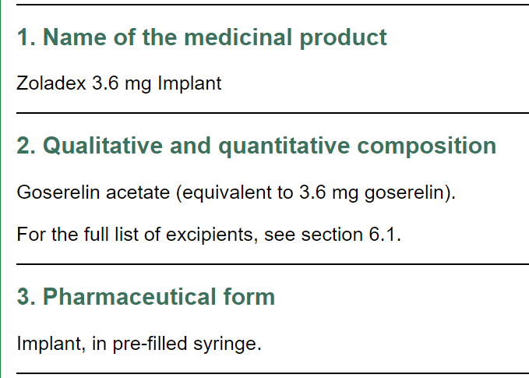
Hormone implants

Slide 17
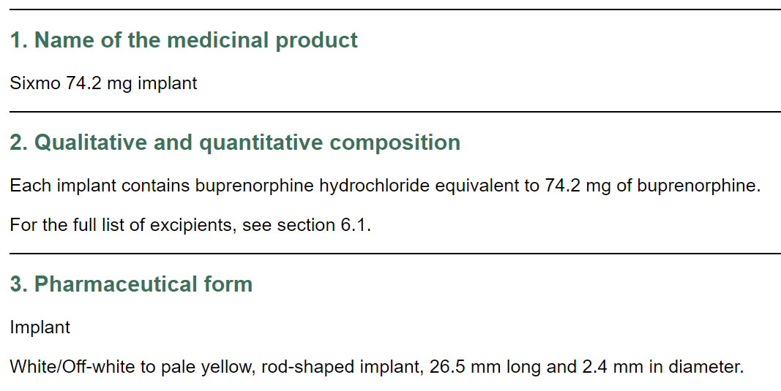
Non-steroid implant:

Slide 18
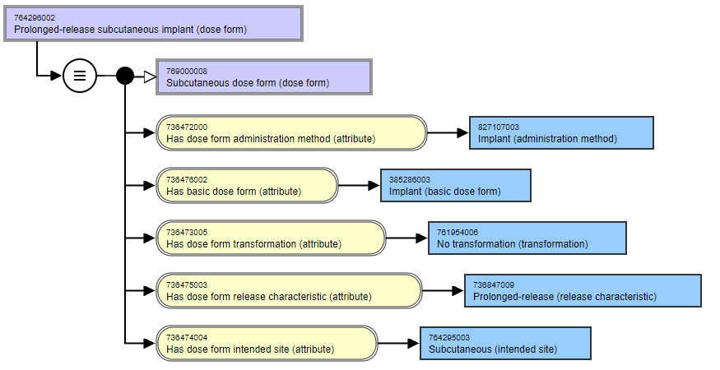
Subcutaneous implant:

Slide 19
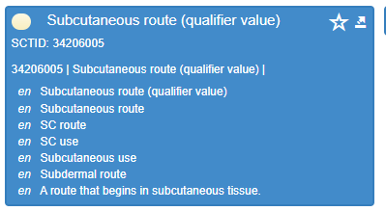
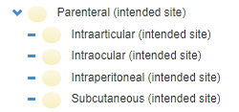
S-C implant comments
SNOMED CT considers “subdermal” to be a synonym of subcutaneous when describing routes of administration, so the Nexplanon implant would be “subcutaneous”
SNOMED CT’s subcutaneous implant is more granular than EDQM’s but would classify to it…
This map (implant to SC implant) is OK

Slide 20
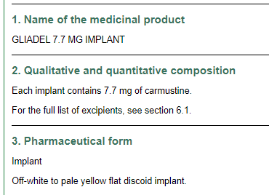
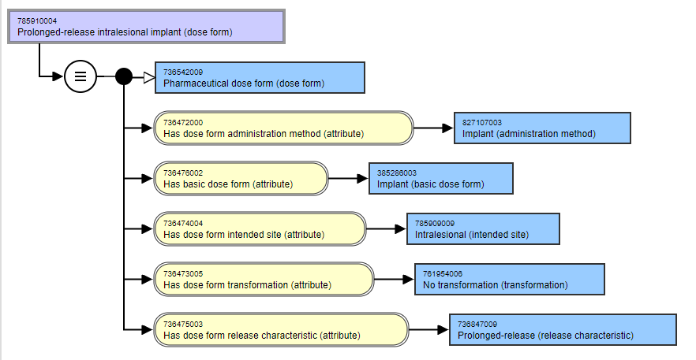
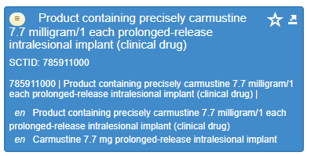
Intralesional implant (1)

Slide 21
Intralesional implant (2)
SNOMED CT has “An intended site for a dose form that is for administration into a localised lesion”
  It is not a child concept of parenteral….
EDQM does not have a lesion intended site – it uses “parenteral”
Parenteral rather than cavity is the main differentiator between an implant and an insert (I think….)
This is the only PDF that uses the “intralesional” intended site
What recommendations (if any) do we want to make?
  Should “intralesional” be a child of parenteral? Not sure
  Even if it is, we would get a 1..* map from EDQM to SNOMED CT
Suggest discussion with SNOMED CT Content Team

Slide 22
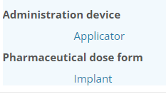
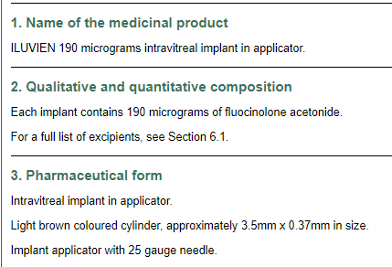
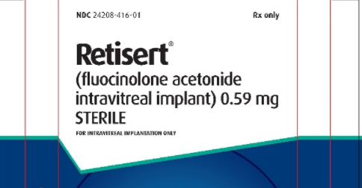

Intravitreal implant (1)

Slide 23
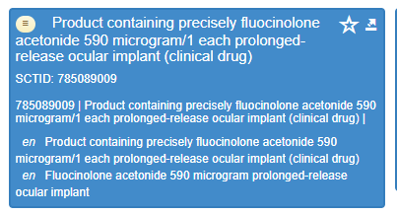
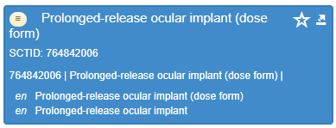
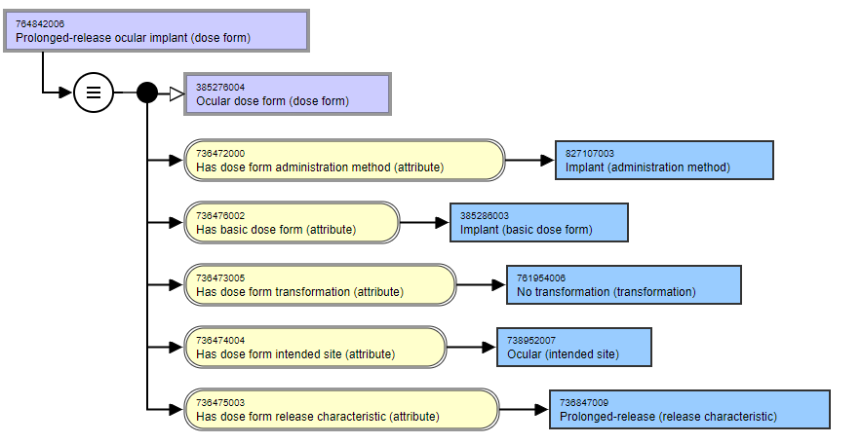
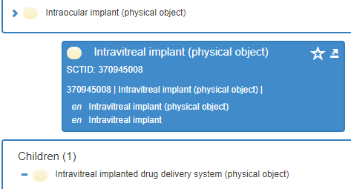
Intravitreal implant (2)

Slide 24
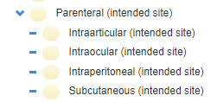
Intravitreal implant (3)
Should “ocular implant” really be “intravitreal implant” for the dose form?
What should we recommend (if anything) for the device concepts?
Should we suggest to EDQM that they might wish to consider having an “intravitreal implant” concept, since they use it in a CMT?
There is currently no “Intravitreal” intended site in SNOMED CT or EDQM
  EDQM ocular: Relating to the eye as the intended site of administration, including where the pharmaceutical product is intended for action on the surface of the eye or conjunctiva, around the eye, or within the eye
  SNOMED CT ocular: An intended site for a dose form that is for administration to the eye or eye structures
  SNOMED CT does have an intravitreal route of administration (into the vitreous humour)
  SNOMED CT does have an “intraocular” intended site
Suggest discussion with SNOMED CT Content Team

Slide 25
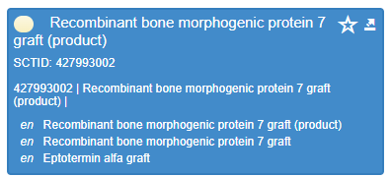
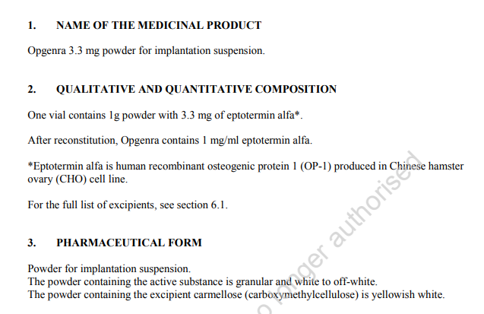
Implantation suspensions (and powder for)

Slide 26
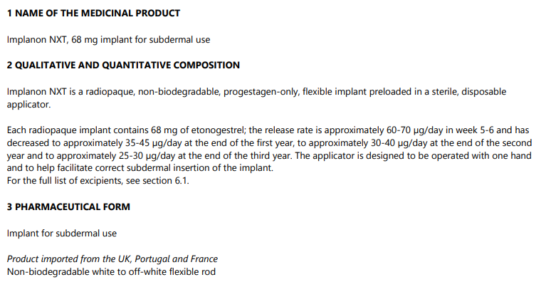
Implantation tablets
Searches suggested that “Implanon” was an implantation tablet…(it is rod shaped)
But on an Irish SmPC it’s a plain “implant” and it’s probably the same product as Nexplanon (!)

Slide 27
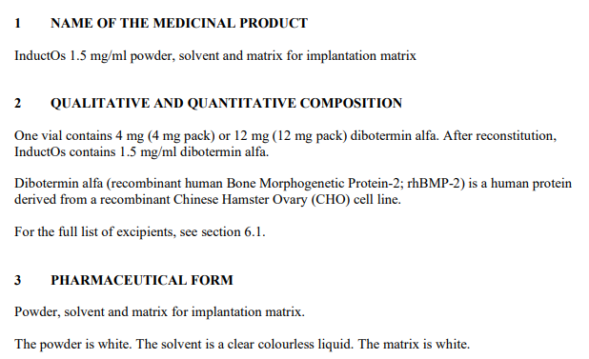
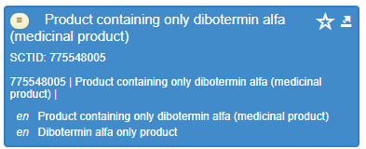
Implantation matrices (and powder for)

Slide 28
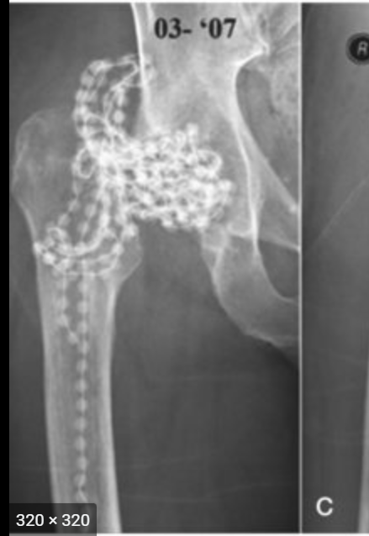
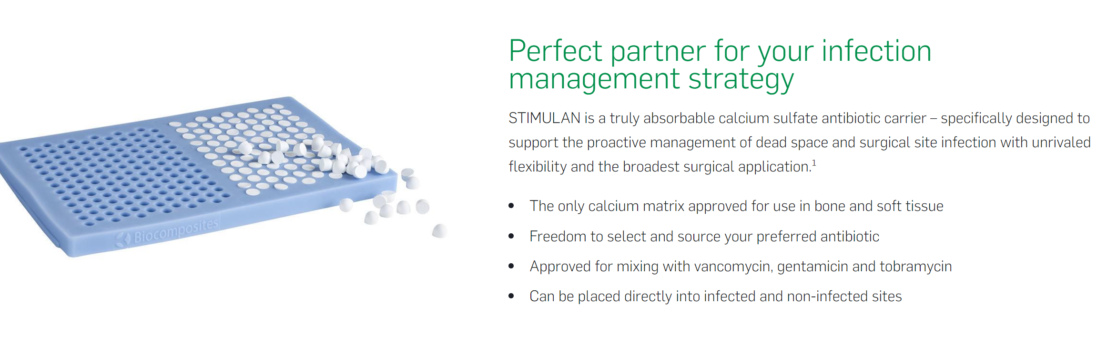
Implantation chains
Are these the gentamicin beads that used to be used in orthopedics?

Slide 29
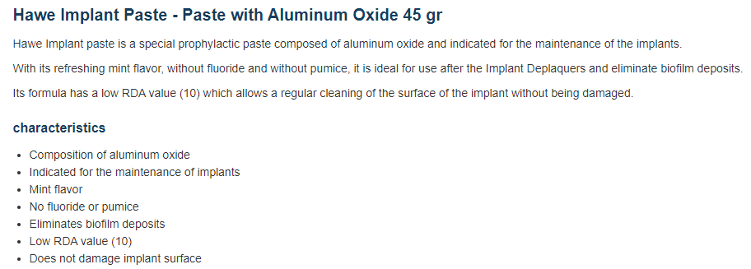
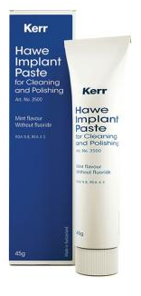
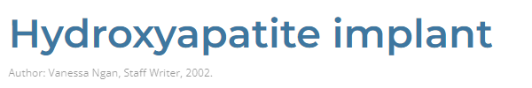
Implantation pastes?
Possibly dental use?
Also orthopedic use?
Might these not be considered as medicinal products?

Slide 30
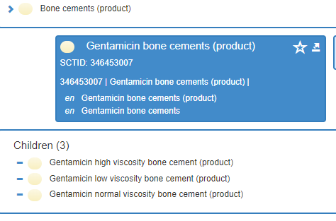
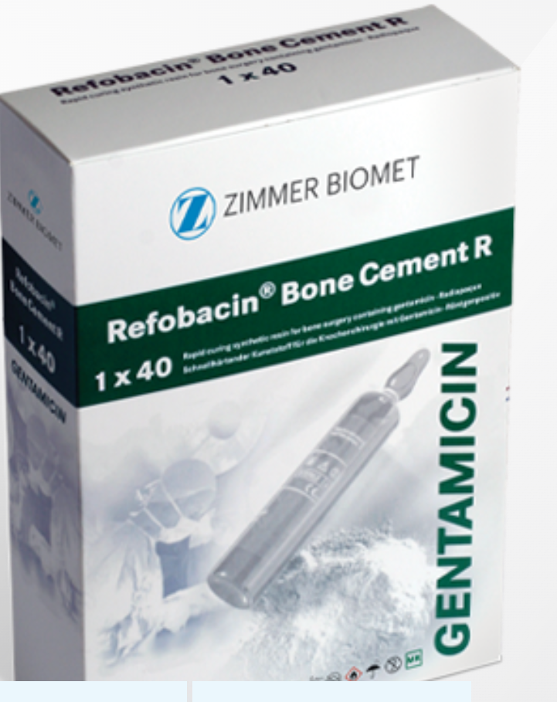
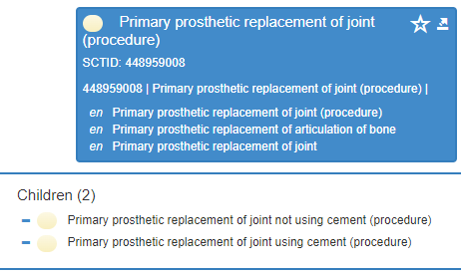
Bone cements?
Product, not medicinal product
Lots of procedures reference use of bone cement (or not)

Slide 31
Implant Dose Form Summary (1)
EDQM ID | EDQM Term | Products | Suggested Mapping | Comments
11301000 | Implant | Many | Prolonged release subcutaneous implant Prolonged release ocular implant Prolonged release intralesional implant | Accept mapping for now; discuss with Content Team
11303500 | Implantation suspension | Bone morphogenic proteins | No map | If future products are authorised, implantation suspension could be added BUT Prefer matrix as implies the solid implant material
50049500 | Powder for implantation suspension | Bone morphogenic proteins | No map
11302000 | Implantation tablet | ?None? | No map | Suggest using plain “implant” This is possibly an old term

Slide 32
Implant Dose Form Summary (2)
EDQM ID | EDQM Term | Products | Suggested Mapping | Comments
11303000 | Implantation chain | (Antibiotic) Beads; Septopal Cadena (ESP); HERAEUS PMMA | No map | Products now discontinued New products now devices?
11303300 | Implantation matrix | Bone morphogenic proteins | No map for now, but add if needed | ? Does it need to be “matrix” ? Yes – the implant forms a matrix when in the body
13018000 | Matrix for implantation matrix | Bone morphogenic proteins | No map for now, but add if needed
13027000 | Powder for implantation matrix | Bone morphogenic proteins | No map for now, but add if needed
13028000 | Powder for implantation paste | (Antibiotic) bone cements Dental products | No map for now | Not medicinal products, usually medical devices
13043000 | Implantation paste | (Antibiotic) bone cements Dental products | No map for now

Slide 33
Swabs, pads…..
EDQM ID | EDQM Term | EDQM Definition | Mapper’s comments
13145000 | Impregnated cutaneous swab | Solid preparation consisting of a piece of absorbent material impregnated usually with a liquid preparation, intended to be applied to the skin for a limited period of time with one or more wiping motions, and which may be attached to an application device such as a stick. Impregnated pad is excluded | no swab BDF in S-CT | ?Products?
12117000 | Impregnated pad | Solid preparation consisting of a piece of absorbent material impregnated with a liquid preparation. Impregnated cutaneous swab is excluded | no "pad" BDF in S-CT France "VICKS INHALER, tampon imprégné pour inhalation par fumigation" | ?Products?
50033000 | Inhalation vapour, impregnated pad | Solid preparation consisting of a piece of absorbent material impregnated usually with a liquid or semi-solid preparation, intended for generation of vapour to be inhaled to obtain a local effect. Comment: After reconsideration of this term, and for reasons of consistency with other related terms, this term replaces 'Inhalation impregnated pad'. |  | ?Products?

Slide 34
……plugs and strips
EDQM ID | EDQM Term | EDQM Definition | Mapper’s comments
12117500 | Impregnated plug | Solid preparation consisting of a piece of material (e.g. polyethylene), usually porous, in which a liquid, semi-solid or solid preparation is impregnated. Implants, pads, sponges and tampons are excluded. | no "plug" BDF in S-CT | ?Products?
50033100 | Inhalation vapour, impregnated plug | Solid preparation consisting of an impregnated plug that generates a vapour to be inhaled, for example by the patient inhaling through a device containing the plug, thereby drawing air through or over it and vaporising the active ingredient(s) impregnated therein |  | ?Products?
10613000 | Ophthalmic strip | Solid sterile single-dose preparation consisting of a strip made of a suitable material usually impregnated with active substance(s) intended for use on the eyeball | S-CT BDF = Strip; EDQM BDF = Impregnated material | ?Fluorescein?

Slide 35
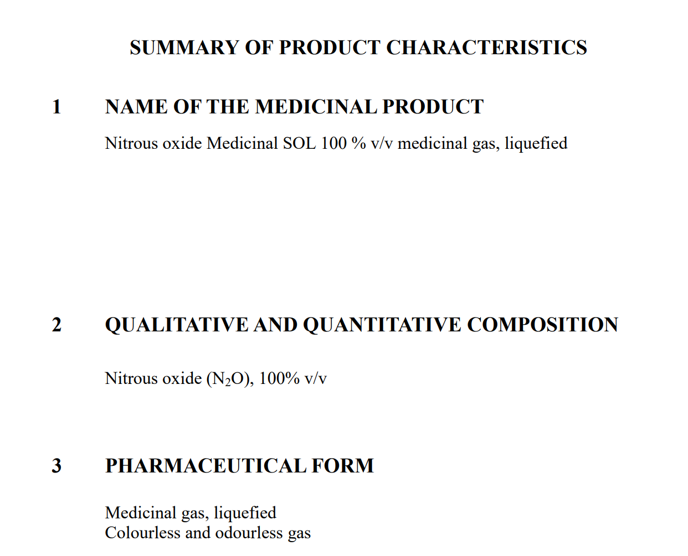
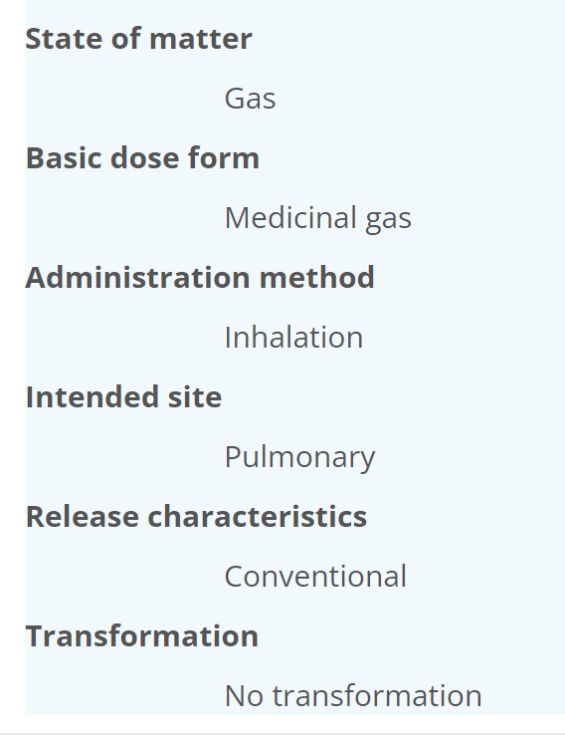
Gas dose forms (1)
EDQM ID | EDQM Term | EDQM Definition | Products
12301000 | Medicinal gas, compressed | A gas packaged under pressure which is entirely gaseous at - 50 °C
12302000 | Medicinal gas, cryogenic | A gas which liquifies at 1.013 bar at a temperature below -150 °C. | Liquid nitrogen for cryotherapy
12303000 | Medicinal gas, liquefied | A gas packaged under pressure, which is partially liquid (gas over liquid) at -50 °C. | Standard medical gas cylinders (oxygen, nitrous oxide etc.)
For all three concepts

Slide 36
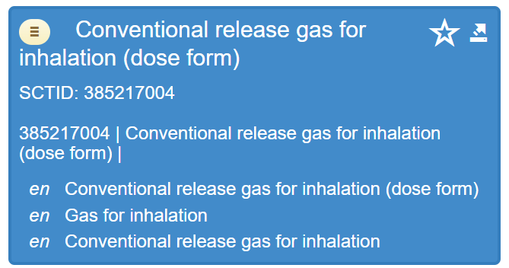
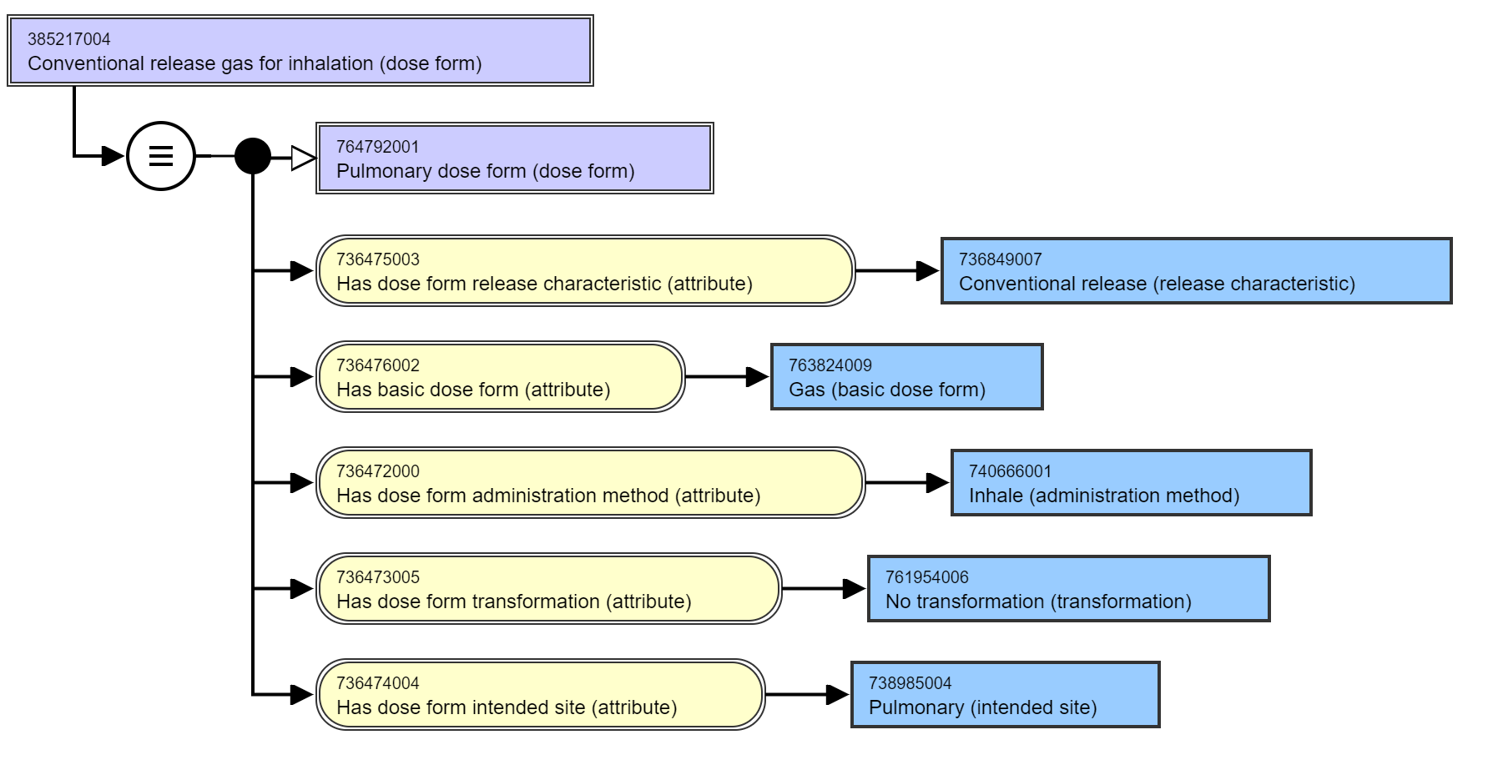
Gas dose forms (2)

Slide 37
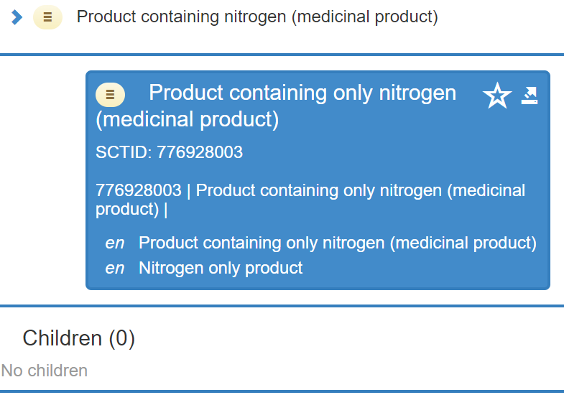
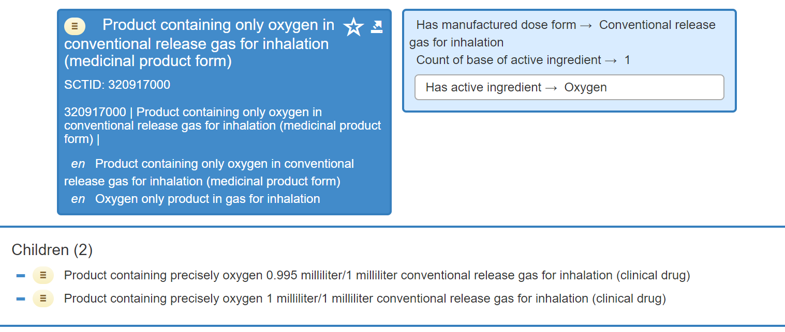
Gas dose forms (3)
? Why is the MPF not a “pulmonary dose form” ?

Slide 38
Gas dose form summary
EDQM ID | EDQM Term | SNOMED CT ID | SNOMED CT FSN
12301000 | Medicinal gas, compressed | No map
12302000 | Medicinal gas, cryogenic | No map for dose form for now
12303000 | Medicinal gas, liquefied | 385217004 | Conventional release gas for inhalation (dose form)

Slide 39
New methods?
Still working on this…..☺

Slide 40
Plaster and Patch
Not forgotten….will come back to this ☺

Slide 41

Next meeting on
Thursday 7th April
at 10:00 UTC
NEXT STEPS
41

Slide 42


THANK YOU
SNOMED International: Delivering SNOMED CT

