Slide 1


SNOMED CT DEUSG Subgroup
EDQM Dose Form Mapping
Linda Bird, SNOMED International
Julie James, Blue Wave Informatics
Thursday 10th March 2022

Slide 2

Welcome
Progress update
Issues discussion
Next meeting
AGENDA
http://snomed.org/deusg

Slide 3

Progress update

Slide 4
Our documentation
Mapping Guidance:
https://confluence.ihtsdotools.org/display/USRG/Mapping+Guidance+for+EDQM+to+SNOMED+CT+Pharmaceutical+Dose+Form+Mapping
“EDQM discussion items” List
https://confluence.ihtsdotools.org/display/USRG/Issues+for+discussion+with+EDQM
“SNOMED CT discussion items” List
https://confluence.ihtsdotools.org/display/USRG/Issues+for+discussion+with+SNOMED+CT
IMPLEMENTATION guidance https://confluence.ihtsdotools.org/display/USRG/Guidance+for+Implementation+of+the+EDQM+PDF+to+SNOMED+CT+PDF+mapping

Slide 5
Mapping Spreadsheet update
The number of “tabs” is still expanding as we organise various subject areas
    Injection/Infusion
    Misc awaiting change
    François has updated the requests with concepts that have been added to the Daily Build;
        We will be meeting next week to do some prioritising of requests
        New concepts are (possibly) easier than changes

Slide 6
Our numbers
Date | WIP | RC1 | No Match | In “holding” | New requests | Change requests
15:12:2021 | 255 | 115 |  | 6 | 5
10:01:2022 | 255 | 130 |  | 21 | 5 | 1
27:01:2022 | 242 | 123 | 3 | 22 | 10 | 3
10:02:2022 | 214 | 138 | 3 | 37 | 14 | 4
24:02:2022 | 190 | 138 | 10 | 54 | 16 | 7
10:03:2022 | 163 | 138 | 10 | 65 | 20 | 17
In “holding”:
Capsules = 6
Multiple sites/methods = 10
Intravesical/Urethral = 5
Infusion/Injection = 3
Misc = 5
Dispersions = 12
Implants, Inserts etc. 24

Slide 7
Issues for discussion

Slide 8

Implants
There are 10 “implant” dose forms in EDQM
And 4 in SNOMED CT
No implant dose forms have currently found their way to RC1 – all are “unmapped” in WIP – this may mean there is quite a conceptual “mismatch”
We will explore….
And we also find inserts, systems, sponges, tampons and sticks

Slide 9
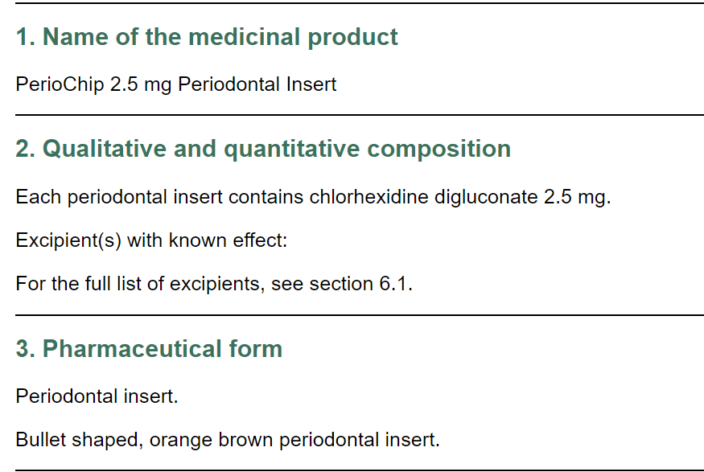
EDQM insert concepts:
EDQM ID | EDQM Term | EDQM definition | Comments from mappers
10411000 | Periodontal insert | Solid single-dose preparation consisting of a medicated insert to be placed within the tooth socket/periodontal membrane. The biodegradable insert is a sheet which slowly releases active substance(s). | Can't find peridontal on S-CT at all. <JMJ> Also periodontal gel, periodontal powder
10612000 | Ophthalmic insert | Solid sterile preparation of suitable size and shape, designed to be inserted in the conjunctival sac to produce a local or ocular effect by the release of active substance(s) over a determined period of time. Ophthalmic inserts generally consist of a reservoir of active substance(s) embedded in a matrix or bounded by a rate-controlling membrane. They are presented individually in sterile containers | Already on RC1 as exact match: 385132002| Prolonged release ophthalmic insert (dose form)
EDQM Periodontal insert:
BDF = insert
Admin method = insertion
Intended site = dental
RC = prolonged
No transform
Suggestion:
Request new PDF concept addition
AND new intended site = Periodontal, as child of dental site (In S-CT Periodontal route is child of Dental route; Periodontal disease is_a Disorder of teeth AND/OR supporting structures) - Agreed

Slide 10
EDQM tampon concepts:
EDQM ID | EDQM Term | S-CT ID | S-CT FSN | EDQM definition | Comments from mappers
10914000 | Medicated vaginal tampon | 739662008 | Conventional release vaginal tampon (dose form) | Solid single-dose preparation consisting of a suitable material impregnated with active substance(s) intended to be inserted in the vagina for a limited period of time | S-CT Basic dose form is tampon, EDQM basic dose form is impregnated material
11015000 | Rectal tampon | 385196001 | Conventional release rectal tampon (dose form) | Solid single-dose preparation consisting of a suitable material impregnated with active substance(s) intended to be inserted in the rectum for a limited period of time usually for a local effect | Basic dose form is impregnated material, S-CT basic dose form is tampon
10714000 | Ear tampon | 385147006 | Conventional release ear tampon (dose form) | Solid single-dose preparation intended to be inserted into the external auditory meatus for a limited period of time, consisting of a suitable material impregnated with active substance(s) | no major difference...S-CT basic dose form is tampon, EDQM basic dose form is 'impregnanted material...' S-CT says otic, EDQM uses the word auricular.

Slide 11
EDQM tampon concepts (2):
Mappers said this was not “exact” because of difference in BDF:
S-CT = Tampon - A solid single-dose form consisting of a suitable material intended for insertion into a body cavity for a limited time prior to removal
EDQM = Impregnated material – A type of solid pharmaceutical dose form consisting of material onto or into which active substance(s) are absorbed for subsequent release after administration, often over an extended period of time
Interestingly, none of the tampon PDFs are prolonged release
Is there concern regarding the difference in basic dose form? Do we need to do anything, or could these go to RC1 as is?
Agreed to update the definition in S-CT to include the purpose (release of active substance(s)) then accept that these can be an exact match and move to RC1

Slide 12
EDQM stick concepts (1):
EDQM ID | EDQM Term | S-CT ID | S-CT FSN | EDQM definition | Comments from mappers etc.
10812000 | Nasal stick | 385162008 | Conventional release nasal stick (dose form) | Solid single-dose preparation, usually rod-shaped or conical, intended for nasal use, usually to obtain a local effect. | S-CT has administration method 'apply'. EDQM has administration method 'application' 'insertion'.
10715000 | Ear stick | 385148001 | Conventional release otic stick (dose form) | Solid single-dose preparation of usually conical shape intended to be inserted in the external auditory meatus where it melts or dissolves | S-CT administration method is apply, EDQM administration method is application or insertion. Site otic v auricular.
12104000 | Wound stick | No match |  | Solid sterile single-dose preparation, usually rod-shaped or conical, consisting of active substance(s) dissolved or dispersed in a suitable basis that may dissolve or melt at body temperature, intended to be inserted into wounds.
10403000 | Dental stick | 385089000 | Conventional release dental stick (dose form) |  | Exact match and in RC1
10523000 | Cutaneous stick | 385118004 | Conventional release cutaneous stick (dose form) |  | Exact match and in RC1 with cutaneous note Method for EDQM and S-C T is apply
11505000 | Urethral stick | 385246006 | Conventional release urethral stick (dose form) |  | Intravesical/Urethral; Apply versus Insert for method CRS for method change in list

Slide 13
EDQM stick concepts (2):
Should we ask for a method change (to “insert”) for nasal stick and ear stick?
Solids are usually “inserted”; insertions are usually left in place for a prolonged period of time (i.e. method takes longer to achieve than swallowing a tablet or applying a cream); team had varying views.
Agreed to request the change and see what happens ☺
Do we have any “wound stick” products? EDQM has the Intended site as “Unknown/Miscellaneous” because the wound could be anywhere around the body (but is not “cutaneous”)
No map – also would not be added; if a product is found, negotiate for a different dose form

Slide 14
EDQM system concepts (1):
EDQM ID | EDQM Term | S-CT ID | S-CT FSN | EDQM definition | Comments from mappers
10915000 | Vaginal delivery system | No match |  | Drug delivery system intended to be inserted in the vagina where it releases its contents over an extended period of time. Medicated sponge and medicated vaginal tampon are excluded | Found a product – Propess: “a non-biodegradable polymeric drug delivery device containing 10 mg dinoprostone” dispersed throughout its matrix and releases approximately 0.3 mg/hour dinoprostone over a 24-hour period. S-CT doesn’t have a concept that matches this...
11901000 | Intrauterine delivery system | 784576003 | Prolonged-release intrauterine drug delivery system (dose form) | Solid single-dose delivery system intended for intrauterine use that releases its contents of active substance(s) over an extended period of time | EDQM has basic dose form 'system'. S-CT doesn't define a basic dose form. Both are defined as 'prolonged-release’. Various products, especially levonorgestrel
10547000 | Transdermal system | 421716009 | Prolonged-release transdermal drug delivery system (dose form) | Assembly of components intended for transdermal delivery driven by external forces (e.g. electric current, chemical reaction,...). Transdermal patch is excluded. | Products? Is this for iontophoresis?
None of these are on RC1 yet

Slide 15
EDQM system concepts (2):
EDQM definition of “system” as a basic dose form, which has an “unspecified” state of matter is:
A type of pharmaceutical dose form consisting of one or more components that are used to deliver active substance(s) in a specified manner, usually with a modified release mechanism, after administration to a specified location on or in the body; to be used only where more specific terms are not applicable
Are we OK with S-CT having no basic dose form? Why is “solid” not the state of matter in EDQM?
Agreed to request that SNOMED CT has a solid basic dose form of “system” and therefore that the existing “system” dose form concepts can be fully defined.
We should request addition of “prolonged release vaginal delivery system”? Yes
NB: There is a US clonidine product that is described as a “transdermal system” but it is also described as a “patch” which would be the dose form we would recommend for it. More “transdermal system” products may be in the pipeline, so this dose form should remain in SNOMED CT – see https://tel.archives-ouvertes.fr/tel-01829981/file/2018YassineTALBI.pdf

Slide 16
EDQM other concepts:
EDQM ID | EDQM Term | S-CT ID | S-CT FSN | EDQM definition | Comments from mappers
12119000 | Medicated sponge | 385119007 | Conventional release cutaneous sponge (dose form) | Solid preparation consisting of a sponge impregnated with active substance(s); different routes of administration are possible EDQM Comment "Replaces 'cutaneous sponge' and 'vaginal sponge" | EQDM Administration method : Application and Insertion S-CT : BDF = cutaneous sponge; Admin method = Apply
 |  | 424552006 | Conventional release vaginal sponge (dose form) |  | S-CT: BDF = vaginal sponge; Admin method = Insert
12130000 | Medicated thread |  |  | Solid preparation consisting of a biodegradable or non-degradable thread impregnated with active substance(s). | no "thread" BDF in S-CT EDQM BDF = impregnated material Admin method = not specified Intended site = Unknown Release = Conventional No transform
No “thread” products that I can find….as medicines….One dental product for taking impressions - https://gingi-pak.com/product/z-twist-weave/
Ophthalmic sponge, contraceptive sponge = physical object; No “sponge” CDs in SNOMED CT; accept the 1..* map

Slide 17
EDQM implant concepts (1):
EDQM ID | EDQM Term | EDQM definition | Comments from mappers
11303500 | Implantation suspension | Liquid sterile preparation consisting of a suspension intended for implantation in the body; the active substance(s) are released over an extended period of time to obtain a local or systemic effect | edqm: implant SOM = liquid sct: implant SOM = solid
11302000 | Implantation tablet | Solid sterile preparation prepared by compression of a solid active substance as such or of a formulation thereof into an implant of a size and shape suitable for implantation, usually subcutaneously. Each implantation tablet is presented in a sterile container. Implantation tablets are intended for release over an extended period of time in order to obtain local or systemic effect | no real product in our MPD
11301000 | Implant | Solid sterile preparation of a size and shape suitable for implantation. It may be prepared by moulding or other means other than compression. Each implant is presented in a sterile container that may be provided with an administration device. Implants are intended for release over an extended period of time in order to obtain local or systemic effect. 'Implantation tablet', 'Implantation chain' and 'Implantation matrix' are excluded | sct: 385286003 |Implant (basic dose form)| ; one real product, doscoid form for intracavitary implantation
11303000 | Implantation chain | Solid sterile preparation consisting of small spheres mounted on a non-degradable thread to form a chain that allows withdrawal of the remainder of the chain after a certain period of action. Each implantation chain is presented in a sterile container. The implantation chain is intended for release over an extended period of time in order to obtain local or systemic effec | no real product in our MPD
11303300 | Implantation matrix | Solid sterile preparation consisting of a usually pliable, absorbent piece of material (e.g. collagen), usually impregnated with a liquid preparation, intended for implantation in the body. The material may be cut into smaller pieces before implantation, and may be shaped around a tissue (e.g. a bone) or inserted into a medical device that is then implanted. Implantation matrices are intended for release over an extended period of time, usually in order to obtain a local effect. Usually the matrix disappears with time. When the product is packaged as a separate matrix, powder and solvent (or matrix and solution), which are used to prepare the implantation matrix immediately before use, the appropriate combined term should be used; see for example ‘Powder, solvent and matrix for implantation matrix’. | no real product in our MPD

Slide 18
EDQM implant concepts (2):
EDQM ID | EDQM Term | EDQM definition | Comments from mappers
13018000 | Matrix for implantation matrix | Solid sterile preparation consisting of a usually pliable, absorbent piece of material (e.g. collagen) intended to be used in the preparation of an implantation matrix.
50049500 | Powder for implantation suspension | Solid sterile preparation consisting of one or more powders, including freeze-dried powders, intended to be dispersed in the specified liquid to obtain an implantation suspension
13027000 | Powder for implantation matrix | Solid sterile preparation consisting of one or more powders, including freeze-dried powders, intended to be used in the preparation of an implantation matrix, e.g. by dissolving in the specified liquid to prepare the solution used to impregnate the matrix | SCT focuses on where the implant "goes" (intralesional, subcutan). EDQM focuses on what the implant is (implant, matrix, tablet, chain, paste etc)
13028000 | Powder for implantation paste | Solid sterile preparation consisting of one or more powders intended to be mixed with the specified liquid or paste to obtain an implantation paste
13043000 | Implantation paste | Semi-solid sterile preparation containing large proportions of solids finely dispersed in the basis, intended to be implanted in the body for release of the active substance(s) over an extended period of time, usually to obtain a systemic effect | no parenteral paste, nor implant associated AM, some BDF implant with IS subcutaneaous. No French Drug example to investigate deeper

Slide 19
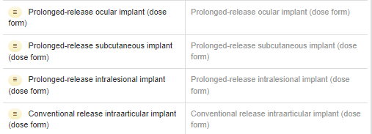
SNOMED CT implant PDF concepts
CDs using “implant” PDFs include
A ganiciclovir ocular implant
A dexamethasone and a fluocinolone ocular implant
Estradiol, etonorgestrel and levonorgestrel subcutaneous implants
A carmustine intralesional implant
Testosterone and goserelin subcutaneous implants
An autologous cultured chondrocyte intraarticular implant

Slide 20
Thoughts?
When is a prolonged release suspension not an implant?
When is an insert not an implant? Is it “into an orifice” rather than “parenteral”
Should suppositories and pessaries be considered as subtypes of insert?
An implant as a solid rather than an implant (question)
Car T – modified T cell implant (probably a dispersion)
Chondrocyte implant – cells or (lump of tissue)?

Slide 21
Discussion points
Clearly quite a mismatch between EDQM and SNOMED CT for implant concepts
Not sure if there is clinical value for all the different types of implant concepts in EDQM (although there may be a need to differentiate between a gentamicin matrix implant and a gentamicin chain implant – we need to explore this further)
See for example a Septopal product
Also do more with the known implant products (goserelin, carmustine etc.)

Slide 22
Plaster and Patch
Not forgotten….will come back to this ☺

Slide 23
New method?
Still working on this…..☺

Slide 24

Next meeting on
Thursday 24th March
at 10:00 UTC
NEXT STEPS
24

Slide 25


THANK YOU
SNOMED International: Delivering SNOMED CT

