Slide 1

Nursing Clinical Reference Group Meeting
March 8, 2022 2000 UTC
Ian Green 17th, March 2020

Slide 2
Agenda
01
04
Welcome and Introductions
Christine Spisla/Erica Culp
5 minutes
Group Discussion:
Goal setting
Pain Location Value set
Christine Spisla/Erica Culp
30 minutes.
02
05
SNOMED International News/ Updates
April Business meetings
Jane Millar/Ian Green
Call for future Nursing CRG discussion topics
Christine Spisla/Erica Culp
5 minutes
03
Terminology Consultation
Body Structure
Cathy Richardson

Slide 3
Nursing Clinical Reference Group
The SNOMED CT Nursing Clinical Reference Group aims to provide a global forum for the nursing community and clinicians interested in nursing. The role of all Clinical Reference Groups is to provide a forum to discuss issues, and influence the development and improvement of content in SNOMED CT.
The SNOMED CT Nursing Clinical Reference Group aims to represent the needs of nursing and clinical nursing documentation in SNOMED CT and support terminology development that will drive implementation of nursing focused SNOMED CT globally.

Slide 4
SNOMED International updates….
April Business Meetings
Standardized Care Plan in Norway, and they are planning for distribution using Snowstorm.

Slide 5
Terminology Consultation….
Comparing three different types of (body structure) hierarchy
General (body structure):
Entire (body structure):
Region (body structure):

Slide 6
Pain Assessment value set…..
Recap of February Nursing CRG meeting
Discussion Next Steps March 2022
Review terminology value set in small parts, continue with location value terms.
Gather a list of pain assessment tools used in your country or organization.
Identify and gather group members national/organizational requirements regarding Pain assessment.

Slide 7
Pain Assessment value set: Location
Issue Possible change content request in SNOMED CT—Pain Location
Background:
Presented here is a list of pain location terms from an US based study https://www.ncbi.nlm.nih.gov/pmc/articles/PMC5851787/. Pain location values terms are categorized by separate lists: location by directional term, location by body site and location by body side. The nursing CRG is going through US pain location terms to identifying terminology that is internationally relevant and match these terms to corresponding SCT-terms or suggest new SCT-terms/synonyms.
End goal: a list of SCT-concepts that can represent an international pain value set for “location”
Review questions:
What are use cases in nursing practice for assessing and documenting pain?
Are there any suggestions for inclusion of terms not listed?
Are there any synonyms suggestions?
Is there a need for a content change request? (new concept or new synonym)

Slide 8
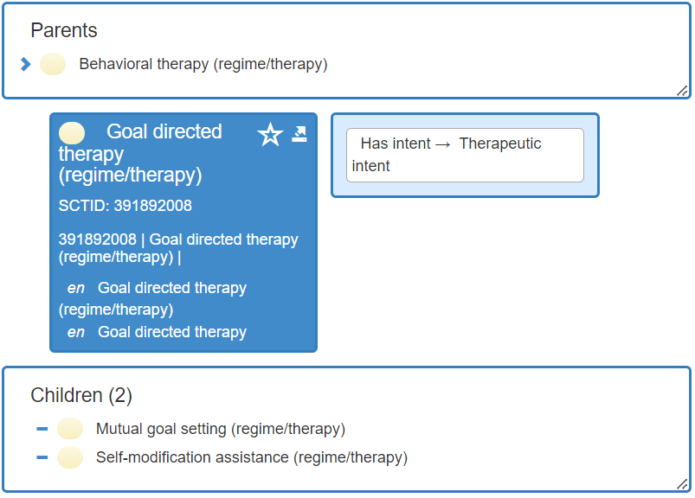
391892008 |Goal directed therapy (regime/therapy)|
Issue: Clarify/remodeling
Background: Nutrition Group ask for input of the Nursing CRG
Critical care: GDT
Nursing process: assessment, diagnosis, planning, implementation, evaluation
Is there a 363702006 |Has focus (attribute)|:
225294001 |Identifying goals (procedure)| ?

Slide 9
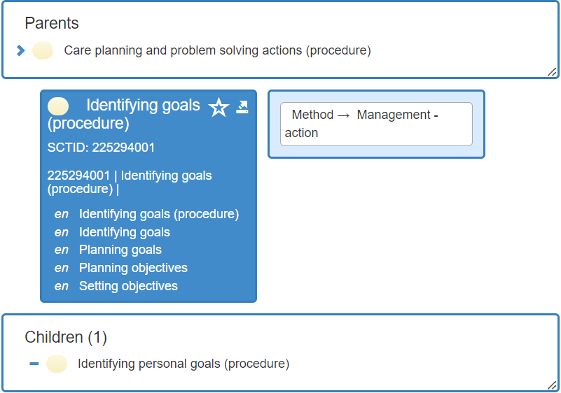
391892008 |Goal directed therapy (regime/therapy)|
Nursing process: planning
363702006 |Has focus (attribute)|:
225294001 |Identifying goals (procedure)|

Slide 10
Pain Assessment value set…..
Body Location: Direction | Fully Specified Namn | SCTID | Definition/Comment
Anterior | Anterior (qualifier value) | 255549009 | Describes the front or direction toward the front of the body. The toes are anterior to the foot.
Posterior | Posterior (qualifier value) | 255551008 | Describes the back or direction toward the back of the body. The popliteus is posterior to the patella
Dorsal | Dorsal (qualifier value) | 255554000 | Synonym for posterior meaning towards the back of the body.
Ventral | Ventral part (qualifier value) | 261186005 | Synonym for anterior meaning towards the front of the body.
Distal | Distal (qualifier value) | 46053002 | Describes a position in a limb that is farther from the point of attachment or the trunk of the body. The crus is distal to the femur.
Proximal | Proximal (qualifier value) | 40415009 | Describes a position in a limb that is nearer to the point of attachment or the trunk of the body. The brachium is proximal to the antebrachium.
Upper | Upper (qualifier value) | 261183002 | Describes a position above the transverse plane possible replacement/addition: 264217000 |Superior (qualifier value)| refers to a structure near the vertex (top of the skull)
Lower | Lower (qualifier value) | 261122009 | Describes a position below the transverse plane possible replacement/addition:261089000 |Inferior (qualifier value)| denotes a structure that is situated towards the soles of the feet

Slide 11
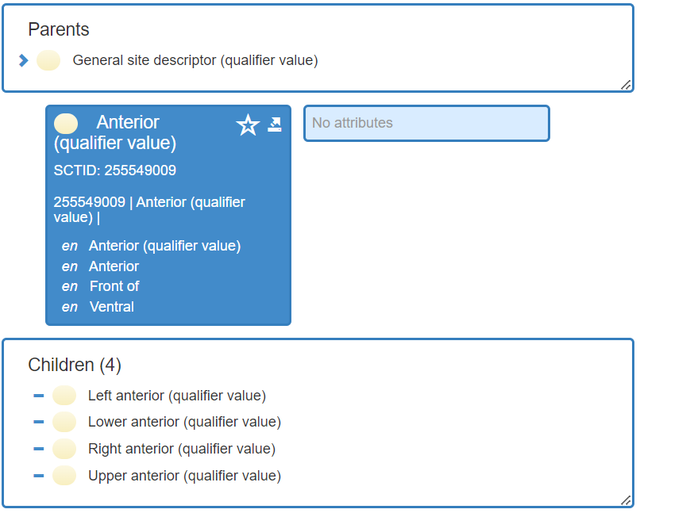
Pain Assessment value set: Location directional terms
Issue: Anterior
Background: describes the front or direction toward the front of the body. The toes are anterior to the foot. to have a continuous pain that is unpleasant but not very strong
SCTID: 255549009 |Anterior (qualifier value)|
1. Already deemed internationally relevant
2. Are any terms synonymous?
3. Content change request?

Slide 12
Pain Location: Anterior
SCTID: 255549009 |Anterior (qualifier value)|
Synonyms: Ventral
Content change request: None
Should this term be included in an International pain quality value set…..
Group Decision:
Yes

Slide 13
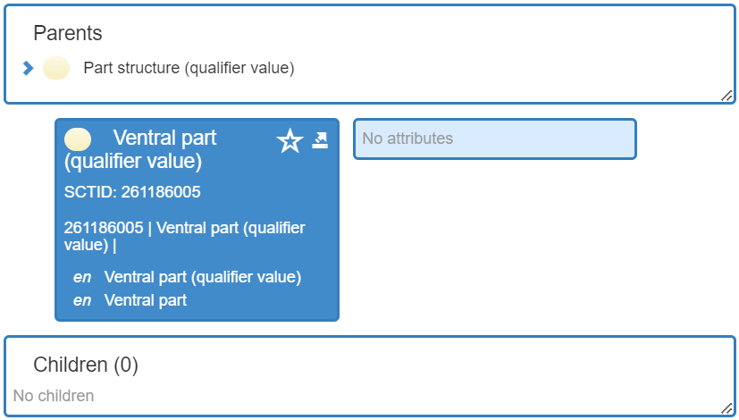
Pain Assessment value set: Location directional terms
Issue: Ventral
Background: https://www.merriam-webster.com/dictionary/ventral#:~:text=Medical%20Definition%20of%20ventral,part%20of%20the%20human%20body
being or located near, on, or toward the front or anterior part of the human body
SCTID: 261186005 |Ventral part (qualifier value)| not a match
1. Internationally relevant?
2. Are any terms synonymous?
3. Content change request?

Slide 14
Pain Location: Ventral
SCTID: 255549009 | Ventral (qualifier value)|
Synonyms: Anterior
Content change request: None
Should this term be included in an International pain quality value set…..
Group Decision:

Slide 15
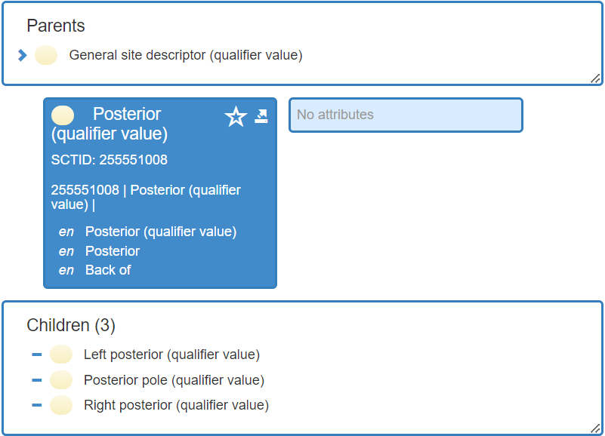
Pain Assessment value set: Location directional terms
Issue: Posterior
Background: describes the back or direction toward the back of the body. The popliteus is posterior to the patella
SCTID: 255551008 |Posterior (qualifier value)|
1. Internationally relevant?
2. Are any terms synonymous?
3. Content change request?

Slide 16
Pain Location: Posterior
SCTID: 255551008 |Posterior (qualifier value)|
Synonyms: Dorsal?
Content change request: Possible?
Should this term be included in an International pain quality value set…..
Group Decision:

Slide 17
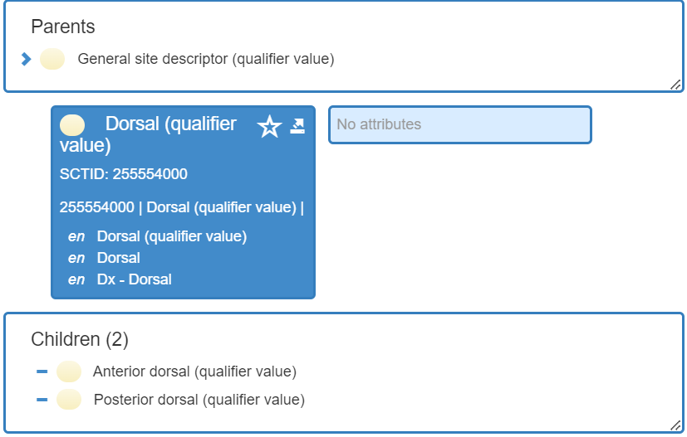
Pain Assessment value set: Location directional terms
Issue: Dorsal
Background: https://www.merriam-webster.com/dictionary/dorsal#:~:text=1%20%3A%20relating%20to%20or%20situated,noun%20(2)
relating to or situated near or on the back especially of an animal or of one of its parts
SCTID: 255554000 |Dorsal (qualifier value)|
1. Already deemed internationally relevant.
2. Are any terms synonymous?
3. Content change request?

Slide 18
Pain Location: Dorsal
SCTID: 255554000 |Dorsal (qualifier value)|
Synonyms: Posterior?
Content change request: Possible?
Should this term be included in an International pain quality value set…..
Group Decision:

Slide 19
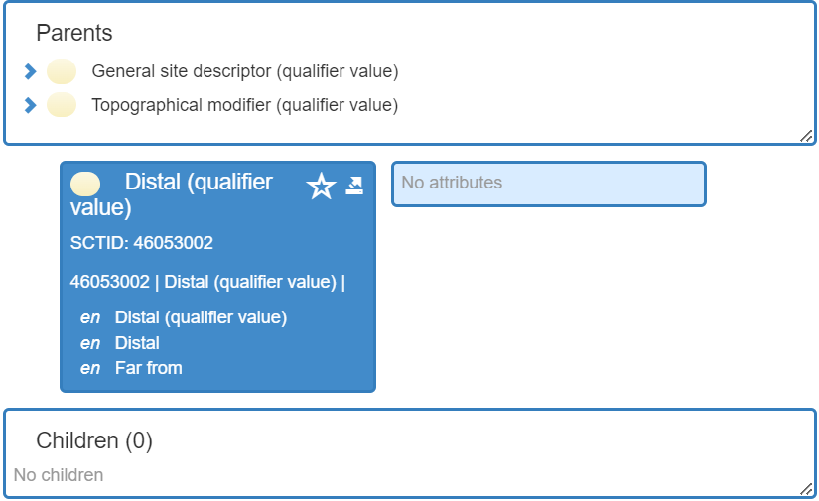
Pain Assessment value set: Location directional terms
Issue: Distal
Background: Describes a position in a limb that is farther from the point of attachment or the trunk of the body. The crus is distal to the femur.
SCTID: 46053002 |Distal (qualifier value)|
1. Already deemed internationally relevant.
2. Are any terms synonymous?
3. Content change request?
Topographical: relating to or representing the physical distribution of parts or features on the surface of or within an organ or organism.

Slide 20
Pain Location: Distal
SCTID: 255554000 |Dorsal (qualifier value)|
Synonyms:
Content change request:
Should this term be included in an International pain quality value set…..
Group Decision:

Slide 21
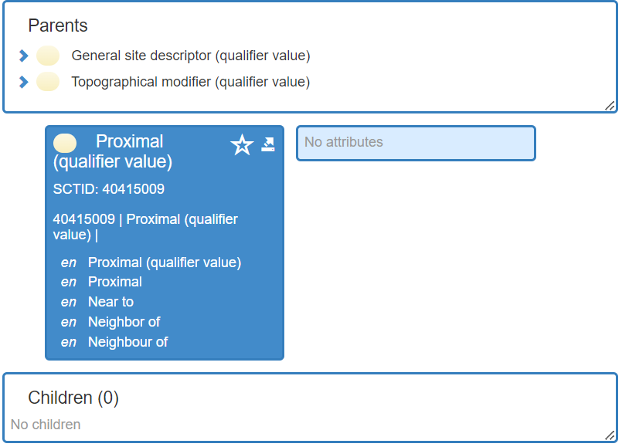
Pain Assessment value set: Location directional terms
Issue: Proximal
Background: describes a position in a limb that is nearer to the point of attachment or the trunk of the body. The brachium is proximal to the antebrachium.
SCTID: 40415009 |Proximal (qualifier value)|
1. Already deemed internationally relevant.
2. Are any terms synonymous?
3. Content change request?
Topographical: relating to or representing the physical distribution of parts or features on the surface of or within an organ or organism.

Slide 22
Pain Location: Proximal
SCTID: 40415009 |Proximal (qualifier value)|
Synonyms:
Content change request:
Should this term be included in an International pain quality value set…..
Group Decision:

Slide 23
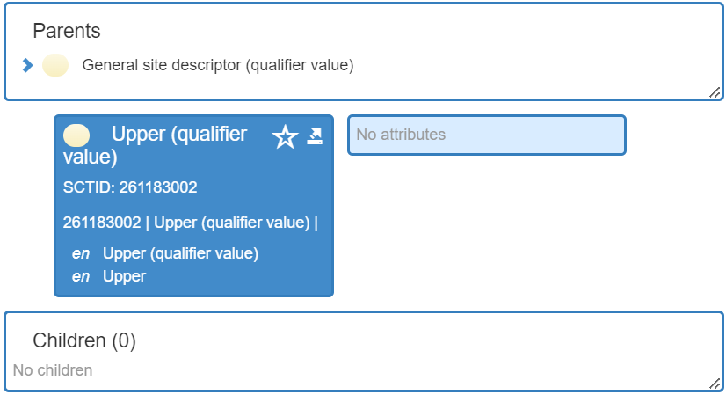
Pain Assessment value set: Location directional terms
Issue: Upper
Background: describes a position above the transverse plane
SCTID: 261183002 |Upper (qualifier value)|
1. Already deemed internationally relevant.
2. Are any terms synonymous?
3. Content change request?

Slide 24
Pain Location: Upper
SCTID: 261183002 |Upper (qualifier value)|
Synonyms:
Content change request:
Should this term be included in an International pain quality value set…..
Group Decision:

Slide 25

Pain Assessment value set: Location directional terms
Issue: Lower
Background: describes a position below the transverse plane
SCTID: 261122009 |Lower (qualifier value)|
1. Already deemed internationally relevant.
2. Are any terms synonymous?
3. Content change request?

Slide 26
Pain Location: Lower
SCTID: 261183002 |Upper (qualifier value)|
Synonyms:
Content change request:
Should this term be included in an International pain quality value set…..
Group Decision:

Slide 27
272425003 |General site descriptor (qualifier value)|
Superior (qualifier value) | Superior | 264217000
Inferior (qualifier value) | Inferior | 261089000
Top (qualifier value) | Top | 421812003
Bottom (qualifier value) | Bottom | 421610009
Superficial (qualifier value) | Superficial | 26283006
Deep (qualifier value) | Deep | 795002
Internal (qualifier value) | Internal | 260521003
External (qualifier value) | External | 261074009

Slide 28
April Open Discussion…..
April Business Meetings
Continuation of pain assessment

Slide 29
Thank you for participating
We look forward to seeing you at our next Nursing CRG Meeting
April 12th 2022 1900 UTC
Christine and Erica

