Slide 1


SNOMED CT DEUSG Subgroup
EDQM Dose Form Mapping
Linda Bird, SNOMED International
Julie James, Blue Wave Informatics
Thursday 10th February 2022

Slide 2

Welcome
Progress update
Issues discussion
Next meeting
AGENDA
http://snomed.org/deusg

Slide 3

Progress update

Slide 4
Our documentation
Mapping Guidance:
https://confluence.ihtsdotools.org/display/USRG/Mapping+Guidance+for+EDQM+to+SNOMED+CT+Pharmaceutical+Dose+Form+Mapping
“EDQM discussion items” List
https://confluence.ihtsdotools.org/display/USRG/Issues+for+discussion+with+EDQM
“SNOMED CT discussion items” List
https://confluence.ihtsdotools.org/display/USRG/Issues+for+discussion+with+SNOMED+CT
IMPLEMENTATION guidance https://confluence.ihtsdotools.org/display/USRG/Guidance+for+Implementation+of+the+EDQM+PDF+to+SNOMED+CT+PDF+mapping

Slide 5
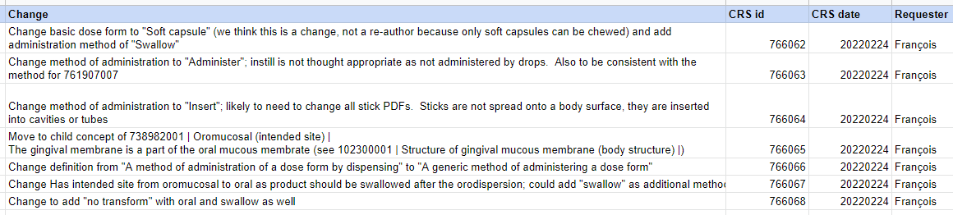
Mapping Spreadsheet update
The number of “tabs” is expanding as we organise various subject areas
    Injection/Infusion
    Misc awaiting change
    François has added columns for tracking the Change Requests that he has submitted

Slide 6
Our numbers
Date | WIP | RC1 | No Match | In “holding” | New requests | Change requests
15:12:2021 | 255 | 115 |  | 6 | 5
10:01:2022 | 255 | 130 |  | 21 | 5 | 1
27:01:2022 | 242 | 123 | 3 | 22 | 10 | 3
10:02:2022 | 214 | 138 | 3 | 37 | 14 | 4
24:02:2022 | 190 | 138 | 10 | 54 | 16 | 7
In “holding”:
Capsules = 6
Multiple sites/methods = 10
Intravesical/Urethral = 5
Infusion/Injection = 3
Misc = 5
Dispersions = 12

Slide 7
Issues for discussion

Slide 8
The Attributes
We have never “mapped attributes” directly – we decided it was not in scope
But at this point, where we are looking in detail, we can see some mismatches that we do need to review
  Definitions – like the S-CT one for “administer”
  Inconsistent use of “apply” – (e.g. for oral gel)
  The basic dose form hierarchy as we are looking at it in the dispersion slides
So, it is clear we are having to look at the attributes in some detail now, to help with our “no matches” and our “not good enough matches”

Slide 9
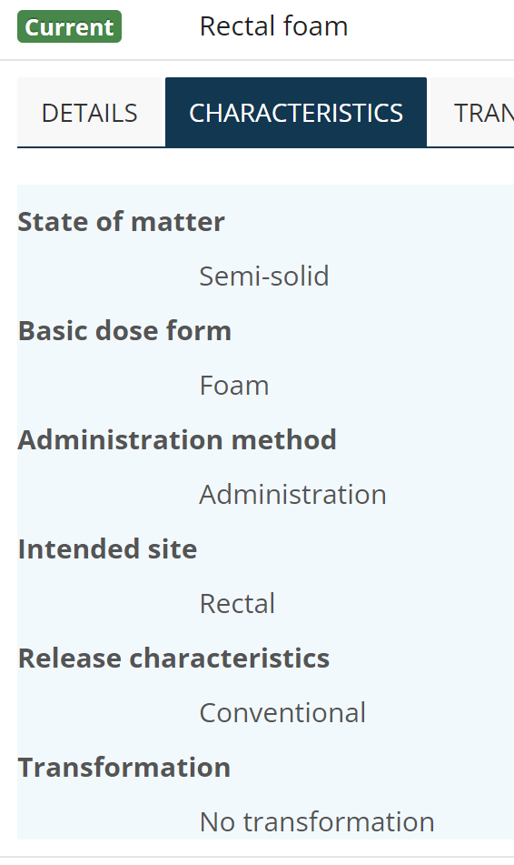
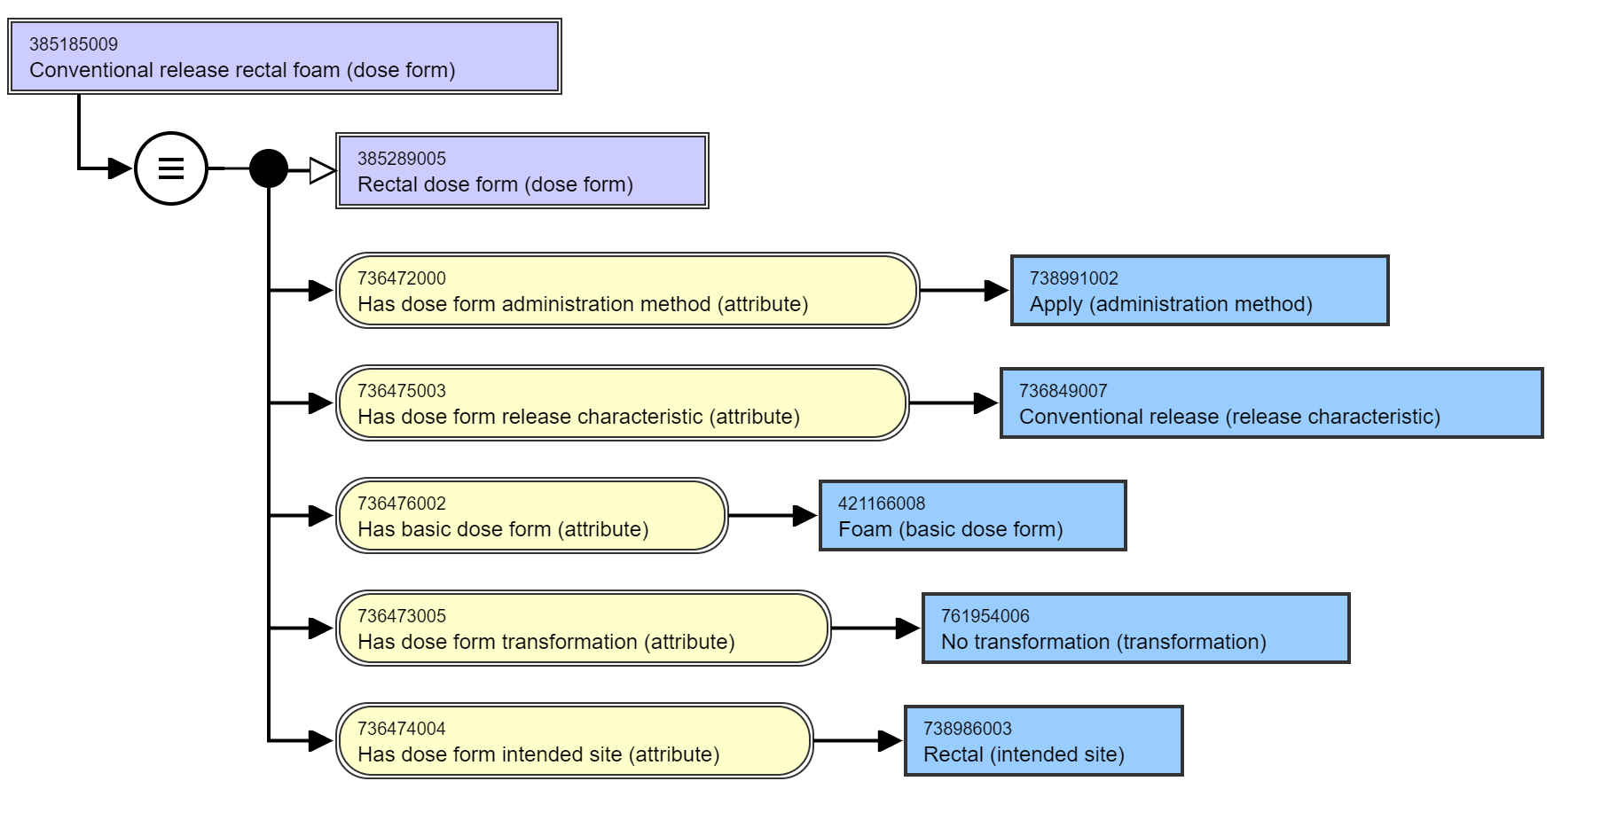
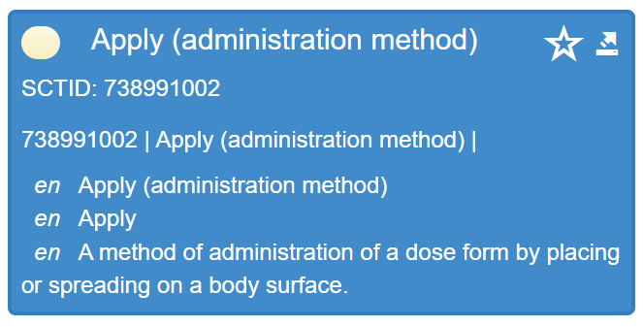
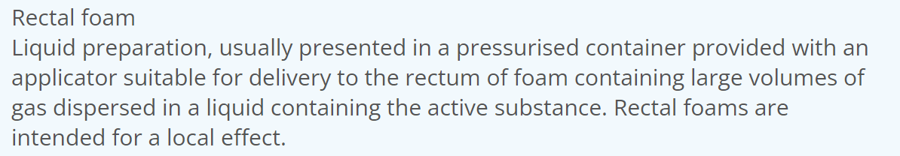
Rectal Foam

Slide 10
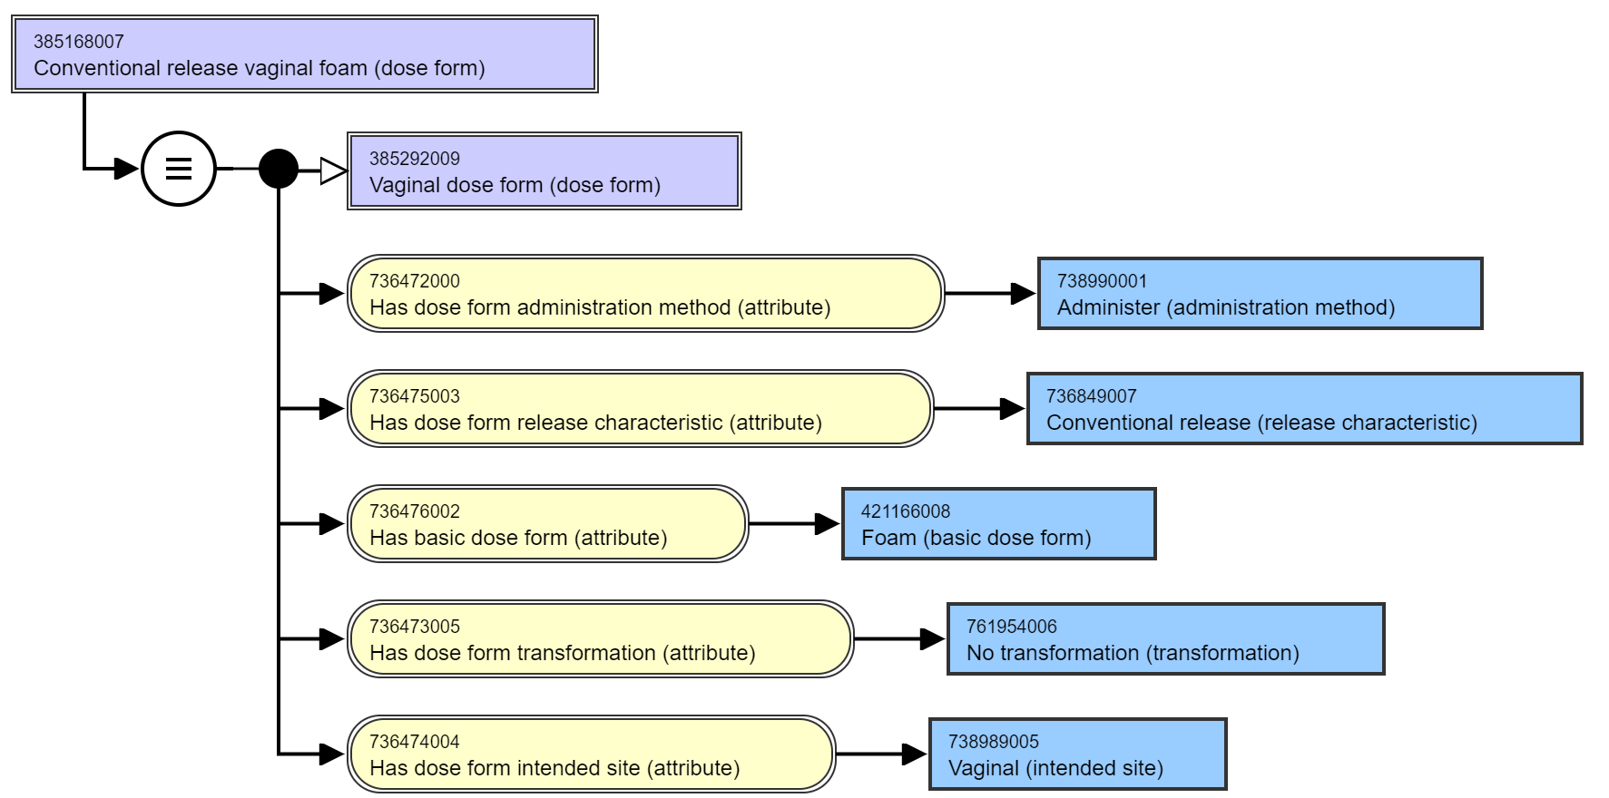
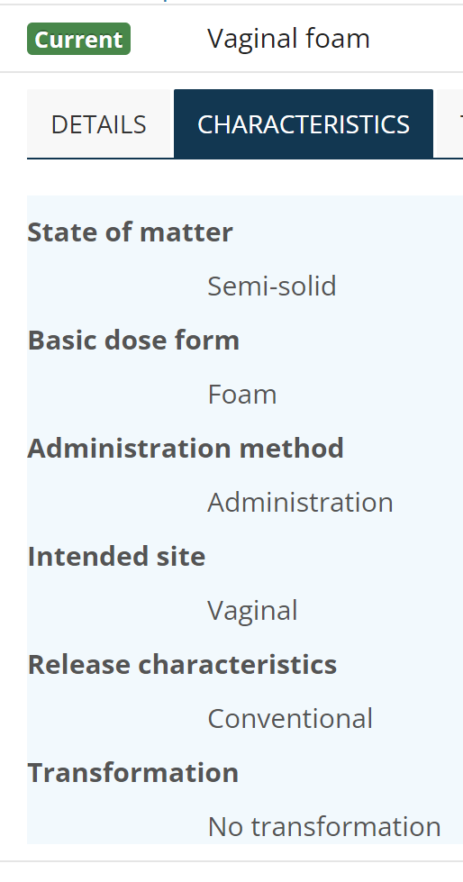
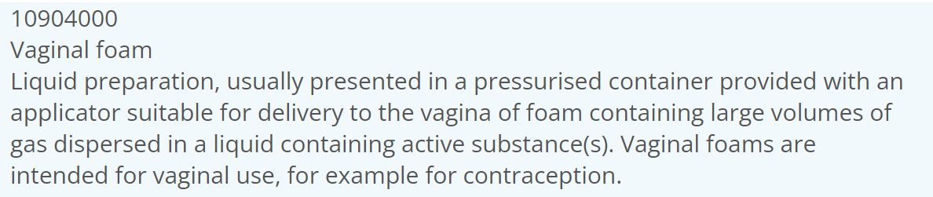
Vaginal foam

Slide 11
New method?
We’ve submitted a change request for a better definition for “administer” but we also feel we need a new method to describe those semi-solid dose forms that are introduced to body cavities (so not “applied to surfaces”) – like the rectal and vaginal foams
A separate set of slides will be distributed with details for this

Slide 12
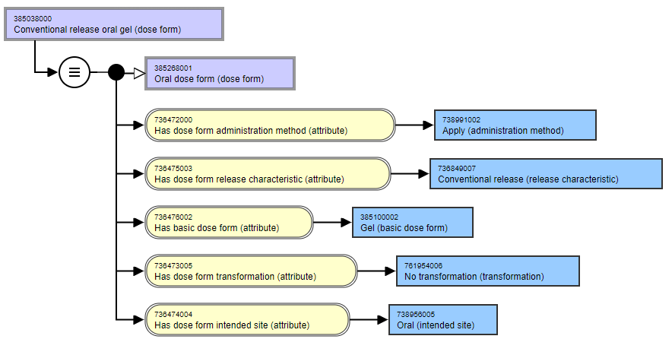
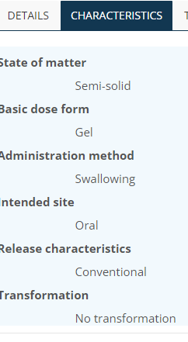
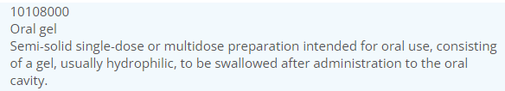
Oral gel
Oral gel products should be for swallowing, not applying
We will submit as a change request but it will probably require that the concept be re-authored
For the CDs we have using this PDF, one (miconazole) can keep this, but the carbenolone sodium and choline salicylate CDs should use the PDF “oromucosal gel”

Slide 13
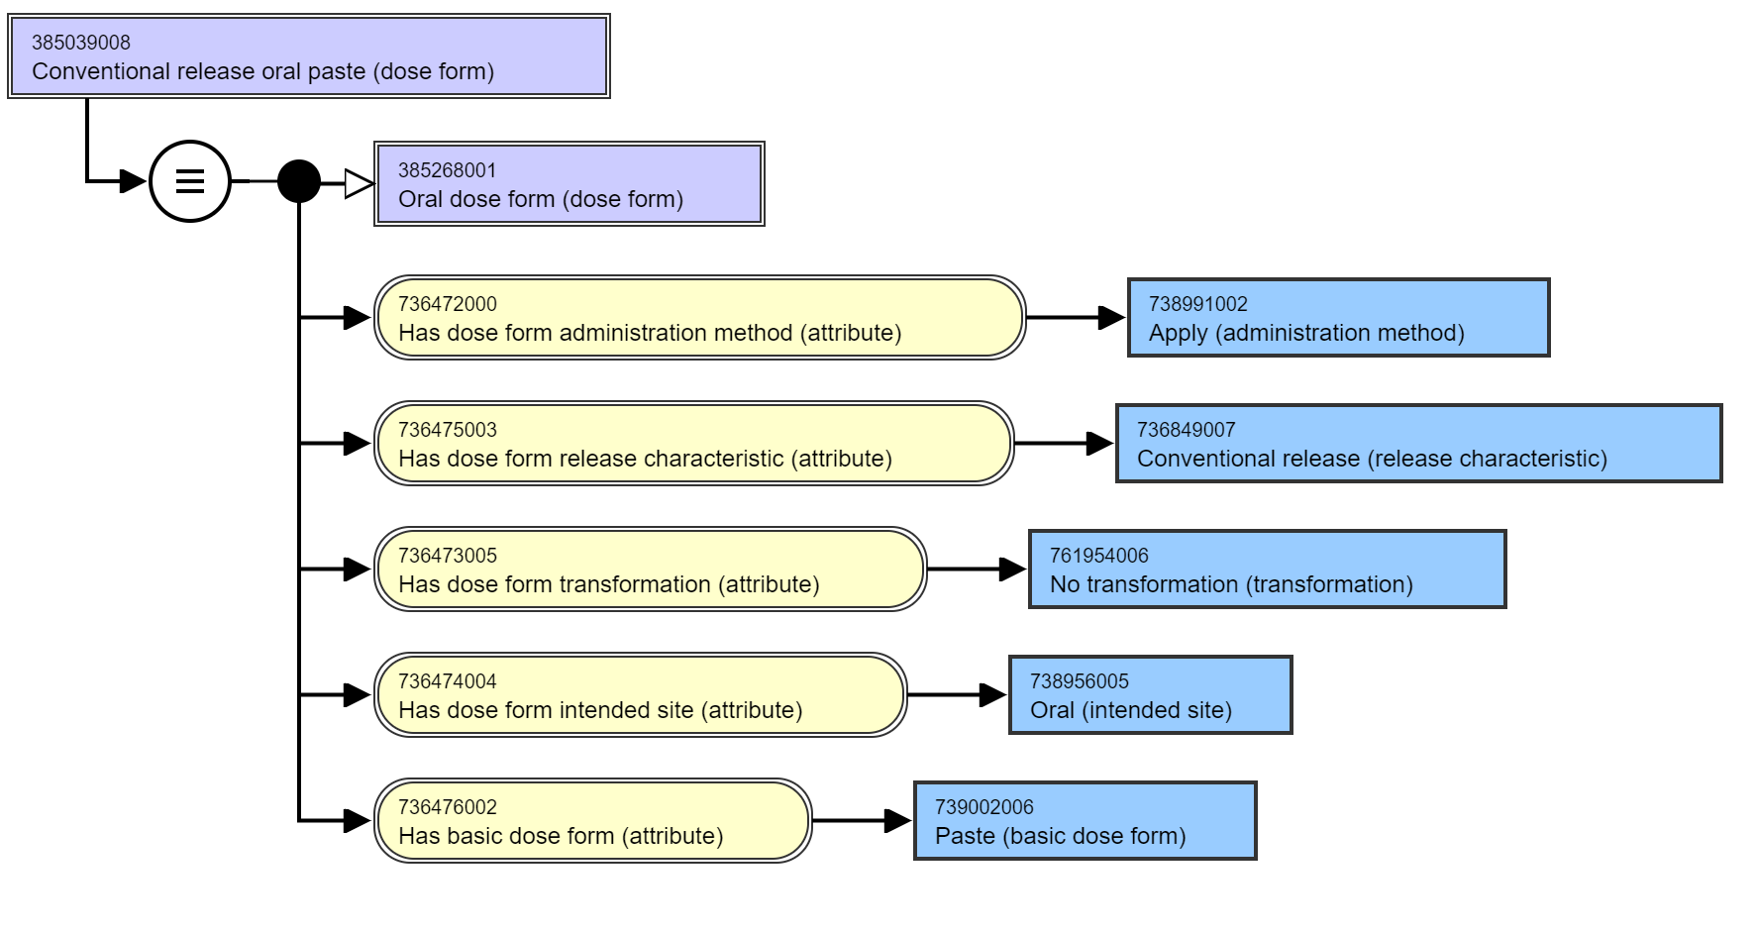
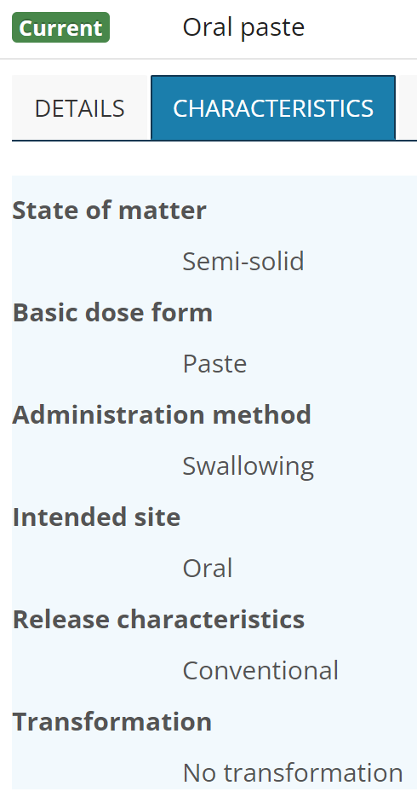
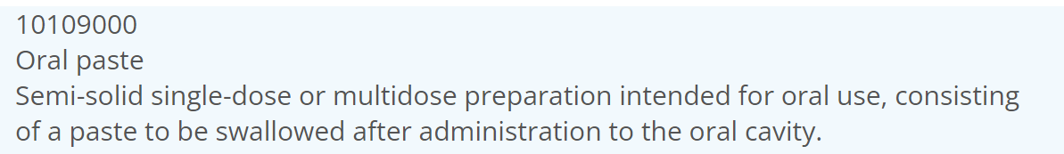
Oral paste
Oral paste products are for swallowing, not applying
We will submit as a change request but it will probably require that the concept be re-authored
BUT the 3 CDs currently using the “oral paste” PDF possibly need a different dose form:
The amlexanox and carmellose CDs should use “oromucosal paste; the fluoride ion CD should probably use “dental paste” as its PDF

Slide 14
Dispersions
Slides circulated – and included here following
Comment from David via email – to add in the magic particle size to the definition:
“A liquid dose form consisting of semi-solid, gaseous or small (less than 1 micron) liquid particles dispersed in a suitable vehicle”

Slide 15
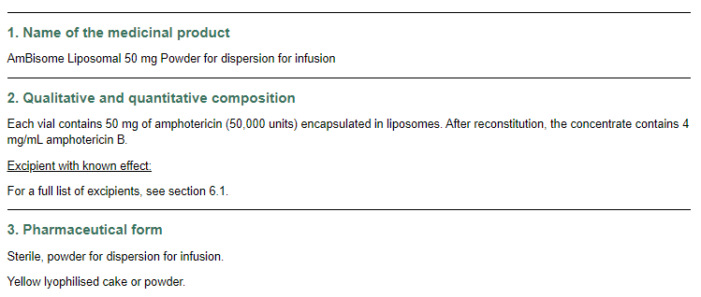
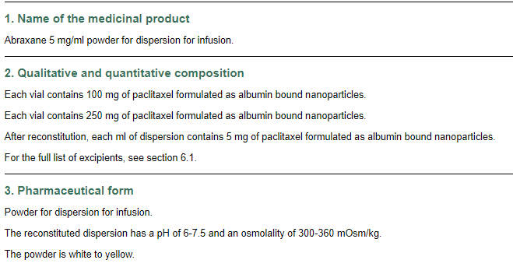
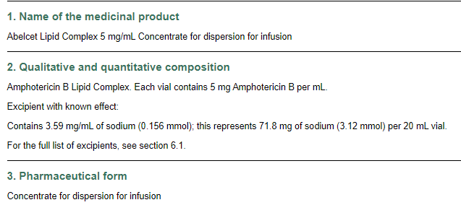
We have to deal with dispersion dose forms….

Slide 16
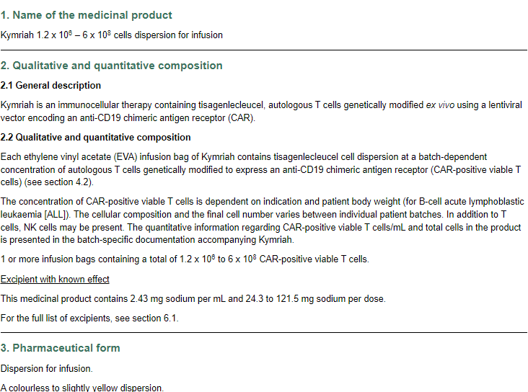
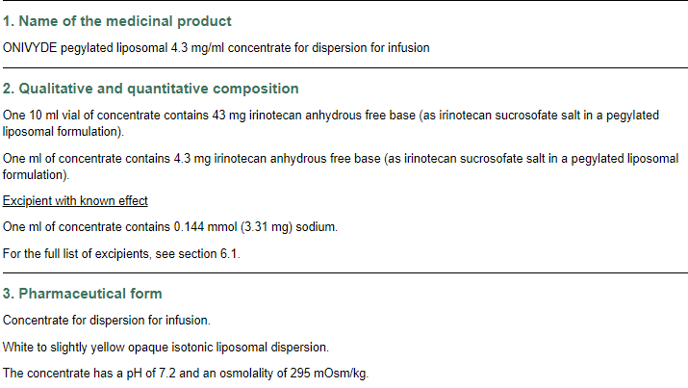
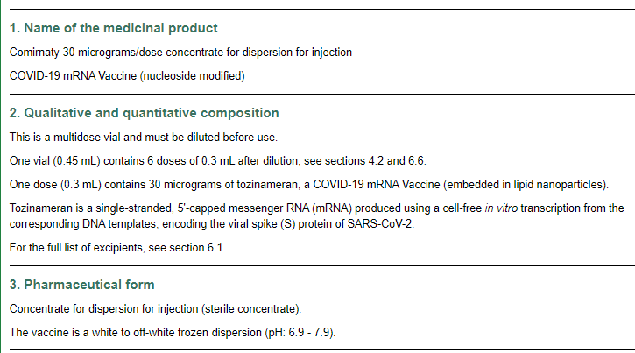
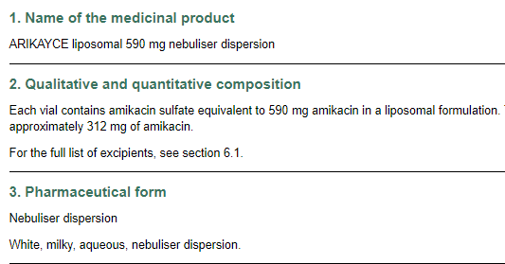
There are plenty of products using them….
Including this rather important one….

Slide 17
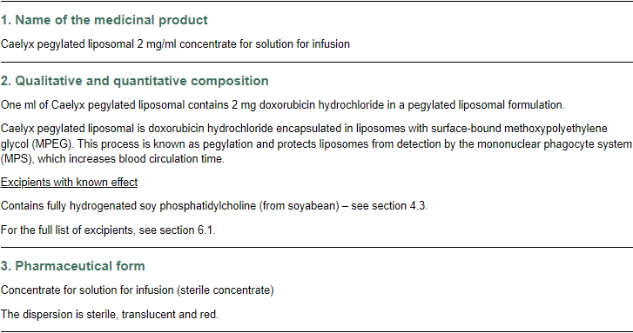
Even if not always consistently….

Slide 18
The list of EDQM dispersion dose forms includes….
Concentrate and solvent for dispersion for injection
Concentrate for dispersion for infusion
Concentrate for dispersion for injection
Dispersion for concentrate for dispersion for infusion
Dispersion for infusion
Dispersion for injection
Dispersion for injection/infusion
Nebuliser dispersion
………….
We know we have a separate issue with “concentrate” dose forms, here we focus on the dispersion challenge

Slide 19
Rationale for “dispersion” as a dose form (EDQM)
Suspension dose forms are systems where the dispersed substance(s) are solid particles that are practically insoluble in the vehicle
  THEREFORE they cannot be given IV, especially as infusions
  The concept “suspension for infusion” is deprecated, with patient safety being the reason, along with the note that “Liquid dispersed formulations, other than solid-particle suspensions and emulsions, are referred to as dispersions”
  “Suspension for injection” and related concepts are valid; suspensions can (and are) given IM and SC

Slide 20
Dispersion systems
Whilst it is true that, in chemistry, a dispersion is any “system in which distributed particles of one material are dispersed in a continuous phase of another material. The two phases may be in the same or different states of matter” so that solutions, suspensions and emulsions are all dispersions…..
In pharmaceutics, and in particular when describing pharmaceutical dose forms, there has to be some explanation, interpretation, and clarification when putting all these things together in a manageable way….
And to try to be as safe as possible for the clinicians who use the products and the patients who receive them

Slide 21
Definitions from the European Pharmacopoeia
Colloidal dispersion
A colloidal dispersion is a system in which particles of colloidal size (a nominal diameter between approximately 1 nm and 1 µm) of any nature (solid, liquid or gas, including liposomes and nanosystems) are dispersed in a continuous phase of a different composition and/or state. The use of ‘nominal diameter’ is intended to convey that not all particles are spherical. Dispersions of particles below 1 μm are considered less likely to undergo sedimentation because of the effect of Brownian motion.
Suspension
A suspension is a dispersed system comprising solid particles of a nominal diameter greater than approximately 1 µm, dispersed in a liquid or semi-solid continuous phase. If the solid particles are of a nominal diameter lower than approximately 1 µm, the system is a colloidal suspension
Emulsion
An emulsion is a dispersed system consisting of a mixture of at least 2 liquids that are not miscible with each other. One of the liquids is dispersed in the other as droplets of a diameter greater than approximately 1 µm. If the droplets are of a nominal diameter lower than approximately 1 µm, the system is a colloidal emulsion.

Slide 22
Comments on the Definitions from the EP
Particle size: 1 µm (diameter 1 micrometre) is the magic size
The EP recognises that suspensions and emulsions are dispersions, but introduces the EP concept of “a dispersion” to separate out those systems with small semi-solid or gaseous particles (liposomes, microbubbles, cells) which can be given IV from those that are larger and “more solid” and which therefore cannot be given IV.
If a “suspension” system has solid particles that are smaller than 1 µm it is a “colloidal suspension” – this is in effect “a dispersion”
A suspension has solid particles that are larger than 1 µm, and a suspension will sediment
An emulsion has immiscible liquid particles dispersed in a liquid stabilised by an emulsifier so that they should not sediment; an emulsion will scatter light” - often on the bluish spectrum. Size is also important for emulsions, with particles larger that 1 µm being plain emulsions and those with particles smaller than 1 µm being “colloidal emulsions”. This does not seem to (need to have) been carried through into the PDFs.
The PDF “Emulsion for infusion” is explicitly “oil-in-water” whereas “Emulsion for injection” can be “oil-in-water” OR “water-in-oil”

Slide 23
The EP definitions go forward into the Basic Dose Form definitions:
(Pure) Liquid: A type of liquid pharmaceutical dose form consisting of a pure substance in a liquid state
Dispersion: A type of liquid pharmaceutical dose form consisting of one or more substances, excluding solid particles and large liquid droplets, that are dispersed in an appropriate liquid vehicle. Liposomes, microbubbles, cells and colloidal dispersions (droplets with a nominal diameter less than approximately 1 micrometre in size) are included; for solid particle dispersions, see 'Suspension'; for non-miscible, large-droplet liquid dispersions, see 'Emulsion’.
Emulsion: A type of liquid pharmaceutical dose form consisting of a stable dispersion of non-miscible liquids; it consists either of oil droplets in an aqueous continuous phase (oil-in-water emulsion) or aqueous droplets in an oily continuous phase (water-in-oil emulsion); for colloidal dispersions (droplets with a nominal diameter less than approximately 1 micrometre in size), see 'Dispersion’.
Solution: A type of liquid pharmaceutical dose form consisting of one or more substances dissolved in, or miscible with, an appropriate solvent, forming a single-phase liquid
Suspension: A type of liquid pharmaceutical dose form consisting of one or more substances dispersed in a liquid vehicle; the dispersed substance(s) are solid particles that are practically insoluble in the vehicle

Slide 24
So…. Although in chemistry we might see a hierarchy like this:
Liquid state of matter
Dispersion
Solution
Suspension
Pure Liquid
Emulsion

Slide 25
…. In pharmaceutics we could see the hierarchy like this:
Liquid dose form
Solution
A type of liquid pharmaceutical dose form consisting of one or more substances dissolved in, or miscible with, an appropriate solvent, forming a single-phase liquid
Emulsion
A type of liquid pharmaceutical dose form consisting of a stable dispersion of non-miscible liquids; it consists either of oil droplets in an aqueous continuous phase (oil-in-water emulsion) or aqueous droplets in an oily continuous phase (water-in-oil emulsion); for colloidal dispersions (droplets with a nominal diameter less than approximately 1 micrometre in size), see 'Dispersion'.
Dispersion
A type of liquid pharmaceutical dose form consisting of one or more substances, excluding solid particles and large liquid droplets, that are dispersed in an appropriate liquid vehicle. Liposomes, microbubbles, cells and colloidal dispersions (droplets with a nominal diameter less than approximately 1 micrometre in size) are included; for solid particle dispersions, see 'Suspension'; for non-miscible, large-droplet liquid dispersions, see 'Emulsion'.
Suspension
A type of liquid pharmaceutical dose form consisting of one or more substances dispersed in a liquid vehicle; the dispersed substance(s) are solid particles that are practically insoluble in the vehicle
Pure liquid
A type of liquid pharmaceutical dose form consisting of a pure substance in a liquid state

Slide 26
To move forward:
At our 10th February EDQM to SNOMED CT Dose Form Mapping meeting, we agreed that, given what we now understand about “dispersion” dose forms in EDQM and that we have a range of products that have dispersion dose forms, we should request
That dispersion PDFs are added to SNOMED CT, and therefore that
A basic dose form of “dispersion” should be added to support the full definition of the PDFs
The “dispersion” basic dose form will need
  To be sibling concept to solution, suspension and emulsions BDFs
  To have a suitable text definition

Slide 27
SNOMED CT: Selected liquid basic dose forms (current)
Basic dose form (basic dose form)
Emulsion (basic dose form)
A liquid dose form consisting of an oil-in-water emulsion
Solution (basic dose form)
A liquid dose form consisting of active substance(s) in an aqueous solution
Suspension (basic dose form)
A liquid dose form consisting of a suspension of fine particles in a suitable vehicle

Slide 28
Comparison of full list of liquid basic dose forms (current) 1
BDF | EDQM Definition | SNOMED CT Definition | Comment
Collodion | A type of liquid pharmaceutical dose form usually consisting of a solution of pyroxylin in ether and ethanol | A liquid dose form consisting of active substance(s) in a mixture of ether and ethanol This is not a correct definition – the pyroxylin (nitrocellulose) must be present Change request | No PDFs use this BDF (and therefore no CDs); ALSO MP: 775377007 | Product containing only collodion (medicinal product) | There can be PDFs (e.g. with salicylic acid) but there should not be an MP
Concentrate | A type of liquid pharmaceutical dose form consisting of a concentrated preparation that must be diluted before administration | Not currently present | To be discussed
Dispersion | A type of liquid pharmaceutical dose form consisting of one or more substances, excluding solid particles and large liquid droplets, that are dispersed in an appropriate liquid vehicle. Liposomes, microbubbles, cells and colloidal dispersions (droplets with a nominal diameter less than approximately 1 micrometre in size) are included; for solid particle dispersions, see 'Suspension'; for non-miscible, large-droplet liquid dispersions, see 'Emulsion’ | Not currently present | The issue in hand ☺

Slide 29
Comparison of full list of liquid basic dose forms (current) 2
BDF | EDQM Definition | SNOMED CT Definition | Comment
Drops | A type of liquid pharmaceutical dose form that may be a dispersion, an emulsion, a solution or a suspension, and that is administered in small volumes by instillation; to be used only when further details of the specific form (e.g. dispersion, emulsion, solution, suspension) are unknown | Not present as BDF | Drops are present in PDFs, using “instill” as the method to get full definition
Elixir | Not present | No definition Is a historic concept describing a sweetened alcoholic aqueous solution; Retire as a basic dose form and exist only as a PDF for use if needed | One PDF – “oral elixir”; one CD - Phenobarbital 3 mg/mL oral elixir – could be an oral solution
Emulsion | A type of liquid pharmaceutical dose form consisting of a stable dispersion of non-miscible liquids; it consists either of oil droplets in an aqueous continuous phase (oil-in-water emulsion) or aqueous droplets in an oily continuous phase (water-in-oil emulsion); for colloidal dispersions (droplets with a nominal diameter less than approximately 1 micrometre in size), see 'Dispersion' | A liquid dose form consisting of an oil-in-water emulsion Definition to be updated A liquid dose form consisting of a system of non-miscible liquids where droplets of the discrete phase are distributed in the continuous phase ((usually oily in aqueous but can be aqueous in oily) | Not all emulsions are oil-in-water
Lacquer | A type of liquid pharmaceutical dose form consisting of one or more substances dissolved or suspended in a volatile solvent that evaporates to leave a hard coating | Not currently present | Request to add to SNOMED CT as per 3-Feb meeting

Slide 30
Comparison of full list of liquid basic dose forms (current) 3
BDF | EDQM Definition | SNOMED CT Definition | Comment
Foam | A type of semi-solid pharmaceutical dose form consisting of a large volume of gas dispersed in a liquid or sometimes a solid phase | A liquid dose form usually presented in a pressurised multi-dose container equipped with an applicator suitable for delivery of a foam consisting of large volumes of gas dispersed in a liquid containing active substance(s) | The basic dose form is a semi-solid not a liquid – the liquid is transformed to the foam Change to semi-solid grouping
Lacquer | A type of liquid pharmaceutical dose form consisting of one or more substances dissolved or suspended in a volatile solvent that evaporates to leave a hard coating | Not currently present | Request to add to SNOMED CT as per 3-Feb meeting
(Pure) Liquid | A type of liquid pharmaceutical dose form consisting of a pure substance in a liquid state | Not present | Request for addition to SNOMED CT – see slide following

Slide 31
(Pure) Liquid basic dose form (new)
Definition: A liquid dose form consisting of a pure substance in its liquid state
Note: To be used in a PDF (so combined with site, method etc) and then the pure active ingredient substance is named in the CD
Example 1:
PDF: conventional release liquid for ear drops
CD: Olive oil 1000mg/mL ear drops
Example 2:
PDF: conventional release liquid for inhalation
CD: Isoflurane 1000mg/mL liquid for inhalation

Slide 32
Comparison of full list of liquid basic dose forms (current) 4
BDF | EDQM Definition | SNOMED CT Definition | Comment
Lotion | Not present | No definition | Two PDFs – Cutaneous lotion and eye lotion; lots of CDs
Oil | Not present as BDF or PDF | A liquid dose form consisting of active substance(s) dissolved in a hydrophobic base | Three PDFs; 6 CDs – all could be solution – see slide following
Pressurized emulsion |  | No definition – we are about to do the pulmonary dose forms in detail | Present in EDQM as PDF (Pressurised inhalation, emulsion) with BDF = emulsion
Pressurized solution |  | No definition – we are about to do the pulmonary dose forms in detail | Present in EDQM as PDF (Pressurised inhalation, solution) with BDF = solution
Pressurized suspension |  | No definition – we are about to do the pulmonary dose forms in detail | Present in EDQM as PDF (Pressurised inhalation, suspension) with BDF = suspension
Shampoo | A type of liquid (or occasionally semi-solid) pharmaceutical dose form that contains surface-active agents and usually forms a foam after rubbing on the scalp with water | Not present | Shampoo is PDF in SNOMED CT but it does not have a basic dose form although Ed Guide says it should

Slide 33
Oil – basic dose form - retire
Used in 3 PDFs and 6 CDs:
1173983000 |Conventional release cutaneous oil for bathing (dose form)|
  173982005 | Product containing precisely light liquid paraffin 634 milligram/1 gram conventional release cutaneous oil for bathing (clinical drug)
  This comes from the “bath additive” issue….we shouldn’t have called it an oil ☹ - It’s Oilatum https://www.medicines.org.uk/emc/product/5454 - should have called it a “cutaneous emulsion for bathing” as we did for the coal tar product
420540006 |Conventional release cutaneous oil (dose form)|
  786869003 | Product containing precisely cetyl dimeticone 50 milligram/1 milliliter conventional release cutaneous oil (clinical drug) |
    Present in RxNorm, not in Daily Med; cannot trace an authorised product
  14272004 | Product containing precisely fluocinolone acetonide 100 microgram/1 milliliter conventional release cutaneous oil (clinical drug) |
    Think this is Synalar https://dailymed.nlm.nih.gov/dailymed/drugInfo.cfm?setid=4feecef4-553f-4a90-a3ce-a19eb04bd68e – called a “topical solution” in Daily Med; therefore should have dose form “cutaneous solution”

Slide 34
Oil – basic dose form (2)
420253005 |Prolonged-release oil for injection (dose form)|
782053007 | Product containing precisely phenol 50 milligram/1 milliliter prolonged-release oil for injection (clinical drug) |
  Should be “solution for injection; is not “prolonged release” https://www.medicines.org.uk/emc/product/3608/smpc
781920002 | Product containing precisely haloperidol (as haloperidol decanoate) 100 milligram/1 milliliter prolonged-release oil for injection (clinical drug)
781919008 | Product containing precisely haloperidol (as haloperidol decanoate) 50 milligram/1 milliliter prolonged-release oil for injection (clinical drug) |
  Both the above should be “solution for injection” it’s the decanoate substance that makes the CD have a long action not the formulation https://www.medicines.org.uk/emc/product/968

Slide 35
More on oils
Lots of “oil” substances
  Lavender oil
  Rose oil
  Pine oil
  Orange oil
  Clove oil
  Castor oil…etc. etc.
The group noted these are “essential oils” where the oil forms the vehicle for the distilled extraction of the natural oil are substances
Lots of “oil” MPs and MP onlys, using the oil substance as the active ingredient
  Lavender oil only product
  Rose oil only product
  Pine oil only product
  Orange oil only product
  Clove oil only product
  Castor oil only product…etc. etc.
What would be CDs for these? Or do we avoid them?

Slide 36
Comparison of full list of liquid basic dose forms (current) 5
BDF | EDQM Definition | SNOMED CT Definition | Comment
Solution | A type of liquid pharmaceutical dose form consisting of one or more substances dissolved in, or miscible with, an appropriate solvent, forming a single-phase liquid | A liquid dose form consisting of active substance(s) in an aqueous solution Definition to be updated A liquid dose form consisting of active substance(s) dissolved in a single phase solvent liquid which may be aqueous or oily | Not all solutions are aqueous
Spirit | Not present | A liquid dose form consisting of active substance(s) in an alcohol | A type of solution? Usually the active substance is volatile NO PDFs use this concept - retire
Spray | A type of pharmaceutical dose form that may be liquid, semi-solid or solid, administered as a dispersion in air; to be used only when further details of the specific form (e.g. solution, suspension, powder) are unknown | Not present as BDF | Sprays are present in PDFs, using “spray” as the method to get full definition

Slide 37
Comparison of full list of liquid basic dose forms (current) 6
BDF | EDQM Definition | SNOMED CT Definition | Comment
Suspension | A type of liquid pharmaceutical dose form consisting of one or more substances dispersed in a liquid vehicle; the dispersed substance(s) are solid particles that are practically insoluble in the vehicle | A liquid dose form consisting of a suspension of fine particles in a suitable vehicle
Syrup | A type of liquid pharmaceutical dose form consisting of a viscous liquid usually with a high concentration of sugar or other sweetening agent | A liquid dose form consisting of active substance(s) dissolved in a concentrated solution of sugar | Make a child of solution
Tincture | Not present | A liquid dose form consisting an alcoholic extract of plant or animal material | No PDFs; No CDs 10 Substances described as “Tinctures” (e.g. Iodine tincture, Arnica tincture) 3 MPs use tincture substances (Arnica and benzoin)
Tinctures are much like the essential oils, but instead of using an oil for the solution, tinctures use an alcohol (but usually not pure alcohol – may be only 20%)

Slide 38
SNOMED CT: Liquid basic dose forms (Current)
Liquid basic dose form (basic dose form)
Emulsion
Solution
Suspension
Collodion
Pressurised emulsion
Foam
Lotion
Elixir
Syrup
Oil
Pressurised solution
Pressurised suspension
Spirit
Red = retire
Orange = change
Purple = to be reviewed

Slide 39
SNOMED CT: Liquid basic dose forms (Future)
Basic dose form (basic dose form)
Emulsion
A liquid dose form consisting of a stable system of non-miscible liquids; the continuous phase may be aqueous or oily
Solution
Syrup
Suspension
A liquid dose form consisting of insoluble solid particles suspended in a suitable vehicle
Dispersion
Lacquer
(Pure) Liquid
A liquid dose form consisting of semi-solid, gaseous or small (less than 1 micron) liquid particles dispersed in a suitable vehicle
A liquid dose form consisting of active substance(s) suspended or dissolved in a volatile liquid which evaporates to leave them in a hard coating
A liquid dose form consisting of a pure substance in its liquid state
A liquid dose form consisting of active substances dissolved in a single (aqueous or oily) continuous phase
A liquid dose form consisting of active substance(s) dissolved in continuous phase with a high concentration of sugar or sweetener
Collodion
A liquid dose form consisting of active substance(s) in a mixture of pyroxylin in ether and ethanol

Slide 40
Additional recommendation (suggestion)
When authoring clinical drugs, especially in the International Edition, the “correct” pharmaceutical dose form should be assigned wherever possible, even if this differs from what is exactly stated in the product literature
We recognise that this might cause some issues in classification, but for abstract concepts like the CD, where (in the International Edition) there is no direct traceability back to product literature and actual products, to use the dose form that gives the best (safest) description of a medicinal product in its “clinical view”

Slide 41

Implants
There are 10 “implant” dose forms in EDQM
And 4 in SNOMED CT
No implant dose forms have currently found their way to RC1 – all are “unmapped” in WIP – this may mean there is quite a conceptual “mismatch”
We will explore….

Slide 42
EDQM implant concepts (1):
EDQM ID | EDQM Term | EDQM definition | Comments from mappers
11303500 | Implantation suspension | Liquid sterile preparation consisting of a suspension intended for implantation in the body; the active substance(s) are released over an extended period of time to obtain a local or systemic effect | edqm: implant SOM = liquid sct: implant SOM = solid
11302000 | Implantation tablet | Solid sterile preparation prepared by compression of a solid active substance as such or of a formulation thereof into an implant of a size and shape suitable for implantation, usually subcutaneously. Each implantation tablet is presented in a sterile container. Implantation tablets are intended for release over an extended period of time in order to obtain local or systemic effect | no real product in our MPD
11301000 | Implant | Solid sterile preparation of a size and shape suitable for implantation. It may be prepared by moulding or other means other than compression. Each implant is presented in a sterile container that may be provided with an administration device. Implants are intended for release over an extended period of time in order to obtain local or systemic effect. 'Implantation tablet', 'Implantation chain' and 'Implantation matrix' are excluded | sct: 385286003 |Implant (basic dose form)| ; one real product, doscoid form for intracavitary implantation
11303000 | Implantation chain | Solid sterile preparation consisting of small spheres mounted on a non-degradable thread to form a chain that allows withdrawal of the remainder of the chain after a certain period of action. Each implantation chain is presented in a sterile container. The implantation chain is intended for release over an extended period of time in order to obtain local or systemic effec | no real product in our MPD
11303300 | Implantation matrix | Solid sterile preparation consisting of a usually pliable, absorbent piece of material (e.g. collagen), usually impregnated with a liquid preparation, intended for implantation in the body. The material may be cut into smaller pieces before implantation, and may be shaped around a tissue (e.g. a bone) or inserted into a medical device that is then implanted. Implantation matrices are intended for release over an extended period of time, usually in order to obtain a local effect. Usually the matrix disappears with time. When the product is packaged as a separate matrix, powder and solvent (or matrix and solution), which are used to prepare the implantation matrix immediately before use, the appropriate combined term should be used; see for example ‘Powder, solvent and matrix for implantation matrix’. | no real product in our MPD

Slide 43
EDQM implant concepts (2):
EDQM ID | EDQM Term | EDQM definition | Comments from mappers
13018000 | Matrix for implantation matrix | Solid sterile preparation consisting of a usually pliable, absorbent piece of material (e.g. collagen) intended to be used in the preparation of an implantation matrix.
50049500 | Powder for implantation suspension | Solid sterile preparation consisting of one or more powders, including freeze-dried powders, intended to be dispersed in the specified liquid to obtain an implantation suspension
13027000 | Powder for implantation matrix | Solid sterile preparation consisting of one or more powders, including freeze-dried powders, intended to be used in the preparation of an implantation matrix, e.g. by dissolving in the specified liquid to prepare the solution used to impregnate the matrix | SCT focuses on where the implant "goes" (intralesional, subcutan). EDQM focuses on what the implant is (implant, matrix, tablet, chain, paste etc)
13028000 | Powder for implantation paste | Solid sterile preparation consisting of one or more powders intended to be mixed with the specified liquid or paste to obtain an implantation paste
13043000 | Implantation paste | Semi-solid sterile preparation containing large proportions of solids finely dispersed in the basis, intended to be implanted in the body for release of the active substance(s) over an extended period of time, usually to obtain a systemic effect | no parenteral paste, nor implant associated AM, some BDF implant with IS subcutaneaous. No French Drug example to investigate deeper

Slide 44
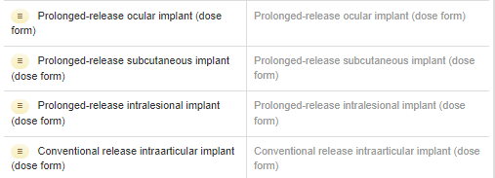
SNOMED CT implant PDF concepts
CDs using “implant” PDFs include
A ganiciclovir ocular implant
A dexamethasone and a fluocinolone ocular implant
Estradiol, etonorgestrel and levonorgestrel subcutaneous implants
A carmustine intralesional implant
Testosterone and goserelin subcutaneous implants
An autologous cultured chondrocyte intraarticular implant

Slide 45
Thoughts?
When is a prolonged release suspension not an implant?
An implant as a solid rather than an implant (question)
Car T – modified T cell implant (probably a dispersion)
Chondrocyte implant – cells or (lump of tissue)?

Slide 46
Plaster and Patch
Not forgotten….will come back to this ☺

Slide 47

Next meeting on
Thursday 10th March
at 10:00 UTC
NEXT STEPS
47

Slide 48


THANK YOU
SNOMED International: Delivering SNOMED CT

