Slide 1


SNOMED CT DEUSG Subgroup
EDQM Dose Form Mapping
Linda Bird, SNOMED International
Julie James, Blue Wave Informatics
Thursday 4th November 2021

Slide 2

Welcome
Mapping activity
Issues for discussion
Next meeting
AGENDA
http://snomed.org/deusg
Notes:
What have you been doing and what have I been doing?

Slide 3

Mapping Activity

Slide 4
Our documentation
Mapping Guidance:
https://confluence.ihtsdotools.org/display/USRG/Mapping+Guidance+for+EDQM+to+SNOMED+CT+Pharmaceutical+Dose+Form+Mapping
“EDQM discussion items” List
https://confluence.ihtsdotools.org/display/USRG/Issues+for+discussion+with+EDQM
“SNOMED CT discussion items” List
https://confluence.ihtsdotools.org/display/USRG/Issues+for+discussion+with+SNOMED+CT

Slide 5
Where are we now?
83 EDQM dose forms not yet evaluated (out of nearly 400)
Tara – a small handful (about 5)
Martha – <40
Catherine/Elisabeth - <40
Can we help each other out….(I think Olivier may have already offered….)

Slide 6
What is it looking like?
179 1..1 matches
Of which 109 also matched on the attributes
  Which means 70 did not! –
  Many of these were the Transdermal/Cutaneous intended site, but also mismatches on oromucosal etc.
    Chris: Historically – “to be applied to the skin” so “Transdermal/Cutaneous” is a grouping concept that reflects that
    A split has been recommended by an ontologic investigation (RvdS
    Any change has to be proposed to (and accepted by) the Standard Terms Working Party before any change could be made; NB it is the term and the definition that has (until now) been most important
  From us as SNOMED DEUSG mappers/users/implementers, we support the splitting of the Transdermal/Cutaneous intended site as this supports/facilitates the connection between the regulatory and the clinical, which patient care MPD all have to do
  We would also support a revision of the oromucosal intended sites….we will share our discussions on this with Chris on a future call

Slide 7
What is it looking like?
105 1..0 no matches
Lots of X for Y for Z (e.g. “Dispersion for concentrate for dispersion for infusion”
Many have “dispersion” in them…..
It would probably be helpful if we reprised our “Dispersion” discussion of early October with Chris
We must remember that changes to the attributes do not affect the change to the EDQM concept itself, and therefore that SmPC are unlikely to change their dose form information much
BUT as experience becomes greater with using the PDFs etc, we can hope for generally “better data” over time

Slide 8
Multiple site dose forms: follow up
François….?
The CRS requests are in and will be going through the process

Slide 9
Update to main DEUSG
Scheduled for 28th November (I think) – we have another meeting before then (on the 18th November)

Slide 10
Issues for discussion

Slide 11
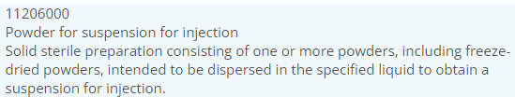

13048000: Granules for suspension for injection
The only parenteral use of granules as opposed to powder….
Why?
When does a powder become a granule?
Powder: “dry substance composed of finely divided particles”
Granule: “small particles gathered into a larger, permanent aggregate in which the original particles can still be identified”
Research suggests that granules may be considered a subtype of powders (?)

Slide 12
13048000: Granules for suspension for injection
Chris:
For human use, all parenteral powders are just “powders”;
for some reason the veterinary authorities like to differentiate lyophilised powders
Not clear if there are any products using this dose form, nor whether there is any practical difference between a “powder for suspension for injection” and this concept
If we need to map, we probably could map to the powder for suspension for injection concept

Slide 13
Oromucosal and Orodispersible
10236100: Orodispersible film
Solid preparation consisting of a single- or multilayer sheet of suitable material(s) intended to be placed in the mouth where it disperses rapidly before being swallowed
BDF = Film; AdmMethod = Orodispersion; IntSite = Oral
10223000: Orodispersible tablet
Solid single-dose preparation consisting of an uncoated tablet intended to be placed in the mouth where it disperses rapidly in saliva before being swallowed
BDF = Tablet; AdmMethod = Orodispersion; IntSite = Oral
Orodispersion = Administration of a pharmaceutical product by placing it in the mouth and allowing it to dissipate; the product is usually then swallowed
[S-CT = orodisperse]

Slide 14
Oromucosal and Orodispersible
13149000: Oromucosal film (possibly no products yet marketed)
Solid preparation consisting of a single- or multilayer sheet of suitable material(s) intended for oromucosal use. It is applied to the oral cavity or onto specific parts of the oral cavity, usually to obtain a systemic effect. Where a preparation is intended for use only at a single specific part of the oral cavity, the appropriate specific term (e.g. Buccal film, Sublingual film) is used instead
BDF = Film; AdmMethod = Application; IntSite = Oromucosal
10317000: Oromucosal capsule
Solid single-dose preparation contained in a soft shell to be chewed or sucked to obtain a local effect in the oral cavity
BDF = Capsule; AdmMethod = Sucking/Chewing; IntSite = Oromucosal

Slide 15
Lyophilisate
10224000: Oral lyophilisate
Solid single-dose preparation made by freeze-drying of a liquid or semi-solid preparation. This fast-releasing preparation is intended to be placed in the mouth where its contents are released in saliva and swallowed or, alternatively, to be dissolved in water before oral administration
BDF = Lyophilisate; AdmMethod = Swallowing; IntSite = Oral
13127000 : Sublingual lyophilisate
Solid single-dose preparation made by freeze-drying of a liquid or semi-solid preparation, intended for sublingual use
BDF = Lyophilisate; AdmMethod = Administration; IntSite = Oromucosal

Slide 16
Comments from Chris
Orodispersible dose forms should disperse in the mouth but the majority of the product should be swallowed – therefore the “intended site” is oral
Oromucosal dose forms should either be for direct oromucosal use or for oromucosal absorption therefore the “intended site” is oromucosal (or a sub-concept like sublingual)

Slide 17
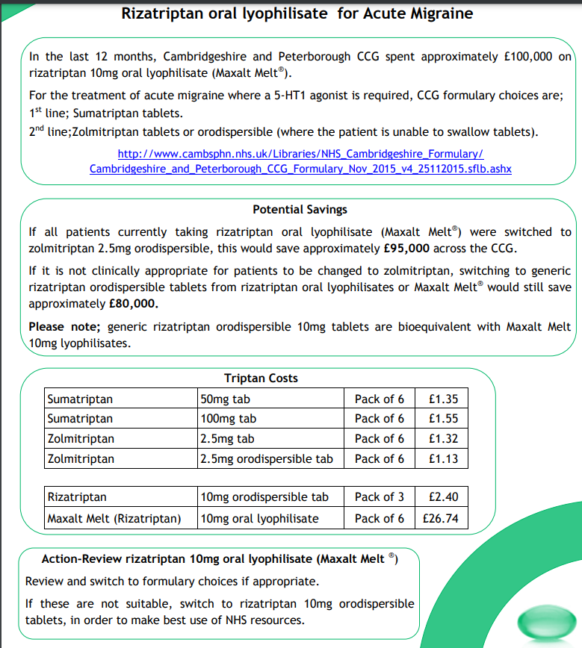
Bioequivalence Study of Two Orodispersible Rizatriptan Formulations of 10 mg in Healthy Volunteers
Sci Pharm. 2016; 84(3): 514–522.
https://www.who.int/medicines/areas/quality_safety/quality_assurance/Annex5TRS-970.pdf?ua=1
“Orodispersible dose forms”
Tablets
Lyophilisates
Films/wafers
“Orodispersible dosage forms are intended for systemic effect after being swallowed but absorption may also take place in the mouth and pharynx. Taste masking may be necessary using water-soluble sweeteners and flavouring”

Slide 18
We also have some administration“mismatches”
10108000: Oral gel mapped to 385038000: Conventional release oral gel
EDQM AdmMethod = Swallow
S-CT AdmMethod = Apply
Daktarin – is it really an oral gel? Indication: Oral treatment of candidosis of the oropharynx
This product may well “update” to being an oromucosal gel in the future
An “oral gel” would be something similar to the energy gels used in sports etc – a gel that is swallowed
10109000: Oral paste mapped to 385039008: Conventional release oral paste
EDQM AdmMethod = Swallow
S-CT AdmMethod = Apply

Slide 19
Relating “solution” and “spray, solution”
Similar challenge to “solution” and “drops, solution” (same for suspension and emulsion too)
Both “drops” and “spray” can be basic dose forms (!) if the solution/emulsion/suspension is not specified
We did not discuss this section, but Chris confirmed that these two basic dose forms are “legacy” from the times when the solution/suspension/emulsion information was not provided
We will come back to this, as it may have some effect on how some things classify in SNOMED CT

Slide 20

Team support:
Julie will reach out separately to Olivier and Martha to share a few more concepts to map

Slide 21

Next meeting on
Thursday 18th November
at 10:00 UTC
NEXT STEPS
21

Slide 22


THANK YOU
SNOMED International: Delivering SNOMED CT

