Slide 1


SNOMED CT DEUSG Subgroup
EDQM Dose Form Mapping
Linda Bird, SNOMED International
Julie James, Blue Wave Informatics
Thursday 10th February 2022

Slide 2

Welcome
Progress update
Issues discussion
Next meeting
AGENDA
http://snomed.org/deusg
Notes:
What have you been doing and what have I been doing?

Slide 3

Progress update

Slide 4
Our documentation
Mapping Guidance:
https://confluence.ihtsdotools.org/display/USRG/Mapping+Guidance+for+EDQM+to+SNOMED+CT+Pharmaceutical+Dose+Form+Mapping
“EDQM discussion items” List
https://confluence.ihtsdotools.org/display/USRG/Issues+for+discussion+with+EDQM
“SNOMED CT discussion items” List
https://confluence.ihtsdotools.org/display/USRG/Issues+for+discussion+with+SNOMED+CT
IMPLEMENTATION guidance https://confluence.ihtsdotools.org/display/USRG/Guidance+for+Implementation+of+the+EDQM+PDF+to+SNOMED+CT+PDF+mapping

Slide 5
Mapping Spreadsheet update
The number of “tabs” is expanding as we organise various subject areas
    Injection/Infusion
    Misc awaiting change

Slide 6
Our numbers
Date | WIP | RC1 | No Match | In “holding” | New requests | Change requests
15:12:2021 | 255 | 115 |  | 6 | 5
10:01:2022 | 255 | 130 |  | 21 | 5 | 1
27:01:2022 | 242 | 123 | 3 | 22 | 10 | 3
10:02:2022 | 214 | 138 | 3 | 37 | 14 | 4
In “holding”:
Capsules = 6
Multiple sites/methods = 10
Intravesical/Urethral = 5
Infusion/Injection = 3
Misc = 1
Dispersions = 12

Slide 7
Issues for discussion

Slide 8
Various “oromucosal” concepts have moved to RC1
EDQM Code | EDQM Name | S-CT ID | S-CT FSN
10318000 | Sublingual tablet | 385084005 | Conventional release sublingual tablet (dose form)
10319000 | Muco-adhesive buccal tablet | 385086007 | Prolonged-release muco-adhesive buccal tablet (dose form)
10320000 | Buccal tablet | 385085006 | Conventional release buccal tablet (dose form)
10315000 | Gingival gel | 385081002 | Conventional release gingival gel (dose form)
10316000 | Gingival paste | 385082009 | Conventional release gingival paste (dose form)
10312000 | Gingival solution | 385077002 | Conventional release gingival solution (dose form)
S-CT has a more specific site of administration than EDQM, which uses “oromucosal” as a grouper concept as previously discussed (04:11:2021)

Slide 9
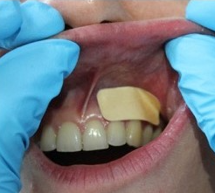
Other “oromucosal” currently do not map:
EDQM Code | EDQM Name | Any products? | EDQM Definition / Notes
13141000 | Oromucosal pouch | Would require further discussion before recommending adding this dose form Pouch: Tobacco product in Sweden (NRT) – no map at present; “snus” – but in NOR not a medicinal product | Solid single-dose preparation consisting of a small bag made of a suitable material containing a preparation such as a powder; it is intended to be placed in the oral cavity to obtain either a systemic or a local effect by delivering the active substance(s) over a certain period of time, after which it is then removed
50039000 | Oromucosal patch | Old term (2006) 2016 Steroid patch Rivelin Add if needed | Flexible single-dose preparation intended to be applied to the oral cavity to obtain either a systemic or a local effect by delivering the active substance(s) over a certain period of time, after which it is then removed
10317000 | Oromucosal capsule | Add if needed | No oromucosal tablet present (SL tab, buccal tab etc.) Almost overlaps with lozenge or pastille, but is a “soft capsule” so different BDF
10314005 | Oromucosal ointment | carbénoxolone SANODIN pom buc | Is used in any part of the oral cavity – request new concept
10314010 | Oromucosal cream | lidocaine DYNEXAN 2 % crème buccale DYNEXANGIVAL 1 % crème buccale | Is used in any part of the oral cavity – request new concept
Discussion: Oromucosal translates as buccale in Fr and Es; buccogingival = buccal; EP oromucosal preparations monograph (1807) but Es uses buccale for both

Slide 10
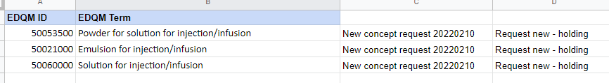
Various “injection/infusion” concepts have been added to a holding tab and the Concept Request list
This is following the work on Injections and Infusions in the DEUSG and the Briefing Note and presentation to DEUSG (03:01:2022)

Slide 11
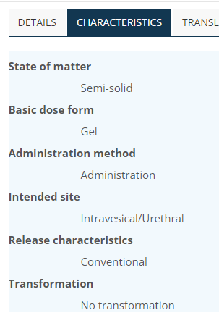
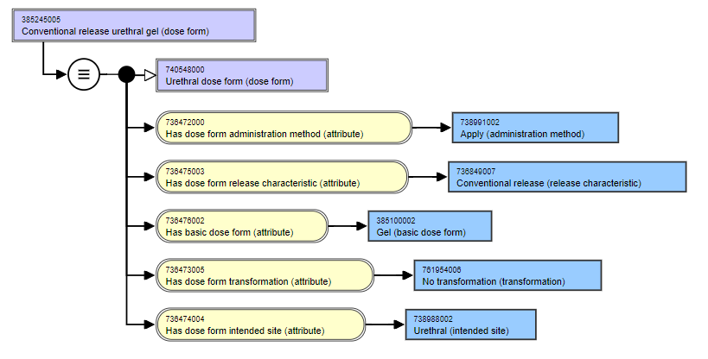
Apply and Administer – Urethral gel (on WIP)

Slide 12
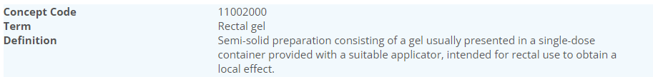
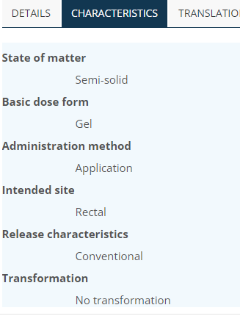
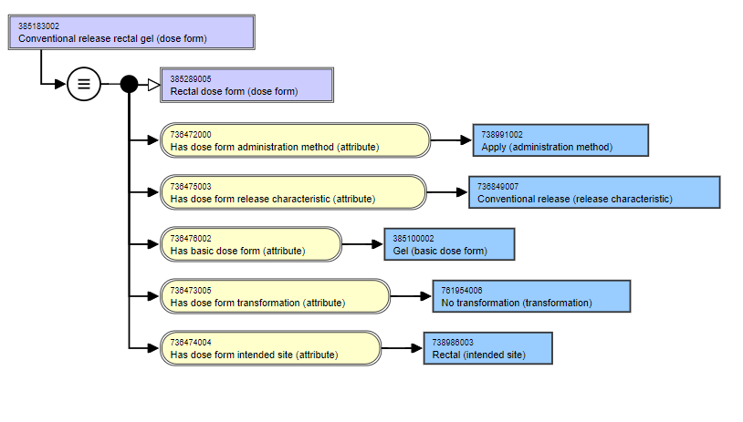
Apply and Administer – Rectal gel (on RC1)

Slide 13
Any thoughts from Chris on “Dispersions”?

Slide 14
Plaster and Patch
Not forgotten….will come back to this ☺

Slide 15

Implants
There are 10 “implant” dose forms in EDQM
And 4 in SNOMED CT
No implant dose forms have currently found their way to RC1 – all are “unmapped” in WIP – this may mean there is quite a conceptual “mismatch”
We will explore….

Slide 16
EDQM implant concepts (1):
EDQM ID | EDQM Term | EDQM definition | Comments from mappers
11303500 | Implantation suspension | Liquid sterile preparation consisting of a suspension intended for implantation in the body; the active substance(s) are released over an extended period of time to obtain a local or systemic effect | edqm: implant SOM = liquid sct: implant SOM = solid
11302000 | Implantation tablet | Solid sterile preparation prepared by compression of a solid active substance as such or of a formulation thereof into an implant of a size and shape suitable for implantation, usually subcutaneously. Each implantation tablet is presented in a sterile container. Implantation tablets are intended for release over an extended period of time in order to obtain local or systemic effect | no real product in our MPD
11301000 | Implant | Solid sterile preparation of a size and shape suitable for implantation. It may be prepared by moulding or other means other than compression. Each implant is presented in a sterile container that may be provided with an administration device. Implants are intended for release over an extended period of time in order to obtain local or systemic effect. 'Implantation tablet', 'Implantation chain' and 'Implantation matrix' are excluded | sct: 385286003 |Implant (basic dose form)| ; one real product, doscoid form for intracavitary implantation
11303000 | Implantation chain | Solid sterile preparation consisting of small spheres mounted on a non-degradable thread to form a chain that allows withdrawal of the remainder of the chain after a certain period of action. Each implantation chain is presented in a sterile container. The implantation chain is intended for release over an extended period of time in order to obtain local or systemic effec | no real product in our MPD
11303300 | Implantation matrix | Solid sterile preparation consisting of a usually pliable, absorbent piece of material (e.g. collagen), usually impregnated with a liquid preparation, intended for implantation in the body. The material may be cut into smaller pieces before implantation, and may be shaped around a tissue (e.g. a bone) or inserted into a medical device that is then implanted. Implantation matrices are intended for release over an extended period of time, usually in order to obtain a local effect. Usually the matrix disappears with time. When the product is packaged as a separate matrix, powder and solvent (or matrix and solution), which are used to prepare the implantation matrix immediately before use, the appropriate combined term should be used; see for example ‘Powder, solvent and matrix for implantation matrix’. | no real product in our MPD

Slide 17
EDQM implant concepts (2):
EDQM ID | EDQM Term | EDQM definition | Comments from mappers
13018000 | Matrix for implantation matrix | Solid sterile preparation consisting of a usually pliable, absorbent piece of material (e.g. collagen) intended to be used in the preparation of an implantation matrix.
50049500 | Powder for implantation suspension | Solid sterile preparation consisting of one or more powders, including freeze-dried powders, intended to be dispersed in the specified liquid to obtain an implantation suspension
13027000 | Powder for implantation matrix | Solid sterile preparation consisting of one or more powders, including freeze-dried powders, intended to be used in the preparation of an implantation matrix, e.g. by dissolving in the specified liquid to prepare the solution used to impregnate the matrix | SCT focuses on where the implant "goes" (intralesional, subcutan). EDQM focuses on what the implant is (implant, matrix, tablet, chain, paste etc)
13028000 | Powder for implantation paste | Solid sterile preparation consisting of one or more powders intended to be mixed with the specified liquid or paste to obtain an implantation paste
13043000 | Implantation paste | Semi-solid sterile preparation containing large proportions of solids finely dispersed in the basis, intended to be implanted in the body for release of the active substance(s) over an extended period of time, usually to obtain a systemic effect | no parenteral paste, nor implant associated AM, some BDF implant with IS subcutaneaous. No French Drug example to investigate deeper

Slide 18
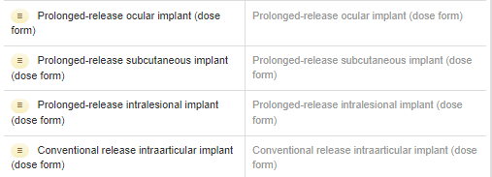
SNOMED CT implant PDF concepts
CDs using “implant” PDFs include
A ganiciclovir ocular implant
A dexamethasone and a fluocinolone ocular implant
Estradiol, etonorgestrel and levonorgestrel subcutaneous implants
A carmustine intralesional implant
Testosterone and goserelin subcutaneous implants
An autologous cultured chondrocyte intraarticular implant

Slide 19
Thoughts?
When is a prolonged release suspension not an implant?

Slide 20

Next meeting on
Thursday 24th February 2022
at 10:00 UTC
NEXT STEPS
20

Slide 21


THANK YOU
SNOMED International: Delivering SNOMED CT

